Slide 1
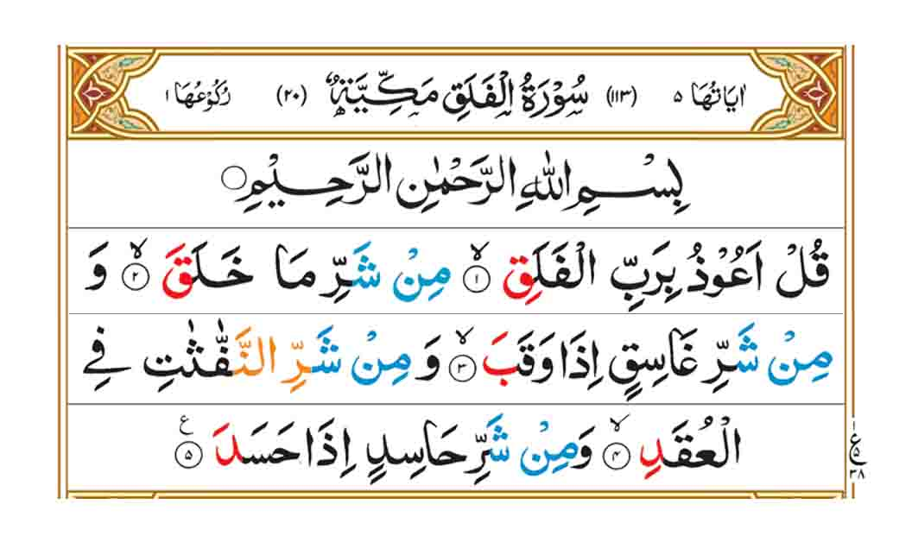

Slide 2
Meaning of Al Falaq
I seek refuge with the Lord of daybreak
From the evil of what He created
And from the evil of the darkness when it settles
And from the evil of those who practice witchcraft
when they blow in the knots
And from the evil of the envious one when he envies.

Slide 3
Background story of Surah al falaq
There is a hadith talking about the reason why this surah was revealed, it was revealed to the prophet because the prophet (ﷺ) was suffering from the effect of a magic spell, the one who put that spell on the prophet is called Labeeb ibn Asam. A few days later the angel Jabril came and revealed both Surah Nas and Surah al Falaq to the prophet (ﷺ).
Jabreel said that “It was the effects of the magic spell by a Jew, and you are feeling bad due to that magic certainly.”
After the prophet recited those two Surahs he started to feel better and the magic was removed.

Slide 4
Explanation of Surah falaq
' I seek refuge' means 'I seek Allah's protection' . Allah answers anyone who asks Him. He gives shelter to anyone who seeks shelter with Him. AI-Mu'awwidhatayn - the last two surahs of the Qur’an (Naas and Falaq) were sent down to teach us how to seek Allah's protection from all kinds of evil . Life has so many things which can be evil. But these two surahs provide strong protection for anyone who desires to seek the protection of Allah .
Daybreak is the morning or the light that expels darkness. The sources of evil are many - reptiles, insects, wild animals and evil men. When darkness thickens, it provides opportunities to evil people and creatures to do evil things.

Slide 5
Explanation of Surah falaq
Those who practise witchcraft'
They are magicians who blow in knots and do similar acts for evil purposes . Magic is a reality. The devils among men and jinn use it. But if we seek Allah’s protection , sorcery will lose its evil effect. The Qur’an forbids the leaning of magic and provides the means of protection against it.

Slide 6
Explanation of Surah falaq
'The evil of the envious one when he envies . '
Envy is a sickness of the soul. It disturbs the life of an individual and society a s a whole. Envy is the pain felt when you see that another person has something good or good moral qualities , and you do your utmost to destroy his qualities. E nvy was the first sin committed when lblees envied Adam AS.
An envious person is a mean enemy who cannot fulfill his wicked desire except by wishing harm to others. Envy is one of the most widespread human vices. This surah can protect us by Allah's Will from evil that comes from outside ourselves .

Slide 7
Ending
May Allah SWT give us ability to recite these two surahs regularly and frequently. Ameen.
Assalamualikum Wa Rahmatullahi Wa Barakatuhu

