Slide 1
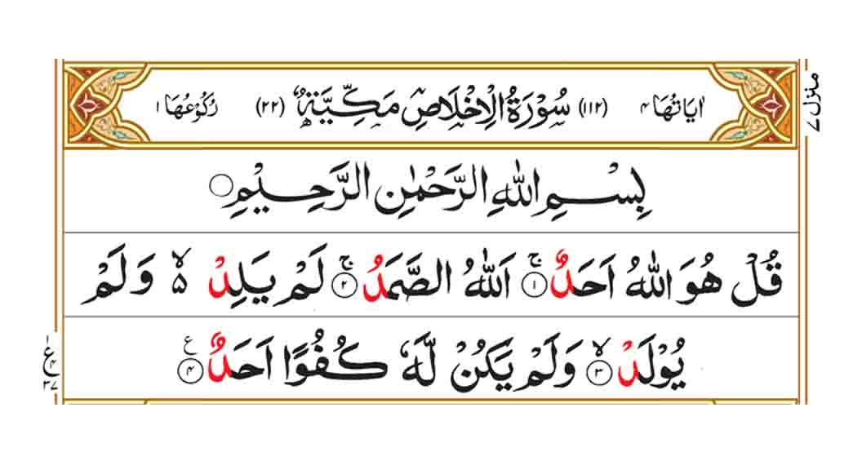

Slide 2
Meaning of Al Falaq
Say: He is Allah, the One and Only;
Allah, the Eternal, Absolute;
He has never had offspring, nor was He born.
And there is none like unto Him.

Slide 3
Background story of Surah Ikhlas

Slide 4
Teachings of Surah Ikhlas
Surah Ikhlas is one of the most important chapters of the Quran because it speaks of one of the pillars of beliefs of Islam, i.e. the unity and oneness of God or monotheism. It is a chapter that describes God and His attributes and introduces Him to us as He would like us to know Him. Therefore, it is of vital importance for every Muslim to read and try to understand the profound teachings given to us in this chapter.

Slide 5
Reaward of reciting Surah Ikhlas
Narrated by Al-Tirmidhi, “Say Surat Al Ikhlas and al-Mu’awwidhatayn three times in the morning and the evening; they will suffice you from everything.”
Aisha RA narrated, “Whenever the Prophet SM went to bed every night, he cupped his hands together and blew over them after reciting Surah Al Ikhlas, Surah an-Nas and Surah al-Falaq. Then, he rubbed his hands over every part of his body he could, starting with his face, head and front. He did that three times every night.”

Slide 6
Ending
May Allah SWT give us ability to recite these three surahs regularly and frequently. Ameen.
Assalamualikum Wa Rahmatullahi Wa Barakatuhu

