Slide 1
1
What is Faith?
Notes:
Let's start with the basics. Since we are going to be talking about faith throughout this book, it makes sense to be sure you as the reader, and I as the author, have a firm biblical grasp of what "faith" is. But before looking at some definitions, think about how you would define faith. What is your concept of faith? How would you explain it to a friend? Does faith mean to accept an idea without question? Is faith going to church, reading your Bible and praying? Have you thought about what it means to call yourself a "believer?"
My faith means everything to me. The decision to give my life to Christ at the age of 20 was the greatest accomplishment of my life. I love Christ and I love His church, but within the church I have met a few people with some strange ideas about faith; ideas that did not come from the Bible but more likely came from traditional patterns of thinking passed down through generations.
Listening to a few Bible class discussions on faith gives the impression that faith is the opposite of fact. "You can study the evidence, or you can live by faith." "Those who need proof just don't know how to accept things by faith." Is it ungodly to seek plausible answers to the basic questions about the existence of God, the inerrancy of His Word and the resurrection of Christ? Some are unwilling to put their faith in Jesus until they have adequate answers to these types of questions. Does that mean their faith is not genuine. Faith is not the blind acceptance of unfounded fables. So here is our first definition of faith:

Slide 2
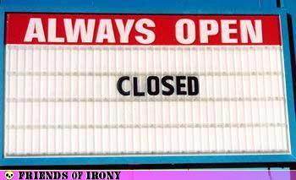

Slide 3
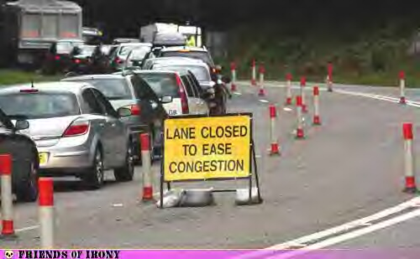

Slide 4
What is Faith?
The judgment that something stated is the truth.
Notes:
FAITH IS TRUST BASED ON PREVIOUS EVIDENCE.
Faith in God is about trust. Some need to see the evidence before they are willing to trust. Now, if you are one of those who needs your questions answered, let me begin with a caution. Don't expect exhaustive evidence. There is nothing wrong with seeking a sensible reason for that which you are going to base your life upon, but not every question you have is going to be answered to your fullest satisfaction. Be reasonable. Like a court trial, you can find sufficient evidence on which you can base what you hold to be true. True faith is something that is tried and tested. It is based on reasonable evidence which supports a specific conclusion.
I have faith that if I put my hand on a hot stove, it will burn my hand. This faith is based on the evidence of past experiences which have led me to this conclusion. Personal embarrassment prevents me from relating all the reasons I hold this conviction, but suffice it to say, I know for a fact a stove will burn human skin. Do you need exhaustive evidence to come to the same conclusion? Do you have to experience it yourself or can you accept the testimony of eyewitnesses in this case?
My faith is based on intelligent reasoning of the evidence. I have seen (and felt) what a stove is capable of doing. Likewise, I have faith in God based on what I have seen Him do in my life and the lives of those around me. I have faith in Jesus because I have learned of His way of life and teaching and I agree with them. Where other ideologies have failed, Jesus' way of doing things fixes real life problems. Witnessing the transition of people's lives strengthens your faith in God. Being obedient to Christ and letting Him change you for the good also strengthens your faith. This is evidence which supports the faith we profess. Faith is the judgment that something stated is the truth.
After this basis of faith is confirmed, then the believer is capable of "stepping out on faith." In other words, after a pattern of rewarded trust in God has been established, a believer is capable of carrying out a biblical command without needing a guarantee of the outcome. We should not have to have a confirmed reward for doing what the Lord of Creation commands us to do. That truly is where faith comes in.

Slide 5
What is Faith?
The judgment that something stated is the truth.
Belief which causes you to do what you do.
Notes:
Once when three young Israelites were going to be executed by fire for not bowing to a king's golden idol they replied,

Slide 6
If it be so, our God whom we serve is able to deliver us from the furnace of blazing fire; and He will deliver us out of your hand, O king.
- Daniel 3:17
Notes:
Once when three young Israelites were going to be executed by fire for not bowing to a king's golden idol they replied,
If it be so, our God whom we serve is able to deliver us from the furnace of blazing fire; and He will deliver us out of your hand, O king.
- Daniel 3:17Shadrach, Meshach and Abed-nego had faith, bold-unshakable-calm faith, that God would deliver them. Was it blind faith? No. Their trust in God was based on evidence of God's propensity for deliverance. They knew what the furnace was capable of, but their confidence was in Jehovah's ability to suspend the laws of nature when it served His purpose to do so.

Slide 7
What is Faith?
The judgment that something stated is the truth.
Belief which causes you to do what you do.
To put your full weight
down upon a cause.
Notes:
Stepping out on faith also means the believer's trust does not have to come with a guarantee of immediate reward.

Slide 8
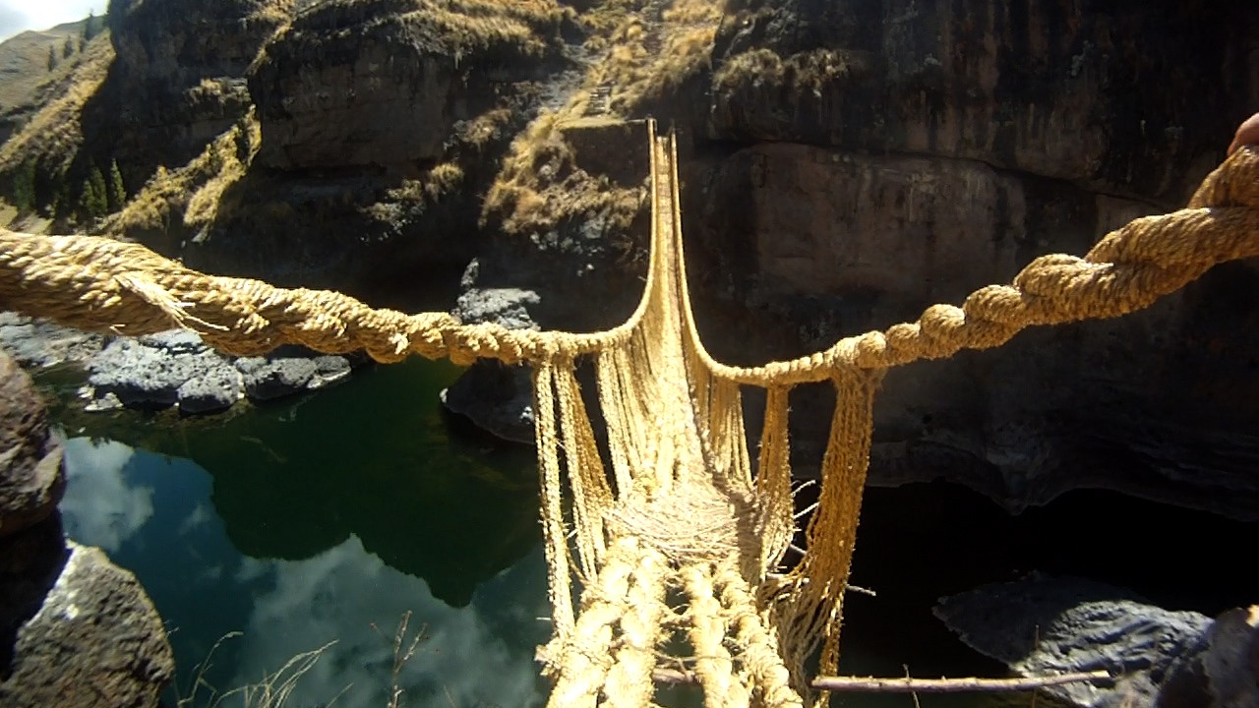
Grass Woven Suspension Bridge
Notes:
FAITH IS PUTTING YOUR FULL WEIGHT DOWN UPON SOMETHING.
A missionary working with a secluded tribe of natives was trying to teach them about Jesus. They had no translation of the Bible in their language, so the missionary set out to provide them with one. As he began putting the Bible into their words, he discovered that they did not have an equivalent for the word "faith" in their native tongue. He kept asking in different ways, but the whole concept of belief or faith was foreign to them which meant he had no way to finish his translation of the Bible.
One day while traveling through the forest they came to a bridge made from ropes of twisted grass. They had to make sure it was safe to cross so one unfortunate soul was coerced into testing the bridge by gradually putting more and more of his weight on the bridge. When he put his full weight on the bridge, they had a word for that. When the missionary heard it he thought, "Aha, that's the word I've been looking for." Their translation of the Bible reads something like this in John 2:11:

Slide 9
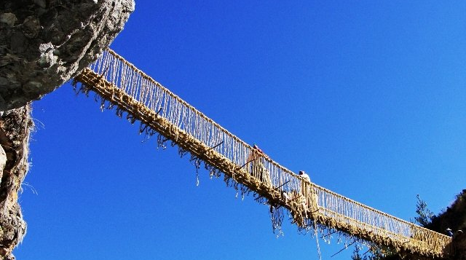
Notes:
This beginning of His signs Jesus did in Cana of Galilee, and manifested His glory, and His disciples [put their full weight down upon] Him.Like the bridge, some believers test God a little, then a little more, but never put their full weight down on Him. They give God only a part of their lives. They follow part of the Bible. Genuine faith is expressed in the old hymn, "I Surrender All." Until total control is surrendered into the hands of Jesus a sojourner is really not "Living by faith." [Another great hymn.] Faith is putting your full weight down, trusting Him completely. We need to be like another old hymn we sing: "None of Self and All of Thee."

Slide 10
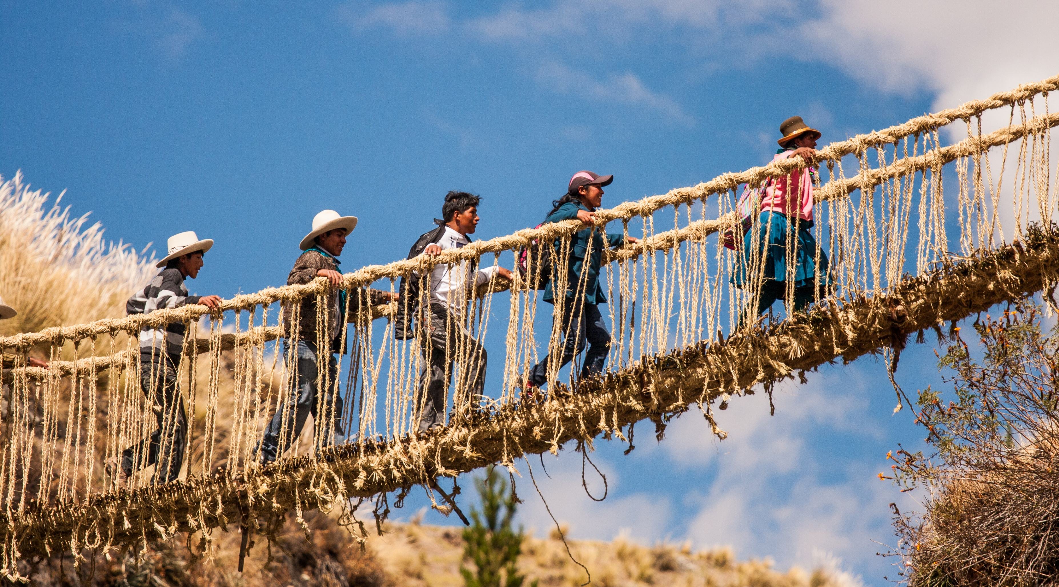

Slide 11
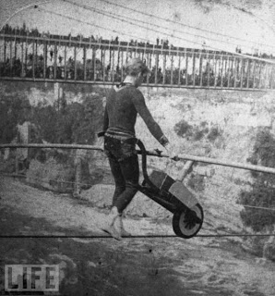
Charles Blondin
1824-1897

Slide 12
But even if He does not, let it be known to you, O king, that we are not going to serve your gods or worship the golden image that you have set up.”
- Daniel 3:18
Notes:
Stepping out on faith also means the believer's trust does not have to come with a guarantee of immediate reward.
But even if He does not, let it be known to you, O king, that we are not going to serve your gods or worship the golden image that you have set up.”
- Daniel 3:18It didn't matter whether God was going to rescue them or not. These young men were loyal to God's pattern of righteous living even if it cost them their lives. That is genuine faith. That's the kind of faith I want. How about you?

Slide 13
What is Faith?
The judgment that something stated is the truth.
Belief which causes you to do what you do.
To put your full weight down upon a cause.
The assent of the mind to a conviction of biblical truth.
Notes:
FAITH IS THE ABSENCE OF DOUBT.
Doubt is the opposite of faith, so the more doubt you can overcome the stronger your faith will be. You can't make yourself believe something without addressing the issues you have doubts about. There's an old proverb that goes like this: "A man persuaded against his will is of the same persuasion still." You can be persuaded to do something against your will. You can make yourself do some things you ought to do but don't really want to do, but if you keep thinking in the back of your mind that it is all a waste of time or you disagree for some reason, is that truly faith? You may have changed your actions but until your mindset changes, you still have not acted in faith.
People change their diet all the time. They lose weight only to gain it all back later. If you want to lose weight and keep it off, you must change your appetite. Learn to like the foods you should eat. The same with faith. If you want your faith to grow, focus on the areas you are weakest in, what you have the most doubts about and let Jesus turn your weaknesses into strengths.
In what area do you have the most doubts about with regard to your Christianity? When the doubts come into your mind, the problem is you begin to believe those doubts. When you believe your doubts, then you start doubting your beliefs. You need to doubt your doubts and then; after conquering those doubts, you will be free to believe your beliefs. (Did you get that? You may want to read it again.)

Slide 14
What is Faith?
The judgment that something stated is the truth.
Belief which causes you to do what you do.
To put your full weight down upon a cause.
The assent of the mind to a conviction of biblical truth.
Confidence to rely on Christ in making moral choices.
Notes:
FAITH IS THE CONVICTION OF A RELIGIOUS TRUTH.
Whatever happened to conviction? Where are the disciples of Jesus who are willing to endure all for the sake of the gospel because of their conviction? Paul told Timothy,
For this reason I endure all things for the sake of those who are chosen, so that they also may obtain the salvation which is in Christ Jesus and with it eternal glory.
- II Timothy 2:10 The Lord's church today needs people with conviction. God needs men and women with a passion for the cause of Christ. He has enough pew warmers already.
Think of it this way. In the church we have plenty of beliefs, but don't seem to have enough belief. There is nothing wrong with beliefs. Beliefs are doctrines and wise is the Christian, and especially the church leader, who is guarded about doctrine, I Timothy 4:16. Hold firm to sound doctrine but let's release within the church a revival of belief, of faith, of conviction. God needs men and women who are not afraid to make sacrifices for the cause they believe in. Be both strong to believe and strong in your beliefs.

Slide 15
For this reason I endure all things for the sake of those who are chosen, so that they also may obtain the salvation which is in Christ Jesus and with it eternal glory.
- II Timothy 2:10
Notes:
The Lord's church today needs people with conviction. God needs men and women with a passion for the cause of Christ. He has enough pew warmers already.
Think of it this way. In the church we have plenty of beliefs, but don't seem to have enough belief. There is nothing wrong with beliefs. Beliefs are doctrines and wise is the Christian, and especially the church leader, who is guarded about doctrine, I Timothy 4:16. Hold firm to sound doctrine but let's release within the church a revival of belief, of faith, of conviction. God needs men and women who are not afraid to make sacrifices for the cause they believe in. Be both strong to believe and strong in your beliefs.

Slide 16
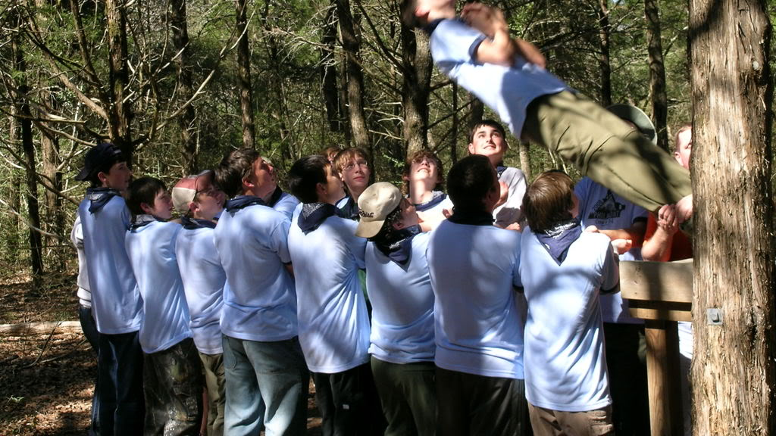
Notes:
FAITH IS RELIANCE UPON CHRIST.
Whenever we worry about our problems, or we struggle trying to handle life in our own way, our lack of faith comes to the surface. It takes true faith to accept Jesus' invitation:
“Come to Me, all who are weary and heavy-laden, and I will give you rest.
- Matthew 11:28It is not easy to leave our worries at the foot of the cross and let the Lord guide us. Deep down we know that relying on Jesus, instead of our own wisdom, is the wisest way to handle our problems. But it is easier said than done, isn't it?
Everyone has something they rely on in a pinch. When times get tough or an important decision has to be made, each individual seeks out a source for reliable direction. What is yours? The world offers many attempts at guidance for life's problems: psychology and man's philosophy, eastern religions, humanism, drugs and alcohol and other methods of escape. You have free will to choose any option you care to. But relying on a source other than Christ results in a spiral of missed opportunities and bad choices. Place ALL your faith in Christ. Rely on Him to guide your every step.

Slide 17
Now faith is the assurance of things hoped for, the conviction of things not seen.
- Hebrews 11:1
Notes:
The Bible says in Hebrews 11:1, "Now faith is the certainty of things hoped for, a proof of things not seen." Is faith a blind acceptance of things that deep down we do not honestly believe? No, it's assurance, "certainty of things hoped for." What do we as Christians hope for? I have the hope that God can change my life. That is why I came to Christ. If I were unsure about whether God could change me, I would be displaying a lack of faith.

Slide 18
The assurance of things hoped for.
Sure that God can
change me and you.
  1 Corinthians 6:9-11
  Philippians 1:3-6
Notes:
Paul once wrote to the church in Corinth,
Or do you not know that the unrighteous will not inherit the kingdom of God? Do not be deceived; neither fornicators, nor idolaters, nor adulterers, nor effeminate, nor homosexuals,
- I Corinthians 6:9He went on to list sins like fornication, homosexuality and drunkenness. Then he said, "Such were some of you;" (I Corinthians 6:11). Notice that he uses the past tense "were." That means they used to be involved in those sins, but they were not anymore. If God can rescue the Corinthians from such demoralizing sins, He can change me too. I can be sure of that.
I also need the assurance that God can change others. Do you have a member at your church who is constantly coming forward, asking for prayers; always having the same struggles? Have you ever said something like, "So-and-so is never going to change." Think about how those words sound in the ears of Jesus. That is a faithless statement. Our faith demands that we see people for what they can become and not merely for what they are now.

Slide 19
⁹ Or do you not know that the unrighteous will not inherit the kingdom of God? Do not be deceived; neither fornicators, nor idolaters, nor adulterers, nor effeminate, nor homosexuals, ¹⁰ nor thieves, nor the covetous, nor drunkards, nor revilers, nor swindlers, will inherit the kingdom of God.
- 1 Corinthians 6:9-10

Slide 20
Such were some of you; but you were washed, but you were sanctified, but you were justified in the name of the Lord Jesus Christ and in the Spirit of our God.
- 1 Corinthians 6:11

Slide 21
³ I thank my God in all my remembrance of you, ⁴ always offering prayer with joy in my every prayer for you all,
- Philippians 1:3-4
Notes:
Paul taught us how to have faith during the slow transformation of others when he prayed for the Philippians.
For I am confident of this very thing, that He who began a good work in you will perfect it until the day of Christ Jesus.
- Philippians 1:6The church in Philippi had struggling Christians the same as we have today and yet Paul was "confident" in their spiritual growth. That confidence was not founded on the ability of people to change themselves, but rather on Jesus' ability to "complete" (perfect) a penitent sinner. Jesus' always follows through on the "good work" He is accomplishing in us.
If we are to be certain of what we hope for, going back to Hebrews 11:1, we need to be sure that life in Christ is the best life available to mankind. This is part of what it means to have faith. In Hebrews 11:6 we read: "And without faith it is impossible to please Him, for the one who comes to God must believe that He exists, and that He proves to be One who rewards those who seek Him." We generally have no problem believing that God exists, but do you believe that God "rewards those who seek Him?"

Slide 22
⁵ in view of your participation in the gospel from the first day until now.
⁶ For I am confident of this very thing, that He who began a good work in you will perfect it until the day of Christ Jesus.
- Philippians 1:5-6

Slide 23
The assurance of things hoped for.
Sure that I will be in heaven with God.
  Hebrews 11:8-10, 13-16, 24-26
Notes:
Faith involves understanding that there is a God who is greater than any of our problems. Even though we will have rough times, God is steadily improving the lives of those who are steadily moving closer to Him. In the last chapter we explored Matthew 17:20:
"if you have faith the size of a mustard seed, you will say to this mountain, 'Move from here to there,' and it will move."Hebrews 5:12 says,
For though by this time you ought to be teachers.Both of these passages infer that God intended for faith to be a continually increasing experience. If we continually grow in our faith like we are supposed to then we are continually growing closer to God and God is continually rewarding those who seek Him. That means life in Christ gets steadily better and better. This is one of the many assurances we have being in Christ Jesus. You can put your faith in that promise.

Slide 24
By faith Abraham, when he was called, obeyed by going out to a place which he was to receive for an inheritance; and he went out, not knowing where he was going.
- Hebrews 11:8

Slide 25
⁹ By faith he lived as an alien in the land of promise, as in a foreign land, dwelling in tents with Isaac and Jacob, fellow heirs of the same promise; ¹⁰ for he was looking for the city which has foundations, whose architect and builder is God.
- Hebrews 11:9-10

Slide 26
¹³ All these died in faith, without receiving the promises, but having seen them and having welcomed them from a distance, and having confessed that they were strangers and exiles on the earth. ¹⁴ For those who say such things make it clear that they are seeking a country of their own.
- Hebrews 11:13-14

Slide 27
¹⁵ And indeed if they had been thinking of that country from which they went out, they would have had opportunity to return. ¹⁶ But as it is, they desire a better country, that is, a heavenly one. Therefore God is not ashamed to be called their God; for He has prepared a city for them.
- Hebrews 11:15-16

Slide 28
²⁴ By faith Moses, when he had grown up, refused to be called the son of Pharaoh’s daughter, ²⁵ choosing rather to endure ill-treatment with the people of God than to enjoy the passing pleasures of sin,
²⁶ considering the reproach of Christ greater riches than the treasures of Egypt; for he was looking to the reward.
- Hebrews 11:24-26

Slide 29
The conviction of things not seen.
Convicted there is a heaven, there is a Devil, there is a Mighty God.
Notes:
Both of these passages infer that God intended for faith to be a continually increasing experience. If we continually grow in our faith like we are supposed to then we are continually growing closer to God and God is continually rewarding those who seek Him. That means life in Christ gets steadily better and better. This is one of the many assurances we have being in Christ Jesus. You can put your faith in that promise.
Faith is "the proof of things not seen." Hebrews 11:1. Having faith means I believe there is a realm that cannot be seen. Not only are we to acknowledge the spiritual domain, we are to be convicted, to know with certainty that our eyes do not have to behold something in order for it to exist.
Jesus used the illustration of the wind in John 3:8 when He was trying to help Nicodemus understand the concept of being born of the water and the Spirit.
The wind blows where it wishes and you hear the sound of it, but do not know where it comes from and where it is going; so is everyone who is born of the Spirit.”
- John 3:8We cannot see the wind. We can only see the effects of the wind. Wind is something we cannot see. Does that mean the wind doesn't exist? Likewise, we cannot see God, but we can see His effect in the world and the evidence of His creation and, therefore, believe. We cannot see love. That does not mean you are a simpleton if you believe in the existence of love. It is logical and reasonable to believe in something unseen.
Christian, you can be confident there is a God in heaven who cares about you personally. This same God inspired men to write the 66 books that make up our Bible and so you can trust what it says as well. The Holy Bible describes an eternal dwelling prepared for us, which we are not able to see with our eyes right now, but we can be certain of its existence.
This Bible also describes an evil force called Satan, who is bent on luring you away from God. You cannot see him either, but hopefully you have the conviction that he is as real as the people around you whom you can see. If we do not believe in Satan, we make a critical tactical error in our war against evil. Satan is very real and active in this world today. The evidence of that is abundant. Have faith. Believe in the unseen.
There you have it. Faith is trust based on prior evidence, the absence of doubt, putting your full weight down upon God, the conviction of religious truth and reliance upon Christ. By faith we have certainty of the things we hope for and proof about the things we cannot see. Faith exists in each Christian but in various amounts. Some have more than others and there is a distinct and biblical way to trace the evolvement of our spirituality. In the next chapter you will learn the basic stages of spiritual growth.

