Slide 1

Seminary Heights Church of Christ
10
Encouragement and Instructions: Remain Faithful – Part 2
II Timothy 2:1-13
Notes:
So far Paul has greeted, prayed for and encouraged Timothy to remain faithful to his calling as an evangelist and the message of the gospel as well as the teachings he has received from Paul as his teacher and instructor. These were important reminders for this young evangelist who was dealing with various church issues and people at Ephesus where Paul had sent him to carry out his ministry. In the section we will study in this chapter, Paul will add another area where Timothy needed to make sure he remained faithful.

Slide 2
Remain Faithful in Service
You therefore, my son, be strong in the grace that is in Christ Jesus.
- II Timothy 2:1
Notes:
As a minister, Timothy's task was to minister or serve the church and so Paul gives him four examples of service from which he could draw encouragement and understanding. Paul refers to him affectionately as "my son" and in this we sense the ache of heart that Paul had for this young man that he had trained and mentored who was now facing the hard (and often painful) work of ministry by himself. It was the feeling a father has when he drops a son off at the airport as the young man leaves for his first military duty station. It's love and pride, fear and nostalgia for his son in the faith who is now grown - all wrapped up in one emotion. It's the catch in a mother's heart when her daughter announces her engagement. Mom is joyful but at the same time wistful and a little sad that their relationship will change forever, and the future will now bring a mixture of happiness and hurt that all new brides and future mothers experience.
As a good Christian father "figure," Paul does what Christian parents today would do: he commends Timothy to the grace of God found in Christ. In other words, he encourages Timothy to find and grow in the strength that comes from God's grace. However, what and how would one do this? Being strong in the grace means that one's strength (to do one's work, deal with obstacles and trials, endure spiritual and emotional challenges) is derived from God's grace and not personal wisdom, strength or will power. In another letter Paul summarized this idea by saying, "I can do all things through Christ who strengthens me" (Philippians 4:13).
Timothy has a difficult ministry and Paul reminds him to go to and depend on God for the physical, emotional and spiritual resources he will need to survive and succeed. Paul then provides four practical examples of those who succeed in their various areas of service:

Slide 3
I can do all things through Him who strengthens me.
- Philippians 4:13
Notes:
can
Jn 15:4 — Remain in me, and I in you. Just as a branch is unable to produce fruit by itself unless it remains on the vine, neither can you unless you remain in me.
Jn 15:5 — I am the vine; you are the branches. The one who remains in me and I in him produces much fruit, because you can do nothing without me.
Jn 15:7 — If you remain in me and my words remain in you, ask whatever you want and it will be done for you.
2Co 3:4 — Such is the confidence we have through Christ before God.
2Co 3:5 — It is not that we are competent in ourselves to claim anything as coming from ourselves, but our adequacy is from God.
through
2Co 12:9 — But he said to me, "My grace is sufficient for you, for my power is perfected in weakness." Therefore, I will most gladly boast all the more about my weaknesses, so that Christ's power may reside in me.
2Co 12:10 — So I take pleasure in weaknesses, insults, hardships, persecutions, and in difficulties, for the sake of Christ. For when I am weak, then I am strong.
Eph 3:16 — I pray that he may grant you, according to the riches of his glory, to be strengthened with power in your inner being through his Spirit,
Eph 6:10 — Finally, be strengthened by the Lord and by his vast strength.
Col 1:11 — being strengthened with all power, according to his glorious might, so that you may have great endurance and patience, joyfully
Isa 40:29-31 — He gives strength to the faint and strengthens the powerless. 30 Youths may become faint and weary, and young men stumble and fall, 31 but those who trust in the LORD will renew their strength; they will soar on wings like eagles; they will run and not become weary, they will walk and not faint.
Isa 41:10 — Do not fear, for I am with you; do not be afraid, for I am your God. I will strengthen you; I will help you; I will hold on to you with my righteous right hand.
Isa 45:24 — It will be said about me, 'Righteousness and strength are found only in the LORD.' " All who are enraged against him will come to him and be put to shame.

Slide 4
Examples of Faithfulness
A. Teachers
The things which you have heard from me in the presence of many witnesses, entrust these to faithful men who will be able to teach others also.
- II Timothy 2:2
Notes:
A. Teachers
The things which you have heard from me in the presence of many witnesses, entrust these to faithful men who will be able to teach others also.
- II Timothy 2:2
Paul summarizes the materials, the method and the goal of his teaching all in one succinct verse. The material is the sum of instructions that he has received from Paul, from doctrine to application to Christian lifestyle. The method is to direct his efforts toward those who are faithful and worthy of being entrusted with the Word of God. Paul mentions faithful men because he wants Timothy to focus on training church leaders. This wouldn't mean that he didn't preach and teach to women in the church, but he was to concentrate on leadership training as one of his priorities. The goal of his teaching ministry was that his students would not only be able to teach others the material, but would also train others to carry on this method of teaching and training into future generations - especially those selected for leadership.
Another example of service...

Slide 5
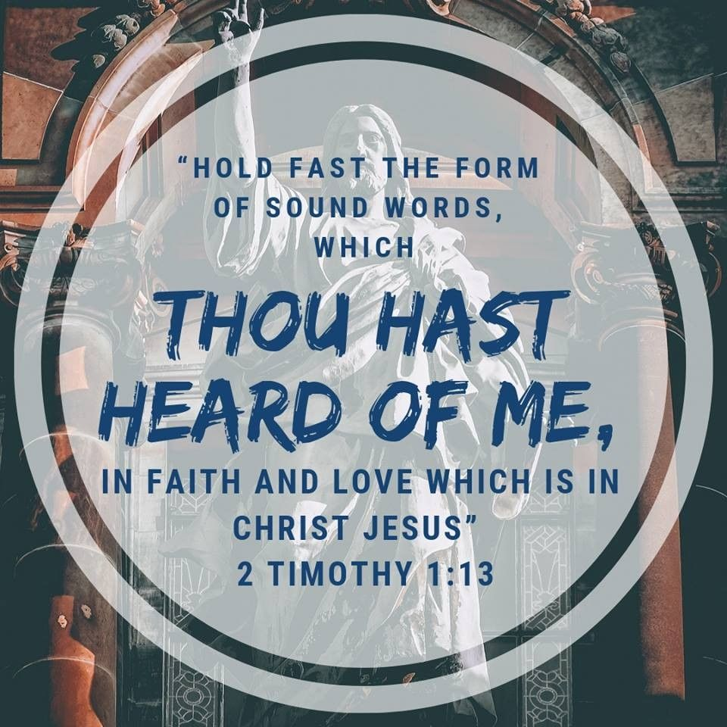
Notes:
the things
2Ti 1:13 — Hold on to the pattern of sound teaching that you have heard from me, in the faith and love that are in Christ Jesus.
2Ti 3:10 — But you have followed my teaching, conduct, purpose, faith, patience, love, and endurance,
2Ti 3:14 — But as for you, continue in what you have learned and firmly believed. You know those who taught you,
among
1Ti 4:14 — Do not neglect the gift that is in you; it was given to you through prophecy, with the laying on of hands by the council of elders.
1Ti 6:12 — Fight the good fight of the faith. Take hold of eternal life to which you were called and about which you have made a good confession in the presence of many witnesses.
the same
2Ti 1:14 — Guard the good deposit through the Holy Spirit who lives in us.
1Ti 1:18 — Timothy, my son, I am giving you this instruction in keeping with the prophecies previously made about you, so that by recalling them you may fight the good fight,
1Ti 5:22 — Don't be too quick to appoint anyone as an elder, and don't share in the sins of others. Keep yourself pure.
faithful
Nu 12:7 — Not so with my servant Moses; he is faithful in all my household.
1Sa 2:35 — " 'Then I will raise up a faithful priest for myself. He will do whatever is in my heart and mind. I will establish a lasting dynasty for him, and he will walk before my anointed one for all time.
Ne 7:2 — Then I put my brother Hanani in charge of Jerusalem, along with Hananiah, commander of the fortress, because he was a faithful man who feared God more than most.
Ps 101:6 — My eyes favor the faithful of the land so that they may sit down with me. The one who follows the way of integrity may serve me.
Pr 13:17 — A wicked envoy falls into trouble, but a trustworthy courier brings healing.
Jer 23:28 — The prophet who has only a dream should recount the dream, but the one who has my word should speak my word truthfully, for what is straw compared to grain? " ​— ​this is the LORD's declaration.
Mt 24:25 — Take note: I have told you in advance.
Lk 12:42 — The Lord said: "Who then is the faithful and sensible manager his master will put in charge of his household servants to give them their allotted food at the proper time?
Lk 16:10-12 — Whoever is faithful in very little is also faithful in much, and whoever is unrighteous in very little is also unrighteous in much. 11 So if you have not been faithful with worldly wealth, who will trust you with what is genuine? 12 And if you have not been faithful with what belongs to someone else, who will give you what is your own?
1Co 4:2 — In this regard, it is required that managers be found faithful.
Col 1:7 — You learned this from Epaphras, our dearly loved fellow servant. He is a faithful minister of Christ on your behalf,
1Ti 1:12 — I give thanks to Christ Jesus our Lord who has strengthenedme, because he considered me faithful, appointing me to the ministry —
Heb 2:17 — Therefore, he had to be like his brothers and sisters in every way, so that he could become a merciful and faithful high priest in matters pertaining to God, to make atonement for the sins of the people.
Heb 3:2 — He was faithful to the one who appointed him, just as Moses was in all God's household.
Heb 3:3 — For Jesus is considered worthy of more glory than Moses, just as the builder has more honor than the house.
Rev 2:10-13 — Don't be afraid of what you are about to suffer. Look, the devil is about to throw some of you into prison to test you, and you will experience affliction for ten days. Be faithful to the point of death, and I will give you the crown of life. 11 "Let anyone who has ears to hear listen to what the Spirit says to the churches. The one who conquers will never be harmed by the second death. 12 "Write to the angel of the church in Pergamum: Thus says the one who has the sharp, double-edged sword: 13 I know where you live ​— ​where Satan's throne is. Yet you are holding on to my name and did not deny your faith in me, even in the days of Antipas, my faithful witness who was put to death among you, where Satan lives.
who
2Ti 2:24 — The Lord's servant must not quarrel, but must be gentle to everyone, able to teach, and patient,
2Ti 2:25 — instructing his opponents with gentleness. Perhaps God will grant them repentance leading them to the knowledge of the truth.
Ezr 7:10 — Now Ezra had determined in his heart to study the law of the LORD, obey it, and teach its statutes and ordinances in Israel.
Ezr 7:25 — And you, Ezra, according to God's wisdom that you possess, appoint magistrates and judges to judge all the people in the region west of the Euphrates who know the laws of your God and to teach anyone who does not know them.
Mal 2:7 — For the lips of a priest should guard knowledge, and people should desire instruction from his mouth, because he is the messenger of the LORD of Armies.
Mt 13:52 — "Therefore," he said to them, "every teacher of the law who has become a disciple in the kingdom of heaven is like the owner of a house who brings out of his storeroom treasures new and old."
1Ti 3:2-9 — An overseer, therefore, must be above reproach, the husband of one wife, self-controlled, sensible, respectable, hospitable, able to teach, 3 not an excessive drinker, not a bully but gentle, not quarrelsome, not greedy. 4 He must manage his own household competently and have his children under control with all dignity. 5 (If anyone does not know how to manage his own household, how will he take care of God's church?) 6 He must not be a new convert, or he might become conceited and incur the same condemnation as the devil. 7 Furthermore, he must have a good reputation among outsiders, so that he does not fall into disgrace and the devil's trap. 8 Deacons, likewise, should be worthy of respect, not hypocritical, not drinking a lot of wine, not greedy for money, 9 holding the mystery of the faith with a clear conscience.
1Ti 4:6 — If you point these things out to the brothers and sisters, you will be a good servant of Christ Jesus, nourished by the words of the faith and the good teaching that you have followed.
Tit 1:5-9 — The reason I left you in Crete was to set right what was left undone and, as I directed you, to appoint elders in every town. 6 An elder must be blameless: the husband of one wife, with faithful children who are not accused of wildness or rebellion. 7 As an overseer of God's household, he must be blameless: not arrogant, not hot-tempered, not an excessive drinker, not a bully, not greedy for money, 8 but hospitable, loving what is good, sensible, righteous, holy, self-controlled, 9 holding to the faithful message as taught, so that he will be able both to encourage with sound teaching and to refute those who contradict it.

Slide 6
18 This charge I commit unto thee, son Timothy, according to the prophecies which went before on thee, that thou by them mightest war a good warfare;
19 Holding faith, and a good conscience; which some having put away concerning faith have made shipwreck:
1 Timothy 1:18-19 (KJV)

Slide 7
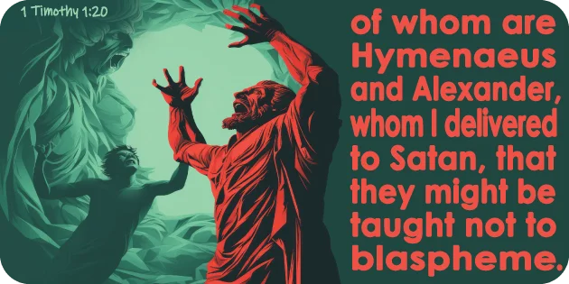
Notes:
1 Timothy 1:20 (KJV)
Of whom is Hymenaeus and Alexander; whom I have delivered unto Satan, that they may learn not to blaspheme.
Hymenaeus
2Ti 2:17 — and their teaching will spread like gangrene. Hymenaeus and Philetus are among them.
Alexander
Ac 19:33 — Some Jews in the crowd gave instructions to Alexander after they pushed him to the front. Motioning with his hand, Alexander wanted to make his defense to the people.
2Ti 2:14 — Remind them of these things, and charge them before God not to fight about words. This is useless and leads to the ruin of those who listen.
2Ti 4:14 — Alexander the coppersmith did great harm to me. The Lord will repay him according to his works.
2Ti 4:15 — Watch out for him yourself because he strongly opposed our words.
I have
Mt 18:17 — If he doesn't pay attention to them, tell the church. If he doesn't pay attention even to the church, let him be like a Gentile and a tax collector to you.
1Co 5:4 — When you are assembled in the name of our Lord Jesus, and I am with you in spirit, with the power of our Lord Jesus,
1Co 5:5 — hand that one over to Satan for the destruction of the flesh, so that his spirit may be saved in the day of the Lord.
2Co 10:6 — And we are ready to punish any disobedience, once your obedience is complete.
2Co 13:10 — This is why I am writing these things while absent, so that when I am there I may not have to deal harshly with you, in keeping with the authority the Lord gave me for building up and not for tearing down.
that
1Co 11:32 — but when we are judged by the Lord, we are disciplined, so that we may not be condemned with the world.
2Th 3:15 — Yet don't consider him as an enemy, but warn him as a brother.
Rev 3:19 — As many as I love, I rebuke and discipline. So be zealous and repent.
blaspheme
Ac 13:45 — But when the Jews saw the crowds, they were filled with jealousy and began to contradict what Paul was saying, insulting him.
2Ti 3:2 — For people will be lovers of self, lovers of money, boastful, proud, demeaning, disobedient to parents, ungrateful, unholy,
Rev 13:1 — And I saw a beast coming up out of the sea. It had ten horns and seven heads. On its horns were ten crowns, and on its heads were blasphemous names.
Rev 13:5 — The beast was given a mouth to utter boasts and blasphemies. It was allowed to exercise authority for forty-two months.
Rev 13:6 — It began to speak blasphemies against God: to blaspheme his name and his dwelling ​— ​those who dwell in heaven.

Slide 8
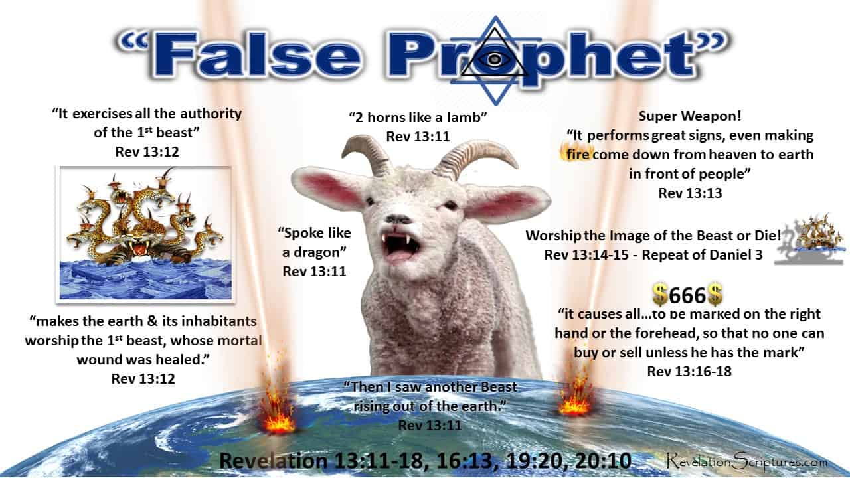

Slide 9
Examples of Faithfulness
B. Soldiers
³ Suffer hardship with me, as a good soldier of Christ Jesus. ⁴ No soldier in active service entangles himself in the affairs of everyday life, so that he may please the one who enlisted him as a soldier.
- II Timothy 2:3-4
Notes:
. Soldier
3Suffer hardship with me, as a good soldier of Christ Jesus. 4No soldier in active service entangles himself in the affairs of everyday life, so that he may please the one who enlisted him as a soldier.
- II Timothy 2:3-4
The recent Secretary of Defense, General Mattis, said in an interview that the main job of the military is to win wars, everything else is secondary and every part of the military serves this one goal. Paul is saying the same thing here. As a soldier in the kingdom, Timothy's task and goal was clear: preach the gospel, plant and organize churches to repeat this cycle. As a young man there would be many distractions within the church (to major in the minors) as well as temptations outside the church (pagan immoral society and activities). If he was to succeed in avoiding both traps, Timothy would have to stay focused on who he was (a preacher) and what he was sent to do (proclaim the gospel, teach the church to obey the commands of Christ, and train leaders to train others for service and future leadership).
endure
2Ti 2:10 — This is why I endure all things for the elect: so that they also may obtain salvation, which is in Christ Jesus, with eternal glory.
2Ti 1:8 — So don't be ashamed of the testimony about our Lord, or of me his prisoner. Instead, share in suffering for the gospel, relying on the power of God.
2Ti 3:11 — along with the persecutions and sufferings that came to me in Antioch, Iconium, and Lystra. What persecutions I endured ​— ​and yet the Lord rescued me from them all.
2Ti 4:5 — But as for you, exercise self-control in everything, endure hardship, do the work of an evangelist, fulfill your ministry.
1Co 13:7 — It bears all things, believes all things, hopes all things, endures all things.
2Co 1:6 — If we are afflicted, it is for your comfort and salvation. If we are comforted, it is for your comfort, which produces in you patient endurance of the same sufferings that we suffer.
Heb 6:15 — And so, after waiting patiently, Abraham obtained the promise.
Heb 10:32 — Remember the earlier days when, after you had been enlightened, you endured a hard struggle with sufferings.
Heb 11:27 — By faith he left Egypt behind, not being afraid of the king's anger, for Moses persevered as one who sees him who is invisible.
Heb 12:2 — keeping our eyes on Jesus, the source and perfecter of our faith. For the joy that lay before him, he endured the cross, despising the shame, and sat down at the right hand of the throne of God.
Heb 12:3 — For consider him who endured such hostility from sinners against himself, so that you won't grow weary and give up.
Jas 1:12 — Blessed is the one who endures trials, because when he has stood the test he will receive the crown of life that God has promised to those who love him.
a good
2Co 10:3-5 — For although we live in the flesh, we do not wage war according to the flesh, 4 since the weapons of our warfare are not of the flesh, but are powerful through God for the demolition of strongholds. We demolish arguments 5 and every proud thing that is raised up against the knowledge of God, and we take every thought captive to obey Christ.
Eph 6:11-18 — Put on the full armor of God so that you can stand against the schemes of the devil. 12 For our struggle is not against flesh and blood, but against the rulers, against the authorities, against the cosmic powers of this darkness, against evil, spiritual forces in the heavens. 13 For this reason take up the full armor of God, so that you may be able to resist in the evil day, and having prepared everything, to take your stand. 14 Stand, therefore, with truth like a belt around your waist, righteousness like armor on your chest, 15 and your feet sandaled with readiness for the gospel of peace. 16 In every situation take up the shield of faith with which you can extinguish all the flaming arrows of the evil one. 17 Take the helmet of salvation and the sword of the Spirit ​— ​which is the word of God. 18 Pray at all times in the Spirit with every prayer and request, and stay alert with all perseverance and intercession for all the saints.
See on
1Ti 1:18 — Timothy, my son, I am giving you this instruction in keeping with the prophecies previously made about you, so that by recalling them you may fight the good fight,

Slide 10
For although we live in the flesh, we do not wage war according to the flesh, 4 since the weapons of our warfare are not of the flesh, but are powerful through God for the demolition of strongholds. We demolish arguments 5 and every proud thing that is raised up against the knowledge of God, and we take every thought captive to obey Christ.
2 Co 10:3-5

Slide 11
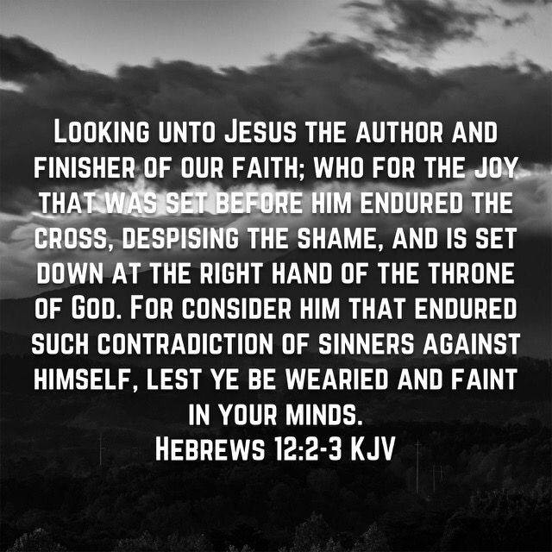
Notes:
that warreth
Dt 20:5-7 — "The officers are to address the army, 'Has any man built a new house and not dedicated it? Let him leave and return home. Otherwise, he may die in battle and another man dedicate it. 6 Has any man planted a vineyard and not begun to enjoy its fruit? Let him leave and return home. Otherwise he may die in battle and another man enjoy its fruit. 7 Has any man become engaged to a woman and not married her? Let him leave and return home. Otherwise he may die in battle and another man marry her.'
Lk 9:59-62 — Then he said to another, "Follow me." "Lord," he said, "first let me go bury my father." 60 But he told him, "Let the dead bury their own dead, but you go and spread the news of the kingdom of God." 61 Another said, "I will follow you, Lord, but first let me go and say good-bye to those at my house." 62 But Jesus said to him, "No one who puts his hand to the plow and looks back is fit for the kingdom of God."
entangleth
2Ti 4:10 — because Demas has deserted me, since he loved this present world, and has gone to Thessalonica. Crescens has gone to Galatia, Titus to Dalmatia.
Lk 8:14 — As for the seed that fell among thorns, these are the ones who, when they have heard, go on their way and are choked with worries, riches, and pleasures of life, and produce no mature fruit.
1Co 9:25 — Now everyone who competes exercises self-control in everything. They do it to receive a perishable crown, but we an imperishable crown.
1Co 9:26 — So I do not run like one who runs aimlessly or box like one beating the air.
1Ti 6:9-12 — But those who want to be rich fall into temptation, a trap, and many foolish and harmful desires, which plunge people into ruin and destruction. 10 For the love of money is a root of all kinds of evil, and by craving it, some have wandered away from the faith and pierced themselves with many griefs. 11 But you, man of God, flee from these things, and pursue righteousness, godliness, faith, love, endurance, and gentleness. 12 Fight the good fight of the faith. Take hold of eternal life to which you were called and about which you have made a good confession in the presence of many witnesses.
2Pe 2:20 — For if, having escaped the world's impurity through the knowledge of the Lord and Savior Jesus Christ, they are again entangled in these things and defeated, the last state is worse for them than the first.
that he
1Co 7:22 — For he who is called by the Lord as a slave is the Lord's freedman. Likewise he who is called as a free man is Christ's slave.
1Co 7:23 — You were bought at a price; do not become slaves of people.
2Co 5:9 — Therefore, whether we are at home or away, we make it our aim to be pleasing to him.
1Th 2:4 — Instead, just as we have been approved by God to be entrusted with the gospel, so we speak, not to please people, but rather God, who examines our hearts.

Slide 12
Examples of Faithfulness
C. Athletes
Also if anyone competes as an athlete, he does not win the prize unless he competes according to the rules.
- II Timothy 2:5
Notes:
C. Athletes
Also if anyone competes as an athlete, he does not win the prize unless he competes according to the rules.
- II Timothy 2:5
Paul has already alluded to the need to the type of work and necessity of staying focused in his service as a minister. By adding the example of an athlete, the Apostle now adds the idea of "how" one does the work. Like an athlete who has to compete in a framework of rules in order to win legitimately, Timothy must teach and preach accurately what he has learned from Paul, not to mention that his life must also accurately reflect his teachings. Hypocrites may be able to correctly teach the doctrine of Christ, but they won't survive the judgment of Christ.

Slide 13
Examples of Faithfulness
D. Farmers
⁶ The hard-working farmer ought to be the first to receive his share of the crops.
⁷ Consider what I say, for the Lord will give you understanding in everything.
- II Timothy 2:6-7
Notes:
D. Farmers
6The hard working farmer ought to be the first to receive his share of the crops. 7Consider what I say, for the Lord will give you understanding in everything.
- II Timothy 2:6-7
Paul's final example reminds Timothy that there is a reward attached to this service. The farmer is the first to profit from his labor and does so at every harvest. The thing he works at and with is also the thing that rewards him. He eats from what he plants and harvests. The "reward" analogy follows the same line of thinking - the teacher's reward is not his paycheck for teaching, it is the understanding he gains from what he studies. This is true for any teacher studying any subject, however, it is especially rich and rewarding for the one whose form of study is God Himself (through the study of His word) because God will bless and reward the student with understanding and knowledge of Himself; and this experience is in itself a genuine foretaste of heaven.
Paul, therefore, encourages Timothy to remain faithful in his service as an evangelist and teacher, and provides four examples of service (teachers, soldiers, athletes, farmers) in order to emphasize the various challenges and features of faithful service. He neatly bookends these passages with two references to God's role in Timothy's ministry. He has suffered false accusations and imprisonment as a common criminal. Nevertheless he has also seen the progress of the gospel and the church despite his personal setbacks.
Again, using himself as an example of a faithful servant, he declares that he is ready to continue suffering (even being killed) while remaining faithful in order to steady and strengthen the faith of those who are chosen. You become the "chosen" when you respond to the gospel with faith expressed through repentance and baptism (Matthew 28:18-20). Here, Paul adds the reward that all Christians will receive (not only faithful teachers) and that is salvation (forgiveness of sins), resurrection from the dead and eternal glory with God in heaven. Note that he says eternal glory and not eternal life, suggesting that our experience after the resurrection will not simply be "existence" or life after death but something more, and Paul hints at what that might be in the following verses.

Slide 14
Understanding /
Knowing God
→
Heaven

Slide 15
God’s Role in Timothy’s Ministry
Timothy’s Ministry
Encourager
Rewarder

Slide 16
⁸ Remember Jesus Christ, risen from the dead, descendant of David, according to my gospel, ⁹ for which I suffer hardship even to imprisonment as a criminal; but the word of God is not imprisoned.
- II Timothy 2:8-9

Slide 17
For this reason I endure all things for the sake of those who are chosen, so that they also may obtain the salvation which is in Christ Jesus and with it eternal glory.
- II Timothy 2:10

Slide 18
Eternal Glory not Eternal Life

Slide 19
¹¹ It is a trustworthy statement:
For if we died with Him,
we will also live with Him;
¹² If we endure,
we will also reign with Him;
If we deny Him, He also will deny us;
- II Timothy 2:11-12
Notes:
11It is a trustworthy statement: For if we died with Him, we will also live with Him; 12If we endure, we will also reign with Him; If we deny Him, He also will deny us; 13If we are faithless, He remains faithful, for He cannot deny Himself.
- II Timothy 2:11-13
This is a kind of "good news/bad news" way of summarizing the different results brought forth from faithfulness and unfaithfulness.
A. The good news - verses 11-12a
If we (Christians) died with Him: He died on the cross, we died in the waters of baptism.
Or do you not know that all of us who have been baptized into Christ Jesus have been baptized into His death?
- Romans 6:3
We will also resurrect with Him. He resurrected from the tomb where He was laid after His crucifixion. We resurrect from the watery grave of baptism.
4therefore we have been buried with Him through baptism into death, so that as Christ was raised from the dead through the glory of the Father, so we too might walk in newness of life. 5For if we have become united with Him in the likeness of His death, certainly we shall also be in the likeness of His resurrection,
- II Timothy 2:4-5
If we endure (remain faithful to our calling, gospel, doctrine, service, etc.) then we will reign with Him in heaven.
So here's the order of our transformation beginning at lost, unregenerated sinner condemned to hell.
1. Regeneration - born again as forgiven, spirit-filled saints at baptism.
3Jesus answered and said to him, "Truly, truly, I say to you, unless one is born again he cannot see the kingdom of God." 4Nicodemus said to Him, "How can a man be born when he is old? He cannot enter a second time into his mother's womb and be born, can he?" 5Jesus answered, "Truly, truly, I say to you, unless one is born of water and the Spirit he cannot enter into the kingdom of God."
- John 3:3-5
Peter said to them, "Repent, and each of you be baptized in the name of Jesus Christ for the forgiveness of your sins; and you will receive the gift of the Holy Spirit."
- Acts 2:38

Slide 20
If we are faithless,
He remains faithful,
for He cannot deny Himself.
- II Timothy 2:13

Slide 21
If we die with Him
We resurrect with Him
Or do you not know that all of us who have been baptized into Christ Jesus have been baptized into His death?
- Romans 6:3

Slide 22
He resurrects from the tomb
We resurrect from the water
⁴ Therefore we have been buried with Him through baptism into death, so that as Christ was raised from the dead through the glory of the Father, so we too might walk in newness of life. ⁵ For if we have become united with Him in the likeness of His death, certainly we shall also be in the likeness of His resurrection,
- Romans 6:4-5

Slide 23
If we endure → we will reign
Notes:
¹¹It is a trustworthy statement: For if we died with Him, we will also live with Him; ¹²If we endure, we will also reign with Him; If we deny Him, He also will deny us; ¹³If we are faithless, He remains faithful, for He cannot deny Himself.
- II Timothy 2:11-13This is a kind of "good news/bad news" way of summarizing the different results brought forth from faithfulness and unfaithfulness.
A. The good news - verses 11-12a
If we (Christians) died with Him: He died on the cross, we died in the waters of baptism.
Or do you not know that all of us who have been baptized into Christ Jesus have been baptized into His death?
- Romans 6:3We will also resurrect with Him. He resurrected from the tomb where He was laid after His crucifixion. We resurrect from the watery grave of baptism.
⁴therefore we have been buried with Him through baptism into death, so that as Christ was raised from the dead through the glory of the Father, so we too might walk in newness of life. ⁵For if we have become united with Him in the likeness of His death, certainly we shall also be in the likeness of His resurrection,
- II Timothy 2:4-5If we endure (remain faithful to our calling, gospel, doctrine, service, etc.) then we will reign with Him in heaven.
So here's the order of our transformation beginning at lost, unregenerated sinner condemned to hell.
1. Regeneration - born again as forgiven, spirit-filled saints at baptism.
³Jesus answered and said to him, "Truly, truly, I say to you, unless one is born again he cannot see the kingdom of God." ⁴Nicodemus said to Him, "How can a man be born when he is old? He cannot enter a second time into his mother's womb and be born, can he?" ⁵Jesus answered, "Truly, truly, I say to you, unless one is born of water and the Spirit he cannot enter into the kingdom of God."
- John 3:3-5Peter said to them, "Repent, and each of you be baptized in the name of Jesus Christ for the forgiveness of your sins; and you will receive the gift of the Holy Spirit."
- Acts 2:38

Slide 24
Transformation (Good News)
1. Regeneration - John 3:3-5; Acts 2:38
³ Jesus answered and said to him, “Truly, truly, I say to you, unless one is born again he cannot see the kingdom of God.” ⁴ Nicodemus said to Him, “How can a man be born when he is old? He cannot enter a second time into his mother’s womb and be born, can he?” ⁵ Jesus answered, “Truly, truly, I say to you, unless one is born of water and the Spirit he cannot enter into the kingdom of God.
Notes:
11It is a trustworthy statement: For if we died with Him, we will also live with Him; 12If we endure, we will also reign with Him; If we deny Him, He also will deny us; 13If we are faithless, He remains faithful, for He cannot deny Himself.
- II Timothy 2:11-13
This is a kind of "good news/bad news" way of summarizing the different results brought forth from faithfulness and unfaithfulness.
A. The good news - verses 11-12a
If we (Christians) died with Him: He died on the cross, we died in the waters of baptism.
Or do you not know that all of us who have been baptized into Christ Jesus have been baptized into His death?
- Romans 6:3
We will also resurrect with Him. He resurrected from the tomb where He was laid after His crucifixion. We resurrect from the watery grave of baptism.
4therefore we have been buried with Him through baptism into death, so that as Christ was raised from the dead through the glory of the Father, so we too might walk in newness of life. 5For if we have become united with Him in the likeness of His death, certainly we shall also be in the likeness of His resurrection,
- II Timothy 2:4-5
If we endure (remain faithful to our calling, gospel, doctrine, service, etc.) then we will reign with Him in heaven.
So here's the order of our transformation beginning at lost, unregenerated sinner condemned to hell.
1. Regeneration - born again as forgiven, spirit-filled saints at baptism.
3Jesus answered and said to him, "Truly, truly, I say to you, unless one is born again he cannot see the kingdom of God." 4Nicodemus said to Him, "How can a man be born when he is old? He cannot enter a second time into his mother's womb and be born, can he?" 5Jesus answered, "Truly, truly, I say to you, unless one is born of water and the Spirit he cannot enter into the kingdom of God."
- John 3:3-5
Peter said to them, "Repent, and each of you be baptized in the name of Jesus Christ for the forgiveness of your sins; and you will receive the gift of the Holy Spirit."
- Acts 2:38

Slide 25
Peter said to them, “Repent, and each of you be baptized in the name of Jesus Christ for the forgiveness of your sins; and you will receive the gift of the Holy Spirit.
- Acts 2:38

Slide 26
Transformation (Good News)
2. Glorification - I Corinthians 15:42-49
⁴² So also is the resurrection of the dead. It is sown a perishable body, it is raised an imperishable body; ⁴³ it is sown in dishonor, it is raised in glory; it is sown in weakness, it is raised in power;
Notes:
2. Glorification - raised from the dead when Jesus returns and equipped with glorified bodies which will enable us to exist in the presence of God in the dimension of pure spirit.
42So also is the resurrection of the dead. It is sown a perishable body, it is raised an imperishable body; 43it is sown in dishonor, it is raised in glory; it is sown in weakness, it is raised in power; 44It is sown a natural body, it is raised a spiritual body. If there is a natural body, there is also a spiritual body. 45So also it is written, "The first MAN, Adam, BECAME A LIVING SOUL." The last Adam became a life-giving spirit. 46However, the spiritual is not first, but the natural; then the spiritual. 47The first man is from the earth, earthy; the second man is from heaven. 48As is the earth, so also are those who are earthy; and as is the heavenly, so also are those who are heavenly. 49Just as we have borne the image of the earthy, we will also bear the image of the heavenly.
- II Corinthians 15:42-49

Slide 27
⁴⁴ it is sown a natural body, it is raised a spiritual body. If there is a natural body, there is also a spiritual body. ⁴⁵ So also it is written, “The first man, Adam, became a living soul.” The last Adam became a life-giving spirit. ⁴⁶ However, the spiritual is not first, but the natural; then the spiritual.
I Corinthians 15:44-46
Notes:
2. Glorification - raised from the dead when Jesus returns and equipped with glorified bodies which will enable us to exist in the presence of God in the dimension of pure spirit.
42So also is the resurrection of the dead. It is sown a perishable body, it is raised an imperishable body; 43it is sown in dishonor, it is raised in glory; it is sown in weakness, it is raised in power; 44It is sown a natural body, it is raised a spiritual body. If there is a natural body, there is also a spiritual body. 45So also it is written, "The first MAN, Adam, BECAME A LIVING SOUL." The last Adam became a life-giving spirit. 46However, the spiritual is not first, but the natural; then the spiritual. 47The first man is from the earth, earthy; the second man is from heaven. 48As is the earth, so also are those who are earthy; and as is the heavenly, so also are those who are heavenly. 49Just as we have borne the image of the earthy, we will also bear the image of the heavenly.
- II Corinthians 15:42-49

Slide 28
⁴⁷ The first man is from the earth, earthy; the second man is from heaven. ⁴⁸ As is the earthy, so also are those who are earthy; and as is the heavenly, so also are those who are heavenly. ⁴⁹ Just as we have borne the image of the earthy, we will also bear the image of the heavenly.
I Corinthians 15:47-49
Notes:
2. Glorification - raised from the dead when Jesus returns and equipped with glorified bodies which will enable us to exist in the presence of God in the dimension of pure spirit.
42So also is the resurrection of the dead. It is sown a perishable body, it is raised an imperishable body; 43it is sown in dishonor, it is raised in glory; it is sown in weakness, it is raised in power; 44It is sown a natural body, it is raised a spiritual body. If there is a natural body, there is also a spiritual body. 45So also it is written, "The first MAN, Adam, BECAME A LIVING SOUL." The last Adam became a life-giving spirit. 46However, the spiritual is not first, but the natural; then the spiritual. 47The first man is from the earth, earthy; the second man is from heaven. 48As is the earth, so also are those who are earthy; and as is the heavenly, so also are those who are heavenly. 49Just as we have borne the image of the earthy, we will also bear the image of the heavenly.
- II Corinthians 15:42-49

Slide 29
Transformation (Good News)
3. Exaltation
It is a trustworthy statement: For if we died with Him, we will also live with Him; – II Timothy 2:11
He who overcomes, I will grant to him to sit down with Me on My throne, as I also overcame and sat down with My Father on His throne. – Revelation 3:21
Notes:
3. Exaltation - this is more than mere existence, exaltation explains why we are equipped with gloried bodies in the first place. Glorification permits Christians to participate in the Godhead.
It is a trustworthy statement: For if we died with Him, we will also live with Him;
- II Timothy 2:11
'He who overcomes, I will grant to him to sit down with Me on My throne, as I also overcame and sat down with My Father on His throne.
- Revelation 3:21
Jesus has enabled us to share His position in the heavens. This is the final step in our transformation and reason to remain faithful - otherwise...

Slide 30
Transformation (Bad News)
^{12b} If we deny Him, He also will deny us; ¹³ If we are faithless, He remains faithful, for He cannot deny Himself.
- II Timothy 12b-13
Notes:
B. The bad news
12bIf we deny Him, He also will deny us; 13If we are faithless, He remains faithful, for He cannot deny Himself.
- II Timothy 2:12b-13
The consequences of being unfaithful are clearly and painfully laid out, and it's personal! We personally reject the faith, deny Christ, become unfaithful servants, teachers, etc. Jesus personally denies us and that denial causes the transformation to stop; our souls are then relegated to suffer without Christ frozen in the imperfect state of our sinfulness.
Paul adds a postscript here that speaks to the utter futility of denying Christ as some do quite openly and provocatively. The reality of Christ's existence and the truth of the gospel is such that a denial by man does not affect the reality and truth of His existence and position. A million people can rise up and say there is no sun in the sky, but its reality and presence is not affected by these denials, even if 20 million denied its presence it would still be shining in the sky. It is the same with Jesus. All the disbelief in the world has no affect on His presence, His cross and His promises for good or for bad.

Slide 31
Man’s denial of Christ does not change the reality of
Jesus’ presence and power.

