Slide 1
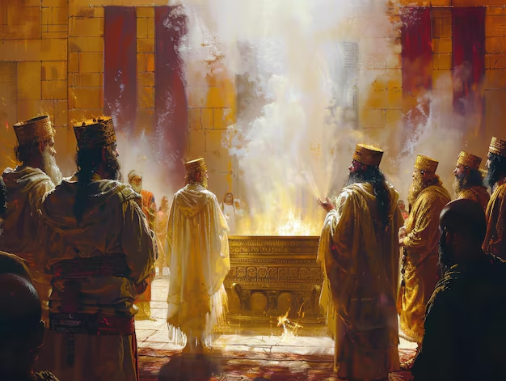
SCENE IV: AARON’S CONECRATION
Notes:
Well after this episode the people re-dedicate themselves and the work to complete the tabernacle, the equipment and special priestly garments is renewed. Moses receives and passes on a new set of commandments and the people prepare to worship God according to His command, purpose and design. So we fast forward to chapter 40 and read of another important episode in Aaron's life. After all is built and set into place the Bible say that the following instructions were given to Moses:

Slide 2
¹² Then you shall bring Aaron and his sons to the doorway of the tent of meeting and wash them with water. ¹³ You shall put the holy garments on Aaron and anoint him and consecrate him, that he may minister as a priest to Me.
- Exodus 40:12-13
Notes:
Exodus 40:1-13 (KJV)
¹ And the LORD spake unto Moses, saying,
² On the first day of the first month shalt thou set up the tabernacle of the tent of the congregation.
³ And thou shalt put therein the ark of the testimony, and cover the ark with the vail.
⁴ And thou shalt bring in the table, and set in order the things that are to be set in order upon it; and thou shalt bring in the candlestick, and light the lamps thereof.
⁵ And thou shalt set the altar of gold for the incense before the ark of the testimony, and put the hanging of the door to the tabernacle.
⁶ And thou shalt set the altar of the burnt offering before the door of the tabernacle of the tent of the congregation.
⁷ And thou shalt set the laver between the tent of the congregation and the altar, and shalt put water therein.
⁸ And thou shalt set up the court round about, and hang up the hanging at the court gate.
⁹ And thou shalt take the anointing oil, and anoint the tabernacle, and all that is therein, and shalt hallow it, and all the vessels thereof: and it shall be holy.
¹⁰ And thou shalt anoint the altar of the burnt offering, and all his vessels, and sanctify the altar: and it shall be an altar most holy.
¹¹ And thou shalt anoint the laver and his foot, and sanctify it.
¹² And thou shalt bring Aaron and his sons unto the door of the tabernacle of the congregation, and wash them with water.
¹³ And thou shalt put upon Aaron the holy garments, and anoint him, and sanctify him; that he may minister unto me in the priest's office.
Isa 11:1-5 — Then a shoot will grow from the stump of Jesse, and a branch from his roots will bear fruit. ² The Spirit of the LORD will rest on him — a Spirit of wisdom and understanding, a Spirit of counsel and strength, a Spirit of knowledge and of the fear of the LORD. ³ His delight will be in the fear of the LORD. He will not judge by what he sees with his eyes, he will not execute justice by what he hears with his ears, ⁴ but he will judge the poor righteously and execute justice for the oppressed of the land. He will strike the land with a scepter from his mouth, and he will kill the wicked with a command from his lips. ⁵ Righteousness will be a belt around his hips; faithfulness will be a belt around his waist.
Isa 61:1-3 — The Spirit of the Lord GOD is on me, because the LORD has anointed me to bring good news to the poor. He has sent me to heal the brokenhearted, to proclaim liberty to the captives and freedom to the prisoners; ² to proclaim the year of the LORD's favor, and the day of our God's vengeance; to comfort all who mourn, ³ to provide for those who mourn in Zion; to give them a crown of beauty instead of ashes, festive oil instead of mourning, and splendid clothes instead of despair. And they will be called righteous trees, planted by the LORD to glorify him.
Mt 3:16 — When Jesus was baptized, he went up immediately from the water. The heavens suddenly opened for him, and he saw the Spirit of God descending like a dove and coming down on him.
Lk 1:35 — The angel replied to her: "The Holy Spirit will come upon you, and the power of the Most High will overshadow you. Therefore, the holy one to be born will be called the Son of God.
Jn 3:34 — For the one whom God sent speaks God's words, since he gives the Spirit without measure.
Ro 8:3 — What the law could not do since it was weakened by the flesh, God did. He condemned sin in the flesh by sending his own Son in the likeness of sinful flesh as a sin offering,
Gal 4:4 — When the time came to completion, God sent his Son, born of a woman, born under the law,
Treasury - Ex 40:13
(Christian Standard Bible)
anoint him
Ex 28:41 — Put these on your brother Aaron and his sons; then anoint, ordain, and consecrate them, so that they may serve me as priests.
Isa 61:1 — The Spirit of the Lord GOD is on me, because the LORD has anointed me to bring good news to the poor. He has sent me to heal the brokenhearted, to proclaim liberty to the captives and freedom to the prisoners;
Jn 3:34 — For the one whom God sent speaks God's words, since he gives the Spirit without measure.
Jn 17:19 — I sanctify myself for them, so that they also may be sanctified by the truth.
Heb 10:10 — By this will, we have been sanctified through the offering of the body of Jesus Christ once for all time.
Heb 10:29 — How much worse punishment do you think one will deserve who has trampled on the Son of God, who has regarded as profane the blood of the covenant by which he was sanctified, and who has insulted the Spirit of grace?
1Jn 2:20 — But you have an anointing from the Holy One, and all of you know the truth.
1Jn 2:27 — As for you, the anointing you received from him remains in you, and you don't need anyone to teach you. Instead, his anointing teaches you about all things and is true and is not a lie; just as it has taught you, remain in him.

Slide 3
¹⁴ You shall bring his sons and put tunics on them; ¹⁵ and you shall anoint them even as you have anointed their father, that they may minister as priests to Me; and their anointing will qualify them for a perpetual priesthood throughout their generations."
- Exodus 40:14-15
Notes:
Treasury - Ex 40:14
(Christian Standard Bible)
Isa 44:3-5 — For I will pour water on the thirsty land and streams on the dry ground; I will pour out my Spirit on your descendants and my blessing on your offspring. ⁴ They will sprout among the grass like poplars by flowing streams. ⁵ This one will say, 'I am the LORD's'; another will use the name of Jacob; still another will write on his hand, 'The LORD's,' and take on the name of Israel."
Isa 61:10 — I rejoice greatly in the LORD, I exult in my God; for he has clothed me with the garments of salvation and wrapped me in a robe of righteousness, as a groom wears a turban and as a bride adorns herself with her jewels.
Jn 1:16 — Indeed, we have all received grace upon grace from his fullness,
Ro 8:30 — And those he predestined, he also called; and those he called, he also justified; and those he justified, he also glorified.
Ro 13:14 — But put on the Lord Jesus Christ, and don't make plans to gratify the desires of the flesh.
1Co 1:9 — God is faithful; you were called by him into fellowship with his Son, Jesus Christ our Lord.
1Co 1:30 — It is from him that you are in Christ Jesus, who became wisdom from God for us ​— ​our righteousness, sanctification, and redemption,
everlasting
Ex 12:14 — "This day is to be a memorial for you, and you must celebrate it as a festival to the LORD. You are to celebrate it throughout your generations as a permanent statute.
Ex 30:31 — "Tell the Israelites: This will be my holy anointing oil throughout your generations.
Ex 30:33 — Anyone who blends something like it or puts some of it on an unauthorized person must be cut off from his people."
Nu 25:13 — It will be a covenant of perpetual priesthood for him and his future descendants, because he was zealous for his God and made atonement for the Israelites."
Ps 110:4 — The LORD has sworn an oath and will not take it back: "You are a priest forever according to the pattern of Melchizedek."
Heb 5:1-14 — For every high priest taken from among men is appointed in matters pertaining to God for the people, to offer both gifts and sacrifices for sins. ² He is able to deal gently with those who are ignorant and are going astray, since he is also clothed with weakness. ³ Because of this, he must make an offering for his own sins as well as for the people. ⁴ No one takes this honor on himself; instead, a person is called by God, just as Aaron was. ⁵ In the same way, Christ did not exalt himself to become a high priest, but God who said to him, You are my Son; today I have become your Father, ⁶ also says in another place, You are a priest forever according to the order of Melchizedek. ⁷ During his earthly life, he offered prayers and appeals with loud cries and tears to the one who was able to save him from death, and he was heard because of his reverence. ⁸ Although he was the Son, he learned obedience from what he suffered. ⁹ After he was perfected, he became the source of eternal salvation for all who obey him, ¹⁰ and he was declared by God a high priest according to the order of Melchizedek. ¹¹ We have a great deal to say about this, and it is difficult to explain, since you have become too lazy to understand. ¹² Although by this time you ought to be teachers, you need someone to teach you the basic principles of God's revelation again. You need milk, not solid food. ¹³ Now everyone who lives on milk is inexperienced with the message about righteousness, because he is an infant. ¹⁴ But solid food is for the mature ​— ​for those whose senses have been trained to distinguish between good and evil.
Heb 7:3 — Without father, mother, or genealogy, having neither beginning of days nor end of life, but resembling the Son of God, he remains a priest forever.
Heb 7:7 — Without a doubt, the inferior is blessed by the superior.
Heb 7:17-24 — For it has been testified: You are a priest forever according to the order of Melchizedek. ¹⁸ So the previous command is annulled because it was weak and unprofitable ¹⁹ (for the law perfected nothing), but a better hope is introduced, through which we draw near to God. ²⁰ None of this happened without an oath. For others became priests without an oath, ²¹ but he became a priest with an oath made by the one who said to him: The Lord has sworn and will not change his mind, "You are a priest forever." ²² Because of this oath, Jesus has also become the guarantee of a better covenant. ²³ Now many have become Levitical priests, since they are prevented by death from remaining in office. ²⁴ But because he remains forever, he holds his priesthood permanently.
Heb 8:1 — Now the main point of what is being said is this: We have this kind of high priest, who sat down at the right hand of the throne of the Majesty in the heavens,

Slide 4
Thus Moses did; according to all that the Lord had commanded him,
so he did.
- Exodus 40:16

Slide 5
This miserable failure, this man who had demonstrated how incompetent he was to do the very thing he was called upon to do.
Notes:
This miserable failure, this man who had demonstrated how incompetent he was to do the very thing he was called upon to do. This is the same man over whom these words were spoken by God Himself. What a happy ending to a sad story of failure.

Slide 6
THOSE WHO EXPERIENCED FAILURE
PETER
DAVID
MOSES
JONAH
PAUL
SAMSON
JACOB
PRODIGAL SON
MARY MAGDALENE
Notes:
The Bible is replete with narratives of human frailty and divine forgiveness. These stories serve as powerful reminders of God's compassion and willingness to embrace those who repent. Below are some notable figures who experienced failure but were ultimately forgiven.
Peter
Peter, one of Jesus' closest disciples, is a prime example of failure and redemption. Despite his fervent declarations of loyalty, Peter denied Jesus three times on the night of His arrest (Luke 22:54-62). The weight of his failure led Peter to bitter weeping. However, after Jesus' resurrection, Peter was forgiven and restored. Jesus appeared to him and asked three times, "Do you love me?" (John 21:15-17), thus giving Peter the opportunity to reaffirm his devotion. Peter went on to become a foundational leader in the early Christian church.
David
King David, revered as one of Israel's greatest kings, succumbed to grave sins when he committed adultery with Bathsheba and orchestrated the death of her husband, Uriah (2 Samuel 11). The prophet Nathan confronted David, leading him to profound repentance and the composition of Psalm 51, a heartfelt plea for forgiveness. Despite the severe consequences of his actions, including the death of his child, David was forgiven by God and continued to reign as king, his lineage ultimately leading to the birth of Jesus.
Moses
Moses, the leader who delivered the Israelites from Egyptian bondage, also faced failure. In a moment of frustration, he disobeyed God's command by striking a rock to bring forth water instead of speaking to it (Numbers 20:8-12). This act of disobedience resulted in Moses being barred from entering the Promised Land. Nonetheless, Moses remained a revered leader, and God continued to guide him until his death on Mount Nebo.
Jonah
The prophet Jonah initially defied God's command to preach repentance to the city of Nineveh (Jonah 1:1-3). Instead, he fled in the opposite direction, only to be swallowed by a great fish. In the belly of the fish, Jonah repented and cried out to God for forgiveness (Jonah 2). God responded by delivering Jonah and giving him a second chance to fulfill his mission. Jonah's story underscores the theme of divine mercy and the possibility of redemption even after initial failure.
Paul
Before becoming a central figure in Christianity, Paul (formerly Saul) was a zealous persecutor of Christians. He was present at the stoning of Stephen and actively sought to imprison followers of Jesus (Acts 8:1-3). However, on the road to Damascus, Paul experienced a dramatic encounter with the risen Christ, leading to his conversion (Acts 9:1-19). Despite his past actions, Paul was forgiven and transformed into a passionate apostle, authoring many New Testament letters and spreading the gospel far and wide.
Samson
Samson, known for his extraordinary strength, failed to live up to his Nazirite vow by engaging in reckless behavior and revealing the secret of his strength to Delilah (Judges 16:1-22). Consequently, he was captured and blinded by the Philistines. In his final moments, Samson repented and called upon God for strength one last time. God granted his request, allowing him to bring down the temple of Dagon, defeating his enemies even in death (Judges 16:28-30).
Jacob
Jacob, later named Israel, resorted to deception to obtain his brother Esau's birthright and blessing (Genesis 27:1-29). This deceit led to years of estrangement and conflict. Over time, Jacob encountered God and wrestled with an angel, seeking forgiveness and blessing (Genesis 32:24-30). His transformation was marked by a new name, Israel, and reconciliation with Esau.
The Prodigal Son
Although not a historical figure, the parable of the Prodigal Son (Luke 15:11-32) vividly illustrates the themes of failure and forgiveness. The younger son squanders his inheritance in reckless living and finds himself destitute. In his despair, he returns to his father, humbly seeking forgiveness. His father, embodying God's unconditional love, welcomes him back with open arms and celebrates his return. This story highlights the boundless nature of divine mercy.
Mary Magdalene
Mary Magdalene, once possessed by seven demons (Luke 8:2), experienced profound redemption through her encounter with Jesus. She became one of his most devoted followers, witnessing his crucifixion and being among the first to see the resurrected Christ (John 20:11-18). Her transformation from a troubled past to a faithful disciple underscores the power of forgiveness.

Slide 7

Forgiveness and Forgetting in Scripture
Divine Mercy and Renewal
Notes:
Divine Mercy and Renewal
Throughout the Bible, the theme of forgiveness is intertwined with the promise of God’s mercy to remember our sins no more. This profound act of divine grace is a cornerstone of the Christian faith, illustrating the boundless love and compassion of God. Here are some of the key scriptures that highlight this incredible aspect of forgiveness:
Jeremiah 31:34
“No longer will they teach their neighbor, or say to one another, ‘Know the Lord,’ because they will all know me, from the least of them to the greatest,” declares the Lord. “For I will forgive their wickedness and will remember their sins no more.”
This verse from Jeremiah speaks directly to the promise of a new covenant, where God’s forgiveness is accompanied by a pledge to forget our sins. It emphasizes a future where knowledge of God is universal, and divine mercy is extended to all.
Hebrews 8:12
“For I will forgive their wickedness and will remember their sins no more.”
Echoing the words of Jeremiah, this scripture in Hebrews reaffirms God’s commitment to forgiveness and the erasure of our transgressions. It underscores the transformative power of God’s mercy, offering believers a fresh start.
Psalm 103:12
“As far as the east is from the west, so far has he removed our transgressions from us.”
This verse from the Psalms paints a vivid picture of the extent of God’s forgiveness. By removing our sins to an infinite distance, God ensures they are forgotten and no longer hold power over us.
Isaiah 43:25
“I, even I, am he who blots out your transgressions, for my own sake, and remembers your sins no more.”
In Isaiah, God declares His intent to erase our sins, not for our sake, but for His own. This highlights the divine nature of forgiveness and the desire of God to maintain a holy relationship with His people.
Micah 7:18-19
“Who is a God like you, who pardons sin and forgives the transgression of the remnant of his inheritance? You do not stay angry forever but delight to show mercy. You will again have compassion on us; you will tread our sins underfoot and hurl all our iniquities into the depths of the sea.”
Micah’s words celebrate the uniqueness of God’s mercy. By casting our sins into the depths of the sea, God ensures they are forgotten and irretrievable, signifying total forgiveness.
Conclusion
These scriptures provide a powerful testament to the concept of forgiveness and God’s promise to remember our sins no more. They offer hope and reassurance that, no matter our failures, divine mercy and grace are always available for those who seek repentance. The Bible's portrayal of God's forgiveness serves as a constant reminder of His unwavering love and the transformative power of His grace.

Slide 8
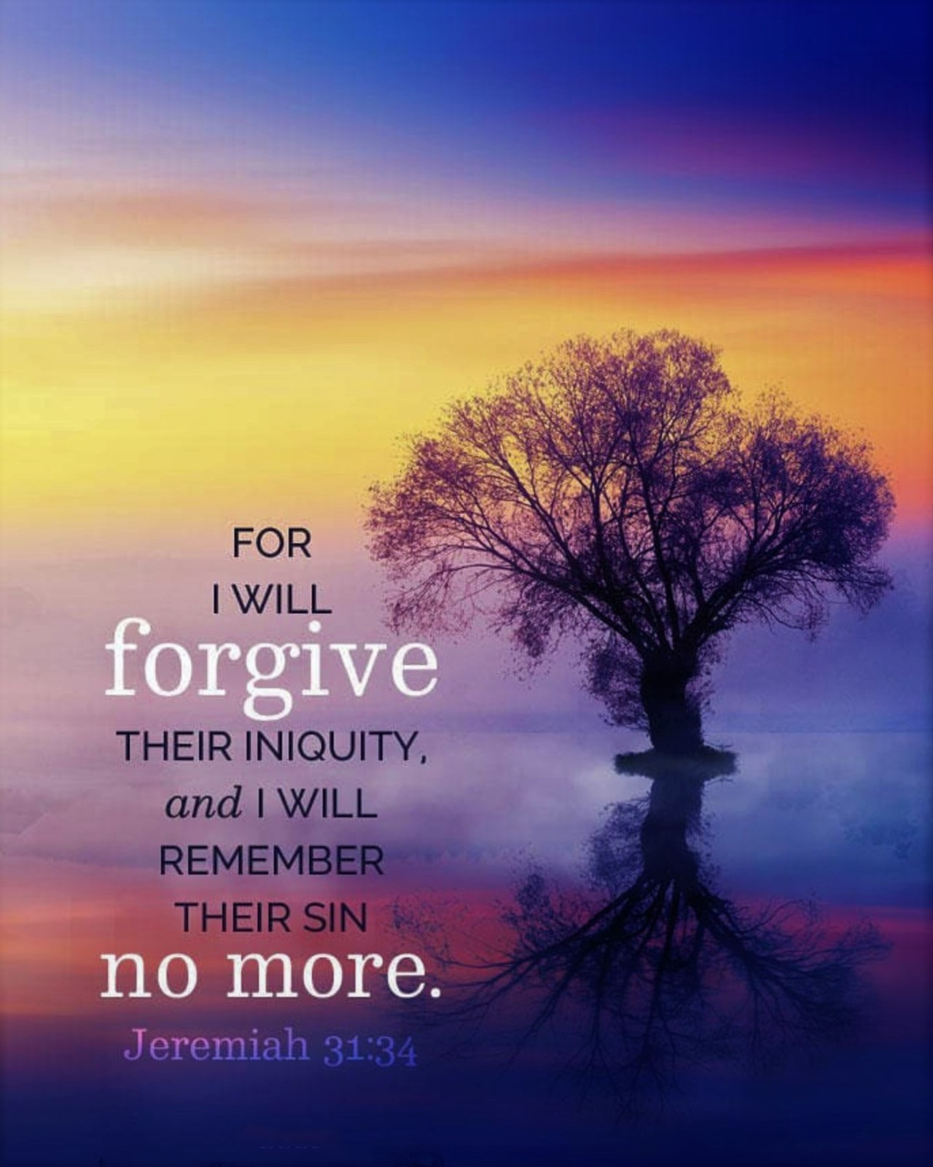

Slide 9
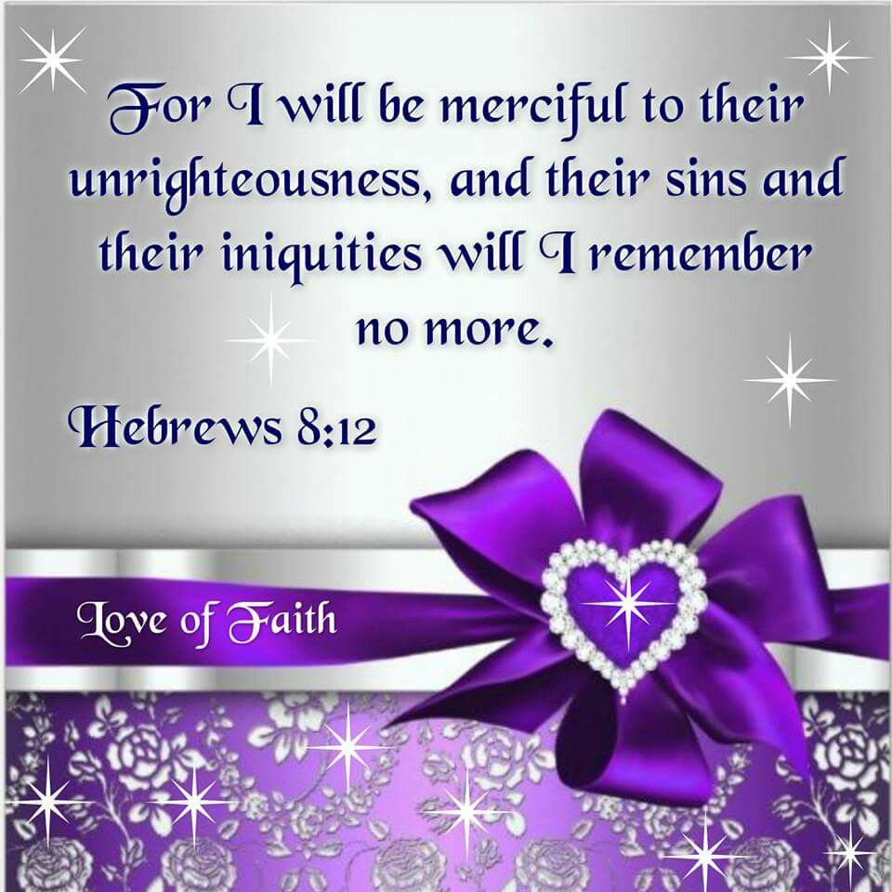

Slide 10
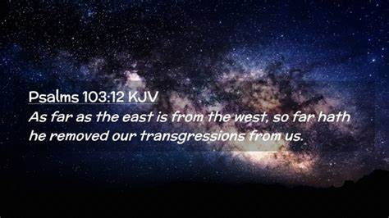

Slide 11
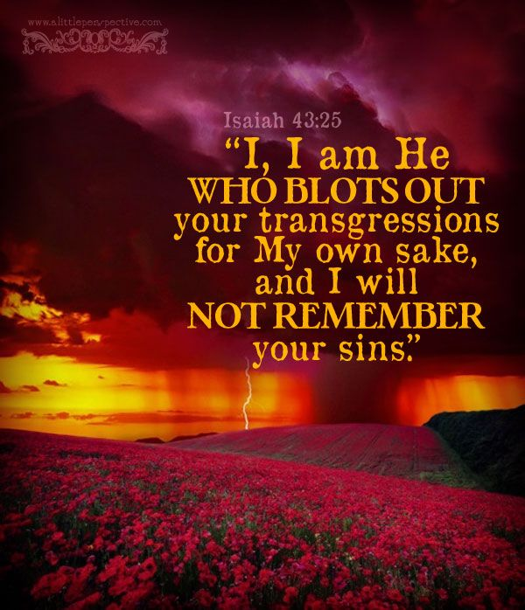

Slide 12
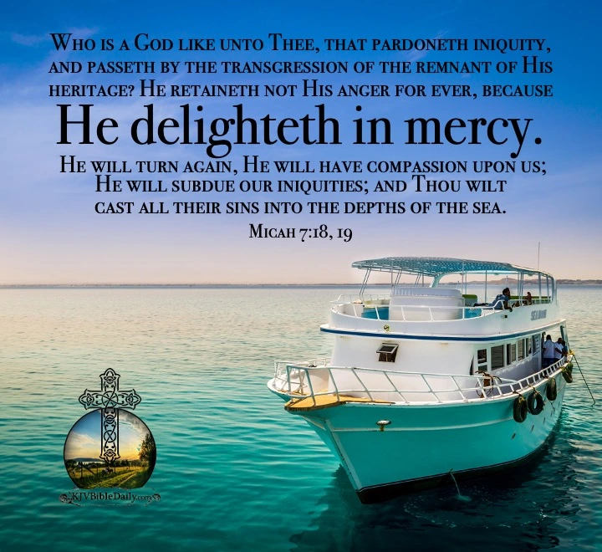

Slide 13
Lessons
Even great people fail
Notes:
Lesson #1 - Even great people fail.
Aaron was chosen by God, given power and position but this did not guarantee a life without failure. God can use us to serve Him not because we're great, but because He's great. "A" types, over-achievers, those who've succeeded in many areas need to understand that they can fail and fail badly. When they do, they need to realize that God can still use them, even after they've failed because His love is greater than any of our post or future achievements.

Slide 14
Lessons
Even great people fail
Our failures are never forgotten but they are forgiven
Notes:
Lesson #2 - Our failures are never forgotten but they are forgiven.
Poor Aaron, his failure is forever recorded in the Bible for all to see. But Aaron could go on with his life and his ministry because God forgave him this stumble. Some people think that so long as they can remember their own or somebody else's mistake, there's no real forgiveness. Aaron's story reminds us that we need to focus more on God's forgiveness instead of our failures if we wish to regain our confidence for the future as well as the ability and desire to forgive others. If you dwell mainly on your or someone else's failures you will never succeed at forgiveness and receive the healing that comes with it.

Slide 15
Lessons
Even great people fail
Our failures are never forgotten but they are forgiven
Failure lays the ground work
for improvement
Notes:
Lesson #3 - Failure lays the ground work for improvement.
Aaron learned a hard lesson from the episode with the golden calf. It was a lesson that prepared him for the rigorous ministry of the priesthood. His failure improved his capacity for understanding and compassion. Despite the splendor of the tabernacle and the divine mysteries of the sacrificial system; aside from the beauty and commanding presence of the priestly garments --- Aaron never lost sight of the fact that like the people he represented, he too was only a frail human being, in need of God's mercy.
This lesson had been indelibly stamped on his heart through failure and he was a more effective minister because of it. From start to finish the Bible tells and retells the story of man's continual failure in keeping God's commands. It also recounts God's continual effort at forgiving and restoring a failed humanity. This should give us confidence to approach Him the next time we think we've failed too badly to ask for forgiveness, to ask Him to be our Lord and we are His sons and daughters, or ministers again.

