Slide 1

9
Encouragement and Instructions: Remain Faithful – Part 1
II Timothy 1:6-18
Notes:
Paul began his letter to Timothy with a greeting and a prayer of thanksgiving where he comments on his fatherly affection for Timothy who he hopes will soon visit him in prison where he waits for the day of his execution. He then makes a bridge statement concerning Timothy's faith instilled in him by his mother and grandmother. Paul uses this device (bridge statement) to transition from commenting on the faith of Timothy's family to an exhortation about remaining faithful despite the difficulties they now face because of their common belief and work.

Slide 2
Remain Faithful
Notes:
Remain Faithful — 1:6-18
In the section we will study, Paul will encourage Timothy to remain faithful. He has noted that Timothy, as well as his mother and grandmother were all faithful. In this passage he will list things that Timothy should remain faithful to as a way of living out the faith that is within him.

Slide 3
Remain Faithful
To your calling
Notes:
Remain Faithful — 1:6-18
In the section we will study, Paul will encourage Timothy to remain faithful. He has noted that Timothy, as well as his mother and grandmother were all faithful. In this passage he will list things that Timothy should remain faithful to as a way of living out the faith that is within him.
1. Remain faithful to your calling - 1:6-7
Timothy was faithful from an early age and highly regarded by the church when Paul first chose him as his helper in the work of the gospel (Acts 16:1-3). Eventually Timothy was commended (ordained) as an evangelist in his own right and continued to work alongside of Paul (laying on of hands - I Timothy 4:13-14). At some point Paul left Timothy in Ephesus (I Timothy 1:3) to continue the work there on his own. Much of I Timothy provides teaching that the young evangelist could use as he organized and ministered to this church.
The work of the gospel was challenging in itself but made more difficult in the early years because of the attacks they had to endure from the Jewish leaders who wanted to destroy the faith and those who promoted it. Now, however, it was the Roman government that was denouncing the Christian religion and about to execute one of its prominent leaders. This turn of events sent a chill through the churches in the Roman Empire and put on notice its high profile leaders (the Apostles and ministers like Timothy, Mark and Titus). Despite these threats, however, now was not the time to shrink back or keep a low profile.

Slide 4

Notes:
the spirit
Ac 20:24 — But I consider my life of no value to myself; my purpose is to finish my course and the ministry I received from the Lord Jesus, to testify to the gospel of God's grace.
Ac 21:13 — Then Paul replied, "What are you doing, weeping and breaking my heart? For I am ready not only to be bound but also to die in Jerusalem for the name of the Lord Jesus."
Ro 8:15 — You did not receive a spirit of slavery to fall back into fear. Instead, you received the Spirit of adoption, by whom we cry out, "Abba, Father! "
Heb 2:15 — and free those who were held in slavery all their lives by the fear of death.
1Jn 4:18 — There is no fear in love; instead, perfect love drives out fear, because fear involves punishment. So the one who fears is not complete in love.

Slide 5
⁶ For this reason I remind you to kindle afresh the gift of God which is in you through the laying on of my hands. ⁷ For God has not given us a spirit of timidity, but of power and love and discipline.
- II Timothy 1:6-7
Notes:
6For this reason I remind you to kindle afresh the gift of God which is in you through the laying on of my hands. 7For God has not given us a spirit of timidity, but of power and love and discipline.
- II Timothy 1:6-7
It is not that Timothy had been slacking, and Paul is trying to encourage him to preach again. Timothy's zeal for ministry was still burning strongly and Paul's encouragement here is that he should keep fanning the flames so that the discouragement of the times not diminish it. Paul reminds Timothy of the presence within him. At baptism Timothy received the indwelling of the Holy Spirit (Acts 2:38). It was the Spirit of God within him that animated and directed his ministry, and Paul reminds him of what John taught concerning the Spirit of God within man -

Slide 6


Slide 7
Now I want to remind you, although you came to know all these things once and for all, that Jesus saved a people out of Egypt and later destroyed those who did not believe;
Jude 1:5

Slide 8
But I consider my life of no value to myself; my purpose is to finish my course and the ministry I received from the Lord Jesus, to testify to the gospel of God's grace.
Ac 20:24

Slide 9
You are from God, little children, and have overcome them; because greater is He who is in you than he who is in the world.
- I John 4:4
Notes:
You are from God, little children, and have overcome them; because greater is He who is in you than he who is in the world.
- I John 4:4
That Spirit, Paul says, equips every Christian including Timothy with three things that enable a believer to face any kind of obstacle or attack:
Power - not just courage or bravery but the power to hold on, to endure, to suffer and even die without giving up faith or the hope of heaven. The Spirit enables us to not be afraid or broken but to remain faithful, even fruitful in times of difficulty.
Love - difficulties and suffering cannot change or destroy the attitude of love in a Christian's heart constantly renewed and enabled by the Spirit of God.
Discipline - Christians don't lose their minds or their bearing in times of trouble. The Spirit of God and His word steady the mind and heart of the believer in both good and bad times.

Slide 10
The Spirit Provides:
Power
Notes:
You are from God, little children, and have overcome them; because greater is He who is in you than he who is in the world.
- I John 4:4
That Spirit, Paul says, equips every Christian including Timothy with three things that enable a believer to face any kind of obstacle or attack:
Power - not just courage or bravery but the power to hold on, to endure, to suffer and even die without giving up faith or the hope of heaven. The Spirit enables us to not be afraid or broken but to remain faithful, even fruitful in times of difficulty.
Love - difficulties and suffering cannot change or destroy the attitude of love in a Christian's heart constantly renewed and enabled by the Spirit of God.
Discipline - Christians don't lose their minds or their bearing in times of trouble. The Spirit of God and His word steady the mind and heart of the believer in both good and bad times.

Slide 11
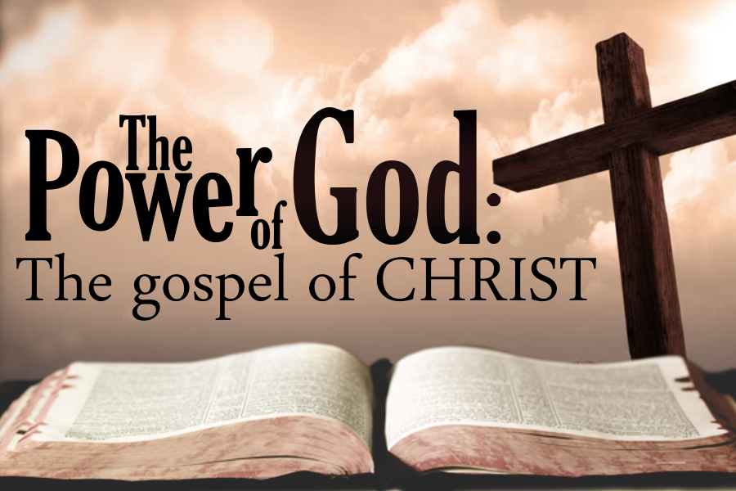
Notes:
but
Mic 3:8 — As for me, however, I am filled with power by the Spirit of the LORD, with justice and courage, to proclaim to Jacob his rebellion and to Israel his sin.
Zec 4:6 — So he answered me, "This is the word of the LORD to Zerubbabel: 'Not by strength or by might, but by my Spirit,' says the LORD of Armies.
Lk 10:19 — Look, I have given you the authority to trample on snakes and scorpions and over all the power of the enemy; nothing at all will harm you.
Lk 24:49 — And look, I am sending you what my Father promised. As for you, stay in the city until you are empowered from on high.”
Ac 1:8 — But you will receive power when the Holy Spirit has come on you, and you will be my witnesses in Jerusalem, in all Judea and Samaria, and to the end of the earth."
Ac 6:8 — Now Stephen, full of grace and power, was performing great wonders and signs among the people.
Ac 9:22 — But Saul grew stronger and kept confounding the Jews who lived in Damascus by proving that Jesus is the Messiah.
Ac 10:38 — how God anointed Jesus of Nazareth with the Holy Spirit and with power, and how he went about doing good and healing all who were under the tyranny of the devil, because God was with him.
1Co 2:4 — My speech and my preaching were not with persuasive words of wisdom but with a demonstration of the Spirit's power,

Slide 12
As for me, however, I am filled with power by the Spirit of the LORD, with justice and courage, to proclaim to Jacob his rebellion and to Israel his sin.
Mic 3:8

Slide 13
how God anointed Jesus of Nazareth with the Holy Spirit and with power, and how he went about doing good and healing all who were under the tyranny of the devil, because God was with him.
Ac 10:38
Notes:
Acts 10:34-48 (KJV)
34 Then Peter opened his mouth, and said, Of a truth I perceive that God is no respecter of persons:
35 But in every nation he that feareth him, and worketh righteousness, is accepted with him.
36 The word which God sent unto the children of Israel, preaching peace by Jesus Christ: (he is Lord of all:)
37 That word, I say, ye know, which was published throughout all Judaea, and began from Galilee, after the baptism which John preached;
38 How God anointed Jesus of Nazareth with the Holy Ghost and with power: who went about doing good, and healing all that were oppressed of the devil; for God was with him.
39 And we are witnesses of all things which he did both in the land of the Jews, and in Jerusalem; whom they slew and hanged on a tree:
40 Him God raised up the third day, and shewed him openly;
41 Not to all the people, but unto witnesses chosen before of God, even to us, who did eat and drink with him after he rose from the dead.
42 And he commanded us to preach unto the people, and to testify that it is he which was ordained of God to be the Judge of quick and dead.
43 To him give all the prophets witness, that through his name whosoever believeth in him shall receive remission of sins.
44 While Peter yet spake these words, the Holy Ghost fell on all them which heard the word.
45 And they of the circumcision which believed were astonished, as many as came with Peter, because that on the Gentiles also was poured out the gift of the Holy Ghost.
46 For they heard them speak with tongues, and magnify God. Then answered Peter,
47 Can any man forbid water, that these should not be baptized, which have received the Holy Ghost as well as we?
48 And he commanded them to be baptized in the name of the Lord. Then prayed they him to tarry certain days.

Slide 14
The Spirit Provides:
Power
Love
Notes:
You are from God, little children, and have overcome them; because greater is He who is in you than he who is in the world.
- I John 4:4
That Spirit, Paul says, equips every Christian including Timothy with three things that enable a believer to face any kind of obstacle or attack:
Power - not just courage or bravery but the power to hold on, to endure, to suffer and even die without giving up faith or the hope of heaven. The Spirit enables us to not be afraid or broken but to remain faithful, even fruitful in times of difficulty.
Love - difficulties and suffering cannot change or destroy the attitude of love in a Christian's heart constantly renewed and enabled by the Spirit of God.
Discipline - Christians don't lose their minds or their bearing in times of trouble. The Spirit of God and His word steady the mind and heart of the believer in both good and bad times.

Slide 15
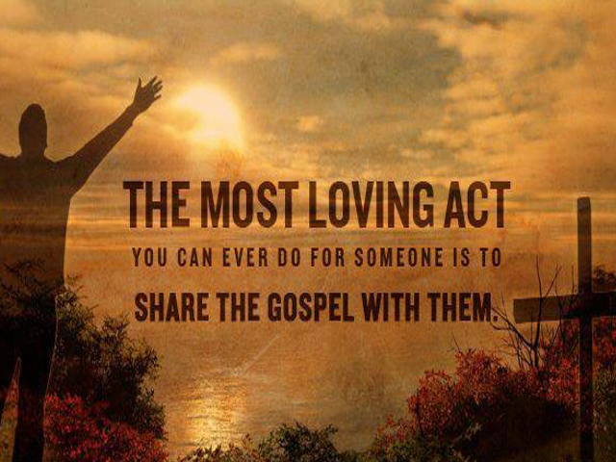

Slide 16
Since you have purified yourselves by your obedience to the truth, so that you show sincere brotherly love for each other, from a pure heart love one another constantly,
1Pe 1:22
Notes:
of love
Ro 5:5 — This hope will not disappoint us, because God's love has been poured out in our hearts through the Holy Spirit who was given to us.
Gal 5:22 — But the fruit of the Spirit is love, joy, peace, patience, kindness, goodness, faithfulness,
Col 1:8 — and he has told us about your love in the Spirit.
1Pe 1:22 — Since you have purified yourselves by your obedience to the truth, so that you show sincere brotherly love for each other, from a pure heart love one another constantly,

Slide 17
The Spirit Provides:
Power
Love
Discipline (SOUND MIND)
Notes:
You are from God, little children, and have overcome them; because greater is He who is in you than he who is in the world.
- I John 4:4
That Spirit, Paul says, equips every Christian including Timothy with three things that enable a believer to face any kind of obstacle or attack:
Power - not just courage or bravery but the power to hold on, to endure, to suffer and even die without giving up faith or the hope of heaven. The Spirit enables us to not be afraid or broken but to remain faithful, even fruitful in times of difficulty.
Love - difficulties and suffering cannot change or destroy the attitude of love in a Christian's heart constantly renewed and enabled by the Spirit of God.
Discipline - Christians don't lose their minds or their bearing in times of trouble. The Spirit of God and His word steady the mind and heart of the believer in both good and bad times.

Slide 18
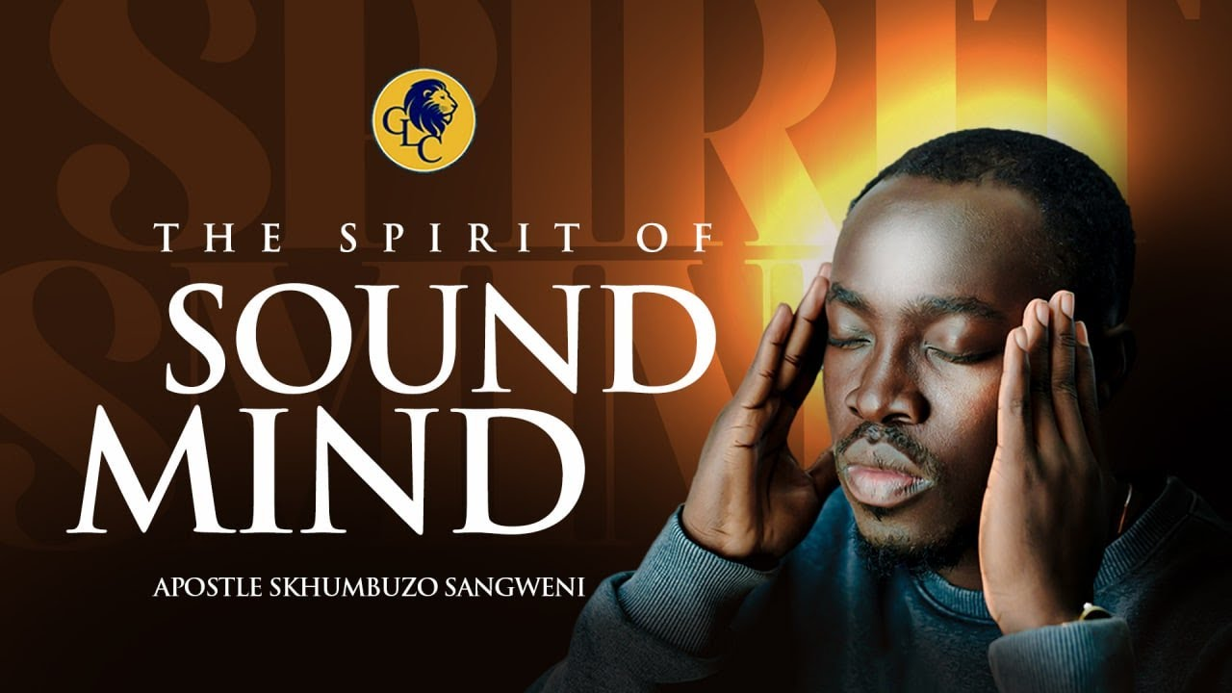
Notes:
a sound
Ps 119:80 — May my heart be blameless regarding your statutes so that I will not be put to shame.
Pr 2:7 — He stores up success for the upright; He is a shield for those who live with integrity
Pr 8:14 — I possess good advice and sound wisdom; I have understanding and strength.
Lk 8:35 — Then people went out to see what had happened. They came to Jesus and found the man the demons had departed from, sitting at Jesus's feet, dressed and in his right mind. And they were afraid.
Lk 15:17 — When he came to his senses, he said, 'How many of my father's hired workers have more than enough food, and here I am dying of hunger!
Ac 26:11 — In all the synagogues I often punished them and tried to make them blaspheme. Since I was terribly enraged at them, I pursued them even to foreign cities.
Ac 26:25 — But Paul replied, "I'm not out of my mind, most excellent Festus. On the contrary, I'm speaking words of truth and good judgment.
2Co 5:13 — For if we are out of our mind, it is for God; if we are in our right mind, it is for you.
2Co 5:14 — For the love of Christ compels us, since we have reached this conclusion: If one died for all, then all died.

Slide 19
I possess good advice and sound wisdom; I have understanding and strength.
Pr 8:14

Slide 20
Paul is reminding Timothy of the spiritual resources that he has in Christ that will enable him to stay true to his calling as an evangelist.

Slide 21
Remain Faithful
To your calling
To the gospel
Notes:
2. Remain faithful to the Gospel - 1:8-12
Before, they could preach the gospel in the open, but now to do so would become risky.
8Therefore do not be ashamed of the testimony of our Lord or of me His prisoner, but join with me in suffering for the gospel according to the power of God, 9who has saved us and called us with a holy calling, not according to our works, but according to His own purpose and grace which was granted us in Christ Jesus from all eternity, 10but now has been revealed by the appearing of our Savior Christ Jesus, who abolished death and brought life and immortality to light through the gospel,11for which I was appointed a preacher and an apostle and a teacher.12For this reason I also suffer these things, but I am not ashamed; for I know whom I have believed and I am convinced that He is able to guard what I have entrusted to Him until that day.
- II Timothy 1:8-12
The choice was to preach the gospel and risk arrest and possibly death, or to be quiet and avoid trouble. Paul reviews the two main blessings of the gospel: a) salvation by grace and not works, b) the promise of eternal life.
Paul, who has preached this message openly and is now suffering the consequences for doing this, nevertheless claims that it was worth it since he has: knowledge of God, guaranteed salvation and assurance that He did the "best" thing possible. Paul doesn't want Timothy to shy away from the message of the gospel (ashamed) or the proclaiming of it either. He wants the young preacher to be ready to suffer on account of the gospel, trusting that God is aware of the possible negative circumstances that may arise in doing this, and assuring him that He is able to fulfill all of His promises despite these.

Slide 22
⁸ Therefore do not be ashamed of the testimony of our Lord or of me His prisoner, but join with me in suffering for the gospel according to the power of God, ⁹ who has saved us and called us with a holy calling, not according to our works, but according to His own purpose and grace which was granted us in Christ Jesus from all eternity,
- II Timothy 1:8-9

Slide 23
¹⁰ but now has been revealed by the appearing of our Savior Christ Jesus, who abolished death and brought life and immortality to light through the gospel, ¹¹ for which I was appointed a preacher and an apostle and a teacher.
- II Timothy 1:10-11

Slide 24
For this reason I also suffer these things, but I am not ashamed; for I know whom I have believed and I am convinced that He is able to guard what I have entrusted to Him until that day.
- II Timothy 1:12

Slide 25
The choice was to preach the gospel and risk arrest and possibly death, or to be quiet and avoid trouble.

Slide 26
2 – MAIN BLESSINGS OF THE GOSPEL
a) salvation by grace and not works,
b) the promise of eternal life.
Notes:
The choice was to preach the gospel and risk arrest and possibly death, or to be quiet and avoid trouble. Paul reviews the two main blessings of the gospel: a) salvation by grace and not works, b) the promise of eternal life.
Paul, who has preached this message openly and is now suffering the consequences for doing this, nevertheless claims that it was worth it since he has: knowledge of God, guaranteed salvation and assurance that He did the "best" thing possible. Paul doesn't want Timothy to shy away from the message of the gospel (ashamed) or the proclaiming of it either. He wants the young preacher to be ready to suffer on account of the gospel, trusting that God is aware of the possible negative circumstances that may arise in doing this, and assuring him that He is able to fulfill all of His promises despite these.

Slide 27
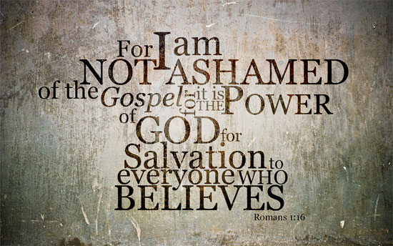
Notes:
Paul doesn't want Timothy to shy away from the message of the gospel (ashamed) or the proclaiming of it either. He wants the young preacher to be ready to suffer on account of the gospel, trusting that God is aware of the possible negative circumstances that may arise in doing this, and assuring him that He is able to fulfill all of His promises despite these.

Slide 28
Remain Faithful
To your calling
To the gospel
To the doctrine
Notes:
3. Remain faithful to the doctrine - 1:13-18
13Retain the standard of sound words which you have heard from me, in the faith and love which are in Christ Jesus. 14Guard, through the Holy Spirit who dwells in us, the treasure which has been entrusted to you.
II Timothy 1:13-14
Paul has previously written to Timothy about the problem of false teachers in his first letter, so it is natural for him to make mention of this once again but in a more general way.
Paul not only taught Timothy the gospel as well as the other teachings of Jesus, he also modeled the way these were to be taught.
The standard or pattern of sound words are the inspired teachings themselves. Faith and love in Christ are the way or manner these were taught, applied and lived out.
Timothy was to maintain and repeat in his ministry the content as well as the manner of teaching and living that had been taught and modeled for him by Paul, his teacher and mentor.

Slide 29
¹³ Retain the standard of sound words which you have heard from me, in the faith and love which are in Christ Jesus. ¹⁴ Guard, through the Holy Spirit who dwells in us, the treasure which has been entrusted to you.
- II Timothy 1:13-14
Notes:
3. Remain faithful to the doctrine - 1:13-18
13Retain the standard of sound words which you have heard from me, in the faith and love which are in Christ Jesus. 14Guard, through the Holy Spirit who dwells in us, the treasure which has been entrusted to you.
II Timothy 1:13-14
Paul has previously written to Timothy about the problem of false teachers in his first letter, so it is natural for him to make mention of this once again but in a more general way.
Paul not only taught Timothy the gospel as well as the other teachings of Jesus, he also modeled the way these were to be taught.
The standard or pattern of sound words are the inspired teachings themselves. Faith and love in Christ are the way or manner these were taught, applied and lived out.
Timothy was to maintain and repeat in his ministry the content as well as the manner of teaching and living that had been taught and modeled for him by Paul, his teacher and mentor.
Paul was about to be executed and Timothy was to carry on Paul's ministry of preaching, teaching and church establishment after the Apostle was gone. This would require that Timothy guard the essential message of the gospel given to him by Paul so that he could pass it on unchanged to the next generation. Again, Paul refers to the Holy Spirit as the One who will enable Timothy to maintain the purity of the message and manner it is to be proclaimed. As a normal sinful human being, Timothy could not do this, but with the Holy Spirit to guide and inspire him, Timothy would be able to keep this charge.

Slide 30
⁴ Now there are varieties of gifts, but the same Spirit. ⁵ And there are varieties of ministries, and the same Lord. ⁶ There are varieties of effects, but the same God who works all things in all persons. ⁷ But to each one is given the manifestation of the Spirit for the common good.
- I Corinthians 12:4-7
Notes:
n the first century, before the inspired writings were completed and collected into one New Testament Canon (AD 397 - Council of Cartage), many in the church had spiritual gifts that enabled them to speak, teach and apply God's word accurately. In other words, what ministers and Bible teachers at every level do today based on their education and training in God's word, these same people in the first century carried out these things accurately through the agency and empowerment of the Holy Spirit.
4Now there are varieties of gifts, but the same Spirit. 5And there are varieties of ministries, and the same Lord. 6There are varieties of effects, but the same God who works all things in all persons. 7But to each one is given the manifestation of the Spirit for the common good. 8For to one is given the word of wisdom through the Spirit, and to another the word of knowledge according to the same Spirit; 9to another faith by the same Spirit, and to another gifts of healing by the one Spirit, 10and to another the effecting of miracles, and to another prophecy, and to another the distinguishing of spirits, to another various kinds of tongues, and to another the interpretation of tongues. 11But one and the same Spirit works all these things, distributing to each one individually just as He wills.
- I Corinthians 12:4-11

Slide 31
⁸ For to one is given the word of wisdom through the Spirit, and to another the word of knowledge according to the same Spirit; ⁹ to another faith by the same Spirit, and to another gifts of healing by the one Spirit,
- I Corinthians 12:8-9

Slide 32
¹⁰ and to another the effecting of miracles, and to another prophecy, and to another the distinguishing of spirits, to another various kinds of tongues, and to another the interpretation of tongues. ¹¹ But one and the same Spirit works all these things, distributing to each one individually just as He wills.
- I Corinthians 12:10-11
Notes:
To be sure, Timothy had a part to play in both keeping himself pure and following carefully the things he had been taught by Paul, but if he followed the lead and prompting of the Holy Spirit, he, like Paul, would be a faithful minister to the end. Today all those baptized into Christ receive the Holy Spirit and the Spirit does influence our lives, especially in regards to our faith. In Romans 8, Paul says that the Spirit:

Slide 33
The Holy Spirit:
Helps us put to death sin – Romans 8:13
Helps us relate to God – Romans 8:15
Helps us produce spiritual fruit – Romans 8:23
Helps us connect with God – Romans 8:26
Raises us from the dead – Romans 8:11
Notes:
Helps us put to death the deeds of the flesh, meaning He helps us overcome sin (Romans 8:13).
Helps us who are flesh, relate to our heavenly Father who is pure spirit (Romans 8:15).
Helps us produce spiritual fruit (Romans 8:23).
Helps us connect with God in prayer (Romans 8:26).
God will raise us from the dead through the power of the Holy Spirit who dwells within us (Romans 8:11).

Slide 34
The Holy Spirit has always done these things for Christians whether in the first century or now.
Notes:
The Holy Spirit has always done these things for Christians whether in the first century or now. However, in addition to the spiritual help mentioned here, in the first century the Spirit also provided to certain ones in the church (teachers, preachers, saints, elders etc.) certain spiritual gifts (speaking in tongues, inspiration, spiritual knowledge and wisdom, etc.) to help them in establishing and growing churches since they did not yet have the main tool necessary to do this work: the complete New Testament.
Today, the Spirit continues to bless us in the ways listed in Romans 8:11-26, but no longer provides miraculous gifts (inspiration, tongues, spiritual wisdom and knowledge directly given by God) because for almost 18 centuries we have had access to the complete New Testament. What a few of them in the first century knew and taught from inspiration and spiritually guided wisdom, everyone can now know and teach from God's word available to all.

Slide 35
¹⁴ Therefore, beloved, since you look for these things, be diligent to be found by Him in peace, spotless and blameless,
¹⁵ and regard the patience of our Lord as salvation; just as also our beloved brother Paul, according to the wisdom given him, wrote to you,
- II Peter 3:14-15
Notes:
My point with all of this is that Paul, as an Apostle, had among his other gifts, the spiritual gift of inspiration. What he wrote was inspired by God. Even Peter, the Apostle, recognized this gift that Paul had.
14Therefore, beloved, since you look for these things, be diligent to be found by Him in peace, spotless and blameless, 15and regard the patience of our Lord as salvation; just as also our beloved brother Paul, according to the wisdom given him, wrote to you, 16as also in all his letters, speaking in them of these things, in which are some things hard to understand, which the untaught and unstable distort, as they do also the rest of the Scriptures, to their own destruction.
- II Peter 3:14-16

Slide 36
as also in all his letters, speaking in them of these things, in which are some things hard to understand, which the untaught and unstable distort, as they do also the rest of the Scriptures, to their own destruction.
- II Peter 3:16
Notes:
My point with all of this is that Paul, as an Apostle, had among his other gifts, the spiritual gift of inspiration. What he wrote was inspired by God. Even Peter, the Apostle, recognized this gift that Paul had.
14Therefore, beloved, since you look for these things, be diligent to be found by Him in peace, spotless and blameless, 15and regard the patience of our Lord as salvation; just as also our beloved brother Paul, according to the wisdom given him, wrote to you, 16as also in all his letters, speaking in them of these things, in which are some things hard to understand, which the untaught and unstable distort, as they do also the rest of the Scriptures, to their own destruction.
- II Peter 3:14-16

Slide 37
¹¹ Prescribe and teach these things.
¹² Let no one look down on your youthfulness, but rather in speech, conduct, love, faith and purity, show yourself an example of those who believe.
- I Timothy 4:11-12
Notes:
Timothy, on the other hand, was not inspired and we don't have any of his writings, however, what Paul says about him suggests that he may have been gifted with spiritual knowledge and/or wisdom which made him a valuable worker and teacher to assist Paul.
11Prescribe and teach these things. 12Let no one look down on your youthfulness, but rather in speech, conduct, love, faith and purity, show yourself an example of those who believe. 13Until I come, give attention to the public reading of Scripture, to exhortation and teaching. 14Do not neglect the spiritual gift within you, which was bestowed on you through prophetic utterance with the laying on of hands by the presbytery.
- I Timothy 4:11-14

Slide 38
¹³ Until I come, give attention to the public reading of Scripture, to exhortation and teaching. ¹⁴ Do not neglect the spiritual gift within you, which was bestowed on you through prophetic utterance with the laying on of hands by the presbytery.
- I Timothy 4:13-14
Notes:
Timothy, on the other hand, was not inspired and we don't have any of his writings, however, what Paul says about him suggests that he may have been gifted with spiritual knowledge and/or wisdom which made him a valuable worker and teacher to assist Paul.
11Prescribe and teach these things. 12Let no one look down on your youthfulness, but rather in speech, conduct, love, faith and purity, show yourself an example of those who believe. 13Until I come, give attention to the public reading of Scripture, to exhortation and teaching. 14Do not neglect the spiritual gift within you, which was bestowed on you through prophetic utterance with the laying on of hands by the presbytery.
- I Timothy 4:11-14

Slide 39
¹⁵ You are aware of the fact that all who are in Asia turned away from me, among whom are Phygelus and Hermogenes.
¹⁶ The Lord grant mercy to the house of Onesiphorus, for he often refreshed me and was not ashamed of my chains;
- II Timothy 1:15-16
Notes:
This may explain more clearly Paul's encouragement to guard through the Holy Spirit the store of knowledge and teachings about the gospel that Timothy possessed.
15You are aware of the fact that all who are in Asia turned away from me, among whom are Phygelus and Hermogenes, 16The Lord grant mercy to the house of Onesiphorus, for he often refreshed me and was not ashamed of my chains; 17but when he was in Rome, he eagerly searched for me and found me - 18the Lord grant to him to find mercy from the Lord on that day - and you know very well what services he rendered at Ephesus.
- II Timothy 1:15-18

Slide 40
¹⁷ but when he was in Rome, he eagerly searched for me and found me— ¹⁸ the Lord grant to him to find mercy from the Lord on that day—and you know very well what services he rendered at Ephesus.
- II Timothy 1:17-18
Notes:
This may explain more clearly Paul's encouragement to guard through the Holy Spirit the store of knowledge and teachings about the gospel that Timothy possessed.
15You are aware of the fact that all who are in Asia turned away from me, among whom are Phygelus and Hermogenes, 16The Lord grant mercy to the house of Onesiphorus, for he often refreshed me and was not ashamed of my chains; 17but when he was in Rome, he eagerly searched for me and found me - 18the Lord grant to him to find mercy from the Lord on that day - and you know very well what services he rendered at Ephesus.
- II Timothy 1:15-18

Slide 41
Paul breaks his line of thought concerning various instructions and encouragements by citing two examples:

Slide 42
Phygelus
Hermogenes
Notes:
Phygelus and Hermogenes - Paul likely tried to encourage various leaders from the churches in Asia Minor (Ephesus, Colossae) to come to his trial and testify on his behalf (that he wasn't an instigator or political rebel), however, none from these churches agreed to plead on his behalf, including the two men he names who probably were at the church in Ephesus where Timothy was preaching.
When Paul says "all in Asia turned away" he is not referring to the entire population but rather all those he asked to come testify on his behalf. He didn't ask this of Timothy since he was his chief co-worker and acknowledging this at trial would put Timothy in real danger.
Phygelus and Hermogenes represent those who were unwilling to take a risk for their faith. This episode exposed the weakness of their faith and is also a warning to Timothy about them.

Slide 43
Onesiphorus
Not ashamed
Strong faith
Looked for opportunity to serve
Notes:
B. Onesiphorus - Unlike the other two, this man was not ashamed of Paul's imprisonment.
In other words, the Apostle's imprisonment did not weaken or destroy this brother's faith.
On the contrary, it presented this faithful Christian man an opportunity for service in finding and ministering to Paul's physical and emotional needs ("I was in prison and you visited me." Matthew 25:36). It seems that he also was a faithful and fruitful member of the church at Ephesus.
Paul pronounces a blessing on this man - that he receive mercy from the Lord in the way that he showed mercy on Paul.
And so, Paul encourages Timothy to remain faithful to his calling as an evangelist, faithful to the gospel message, and faithful to the content and manner of teaching given and modeled for him by Paul himself. He then reminds him of men, who by their actions, demonstrated clear examples of what faithful and unfaithful Christians acted like in "real time."

Slide 44
Lessons
We have the
same responsibilities
Notes:
Lessons
1. We, as Christians, have the same responsibilities today. We must also teach and preserve the integrity of the gospel message (saved by grace through faith expressed by repentance and baptism) as well as the teachings of Christ in the New Testament. Our task is to prepare the next generation to do this for the following generation who will continue for the next until Jesus returns. We are always one generation away from apostasy.

Slide 45
Lessons
We have the same responsibilities
God will test us
Notes:
2. God will test our faith. The only way we can determine if our faith is weak or strong is through testing. We never know when or how, but we can be sure that it will happen, just like the test of the men named by Paul in verses 15-16.
The key to passing the test is to realize that our faith is being examined. When a crisis or challenge appears, it's not really about health or money; it's not really about justice or fairness; it's not really about success or failure.
When Christians face a crisis or challenge, it's always about faith; determining if it is weak, strong, ignorant or enlightened. We pass the test of faith when we go to God for help, understanding, strength, strategy or endurance.
The questions embedded in the crisis, trial or challenge are always "Do you still believe, and do you still trust me?" and the right answer is always "Here I am, Lord, use me, teach me, refine me, prepare me."

