Slide 1

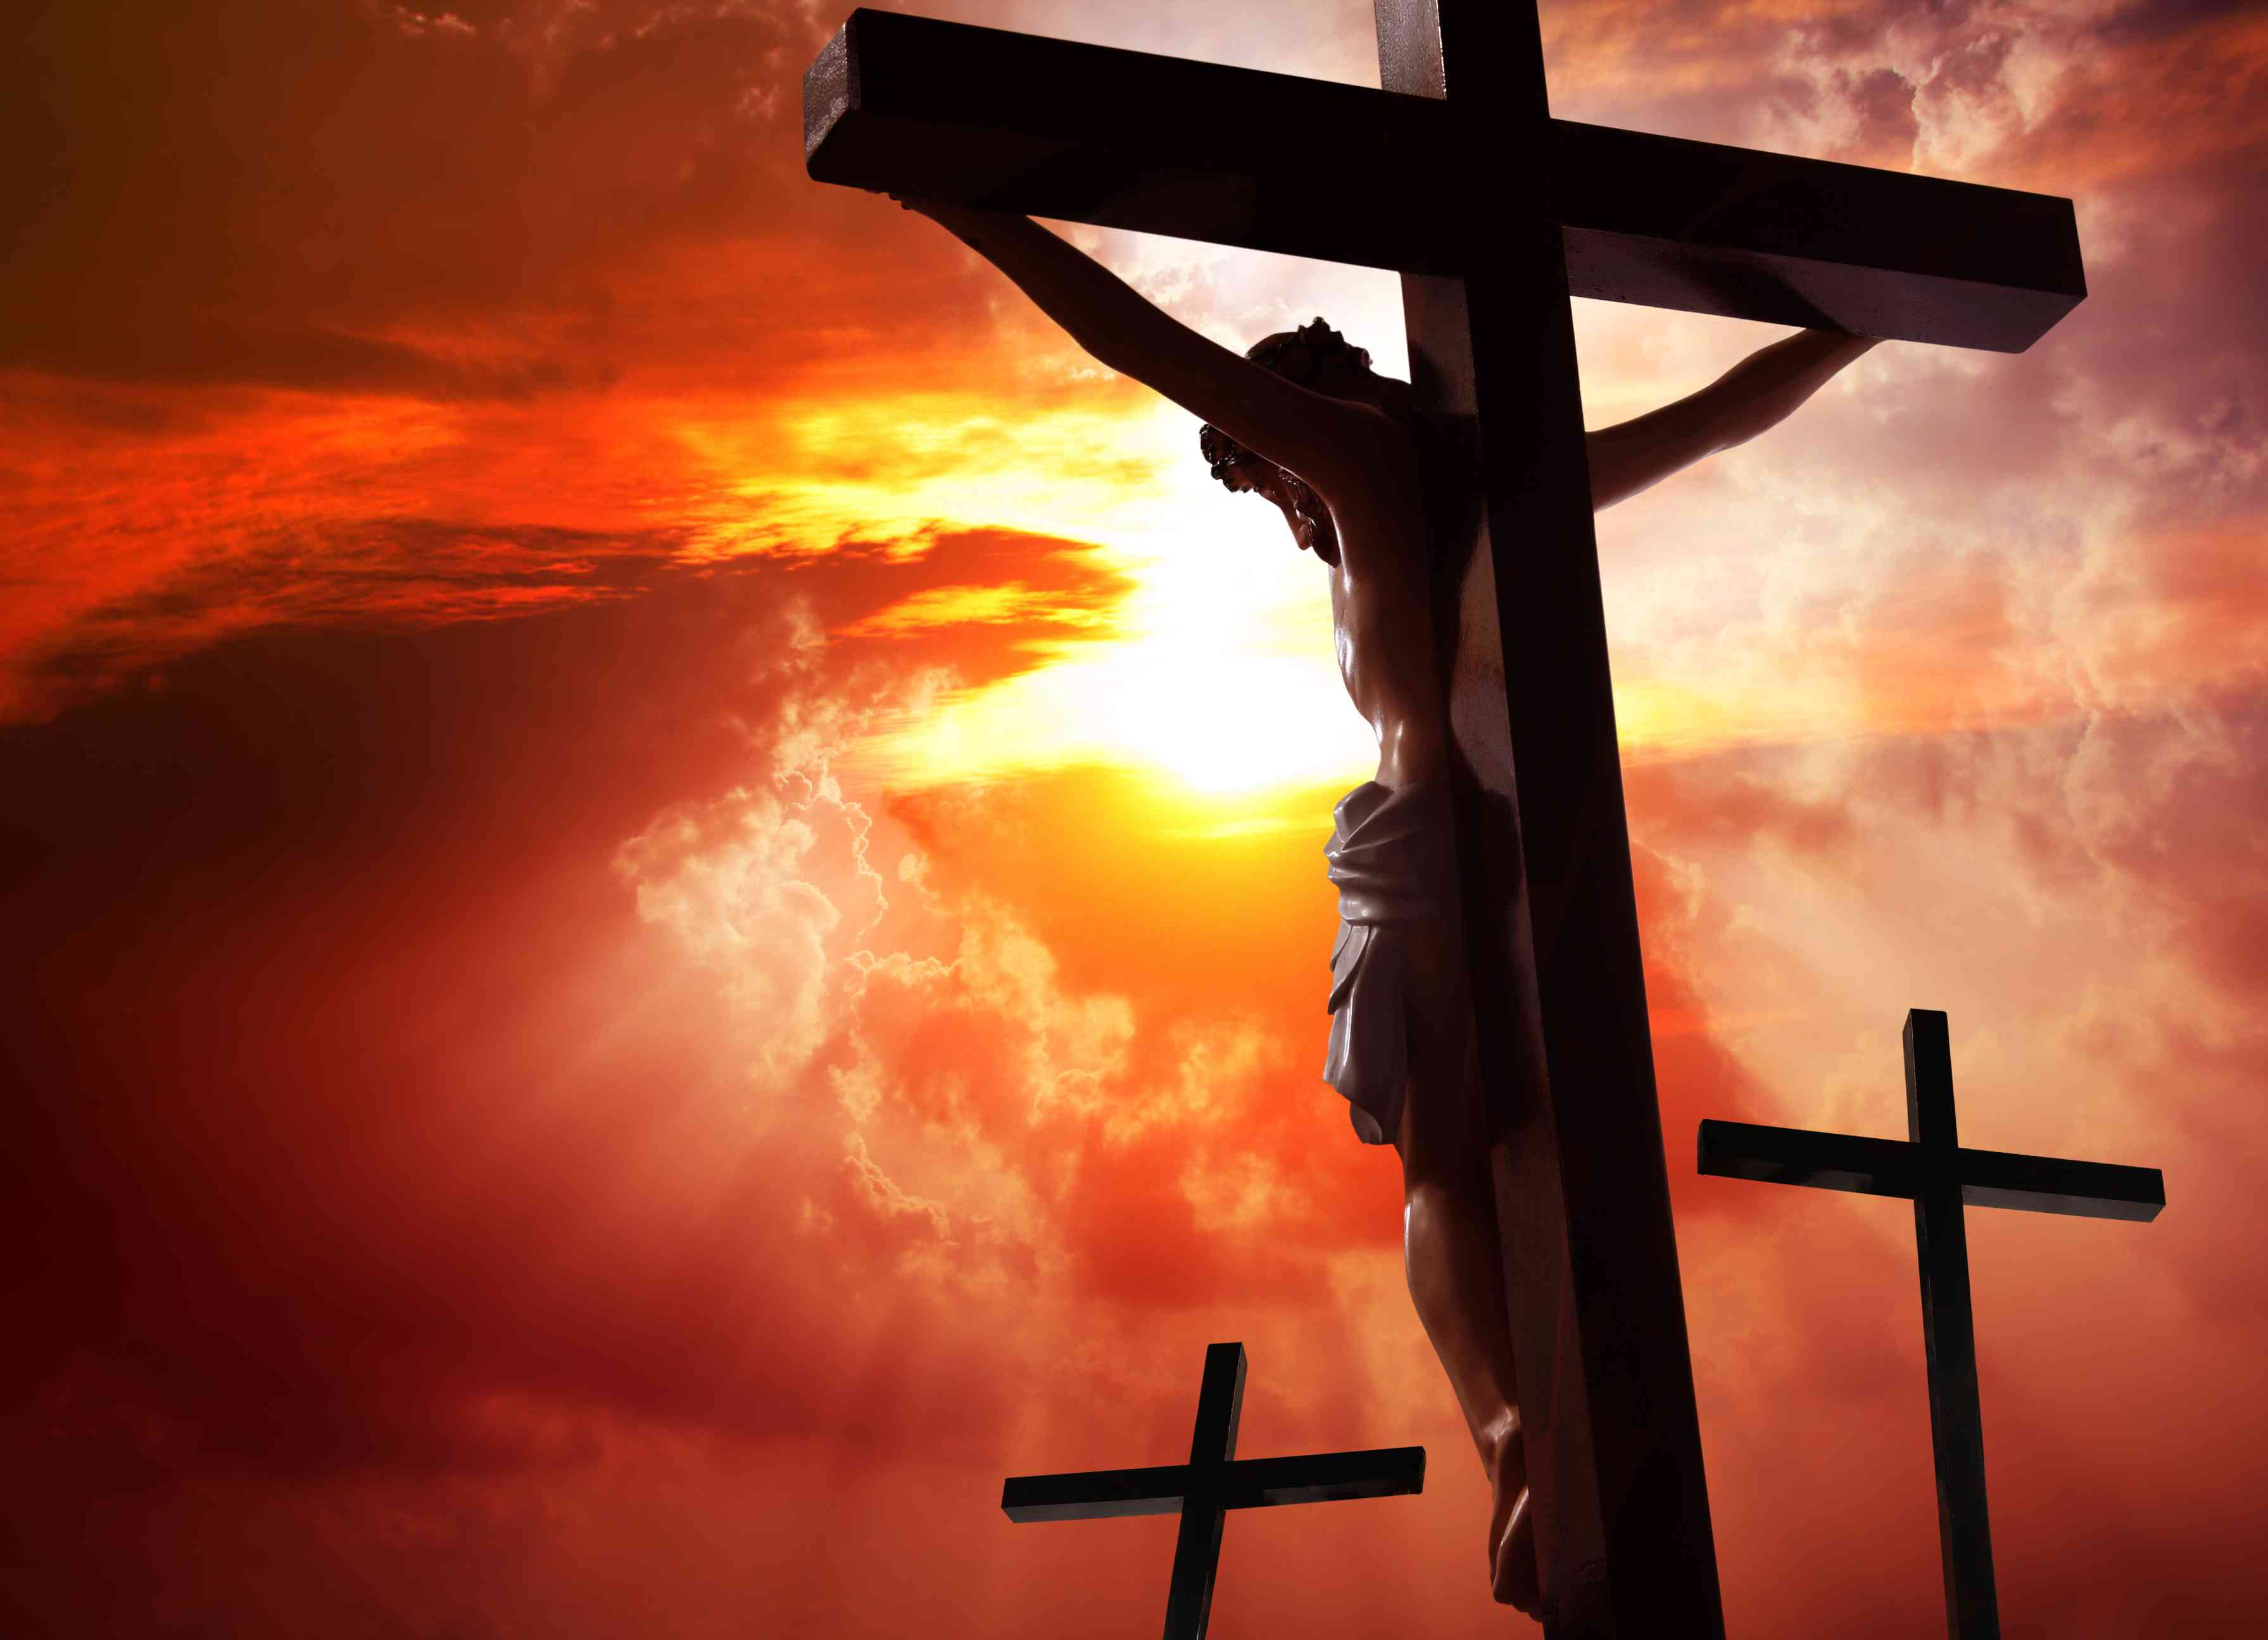
12
Jerusalem
The Crucifixion
Matt. 26:57-61; 27:27-31, 45-54

Slide 2
INTRODUCTION
I. TRIALS – MATTHEW 26:57-61
II. MOCKERY – MATTHEW 27:27-31
III. DEATH – MATTHEW 27:45-54

Slide 3
INTRODUCTION
Disciples sent to prepare Passover Week
- Matthew 26:17-19
- Mark 14:12-16; Luke 22:7-13

Slide 4
INTRODUCTION
Jesus eats the Passover Meal with Apostles
- Matthew 26:20-25
- Mark 14:17-21; 27-31
- Luke 22:14; 21-38
- John 13:1-38

Slide 5
Last Passover to Crucifixion Week
Jesus initiates the Lord’s Supper
- Matthew 26:26-29
- Mark 14:22-25
- Luke 22:15-20

Slide 6
Last Passover to Crucifixion Week
Farewell address
and prayer
- John 14:1-17:26

Slide 7
Farewell Address Included:
An assurance - He is the Way
A Guarantee - Prayers will be answered
A Promise - The Holy Spirit will come
An Exhortation - To remain faithful

Slide 8
Farewell Address Included:
A Warning - Persecution to come
An Explanation - The ministry of the H.S.
An Encouragement - Jesus with them
A Prayer - God glorified through them

Slide 9
Last Passover to Crucifixion Week
Agony and betrayal in the garden
- Matthew 26:30; 36-56
- Mark 14:26; 32-52
- Luke 22:39-53
- John 18:1-12

Slide 10
Last Passover to Crucifixion Week
Jesus before the
High Priest
- Matthew 26:57-68
- Mark 14:53-72
- Luke 22:54-71
- John 18:13-27

Slide 11
INTRODUCTION
Day proceeding the Sabbath of Passover – (John 19:31)
Jesus the Lamb without blemish and without spot –(1 Peter 1:19)
Who did no sin, neither was guile found in his mouth:
1 Peter 2:22 (KJV)

Slide 12

I. TRIALS – MATTHEW 26:57-61

Slide 13
57 And they that had laid hold on Jesus led him away to Caiaphas the high priest, where the scribes and the elders were assembled.
Matthew 26:57 (KJV)
Notes:
Treasury - Matt 26:57
(Christian Standard Bible)
Ps 56:5 — They twist my words all day long; all their thoughts against me are evil.
Ps 56:6 — They stir up strife, they lurk; they watch my steps while they wait to take my life.
Mk 14:53 — They led Jesus away to the high priest, and all the chief priests, the elders, and the scribes assembled.
Mk 14:54 — Peter followed him at a distance, right into the high priest's courtyard. He was sitting with the servants, warming himself by the fire.
Lk 22:54 — They seized him, led him away, and brought him into the high priest's house. Meanwhile Peter was following at a distance.
Lk 22:55 — They lit a fire in the middle of the courtyard and sat down together, and Peter sat among them.
Jn 11:49 — One of them, Caiaphas, who was high priest that year, said to them, "You know nothing at all!
Jn 18:12-14 — Then the company of soldiers, the commander, and the Jewish officials arrested Jesus and tied him up. ¹³ First they led him to Annas, since he was the father-in-law of Caiaphas, who was high priest that year. ¹⁴ Caiaphas was the one who had advised the Jews that it would be better for one man to die for the people.
Jn 18:24 — Then Annas sent him bound to Caiaphas the high priest.

Slide 14
58 But Peter followed him afar off unto the high priest's palace, and went in, and sat with the servants, to see the end.
Matthew 26:58 (KJV)
Notes:
and went
Jn 18:15 — Simon Peter was following Jesus, as was another disciple. That disciple was an acquaintance of the high priest; so he went with Jesus into the high priest's courtyard.
Jn 18:16 — But Peter remained standing outside by the door. So the other disciple, the one known to the high priest, went out and spoke to the girl who was the doorkeeper and brought Peter in.
Jn 18:25 — Now Simon Peter was standing and warming himself. They said to him, "You aren't one of his disciples too, are you? " He denied it and said, "I am not."

Slide 15
59 Now the chief priests, and elders, and all the council, sought false witness against Jesus, to put him to death;
Matthew 26:59 (KJV)
Notes:
sought
Dt 19:16-21 — "If a malicious witness testifies against someone accusing him of a crime, 17 the two people in the dispute are to stand in the presence of the LORD before the priests and judges in authority at that time. 18 The judges are to make a careful investigation, and if the witness turns out to be a liar who has falsely accused his brother, 19 you must do to him as he intended to do to his brother. You must purge the evil from you. 20 Then everyone else will hear and be afraid, and they will never again do anything evil like this among you. 21 Do not show pity: life for life, eye for eye, tooth for tooth, hand for hand, and foot for foot.
1Ki 21:8-13 — So she wrote letters in Ahab's name and sealed them with his seal. She sent the letters to the elders and nobles who lived with Naboth in his city. 9 In the letters, she wrote: Proclaim a fast and seat Naboth at the head of the people. 10 Then seat two wicked men opposite him and have them testify against him, saying, "You have cursed God and the king! " Then take him out and stone him to death. 11 The men of his city, the elders and nobles who lived in his city, did as Jezebel had sent word to them, just as it was written in the letters she had sent them. 12 They proclaimed a fast and seated Naboth at the head of the people. 13 The two wicked men came in and sat opposite him. Then the wicked men testified against Naboth in the presence of the people, saying, "Naboth has cursed God and the king! " So they took him outside the city and stoned him to death with stones.
Ps 27:12 — Do not give me over to the will of my foes, for false witnesses rise up against me, breathing violence.
Ps 35:11 — Malicious witnesses come forward; they question me about things I do not know.
Ps 35:12 — They repay me evil for good, making me desolate.
Ps 94:20 — Can a corrupt throne be your ally, a throne that makes evil laws?
Ps 94:21 — They band together against the life of the righteous and condemn the innocent to death.
Pr 25:18 — A person giving false testimony against his neighbor is like a club, a sword, or a sharp arrow.
Mk 14:55 — The chief priests and the whole Sanhedrin were looking for testimony against Jesus to put him to death, but they could not find any.
Mk 14:56 — For many were giving false testimony against him, and the testimonies did not agree.
Ac 6:11-13 — Then they secretly persuaded some men to say, "We heard him speaking blasphemous words against Moses and God." 12 They stirred up the people, the elders, and the scribes; so they came, seized him, and took him to the Sanhedrin. 13 They also presented false witnesses who said, "This man never stops speaking against this holy place and the law.
Ac 24:1-13 — Five days later Ananias the high priest came down with some elders and a lawyer named Tertullus. These men presented their case against Paul to the governor. 2 When Paul was called in, Tertullus began to accuse him and said: "We enjoy great peace because of you, and reforms are taking place for the benefit of this nation because of your foresight. 3 We acknowledge this in every way and everywhere, most excellent Felix, with utmost gratitude. 4 But, so that I will not burden you any further, I request that you would be kind enough to give us a brief hearing. 5 For we have found this man to be a plague, an agitator among all the Jews throughout the Roman world, and a ringleader of the sect of the Nazarenes. 6 He even tried to desecrate the temple, and so we apprehended him. By examining him yourself you will be able to discern the truth about these charges we are bringing against him." 7 8 9 The Jews also joined in the attack, alleging that these things were true. 10 When the governor motioned for him to speak, Paul replied: "Because I know you have been a judge of this nation for many years, I am glad to offer my defense in what concerns me. 11 You can verify for yourself that it is no more than twelve days since I went up to worship in Jerusalem. 12 They didn't find me arguing with anyone or causing a disturbance among the crowd, either in the temple or in the synagogues or anywhere in the city. 13 Neither can they prove the charges they are now making against me.

Slide 16
60 But found none: yea, though many false witnesses came, yet found they none. At the last came two false witnesses,
Matthew 26:60 (KJV)
Notes:
found none
Da 6:4 — The administrators and satraps, therefore, kept trying to find a charge against Daniel regarding the kingdom. But they could find no charge or corruption, for he was trustworthy, and no negligence or corruption was found in him.
Da 6:5 — Then these men said, "We will never find any charge against this Daniel unless we find something against him concerning the law of his God."
Tit 2:8 — Your message is to be sound beyond reproach, so that any opponent will be ashamed, because he doesn't have anything bad to say about us.
1Pe 3:16 — Yet do this with gentleness and respect, keeping a clear conscience, so that when you are accused, those who disparage your good conduct in Christ will be put to shame.
At
Dt 19:15 — "One witness cannot establish any iniquity or sin against a person, whatever that person has done. A fact must be established by the testimony of two or three witnesses.
Mk 14:57-59 — Some stood up and gave false testimony against him, stating, 58 "We heard him say, 'I will destroy this temple made with human hands, and in three days I will build another not made by hands.' " 59 Yet their testimony did not agree even on this.

Slide 17
61 And said, This fellow said, I am able to destroy the temple of God, and to build it in three days.
Matthew 26:61 (KJV)
Notes:
This
Mt 26:71 — When he had gone out to the gateway, another woman saw him and told those who were there, "This man was with Jesus the Nazarene! "
Mt 12:24 — When the Pharisees heard this, they said, "This man drives out demons only by Beelzebul, the ruler of the demons."
Ge 19:9 — "Get out of the way! " they said, adding, "This one came here as an alien, but he's acting like a judge! Now we'll do more harm to you than to them." They put pressure on Lot and came up to break down the door.
1Ki 22:27 — and say, 'This is what the king says: Put this guy in prison and feed him only a little bread and water until I come back safely.' "
2Ki 9:11 — When Jehu came out to his master's servants, they asked, "Is everything all right? Why did this crazy person come to you? " Then he said to them, "You know the sort and their ranting."
Ps 22:6 — But I am a worm and not a man, scorned by mankind and despised by people.
Ps 22:7 — Everyone who sees me mocks me; they sneer and shake their heads:
Isa 49:7 — This is what the LORD, the Redeemer of Israel, his Holy One, says to one who is despised, to one abhorred by people, to a servant of rulers: "Kings will see, princes will stand up, and they will all bow down because of the LORD, who is faithful, the Holy One of Israel ​— ​and he has chosen you."
Isa 53:3 — He was despised and rejected by men, a man of suffering who knew what sickness was. He was like someone people turned away from; he was despised, and we didn't value him.
Lk 23:2 — They began to accuse him, saying, "We found this man misleading our nation, opposing payment of taxes to Caesar, and saying that he himself is the Messiah, a king."
Jn 9:29 — We know that God has spoken to Moses. But this man ​— ​we don't know where he's from."
Ac 17:18 — Some of the Epicurean and Stoic philosophers also debated with him. Some said, "What is this ignorant showoff trying to say? " Others replied, "He seems to be a preacher of foreign deities" ​— ​because he was telling the good news about Jesus and the resurrection.
Ac 18:13 — "This man," they said, " is persuading people to worship God in ways contrary to the law."
Ac 22:22 — They listened to him up to this point. Then they raised their voices, shouting, "Wipe this man off the face of the earth! He should not be allowed to live! "
I am
Mt 27:40 — and saying, "You who would destroy the temple and rebuild it in three days, save yourself! If you are the Son of God, come down from the cross! "
Jer 26:8-11 — When he finished the address the LORD had commanded him to deliver to all the people, immediately the priests, the prophets, and all the people took hold of him, yelling, "You must surely die! 9 How dare you prophesy in the name of the LORD, 'This temple will become like Shiloh and this city will become an uninhabited ruin'! " Then all the people crowded around Jeremiah at the LORD's temple. 10 When the officials of Judah heard about these things, they went from the king's palace to the LORD's temple and sat at the entrance of the New Gate of the LORD's temple. 11 Then the priests and prophets said to the officials and all the people, "This man deserves the death sentence because he has prophesied against this city, as you have heard with your own ears."
Jer 26:16-19 — Then the officials and all the people told the priests and prophets, "This man doesn't deserve the death sentence, for he has spoken to us in the name of the LORD our God! " 17 Some of the elders of the land stood up and said to all the assembled people, 18 "Micah the Moreshite prophesied in the days of King Hezekiah of Judah and said to all the people of Judah, 'This is what the LORD of Armies says: Zion will be plowed like a field, Jerusalem will become ruins, and the temple's mountain will be a high thicket.' 19 Did King Hezekiah of Judah and all the people of Judah put him to death? Did not the king fear the LORD and plead for the LORD's favor, and did not the LORD relent concerning the disaster he had pronounced against them? We are about to bring a terrible disaster on ourselves! "
Mk 15:29 — Those who passed by were yelling insults at him, shaking their heads, and saying, "Ha! The one who would destroy the temple and rebuild it in three days,
Jn 2:19-21 — Jesus answered, "Destroy this temple, and I will raise it up in three days." 20 Therefore the Jews said, "This temple took forty-six years to build, and will you raise it up in three days? " 21 But he was speaking about the temple of his body.
Ac 6:13 — They also presented false witnesses who said, "This man never stops speaking against this holy place and the law.

Slide 18
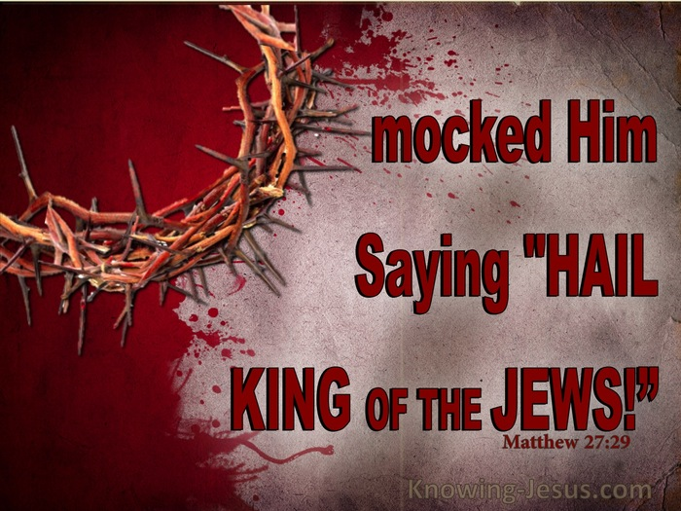
II. MOCKERY – MATTHEW 27:27-31

Slide 19
Last Passover to Crucifixion Week
Jesus before Pilate and Herod
- Matthew 27:1-2; 11-30
- Mark 15:1-19
- Luke 23:1-25
- John 18:28-19:16

Slide 20
Last Passover to Crucifixion Week
Judas’ suicide
- Matthew 27:3-10

Slide 21
Last Passover to Crucifixion Week
Jesus is Crucified
- Matthew 15:20-32
- Luke 23:26-38
- John 19:16-22

Slide 22
27 Then the soldiers of the governor took Jesus into the common hall, and gathered unto him the whole band of soldiers.
Matthew 27:27 (KJV)
Notes:
common hall
Mk 15:16 — The soldiers led him away into the palace (that is, the governor's residence) and called the whole company together.
Jn 18:28 — Then they led Jesus from Caiaphas to the governor's headquarters. It was early morning. They did not enter the headquarters themselves; otherwise they would be defiled and unable to eat the Passover.
Jn 18:33 — Then Pilate went back into the headquarters, summoned Jesus, and said to him, "Are you the King of the Jews? "
Jn 19:8 — When Pilate heard this statement, he was more afraid than ever.
Jn 19:9 — He went back into the headquartersand asked Jesus, “Where are you from? ” But Jesus did not give him an answer.
Ac 23:35 — he said, "I will give you a hearing whenever your accusers also get here." He ordered that he be kept under guard in Herod's palace.
Gr
Jn 18:3 — So Judas took a company of soldiers and some officials from the chief priests and the Pharisees and came there with lanterns, torches, and weapons.
Ac 10:1 — There was a man in Caesarea named Cornelius, a centurion of what was called the Italian Regiment.
Ac 27:1 — When it was decided that we were to sail to Italy, they handed over Paul and some other prisoners to a centurion named Julius, of the Imperial Regiment.

Slide 23
28 And they stripped him, and put on him a scarlet robe.
Matthew 27:28 (KJV)
Notes:
Treasury - Matt 27:28
(Christian Standard Bible)
stripped
Mk 15:17 — They dressed him in a purple robe, twisted together a crown of thorns, and put it on him.
Lk 23:11 — Then Herod, with his soldiers, treated him with contempt, mocked him, dressed him in bright clothing, and sent him back to Pilate.
Jn 19:2-5 — The soldiers also twisted together a crown of thorns, put it on his head, and clothed him in a purple robe. 3 And they kept coming up to him and saying, “Hail, King of the Jews! ” and were slapping his face. 4 Pilate went outside again and said to them, “Look, I’m bringing him out to you to let you know I find no grounds for charging him.” 5 Then Jesus came out wearing the crown of thorns and the purple robe. Pilate said to them, “Here is the man! ”

Slide 24
29 And when they had platted a crown of thorns, they put it upon his head, and a reed in his right hand: and they bowed the knee before him, and mocked him, saying, Hail, King of the Jews!
Matthew 27:29 (KJV)
Notes:
platted
Mt 20:19 — They will hand him over to the Gentiles to be mocked, flogged, and crucified, and on the third day he will be raised. "
Ps 35:15 — But when I stumbled, they gathered in glee; they gathered against me. Assailants I did not know tore at me and did not stop.
Ps 35:16 — With godless mockery they gnashed their teeth at me.
Ps 69:7 — For I have endured insults because of you, and shame has covered my face.
Ps 69:19 — You know the insults I endure — my shame and disgrace. You are aware of all my adversaries.
Ps 69:20 — Insults have broken my heart, and I am in despair. I waited for sympathy, but there was none; for comforters, but found no one.
Isa 49:7 — This is what the LORD, the Redeemer of Israel, his Holy One, says to one who is despised, to one abhorred by people, to a servant of rulers: "Kings will see, princes will stand up, and they will all bow down because of the LORD, who is faithful, the Holy One of Israel ​— ​and he has chosen you."
Isa 53:3 — He was despised and rejected by men, a man of suffering who knew what sickness was. He was like someone people turned away from; he was despised, and we didn't value him.
Jer 20:7 — You deceived me, LORD, and I was deceived. You seized me and prevailed. I am a laughingstock all the time; everyone ridicules me.
Heb 12:2 — keeping our eyes on Jesus, the source and perfecter of our faith. For the joy that lay before him, he endured the cross, despising the shame, and sat down at the right hand of the throne of God.
Heb 12:3 — For consider him who endured such hostility from sinners against himself, so that you won't grow weary and give up.
Hail
Mt 27:37 — Above his head they put up the charge against him in writing: THIS IS JESUS, THE KING OF THE JEWS.
Mt 26:49 — So immediately he went up to Jesus and said, "Greetings, Rabbi! " and kissed him.
Mk 15:18 — And they began to salute him, "Hail, King of the Jews! "
Lk 23:36 — The soldiers also mocked him. They came offering him sour wine
Lk 23:37 — and said, "If you are the King of the Jews, save yourself! "
Jn 19:3 — And they kept coming up to him and saying, “Hail, King of the Jews! ” and were slapping his face.

Slide 25
30 And they spit upon him, and took the reed, and smote him on the head.
Matthew 27:30 (KJV)
Notes:
Treasury - Matt 27:30
(Christian Standard Bible)
Mt 26:67 — Then they spat in his face and beat him; others slapped him
Job 30:8-10 — Foolish men, without even a name. They were forced to leave the land. 9 Now I am mocked by their songs; I have become an object of scorn to them. 10 They despise me and keep their distance from me; they do not hesitate to spit in my face.
Isa 49:7 — This is what the LORD, the Redeemer of Israel, his Holy One, says to one who is despised, to one abhorred by people, to a servant of rulers: "Kings will see, princes will stand up, and they will all bow down because of the LORD, who is faithful, the Holy One of Israel ​— ​and he has chosen you."
Isa 50:6 — I gave my back to those who beat me, and my cheeks to those who tore out my beard. I did not hide my face from scorn and spitting.
Isa 52:14 — Just as many were appalled at you — his appearance was so disfigured that he did not look like a man, and his form did not resemble a human being —
Isa 53:3 — He was despised and rejected by men, a man of suffering who knew what sickness was. He was like someone people turned away from; he was despised, and we didn't value him.
Isa 53:7 — He was oppressed and afflicted, yet he did not open his mouth. Like a lamb led to the slaughter and like a sheep silent before her shearers, he did not open his mouth.
Mic 5:1 — Now, daughter who is under attack, you slash yourself in grief; a siege is set against us! They are striking the judge of Israel on the cheek with a rod.
Mk 15:19 — They were hitting him on the head with a stick and spitting on him. Getting down on their knees, they were paying him homage.
Lk 18:32 — For he will be handed over to the Gentiles, and he will be mocked, insulted, spit on;
Lk 18:33 — and after they flog him, they will kill him, and he will rise on the third day."

Slide 26
31 And after that they had mocked him, they took the robe off from him, and put his own raiment on him, and led him away to crucify him.
Matthew 27:31 (KJV)
Notes:
Treasury - Matt 27:31
(Christian Standard Bible)
and led
Mt 20:19 — They will hand him over to the Gentiles to be mocked, flogged, and crucified, and on the third day he will be raised. "
Mt 21:39 — So they seized him, threw him out of the vineyard, and killed him.
Nu 15:35 — Then the LORD told Moses, "The man is to be put to death. The entire community is to stone him outside the camp."
1Ki 21:10 — Then seat two wicked men opposite him and have them testify against him, saying, "You have cursed God and the king! " Then take him out and stone him to death.
1Ki 21:13 — The two wicked men came in and sat opposite him. Then the wicked men testified against Naboth in the presence of the people, saying, "Naboth has cursed God and the king! " So they took him outside the city and stoned him to death with stones.
Isa 53:7 — He was oppressed and afflicted, yet he did not open his mouth. Like a lamb led to the slaughter and like a sheep silent before her shearers, he did not open his mouth.
Jn 19:16 — Then he handed him over to be crucified. The Crucifixion Then they took Jesus away.
Jn 19:27 — Then he said to the disciple, “Here is your mother.” And from that hour the disciple took her into his home.
Ac 7:58 — They dragged him out of the city and began to stone him. And the witnesses laid their garments at the feet of a young man named Saul.
Heb 13:12 — Therefore, Jesus also suffered outside the gate, so that he might sanctify the people by his own blood.

Slide 27
32 And as they came out, they found a man of Cyrene, Simon by name: him they compelled to bear his cross.
Matthew 27:32 (KJV)
Notes:
as
Lev 4:3 — "If the anointed priest sins, bringing guilt on the people, he is to present to the LORD a young, unblemished bull as a sin offering for the sin he has committed.
Lev 4:12 — all the rest of the bull ​— ​he must bring to a ceremonially clean place outside the camp to the ash heap, and must burn it on a wood fire. It is to be burned at the ash heap.
Lev 4:21 — Then he will bring the bull outside the camp and burn it just as he burned the first bull. It is the sin offering for the assembly.
Nu 15:35 — Then the LORD told Moses, "The man is to be put to death. The entire community is to stone him outside the camp."
Nu 15:36 — So the entire community brought him outside the camp and stoned him to death, as the LORD had commanded Moses.
1Ki 21:10 — Then seat two wicked men opposite him and have them testify against him, saying, "You have cursed God and the king! " Then take him out and stone him to death.
1Ki 21:13 — The two wicked men came in and sat opposite him. Then the wicked men testified against Naboth in the presence of the people, saying, "Naboth has cursed God and the king! " So they took him outside the city and stoned him to death with stones.
Ac 7:58 — They dragged him out of the city and began to stone him. And the witnesses laid their garments at the feet of a young man named Saul.
Heb 13:11 — For the bodies of those animals whose blood is brought into the most holy place by the high priest as a sin offering are burned outside the camp.
Heb 13:12 — Therefore, Jesus also suffered outside the gate, so that he might sanctify the people by his own blood.
they found
Mt 16:24 — Then Jesus said to his disciples, "If anyone wants to follow after me, let him deny himself, take up his cross, and follow me.
Mk 15:21 — They forced a man coming in from the country, who was passing by, to carry Jesus's cross. He was Simon of Cyrene, the father of Alexander and Rufus.
Lk 23:26 — As they led him away, they seized Simon, a Cyrenian, who was coming in from the country, and laid the cross on him to carry behind Jesus.
Cyrene
Ac 2:10 — Phrygia and Pamphylia, Egypt and the parts of Libya near Cyrene; visitors from Rome (both Jews and converts),
Ac 6:9 — Opposition arose, however, from some members of the Freedmen's Synagogue, composed of both Cyrenians and Alexandrians, and some from Cilicia and Asia, and they began to argue with Stephen.
Ac 11:20 — But there were some of them, men from Cyprus and Cyrene, who came to Antioch and began speaking to the Greeks also, proclaiming the good news about the Lord Jesus.
Ac 13:1 — Now in the church at Antioch there were prophets and teachers: Barnabas, Simeon who was called Niger, Lucius of Cyrene, Manaen, a close friend of Herod the tetrarch, and Saul.

Slide 28


III. DEATH – MATTHEW 27:45-54

Slide 29
Last Passover to Crucifixion Week
Jesus dies on the cross
- Matthew 27:45-61
- Mark 15:33-47
- Luke 23:39-56
- John 19:23-42

Slide 30
Saturday - April 7th
Pilate sets a seal
on the tomb
- Matthew 27:62-66

Slide 31
45 Now from the sixth hour there was darkness over all the land unto the ninth hour.
Matthew 27:45 (KJV)
Notes:
from
Mk 15:25 — Now it was nine in the morning when they crucified him.
Mk 15:33 — When it was noon, darkness came over the whole land until three in the afternoon.
Mk 15:34 — And at three Jesus cried out with a loud voice, "Eloi, Eloi, lemá sabachtháni? " which is translated, "My God, my God, why have you abandoned me? "
Lk 23:44 — It was now about noon, and darkness came over the whole land until three,
Lk 23:45 — because the sun's light failed. The curtain of the sanctuary was split down the middle.
darkness
Isa 50:3 — I dress the heavens in black and make sackcloth their clothing.
Am 8:9 — And in that day — this is the declaration of the Lord GOD — I will make the sun go down at noon; I will darken the land in the daytime.
Rev 8:12 — The fourth angel blew his trumpet, and a third of the sun was struck, a third of the moon, and a third of the stars, so that a third of them were darkened. A third of the day was without light and also a third of the night.
Rev 9:2 — He opened the shaft to the abyss, and smoke came up out of the shaft like smoke from a great furnace so that the sun and the air were darkened by the smoke from the shaft.

Slide 32
46 And about the ninth hour Jesus cried with a loud voice, saying, Eli, Eli, lama sabachthani? that is to say, My God, my God, why hast thou forsaken me?
Matthew 27:46 (KJV)
Notes:
Jesus
Mk 15:34 — And at three Jesus cried out with a loud voice, "Eloi, Eloi, lemá sabachtháni? " which is translated, "My God, my God, why have you abandoned me? "
Lk 23:46 — And Jesus called out with a loud voice, "Father, into your hands I entrust my spirit." Saying this, he breathed his last.
Jn 19:28-30 — Afterthis, when Jesus knew that everything was now finished that the Scripture might be fulfilled, he said, “I’m thirsty.” ²⁹ A jar full of sour wine was sitting there; so they fixed a sponge full of sour wine on a hyssop branch and held it up to his mouth. ³⁰ When Jesus had received the sour wine, he said, “It is finished.”Then bowing his head, he gave up his spirit.
Heb 5:7 — During his earthly life, he offered prayers and appeals with loud cries and tears to the one who was able to save him from death, and he was heard because of his reverence.
Eli
Ps 22:1 — My God, my God, why have you abandoned me? Why are you so far from my deliverance and from my words of groaning?
Ps 71:11 — saying, "God has abandoned him; chase him and catch him, for there is no one to rescue him."
Isa 53:10 — Yet the LORD was pleased to crush him severely. When you make him a guilt offering, he will see his seed, he will prolong his days, and by his hand, the LORD's pleasure will be accomplished.
La 1:12 — Is this nothing to you, all you who pass by? Look and see! Is there any pain like mine, which was dealt out to me, which the LORD made me suffer on the day of his burning anger?

Slide 33
47 Some of them that stood there, when they heard that, said, This man calleth for Elias.
Matthew 27:47 (KJV)
Notes:
This
Mt 11:14 — And if you're willing to accept it, he is the Elijah who is to come.
Mal 4:5 — Look, I am going to send you the prophet Elijah before the great and terrible day of the LORD comes.
Mk 15:35 — When some of those standing there heard this, they said, "See, he's calling for Elijah."
Mk 15:36 — Someone ran and filled a sponge with sour wine, fixed it on a stick, offered him a drink, and said, "Let's see if Elijah comes to take him down."

Slide 34
48 And straightway one of them ran, and took a spunge, and filled it with vinegar, and put it on a reed, and gave him to drink.
Matthew 27:48 (KJV)
Notes:
and filled
Mt 27:34 — they gave him wine mixed with gall to drink. But when he tasted it, he refused to drink it.
Ps 69:21 — Instead, they gave me gall for my food, and for my thirst they gave me vinegar to drink.
Lk 23:36 — The soldiers also mocked him. They came offering him sour wine
Jn 19:29 — A jar full of sour wine was sitting there; so they fixed a sponge full of sour wine on a hyssop branch and held it up to his mouth.
Jn 19:30 — When Jesus had received the sour wine, he said, “It is finished.”Then bowing his head, he gave up his spirit.

Slide 35
49 The rest said, Let be, let us see whether Elias will come to save him.
Matthew 27:49 (KJV)
Notes:
let us
Mt 27:43 — He trusts in God; let God rescue him now ​— ​if he takes pleasure in him! For he said, 'I am the Son of God.' "

Slide 36
50 Jesus, when he had cried again with a loud voice, yielded up the ghost.
Matthew 27:50 (KJV)
Notes:
Treasury - Matt 27:50
(Christian Standard Bible)
when
Mk 15:37 — Jesus let out a loud cry and breathed his last.
Lk 23:46 — And Jesus called out with a loud voice, "Father, into your hands I entrust my spirit." Saying this, he breathed his last.
Jn 19:30 — When Jesus had received the sour wine, he said, “It is finished.”Then bowing his head, he gave up his spirit.
yielded
Mt 20:28 — just as the Son of Man did not come to be served, but to serve, and to give his life as a ransom for many."
Ps 22:14 — I am poured out like water, and all my bones are disjointed; my heart is like wax, melting within me.
Ps 22:15 — My strength is dried up like baked clay; my tongue sticks to the roof of my mouth. You put me into the dust of death.
Isa 53:9-12 — He was assigned a grave with the wicked, but he was with a rich man at his death, because he had done no violence and had not spoken deceitfully. 10 Yet the LORD was pleased to crush him severely. When you make him a guilt offering, he will see his seed, he will prolong his days, and by his hand, the LORD's pleasure will be accomplished. 11 After his anguish, he will see light and be satisfied. By his knowledge, my righteous servant will justify many, and he will carry their iniquities. 12 Therefore I will give him the many as a portion, and he will receive the mighty as spoil, because he willingly submitted to death, and was counted among the rebels; yet he bore the sin of many and interceded for the rebels.
Da 9:26 — After those sixty-two weeks the Anointed One will be cut off and will have nothing. The people of the coming ruler will destroy the city and the sanctuary. The end will come with a flood, and until the end there will be war; desolations are decreed.
Jn 10:11 — "I am the good shepherd. The good shepherd lays down his life for the sheep.
Jn 10:15 — just as the Father knows me, and I know the Father. I lay down my life for the sheep.
Heb 2:14 — Now since the children have flesh and blood in common, Jesus also shared in these, so that through his death he might destroy the one holding the power of death ​— ​that is, the devil —
Heb 9:14 — how much more will the blood of Christ, who through the eternal Spirit offered himself without blemish to God, cleanse our consciences from dead works so that we can serve the living God?

Slide 37
51 And, behold, the veil of the temple was rent in twain from the top to the bottom; and the earth did quake, and the rocks rent;
Matthew 27:51 (KJV)
Notes:
the veil
Ex 26:31-37 — "You are to make a curtain of blue, purple, and scarlet yarn, and finely spun linen with a design of cherubim worked into it. 32 Hang it on four gold-plated pillars of acacia wood that have gold hooks and that stand on four silver bases. 33 Hang the curtain under the clasps and bring the ark of the testimony there behind the curtain, so the curtain will make a separation for you between the holy place and the most holy place. 34 Put the mercy seat on the ark of the testimony in the most holy place. 35 Place the table outside the curtain and the lampstand on the south side of the tabernacle, opposite the table; put the table on the north side. 36 "For the entrance to the tent you are to make a screen embroidered with blue, purple, and scarlet yarn, and finely spun linen. 37 Make five pillars of acacia wood for the screen and overlay them with gold; their hooks are to be gold, and you are to cast five bronze bases for them.
Ex 40:21 — He brought the ark into the tabernacle, put up the curtain for the screen, and screened off the ark of the testimony, just as the LORD had commanded him.
Lev 16:2 — The LORD said to Moses: "Tell your brother Aaron that he may not come whenever he wants into the holy place behind the curtain in front of the mercy seat on the ark or else he will die, because I appear in the cloud above the mercy seat.
Lev 16:12-15 — Then he is to take a firepan full of blazing coals from the altar before the LORD and two handfuls of finely ground fragrant incense, and bring them inside the curtain. 13 He is to put the incense on the fire before the LORD, so that the cloud of incense covers the mercy seat that is over the testimony, or else he will die. 14 He is to take some of the bull's blood and sprinkle it with his finger against the east side of the mercy seat; then he will sprinkle some of the blood with his finger before the mercy seat seven times. 15 "When he slaughters the male goat for the people's sin offering and brings its blood inside the curtain, he will do the same with its blood as he did with the bull's blood: He is to sprinkle it against the mercy seat and in front of it.
Lev 21:23 — But because he has a defect, he must not go near the curtain or approach the altar. He is not to desecrate my holy places, for I am the LORD who sets them apart."
2Ch 3:14 — He made the curtain of blue, purple, and crimson yarn and fine linen, and he wove cherubim into it.
Isa 25:7 — On this mountain he will destroy the burial shroud, the shroud over all the peoples, the sheet covering all the nations;
Mk 15:38 — Then the curtain of the temple was torn in two from top to bottom.
Lk 23:45 — because the sun's light failed. The curtain of the sanctuary was split down the middle.
Eph 2:13-18 — But now in Christ Jesus, you who were far away have been brought near by the blood of Christ. 14 For he is our peace, who made both groups one and tore down the dividing wall of hostility. In his flesh, 15 he made of no effect the law consisting of commands and expressed in regulations, so that he might create in himself one new man from the two, resulting in peace. 16 He did this so that he might reconcile both to God in one body through the cross by which he put the hostility to death. 17 He came and proclaimed the good news of peace to you who were far away and peace to those who were near. 18 For through him we both have access in one spirit to the Father.
Heb 6:19 — We have this hope as an anchor for the soul, firm and secure. It enters the inner sanctuary behind the curtain.
Heb 10:19-22 — Therefore, brothers and sisters, since we have boldness to enter the sanctuary through the blood of Jesus ​— ​ 20 he has inaugurated for us a new and living way through the curtain (that is, through his flesh) ​— ​ 21 and since we have a great high priest over the house of God, 22 let us draw near with a true heart in full assurance of faith, with our hearts sprinkled clean from an evil conscience and our bodies washed in pure water.
the earth
Mt 28:2 — There was a violent earthquake, because an angel of the Lord descended from heaven and approached the tomb. He rolled back the stone and was sitting on it.
Ps 18:7 — Then the earth shook and quaked; the foundations of the mountains trembled; they shook because he burned with anger.
Ps 18:15 — The depths of the sea became visible, the foundations of the world were exposed, at your rebuke, LORD, at the blast of the breath of your nostrils.
Mic 1:3 — Look, the LORD is leaving his place and coming down to trample the heights of the earth.
Mic 1:4 — The mountains will melt beneath him, and the valleys will split apart, like wax near a fire, like water cascading down a mountainside.
Na 1:3-5 — The LORD is slow to anger but great in power; the LORD will never leave the guilty unpunished. His path is in the whirlwind and storm, and clouds are the dust beneath his feet. 4 He rebukes the sea and dries it up, and he makes all the rivers run dry. Bashan and Carmel wither; even the flower of Lebanon withers. 5 The mountains quake before him, and the hills melt; the earth trembles at his presence — the world and all who live in it.
Hab 3:10 — The mountains see you and shudder; a downpour of water sweeps by. The deep roars with its voice and lifts its waves high.
Hab 3:13 — You come out to save your people, to save your anointed. You crush the leader of the house of the wicked and strip him from foot to neck. Selah
Heb 12:25-27 — See to it that you do not reject the one who speaks. For if they did not escape when they rejected him who warned them on earth, even less will we if we turn away from him who warns us from heaven. 26 His voice shook the earth at that time, but now he has promised, Yet once more I will shake not only the earth but also the heavens. 27 This expression, "Yet once more," indicates the removal of what can be shaken ​— ​that is, created things ​— ​so that what is not shaken might remain.
Rev 11:13 — At that moment a violent earthquake took place, a tenth of the city fell, and seven thousand people were killed in the earthquake. The survivors were terrified and gave glory to the God of heaven.
Rev 11:19 — Then the temple of God in heaven was opened, and the ark of his covenant appeared in his temple. There were flashes of lightning, rumblings and peals of thunder, an earthquake, and severe hail.

Slide 38
52 And the graves were opened; and many bodies of the saints which slept arose,
Matthew 27:52 (KJV)
Notes:
many
Isa 25:8 — he will destroy death forever. The Lord GOD will wipe away the tears from every face and remove his people's disgrace from the whole earth, for the LORD has spoken.
Isa 26:19 — Your dead will live; their bodies will rise. Awake and sing, you who dwell in the dust! For you will be covered with the morning dew, and the earth will bring out the departed spirits.
Hos 13:14 — I will ransom them from the power of Sheol. I will redeem them from death. Death, where are your barbs? Sheol, where is your sting? Compassion is hidden from my eyes.
Jn 5:25-29 — "Truly I tell you, an hour is coming, and is now here, when the dead will hear the voice of the Son of God, and those who hear will live. 26 For just as the Father has life in himself, so also he has granted to the Son to have life in himself. 27 And he has granted him the right to pass judgment, because he is the Son of Man. 28 Do not be amazed at this, because a time is coming when all who are in the graves will hear his voice 29 and come out ​— ​those who have done good things, to the resurrection of life, but those who have done wicked things, to the resurrection of condemnation.
1Co 15:20 — But as it is, Christ has been raised from the dead, the firstfruits of those who have fallen asleep.
slept
Da 12:2 — Many who sleep in the dust of the earth will awake, some to eternal life, and some to disgrace and eternal contempt.
1Co 11:30 — This is why many are sick and ill among you, and many have fallen asleep.
1Co 15:51 — Listen, I am telling you a mystery: We will not all fall asleep, but we will all be changed,
1Th 4:14 — For if we believe that Jesus died and rose again, in the same way, through Jesus, God will bring with him those who have fallen asleep.
1Th 5:10 — who died for us, so that whether we are awake or asleep, we may live together with him.

Slide 39
53 And came out of the graves after his resurrection, and went into the holy city, and appeared unto many.
Matthew 27:53 (KJV)
Notes:
Treasury - Matt 27:53
(Christian Standard Bible)
holy
Mt 4:5 — Then the devil took him to the holy city, had him stand on the pinnacle of the temple,
Ne 11:1 — Now the leaders of the people stayed in Jerusalem, and the rest of the people cast lots for one out of ten to come and live in Jerusalem, the holy city, while the other nine-tenths remained in their towns.
Isa 48:2 — For they are named after the Holy City, and lean on the God of Israel; his name is the LORD of Armies.
Da 9:24 — Seventy weeks are decreed about your people and your holy city — to bring the rebellion to an end, to put a stop to sin, to atone for iniquity, to bring in everlasting righteousness, to seal up vision and prophecy, and to anoint the most holy place.
Rev 11:2 — But exclude the courtyard outside the temple. Don't measure it, because it is given to the nations, and they will trample the holy city for forty-two months.
Rev 21:2 — I also saw the holy city, the new Jerusalem, coming down out of heaven from God, prepared like a bride adorned for her husband.
Rev 22:19 — And if anyone takes away from the words of the book of this prophecy, God will take away his share of the tree of life and the holy city, which are written about in this book.

Slide 40
54 Now when the centurion, and they that were with him, watching Jesus, saw the earthquake, and those things that were done, they feared greatly, saying, Truly this was the Son of God.
Matthew 27:54 (KJV)
Notes:
the centurion
Mt 27:36 — Then they sat down and were guarding him there.
Mt 8:5 — When he entered Capernaum, a centurion came to him, pleading with him,
Ac 10:1 — There was a man in Caesarea named Cornelius, a centurion of what was called the Italian Regiment.
Ac 21:32 — Taking along soldiers and centurions, he immediately ran down to them. Seeing the commander and the soldiers, they stopped beating Paul.
Ac 23:17 — Paul called one of the centurions and said, "Take this young man to the commander, because he has something to report to him."
Ac 23:23 — He summoned two of his centurions and said, "Get two hundred soldiers ready with seventy cavalry and two hundred spearmen to go to Caesarea at nine tonight.
Ac 27:1 — When it was decided that we were to sail to Italy, they handed over Paul and some other prisoners to a centurion named Julius, of the Imperial Regiment.
Ac 27:43 — But the centurion kept them from carrying out their plan because he wanted to save Paul, and so he ordered those who could swim to jump overboard first and get to land.
saw
Mk 15:39 — When the centurion, who was standing opposite him, saw the way he breathed his last, he said, "Truly this man was the Son of God! "
Lk 23:47 — When the centurion saw what happened, he began to glorify God, saying, "This man really was righteous! "
feared
2Ki 1:13 — Then the king sent a third captain with his fifty men. The third captain went up and fell on his knees in front of Elijah and begged him, "Man of God, please let my life and the lives of these fifty servants of yours be precious to you.
2Ki 1:14 — Already fire has come down from heaven and consumed the first two captains with their companies, but this time let my life be precious to you."
Ac 2:37 — When they heard this, they were pierced to the heart and said to Peter and the rest of the apostles: "Brothers, what should we do? "
Ac 16:29 — The jailer called for lights, rushed in, and fell down trembling before Paul and Silas.
Ac 16:30 — He escorted them out and said, "Sirs, what must I do to be saved? "
Rev 11:13 — At that moment a violent earthquake took place, a tenth of the city fell, and seven thousand people were killed in the earthquake. The survivors were terrified and gave glory to the God of heaven.
Truly
Mt 27:40 — and saying, "You who would destroy the temple and rebuild it in three days, save yourself! If you are the Son of God, come down from the cross! "
Mt 27:43 — He trusts in God; let God rescue him now ​— ​if he takes pleasure in him! For he said, 'I am the Son of God.' "
Mt 26:63 — But Jesus kept silent. The high priest said to him, "I charge you under oath by the living God: Tell us if you are the Messiah, the Son of God."
Lk 22:70 — They all asked, "Are you, then, the Son of God? " And he said to them, "You say that I am."
Jn 19:7 — “We have a law,” the Jews replied to him, “and according to that law he ought to die, because he made himself the Son of God.”
Ro 1:4 — and was appointed to be the powerful Son of God according to the Spirit of holiness by the resurrection of the dead.

Slide 41


Slide 42
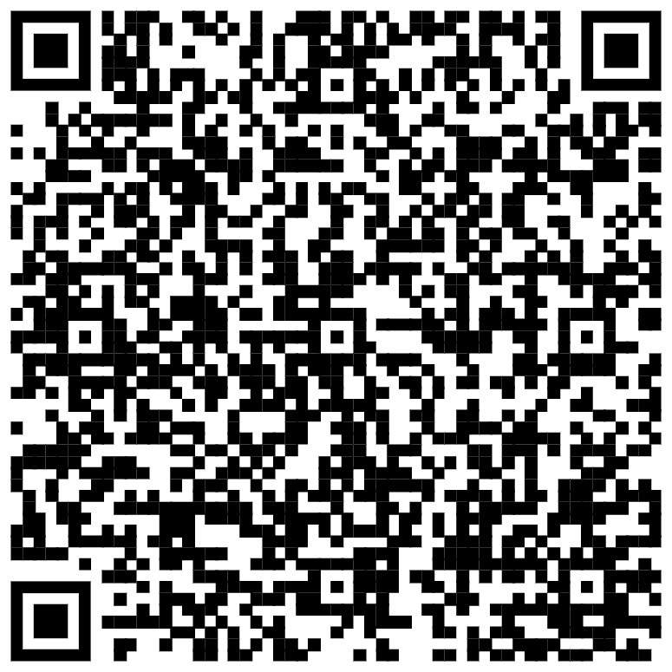
Quiz

