Slide 1
The 4 Components of Saving Faith
Seminary Heights Church of Christ
Ephesians 2:8
Notes:
One of the most familiar phrases in the Christian religion is, "We are saved by faith." I hear that all the time. Listening to Christian radio, driving around, listening to preachers on the radio preach, they say this 10 times in their sermons. And in many ways, these five words summarize the essence or the core idea of the Christian belief system. We are saved by faith. As often as this phrase is used, however, by believers to describe the manner or the method by which one receives salvation, interesting to note that this exact expression does not appear in the New Testament.

Slide 2
“We are saved by faith”

Slide 3
And He said to the woman, “Your faith has saved you; go in peace.”
- Luke 7:50
For by grace you have been saved through faith; and that not of yourselves, it is the gift of God;
- Ephesians 2:8
Notes:
We are saved by faith, that phrase doesn't appear in the New Testament, but rather versions of this idea using different words. For example,
And He said to the woman, "Your faith has saved you; go in peace."
Luke 7:50For by grace you have been saved through faith; and that not of yourselves, it is the gift of God;
- Ephesians 2:8This lesson of course doesn't question the validity of this expression, even though it's not spoken in exactly this way in the scriptures. No, the purpose of my sermon is to more closely examine the connection between faith and salvation that this common phrase.
On the surface, this expression is accurate biblically.
There is a relationship between faith and salvation.
That one, faith, leads to the other, salvation.
What I would like for us to understand are the four components that this type of faith needs to have in order to be a saving faith. Exactly what kind of faith leads to salvation.
First of all, let me affirm that we are definitely saved on the basis of faith, and not any kind of works or personal righteousness.
This is the bedrock of the Christian religion.
However, this faith that saves, this faith that saves us is not just any kind of general, all-purpose type of faith. You know, not simply to say, "I've got faith in the Man upstairs." I hear people say that all the time. "I'm relying on the Big Man upstairs." Or the one I really like is, "don't worry, everything will work out, just believe." That kind of general all-purpose faith that fits every situation. Faith that removes our guilt for sin, faith that guarantees eternal life and enables us to exist in a joyful union with God without fear or shame has four specific components that identifies it as saving faith.

Slide 4
The 4 Components of Saving Faith

Slide 5
The 4 Components of Saving Faith
Understanding
Notes:
Component #1 - Understanding
A faith that saves begins with the understanding of the gospel message. You know, a person doesn't need to be good at math in order to be saved. That's a good thing, because a lot of us wouldn't make it, right? We don't have to know Hebrew or Greek to receive salvation. But a person does have to know who Jesus is and what Jesus has done for us. I mean, the beauty of the Bible is that it can be understood and profitable for everyone, the scholar as well as the barely educated. And God has provided preachers and teachers throughout history to make his Word accessible to all those who seek to know his will.

Slide 6
for all have sinned and fall short of the glory of God,
- Romans 3:23
Notes:
Saving faith understands the essential problem of each person. For example,
Romans 3:23, Paul says, "For all have sinned and fall short of the glory of God." So saving faith understands that everyone is guilty of sin. Saving faith knows this, this fact, this piece of knowledge.
Romans 6:23, Paul says, "For the wage of sin is death." And so saving faith understands the consequences of sin.
I Peter 2:24-25, Peter says, "And he himself bore our sins in his body on the cross, so that we might die to sin and live to righteousness; for by his wounds you were saved."
And so saving faith understands the solution that God has provided sinful man through Jesus Christ. And saving faith understands the response that God requires of us. In John 3:16,

Slide 7
“For the wages of sin is death…
- Romans 6:23a
Notes:
Saving faith understands the essential problem of each person. For example,
Romans 3:23, Paul says, "For all have sinned and fall short of the glory of God." So saving faith understands that everyone is guilty of sin. Saving faith knows this, this fact, this piece of knowledge.
Romans 6:23, Paul says, "For the wage of sin is death." And so saving faith understands the consequences of sin.
I Peter 2:24-25, Peter says, "And he himself bore our sins in his body on the cross, so that we might die to sin and live to righteousness; for by his wounds you were saved."
And so saving faith understands the solution that God has provided sinful man through Jesus Christ. And saving faith understands the response that God requires of us. In John 3:16,

Slide 8
“..and He Himself bore our sins in His body on the cross, so that we might die to sin and live to righteousness; for by His wounds you were healed.”
- I Peter 2:24
Notes:
Saving faith understands the essential problem of each person. For example,
Romans 3:23, Paul says, "For all have sinned and fall short of the glory of God." So saving faith understands that everyone is guilty of sin. Saving faith knows this, this fact, this piece of knowledge.
Romans 6:23, Paul says, "For the wage of sin is death." And so saving faith understands the consequences of sin.
I Peter 2:24-25, Peter says, "And he himself bore our sins in his body on the cross, so that we might die to sin and live to righteousness; for by his wounds you were saved."
And so saving faith understands the solution that God has provided sinful man through Jesus Christ. And saving faith understands the response that God requires of us. In John 3:16,

Slide 9
“For God so loved the world, that He gave His only begotten Son, that whoever believes in Him shall not perish, but have eternal life.
- John 3:16

Slide 10
He who has believed and has been baptized shall be saved; but he who has disbelieved shall be condemned.
- Mark 16:16
Notes:
Saving faith understands the manner in which those who believe in Jesus express their faith, according to God's command. For example, in Mark 16, Jesus says,

Slide 11
Peter said to them, “Repent, and each of you be baptized in the name of Jesus Christ for the forgiveness of your sins; and you will receive the gift of the Holy Spirit.
- Acts 2:38
Notes:
And then in Acts 2:38, Peter says to the crowd after he's preached the gospel to them,

Slide 12
God doesn’t save us without our understanding and knowledge.
Notes:
So my point with all of these passages here is to say that saving faith understands particular things about the issue of salvation. One doesn't have to know all the teachings of the Bible, but without knowing and understanding the details of salvation, there can be no salvation. God doesn't save us without our knowledge of salvation. He doesn't save us without our understanding of who Jesus is and what Jesus has done. He doesn't save you while you're asleep. No. Salvation, saving faith requires a certain understanding.

Slide 13
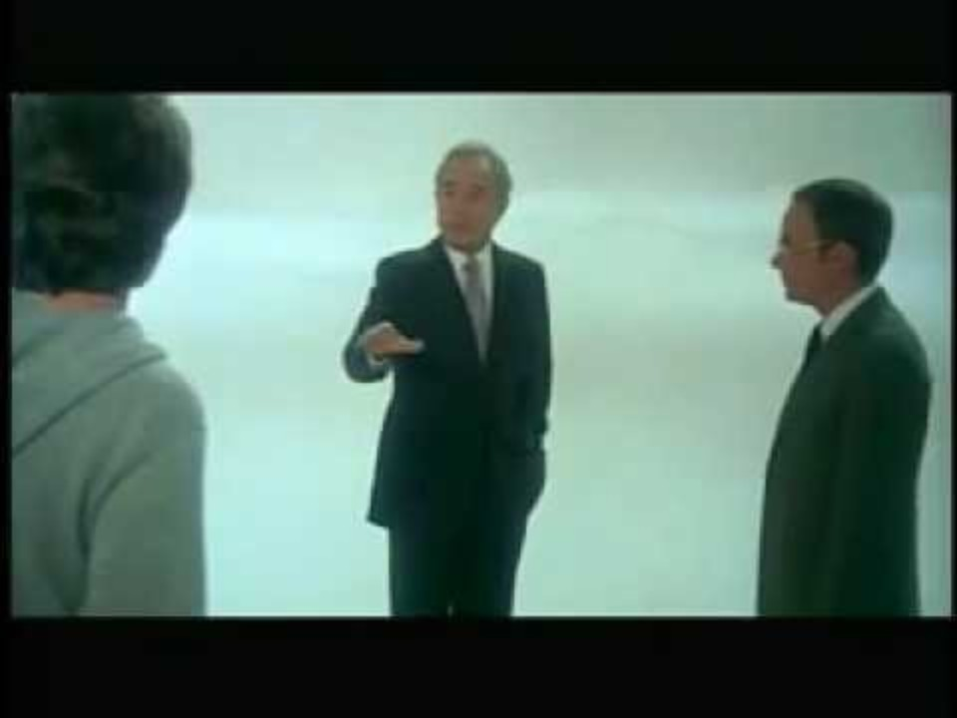
Notes:
This is why children before the age of reason and those who are mentally handicapped or challenged are not subject to the judgment or to the gospel. Why? Because they lack the first component for saving faith through no fault of their own.
They cannot have the knowledge necessary for their faith to qualify as saving faith.
And so salvation and going to heaven, it's not like the movies about heaven where some guy who never believed, had nothing to do with church, and all of a sudden he wakes up. "Oh, where I am?" Well, you're in heaven. "Oh really? "How did I get here?" Yeah, no. That's not how salvation works. You don't go to heaven against your will, without your knowledge, without any understanding.
Saving faith has a basis of understanding and knowledge. No one goes to heaven by accident or without their knowledge. I mean, that's Hollywood heaven, not biblical heaven. And so the people going to heaven know in advance that they're going there and they understand why they're going there.

Slide 14
The 4 Components of Saving Faith
Understanding
Acknowledgement
Notes:
Component #2 - Acknowledgement
Acknowledgement is an act of the will, that we accept some idea or some proposal as true. In this case, the message of the gospel and its primary teaching that Jesus is the Son of God and that we are saved by his death, burial, and resurrection.
Many people know the particulars of the gospel and they understand its meaning and its claims, but they have decided that it is not true and have rejected it. And so saving faith requires acknowledgement because it is this decision in our minds that leads us to the third component of saving faith.

Slide 15
Some know and understand the gospel but reject and refuse to acknowledge it.

Slide 16
The 4 Components of Saving Faith
Understanding
Acknowledgement
Obedience
Notes:
Component #3 - Obedience
A saving faith understands the message of the gospel, acknowledges that it is true, and responds in obedience. This is where we disagree with our Protestant and Evangelical friends. This is, if you've ever wondered theologically, what do we agree on and what do we disagree? Our Baptist friends or Christian Church friends across the street, up until now, they would agree with what I've just said.
But they would disagree right at this point. They teach that saving faith is a combination of understanding and acknowledgement, nothing more. It's what they mean when they say that we're saved by faith alone.

Slide 17
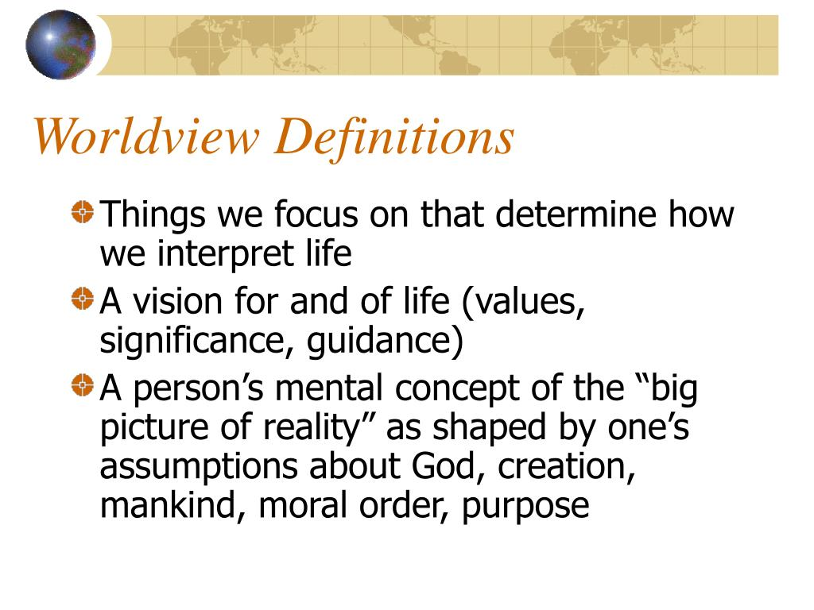

Slide 18
Protestants & Evangelicals:
Understand +
Acknowledge =
Salvation
Notes:
Again, I've listened to these preachers on the radio, and whenever they talk about salvation and faith, they go, "And we're saved by faith alone." And they kind of bite down on the alone part. They claim that anything else is a work or a form of legalism. We on the other hand, in the Churches of Christ, believe that obedience is a natural part of faith because the Bible teaches this principle from Genesis to Revelation. For example,

Slide 19
Church of Christ:
Understand +
Acknowledge +
Obey =
Salvation
(Adam and Eve, Noah, 7 Churches)

Slide 20
Adam and Eve had to obey the command to not eat of the fruit of the tree of the knowledge of good and evil.
There was something required of them in order to be able to ultimately eat of the tree of eternal life.

Slide 21
Noah obeyed God in building the ark according to instructions in order to be saved from the impending flood.

Slide 22
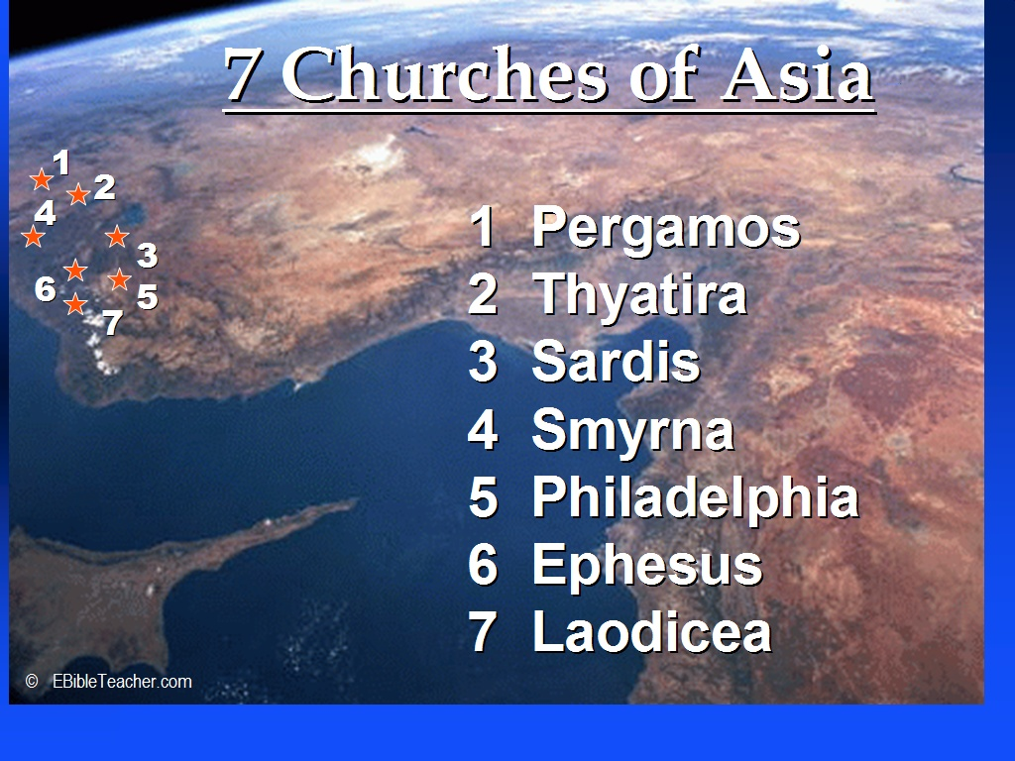
Notes:
The Seven Churches of Asia who received letters in the Book of Revelation had to persevere in order to receive their reward. All transactions between God and mankind are always based on human beings having and persevering in faith. They understand who was calling and directing them, they acknowledge their belief that this was true, and God required a form of obedience to validate their faith.

Slide 23
Obedience Validated Faith
“But someone may well say, ‘You have faith and I have works; show me your faith without works, and I will show you my faith by my works.’”
- James 2:18
Notes:
That's what James talks about in James 2:18.
But someone may well say, "You have faith and I have works; show me your faith without the works, and I will show you my faith by my works."In other words, he gave them a command or a mission or a role or a task that served two purposes. First of all, they carried out God's plan or purpose in some way. And secondly, it provided the believer with a way to express his or her faith in a tangible way. For example,
Abraham what did he do? He was called by God. But what did he do? He left Haran and he traveled to Canaan.
Samson was born a servant of God. But what did he do? He never cut his hair. That was part of the agreement.
Esther had to approach the king, risking her death, on behalf of her people.

Slide 24
Abraham what did he do?
He was called by God.
But what did he do?
He left Haran and he traveled to Canaan.

Slide 25
Samson was born a servant of God.
But what did he do?
He never cut his hair.
That was part of the agreement.

Slide 26
Esther had to approach the king, risking her death, on behalf of her people.
Notes:
These people and so many others in the Old Testament demonstrated their faith by doing something. The apostles received the baptism of John and responded to his call to follow Jesus.
Obedience to God's command to repent and be baptized in the process of salvation is the God-ordained way that we express our belief that the gospel is true. In Mark 16 and Acts 2:38, those are the things that we do to express our faith.
My question is twofold. Number one, saying these words or raising your hand or coming forward for the altar call, are these not things that you have to do? Are they not physical things that must be done? Would the people be saved if they didn't do those things?

Slide 27
“I accept Jesus as my personal Savior”
“I invite Jesus into my heart”
Notes:
I'm always amazed when Baptist Church believers accuse us of demanding works when we teach about the necessity of baptism as a response of faith. And yet they ask their people to say or to think, "I accept Jesus as my personal Savior" or "I invite Jesus into my heart" or any variation of the Sinner's Prayer.
And where in the New Testament is an example of anyone saying or teaching these things? You see, the confidence that I have is rooted in the fact that in the Book of Acts alone there are at least 10 examples of people being baptized as their immediate response to hearing the gospel, and there are zero examples of anyone saying the Sinner's Prayer.
This is where my confidence lies. I'm not bashing our friends across the street, I'm merely stating a fact. The Sinner's Prayer does not appear anywhere in the New Testament. However, someone responding to the gospel by being baptized is everywhere in the New Testament.

Slide 28
Examples of Baptism in the Book of Acts = 10
Examples of the Sinner’s Prayer in the Book of Acts = 0
Notes:
And so saving faith understands the gospel, acknowledges the gospel as true, and obeys. How? By repentance and baptism.

Slide 29
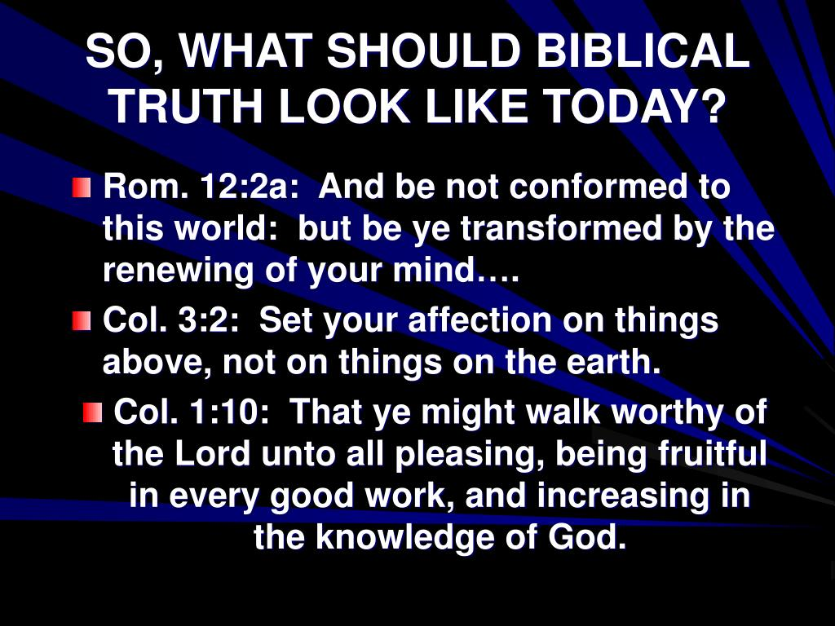

Slide 30
The 4 Components of Saving Faith
Understanding
Acknowledgement
Obedience
Trusts
Notes:
Component #4 - Trusts
Saving faith trusts and has confidence that God can and will keep his promises. Jesus says,
But the one who endures to the end, he will be saved.
- Matthew 24:13

Slide 31
But the one who endures to the end, he will be saved.
- Matthew 24:13
Notes:
What does he mean by endures to the end? Well, endures in faith. Endures hardship and yet remains faithful. Manages prosperity and yet remains faithful. Prosperity is a greater danger to your faith than difficult times. Difficult times tends to draw people to come to God or to ask God for help, but prosperous times many times leads us away from God. And so being faithful to the end, it doesn't mean being perfect until we die. It means we continue believing as true the gospel. We continue believing it as true to the end, despite our weaknesses, despite our failures.

Slide 32
¹³ But we do not want you to be uninformed, brethren, about those who are asleep, so that you will not grieve as do the rest who have no hope. ¹⁴ For if we believe that Jesus died and rose again, even so God will bring with Him those who have fallen asleep in Jesus.
- I Thessalonians 4:13-14
Notes:
This is made possible by trusting God's promises to care for us here and to resurrect us on the last day in the way that he has promised us. Paul talks about this in I Thessalonians. He says,
¹³But we do not want you to be uninformed, brethren, about those who are asleep, so that you will not grieve as do the rest who have no hope. ¹⁴For if we believe that Jesus died and rose again, even so God will bring with Him those who have fallen asleep in Jesus. ¹⁵For this we say to you by the word of the Lord, that we who are alive and remain until the coming of the Lord, will not precede those who have fallen asleep. ¹⁶For the Lord Himself will descend from heaven with a shout, with the voice of the archangel and with the trumpet of God, and the dead in Christ will rise first. ¹⁷Then we who are alive and remain will be caught up together with them in the clouds to meet the Lord in the air, and so we shall always be with the Lord. ¹⁸Therefore comfort one another with these words.
- I Thessalonians 4:13-18The element of trust is an important component and quite necessary because in acknowledging it's true and making a public witness of your faith and baptism, you have entered the spiritual battle that you were once oblivious to.

Slide 33
¹⁵ For this we say to you by the word of the Lord, that we who are alive and remain until the coming of the Lord, will not precede those who have fallen asleep. ¹⁶ For the Lord Himself will descend from heaven with a shout, with the voice of the archangel and with the trumpet of God, and the dead in Christ will rise first.
- I Thessalonians 4:15-16
Notes:
This is made possible by trusting God's promises to care for us here and to resurrect us on the last day in the way that he has promised us. Paul talks about this in I Thessalonians. He says,
¹³But we do not want you to be uninformed, brethren, about those who are asleep, so that you will not grieve as do the rest who have no hope. ¹⁴For if we believe that Jesus died and rose again, even so God will bring with Him those who have fallen asleep in Jesus. ¹⁵For this we say to you by the word of the Lord, that we who are alive and remain until the coming of the Lord, will not precede those who have fallen asleep. ¹⁶For the Lord Himself will descend from heaven with a shout, with the voice of the archangel and with the trumpet of God, and the dead in Christ will rise first. ¹⁷Then we who are alive and remain will be caught up together with them in the clouds to meet the Lord in the air, and so we shall always be with the Lord. ¹⁸Therefore comfort one another with these words.
- I Thessalonians 4:13-18The element of trust is an important component and quite necessary because in acknowledging it's true and making a public witness of your faith and baptism, you have entered the spiritual battle that you were once oblivious to.

Slide 34
¹⁷ Then we who are alive and remain will be caught up together with them in the clouds to meet the Lord in the air, and so we shall always be with the Lord. ¹⁸ Therefore comfort one another with these words.
- I Thessalonians 4:17-18
Notes:
This is made possible by trusting God's promises to care for us here and to resurrect us on the last day in the way that he has promised us. Paul talks about this in I Thessalonians. He says,
¹³But we do not want you to be uninformed, brethren, about those who are asleep, so that you will not grieve as do the rest who have no hope. ¹⁴For if we believe that Jesus died and rose again, even so God will bring with Him those who have fallen asleep in Jesus. ¹⁵For this we say to you by the word of the Lord, that we who are alive and remain until the coming of the Lord, will not precede those who have fallen asleep. ¹⁶For the Lord Himself will descend from heaven with a shout, with the voice of the archangel and with the trumpet of God, and the dead in Christ will rise first. ¹⁷Then we who are alive and remain will be caught up together with them in the clouds to meet the Lord in the air, and so we shall always be with the Lord. ¹⁸Therefore comfort one another with these words.
- I Thessalonians 4:13-18The element of trust is an important component and quite necessary because in acknowledging it's true and making a public witness of your faith and baptism, you have entered the spiritual battle that you were once oblivious to.

Slide 35
Be of sober spirit, be on the alert. Your adversary, the devil, prowls around like a roaring lion, seeking someone to devour.
- I Peter 5:8
Notes:
Someone said to me, I think they used the word lucky. "You're lucky. You lived and you did all kinds of things before you became a Christian. You went to parties and you lived like a sinner and you did all kinds of nasty things. "And I said, "No, no, please don't ever say I was lucky that I did those things. Those things are terrible. I wouldn't want anyone to those things."
I have said many times the one advantage of being converted when you're 30 years old is that you remember what it's like not to be saved. You remember what it's like not to know Christ, to live in a way where there's no reference to God at all in your day. From the moment you wake up until the moment you fall asleep at night, you never think about God, you have no reference to God, you don't ask God for anything, you don't say anything to Him.
I remember what it's like to live in the darkness, and believe me, I wouldn't wish that on anyone. That isn't the life. Paul rightly says, "For those who have no hope." Yeah, that was me. In moments of clarity and moments of self-introspection I would often think, what is life all about? Where am I going? And had no answer.I had no answer to that question. Until someone finally pointed me towards the Bible. And the day that I was baptized was a happy day.
So if the trust in God component is shaken, it then becomes easier to believe and trust in someone or something else that is less challenging, to believe something that's easier to manage and express, to believe something that's more fun and satisfying to the flesh, like believing in yourself or trusting in money.And this of course leads to idolatry which causes the loss of saving faith and consequently the loss of salvation because, as I've explained, we're saved by the type of faith that understands the truth and that accepts the truth, that acts on the truth and that trusts in the truth.

Slide 36
We are saved by the type of faith that:
Understands the Truth
Accepts the Truth
Acts on the Truth
Trusts in the Truth
Notes:
And that truth begins and ends with Jesus Christ.
Jesus said to him, "I am the way, and the truth, and the life; no one comes to the Father but through Me.
-John 14:6Through the process of building a saving faith within us, God manages to recreate the whole person in his likeness as he made him in the beginning.For example, the mind of man is enlightened, that Jesus is God becomes the foundational truth that all knowledge can now be built upon with assurance. Everything you learn about and through Jesus is solid.
No one can take that away from you. Unlike in the world, the philosophies and ideas that you learn and grasp and try to apply may work for a while, and then you find out that oh another idea comes along to knock that one out of the box.

Slide 37
Jesus said to him, “I am the way, and the truth, and the life; no one comes to the Father but through Me.
- John 14:6
Notes:
Do you remember Dr. Spock? I don't mean on character on "Star Trek" I mean Dr. Spock the child doctor that gave advice on how raise children. A whole generation raised their children based on Dr.Spock's advice and what a mess that was. Even Dr. Spock himself later on rejected his previous teaching, saying publicly, "I was wrong. What I taught was incorrect."
That's my point. When we learn something from the Word, when we learn something about Christ, that which we have learned can be built upon but it can never be discarded, it can never be proven untrue.And so the mind of man is enlightened through saving faith.
The will of man is divinely engaged once again. The exercise of believing in Jesus enables the believer to have a relationship with the true and living God, which is the essence of spiritual life.Why do you think the Bible is always trying to help us develop a closer relationship with God? Why do you think God encourages this? Because a relationship with God is what we're going towards. We're heading towards an eternal relationship with God that will exist without any reference to sin.Without any reference to weakness or death or darkness or ignorance. A perfect relationship with God. And then the body is guided, the body of man is guided. Believers know once again how to live as points of light in a dark and an evil world.
And finally, saving faith, saving faith enables the spirit to be empowered. Through saving faith, man's spirit is engaged to experience the joys of the life to come by continually trusting God in this present life.Is this your faith? You know, when we take communion, we're encouraged to examine ourselves or examine our faith. Next time you have to do that, examine your faith based on the criteria that I've given you this evening.
Is this your faith? Is it one you'd like to have? Is it one you'd want more teaching about? And so the invitation's based on this idea here. I encourage you to respond. If you understand your condition as a guilty sinner and believe that Jesus is the Son of God and died for your sins, but you have yet to express your faith in repentance and baptism as God has commanded in his Word, if this is you, then by all means don't delay in making your public confession of faith today.
Or I encourage you to respond if you need more teaching in order to make up your mind about the gospel. And finally, I encourage your response if you need the prayers of the church in order to draw closer to God in the way you act, the way you think, the things that you believe.

Slide 38
Saving faith recreates the whole person in the image of God:
The mind is enlightened
Notes:
Do you remember Dr. Spock? I don't mean on character on "Star Trek" I mean Dr. Spock the child doctor that gave advice on how raise children. A whole generation raised their children based on Dr.Spock's advice and what a mess that was. Even Dr. Spock himself later on rejected his previous teaching, saying publicly, "I was wrong. What I taught was incorrect."
That's my point. When we learn something from the Word, when we learn something about Christ, that which we have learned can be built upon but it can never be discarded, it can never be proven untrue.And so the mind of man is enlightened through saving faith.
The will of man is divinely engaged once again. The exercise of believing in Jesus enables the believer to have a relationship with the true and living God, which is the essence of spiritual life.Why do you think the Bible is always trying to help us develop a closer relationship with God? Why do you think God encourages this? Because a relationship with God is what we're going towards. We're heading towards an eternal relationship with God that will exist without any reference to sin.Without any reference to weakness or death or darkness or ignorance. A perfect relationship with God. And then the body is guided, the body of man is guided. Believers know once again how to live as points of light in a dark and an evil world.
And finally, saving faith, saving faith enables the spirit to be empowered. Through saving faith, man's spirit is engaged to experience the joys of the life to come by continually trusting God in this present life.Is this your faith? You know, when we take communion, we're encouraged to examine ourselves or examine our faith. Next time you have to do that, examine your faith based on the criteria that I've given you this evening.
Is this your faith? Is it one you'd like to have? Is it one you'd want more teaching about? And so the invitation's based on this idea here. I encourage you to respond. If you understand your condition as a guilty sinner and believe that Jesus is the Son of God and died for your sins, but you have yet to express your faith in repentance and baptism as God has commanded in his Word, if this is you, then by all means don't delay in making your public confession of faith today.
Or I encourage you to respond if you need more teaching in order to make up your mind about the gospel. And finally, I encourage your response if you need the prayers of the church in order to draw closer to God in the way you act, the way you think, the things that you believe.

Slide 39
Saving faith recreates the whole person in the image of God:
The mind is enlightened
The will is divinely engaged
Notes:
Do you remember Dr. Spock? I don't mean on character on "Star Trek" I mean Dr. Spock the child doctor that gave advice on how raise children. A whole generation raised their children based on Dr.Spock's advice and what a mess that was. Even Dr. Spock himself later on rejected his previous teaching, saying publicly, "I was wrong. What I taught was incorrect."
That's my point. When we learn something from the Word, when we learn something about Christ, that which we have learned can be built upon but it can never be discarded, it can never be proven untrue.And so the mind of man is enlightened through saving faith.
The will of man is divinely engaged once again. The exercise of believing in Jesus enables the believer to have a relationship with the true and living God, which is the essence of spiritual life.Why do you think the Bible is always trying to help us develop a closer relationship with God? Why do you think God encourages this? Because a relationship with God is what we're going towards. We're heading towards an eternal relationship with God that will exist without any reference to sin.Without any reference to weakness or death or darkness or ignorance. A perfect relationship with God. And then the body is guided, the body of man is guided. Believers know once again how to live as points of light in a dark and an evil world.
And finally, saving faith, saving faith enables the spirit to be empowered. Through saving faith, man's spirit is engaged to experience the joys of the life to come by continually trusting God in this present life.Is this your faith? You know, when we take communion, we're encouraged to examine ourselves or examine our faith. Next time you have to do that, examine your faith based on the criteria that I've given you this evening.
Is this your faith? Is it one you'd like to have? Is it one you'd want more teaching about? And so the invitation's based on this idea here. I encourage you to respond. If you understand your condition as a guilty sinner and believe that Jesus is the Son of God and died for your sins, but you have yet to express your faith in repentance and baptism as God has commanded in his Word, if this is you, then by all means don't delay in making your public confession of faith today.
Or I encourage you to respond if you need more teaching in order to make up your mind about the gospel. And finally, I encourage your response if you need the prayers of the church in order to draw closer to God in the way you act, the way you think, the things that you believe.

Slide 40
Saving faith recreates the whole person in the image of God:
The mind is enlightened
The will is divinely engaged
The body is guided

Slide 41
Saving faith recreates the whole person in the image of God:
The mind is enlightened
The will is divinely engaged
The body is guided
The spirit is empowered
Notes:
Do you remember Dr. Spock? I don't mean on character on "Star Trek" I mean Dr. Spock the child doctor that gave advice on how raise children. A whole generation raised their children based on Dr.Spock's advice and what a mess that was. Even Dr. Spock himself later on rejected his previous teaching, saying publicly, "I was wrong. What I taught was incorrect."
That's my point. When we learn something from the Word, when we learn something about Christ, that which we have learned can be built upon but it can never be discarded, it can never be proven untrue.And so the mind of man is enlightened through saving faith.
The will of man is divinely engaged once again. The exercise of believing in Jesus enables the believer to have a relationship with the true and living God, which is the essence of spiritual life.Why do you think the Bible is always trying to help us develop a closer relationship with God? Why do you think God encourages this? Because a relationship with God is what we're going towards. We're heading towards an eternal relationship with God that will exist without any reference to sin.Without any reference to weakness or death or darkness or ignorance. A perfect relationship with God. And then the body is guided, the body of man is guided. Believers know once again how to live as points of light in a dark and an evil world.
And finally, saving faith, saving faith enables the spirit to be empowered. Through saving faith, man's spirit is engaged to experience the joys of the life to come by continually trusting God in this present life.Is this your faith? You know, when we take communion, we're encouraged to examine ourselves or examine our faith. Next time you have to do that, examine your faith based on the criteria that I've given you this evening.
Is this your faith? Is it one you'd like to have? Is it one you'd want more teaching about? And so the invitation's based on this idea here. I encourage you to respond. If you understand your condition as a guilty sinner and believe that Jesus is the Son of God and died for your sins, but you have yet to express your faith in repentance and baptism as God has commanded in his Word, if this is you, then by all means don't delay in making your public confession of faith today.
Or I encourage you to respond if you need more teaching in order to make up your mind about the gospel. And finally, I encourage your response if you need the prayers of the church in order to draw closer to God in the way you act, the way you think, the things that you believe.

Slide 42
Respond if:
You need to express your faith
You need more teaching about faith
You need prayer to strengthen your faith
Notes:
Do you remember Dr. Spock? I don't mean on character on "Star Trek" I mean Dr. Spock the child doctor that gave advice on how raise children. A whole generation raised their children based on Dr.Spock's advice and what a mess that was. Even Dr. Spock himself later on rejected his previous teaching, saying publicly, "I was wrong. What I taught was incorrect."
That's my point. When we learn something from the Word, when we learn something about Christ, that which we have learned can be built upon but it can never be discarded, it can never be proven untrue.And so the mind of man is enlightened through saving faith.
The will of man is divinely engaged once again. The exercise of believing in Jesus enables the believer to have a relationship with the true and living God, which is the essence of spiritual life.Why do you think the Bible is always trying to help us develop a closer relationship with God? Why do you think God encourages this? Because a relationship with God is what we're going towards. We're heading towards an eternal relationship with God that will exist without any reference to sin.Without any reference to weakness or death or darkness or ignorance. A perfect relationship with God. And then the body is guided, the body of man is guided. Believers know once again how to live as points of light in a dark and an evil world.
And finally, saving faith, saving faith enables the spirit to be empowered. Through saving faith, man's spirit is engaged to experience the joys of the life to come by continually trusting God in this present life.Is this your faith? You know, when we take communion, we're encouraged to examine ourselves or examine our faith. Next time you have to do that, examine your faith based on the criteria that I've given you this evening.
Is this your faith? Is it one you'd like to have? Is it one you'd want more teaching about? And so the invitation's based on this idea here. I encourage you to respond. If you understand your condition as a guilty sinner and believe that Jesus is the Son of God and died for your sins, but you have yet to express your faith in repentance and baptism as God has commanded in his Word, if this is you, then by all means don't delay in making your public confession of faith today.
Or I encourage you to respond if you need more teaching in order to make up your mind about the gospel. And finally, I encourage your response if you need the prayers of the church in order to draw closer to God in the way you act, the way you think, the things that you believe.

