Slide 1
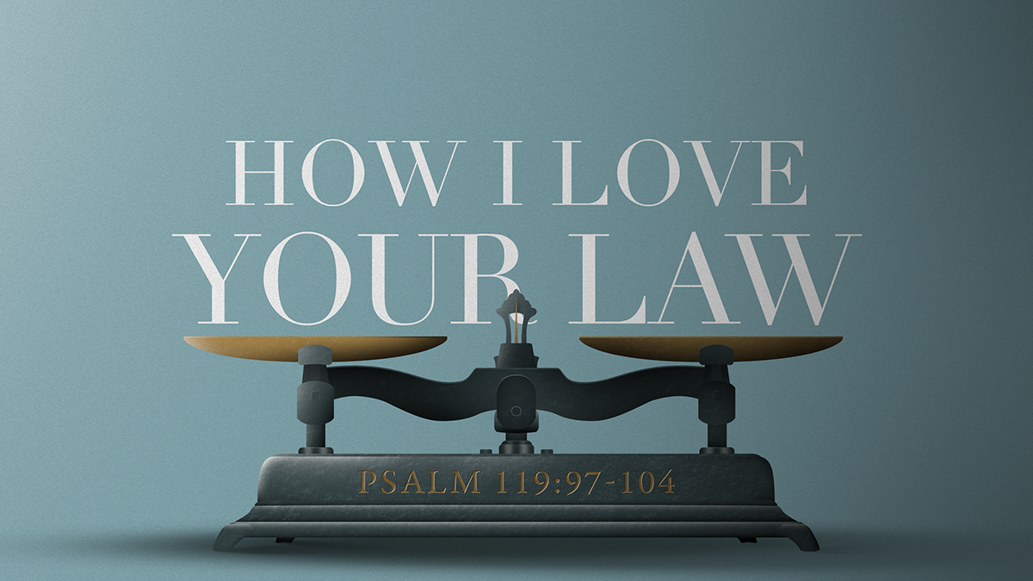
How I Love Your Law
Lesson # 7
Psalms 119:97-112

Slide 2
How I Love Your Law
Introduction
I. WHAT THE LAW DOES FOR ME (VS.97-104)
II. IT IS MY LIGHT AND LAMP (VS. 105-108)
III. I DO NOT FORGET YOUR LAW (VS. 109-112)

Slide 3
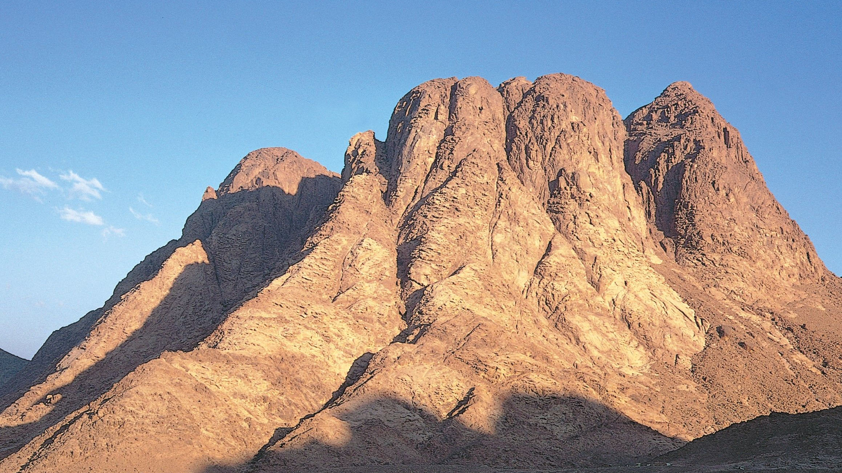
Mount Sinai
Notes:
Israel assembled before Mount Sinai , God delivered the law to Moses, their leader. The Mountian was completely in Smoke.
Exodus 19:18 (KJV)
18 And mount Sinai was altogether on a smoke, because the LORD descended upon it in fire: and the smoke thereof ascended as the smoke of a furnace, and the whole mount quaked greatly.

Slide 4
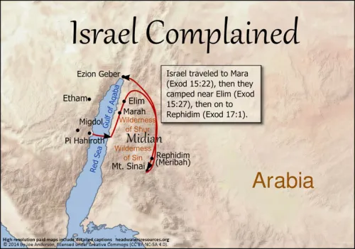
ISRAEL’S
JOURNEY
Notes:
BEFORE THE CHILDREN OF ISRAEL ENTERED THE PROMISE LAND – MOSES SPOKE TO THE NATION AND CHARGED THEM TO OBEY THE LAW OF GO

Slide 5

Notes:
Before they entered into the Promise Land – Moses gave a charge to the children of Israel:

Slide 6
1 And Moses called all Israel, and said unto them, Hear, O Israel, the statutes and judgments which I speak in your ears this day, that ye may learn them, and keep, and do them.
Deuteronomy 5:1 (KJV)
Notes:
Treasury - Deut 5:1
(Christian Standard Bible)
all Israel
Dt 1:1 — These are the words Moses spoke to all Israel across the Jordan in the wilderness, in the Arabah opposite Suph, between Paran and Tophel, Laban, Hazeroth, and Di-zahab.
Dt 29:2 — Moses summoned all Israel and said to them, "You have seen with your own eyes everything the LORD did in Egypt to Pharaoh, to all his officials, and to his entire land.
Dt 29:10 — "All of you are standing today before the LORD your God ​— ​your leaders, tribes, elders, officials, all the men of Israel,
Hear
Dt 4:1 — "Now, Israel, listen to the statutes and ordinances I am teaching you to follow, so that you may live, enter, and take possession of the land the LORD, the God of your fathers, is giving you.
keep, and
Mt 23:3 — Therefore do whatever they tell you, and observe it. But don't do what they do, because they don't practice what they teach.

Slide 7
2 The LORD our God made a covenant with us in Horeb.
Deuteronomy 5:2 (KJV)
Notes:
Christian Standard Bible)
Dt 4:23 — Be careful not to forget the covenant of the LORD your God that he made with you, and make an idol for yourselves in the shape of anything he has forbidden you.
Ex 19:5-8 — Now if you will carefully listen to me and keep my covenant, you will be my own possession out of all the peoples, although the whole earth is mine, ⁶ and you will be my kingdom of priests and my holy nation.' These are the words that you are to say to the Israelites." ⁷ After Moses came back, he summoned the elders of the people and set before them all these words that the LORD had commanded him. ⁸ Then all the people responded together, "We will do all that the LORD has spoken." So Moses brought the people's words back to the LORD.
Ex 24:8 — Moses took the blood, splattered it on the people, and said, "This is the blood of the covenant that the LORD has made with you concerning all these words."
Heb 8:6-13 — But Jesus has now obtained a superior ministry, and to that degree he is the mediator of a better covenant, which has been established on better promises. ⁷ For if that first covenant had been faultless, there would have been no occasion for a second one. ⁸ But finding fault with his people, he says: See, the days are coming, says the Lord, when I will make a new covenant with the house of Israel and with the house of Judah — ⁹ not like the covenant that I made with their ancestors on the day I took them by the hand to lead them out of the land of Egypt. I showed no concern for them, says the Lord, because they did not continue in my covenant. ¹⁰ For this is the covenant that I will make with the house of Israel after those days, says the Lord: I will put my laws into their minds and write them on their hearts. I will be their God, and they will be my people. ¹¹ And each person will not teach his fellow citizen, and each his brother or sister, saying, "Know the Lord," because they will all know me, from the least to the greatest of them. ¹² For I will forgive their wrongdoing, and I will never again remember their sins. ¹³ By saying a new covenant, he has declared that the first is obsolete. And what is obsolete and growing old is about to pass away.
Heb 9:19-23 — For when every command had been proclaimed by Moses to all the people according to the law, he took the blood of calves and goats, along with water, scarlet wool, and hyssop, and sprinkled the scroll itself and all the people, ²⁰ saying, This is the blood of the covenant that God has ordained for you. ²¹ In the same way, he sprinkled the tabernacle and all the articles of worship with blood. ²² According to the law almost everything is purified with blood, and without the shedding of blood there is no forgiveness. ²³ Therefore, it was necessary for the copies of the things in the heavens to be purified with these sacrifices, but the heavenly things themselves to be purified with better sacrifices than these.

Slide 8
3 The LORD made not this covenant with our fathers, but with us, even us, who are all of us here alive this day.
Deuteronomy 5:3 (KJV)
Notes:
Treasury - Deut 5:3
(Christian Standard Bible)
Dt 29:10-15 — "All of you are standing today before the LORD your God ​— ​your leaders, tribes, elders, officials, all the men of Israel, 11 your dependents, your wives, and the resident aliens in your camps who cut your wood and draw your water — 12 so that you may enter into the covenant of the LORD your God, which he is making with you today, so that you may enter into his oath 13 and so that he may establish you today as his people and he may be your God as he promised you and as he swore to your fathers Abraham, Isaac, and Jacob. 14 I am making this covenant and this oath not only with you, 15 but also with those who are standing here with us today in the presence of the LORD our God and with those who are not here today.
Ge 17:7 — I will confirm my covenant that is between me and you and your future offspring throughout their generations. It is a permanent covenant to be your God and the God of your offspring after you.
Ge 17:21 — But I will confirm my covenant with Isaac, whom Sarah will bear to you at this time next year."
Ps 105:8-10 — He remembers his covenant forever, the promise he ordained for a thousand generations — 9 the covenant he made with Abraham, swore to Isaac, 10 and confirmed to Jacob as a decree and to Israel as a permanent covenant:
Jer 32:38-40 — They will be my people, and I will be their God. 39 I will give them integrity of heart and action so that they will fear me always, for their good and for the good of their descendants after them. 40 "I will make a permanent covenant with them: I will never turn away from doing good to them, and I will put fear of me in their hearts so they will never again turn away from me.
Mt 13:17 — For truly I tell you, many prophets and righteous people longed to see the things you see but didn't see them, to hear the things you hear but didn't hear them.
Gal 3:17-21 — My point is this: The law, which came 430 years later, does not invalidate a covenant previously established by God and thus cancel the promise. 18 For if the inheritance is based on the law, it is no longer based on the promise; but God has graciously given it to Abraham through the promise. 19 Why then was the law given? It was added for the sake of transgressions until the Seed to whom the promise was made would come. The law was put into effect through angels by means of a mediator. 20 Now a mediator is not just for one person alone, but God is one. 21 Is the law therefore contrary to God's promises? Absolutely not! For if the law had been granted with the ability to give life, then righteousness would certainly be on the basis of the law.
Heb 8:8 — But finding fault with his people, he says: See, the days are coming, says the Lord, when I will make a new covenant with the house of Israel and with the house of Judah —
Heb 8:9 — not like the covenant that I made with their ancestors on the day I took them by the hand to lead them out of the land of Egypt. I showed no concern for them, says the Lord, because they did not continue in my covenant.

Slide 9
4 The LORD talked with you face to face in the mount out of the midst of the fire,
Deuteronomy 5:4 (KJV)
Notes:
Treasury - Deut 5:4
(Christian Standard Bible)
Dt 5:24-26 — You said, 'Look, the LORD our God has shown us his glory and greatness, and we have heard his voice from the fire. Today we have seen that God speaks with a person, yet he still lives. 25 But now, why should we die? This great fire will consume us and we will die if we hear the voice of the LORD our God any longer. 26 For who out of all mankind has heard the voice of the living God speaking from the fire, as we have, and lived?
Dt 4:33 — Has a people heard God's voice speaking from the fire as you have, and lived?
Dt 4:36 — He let you hear his voice from heaven to instruct you. He showed you his great fire on earth, and you heard his words from the fire.
Dt 34:10 — No prophet has arisen again in Israel like Moses, whom the LORD knew face to face.
Ex 19:9 — The LORD said to Moses, "I am going to come to you in a dense cloud, so that the people will hear when I speak with you and will always believe you." Moses reported the people's words to the LORD,
Ex 19:18 — Mount Sinai was completely enveloped in smoke because the LORD came down on it in fire. Its smoke went up like the smoke of a furnace, and the whole mountain shook violently.
Ex 19:19 — As the sound of the trumpet grew louder and louder, Moses spoke and God answered him in the thunder.
Ex 20:18-22 — All the people witnessed the thunder and lightning, the sound of the trumpet, and the mountain surrounded by smoke. When the people saw it they trembled and stood at a distance. 19 "You speak to us, and we will listen," they said to Moses, "but don't let God speak to us, or we will die." 20 Moses responded to the people, "Don't be afraid, for God has come to test you, so that you will fear him and will not sin." 21 And the people remained standing at a distance as Moses approached the total darkness where God was. 22 Then the LORD told Moses, "This is what you are to say to the Israelites: You have seen that I have spoken to you from heaven.
Ex 33:11 — The LORD would speak with Moses face to face, just as a man speaks with his friend, then Moses would return to the camp. His assistant, the young man Joshua son of Nun, would not leave the inside of the tent.
Nu 12:8 — I speak with him directly, openly, and not in riddles; he sees the form of the LORD. So why were you not afraid to speak against my servant Moses? "

Slide 10
5 (I stood between the LORD and you at that time, to shew you the word of the LORD: for ye were afraid by reason of the fire, and went not up into the mount;) saying,
Deuteronomy 5:5 (KJV)
Notes:
Treasury - Deut 5:5
(Christian Standard Bible)
Dt 5:27 — Go near and listen to everything the LORD our God says. Then you can tell us everything the LORD our God tells you; we will listen and obey.'
Ge 18:22 — The men turned from there and went toward Sodom while Abraham remained standing before the LORD.
Ex 19:16 — On the third day, when morning came, there was thunder and lightning, a thick cloud on the mountain, and a very loud trumpet sound, so that all the people in the camp shuddered.
Ex 20:18-21 — All the people witnessed the thunder and lightning, the sound of the trumpet, and the mountain surrounded by smoke. When the people saw it they trembled and stood at a distance. 19 "You speak to us, and we will listen," they said to Moses, "but don't let God speak to us, or we will die." 20 Moses responded to the people, "Don't be afraid, for God has come to test you, so that you will fear him and will not sin." 21 And the people remained standing at a distance as Moses approached the total darkness where God was.
Ex 24:2 — Moses alone is to approach the LORD, but the others are not to approach, and the people are not to go up with him."
Ex 24:3 — Moses came and told the people all the commands of the LORD and all the ordinances. Then all the people responded with a single voice, "We will do everything that the LORD has commanded."
Nu 16:48 — He stood between the dead and the living, and the plague was halted.
Ps 106:23 — So he said he would have destroyed them — if Moses his chosen one had not stood before him in the breach to turn his wrath away from destroying them.
Jer 30:21 — Jacob's leader will be one of them; his ruler will issue from him. I will invite him to me, and he will approach me, for who would otherwise risk his life to approach me? This is the LORD's declaration.
Zec 3:1-5 — Then he showed me the high priest Joshua standing before the angel of the LORD, with Satan standing at his right side to accuse him. 2 The LORD said to Satan: "The LORD rebuke you, Satan! May the LORD who has chosen Jerusalem rebuke you! Isn't this man a burning stick snatched from the fire? " 3 Now Joshua was dressed with filthy clothes as he stood before the angel. 4 So the angel of the LORD spoke to those standing before him, "Take off his filthy clothes! " Then he said to him, "See, I have removed your iniquity from you, and I will clothe you with festive robes." 5 Then I said, "Let them put a clean turban on his head." So a clean turban was placed on his head, and they clothed him in garments while the angel of the LORD was standing nearby.
Gal 3:19 — Why then was the law given? It was added for the sake of transgressions until the Seed to whom the promise was made would come. The law was put into effect through angels by means of a mediator.
Heb 9:24 — For Christ did not enter a sanctuary made with hands (only a model of the true one) but into heaven itself, so that he might now appear in the presence of God for us.
Heb 12:18-24 — For you have not come to what could be touched, to a blazing fire, to darkness, gloom, and storm, 19 to the blast of a trumpet, and the sound of words. Those who heard it begged that not another word be spoken to them, 20 for they could not bear what was commanded: If even an animal touches the mountain, it must be stoned. 21 The appearance was so terrifying that Moses said, I am trembling with fear. 22 Instead, you have come to Mount Zion, to the city of the living God (the heavenly Jerusalem), to myriads of angels, a festive gathering, 23 to the assembly of the firstborn whose names have been written in heaven, to a Judge, who is God of all, to the spirits of righteous people made perfect, 24 and to Jesus, the mediator of a new covenant, and to the sprinkled blood, which says better things than the blood of Abel.

Slide 11
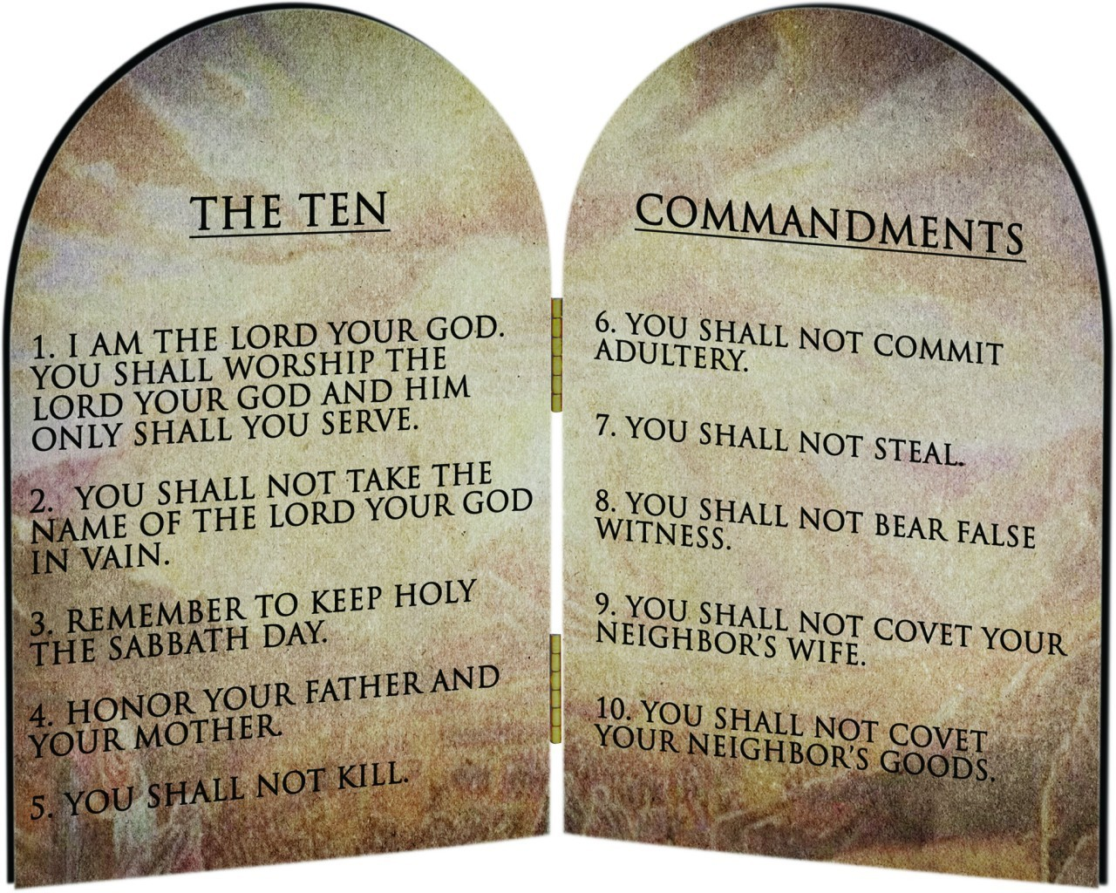
Restating
Notes:
Why where these important for Israel?

Slide 12
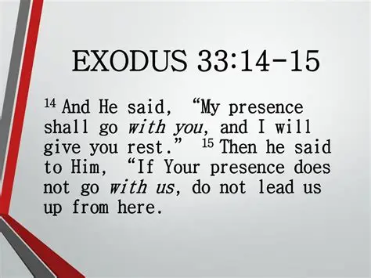

Slide 13

Despite God’s Intentions for The Law
“People Didn’t Always View The Law Positively”

Slide 14
1 Whosoever believeth that Jesus is the Christ is born of God: and every one that loveth him that begat loveth him also that is begotten of him.
1 John 5:1 (KJV)
Notes:
Treasury - 1 John 5:1
(Christian Standard Bible)
believeth
1Jn 2:22 — Who is the liar, if not the one who denies that Jesus is the Christ? This one is the antichrist: the one who denies the Father and the Son.
1Jn 2:23 — No one who denies the Son has the Father; he who confesses the Son has the Father as well.
1Jn 4:2 — This is how you know the Spirit of God: Every spirit that confesses that Jesus Christ has come in the flesh is from God,
1Jn 4:14 — And we have seen and we testify that the Father has sent his Son as the world's Savior.
1Jn 4:15 — Whoever confesses that Jesus is the Son of God ​— ​God remains in him and he in God.
Mt 16:16 — Simon Peter answered, "You are the Messiah, the Son of the living God."
Jn 1:12 — But to all who did receive him, he gave them the right to be children of God, to those who believe in his name,
Jn 1:13 — who were born, not of natural descent, or of the will of the flesh, or of the will of man, but of God.
Jn 6:69 — We have come to believe and know that you are the Holy One of God."
Ac 8:37 —
Ro 10:9 — If you confess with your mouth, "Jesus is Lord," and believe in your heart that God raised him from the dead, you will be saved.
Ro 10:10 — One believes with the heart, resulting in righteousness, and one confesses with the mouth, resulting in salvation.
is born
1Jn 5:4 — because everyone who has been born of God conquers the world. This is the victory that has conquered the world: our faith.
1Jn 2:29 — If you know that he is righteous, you know this as well: Everyone who does what is right has been born of him.
1Jn 3:9 — Everyone who has been born of God does not sin, because his seed remains in him; he is not able to sin, because he has been born of God.
1Jn 4:7 — Dear friends, let us love one another, because love is from God, and everyone who loves has been born of God and knows God.
and every
1Jn 2:10 — The one who loves his brother or sister remains in the light, and there is no cause for stumbling in him.
1Jn 3:14 — We know that we have passed from death to life because we love our brothers and sisters. The one who does not love remains in death.
1Jn 3:17 — If anyone has this world's goods and sees a fellow believer in need but withholds compassion from him ​— ​how does God's love reside in him?
1Jn 4:20 — If anyone says, "I love God," and yet hates his brother or sister, he is a liar. For the person who does not love his brother or sister whom he has seen cannot love God whom he has not seen.
Jn 15:23 — The one who hates me also hates my Father.
Jas 1:18 — By his own choice, he gave us birth by the word of truth so that we would be a kind of firstfruits of his creatures.
1Pe 1:3 — Blessed be the God and Father of our Lord Jesus Christ. Because of his great mercy he has given us new birth into a living hope through the resurrection of Jesus Christ from the dead
1Pe 1:22 — Since you have purified yourselves by your obedience to the truth, so that you show sincere brotherly love for each other, from a pure heart love one another constantly,
1Pe 1:23 — because you have been born again ​— ​not of perishable seed but of imperishable ​— ​through the living and enduring word of God.

Slide 15
2 By this we know that we love the children of God, when we love God, and keep his commandments.
1 John 5:2 (KJV)
Notes:
Treasury - 1 John 5:2
(Christian Standard Bible)
1Jn 3:22-24 — and receive whatever we ask from him because we keep his commands and do what is pleasing in his sight. ²³ Now this is his command: that we believe in the name of his Son Jesus Christ, and love one another as he commanded us. ²⁴ The one who keeps his commands remains in him, and he in him. And the way we know that he remains in us is from the Spirit he has given us.
1Jn 4:21 — And we have this command from him: The one who loves God must also love his brother and sister.
Jn 13:34 — “I give you a new command: Love one another. Just as I have loved you, you are also to love one another.
Jn 13:35 — By this everyone will know that you are my disciples, if you love one another.”
Jn 15:17 — "This is what I command you: Love one another.

Slide 16
3 For this is the love of God, that we keep his commandments: and his commandments are not grievous.
1 John 5:3 (KJV)
Notes:
Treasury - 1 John 5:3
(Christian Standard Bible)
this
Ex 20:6 — but showing faithful love to a thousand generations of those who love me and keep my commands.
Dt 5:10 — but showing faithful love to a thousand generations of those who love me and keep my commands.
Dt 7:9 — Know that the LORD your God is God, the faithful God who keeps his gracious covenant loyalty for a thousand generations with those who love him and keep his commands.
Dt 10:12 — "And now, Israel, what does the LORD your God ask of you except to fear the LORD your God by walking in all his ways, to love him, and to worship the LORD your God with all your heart and all your soul?
Dt 10:13 — Keep the LORD's commands and statutes I am giving you today, for your own good.
Da 9:4 — I prayed to the LORD my God and confessed: Ah, Lord ​— ​the great and awe-inspiring God who keeps his gracious covenant with those who love him and keep his commands —
Mt 12:47-50 — Someone told him, "Look, your mother and your brothers are standing outside, wanting to speak to you." 48 He replied to the one who was speaking to him, "Who is my mother and who are my brothers? " 49 Stretching out his hand toward his disciples, he said, "Here are my mother and my brothers! 50 For whoever does the will of my Father in heaven is my brother and sister and mother."
Jn 14:15 — "If you love me, you will keep my commands.
Jn 14:21-24 — The one who has my commands and keeps them is the one who loves me. And the one who loves me will be loved by my Father. I also will love him and will reveal myself to him." 22 Judas (not Iscariot) said to him, "Lord, how is it you're going to reveal yourself to us and not to the world? " 23 Jesus answered, "If anyone loves me, he will keep my word. My Father will love him, and we will come to him and make our home with him. 24 The one who doesn't love me will not keep my words. The word that you hear is not mine but is from the Father who sent me.
Jn 15:10 — If you keep my commands you will remain in my love, just as I have kept my Father's commands and remain in his love.
Jn 15:14 — You are my friends if you do what I command you.
2Jn 1:6 — This is love: that we walk according to his commands. This is the command as you have heard it from the beginning: that you walk in love.
and
Ps 19:7-11 — The instruction of the LORD is perfect, renewing one's life; the testimony of the LORD is trustworthy, making the inexperienced wise. 8 The precepts of the LORD are right, making the heart glad; the command of the LORD is radiant, making the eyes light up. 9 The fear of the LORD is pure, enduring forever; the ordinances of the LORD are reliable and altogether righteous. 10 They are more desirable than gold — than an abundance of pure gold; and sweeter than honey dripping from a honeycomb. 11 In addition, your servant is warned by them, and in keeping them there is an abundant reward.
Ps 119:45 — I will walk freely in an open place because I study your precepts.
Ps 119:47 — I delight in your commands, which I love.
Ps 119:48 — I will lift up my hands to your commands, which I love, and will meditate on your statutes.
Ps 119:103 — How sweet your word is to my taste — sweeter than honey in my mouth.
Ps 119:104 — I gain understanding from your precepts; therefore I hate every false way.
Ps 119:127 — Since I love your commands more than gold, even the purest gold,
Ps 119:128 — I carefully follow all your precepts and hate every false way.
Ps 119:140 — Your word is completely pure, and your servant loves it.
Pr 3:17 — Her ways are pleasant, and all her paths, peaceful.
Mic 6:8 — Mankind, he has told each of you what is good and what it is the LORD requires of you: to act justly, to love faithfulness, and to walk humbly with your God.
Mt 11:28-30 — "Come to me, all of you who are weary and burdened, and I will give you rest. 29 Take up my yoke and learn from me, because I am lowly and humble in heart, and you will find rest for your souls. 30 For my yoke is easy and my burden is light."
Ro 7:12 — So then, the law is holy, and the commandment is holy and just and good.
Ro 7:22 — For in my inner self I delight in God's law,
Heb 8:10 — For this is the covenant that I will make with the house of Israel after those days, says the Lord: I will put my laws into their minds and write them on their hearts. I will be their God, and they will be my people.

Slide 17
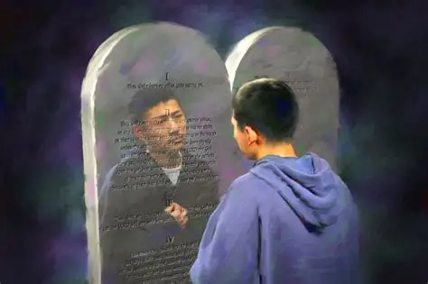
I. WHAT THE LAW DOES FOR ME (VS.97-104)
Notes:
Our Lesson begins with a declaration of the psalmist’s love for God’s law )Psalm 119:97
Psalm 119:97 (KJV)
97 O how love I thy law! it is my meditation all the day.
Treasury - Psalm 119:97
(Christian Standard Bible)
O how
Ps 119:48 — I will lift up my hands to your commands, which I love, and will meditate on your statutes.
Ps 119:113 — I hate those who are double-minded, but I love your instruction.
Ps 119:127 — Since I love your commands more than gold, even the purest gold,
Ps 119:159 — Consider how I love your precepts; LORD, give me life according to your faithful love.
Ps 119:165 — Abundant peace belongs to those who love your instruction; nothing makes them stumble.
Ps 119:167 — I obey your decrees and love them greatly.
Ps 1:2 — Instead, his delight is in the LORD's instruction, and he meditates on it day and night.
Dt 6:6-9 — These words that I am giving you today are to be in your heart. 7 Repeat them to your children. Talk about them when you sit in your house and when you walk along the road, when you lie down and when you get up. 8 Bind them as a sign on your hand and let them be a symbol on your forehead. 9 Write them on the doorposts of your house and on your city gates.
Dt 17:19 — It is to remain with him, and he is to read from it all the days of his life, so that he may learn to fear the LORD his God, to observe all the words of this instruction, and to do these statutes.
Jos 1:8 — This book of instruction must not depart from your mouth; you are to meditate on it day and night so that you may carefully observe everything written in it. For then you will prosper and succeed in whatever you do.
Pr 2:10 — For wisdom will enter your heart, and knowledge will delight you.
Pr 18:1 — One who isolates himself pursues selfish desires; he rebels against all sound wisdom.

Slide 18
97 O how love I thy law! it is my meditation all the day.
Psalm 119:97 (KJV)
Notes:
Treasury - Psalm 119:97
(Christian Standard Bible)
O how
Ps 119:48 — I will lift up my hands to your commands, which I love, and will meditate on your statutes.
Ps 119:113 — I hate those who are double-minded, but I love your instruction.
Ps 119:127 — Since I love your commands more than gold, even the purest gold,
Ps 119:159 — Consider how I love your precepts; LORD, give me life according to your faithful love.
Ps 119:165 — Abundant peace belongs to those who love your instruction; nothing makes them stumble.
Ps 119:167 — I obey your decrees and love them greatly.
Ps 1:2 — Instead, his delight is in the LORD's instruction, and he meditates on it day and night.
Dt 6:6-9 — These words that I am giving you today are to be in your heart. 7 Repeat them to your children. Talk about them when you sit in your house and when you walk along the road, when you lie down and when you get up. 8 Bind them as a sign on your hand and let them be a symbol on your forehead. 9 Write them on the doorposts of your house and on your city gates.
Dt 17:19 — It is to remain with him, and he is to read from it all the days of his life, so that he may learn to fear the LORD his God, to observe all the words of this instruction, and to do these statutes.
Jos 1:8 — This book of instruction must not depart from your mouth; you are to meditate on it day and night so that you may carefully observe everything written in it. For then you will prosper and succeed in whatever you do.
Pr 2:10 — For wisdom will enter your heart, and knowledge will delight you.
Pr 18:1 — One who isolates himself pursues selfish desires; he rebels against all sound wisdom.

Slide 19
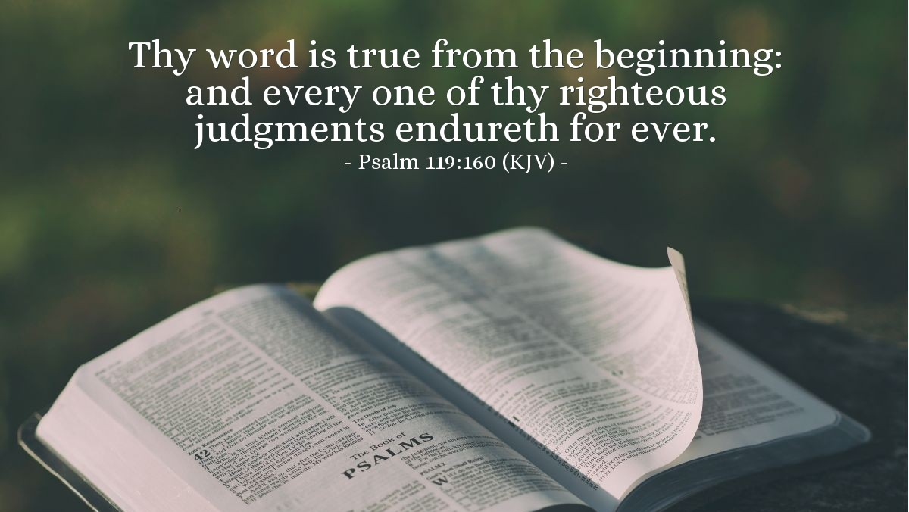
God’s Word Does Not Change

Slide 20
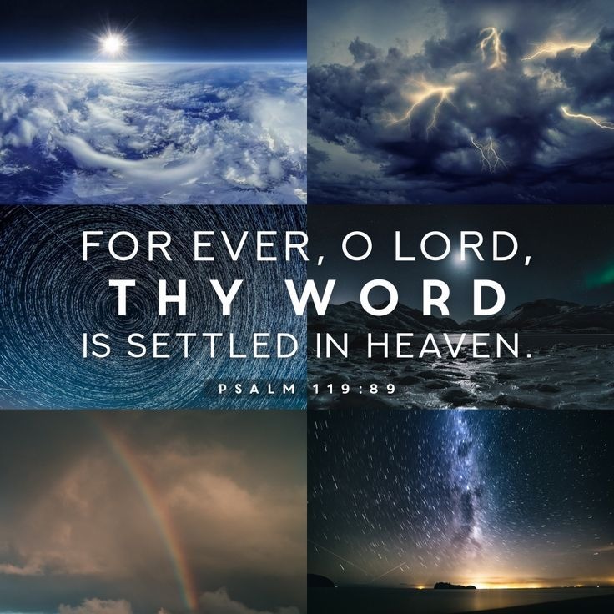

Slide 21
98 Thou through thy commandments hast made me wiser than mine enemies: for they are ever with me.
Psalm 119:98 (KJV)
Notes:
Treasury - Psalm 119:98
(Christian Standard Bible)
through
Ps 119:104 — I gain understanding from your precepts; therefore I hate every false way.
Dt 4:6 — Carefully follow them, for this will show your wisdom and understanding in the eyes of the peoples. When they hear about all these statutes, they will say, 'This great nation is indeed a wise and understanding people.'
Dt 4:8 — And what great nation has righteous statutes and ordinances like this entire law I set before you today?
1Sa 18:5 — David marched out with the army and was successful in everything Saul sent him to do. Saul put him in command of the fighting men, which pleased all the people and Saul's servants as well.
1Sa 18:14 — and continued to be successful in all his activities because the LORD was with him.
1Sa 18:30 — Every time the Philistine commanders came out to fight, David was more successful than all of Saul's officers. So his name became well known.
Pr 2:6 — For the LORD gives wisdom; from his mouth come knowledge and understanding.
Col 3:16 — Let the word of Christ dwell richly among you, in all wisdom teaching and admonishing one another through psalms, hymns, and spiritual songs, singing to God with gratitude in your hearts.
they are ever
Ps 119:11 — I have treasured your word in my heart so that I may not sin against you.
Ps 119:30 — I have chosen the way of truth; I have set your ordinances before me.
Ps 119:105 — Your word is a lamp for my feet and a light on my path.
Jas 1:25 — But the one who looks intently into the perfect law of freedom and perseveres in it, and is not a forgetful hearer but a doer who works ​— ​this person will be blessed in what he does.

Slide 22
99 I have more understanding than all my teachers: for thy testimonies are my meditation.
Psalm 119:99 (KJV)
Notes:
Treasury - Psalm 119:99
(Christian Standard Bible)
than all
Dt 4:6-8 — Carefully follow them, for this will show your wisdom and understanding in the eyes of the peoples. When they hear about all these statutes, they will say, 'This great nation is indeed a wise and understanding people.' 7 For what great nation is there that has a god near to it as the LORD our God is to us whenever we call to him? 8 And what great nation has righteous statutes and ordinances like this entire law I set before you today?
2Sa 15:24-26 — Zadok was also there, and all the Levites with him were carrying the ark of the covenant of God. They set the ark of God down, and Abiathar offered sacrifices until the people had finished marching past. 25 Then the king instructed Zadok, "Return the ark of God to the city. If I find favor with the LORD, he will bring me back and allow me to see both it and its dwelling place. 26 However, if he should say, 'I do not delight in you,' then here I am ​— ​he can do with me whatever pleases him."
1Ch 15:11-13 — David summoned the priests Zadok and Abiathar and the Levites Uriel, Asaiah, Joel, Shemaiah, Eliel, and Amminadab. 12 He said to them, "You are the heads of the Levite families. You and your relatives must consecrate yourselves so that you may bring the ark of the LORD God of Israel to the place I have prepared for it. 13 For the LORD our God burst out in anger against us because you Levites were not with us the first time, for we didn't inquire of him about the proper procedures."
2Ch 29:15-36 — They gathered their brothers together, consecrated themselves, and went according to the king's command by the words of the LORD to cleanse the LORD's temple. 16 The priests went to the entrance of the LORD's temple to cleanse it. They took all the unclean things they found in the LORD's sanctuary to the courtyard of the LORD's temple. Then the Levites received them and took them outside to the Kidron Valley. 17 They began the consecration on the first day of the first month, and on the eighth day of the month they came to the portico of the LORD's temple. They consecrated the LORD's temple for eight days, and on the sixteenth day of the first month they finished. 18 Then they went inside to King Hezekiah and said, "We have cleansed the whole temple of the LORD, the altar of burnt offering and all its utensils, and the table for the rows of the Bread of the Presence and all its utensils. 19 We have set up and consecrated all the utensils that King Ahaz rejected during his reign when he became unfaithful. They are in front of the altar of the LORD." 20 King Hezekiah got up early, gathered the city officials, and went to the LORD's temple. 21 They brought seven bulls, seven rams, seven lambs, and seven male goats as a sin offering for the kingdom, for the sanctuary, and for Judah. Then he told the descendants of Aaron, the priests, to offer them on the altar of the LORD. 22 So they slaughtered the bulls, and the priests received the blood and splattered it on the altar. They slaughtered the rams and splattered the blood on the altar. They slaughtered the lambs and splattered the blood on the altar. 23 Then they brought the goats for the sin offering right into the presence of the king and the congregation, who laid their hands on them. 24 The priests slaughtered the goats and put their blood on the altar for a sin offering, to make atonement for all Israel, for the king said that the burnt offering and sin offering were for all Israel. 25 Hezekiah stationed the Levites in the LORD's temple with cymbals, harps, and lyres according to the command of David, Gad the king's seer, and the prophet Nathan. For the command was from the LORD through his prophets. 26 The Levites stood with the instruments of David, and the priests with the trumpets. 27 Then Hezekiah ordered that the burnt offering be offered on the altar. When the burnt offerings began, the song of the LORD and the trumpets began, accompanied by the instruments of King David of Israel. 28 The whole assembly was worshiping, singing the song, and blowing the trumpets ​— ​all this continued until the burnt offering was completed. 29 When the burnt offerings were completed, the king and all those present with him bowed down and worshiped. 30 Then King Hezekiah and the officials told the Levites to sing praise to the LORD in the words of David and of the seer Asaph. So they sang praises with rejoicing and knelt low and worshiped. 31 Hezekiah concluded, "Now you are consecrated to the LORD. Come near and bring sacrifices and thank offerings to the LORD's temple." So the congregation brought sacrifices and thank offerings, and all those with willing hearts brought burnt offerings. 32 The number of burnt offerings the congregation brought was seventy bulls, one hundred rams, and two hundred lambs; all these were for a burnt offering to the LORD. 33 Six hundred bulls and three thousand sheep and goats were consecrated. 34 However, since there were not enough priests, they weren't able to skin all the burnt offerings, so their Levite brothers helped them until the work was finished and until the priests consecrated themselves. For the Levites were more conscientious to consecrate themselves than the priests were. 35 Furthermore, the burnt offerings were abundant, along with the fat of the fellowship offerings and with the drink offerings for the burnt offering. So the service of the LORD's temple was established. 36 Then Hezekiah and all the people rejoiced over how God had prepared the people, for it had come about suddenly.
2Ch 30:22 — Then Hezekiah encouraged all the Levites who performed skillfully before the LORD. They ate at the appointed festival for seven days, sacrificing fellowship offerings and giving thanks to the LORD, the God of their ancestors.
Jer 2:8 — The priests quit asking, "Where is the LORD? " The experts in the law no longer knew me, and the rulers rebelled against me. The prophets prophesied by Baal and followed useless idols.
Jer 8:8 — "How can you claim, 'We are wise; the law of the LORD is with us'? In fact, the lying pen of scribes has produced falsehood.
Jer 8:9 — The wise will be put to shame; they will be dismayed and snared. They have rejected the word of the LORD, so what wisdom do they really have?
Mt 11:25 — At that time Jesus said, "I praise you, Father, Lord of heaven and earth, because you have hidden these things from the wise and intelligent and revealed them to infants.
Mt 13:11 — He answered, "Because the secrets of the kingdom of heaven have been given for you to know, but it has not been given to them.
Mt 15:6-9 — he does not have to honor his father.' In this way, you have nullified the word of God because of your tradition. 7 Hypocrites! Isaiah prophesied correctly about you when he said: 8 This people honor me with their lips, but their heart is far from me. 9 They worship me in vain, teaching as doctrines human commands."
Mt 15:14 — Leave them alone! They are blind guides. And if the blind guide the blind, both will fall into a pit."
Mt 23:24-36 — Blind guides! You strain out a gnat, but gulp down a camel! 25 "Woe to you, scribes and Pharisees, hypocrites! You clean the outside of the cup and dish, but inside they are full of greed and self-indulgence. 26 Blind Pharisee! First clean the inside of the cup, so that the outside of it may also become clean. 27 "Woe to you, scribes and Pharisees, hypocrites! You are like whitewashed tombs, which appear beautiful on the outside, but inside are full of the bones of the dead and every kind of impurity. 28 In the same way, on the outside you seem righteous to people, but inside you are full of hypocrisy and lawlessness. 29 "Woe to you, scribes and Pharisees, hypocrites! You build the tombs of the prophets and decorate the graves of the righteous, 30 and you say, 'If we had lived in the days of our ancestors, we wouldn't have taken part with them in shedding the prophets' blood.' 31 So you testify against yourselves that you are descendants of those who murdered the prophets. 32 Fill up, then, the measure of your ancestors' sins! 33 "Snakes! Brood of vipers! How can you escape being condemned to hell? 34 This is why I am sending you prophets, sages, and scribes. Some of them you will kill and crucify, and some of them you will flog in your synagogues and pursue from town to town. 35 So all the righteous blood shed on the earth will be charged to you, from the blood of righteous Abel to the blood of Zechariah, son of Berechiah, whom you murdered between the sanctuary and the altar. 36 Truly I tell you, all these things will come on this generation.
Heb 5:12 — Although by this time you ought to be teachers, you need someone to teach you the basic principles of God's revelation again. You need milk, not solid food.
for thy
Ps 119:24 — your decrees are my delight and my counselors.
2Ti 3:15-17 — and you know that from infancy you have known the sacred Scriptures, which are able to give you wisdom for salvation through faith in Christ Jesus. 16 All Scripture is inspired by God and is profitable for teaching, for rebuking, for correcting, for training in righteousness, 17 so that the man of God may be complete, equipped for every good work.

Slide 23
100 I understand more than the ancients, because I keep thy precepts.
Psalm 119:100 (KJV)
Notes:
Treasury - Psalm 119:100
(Christian Standard Bible)
understand
1Ki 12:6-15 — Then King Rehoboam consulted with the elders who had served his father Solomon when he was alive, asking, "How do you advise me to respond to this people? " 7 They replied, "Today if you will be a servant to this people and serve them, and if you respond to them by speaking kind words to them, they will be your servants forever." 8 But he rejected the advice of the elders who had advised him and consulted with the young men who had grown up with him and attended him. 9 He asked them, "What message do you advise that we send back to this people who said to me, 'Lighten the yoke your father put on us'? " 10 Then the young men who had grown up with him told him, "This is what you should say to this people who said to you, 'Your father made our yoke heavy, but you, make it lighter on us! ' This is what you should tell them: 'My little finger is thicker than my father's waist! 11 Although my father burdened you with a heavy yoke, I will add to your yoke; my father disciplined you with whips, but I will discipline you with barbed whips.' " 12 So Jeroboam and all the people came to Rehoboam on the third day, as the king had ordered: "Return to me on the third day." 13 Then the king answered the people harshly. He rejected the advice the elders had given him 14 and spoke to them according to the young men's advice: "My father made your yoke heavy, but I will add to your yoke; my father disciplined you with whips, but I will discipline you with barbed whips." 15 The king did not listen to the people, because this turn of events came from the LORD to carry out his word, which the LORD had spoken through Ahijah the Shilonite to Jeroboam son of Nebat.
Job 12:12 — Wisdom is found with the elderly, and understanding comes with long life.
Job 15:9 — What do you know that we don't? What do you understand that is not clear to us?
Job 15:10 — Both the gray-haired and the elderly are with us— older than your father.
Job 32:4 — Now Elihu had waited to speak to Job because they were all older than he.
Job 32:10 — Therefore I say, "Listen to me. I too will declare what I know."
because
Ps 111:10 — The fear of the LORD is the beginning of wisdom; all who follow his instructions have good insight. His praise endures forever.
Job 28:28 — He said to mankind, "The fear of the LORD—that is wisdom. And to turn from evil is understanding."
Jer 8:8 — "How can you claim, 'We are wise; the law of the LORD is with us'? In fact, the lying pen of scribes has produced falsehood.
Jer 8:9 — The wise will be put to shame; they will be dismayed and snared. They have rejected the word of the LORD, so what wisdom do they really have?
Mt 7:24 — "Therefore, everyone who hears these words of mine and acts on them will be like a wise man who built his house on the rock.
Jas 3:13 — Who among you is wise and understanding? By his good conduct he should show that his works are done in the gentleness that comes from wisdom.

Slide 24
101 I have refrained my feet from every evil way, that I might keep thy word.
Psalm 119:101 (KJV)
Notes:
Treasury - Psalm 119:101
(Christian Standard Bible)
refrained
Ps 119:59 — I thought about my ways and turned my steps back to your decrees.
Ps 119:60 — I hurried, not hesitating to keep your commands.
Ps 119:104 — I gain understanding from your precepts; therefore I hate every false way.
Ps 119:126 — It is time for the LORD to act, for they have violated your instruction.
Ps 18:23 — I was blameless toward him and kept myself from my iniquity.
Pr 1:15 — my son, don't travel that road with them or set foot on their path,
Isa 53:6 — We all went astray like sheep; we all have turned to our own way; and the LORD has punished him for the iniquity of us all.
Isa 55:7 — Let the wicked one abandon his way and the sinful one his thoughts; let him return to the LORD, so he may have compassion on him, and to our God, for he will freely forgive.
Jer 2:36 — How unstable you are, constantly changing your ways! You will be put to shame by Egypt just as you were put to shame by Assyria.
Tit 2:11 — For the grace of God has appeared, bringing salvation for all people,
Tit 2:12 — instructing us to deny godlessness and worldly lusts and to live in a sensible, righteous, and godly way in the present age,
1Pe 2:1 — Therefore, rid yourselves of all malice, all deceit, hypocrisy, envy, and all slander.
1Pe 2:2 — Like newborn infants, desire the pure milk of the word, so that you may grow up into your salvation,
1Pe 3:10 — For the one who wants to love life and to see good days, let him keep his tongue from evil and his lips from speaking deceit,
1Pe 3:11 — and let him turn away from evil and do what is good. Let him seek peace and pursue it,

Slide 25
102 I have not departed from thy judgments: for thou hast taught me.
Psalm 119:102 (KJV)
Notes:
Treasury - Psalm 119:102
(Christian Standard Bible)
departed
Ps 18:21 — For I have kept the ways of the LORD and have not turned from my God to wickedness.
Pr 5:7 — So now, sons, listen to me, and don't turn away from the words from my mouth.
Jer 32:40 — "I will make a permanent covenant with them: I will never turn away from doing good to them, and I will put fear of me in their hearts so they will never again turn away from me.
for thou
Eph 4:20-24 — But that is not how you came to know Christ, 21 assuming you heard about him and were taught by him, as the truth is in Jesus, 22 to take off your former way of life, the old self that is corrupted by deceitful desires, 23 to be renewed in the spirit of your minds, 24 and to put on the new self, the one created according to God's likeness in righteousness and purity of the truth.
1Th 2:13 — This is why we constantly thank God, because when you received the word of God that you heard from us, you welcomed it not as a human message, but as it truly is, the word of God, which also works effectively in you who believe.
1Jn 2:19 — They went out from us, but they did not belong to us; for if they had belonged to us, they would have remained with us. However, they went out so that it might be made clear that none of them belongs to us.
1Jn 2:27 — As for you, the anointing you received from him remains in you, and you don't need anyone to teach you. Instead, his anointing teaches you about all things and is true and is not a lie; just as it has taught you, remain in him.

Slide 26
103 How sweet are thy words unto my taste! yea, sweeter than honey to my mouth!
Psalm 119:103 (KJV)
Notes:
(Christian Standard Bible)
sweet
Ps 19:10 — They are more desirable than gold — than an abundance of pure gold; and sweeter than honey dripping from a honeycomb.
Ps 63:5 — You satisfy me as with rich food; my mouth will praise you with joyful lips.
Job 23:12 — I have not departed from the commands from his lips; I have treasured the words from his mouth more than my daily food.
Pr 3:17 — Her ways are pleasant, and all her paths, peaceful.
Pr 8:11 — For wisdom is better than jewels, and nothing desirable can equal it.
Pr 24:13 — Eat honey, my son, for it is good, and the honeycomb is sweet to your palate;
Pr 24:14 — realize that wisdom is the same for you. If you find it, you will have a future, and your hope will never fade.
SS 1:2-4 — Oh, that he would kiss me with the kisses of his mouth! For your caresses are more delightful than wine. 3 The fragrance of your perfume is intoxicating; your name is perfume poured out. No wonder young women adore you. 4 Take me with you ​— ​let's hurry. Oh, that the king would bring me to his chambers. Young Women We will rejoice and be glad in you; we will celebrate your caresses more than wine. Woman It is only right that they adore you.
SS 5:1 — I have come to my garden ​— ​my sister, my bride. I gather my myrrh with my spices. I eat my honeycomb with my honey. I drink my wine with my milk. Narrator Eat, friends! Drink, be intoxicated with caresses!

Slide 27
104 Through thy precepts I get understanding: therefore I hate every false way.
Psalm 119:104 (KJV)
Notes:
Treasury - Psalm 119:104
(Christian Standard Bible)
Through
Ps 119:98 — Your commands make me wiser than my enemies, for they are always with me.
Ps 119:100 — I understand more than the elders because I obey your precepts.
therefore
Ps 119:128 — I carefully follow all your precepts and hate every false way.
Ps 36:4 — Even on his bed he makes malicious plans. He sets himself on a path that is not good, and he does not reject evil.
Ps 97:10 — You who love the LORD, hate evil! He protects the lives of his faithful ones; he rescues them from the power of the wicked.
Ps 101:3 — I will not let anything worthless guide me. I hate the practice of transgression; it will not cling to me.
Pr 8:13 — To fear the LORD is to hate evil. I hate arrogant pride, evil conduct, and perverse speech.
Am 5:15 — Hate evil and love good; establish justice in the city gate. Perhaps the LORD, the God of Armies, will be gracious to the remnant of Joseph.
Ro 12:9 — Let love be without hypocrisy. Detest evil; cling to what is good.
false way
Ps 119:29 — Keep me from the way of deceit and graciously give me your instruction.
Ps 119:30 — I have chosen the way of truth; I have set your ordinances before me.
Pr 14:12 — There is a way that seems right to a person, but its end is the way to death.
Mt 7:13 — "Enter through the narrow gate. For the gate is wide and the road broad that leads to destruction, and there are many who go through it.

Slide 28
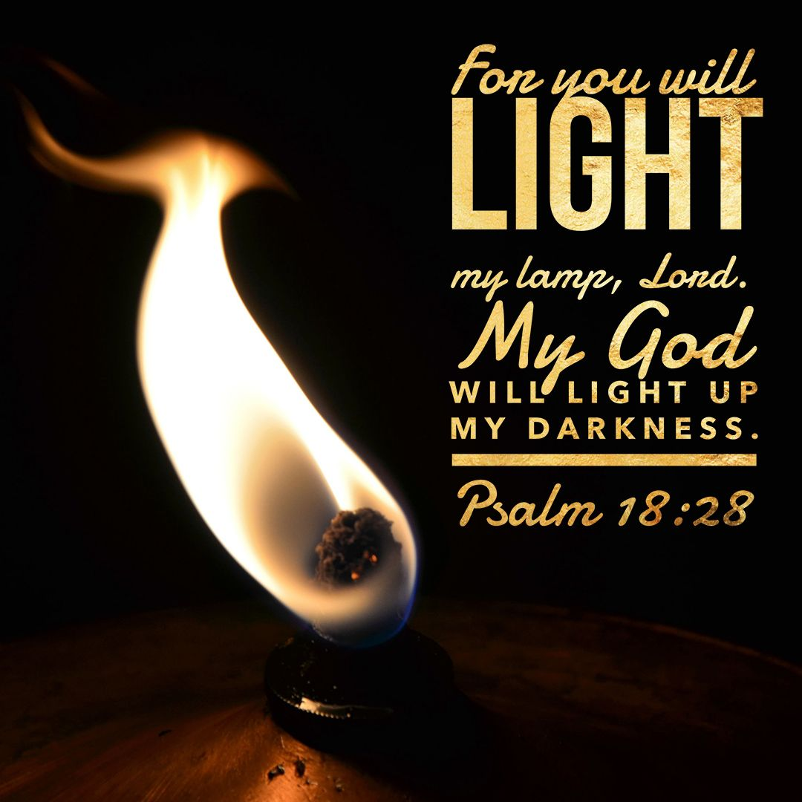
II. IT IS MY LIGHT AND LAMP (VS. 105-108)

Slide 29
105 Thy word is a lamp unto my feet, and a light unto my path.
Psalm 119:105 (KJV)
Notes:
Treasury - Psalm 119:105
(Christian Standard Bible)
word
Ps 19:8 — The precepts of the LORD are right, making the heart glad; the command of the LORD is radiant, making the eyes light up.
Ps 43:3 — Send your light and your truth; let them lead me. Let them bring me to your holy mountain, to your dwelling place.
Pr 6:23 — For a command is a lamp, teaching is a light, and corrective discipline is the way to life.
Eph 5:13 — Everything exposed by the light is made visible,
2Pe 1:19 — We also have the prophetic word strongly confirmed, and you will do well to pay attention to it, as to a lamp shining in a dark place, until the day dawns and the morning star rises in your hearts.
lamp
Ps 18:28 — LORD, you light my lamp; my God illuminates my darkness.
Job 29:3 — when his lamp shone above my head, and I walked through darkness by his light!

Slide 30
106 I have sworn, and I will perform it, that I will keep thy righteous judgments.
Psalm 119:106 (KJV)
Notes:
Treasury - Psalm 119:106
(Christian Standard Bible)
sworn
Ps 56:12 — I am obligated by vows to you, God; I will make my thank offerings to you.
Ps 66:13 — I will enter your house with burnt offerings; I will pay you my vows
Ps 66:14 — that my lips promised and my mouth spoke during my distress.
2Ch 15:13 — Whoever would not seek the LORD God of Israel would be put to death, young or old, man or woman.
2Ch 15:14 — They took an oath to the LORD in a loud voice, with shouting, with trumpets, and with rams' horns.
Ne 10:29 — join with their noble brothers and commit themselves with a sworn oath to follow the law of God given through God's servant Moses and to obey carefully all the commands, ordinances, and statutes of the LORD our Lord.
Ecc 5:4 — When you make a vow to God, don't delay fulfilling it, because he does not delight in fools. Fulfill what you vow.
Ecc 5:5 — Better that you do not vow than that you vow and not fulfill it.
Mt 5:33 — "Again, you have heard that it was said to our ancestors, You must not break your oath, but you must keep your oaths to the Lord.
2Co 8:5 — and not just as we had hoped. Instead, they gave themselves first to the Lord and then to us by God's will.
that I will
Ps 119:115 — Depart from me, you evil ones, so that I may obey my God's commands.
2Ki 23:3 — Next, the king stood by the pillar and made a covenant in the LORD's presence to follow the LORD and to keep his commands, his decrees, and his statutes with all his heart and with all his soul in order to carry out the words of this covenant that were written in this book; all the people agreed to the covenant

Slide 31
107 I am afflicted very much: quicken me, O LORD, according unto thy word.
Psalm 119:107 (KJV)
Notes:
Treasury - Psalm 119:107
(Christian Standard Bible)
afflicted
Ps 6:1 — LORD, do not rebuke me in your anger; do not discipline me in your wrath.
Ps 22:14-18 — I am poured out like water, and all my bones are disjointed; my heart is like wax, melting within me. 15 My strength is dried up like baked clay; my tongue sticks to the roof of my mouth. You put me into the dust of death. 16 For dogs have surrounded me; a gang of evildoers has closed in on me; they pierced my hands and my feet. 17 I can count all my bones; people look and stare at me. 18 They divided my garments among themselves, and they cast lots for my clothing.
Ps 34:19 — One who is righteous has many adversities, but the LORD rescues him from them all.
quicken
Ps 119:25 — My life is down in the dust; give me life through your word.
Ps 119:88 — Give me life in accordance with your faithful love, and I will obey the decree you have spoken.
Ps 143:11 — For your name's sake, LORD, let me live. In your righteousness deliver me from trouble,

Slide 32
108 Accept, I beseech thee, the freewill offerings of my mouth, O LORD, and teach me thy judgments.
Psalm 119:108 (KJV)
Notes:
Treasury - Psalm 119:108
(Christian Standard Bible)
Accept
Nu 29:39 — "Offer these to the LORD at your appointed times in addition to your vow and freewill offerings, whether burnt, grain, drink, or fellowship offerings."
Hos 14:2 — Take words of repentance with you and return to the LORD. Say to him: "Forgive all our iniquity and accept what is good, so that we may repay you with praise from our lips.
Heb 13:15 — Therefore, through him let us continually offer up to God a sacrifice of praise, that is, the fruit of lips that confess his name.
teach
Ps 119:12 — LORD, may you be blessed; teach me your statutes.
Ps 119:26 — I told you about my life, and you answered me; teach me your statutes.
Ps 119:130 — The revelation of your words brings light and gives understanding to the inexperienced.
Ps 119:169 — Let my cry reach you, LORD; give me understanding according to your word.

Slide 33
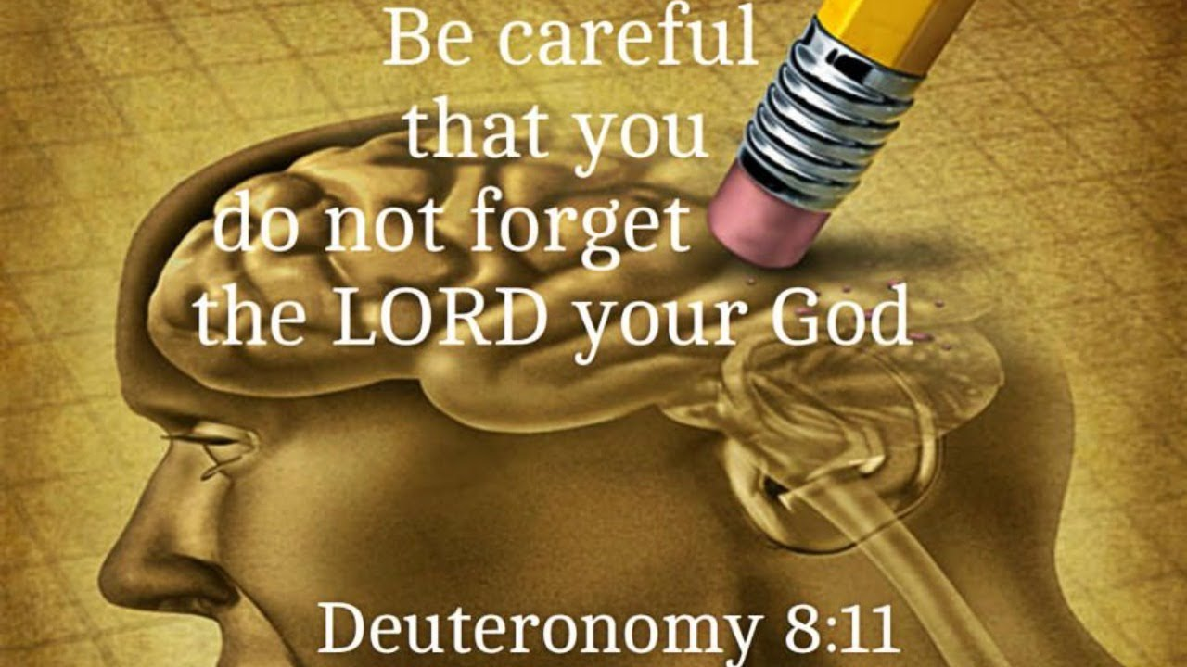
III. I DO NOT FORGET YOUR LAW (VS. 109-112)

Slide 34
109 My soul is continually in my hand: yet do I not forget thy law.
Psalm 119:109 (KJV)
Notes:
Treasury - Psalm 119:109
(Christian Standard Bible)
My soul
Jdg 12:3 — When I saw that you weren't going to deliver me, I took my life in my own hands and crossed over to the Ammonites, and the LORD handed them over to me. Why then have you come today to fight against me? "
1Sa 19:5 — He took his life in his hands when he struck down the Philistine, and the LORD brought about a great victory for all Israel. You saw it and rejoiced, so why would you sin against innocent blood by killing David for no reason? "
1Sa 20:3 — But David said, "Your father certainly knows that I have found favor with you. He has said, 'Jonathan must not know of this, or else he will be grieved.' " David also swore, "As surely as the LORD lives and as you yourself live, there is but a step between me and death."
Job 13:14 — I will put myself at risk and take my life in my own hands.
Ro 8:36 — As it is written: Because of you we are being put to death all day long; we are counted as sheep to be slaughtered.
1Co 15:31 — I face death every day, as surely as I may boast about you, brothers and sisters, in Christ Jesus our Lord.
2Co 11:23 — Are they servants of Christ? I'm talking like a madman ​— ​I'm a better one: with far more labors, many more imprisonments, far worse beatings, many times near death.
yet do I not
Ps 119:83 — Though I have become like a wineskin dried by smoke, I do not forget your statutes.
Ps 119:117 — Sustain me so that I can be safe and always be concerned about your statutes.
Ps 119:152 — Long ago I learned from your decrees that you have established them forever.

Slide 35
110 The wicked have laid a snare for me: yet I erred not from thy precepts.
Psalm 119:110 (KJV)
Notes:
Treasury - Psalm 119:110
(Christian Standard Bible)
wicked
Ps 119:85 — The arrogant have dug pits for me; they violate your instruction.
Ps 10:8-18 — He waits in ambush near settlements; he kills the innocent in secret places. His eyes are on the lookout for the helpless; 9 he lurks in secret like a lion in a thicket. He lurks in order to seize a victim; he seizes a victim and drags him in his net. 10 So he is oppressed and beaten down; helpless people fall because of the wicked one's strength. 11 He says to himself, "God has forgotten; he hides his face and will never see." 12 Rise up, LORD God! Lift up your hand. Do not forget the oppressed. 13 Why has the wicked person despised God? He says to himself, "You will not demand an account." 14 But you yourself have seen trouble and grief, observing it in order to take the matter into your hands. The helpless one entrusts himself to you; you are a helper of the fatherless. 15 Break the arm of the wicked, evil person, until you look for his wickedness, but it can't be found. 16 The LORD is King forever and ever; the nations will perish from his land. 17 LORD, you have heard the desire of the humble; you will strengthen their hearts. You will listen carefully, 18 doing justice for the fatherless and the oppressed so that mere humans from the earth may terrify them no more.
Ps 124:6 — Blessed be the LORD, who has not let us be ripped apart by their teeth.
Ps 124:7 — We have escaped like a bird from the hunter's net; the net is torn, and we have escaped.
Ps 140:5 — The proud hide a trap with ropes for me; they spread a net along the path and set snares for me. Selah
Ps 141:9 — Protect me from the trap they have set for me, and from the snares of evildoers.
Pr 1:11 — If they say ​— ​"Come with us! Let's set an ambush and kill someone. Let's attack some innocent person just for fun!
Pr 1:12 — Let's swallow them alive, like Sheol, whole, like those who go down to the Pit.
Jer 18:22 — Let a cry be heard from their houses when you suddenly bring raiders against them, for they have dug a pit to capture me and have hidden snares for my feet.
yet I erred
Ps 119:10 — I have sought you with all my heart; don't let me wander from your commands.
Ps 119:21 — You rebuke the arrogant, the ones under a curse, who wander from your commands.
Ps 119:51 — The arrogant constantly ridicule me, but I do not turn away from your instruction.
Ps 119:87 — They almost ended my life on earth, but I did not abandon your precepts.
Ps 119:95 — The wicked hope to destroy me, but I contemplate your decrees.
Da 6:10 — When Daniel learned that the document had been signed, he went into his house. The windows in its upstairs room opened toward Jerusalem, and three times a day he got down on his knees, prayed, and gave thanks to his God, just as he had done before.
Lk 20:19-26 — Then the scribes and the chief priests looked for a way to get their hands on him that very hour, because they knew he had told this parable against them, but they feared the people. 20 They watched closely and sent spies who pretended to be righteous, so that they could catch him in what he said, to hand him over to the governor's rule and authority. 21 They questioned him, "Teacher, we know that you speak and teach correctly, and you don't show partiality but teach truthfully the way of God. 22 Is it lawful for us to pay taxes to Caesar or not? " 23 But detecting their craftiness, he said to them, 24 "Show me a denarius. Whose image and inscription does it have? " "Caesar's," they said. 25 "Well then," he told them, "give to Caesar the things that are Caesar's, and to God the things that are God's." 26 They were not able to catch him in what he said in public, and being amazed at his answer, they became silent.

Slide 36
111 Thy testimonies have I taken as an heritage for ever: for they are the rejoicing of my heart.
Psalm 119:111 (KJV)
Notes:
Treasury - Psalm 119:111
(Christian Standard Bible)
Thy testimonies
Ps 119:14 — I rejoice in the way revealed by your decrees as much as in all riches.
Ps 119:127 — Since I love your commands more than gold, even the purest gold,
Ps 119:162 — I rejoice over your promise like one who finds vast treasure.
Ps 16:5 — LORD, you are my portion and my cup of blessing; you hold my future.
Dt 33:4 — Moses gave us instruction, a possession for the assembly of Jacob.
Isa 54:17 — No weapon formed against you will succeed, and you will refute any accusation raised against you in court. This is the heritage of the LORD's servants, and their vindication is from me." This is the LORD's declaration.
Ac 26:18 — to open their eyes so that they may turn from darkness to light and from the power of Satan to God, that they may receive forgiveness of sins and a share among those who are sanctified by faith in me.'
Col 1:12 — giving thanks to the Father, who has enabled you to share in the saints' inheritance in the light.
Heb 9:15 — Therefore, he is the mediator of a new covenant, so that those who are called might receive the promise of the eternal inheritance, because a death has taken place for redemption from the transgressions committed under the first covenant.
1Pe 1:4 — and into an inheritance that is imperishable, undefiled, and unfading, kept in heaven for you.
for they
Ps 119:74 — Those who fear you will see me and rejoice, for I put my hope in your word.
Ps 119:92 — If your instruction had not been my delight, I would have died in my affliction.
Ps 119:174 — I long for your salvation, LORD, and your instruction is my delight.
Ps 19:8 — The precepts of the LORD are right, making the heart glad; the command of the LORD is radiant, making the eyes light up.
Jer 15:16 — Your words were found, and I ate them. Your words became a delight to me and the joy of my heart, for I bear your name, LORD God of Armies.
1Pe 1:8 — Though you have not seen him, you love him; though not seeing him now, you believe in him, and you rejoice with inexpressible and glorious joy,

Slide 37
112 I have inclined mine heart to perform thy statutes alway, even unto the end.
Psalm 119:112 (KJV)
Notes:
Treasury - Psalm 119:112
(Christian Standard Bible)
inclined
Ps 119:36 — Turn my heart to your decrees and not to dishonest profit.
Ps 141:4 — Do not let my heart turn to any evil thing or perform wicked acts with men who commit sin. Do not let me feast on their delicacies.
Jos 24:23 — "Then get rid of the foreign gods that are among you and turn your hearts to the LORD, the God of Israel."
1Ki 8:58 — so that he causes us to be devoted to him, to walk in all his ways, and to keep his commands, statutes, and ordinances, which he commanded our ancestors.
2Ch 19:3 — However, some good is found in you, for you have eradicated the Asherah poles from the land and have decided to seek God."
Php 2:13 — For it is God who is working in you both to will and to work according to his good purpose.
perform
Ps 119:33 — Teach me, LORD, the meaning of your statutes, and I will always keep them.
Ps 119:44 — I will always obey your instruction, forever and ever.
1Pe 1:13 — Therefore, with your minds ready for action, be sober-minded and set your hope completely on the grace to be brought to you at the revelation of Jesus Christ.
Rev 2:10 — Don't be afraid of what you are about to suffer. Look, the devil is about to throw some of you into prison to test you, and you will experience affliction for ten days. Be faithful to the point of death, and I will give you the crown of life.

