Slide 1
Workshop - Flap System Setup

Slide 2
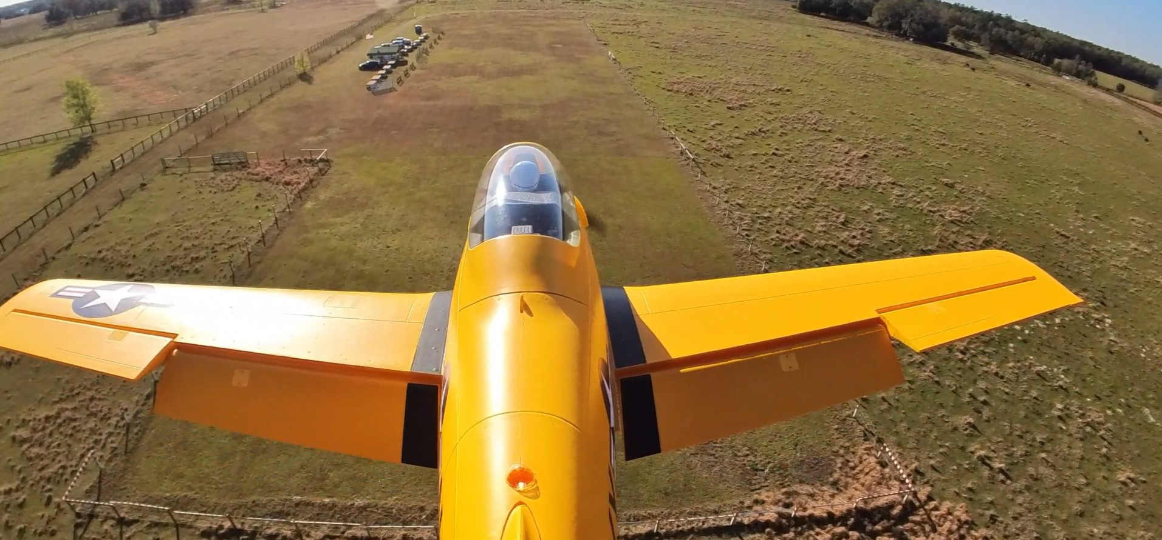
Discussion Agenda
What is Flap System and its intended uses?
Why use it? Pros & Cons
How to set it up.
Examples of how to use it.
Conclusion and Suggestions.
Bonus Item – Spectrum Programmer

Slide 3
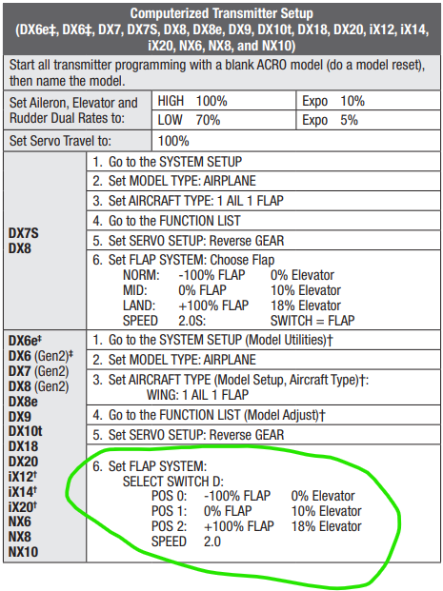
What is Flap System and its intended uses?
Flap System
Flap System is a transmitter configuration to employee inboard wing based Flaps.
It allows for pre-configuration of Flaps and Elevator rates and movement
Intended Uses
Shorten takeoff distance
Slow airspeed for landing
Help Modulate sink rate for landing

Slide 4
Why Use It – PROS & CONS
PROS
Shortens takeoff distance.
Slows landing speed and distance.
Helps to modulate consistent sink rate.
Facilitates way cool slow passes.
CONS
Can make tail draggers dig in because of prop wash over the flap surface lifting the tail.

Slide 5
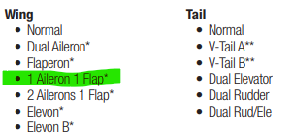
How To Set It UP

Slide 6
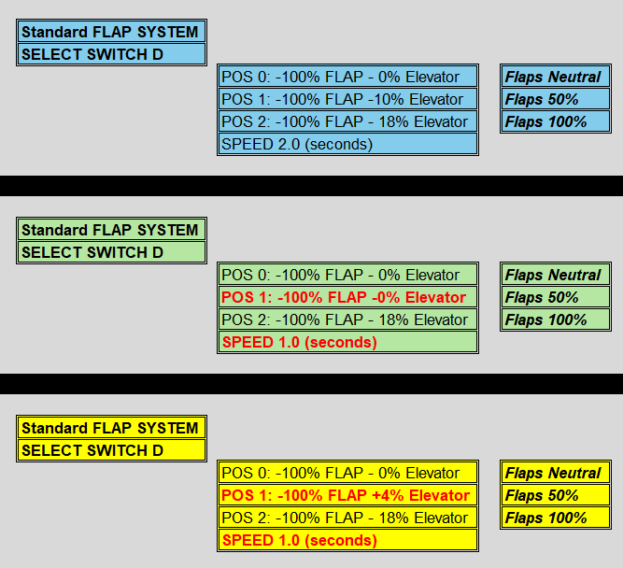
Setup Examples

Slide 7
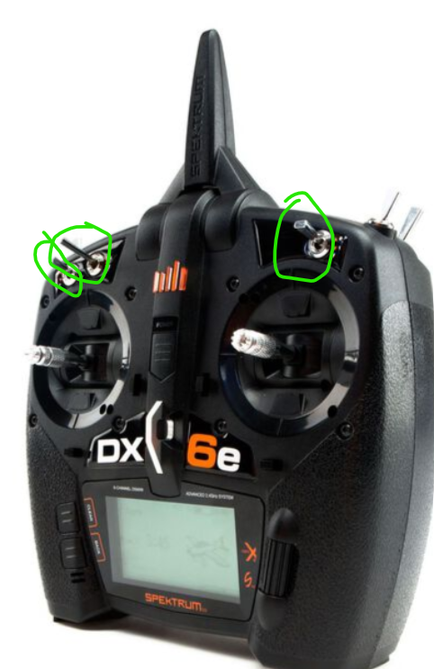
Conclusion and Suggestions
Use 3 way switches the same way for Flaps, Retracts, and Dual Rates – Example C,D,E are down for takeoff and landing and up for flight.
Set up all your planes the same or as close as possible so you don’t have to guess or remember settings.
Set FLAP DEPLOY SPEED between 1 and 2 seconds.
You don’t have to use 0%, 50%, 100%
Use experimentation
Your Mileage May Very

Slide 8
Q & A

