Slide 1
Principles Of Lean Manufacturing
Notes:
Revision: September 2016 – updated to 2015 impacts

Slide 2
Defining Lean
“A systematic approach to identifying and eliminating waste (non-value-added activities) through continuous improvement by flowing the product at the pull of the customer in pursuit of perfection.”
The MEP Lean Network
Notes:
Much information packed into this definition:
A systematic approach – not just a random application of tools
Identifying and eliminating waste
Continuous improvement
Flowing the product at the pull of the customer
In pursuit of perfection
_______________________________________________________________
_______________________________________________________________
_______________________________________________________________
_______________________________________________________________
_______________________________________________________________
_______________________________________________________________
_______________________________________________________________
_______________________________________________________________

Slide 3
Definition Of Value-Added
Value-Added
Any activity that increases the market form or function of the product or service. (These are things the customer is willing to pay for.)
Non-Value-Added
Any activity that does not add market form or function or is not necessary. (These activities should be eliminated, simplified, reduced, or integrated.)
Non-Value-Added but Required
Any non-value-added activity that is required by law, the customer, or the organization. (These activities should still be reduced, if possible).
Notes:
_______________________________________________________________
_______________________________________________________________
_______________________________________________________________
_______________________________________________________________
_______________________________________________________________
_______________________________________________________________
_______________________________________________________________
_______________________________________________________________
May want to mention the “3Cs” definition of value add:
Customer cares (is willing to pay for)
Changes the product or service
Correct the first time
For an activity to be considered value added, it must meet ALL THREE of the above

Slide 4
Lean = Eliminating Waste
Value-Added
Non-Value-Added
Defects
Over-production
Waiting
Non-utilized People
Transportation
Inventory
Motion
Extra Processing
Typically 95-99% of all lead time is non-value-added.
Notes:
_______________________________________________________________
_______________________________________________________________
_______________________________________________________________
_______________________________________________________________
_______________________________________________________________
_______________________________________________________________
_______________________________________________________________
_______________________________________________________________
“DOWNTIME” is an easy acronym to remember the 8 wastes, but some of the wastes may need better explanations:
“non-utilized people” means not using peoples Knowledge, Skills, and Abilities (KSA)
EXCESS inventory is a waste, SOME inventory is needed for a system to operate
Extra Processing is sometimes called “over-processing”

Slide 5
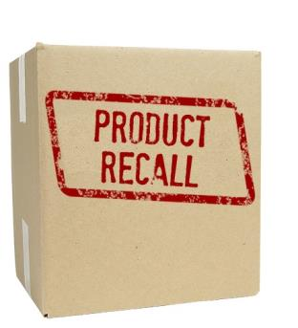
Defects
Inspection and repair of material in inventory
Causes of defects:
  Weak process control
  Poor quality
  Deficient planned maintenance
  Inadequate education/training/work instructions
  Product design
  Customer needs not understood

Slide 6
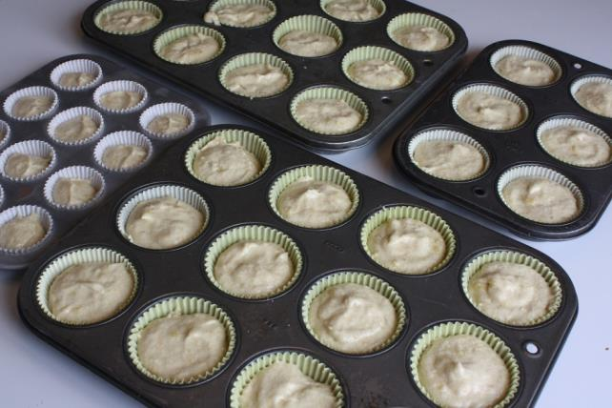
Over-production
Making more, earlier, or faster than is required by the next process
Causes of overproduction:
  Just-in-case logic
  Misuse of automation
  Long process setup
  Un-level scheduling
  Unbalanced workload
Notes:
The muffin tins are meant to show over-production: the muffin tin holds 12 muffins, so we always make 12 muffins – even if the customer only orders 1 or 2.

Slide 7

Waiting Waste
People or machine idle or waiting
Causes of waiting waste:
  Unbalanced workload
  Unplanned maintenance
  Long process setup times
  Misuses of automation
  Upstream quality problems
  Un-level scheduling

Slide 8

Non-Utilized People Waste
The waste of not using people’s mental, creative, and physical abilities
Causes of people waste:
    Old guard thinking, politics, the business culture
    Poor hiring practices
    Low or no investment in training
    Low pay, high turnover strategy
Notes:
Note that this is the 8th waste, added after the original 7 wastes created by Taiichi Ohno.
This waste may be harder to observe compared to excess inventory, waiting, etc.

Slide 9
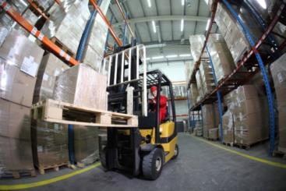
Transportation Waste
Transporting parts and materials around the plant
Causes of transportation waste:
  Poor plant layout
  Poor understanding of the process flow for production
  Large batch sizes, long lead times, and large storage areas
Notes:
Transportation = movement of the product, material, etc.

Slide 10
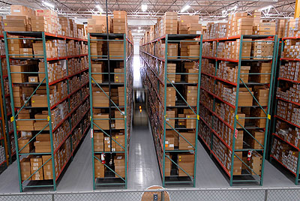
Inventory Waste
Any supply in excess of a one-piece flow through your manufacturing process
Causes of excess inventory:
  Need for buffer against inefficiencies and unexpected problems
  Product complexity
  Unleveled scheduling
  Poor market forecast
  Unbalanced workload
  Misunderstood communications
  Reward system
  Unreliable shipments by suppliers
Notes:
Assembly processes need some inventory to build, the waste is with excessive inventory.

Slide 11

Motion Waste
Any movement of people or machines that does not add value to the product or service
Causes of motion waste:
  Poor people/machine effectiveness
  Inconsistent work methods
  Unfavorable layout
  Poor workplace organization and housekeeping
  Extra “busy” movements while waiting
Notes:
Motion = human motion: reaching, twisting, bending, poor ergonomics, etc.

Slide 12
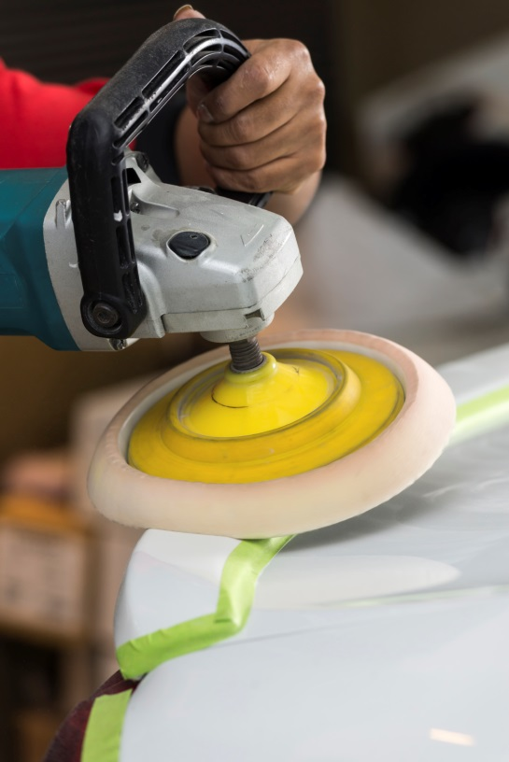
Extra Processing Waste
Effort that adds no value to the product or service from the customers’ viewpoint
Causes of processing waste:
  Just-in-case logic
  True customer requirements not clearly defined
  Mis-communication
  Redundant approvals
  Extra copies/excessive information
Notes:
Not all processing is waste, but “over-doing it” is a waste.
The waste is in over-processing: polishing a component well beyond what the customer needs or is willing to pay for, for example.

Slide 13
Lean Building Blocks
Continuous Improvement
Pull/Kanban
Cellular/Flow
TPM
Quality at Source
POUS
Batch Reduction
Stabilize Improve Optimize
Plant Layout
Quick Changeover
Teams
5S System
Visual
Standardized Work
Value
Stream
Mapping
Notes:
Modified CI House
Highlighted tools will be discussed next.
Stabilizing tools: 5S, visual controls, standardized work
Improving tools: Teams, plant layout, quick changeover, batch reduction, quality at the source, point of use storage
Optimizing tools: Pull/kanban, cellular/flow, TPM
In general, stabilizing tools should be applied first, then improving tools, then the advanced tools.

Slide 14
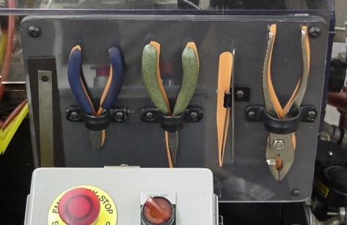
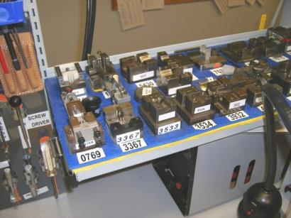
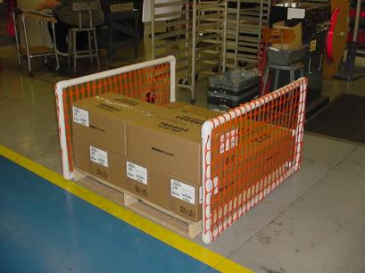
Work Place Organization (5S)
A safe, clean, neat arrangement of the workplace provides a specific location for everything, and eliminates anything not required.
Notes:
Left photo is of a tool board or shadow board.
Center photo has fixtures labelled plus the location on the workbench labelled.
Right photo is a visual for the location of pallet, also serves to warn people of empty pallet (tripping hazard). This is also a good example of “creativity before capital” (not spending lots of money on solutions). The pallet fence is constructed from PVC pipes and orange snow fence material available at hardware stores – probably $20 or less of material.

Slide 15
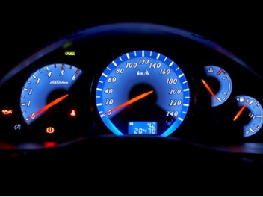
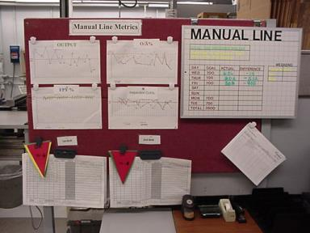
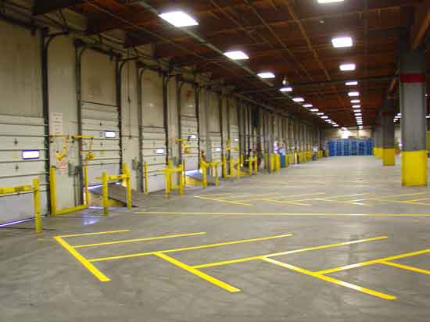
Visual Controls
Simple signals that provide an immediate understanding of a situation or condition. They are efficient, self-regulating, and worker-managed.
Examples:
  Color-coded dies, tools, pallets
  Lines on the floor to delineate storage areas, walkways, work areas, etc.
  Andon lights
Notes:
Added photos
Think of instrument panels in cars, highway signs, striping on roads, etc.

Slide 16
Plant Layout
QC
Ship
Raw Stock
Rec
Screw Machine
QC
Shear
Stamp
Lathe
Drill
Brake
Mill
Assembly
Weld
Grind
Finish
Parts Stock
Notes:
Typical plant layout is “functional” layout – areas grouped by function or department. This usually adds travel distance and introduces stopping points between each department that add to the overall lead time.

Slide 17
Lean Building Blocks
Continuous Improvement
Pull/Kanban
Cellular/Flow
TPM
Quality at Source
POUS
Batch Reduction
Stabilize Improve Optimize
Plant Layout
Quick Changeover
Teams
5S System
Visual
Standardized Work
Value
Stream
Mapping
Notes:
Modified house
Next set of tools to discuss is highlighted in yellow.

Slide 18
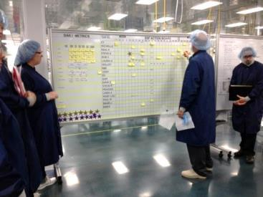
Lean Workforce Practices
Teams
  With rotation of highly specified jobs
  Cross-trained and multi-skilled employees
  Who can work many operations within a cell and operations in different cells
Continuous improvement philosophy
Process quality, not inspection
Use of participatory decision-making
  Quality Control Circles, team-based problem-solving, suggestion systems, etc.
Notes:
Photo shows a daily start up meeting – a short (~10 minutes) stand-up meeting on the factory floor to discuss job assignments, machine or part issues, etc.
See the book “Creating a Lean Culture” by David Mann for more information on “daily accountability meetings”

Slide 19
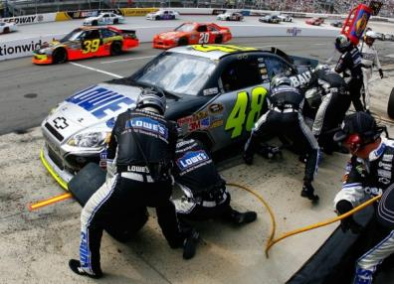
Quick Changeover
Definition: The time between the last good piece off the current run and the first good piece off the next run.
Before Shigeo Shingo’s Single Minute Exchange of Die (SMED) improvements, basic setup tasks and related time breakdowns:
Percent of time of changeover
Preparation, after-process adjustment, checking, storing and moving materials, parts, and tools
30%
50%
Removing and mounting of parts and tools
5%
Machine measurements, settings, and calibrations
15%
Trial runs and adjustments
Notes:
Think of racing pit stops. In NASCAR, teams can change 4 tires and fill the tank with fuel in less than 14 seconds. Even with 6 people doing the work, that is still less than 90 seconds on manpower. This is accomplished with specialized tools, training, and practice.

Slide 20
Impact Of Batch Size Reduction
• Batch & Queue Processing
Process
Process
Process
A
B
C
10 minutes
10 minutes
10 minutes
Lead
Time:
30+ minutes for total order
21+ minutes for first piece
• Continuous Flow Processing
Process
A
Process
B
Process
Process
A
B
C
12 min. for total order
3 min. for first part

Slide 21
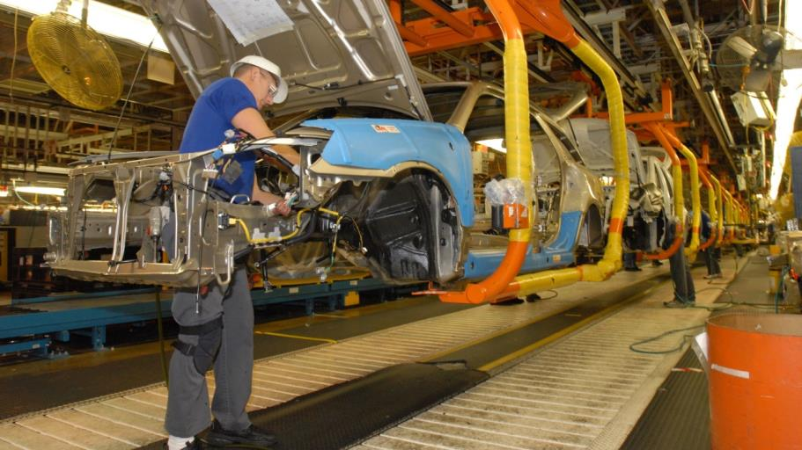
Batch Size Reduction
The best batch size is one piece flow, or make one and move one.
Notes:
Automotive assembly lines build in batches of one, sometimes with different models or even brands (Toyota and Lexus on same line).

Slide 22
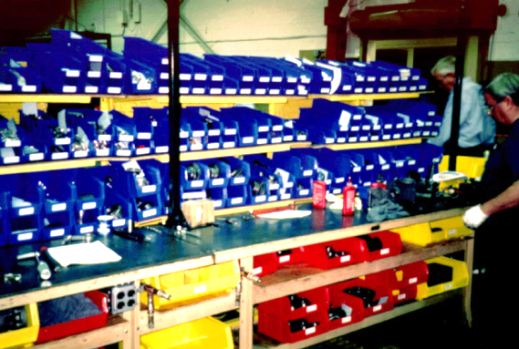
Point Of Use Storage (POUS)
Raw material is stored at workstation where used
Works best if vendor relationship permits frequent, on-time, small shipments
Simplifies physical inventory tracking, storage, and handling
Notes:
Make material easily accessible for the factory operator or person needing to use the material. Could be raw materials, sub-assemblies, tools, work instructions, etc.

Slide 23
Quality At The Source
Source Inspection:
  Operators must be certain that the product they are passing to the next work station is of acceptable quality.
  Operators must be given the means to perform inspection at the source, before they pass it along.
  Samples or established standards are visible.
  Process documentation defining quality inspection requirements for each work station may need to be developed.

Slide 24
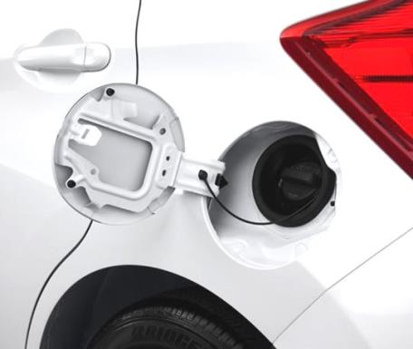
Quality At The Source
Mistake Proofing:
  The use of devices or methods that either make it impossible for an error to occur, or makes the error immediately obvious (ASQ definition).
Notes:
Gas cap tether is an example of a simple mistake proofing device.
Ask the class for other examples.
USB cord orientation, ground prong on electrical cords, etc.

Slide 25
Lean Building Blocks
Continuous Improvement
Pull/Kanban
Cellular/Flow
TPM
Quality at Source
POUS
Batch Reduction
Stabilize Improve Optimize
Plant Layout
Quick Changeover
Teams
5S System
Visual
Standardized Work
Value
Stream
Mapping
Notes:
Modified house

Slide 26
Push Vs. Pull Systems
Push System
  Resources are provided to the consumer based on forecasts or schedules
Pull System
  A method of controlling the flow of resources by replacing only what has been consumed

Slide 27
Pull System
Pull System is a flexible and simple method of controlling/balancing the flow of resources
  Eliminating waste of handling, storage, expediting, obsolescence, repair, rework, facilities, equipment, excess inventory (work-in-process and finished)
Pull System consists of:
  Production based on actual consumption
  Small lots
  Low inventories
  Management by sight
  Better communication

Slide 28
Pull System Flow Diagram
Information Flow
Part: A123
Qty: 1
Loc: FG102
Raw
Matl
Process
A
Process
B
Process
C
Fin.
Goods
Customer
Supplier
Part Flow
Kanban
Locations
Notes:
Added kanban card and boxed item to animation.

Slide 29
Cellular Manufacturing
Linking of manual and machine operations into the most efficient combination to maximize value-added content while minimizing waste.
Punch
De-burr
Cut to size
Package
Form
Sand

Slide 30
Total Productive Maintenance (TPM)
Systematic approach to the elimination of the six major equipment losses:
  Setup and adjustment
  Breakdowns
  Idling and minor stoppages
  Reduced speed
  Startup
  Defects and rework
Enlisting the participation of all employees to create an environment that fosters improvement efforts in safety, quality, cost, delivery, and creativity
Charting/analyzing equipment performance to identify root cause of problems, and implementing sustainable improvements
Notes:
It is costly to run equipment until failure. It is usually much more cost effective to take time up front and care for the equipment.
Think of car maintenance, regular oil changes, washing car, etc.

Slide 31


Benefits of Lean
Expect significant reductions in:
  Lead time
  WIP inventory
  Space requirements
Expect increases in:
  Productivity
  Quality
  Customer satisfaction
Notes:
Results will vary depending on the business and level of success.
50-75% reduction in leadtime is not uncommon

