Slide 1

IMIN Network
Standard Work Exercise – Draw a pig

Slide 2
Round 1
Grab a blank sheet of paper
In 2 minutes or less draw a pig
Go!

Slide 3
Round 2
Follow the provided work instruction and draw a pig on the grid paper provided
You have 2 minutes
Go!

Slide 4


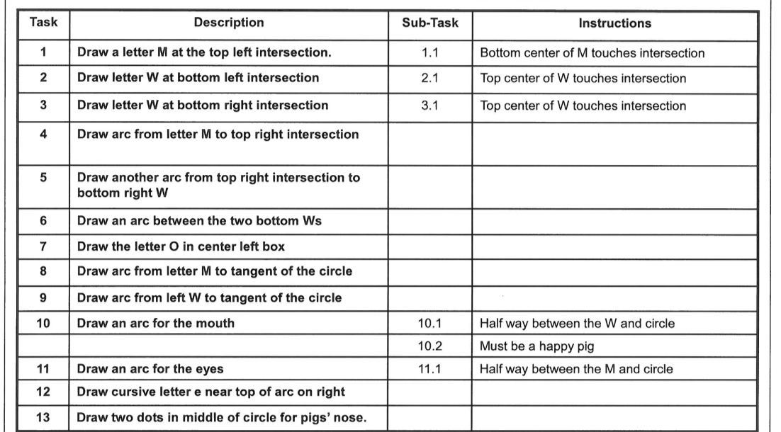

Slide 5
Round 3
Draw a pig using the provided work instructions and the image
You have 2 minutes
Go!

Slide 6
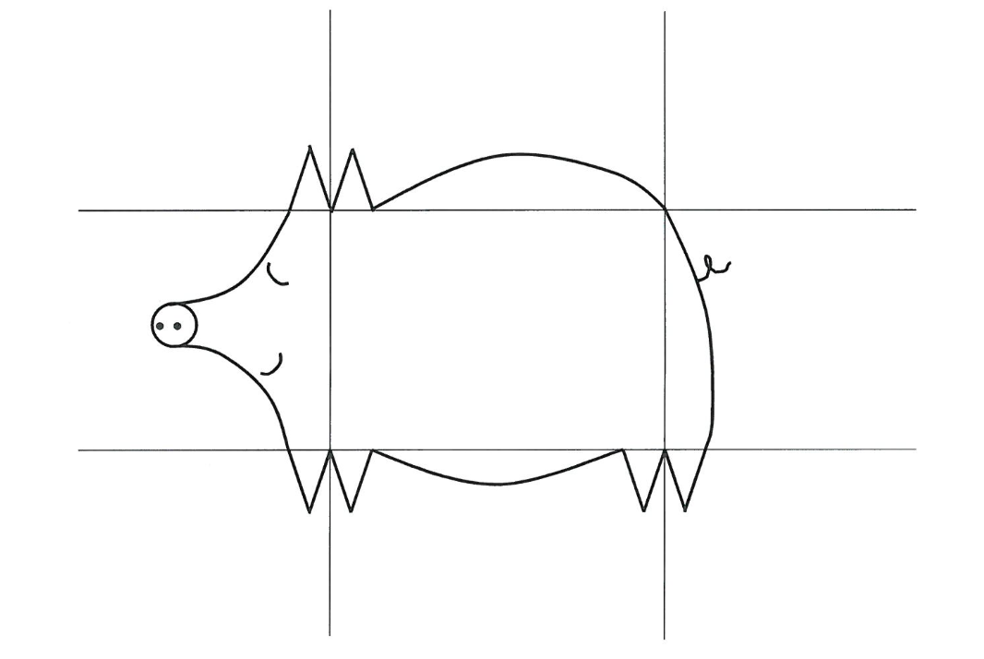
Pig Solution

Slide 7
Take-A-wAYS
What round did you find to be the easiest?
What do you notice about all of the drawings in round 1 vs. round 3?

