Slide 1
Lean Daily Management (LDM) March 20, 2017

Slide 2
Overview
Lean Daily Management (LDM) is the system that allows you to deliver customer value through proper support and leadership to those who are closest to the process (customers and process owners).
Some of the Lean Daily management elements which are commonly used are Leader Standard Work (LSW), visual control boards, and daily accountability.
The elements are not effective unless used with the right mindset - starting with effective lean management.

Slide 3
“Reality” of missed opportunity to sustain

Slide 4
Traditional vs. Lean Work Environment
Traditional
Complex
Management by status reporting
Push system
Just-in-case inventory
Batch production
Long lead time
Quality inspected in
Functionally managed
Lean
Simple and visual
Management by sight
Pull system
Inventory as needed
Single item or small lot size
Minimal lead time
Quality built in
Value stream managed
In a Lean system, abnormalities are easily seen

Slide 5
Traditional vs. Lean Leadership
Traditional
Staff meets goals set by leader
Leader plans
Information controller
Sole problem solver
Technical expert
Lean
Ensures team goals support vision
Direction setter (visionary)
Information conduit (sharing)
Facilitates ‘root cause’ analysis
Technical resource
Creating a culture of Problem Solvers

Slide 6
The Core of Lean Daily Management
Process Focus
Predictable Outcome
Lean Operating System
Assure Delivery & Minimum Cost
JUST IN TIME
Operate with the minimum resources required to consistently deliver:
Just what is needed.
In just the required amount.
Just where it is needed.
Just when it is needed.
Assure Product &
Process Quality
QUALITY
One-by-one confirmation to detect abnormalities.
Stop and respond to every abnormality.
Separate machine work from human work. Enable machines to detect abnormalities and stop autonomously.
Assure Safety and Morale
OBJECTIVES METHODS
PRINCIPLES
Act Plan
Develop Skills
Standard Work
Paced Production
Check Do
Minimal levels of material
Inventory
One - Piece Flow
Effective use of machines
Signal identifying abnormality
Produce only on demand
Level Production
5S / Visual Management
Continuous Cost Reduction Through The Elimination of Waste
Eliminate waste as it is revealed through inconsistent or unexpected results.

Slide 7
Lean Daily Management System
Leader Standard Work (LSW)
Visual Controls (Visual walls)
Lean Daily Management
Leadership
DISCIPLINE (Audits)
Daily Accountability
(Huddles/Tiered meetings)

Slide 8
Overview of LDM System Elements
Sustains Proper Behaviors
Effects All Levels of Management
Leader Standard Work
Status
Problem Tracking
Tier 3
Accountability Board
RESPONSIBILITY
Greg
Joe
Amy
Jim
Kim
James
Brett
Bad Part
Broke Tool
Andon
Leader Response

Slide 9
Leader Standard Work (LSW)
Provides a structure and routine for Leaders
Sets Standards for the Expected Behaviors of Leaders
Drives Accountability by Measuring “Actual versus Plan”
Director
Manager
Standard Work
What To Do When To Do it Was It Completed (if not-Why?)
Supervisor
Standard Work
Team Leader
Standard Work
Standard Work
What To Do
What To Do
When To Do it Was It Completed (if not-Why?)
When To Do it Was It Completed (if not-Why?)
What To Do When To Do it Was It Completed (if not-Why?)

Slide 10
Who Should Have Leader Standard Work?
Role | % of work time that should be standard | Responsibilities
Executives | 15% | Verify processes are improving
Value Stream Manager | 25% | Monitor and support Managers
Managers | 50% | Monitor and support Supervisors
Supervisors | 50% | Monitor and support team leaders
Team Leaders | 80% | Ensure operator standard work is followed
Operators (associates) | 95% | Used in performing task consistently
 | Standard work is more defined and specific in roles closest to the process

Slide 11
Leader Standard Work - Manager
Prepare for Team Meeting
Verify Self Checks and Successive Checks
Audit safety compliance items
Ensure all issues have been documented
Determine overtime requirements
Review production requirements
Audit cross-training plans

Slide 12
Leader Standard Work - Manager
Each layer of Management has a list of tasks / responsibilities
To complete in a particular Time Frame
That supports the function and improvement of the business
Promoting accountability and visibility

Slide 13
Leader Standard Work - Team Leader
Team Leader Standard Work
Name: | Area: |  |  |  |  |  |  | Date:
Start of Shift | Initial | Turn this form into your supervisor at the end of the day
Verify all TM's have proper PPE in place (Safety glasses/shoes, ear plugs)
Read TOS bit / Lead Stretches (Energy stretch routine)
Distribute TM's daily consumables |  | Issues (why was the std. work not followed): Each requires an A3 report
Unplanned absences noted and Supervisor notified
Status board filled out with Serial Numbers
Verify SWIP is complete and in the designated location
Each Takt Time (Check off when complete) | unit 1 | unit 2 | unit 3 | unit 4 | unit 5 | unit 6 | unit 7 | unit 8 | unit 9 | unit 10 | unit 11 | unit 12
Verify self and successive check sheets are complete and signed off
Verify Status Board completed and up-to-date
Respond to Andon calls within 30 seconds
Escalate to Supervisor: safety items, missing/late/non-conforming parts
All non-conforming parts (once tagged) delivered to QRB area
Verify certification sheets are signed off (Assy. only)
During Production
Verify TM's are following Standard Work Sequence (2 times per day)
Serial Number: |  |  |  | Model: |  |  |  | TM: |  |  | Yes/No:
Serial Number: |  |  |  | Model: |  |  |  | TM: |  |  | Yes/No:
Serial Number: |  |  |  | Model: |  |  |  | TM: |  |  | Yes/No:
At the End of Shift | Initial | COMMENTS / NOTES:
Ensure all extra parts are removed from the area
Verify 5S work was completed and signed-off by each TM
Verify SWIP is in place
Plan for next day (coverage for TM's planned time off)
Gemba walk with supervisor

Slide 14
Visual Controls
The purpose for visual controls is:
to focus on the process and
make it easy to compare actual vs. expected performance.
Visual Controls are an important enabler for disciplined focus on adherence to lean processes.

Slide 15
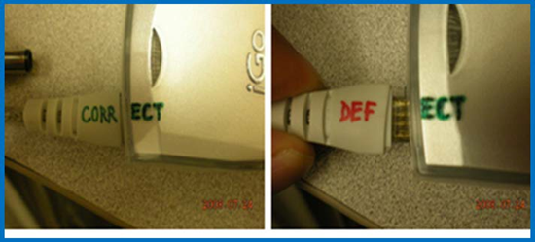
Visual Controls
Visual Controls highlight:
when the process is not performing as expected
where improvement might be needed enabling us to take immediate corrective actions.
Visual controls vary widely (charts, checks, dashboards, scorecards, display boards)

Slide 16
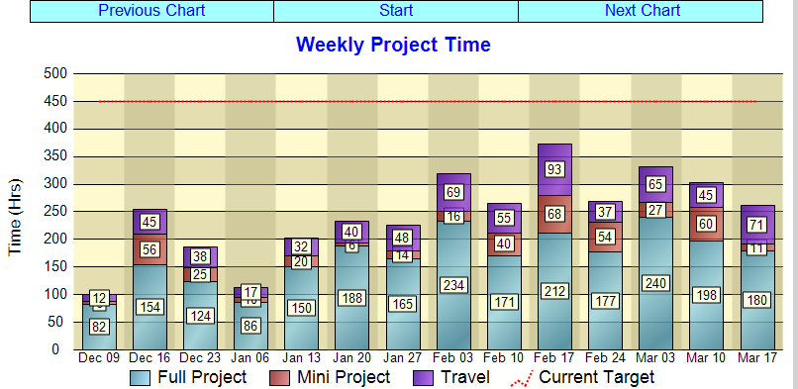
Visibility Wall
A visibility wall provides a permanent location to easily view the work of the organization
Posting categories could include quality, cost, delivery, safety and morale.
Each wall has:
a statement of purpose,
a communications section for the unit or value stream activities and
status of improvement ideas or projects.

Slide 17
Production Display Boards
An “at-a-glance” visual display of the status of the production/office area
Provides a way to quickly and easily see the status of processes
Helps bring focus to the process to drive improvements

Slide 18
Andon (Signal to Identify Abnormalities)
A signal to notify management and support personnel of a safety, quality, or process problem
The signal helps the team determine the root cause of the abnormality, defect, or delay in order to prevent a re-occurrence

Slide 19
Escalation Procedure
Structured series of steps to be followed whenever a team member (at any level) encounters an abnormal condition
Detect/Stop
Intermediate Fix
Escalation is used to raise the level of awareness and sense of urgency in the identification and rapid resolution of problems or issues in production
Countermeasure

Slide 20
Daily Accountability-Huddles
Daily huddles are team or cross-functional group meetings focusing on process status, identification of challenges
Benefit: Enable the team to raise and address issues as they occur, preventing larger problems from developing.
Huddles typically occur at the visibility wall at the same time each day.

Slide 21
Problem Tracking
Methodology to track issues that cause variation from a safety, quality, cost or delivery standard

Slide 22
Daily Accountability -Tiered Meetings
Three Separate but Interconnected Meetings:
Tier 1 - Team Leader with Team Members
Tier 2 - Supervisor with Team Leaders
Tier 3 - Manager with Supervisor(s) and support staff (possibly Director)

Slide 23
Tiered meetings: Standards / Content
Tier 1 – Team Leaders & Team Members | Tier 2 – Supervisors & Team Leaders | Tier 3 – Manager, Supervisor & Support
Safety PPE Injuries from previous period Attendance Backfill / X-training Delivery Schedule Line Stop from previous period Concerns This Period Materials / WIP Equipment / Tools Process / Methods | Safety Issues from previous period Attendance Plan for next period Delivery Schedule for next period Line Stop from previous period Plan vs. Actual from previous period Quality Issues from previous period Projects Done by Team / Move to Accnt. Board | Safety Safe Day previous period? Delivery Plan vs. Actual from previous period Conversions / RA from previous period Downtime from previous period Quality Direct Run from previous period First Pass Yield from previous period Units in Quarantine Abnormalities All un-planned events that effected the Daily PLAN

Slide 24
Leadership DISCIPLINE-Audits

Slide 25
Daily Accountability Board
Accountability reinforces the need to adhere to commitments
Ensures Timely Counter Measure Implementation
30, 60, 90 Day
Section
Name Department
Incoming Queue

Slide 26
Lean Daily Management Implementation
Leader Standard Work (LSW)
Visual Controls (Visual walls)
Identify the demand
Understand your
takt time (pace)
Understand your processes
Develop daily
Develop a
production board
Develop a response plan (escalation)
management processes
Lean Daily Management
Leadership
DISCIPLINE (Audits)
Daily Accountability
(Huddles/Tiered meetings)
Monitor problems
Monitor performance
Conduct daily stand-up meetings

Slide 27
Benefits
Helps provide data on where you are (actual) compared to where you want to go (planned)
Improves safety and morale plant wide
Assists with meeting customer demand
Improves process quality
Reduces process variation
Ensures effective problem solving
Helps standardize the way organizations manage their facilities
Ensures sustainability for improvement efforts

Slide 28
Lean Daily Management - Summary
Supports all principles of the Lean Operating/Business System
Ensures countermeasures are put into place for identified non- conformances
Process focused, people supportive
Allows for a reliable method for problem solving
Problems are more visual to allow quick action
Relies on Leader Standard Work to sustain correct behaviors
Gives transparency to management decisions

Slide 29
Questions?

Slide 30
How to Proceed
Identify the area
Determining rework vs. regrind
Communication in scheduling trucks
Missing late orders of production supplies
Accuracy of production data entered in the ERP system
Identify the persons responsible and accountable
Operators in the area
Team leads in the area
Supervisors
Managers
Value Stream or CI Manager
Executive
Develop Leader Standard Work Sheets – Checklists
*

Slide 31
How to Proceed
Develop Visual Controls – Production, quality, safety tracking for the area; charts, dashboards, scorecards, display boards, etc.
Locate a “Visibility Wall” - Could be in each area or a central location to all. Could consist of:
Production data
Andon visual indicators relating to performance
Escalation procedures for problem solving
Schedule daily huddles at the visibility wall with those in the area
Schedule the tiered meetings – Daily huddle could be considered the Tier 1 meeting
Develop leadership discipline audits – Perform random audits
Create and display at the Visibility Wall – Leadership discipline daily accountability board

Slide 32
Lean Daily Management Goals
Support Lean Principles
Minimal inventory
Lean Operating System
Assure Delivery & Minimum Cost
Assure Product &
Process Quality
QUALITY
One-by-one confirmation to detect abnormalities.
Stop and respond to every abnormality.
Separate machine work from human work. Enable machines to detect abnormalities and stop autonomously.
Assure Safety and Morale
JUST IN TIME
Operate with the minimum resources required to consistently deliver:
Just what is needed.
In just the required amount.
Just where it is needed.
Just when it is needed.
OBJECTIVES METHODS
PRINCIPLES
Act Plan
Develop Skills
Standard Work
Paced Production
Check Do
Minimal levels of material
Inventory
One - Piece Flow
Effective use of machines
Signal identifying abnormality
Produce only on demand
Level Production
5S / Visual Management
Continuous Cost Reduction Through The Elimination of Waste
Eliminate waste as it is revealed through inconsistent or unexpected results.

Slide 33
Visual Management
Exposes non-conformances
Allows for quick action
Plan vs. Actual
Assure Delivery & Minimum Cost
Lean Operating System
Assure Product &
Process Quality
Assure Safety and Morale
JUST IN TIME
OBJECTIVES METHODS
PRINCIPLES
QUALITY
One-by-one confirmation to detect abnormalities.
Stop and respond to every abnormality.
Separate machine work from human work. Enable machines to detect abnormalities and stop autonomously.
Operate with the minimum resources required to consistently deliver:
Just what is needed.
In just the required amount.
Just where it is needed.
Just when it is needed.
Develop Skills
Paced Production
Act Plan
Standard Work
Check Do
Minimal levels of material
Inventory
One - Piece Flow
Effective use of machines
Signal identifying abnormality
Produce only on demand
Level Production
5S / Visual Management
Continuous Cost Reduction Through The Elimination of Waste
Eliminate waste as it is revealed through inconsistent or unexpected results.

