Slide 1
“Talking About My Generation”
How Do we Make It Work?

Slide 2
What is your perspective?
Like the title, each generation talks about the next generations and are concerned about how they will do. And, they do ok.
There are some distinct generational differences, paradigms, and values.
Truth is probably some of both!
“Regardless of your generation or current phase of life, chances are you share the commonly held that your own peers’ recent lifecycle experiences are the norm.” Strauss and Howe

Slide 3
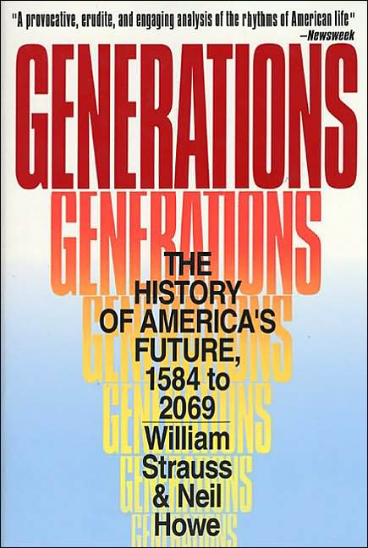
In 1991, William Strauss and Neil Howe published a groundbreaking book entitled, Generations The History of America’s Future, 1584 to 2069. Part sociology and part interpretation of history, it presents an interesting perspective on the idea of generations.

Slide 4
Generations Theory
The two cycle model of American history- every 80-90 years includes a “secular crisis” and a cultural “awakening”
A timing of the crisis and awakening shapes each generation, producing repeating characteristics
There are 4 identifiable generations in US history

Slide 5
Boomers (1943-1960)
Key Values/Terms Descriptors
Meaning Crusaders
Purpose Value centered
Inspired Individualists
Attractive Moralists

Slide 6
Gen X (1961-1981)
Key Values/Terms Descriptors
Proven Under protected children
Practical Challenge the institutions
Frank Disillusioned
Genuine Pragmatic

Slide 7
Millennial (1982-2002)
Key Values/Terms Descriptors
Integrity Optimistic (overly confident)
Team Team oriented
Helping Others Energetic
Personal Economic prosperity
Duty

Slide 8
Silent/Traditionalists/Gen Z (2002-??)
Key Values/Terms Descriptors
Pluralism Loyalty
Expertise Respect
Social Justice Status Quo
Obedience

Slide 9
Not Better or Worse But Different?
We are shaped by
  Our stage of life
  Our circumstances
  Our Generation
  What do we need to talk about and how do we have these conversations?

Slide 10
Sticking Points: Book written by Haydn Shaw looking at 12 “rub” points
Communication Loyalty
Decision Making Meetings
Dress Code Policies
Feedback Respect
Fun at Work Training
Knowledge Transfer Work Ethic

Slide 11
A Little Deeper Dig
Rather than tackling these individually (do on your own), I want to make a few general observations based on book and conversations.
  Work relationships: Millennials appear to be more relational. They want social connection, often prefer team environments, and resist process/structure. Collaboration and mutual respect are highly valued.
  They communicate differently. DUH! It’s 24/7 and they are always plugged in. They don’t want or need the official memo from “authority”. It’s more continuous and informal
  They expect to have many jobs/careers in their lifetime. It doesn’t mean they are less loyal or committed, just that they assume they will move on at some point.

Slide 12
Change the “about” to a “with”
The successful organizations will be the ones that talk with people, not to or about people. How do we do that?
Michael Stanier wrote an excellent book entitled, The Coaching Habit. He shares some research from a neuroscientist who claims that 5 times per second, we ask ourselves the same question.
The question:
          AM I SAFE?

Slide 13
Am I Safe?
Four Elements of Safety
  Tribe
  Expectations
  Rank
  Autonomy

Slide 14
Next?
Intentionally recruit and hire from the different generations
Have an onboarding strategy and plan
Pursue ongoing conversations around these sticking points
Keep an open mind about what you hear and how you do business

