Slide 1
Majoda Stables Our mission is to foster connection and well-being through creative horsemanship in an environment of love and trust.
Phone: (856) 231-7552
Main contact: Diane Baker – Hallowell
Website: MajodaStables.com
Social Media: Facebook: MajodaStables  Instagram: @majodastables  Youtube: MajodaStables
620 Garwood Road, Moorestown, NJ 08057
September 8, 2022

Slide 2
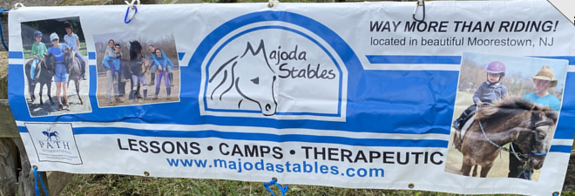
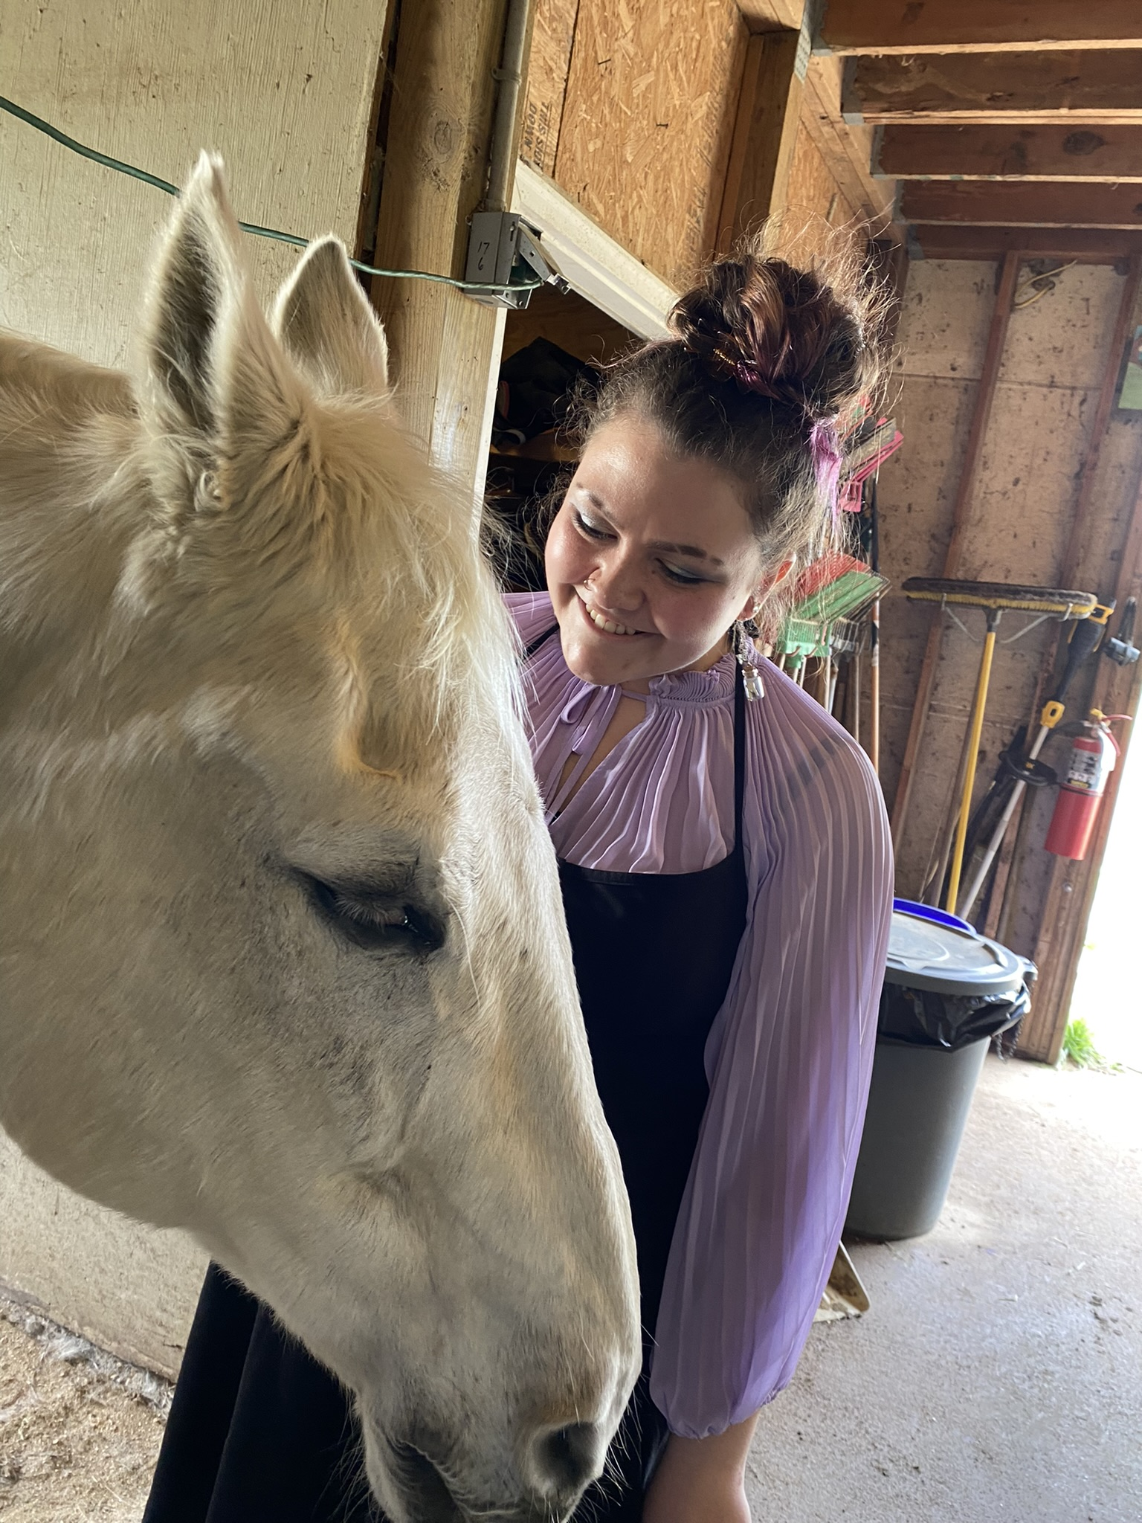
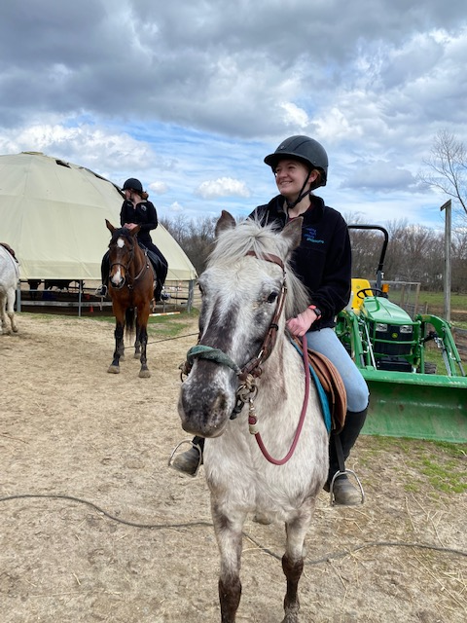
What Makes Majoda Stables Different?
Unique from many horseback riding facilities, Majoda is a casual, pressure-free, loving environment for people of any age and any ability who enjoy horses and want to be around them.
Our focus is on the love of horses, riding and barn life - not competition. Majoda teaches a healthy, holistic, community-centric approach to horsemanship centered on diversity, acceptance and inclusion.
No special equipment or clothing is needed (other than safely helmets, provided to our riders at no charge) We are happy in our jeans, leggings and rubber boots.
We’d love to tell you more about our approach to natural horsemanship and why so many people love it here at Majoda Stables.
Find out more, interviews, and questions:
Diane Baker – Hallowell – Owner/Operator
Vera Hallowell – Head instructor, Barn Manager
856-231-7552

Slide 3
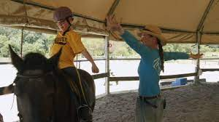
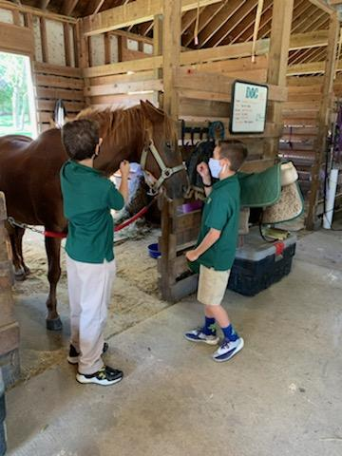
Majoda Stables is for Everyone
Traditional Riding
Barn life
Majoda Stables is so much more than riding lessons. All our riders learn work skills, horsemanship, and how to be responsible, accountable and safe around these sensitive, intelligent animals.
Majoda offers riding instruction from novice to advanced for all ages – preschooler through retiree. Majoda riders often expand their experience to advanced horsemanship, and many become part of brigade of dedicated volunteers.
Therapeutic Riding
For our clients with special needs, therapeutic riding experiences help build physical strength, self-confidence and a sense of accomplishment. Therapeutic riding is open to all ages with a wide range of disabilities. Many of our therapeutic riders began with Majoda as children, continue to ride in our therapeutic program as adults.

Slide 4
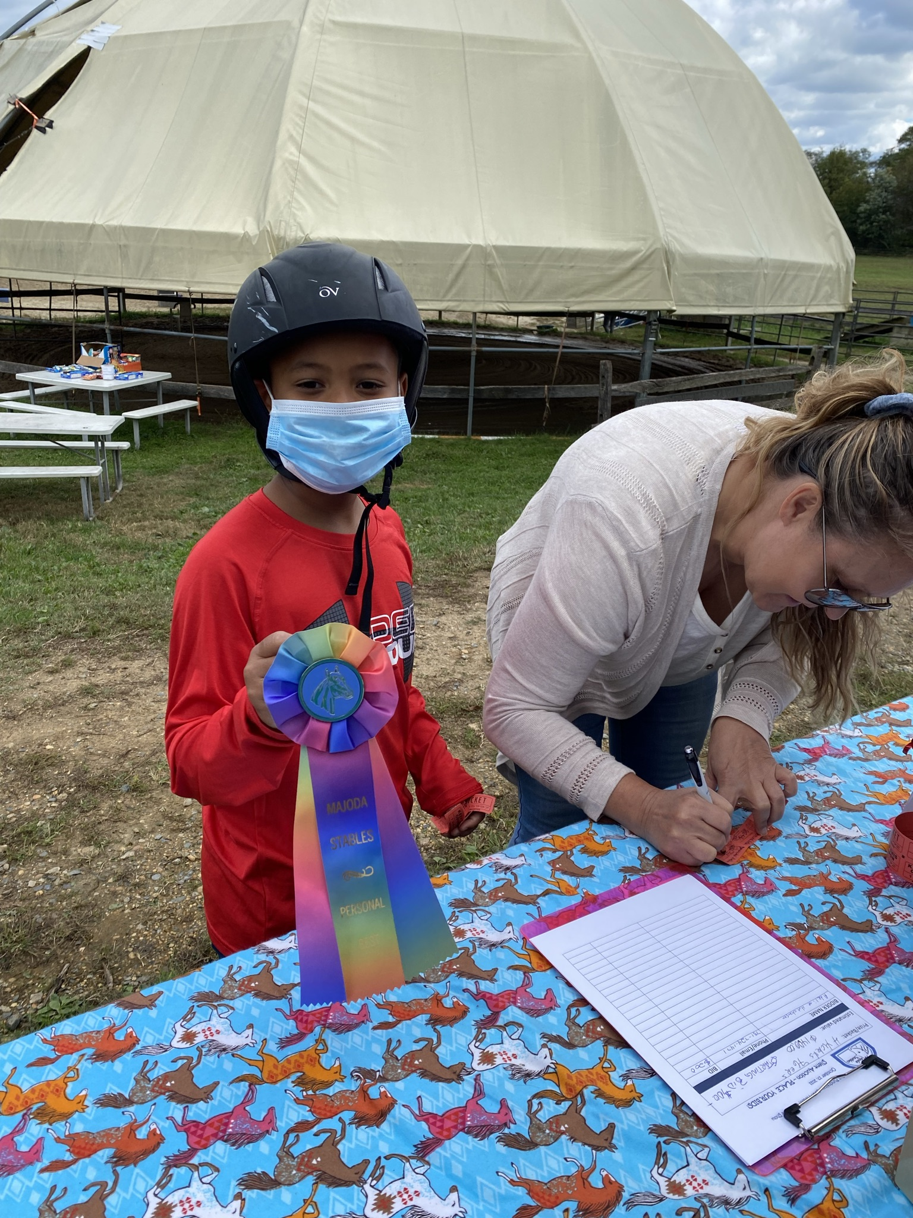
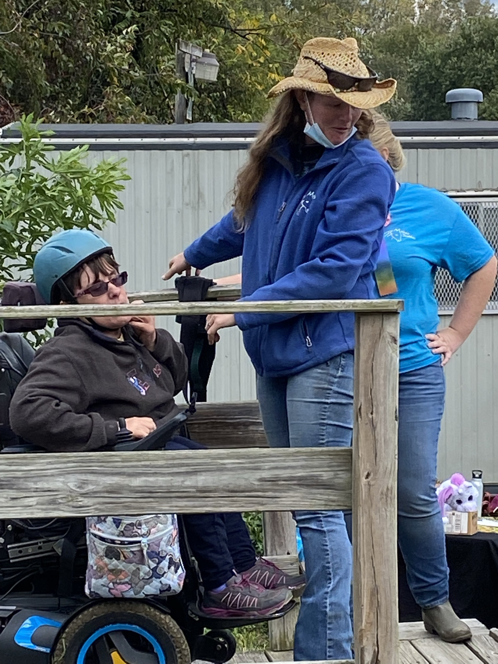
What is Equine Therapy/Therapeutic Riding?
Equine therapy is an experiential therapy using activities and interactions with horses. Making a personal connections with horses and the people who work with horses, helps develop empathy, improves socialization, and assists with impulse control. Equine therapy can be a powerful way to assist those with disabilities, brain injury, or mental illness to become the best versions of themselves, developing self-confidence, appropriate situational response and problem-solving skills while helping improve physical health and offering a sense of accomplishment. And its fun.
Majoda Stables is a certified PATH therapeutic equine facility.
PATH instructors complete a rigorous certification program to meet the standards of knowledge of disabilities, equines, teaching and human-animal interactions necessary to be effective as a therapeutic riding instructor.
To learn more:
https://pathintl.org/

Slide 5
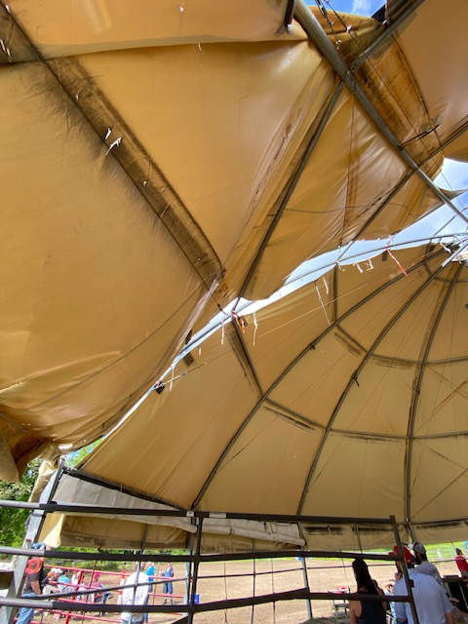
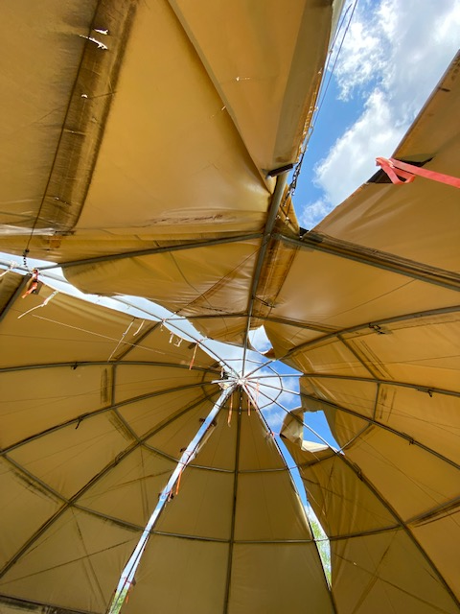
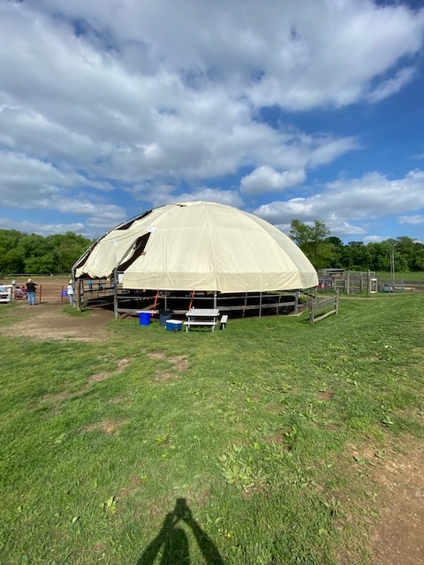
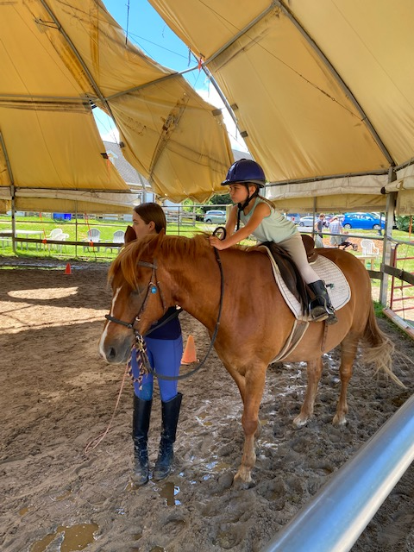
Please help us replace a ruined training pen
Majoda Stables can no longer offer a weather–protected environment for our riders. Earlier in 2022, the canvas roof of the round pen was irreparably damaged. Majoda is seeking a more permanent solution in the form of a Pole Barn - an open-air structure with a full roof and room for spectators.
The planned structure will protect riders and horses from rain, snow, and sun and keep the footing safe and dry. This is particularly important for therapeutic riders with sensitivity challenges.
The approximate cost of the structure is $150,000.00
We are in dire need of media support for our community and corporate outreach to help us raise funds for this critical teaching facility.
Learn more about this important project: https://majodastables.com/the-barn-fund
This entire section outlined in red has now been removed for the safety of horses, riders and instructors
Media contacts:
Diane Baker – Hallowell – Owner/Operator
Vera Hallowell – Head instructor and Barn Manager
856-231-7552

Slide 6
Events and Fun at Majoda Stables
There is always something fun happening at Majoda! We regularly host events that are just for fun (and funds!).
Our twice-annual open house in May and October is a chance for the community to visit and enjoy our farm, and activities. The open house features an inclusive horse show featuring our students, a selection of vendors, food trucks, music, barn visits and interaction with all our farm animals. Our advanced riders perform with professional dancers of the Equus Project. The silent auction and basket raffles are always a good-natured competition.
Movie nights: kids and adults are welcome to enjoy movies under the stars featuring family friendly entertainment of a “Horsey” nature
Dances and musical events– a more grown-up event featuring local musicians, dancing and refreshments.
Summer and holiday camp! Riding lessons on saddle and bareback, swimming pool, trail rides, horsemanship education, arts and crafts, costume parade and a lifetime of memories and friends.
Following us on social media or checking our website regularly will keep you informed of what’s on the event list and how you can participate or cover the event.

Slide 7
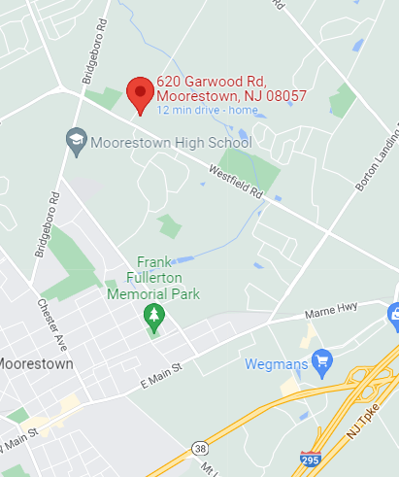
Facts about Majoda Stables
The Organization:
Founded in 1992 in Moorestown, NJ
5013c non-profit therapeutic riding facility
Funding: lessons, camp, events, sponsors
Ownership: Diane Baker- Hallowell
Board President: Renee Tralies
Current board members: 6
The Barn:
Horses: 14
Riding instructors: 6
Volunteers: ~20
Traditional lessons: Group or Individual
Therapeutic: Private lessons only
Press contact: Vera Hallowell or Diane Baker-Hallowell.
Days of operation: Monday – Saturday. Closed on Sunday
Barn manager: Vera Hallowell
Contact information:
Phone: (856) 231-7552
Main contact: Diane Baker – Hallowell
Website: MajodaStables.com
Social Media: Facebook: MajodaStables  Instagram: @majodastables  Youtube: MajodaStables
Media coverage:
6 ABC Philadelphia: https://6abc.com/new-jerseys-majoda-stables-provides-a-therapeutic-horse-riding-program-for-children-and-adults/5492073/
Kids out and about:
https://philly.kidsoutandabout.com/content/majoda-stables
6ABC and shelter me:
https://6abc.com/majoda-stables-horses-horse-rehab-new-jersey-moorestown/5791643/
Burlington County resource center:
https://www.burlingtonresourcenet.org/search/majoda-stables-therapeutic-riding-program/
Location: 620 Garwood Road, Moorestown, NJ 08057
Conveniently located about 30 minutes southeast of Center City Philadelphia, with easy access to I295, I95, Routes 70,73, 38 and 130 and the NJ Turnpike

