Slide 1
Improving School Climate to Support Student Achievement
Resiliency and ACEs

Slide 2
RESILIENCY
&
ACEs

Slide 3
Resiliency
“Resiliency can be defined as the capability to spring back, rebound, successfully adapt in the face of adversity, and develop social and academic competence despite exposure to severe stress…or simply the stress of today’s world.”
Nan Henderson / Mike Milstein

Slide 4
“ACEs” Research
ACES” Research
Adverse Childhood Experiences
Day-to-day trauma…Birth through age 18; Everything is additive

Slide 5
Meeting a Bear in the Forest
Fight or Flight response
Necessary/positive stress
  Adrenalin
  Cortisol
Tolerable Stress
  We get through because of supportive relationships
Toxic Stress/Trauma
  No supportive relationships
  Overactive stress responses

Slide 6
The Brain Control Systems
Children without trauma are governed by their Neocortex
Traditional
Methods work
in this portion
of the brain
Motivation, Emotion, Arousal & Pain
Children WITH trauma are
governed by their Mid-Brain
& their Reptilian Brain…where the problem lies

Slide 7
ACEs SCALE LEARNING TASK I
Using the ACEs Scale assess your own ACEs score…Only if you wish
  From Birth to your 18th Birthday
Write your score (a number only) on a yellow post-it note
Place the note in the bag for posting on the number line

Slide 8
ACEs SCALE LEARNING TASK II
Think of a specific child that has significant behavior issues
Using the ACEs Scale with only as much information as you know informally, come up with an ACEs score
Write that score on a colored post-it note
We will add these to our number line

Slide 9
Maslow’s Hierarchy of Needs

Slide 10
Maslow’s Hierarchy of Needs
xxxxxxxxxxxxxxxxxx

Slide 11
Maslow & Children with Trauma

Slide 12
Development is Hierarchical
Children cannot be expected to begin “on the fifth floor” if they never entered the first floor and moved up to each level before.
Help for Billy: A Beyond Consequences Approach to Helping Challenging Children in the Classroom, p. 41
Heather T. Forbes, LCSW

Slide 13
Growing Brains With Trauma
Children who grow up in safe and healthy environments with loving and supportive care givers come to school and community settings with all of the necessary “pieces” to deal with challenges; Children with trauma have an incomplete set of “pieces” to help them with the same kind of challenges.

Slide 14
ACEs Score of 4+: Changes Begin
In schools & community settings, it is 32+ times more likely to have learning and behavior issues
  Acting out in school, afterschool settings, etc.
  Calling out in class, teams, groups, etc.
  Running out of class, programs, etc.
  Hitting someone near student
  Can’t pay attention
  Impulse control problems
  Difficulty regulating behavior
Typically, in schools, Friday is the worst day at school for acting out, followed by Monday
  Having to leave the relative safety of school (on Friday) and re-entering the school routine from more chaotic weekends (on Monday)

Slide 15
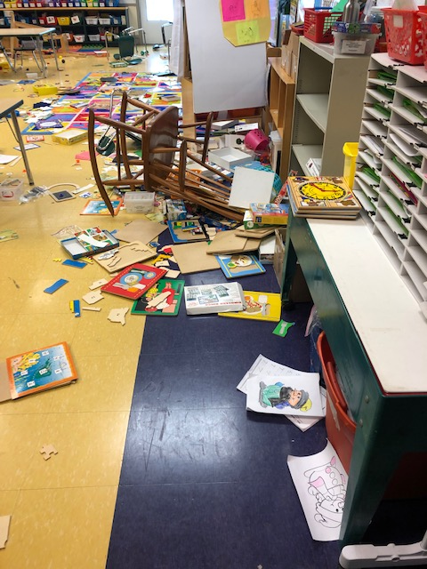
What Trauma Looks Like

Slide 16
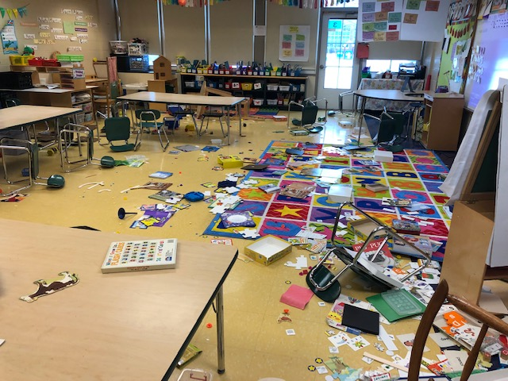
What Trauma Looks Like

Slide 17
Window of Stress Tolerance
Breaking Point
- - - - - - - - - - - -xmm
m
x- - - - - - - - - - - -x
Window of Stress Tolerance for Child without Trauma
Window of Stress Tolerance for Child with Trauma

Slide 18
Which Children Need Attention
We should worry about children who are misbehaving
We should also worry about children who are quiet and/or are over-achievers
  Smart/wise children withdraw in hopes of avoiding more adversity
  These children are wonderful at “masking” their difficult lives
We should be concerned about all children, really
ACEs does not discriminate…this has nothing to do with race, culture, gender, etc.
  Every zip code contains ACEs

Slide 19
BEAR-FREE ENVIRONMENTS!!!
No “Bears” in settings we can design and control
  School
  Offices
  Community Programs
  Homes
  Anywhere!!...

Slide 20
Environments: NO Bears
Every office, classroom, hallway, cafeteria, playground, parking lot, bus stop, playing field, locker room, etc., should be:
  Physically safe
  Emotionally safe
  Culturally safe
  Intellectually safe
  Predictable and consistent
    No surprises
    Understood and expected routines

Slide 21
Variety of Treatments: Building Resilience
Reduce dose of adversity
  Find out family/environment issues
  No bears in offices, school and community settings!!
Build high quality trusting relationships
Universal screening for ACEs at all well-child visits
Find ACEs score and symptoms
Mindfulness/meditation
Nutrition/Exercise
Sleep hygiene
Education around ACEs
Therapy

Slide 22
Dr. Ken Ginsburg
“When working with trauma-impacted students, we must reach their hearts before we can reach their heads.”

Slide 23
The Necessary Elements for Change
Healthy Adult-Child relationships
Regulated Environment
Meeting Children’s Emotional Needs
Reducing the Stress That Leads To Being Overwhelmed
Chance for Change

Slide 24
Children With Trauma Need….
+
+
Kindness, trust, safety & predictability
Clear expectations, rules & boundaries

Slide 25
Resiliency Factors
In your small table groups, sort the provided cards:
Does the card represent a
Skill, Opportunity or Support that has been shown to help youth thrive in spite of life’s challenges?
YES or NO
“resiliency”

Slide 26
Resiliency: Protective Factors
Careers (hopes and dreams for the future)
Hobbies and interests
Life Skills (responsibility, decision-making, etc)
Making Connections and Being Mentored
Participation at School, Church and Community
Problem-Solving and Information Skills
Reading
Social Skills
Taking Care of others and
Volunteering

Slide 27
Skills, Opportunities & Supports
Sort the same cards into 3 piles:
those representing Skills,
those representing Opportunities,
those representing Supports

Slide 28
The Research Says…
When we look at the original research on resiliency in youth, 70%* of the young people named one of the listed factors as the most important factor in helping them deal with life’s challenges and thrive in spite of these challenges.
* A huge number in research terms
Which factor of these 9 was it?

Slide 29
Resiliency: Protective Factors
Careers (hopes and dreams for the future)
Hobbies and interests
Life Skills (responsibility, decision-making, etc)
Making Connections and Being Mentored
Participation at School, Church and Community
Problem-Solving and Information Skills
Reading
Social Skills
Taking Care of others and
Volunteering
We are not born with resiliency factors…they get built over time

Slide 30
Our Factors
As a small group, rank the resiliency factors 1 to 9:
1 - the factor that schools typically do the best job in teaching & providing opportunities for, to
9 – the factor that schools typically have the most challenges in teaching & providing opportunities for

Slide 31
Now What?
In your small table groups, reflect on the information from Youth as Resources and Resiliency.
Consider opportunities for youth to be resources in your schools, focusing on one resiliency factor area. Each table will take a different resiliency factor. Record your responses on a piece of flip chart paper.

Slide 32
Resiliency: Protective Factors
Careers (hopes and dreams for the future)
Hobbies and interests
Life Skills (responsibility, decision-making, etc)
Making Connections and Being Mentored
Participation at School, Church and Community
Problem-Solving and Information Skills
Reading
Social Skills
Taking Care of others and
Volunteering

