Slide 1
Restorative Practices; Diversity
Yenny Toone

Slide 2
Family Centers ECE Mantra

Slide 3
After doing the training….we tasked ourselves with the responsibility of ensuring children learned about acceptance of all people

Slide 4
So the brainstorming began

Slide 5
-We assessed our classrooms for needs -We reviewed our lesson plans …We realized that we had some activities, and some materials...but was it really woven into the fabric of all we do?
Honest Conversations

Slide 6
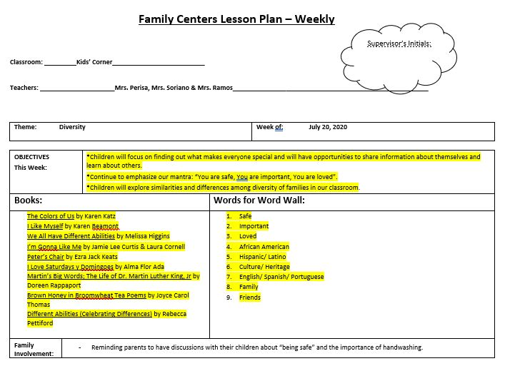
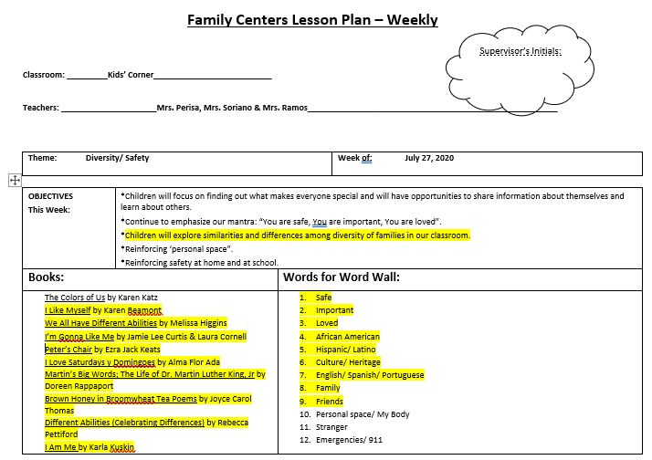
Lesson Plans

Slide 7
Enhanced our stock of classroom materials -Muilti Cultural Puppets -Multi Cultural Crayons & Markers -Muti Culture Dolls -Multi Cultural Manipulative toys & figures -Multi cultural Puzzles & Games -Mirrors
Materials, materials, materials….

Slide 8
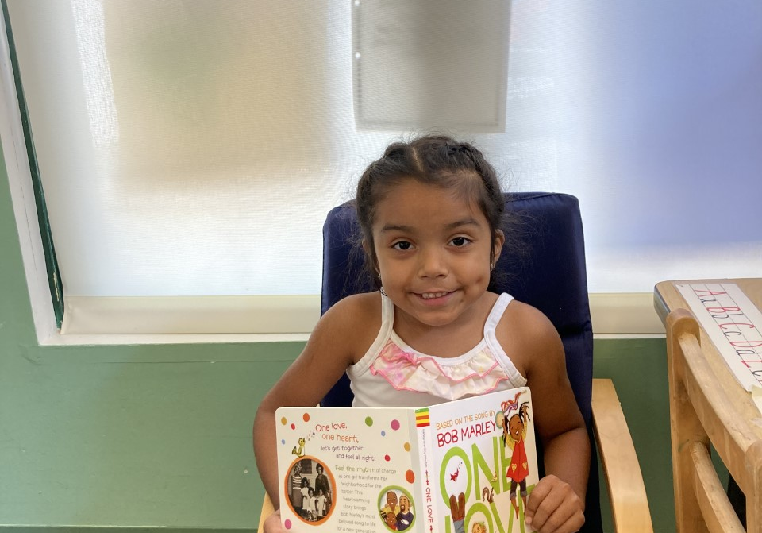
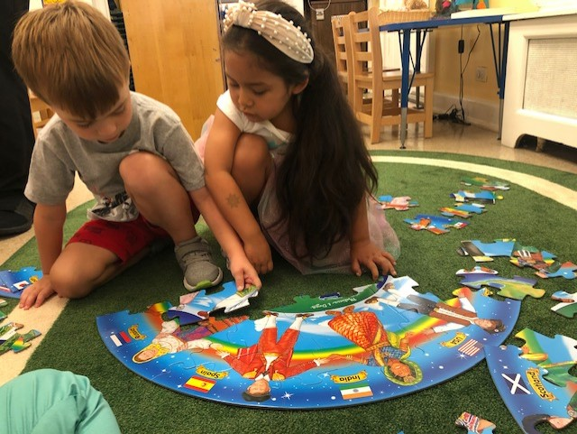
Books & Giant Puzzles

Slide 9
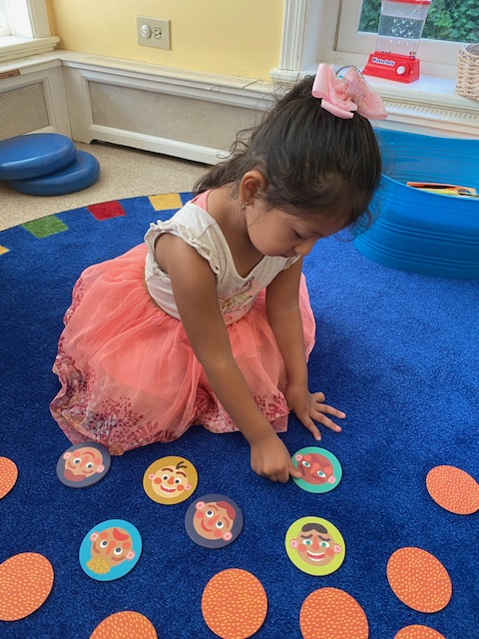
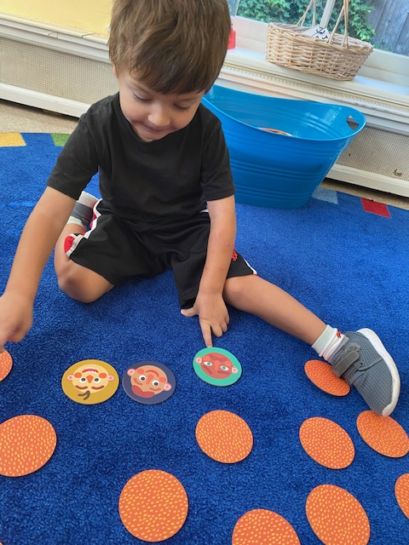
Matching/Memory Games

Slide 10
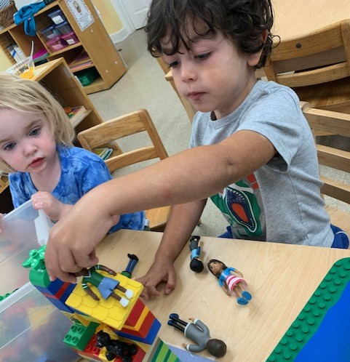
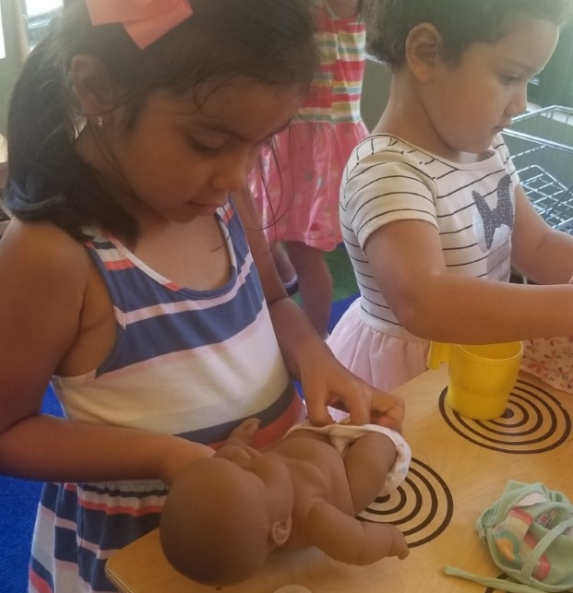
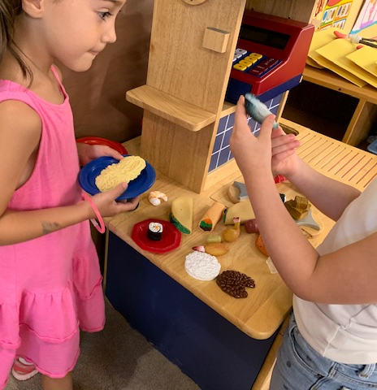
Dolls, Figurines and Foods

