Slide 1
Declutter for lent
Welcome

Slide 2
REVIEW AND START
FIRST SPIRITUAL DISCIPLINE
Deep breathing
OPENING PRAYER
REVIEW
3x – in through the nose/hold
Out through the mouth
Pastor Brenda

Slide 3
Be still and know that I am God. Be still and know that Jesus is Lord. Be still and know God’s Word is here.

Slide 4
WEEK THREE SABBATH
How did we “do” Sabbath this week?
Give examples.

Slide 5
WEEK THREE Declutter your schedule (Sabbath)
Psalm 90:12 Prayer:
Teach me, O God,
to make the most of my time,
so that I may grow in wisdom.
(DID WE USE THIS, THIS WEEK?)

Slide 6
DECLUTTERING FOR LENT WEEK FOUR
DECLUTTERING our minds –
Emotions, Relationships, Forgiveness
Slides for Week 3 are posted on the website.
Slides for Week 4 are posted as well.

Slide 7
DECLUTTERING FOR LENT WEEK FOUR – DECLUTTERING our minds Emotions, Relationships, Forgiveness
Matthew 11:28-30 (NIV)
²⁸ “Come to me, all you who are weary and burdened, and I will give you rest. ²⁹ Take my yoke upon you and learn from me, for I am gentle and humble in heart, and you will find rest for your souls. ³⁰ For my yoke is easy and my burden is light.”

Slide 8
DECLUTTER OUR MINDS Emotions, Relationships, Forgiveness
EMOTIONS

Slide 9
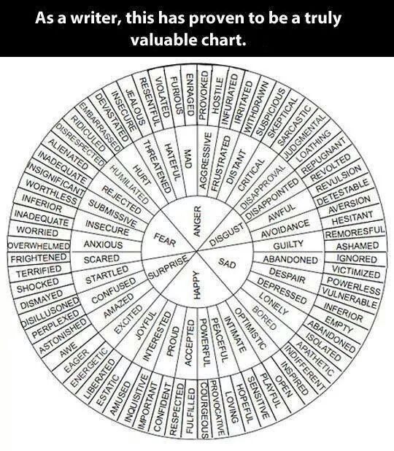
EMOTION WHEEL
Give words to the emotions.
Recognize primary versus secondary emotions
Common emotions known to trigger anger are anxiety, shame, sadness, fear, frustration, guilt, disappointment, worry, embarrassment, jealousy, and hurt. All of these emotions are experienced as negative and are perceived as threatening to our well-being.

Slide 10
DECLUTTER OUR MINDS Emotions, Relationships, Forgiveness
Our stuff
Other people’s stuff with guilt attached
Psychology Today – 5 hours per week feeling guilty
WHY?

Slide 11
DECLUTTER OUR MINDS Emotions, Relationships, Forgiveness
RELATIONSHIPS
Of the Road Of the Heart

Slide 12
DECLUTTER OUR MINDS Emotions, Relationships, Forgiveness
RELATIONSHIPS
Of the Road Of the Heart
We want to control so we don’t get hurt…

Slide 13
DECLUTTER OUR MINDS Emotions, Relationships, Forgiveness
What is forgiveness?

Slide 14
DECLUTTER OUR MINDS Emotions, Relationships, Forgiveness
What is forgiveness?
1. Begins at the cross – In Christ’s birth, death, and resurrection you gain forgiveness of all your sin. And so does everyone else! We forget that part!

Slide 15
DECLUTTER OUR MINDS Emotions, Relationships, Forgiveness
What is forgiveness?
Begins at the cross – In Christ’s birth, death, and resurrection you gain forgiveness of all your sin. And so does everyone else! We forget that part!
Is a process. Why?

Slide 16
DECLUTTER OUR MINDS Emotions, Relationships, Forgiveness
What forgiveness is “not”?
RECONCILIATION

Slide 17
DECLUTTER OUR MINDS Emotions, Relationships, Forgiveness
What forgiveness is “not”?
RECONCILIATION
ACCEPTANCE

Slide 18
DECLUTTER OUR MINDS Emotions, Relationships, Forgiveness
What forgiveness is “not”?
RECONCILIATION
ACCEPTANCE
EXONERATION

Slide 19
DECLUTTER OUR MINDS Emotions, Relationships, Forgiveness
What forgiveness is “not”?
RECONCILIATION
ACCEPTANCE
EXONERATION
PARDONING

Slide 20
DECLUTTER OUR MINDS Emotions, Relationships, Forgiveness
Two kinds of forgiveness
DECISIONAL

Slide 21
DECLUTTER OUR MINDS Emotions, Relationships, Forgiveness
Two kinds of forgiveness
DECISIONAL
EMOTIONAL

Slide 22
DECLUTTER OUR MINDS Emotions, Relationships, Forgiveness
HOW do we forgive?
R E A C H

Slide 23
DECLUTTER OUR MINDS Emotions, Relationships, Forgiveness
HOW do we forgive?
R – Recall
E – Empathize
A – Altruism
C – Commitment
H – Hold onto your forgiveness in Christ

Slide 24
DECLUTTER OUR MINDS Emotions, Relationships, Forgiveness
Why spend so much time on this?
Jesus spends most time talking about MONEY.
Second - Forgiveness

Slide 25
DECLUTTER OUR MINDS Emotions, Relationships, Forgiveness
Unknown – Paralyzed man (Mt 9:1-8)
Specific – Woman caught in adultery (John 4)
Faith – Peter denied Christ (Luke 22:54-65)
Faith – teaching disciples (Luke 15:11-32; Luke 17:1-10)
Known – Criminal on the cross (Luke 23:40)
WOW – People who crucified Christ (Mt 27:35-44)
Financial– (Rom 13:8-14 – no debt outstanding); unforgiving debtor (Mt 18:21-35)

Slide 26
DECLUTTER OUR MINDS Emotions, Relationships, Forgiveness
ULTIMATE: The Lord’s Prayer
Give us
Then forgive us

Slide 27
DECLUTTER OUR MINDS Emotions, Relationships, Forgiveness
Good Friday Blackness
Veil of Unforgiveness
Trinity raise the veil of unforgiveness
Father – God loved the world and sent His Son (God is the author of love)
Son – death on the cross
Holy Spirit – helps us forgive despite our warped memories and inaccurate thinking

Slide 28
DECLUTTERING FOR LENT
Our hearts and minds desire clarity. We like to have a clear picture of a situation, a clear view of how things fit together, and clear insight into our own and the world’s problems. But just as in nature colors and shapes mingle without clear-cut distinctions, human life doesn’t offer the clarity we are looking for. The borders between love and hate, evil and good, beauty and ugliness, heroism and cowardice, care and neglect, guilt and blamelessness are mostly vague, ambiguous and hard to discern.
It is not easy to live faithfully in a world full of ambiguities. We have to learn to make wise choices without needing to be entirely sure.
Henri Nouwen (on coping with ambiguity)

Slide 29
DECLUTTERING FOR LENT
DECLUTTERING OUR MINDS
EMOTIONS, RELATIONSHIPS, FORGIVENESS
What resonates with you the most this week?
Final thoughts?

Slide 30
DECLUTTERING FOR LENT WEEK FOUR
CLOSING PRAYER – The Lord’s Prayer
(DEBTS and DEBTORS)
bfb15235@gmail.com

