Slide 1
Declutter for lent
Welcome

Slide 2
REVIEW AND START
FIRST SPIRITUAL DISCIPLINE
Deep breathing
OPENING PRAYER
REVIEW
3x – in through the nose/hold
Out through the mouth
Pastor Brenda

Slide 3
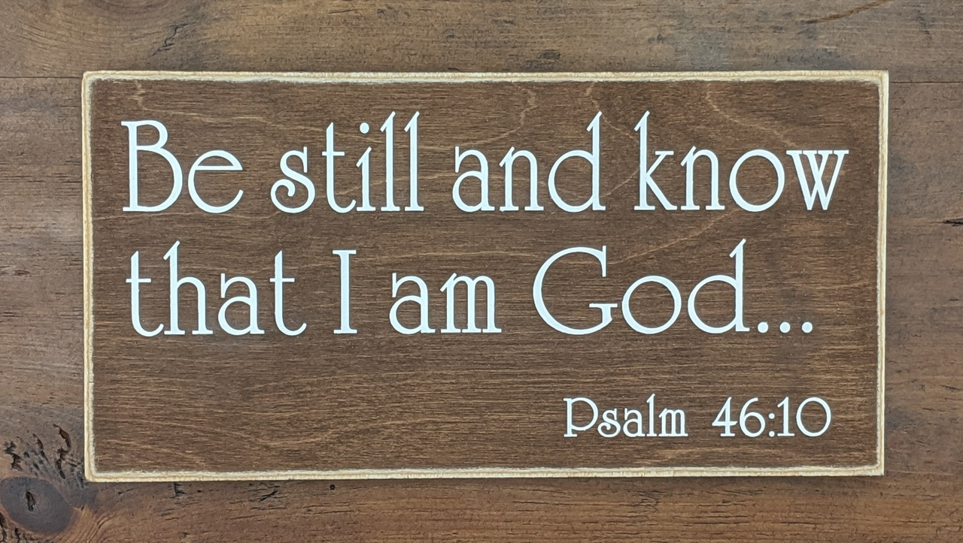
SING!
Be still and know that I am God.
Be still and know that Jesus is Lord.
Be still and know God’s Word is here.

Slide 4
DECLUTTERING FOR LENT WEEK FIVE
WHAT RESONATED WITH YOU OVER THE WEEK?

Slide 5
DECLUTTERING FOR LENT WEEK FIVE
DECLUTTERING our Souls/Spirits
Slides for Week 4 are posted on the website.
Slides for Week 5 are posted as well.

Slide 6
DECLUTTERING FOR LENT WEEK FIVE – DECLUTTERING our Souls/Spirits
Psalm 55:22 Cast your cares on the Lord and he will sustain you; he will never let the righteous be shaken.

Slide 7
DECLUTTERING FOR LENT WEEK FIVE – DECLUTTERING our Souls/Spirits
Psalm 57:1 Have mercy on me, my God, have mercy on me, for in you I take refuge. I will take refuge in the shadow of your wings until the disaster has passed.

Slide 8
DECLUTTERING FOR LENT WEEK FIVE – DECLUTTERING our Souls/Spirits
1 Corinthians 6:19-20
Do you not know that your bodies are temples of the Holy Spirit, who is in you, whom you have received from God? You are not your own; you were bought at a price. Therefore honor God with your bodies.

Slide 9
DECLUTTER OUR SOULS/SPIRITS
STRESS
we want to create “balance”
(rest)

Slide 10
DECLUTTER OUR SOULS/SPIRITS
What causes stress?
(Discuss!)

Slide 11
DECLUTTER OUR SOULS/SPIRITS
Relationships | Emotions
Finances | Physical
Work | Spiritual
Health
Shame, Guilt, Rebellion (SIN!)
Distance from the Lord

Slide 12
DECLUTTER OUR SOULS/SPIRITS
Where do we “find” God?

Slide 13
DECLUTTER OUR SOULS/SPIRITS
Where do we “find” God?
Church!

Slide 14
DECLUTTER OUR SOULS/SPIRITS
Church is the place to “unstuff” ourselves
In church, we are reminded that we are created and loved by God.
In church, we leave “everything” behind and focus on God
Place to receive spiritual nourishment (sacraments!)
OTHERS are there!

Slide 15
DECLUTTER OUR SOULS/SPIRITS
We are a mess…
(Discuss!)

Slide 16
DECLUTTER OUR SOULS/SPIRITS
To be convinced in our hearts that we have forgiveness of sin and peace with God by grace alone is the hardest thing.
Martin Luther

Slide 17
DECLUTTER OUR SOULS/SPIRITS
Comfort:
1. God uses our imperfections to do His best work.

Slide 18
DECLUTTER OUR SOULS/SPIRITS
Comfort:
God uses our imperfections to do His best work.
Grace – unlimited, totally undeserved

Slide 19
DECLUTTER OUR SOULS/SPIRITS
God wants to give us Himself, but if we are too busy holding onto “stuff”, we can’t hold onto Him!
God longs to pour out His mercy on us and draw us into His presence. He pursues us, we don’t pursue Him (John 15:16).

Slide 20
DECLUTTER OUR SOULS/SPIRITS
HOW prepare ourselves to “listen” to Him?
Stop the inflow of “stuff”
Practice ruthless purging
Set limits (Sabbath)
Balance (Stress)
Admit you are a Mess

Slide 21
DECLUTTER OUR SOULS/SPIRITS
HOW????
SPIRITUAL DISCIPLINES

Slide 22
DECLUTTER OUR SOULS/SPIRITS
Spiritual growth is hand crafted – not mass produced. God does not do one-size-fits-all.
Unknown

Slide 23
DECLUTTER OUR SOULS/SPIRITS
SPIRITUAL FORMATION
SPIRITUAL DISCIPLINES
Beginning
April 16th 7pm

Slide 24
DECLUTTERING FOR LENT WEEK FIVE
CLOSING PRAYER – The Lord’s Prayer
(DEBTS and DEBTORS)
bfb15235@gmail.com

