Slide 1
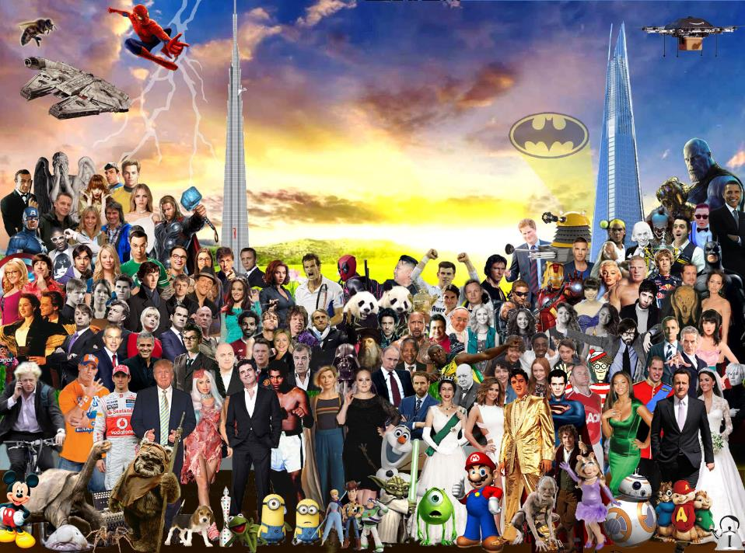
13 QUESTIONS TO TEST YOUR KNOWLEDGE OF THE WORLD’S EVENTS THIS WEEK!

Slide 2
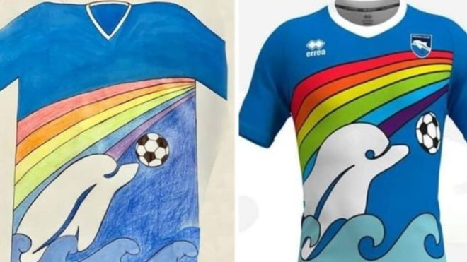
1
Pescaro football team are going to use a shirt designed by a 6 year old next season – what lockdown symbol does it have?
SPORT
A. Rainbow
B: Virus image
C: Sunshine
D: #stayhome

Slide 3
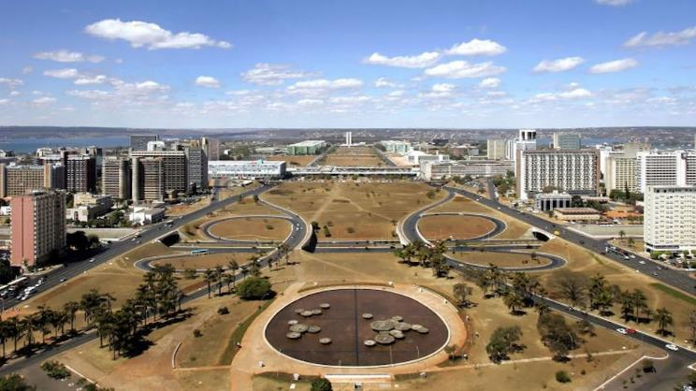
2
Which purpose-built city is 60 years old this week?
WORLD
B: Sydney
A: London
C: Paris
D: Brasilia

Slide 4
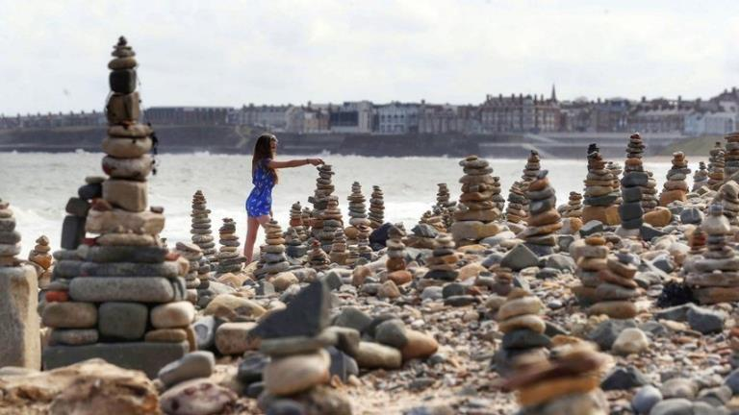
3
People taking their daily exercise this week have each been adding a stone to create these amazing sculptures where?
EXERCISE
A. Colwyn Bay
B: Cardigan Bay
C: Whitley Bay
D: Robin Hood’s Bay

Slide 5
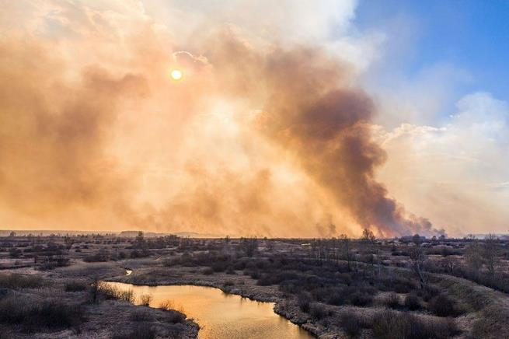
4
A forest fire was raging near which site of a 1986 disaster this week?
NATURE
A. Moscow
B: Chernobyl
C: St Petersburg
D: Vladivostok

Slide 6
5
How many years ago was 1986?
NUMERACY 1 of 1
A: 24
B: 43
C: 34
D: 44

Slide 7
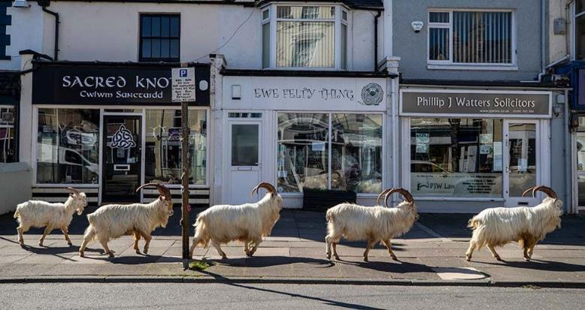
6
Due to a lack of people, what animals were roaming the streets of Llandudno this week?
NATURE
A. Goats
B: Horses
C: Sheep
D: Wolves

Slide 8
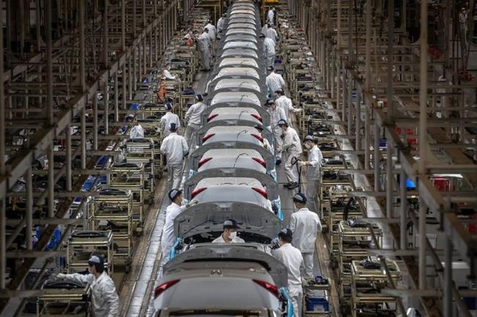
7
Which city lifted their lockdown this week, reopeneing this car factory?
WORLD
A. London
B: Madrid
C: Rome
D: Wuhan

Slide 9
8
How should reopeneing have been spelt?
LITERACY 1 of 2
B: their
A: reeopening
B: reopening
C: reoperning
D: reopeninng

Slide 10
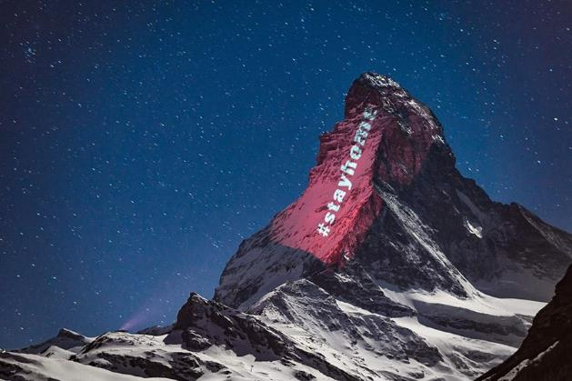
9
Which huge mountain was illuminated with #stayhome?
GEOGRAPHY
A. Matterhorn
B: Everest
C: Eiger
D: Ben Nevis

Slide 11
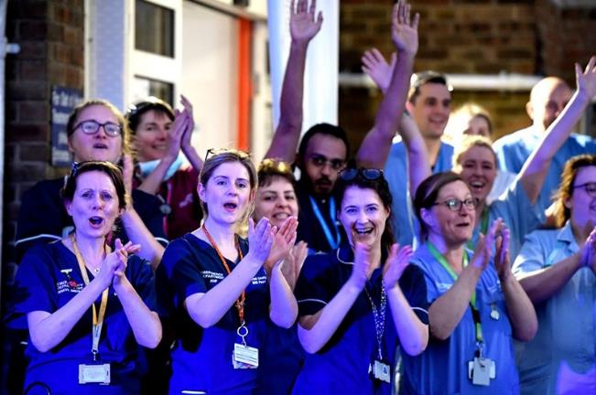
10
The Clap for ____ takes place every Thursday?
UK
A: NHS
B: Teachers
C: Carers
D: Key workers

Slide 12
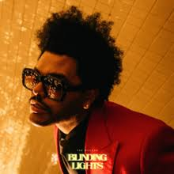
11
Blinding Lights conntinues at number one this week – who is it by?
MUSIC
A. Saint Jhn
B: Drake
D: Weeknd
C. Dua Lipa
C: Thailand

Slide 13
12
How should ‘conntinues’ have been spelt?
LITERACY 2 of 2
A: continues
B: continyews
D: continnues
C: continuese

Slide 14
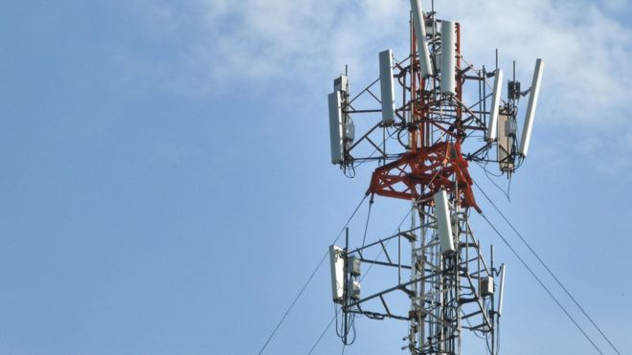
Misinformation, or ‘fake news’, suggested that what was responsible for coronavirus?
13
…and finally…
AND FINALLY…
A. Birds
B: Clouds
C: Rain
D: 5G

Slide 15
ANSWERS…

Slide 16
1
Pescaro football team are going to use a shirt designed by a 6 year old next season – what lockdown symbol does it have?
SPORT
A. Rainbow
B: Virus image
A: Rainbow
C: Sunshine
D: #stayhome

Slide 17
2
Which purpose-built city is 60 years old this week?
WORLD
B: Sydney
A: London
C: Paris
D: Brasilia
D: Brasilia

Slide 18
3
People taking their daily exercise this week have each been adding a stone to create these amazing sculptures where?
EXERCISE
A. Colwyn Bay
B: Cardigan Bay
C: Whitley Bay
D: Robin Hood’s Bay
C: Whitley Bay

Slide 19
4
A forest fire was raging near which site of a 1986 disaster this week?
NATURE
A. Moscow
B: Chernobyl
B: Chernobyl
C: St Petersburg
D: Vladivostok

Slide 20
5
How many years ago was 1986?
NUMERACY 1 of 1
A: 24
B: 43
C: 34
D: 44
C: 34

Slide 21
6
Due to a lack of people, what animals were roaming the streets of Llandudno this week?
NATURE
A. Goats
B: Horses
A: Goats
C: Sheep
D: Wolves

Slide 22
7
Which city lifted their lockdown this week, reopeneing this car factory?
WORLD
A. London
B: Madrid
C: Rome
D: Wuhan
D: Wuhan

Slide 23
8
How should reopeneing have been spelt?
LITERACY 1 of 2
B: their
A: reeopening
B: reopening
B: reopening
C: reoperning
D: reopeninng

Slide 24
9
Which huge mountain was illuminated with #stayhome?
GEOGRAPHY
A: Matterhorn
B: Everest
A. Matterhorn
C: Eiger
D: Ben Nevis

Slide 25
10
The Clap for ____ takes place every Thursday?
UK
A: NHS
B: Teachers
C: Carers
D: Key workers
C: Carers

Slide 26
11
Blinding Lights conntinues at number one this week – who is it by?
MUSIC
A. Saint Jhn
B: Drake
D: Weeknd
C. Dua Lipa
D: Weeknd
C: Thailand

Slide 27
12
How should ‘conntinues’ have been spelt?
LITERACY 2 of 2
A: continues
B: continyews
A: continues
D: continnues
C: continuese

Slide 28
Misinformation, or ‘fake news’, suggested that what was responsible for coronavirus?
13
…and finally…
AND FINALLY…
A. Birds
B: Clouds
C: Rain
D: 5G
D: 5G

Slide 29
How did you do?
0-4 – Even Donald Trump did better…
5-7 – Nope! You may not confer!
8-10 – Amazing – did you use your phone?
11-13 – Phenomenal! Did you watch University Challenge last night or sumfink?
The Demilitarized Zone???!??!?

Slide 30
TIEBREAKERS…

Slide 31
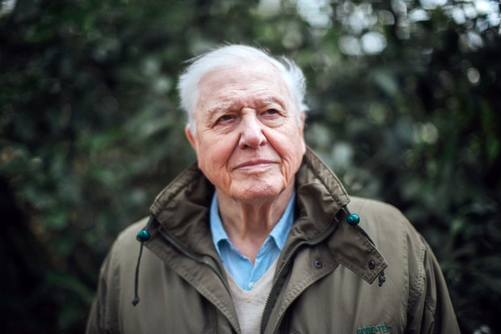
TIEBREAKER 1!
Which PRESENTER this week?
SIR DAVID ATTENBOROUGH
(giving BBC online lessons this week)

Slide 32
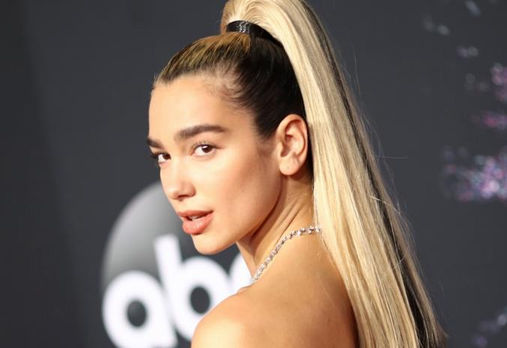
TIEBREAKER 2!
Which MUSICIAN this week?
DUA LIPA
(recording a charity single this week)

Slide 33
Thanks for playing!
See you next time for more!

