Slide 1
English Information Workshop

Slide 2
Aims of this session
To explain how we teach English skills in school.
To show you how you can support your child’s development in English at home.
Speaking and Listening
Reading
Writing
Spelling
Handwriting

Slide 3
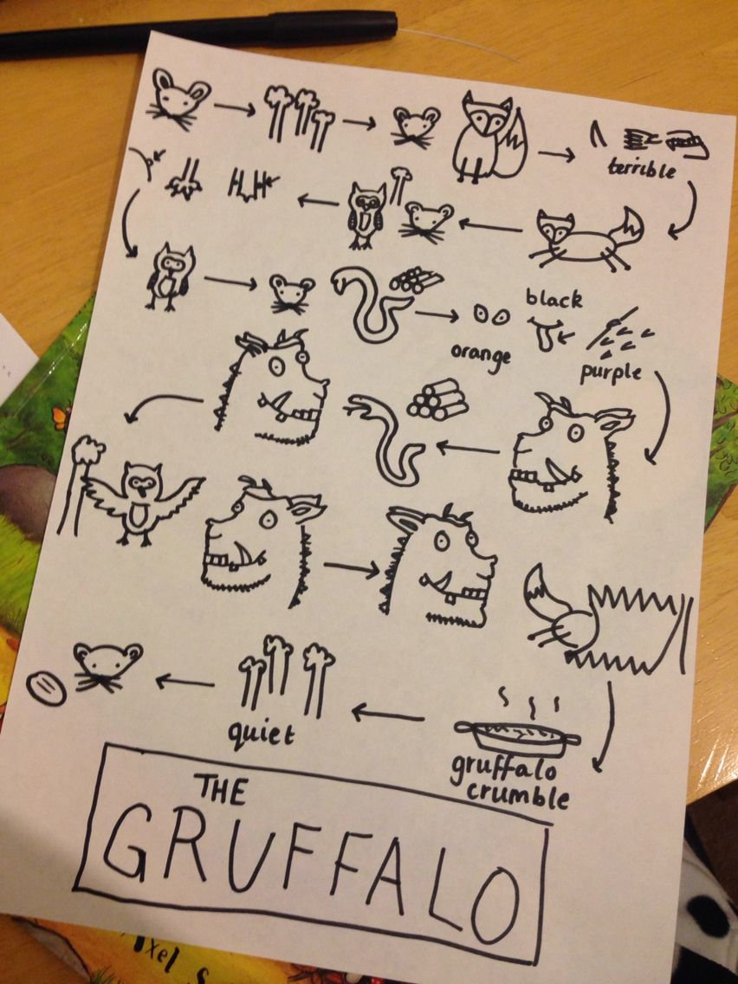
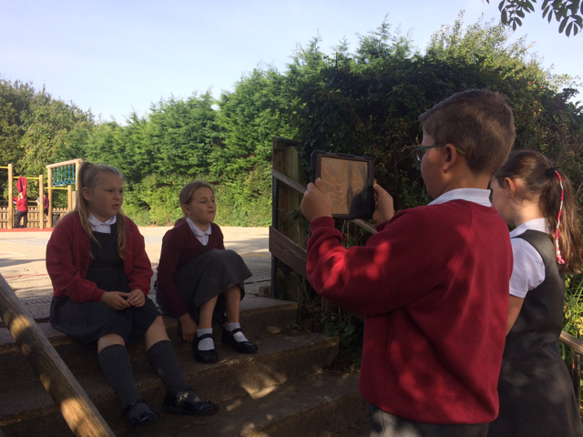
The process of learning a language:
Speaking and Listening opportunities
Notes:
Children really enjoy this aspect – could involve…re-enacting before retelling, being part of the story (Polar Express), News reports, using technology, holding and participating in debates and more!
Also goes as far as opportunities in school council and Christmas/end of year productions
Most lessons involve verbal opportunities prior to writing. We have recently implemented some strategies from Pie Corbett’s Talk4Writing which is based on the children becoming extremely familiar with a text and its key structures before using it as a model to create their own. Pupil feedback really positive and we as teachers can see the impact in writing too.

Slide 4
Why is reading so important?
Books help children develop vital language skills.
Reading can open up new worlds and enrich children's lives.
Reading is a key precursor to good writing.
Reading can enhance children's social skills.
Reading is fun!
Notes:
Children enjoy that special time with you cuddled up with a book – it’s losing importance now with phones and tvs but it’s so important – find the time for 10mins.

Slide 5
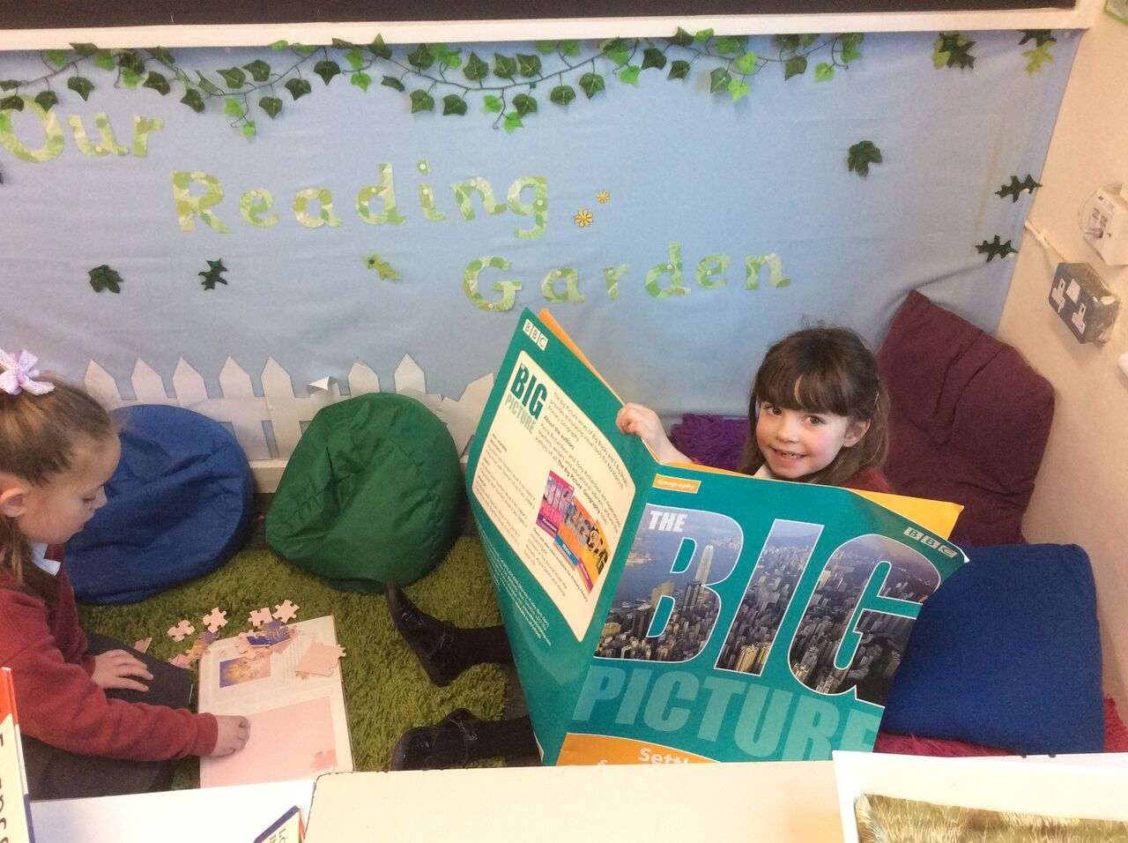
How we approach reading
Daily phonics sessions (YR and Y1/Y2)
Whole School priority – reading for pleasure
Whole class texts
School Library
Home school reading diaries
Reading across the curriculum
- including non-fiction!

Slide 6
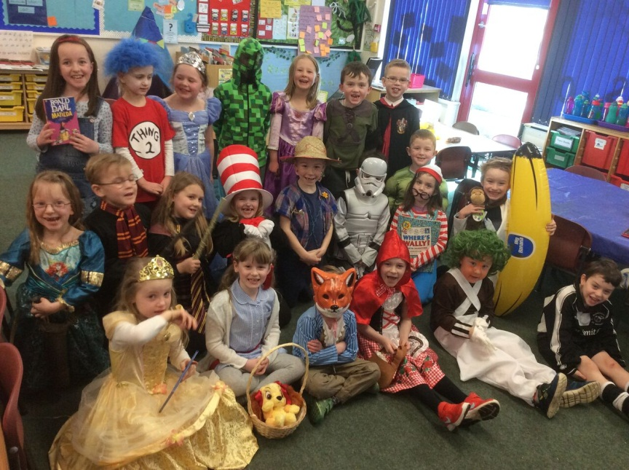
Added Extras!
World Book Day celebrations!
Visiting Authors.
ERIS (Everyone Reading In School)
Visiting Book Fair
Raffle tickets for 5 reads per week
Notes:
World Book Day dance workshops
ERIS – inviting grandparents along etc too!

Slide 7
Teaching Reading
Reception, Y1 + Y2
- Read Write Inc.
Years 2 – 6
- Topic based approach

Slide 8
Read Write Inc.
4/5 sessions per week
groups all taught by trained staff
Structured sessions
Speed sounds
Spelling
Reading - red/green words
writing/comprehension
Notes:
Children in Reception and Year 1 follow the read write inc scheme. This is a phonics based approach to teaching reading, writing and spelling. It is taught daily, usually at the beginning of the day. In Year 1 this happens 4 days a week as Friday mornings are a longer writing session where children are able to apply the skills that they have learnt to writing tasks related to our topic.
All staff RWI trained. Follow quite tight structure. sessions planned in a specific way to maximise children’s learning – pace and repetition but also fun.
Speed sounds daily 10 mins prac sounds, use them to blend building up speed – FIYH
Prac using FF in daily spelling slot.
Children work with a partner when reading their book. They begin by prac the words they will come across – using FT for green words and sight knowledge for red words.
Children read text in pairs then also talk about the story as comprehension and understanding is also an important component. Children complete writing activities about the story in their get writing book. These are related to Reception/Year 1 currriculum expectations and teach skills that the children will then carry over to their writing in other activities.

Slide 9
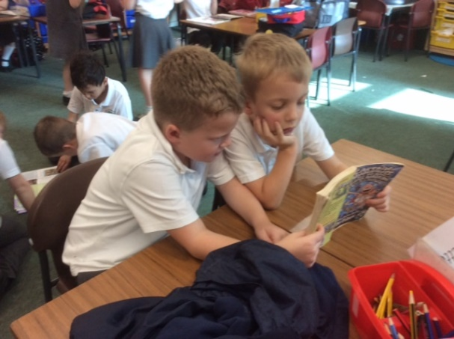
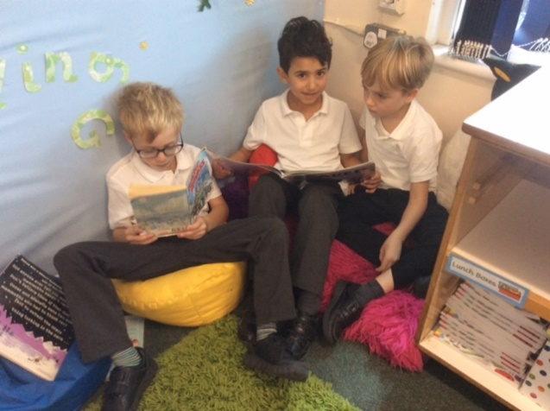
Teaching Reading Years 2-6
Reading is a key element of literacy. By reading a variety of text types children learn new vocabulary, styles and structures for their own writing.
Shared Reading Opportunities
Individual Readers
Reading for Pleasure – ERIS
Linked to Topics
Talk4Writing
Notes:
The majority of reading in school is taught through Shared Reading.
Shared Reading teaches the range of skills which children need to be effective readers.
It is important that children can not only decode words but also that they can make and extract meaning. Shared reading is a form of whole class teaching. A text will be shown to the class, read with the teacher and deconstructed. This is both an effective and a recommended method.
Teachers will also read books to children for pleasure. Listening to a book being read is an effective way for children to engage and respond to a text. Reading is a skill which we teach indirectly, as well directly, throughout a child’s time at school. We hope this encourages children to be readers for life.
Your child will sometimes be heard reading individually and we recognise that children enjoy this and can get some benefit. However this is not the most effective use of a teacher’s or teaching assistant’s time within a large class so may not be regular. In whole class teaching all children can be provided with a level of high quality teaching – although some children need additional support and this is planned for accordingly.

Slide 10
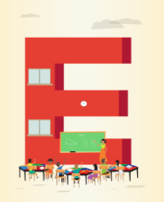
What can you do at home?
Listen to your child read – REGULARLY – Little and often is best
Read to your child.
If your child is reluctant, take turns reading pages or sentences to lessen the load.
Tell stories/Make up stories using toys.
Ask questions about what they have read/listened to – understanding is just as important!
Visit local libraries and bookshops.
Read signs out and about – road signs, the supermarket, words on television..the list is endless!
Read as a family – be a role model, share YOUR favourite books too!
Provide opportunities for different texts – newspapers, magazines, poetry etc.
Notes:
Can’t stress enough – just because your child is decoding well there is still a need to read – comprehension plays such a massive role and even links to maths reasoning skills and more!

Slide 11
The process of learning a language:
Speaking and Listening
Speaking and listening is fundamental to developing good communication, reading and writing skills and to ensuring children can access and achieve in all other areas of the curriculum.
It is a critical prerequisite to learning to read and write and enables access to other areas of the curriculum.
In the Early Years Foundation stage communication and language is one of the three prime areas of learning which underpin the rest of the curriculum.
The National Curriculum states that pupils in Key Stages 1 and 2 should be taught to speak clearly and convey ideas confidently using standard English.

Slide 12
The process of learning a language: Writing
Mark making → potato people! → Letter formation EYFS
Strings of letters (in seemingly any order) EYFS/Y1
Words and phrases using phonics → sentences Y1
Sentences → linked sentences → blocks of text Y2
Paragraphs Y3
Short coherent pieces Y4
Longer coherent pieces Y5
Longer pieces across a range of genres Y6
Notes:
Once reading has been mastered – writing comes

Slide 13
Text-based approach
Class Teachers link carefully chosen, high quality key texts to each topic and use these as a basis for teaching reading and writing skills.
Where topics cannot be linked, stand alone skills-based sessions are used.

Slide 14
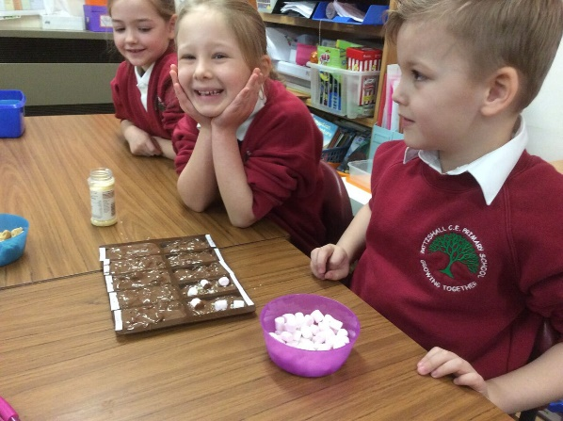
Text-based approach
Class teachers link quality key texts to each topic and use these as a basis for teaching reading and writing skills.
YEARS 1 and 2
Topic | Texts
Great and Ghastly Events | Paddington at the Palace The Queen’s Knickers Once there were Giants Vlad and the Great Fire of London
Australian Adventure | Wombat Stew Wombat goes Walkabout Tiddalick the greedy frog (Aboriginal Tale) The Rainbow Serpent (Aboriginal Tale)
Extreme Weather | Cloudy with a chance of Meatballs Flood The Wind and the Sun The Emporers Egg (Polar climates) Lost and Found – Oliver Jeffers
Notes:
Just some examples of previous and current topics and their linked texts.
Jessica – enjoying making her own chocolate bar – we planned the ingredients and wrote recipes, made packaging, lots of opportunities!

Slide 15
Text-based approach
Class teachers link quality key texts to each topic and use these as a basis for teaching reading and writing skills.
YEARS 3 and 4
Topic | Texts
Buildings | Ug (comic book) Stig of the Dump Noni the Blacksmith (Iron Age) Variety of Roman Myths Firework Maker’s Daughter
Transport | Kensuke’s Kingdom Around the World in 80 Days (Abridged version + film) Journey to the Centre of the Earth (Abridged version)
Eurovision | A Lion in Paris (picture book) Hunchback of Notre Dame The Three Musketeers (Abridged version) Heidi (film clips)

Slide 16
Text-based approach
Class teachers link quality key texts to each topic and use these as a basis for teaching reading and writing skills.
YEARS 5 and 6
Topic | Texts
America | Dr Seuss Oh! The Places you’ll go! If I Ran the Zoo From the Mixed Up Files of Mrs Basil E Frankweiler Huckleberry Finn (Abridged version)
Who Do You Think You Are? | The Important Book (poetry) The Lion, the Witch and the Wardrobe Alice’s Adventures in Wonderland Sherlock Holmes and the Red-Headed League Extracts from Horrible Histories
Earthquake Zones and Volcanoes | The Bermuda Triangle The Mystery of Flight 19 The Marie Celeste The Marwell Manor Mystery Extracts from Horrible Geography

Slide 17
Grammar Progression
Year 1 | Year 2 | Year 3 | Year 4 | Year 5 | Year 6
Noun phrases | Expanded noun phrases | Expanded noun phrases | Expanded noun phrases | Expanded noun phrases | Expanded noun phrases
Subordinating | Subordinating | Subordinating | Subordinating | Subordinating | Subordinating
conjunctions | conjunctions | conjunctions | conjunctions | conjunctions | conjunctions
(B) | (WITB) | (AWHITEBUS) | (AWHITEBUS) | (AWHITEBUS) | (AWHITEBUS)
Co-ordinating | Co-ordinating | Co-ordinating | Co-ordinating | Co-ordinating | Co-ordinating
conjunctions | conjunctions | conjunctions | conjunctions | conjunctions | conjunctions
(BOA) | (BOA) | (FANBOYS) | (FANBOYS) | (FANBOYS) | (FANBOYS)
Past and present tense | Past simple | Past simple | Past simple | Past simple | Past simple
are consistent | Past progressive | Past progressive | Past progressive | Past progressive | Past progressive
 | Present simple | Present simple | Present simple | Present simple | Present simple
 | Present progressive | Present progressive | Present progressive | Present progressive | Present progressive
 |  | Past perfect | Past perfect | Past perfect | Past perfect
 |  | Present perfect | Present perfect | Present perfect | Present perfect
 | Sentence types: | Sentence types: | Sentence types: | Sentence types: | Sentence types:
 | Statement | Statement | Statement | Statement | Statement
 | Command | Command | Command | Command | Command
 | Question | Question | Question | Question | Question
 | Exclamation | Exclamation | Exclamation | Exclamation | Exclamation
 | Adverbs | Adverbials | Adverbials | Adverbials | Adverbials
 |  | (TRaMP) | (TRaMP) | (TRaMP) | (TRaMP)
 |  |  |  | Relative clauses and | Relative clauses and
 |  |  |  | relative pronouns | relative pronouns
 |  |  |  | Modal verbs | Modal verbs
 |  |  |  |  | Subjunctive form
Notes:
Grammar Tests (SPAG) in Y2 and Y6
Interrogating the text
Knowledge of the vocabulary is important
Please encourage children to refer to and use this language at home

Slide 18
Punctuation Progression
Year 1 | Year 2 | Year 3 | Year 4 | Year 5 | Year 6
Aa.!? | Aa.!? | Aa.!? | Aa.!? | Aa.!? | Aa.!?
 | Inverted commas | Inverted commas | Inverted commas | Inverted commas | Inverted commas
 | Commas to separate a | Commas to separate a | Commas to separate a | Commas to separate a | Commas to separate a
 | list | list | list | list | list
 | Apostrophe for | Apostrophe for | Apostrophe for | Apostrophe for | Apostrophe for
 | omission and | omission and | omission and | omission and | omission and
 | possession. | possession | possession | possession | possession
 |  | Commas for fronted | Commas for fronted | Commas for fronted | Commas for fronted
 |  | adverbials | adverbials | adverbials | adverbials
 |  |  |  | Commas for clarity | Commas for clarity
 |  |  |  | Parentheses | Parentheses
 |  |  |  | Dashes | Dashes
 |  |  |  | Brackets | Brackets
 |  |  |  | Commas | Commas
 |  |  |  | Hyphens | Hyphens
 |  |  |  |  | Adding detail
 |  |  |  |  | Dashes
 |  |  |  |  | Colons
 |  |  |  |  | Linking
 |  |  |  |  | Semi-colons
Notes:
Available as handouts FYI but as you can generally see the demand increases each year and quite significantly between y1-y2 and y4-y5

Slide 19
Talk 4 Writing
Cold task
(show us what you know)
Imitation + Investigation
(getting to know a text really well)
Innovation
(Creating a new story by adapting a well-known one)
Independent Application
(Independently creating a story)
Hot task
(show us what you know NOW)
Dependence
Independence
Notes:
Through may of our units we have adopted a talk 4 writing style approach to teaching.
Children begin by being asked to produce a piece of writing of the planned genre in advance of the unit. E.g write a newspaper report.
The teacher then uses this as a key opportunity to assess the needs of the class, groups and individuals to plan the unit.
Children will then be introduced to a strong example text but initially only verbally. They will learn the text using actions and pictures on a story map ( example on next slide).
Once they are really familiar with that, they will be introduced to the written text, which of course, everyone can read, because they all know it off by heart by this point!
They will then over a series of lessons, unpick the text, looking closely at its features and the various grammar and punctuation elements within it.
The next step is to move on to innovating – adapting the model to create their own version. Some children may stick quite closely to the mode, others will be more creative. Teacher uses the written work produced to plan further lessons.
Finally, children will produce a piece independently to show what they have now learned. Clear evidence of progress. Pupil voice interviews show children really enjoy this way of learning. Some examples next page.

Slide 20
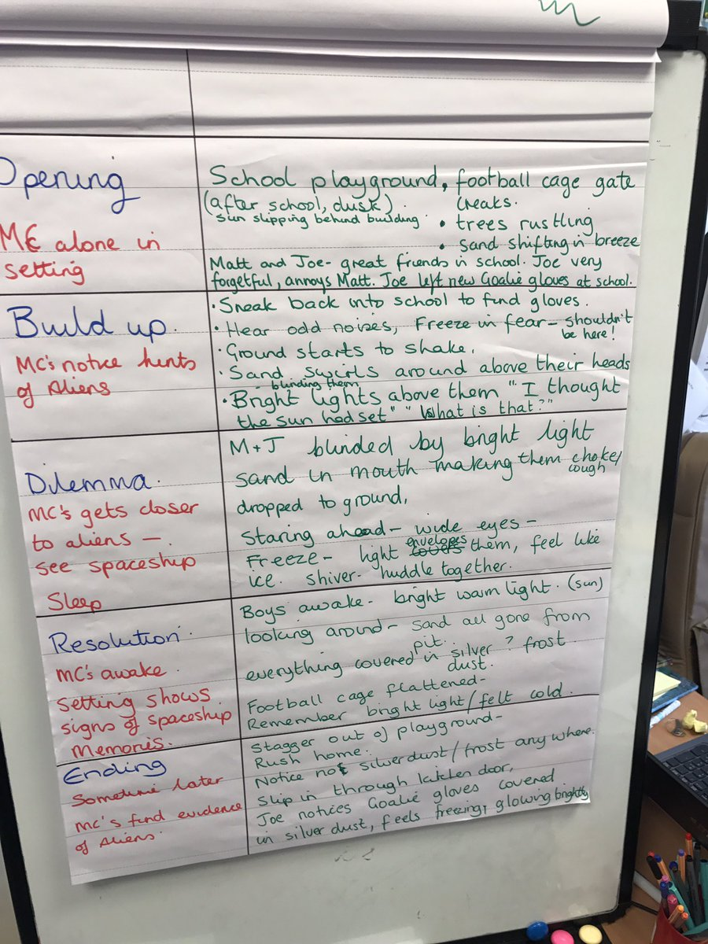
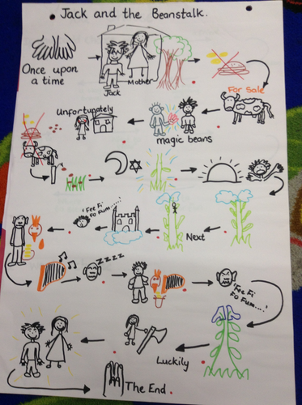
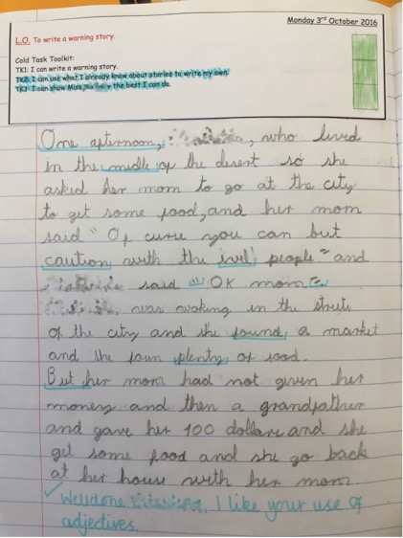
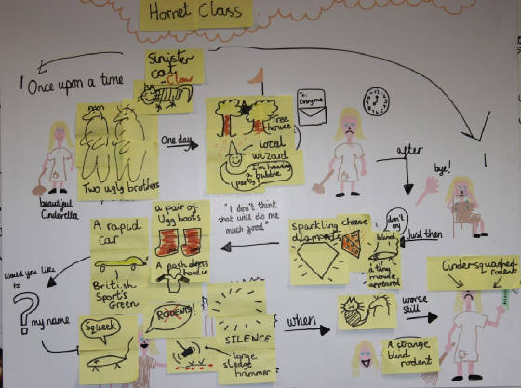
Dependence
Independence
Notes:
Approach to innovation and independence can be adapted based on the age and ability of the children

Slide 21
Spelling
Following the National Curriculum introduced in 2014, we made changes to the way we taught spellings.
The RWI spelling scheme:
Daily session (20mins)
New spelling rule each week
Weekly session on “red words” (common exception words)
How can I help at home?
Look out for the weekly spelling focus in the homework book and practise! Discuss these spellings with your child and spot them in your reading too. ONE WEEK IS NOT ENOUGH to embed learning.
Notes:
5 day timetable
Based on alien characters – these grow and move with the children.
matched to objectives from the NC appropriate to each age group.
Follows on from the phonics scheme used in R and Y1 for smooth transition and consistent throughout the school
We do not do spelling tests – evidence shows they do not work!

Slide 22
Handwriting
Whole school focus: Improving presentation
End of key stage frameworks set by government emphasise the ability to form and join correctly.
PLEASE reinforce the need for good presentation at home – we need to work together.
Notes:
In recent times we have seen the importance of handwriting increase in priority, both on the national assessments and we have also raised the profile as a school. It is on the assessment frameworks so really does matter!!
Little and often as is the case with reading and RWI, it takes time to embed learning and for movements to become natural.

Slide 23
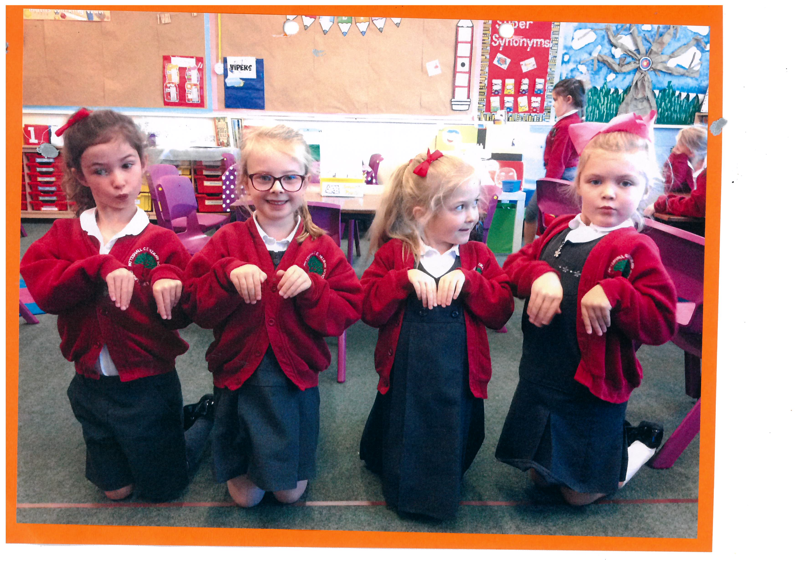
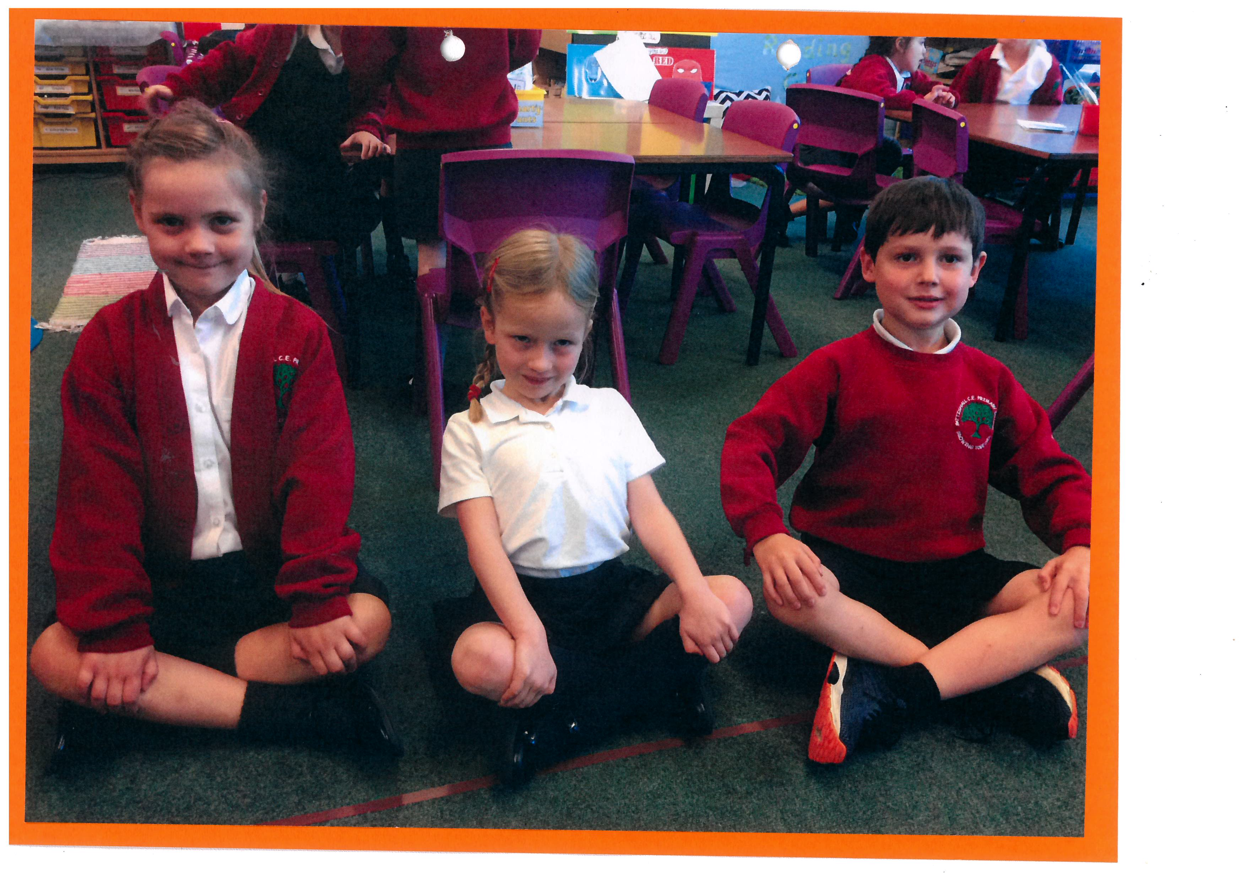
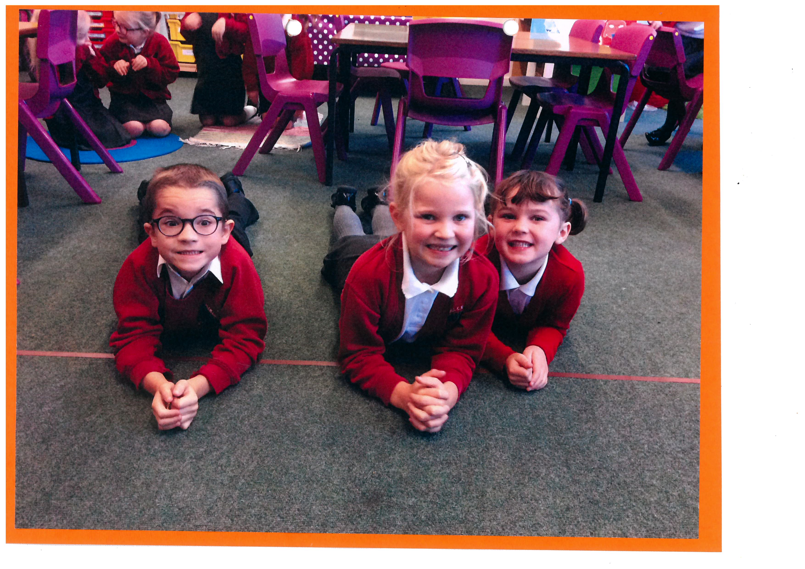
Kinetic Letters
Notes:
Last year we introduced Kinetic Letters primarily to EY/KS1 and hope to see the impact roll upwards.
Kinetic letters is based upon first and foremost spending the time building physical strength and correct pencil grip BEFORE putting pencil to paper!
We do this through exercises and body positions that are specifically targeted at building the muscles needed to write - e.g chair push ups, laying on the floor. We do this during sessions and at other times of day such as doing group work, during the register and in assembly.
This is something that can EASILY be encouraged at home – using the strong lizard position for activities such as colouring, reading, even use of technology!
Also activities such as climbing, trampolining also promote the muscles used in writing.

Slide 24
Kinetic Letters
Notes:
This is the optimum pencil hold that we encourage (explained above) some children may require the support of grips etc.
This again can be encouraged at home when writing and the finer motor skills can also be built through activities such as playdough, tweezers etc.

Slide 25
Kinetic Letters
Notes:
When it moves on to the actual letter writing each letter is made up of six key movements.
The children are introduced to "brave monkey" and "scared monkey" to help with height and orientation on the line.
They practise the letters in the air, then in sand, then on to whiteboards.
We use the "tree" in lots of their written work to support them in applying their skills and all letters are grouped in to families based on similar movements (provide mats to take home)

Slide 26
Writing at home
Age related expectations are on the website – class pages
For handwriting:
Encourage correct pencil hold
Strengthening exercises and activities e.g. trampolining, climbing, jumping, hopping skipping, balancing games
Encourage children to lie in the lizard position
Consider the following to encourage your child to write – it doesn’t have to be structured!
Lists- shopping lists, gift lists, to do lists etc. Birthday cards, postcards and letters etc.
Sticky labels for toy boxes/drawings etc Playing schools, Post Offices etc.
Keep a simple diary Making simple picture and word books
Simple crossword puzzles and word searches
Use a variety of materials to encourage writing:
Paper with pencils, pens and paint, Dry wipe boards, Magnetic letters and words, Chalk boards, Bath time washable crayons
Notes:
Refer to website for ARE

Slide 27
Thank you for listening!
If you've any questions please feel free to ask!

Slide 28
