Slide 1

The Heart of Gold Framework™ Restoring Humanity to Leadership
REMEMBER: See them. Hear them. 10 seconds matters.
MINE FOR GOLD: Be curious. Every person holds value.
TEAM FIRST: Your employees are your first customer.
MODEL CONSISTENCY: What you do daily becomes your culture.
PLAY: Joy fuels connection, energy, and results.
Stay where your feet are… TrayceeMayer.com

Slide 2
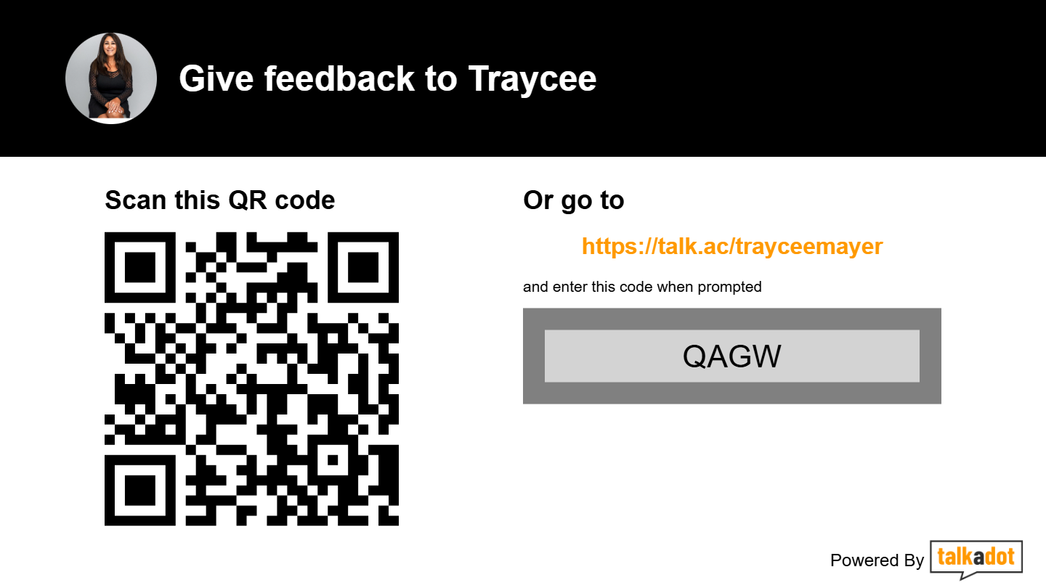
The Heart of Gold Framework
Thankyou!Please give me feedback- it is so appreciated, Good or bad or constructive!

