Slide 1
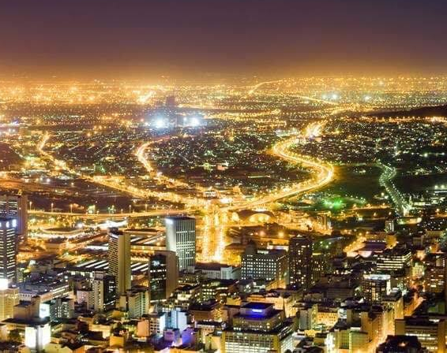
APOSTOLIC KINGDOM FORUM Houston, Texas
https://1drv.ms/p/s!AlA-x-uwoWicxShTBXAYmMgZZyXJ
…making all see what is the fellowship (stewardship) of the ministry ….
Eph. 3:8-10

Slide 2
Apostolic Culture The Context for Kingdom Activities
As we will see with culture the first lens through which we view determines what we see and therefore how we behave. To be apostolic first means that we know, who we are, that we are sent, resourced and assigned. When that awareness is placed before everything else it adds to the expression, beliefs, and behavior of every believer.

Slide 3
Apostolic Companies Functioning
- to execute spiritual strategies
advance apostolic culture in cities, regions, & nations,
- to occupy & legislate God’s
Kingdom rule.

Slide 4
Spiritual Strategies
Ephesians 3:10 to the intent that now the manifold wisdom of God might be made known by the church to the principalities and powers in the heavenly places, according to the eternal purpose which He accomplished in Christ Jesus our Lord, in whom we have boldness and access with confidence through faith in Him.

Slide 5
Occupy & Legislate God’s Kingdom Rule
Luke 19:12-13 He said therefore, A certain nobleman went into a far country to receive for himself a kingdom, and to return.
And he called his ten servants, and delivered them ten pounds, and said unto them, Occupy till I come.

Slide 6
EKKLESIA Legislate God’s Kingdom Rule
Ecclesia defined:
as an assembly of citizens in the definition of ancient Greece.
The collective of kingdom citizens of a city or region is an example of an ecclesia.
Legislate defined:
to perform the function of legislation
- to enforce & enact laws
to mandate, establish, or regulate by or as if
by legislation

Slide 7
THERE IS NOTHING OUR GOD CAN’T DO
I Will Believe for Greater Things
We will believe for Greater Things

Slide 8
Spirit of Faith
1 Corinthians 4:12-13 AMPC
For we who live are constantly [experiencing] being handed over to death for Jesus' sake, that the [resurrection] life of Jesus also may be evidenced through our flesh which is liable to death.
Thus death is actively at work in us, but [it is in order that our] life [may be actively at work] in you.
Yet we have the same spirit of faith as he had who wrote, I have believed, and therefore have I spoken. We too believe, and therefore we speak, [Ps. 116:10.]

Slide 9
Walking in The Spirit of Faith
Galatians 3:2 AMPC
Let me ask you this one question: Did you receive the [Holy] Spirit as the result of obeying the Law and doing its works, or was it by hearing [the message of the Gospel] and believing [it]? [Was it from observing a law of rituals or from a message of faith?]
Are you so foolish and so senseless and so silly? Having begun [your new life spiritually] with the [Holy] Spirit, are you now reaching perfection [by dependence] on the flesh?

Slide 10
The Holy Spirit Supplies
Galatians 3:5-6 AMPC
Then does He who supplies you with His marvelous [Holy] Spirit and works powerfully and miraculously among you do so on [the grounds of your doing] what the Law demands, or because of your believing in and adhering to and trusting in and relying on the message that you heard?
Thus Abraham believed in and adhered to and trusted in and relied on God, and it was reckoned and placed to his account and credited as righteousness (as conformity to the divine will in purpose, thought, and action). [Gen. 15:6.]

Slide 11
The Substance With Which God Builds
Hebrews 11:1
NOW FAITH is the assurance (the confirmation, the title deed) (evidence) of the things [we] hope for, being the proof of things [we] do not see and the conviction of their reality [faith perceiving as real fact what is not revealed to the senses].

Slide 12
Faith Equips for their Intended Purpose
Hebrews 11:2-3
For by [faith–trust and holy fervor born of faith] the men of old had divine testimony borne to them and obtained a good report.
By faith we understand that the worlds [during the successive ages] were framed (fashioned, put in order, and equipped for their intended purpose) by the word of God, so that what we see was not made out of things which are visible.

Slide 13
“Framed” - Katartizo
- To arrange, set in order, equip, adjust,
complete what is lacking, make fully
ready, repair, prepare.
Matthew 4:21…mending their nets, He called them.
Ephesians 4:12..equipping the saints for service, edifying of the body of Christ.

Slide 14
God is Concerned How We Build
I Corinthians 3:9-11
For we are fellow workmen (joint promoters, laborers together) with and for God; you are God's garden and vineyard and field under cultivation, [you are] God's building. [Isa. 61:3.] According to the grace (the special endowment for my task) of God bestowed on me, like a skillful architect and master builder I laid [the] foundation, and now another [man] is building upon it. But let each [man] be careful how he builds upon it, For no other foundation can anyone lay than that which is [already] laid, which is Jesus Christ (the Messiah, the Anointed One).

Slide 15
Imparting the “Spirit of Faith”
As Elders we are to impart “His Spirit” maturing the saints for work of service.
To send
To release
II Corinthians 3:17 Now the Lord is that Spirit: and where the Spirit of the Lord is there is liberty.
No restraint
No delay

Slide 16
New Testament Ruling Elders
Elders (presbuterio) means older, mature. Describes the man.
Bishops (episkopoi) means overseer, Describes the office.
Apostle (poimen) means sheperd,rule. The work (role).
Prophet (poimen) means sheperd, rule. The work (role.
Evangelists (poimen) means sheperd, rule. The work (role).
Pastors (poimen) means sheperd, rule. The work (role).
Teachers (poimen) means sheperd, rule. The work (role)
Bishops & Elders are broad, general terms that do not specify the particular type of ministry.

Slide 17
A ”Disciple” of Christ
Understands the word “apostolic”
Is a doer of the Word
They Do what they know
A Follower of Christ
Does what He commanded to do
Maturity comes from doing the Word.
Maturity - Meat - A Doer

Slide 18
Regression Direction
Romans 8:12-14
though He was a Son, yet He learned obedience by the things which He suffered. And having been perfected, He became the author of eternal salvation to all who obey Him, called by God as High Priest “according to the order of Melchizedek,”of whom we have much to say, and hard to explain, since you have become dull of hearing.
For though by this time you ought to be teachers, you need someone to teach you again the first principles of the oracles of God; and you have come to need milk and not solid food.

Slide 19
Our Advancement or Decline
Hebrews 5:13-14
For everyone who continues to feed on milk is obviously inexperienced an unskilled in the doctrine of righteousness (of conformity to the divine will in purpose, thought, and action), for he is a mere infant [not able to talk yet]!
14 But solid food is for full-grown men, for those whose senses and mental faculties are trained by practice to discriminate an distinguish between what is morally good and noble and what is evil an contrary either to divine or human law.

Slide 20
Maturity of Elders
Hebrews 12:14
But solid food is for full-grown men who are “full age” (Mature/Perfect)…..Teleious:
-to that which has reached an end, that is finished, complete, perfect
It signifies consummate soundness
It includes he idea of being whole
When applied to believers it denotes “maturity”

Slide 21
Apostolic Shift
It begins when we are not just hearers only.
It begins with the doing of what you know.
It begins when we obey His calling.
It begins walking in the “Spirit of Faith.”
Faith equips us for our intended purpose.
Advancement occurs as we do His Word.
Following the Apostolic shift in our lives in the “Spirit of Faith", occupies cities, regions & nations for Him to legislate His ways in your spere of influence.

