Slide 1
YOU Have Not Gone
This WAY Before
- Joshua Chapter 3 -
LIVING THE LIFE YOKED WITH GOD
-His Mercies Are New Every Morning-

Slide 2
LIVING LIFE – In GOD’s YOKE
LIVING LIFE – In SATIN’S YOKE
How Do You Plow Through Each Day?
How Do You Plow Though Challenges?
By Faith – Grace/Humble & Freedom/Liberty
By Sight – Law/Condemnation

Slide 3
“Joshua 3:1-3 “Then Joshua rose early in the morning; and they set out from Acacia Grove & came to the Jordan river, he and all the children of Israel, and lodged there before they crossed over. So it was, after three days, that the officers went through the camp; and they commanded the people, saying, “

Slide 4
“Joshua 3:4 “When you see the ark of the covenant of the LORD your God, and the priests, the Levites, bearing it, then you shall set out from your place and go after it.Yet there shall be a space between you and it, about two thousand cubits by measure. Do not come near it, that you may know the way by which you must go, for you have not passed this way before”.

Slide 5
Being YOKED WITH GOD
-The Abundant Life-
You Will Know The Way To Go
Keep Your Eyes On Him To Show The way.
Dependance On God To Grow In New Adventures & Challenges With Faith.

Slide 6
WHAT IS A YOKE
An Instrument or Harness
A Collar That Causes Pulling Together in a Direction
A Yoke Typifies Labor or Work For Moving/Plowing
It is Something That Ties You To Something Else
God’s Word Represents a Yoke as a Heavy Burden

Slide 7
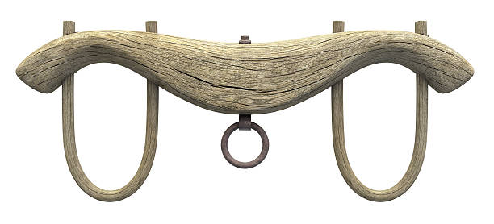
- A YOKE Is Made For PULLING & PLOWING
- To MOVE OR PULL Forward

Slide 8
Different KINDS OF YOKES
The Yoke of Kingdom Relationships…I Corinthians 3:9…for we are God’s fellow workers; God’s field, & building.
The Yoke of Responsibility…1 Timothy 6:1…servants under the yoke count their masters worthy of honor..
The Unequal Yoke…II Corinthians 6:14..Be not unequally yoked with unbelievers….communion of light with darkness?

Slide 9
BURDENs TAKEN AWAY
& THE YOKE DESTROYED
Isaiah 10:27 “It shall come to pass in that day that the burden will be taken away from your shoulder, And his yoke from your neck, and the yoke will be destroyed because of the anointing oil.”

Slide 10
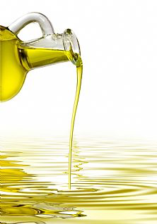
THE ANOINTING BREAKS YOKES
WE HAVE HIS ANOINTING OIL. POUR IT OUT TO LIVE

Slide 11
ANOINTING Oil In You
We have an anointing… I John 2:20,27…but you have an anointing from the Holy One…the anointing abides in you…
The Spirit of God is upon you because God has anointed you….Isaiah 61:1…the Spirit of the Lord is upon Me. Because…the Lord has anointed Me…
God anointed Jesus…Acts 10:38…God anointed with the Holy Spirit & with power..doing good, healing all……

Slide 12
Let THE RIVER Flow
- The ANOINTING oil -
Jesus said…Out of your heart will flow rivers of Living Water…John 7:38
Each One of us grace was given according to the measure of Christ’s Gift…Ephesians 4:7
Manifesting His Spiritual Completeness & Exercising our Spiritual gifts in Unity…Ephesians 4:13

Slide 13
YOKED TOGETHER IN UNITY
-Anointing Oil Flows-
Psalm 133:1-3 “Behold, how good and how pleasant it is For brethren to dwell together in unity! It is like the precious oil upon the head, Running down on the beard, The beard of Aaron, Running down on the edge of his garments. It is like the dew of Hermon, Descending upon the mountains of Zion; For there the LORD commanded the blessing - life.”‭

Slide 14
GET INTO God’s YOKE
Exercising Your God Given Gifts is Being Yoked With God’s intent & Purpose…Ephesians 4:17
We Are Laborers Together With Yokes Are Broken because of The Anointing Oil.. Isaiah 10:27…Corinthians 3:9
Yokes Are Broken Because of The Anointing Oil.. Isaiah 10:27
Yoked with God in His calling for you brings rest. Matt.11:28-30

Slide 15
THE YOKE OF CHRIST
Matthew 11: 28-30 “Take My yoke upon you and learn from Me, for I am gentle and lowly in heart, and you will find rest for your souls. For My yoke is easy and My burden is light.”
Your Yoke Is Christ’s Design For You To Live In.
Inheritance Comes Through Your Calling For You.

