Slide 1


RPL Induction

Slide 2

#RPL
Welcome!
Welcome!
Welcome!
Welcome!
Welcome!

Slide 3


#RPL Assessment
Your Learning Objectives
To understand the definition of RPL
To understand your RPL eligibility and the mapping process
To understand the fees associated with RPL
To understand the RPL Assessment process

Slide 4
The industry explained
Before we introduce you to the RPL process. It is important for you to understand the organisations involved and their roles.
CIMSPA is responsible for the professional standards which underpin job roles. These are developed in collaboration with industry employers.
Awarding Organisations develop regulated vocational qualifications to align to the CIMSPA professional standards. These are endorsed by CIMSPA as licence to practice certificates if they meet all the criteria.
Qualification certificates can then be used to support CIMSPA membership which is recognised by employers in their minimum operating standards.
Transcend is an Ofqual regulated Awarding Organisation. Transcend is a CIMSPA awarding organisation partner. Transcends industry qualifications are endorsed by CIMSPA and recognised by employers.
Transcend qualifications are delivered to learners through reputable education providers. INSPIRATUS is the training provider that is recognised by Transcend to deliver RPL services.

Slide 5
RPL Defined
Recognition of prior learning is the evidencable submission of learning you have completed, skills you have developed and your certificates of achievement ­prior to registering onto a new qualification. These attainments must be directly relevant and comparable to the knowledge and skills which would be assessed as part of the new qualification.
The purpose of RPL is to create the opportunity to recognise your achievements, map these to the new qualification and enable you to be exempt from some or all of the assessment criteria. An effective RPL process means that you do not have to repeat learning or assessment and commit more time to the new qualification than is necessary.

Slide 6
RPL Eligibility
Not everyone is eligible to complete the Transcend RPL process.
Some learners have achieved qualifications which have not been mapped to the new professional standards. Other learners have a wealth of experience having operated in the personal training industry for many years.
The RPL process will enable those with a similar substantial qualifications AND industry experience to achieve the Transcend Level 3 Diploma in Personal Training and associated CIMSPA professional standards. This is achieved by completing a comprehensive mapping exercise which must be supported by valid evidence.
The RPL process is therefore ONLY available to learners who have achieved a comparable substantial qualification OR a higher-level qualification AND have extensive industry experience in a relevant job role.
All other learners are required to attend and register onto a full programme of learning and assessment.

Slide 7
RPL evidence
The evidence required to be mapped and submitted for the Transcend Level 3 Diploma in Personal Training as a MINIMUM:
A comprehensive resume showcasing your industry experience
Copies of valid regulated qualification certificates and transcripts
Employer and client testimonials using the templates that we have designed for you
Evidence of working with a real participant in a live personal training environment through a documented client profile and progressive programme that shows how your client improved.
For those who completed their qualifications years before, evidence of CPD certificates must be provided.

Slide 8
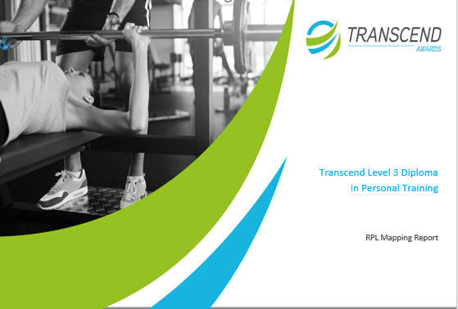
RPL Mapping
To determine your eligibility for RPL you should collate all of your evidence and map this to the criteria in the qualification.
Please open your RPL Mapping document to commence the process.
We will walk you through this right now!

Slide 9
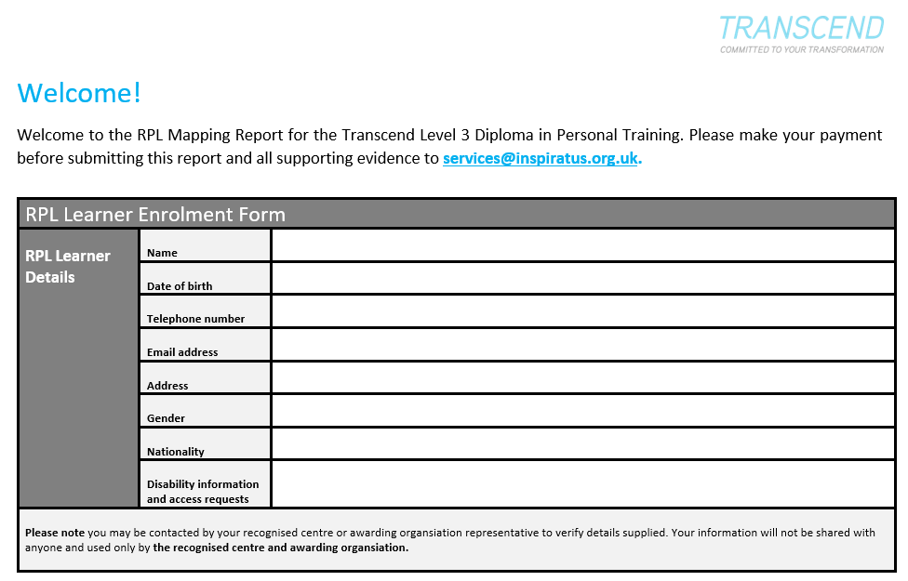
RPL Mapping
Please turn to page 2 of your RPL mapping document.
Insert your personal details.
This is required to be able to register you onto the qualification if you decide to proceed with the RPL process.

Slide 10
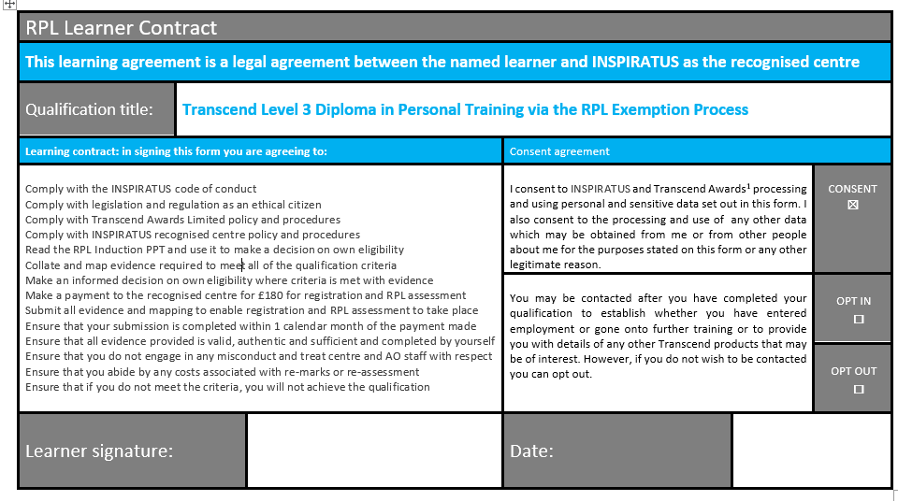
RPL Mapping
Please turn to page 3 of your RPL mapping document.
Complete the declaration and data content form to confirm your Learner Contract
We cannot register you without this being completed.

Slide 11
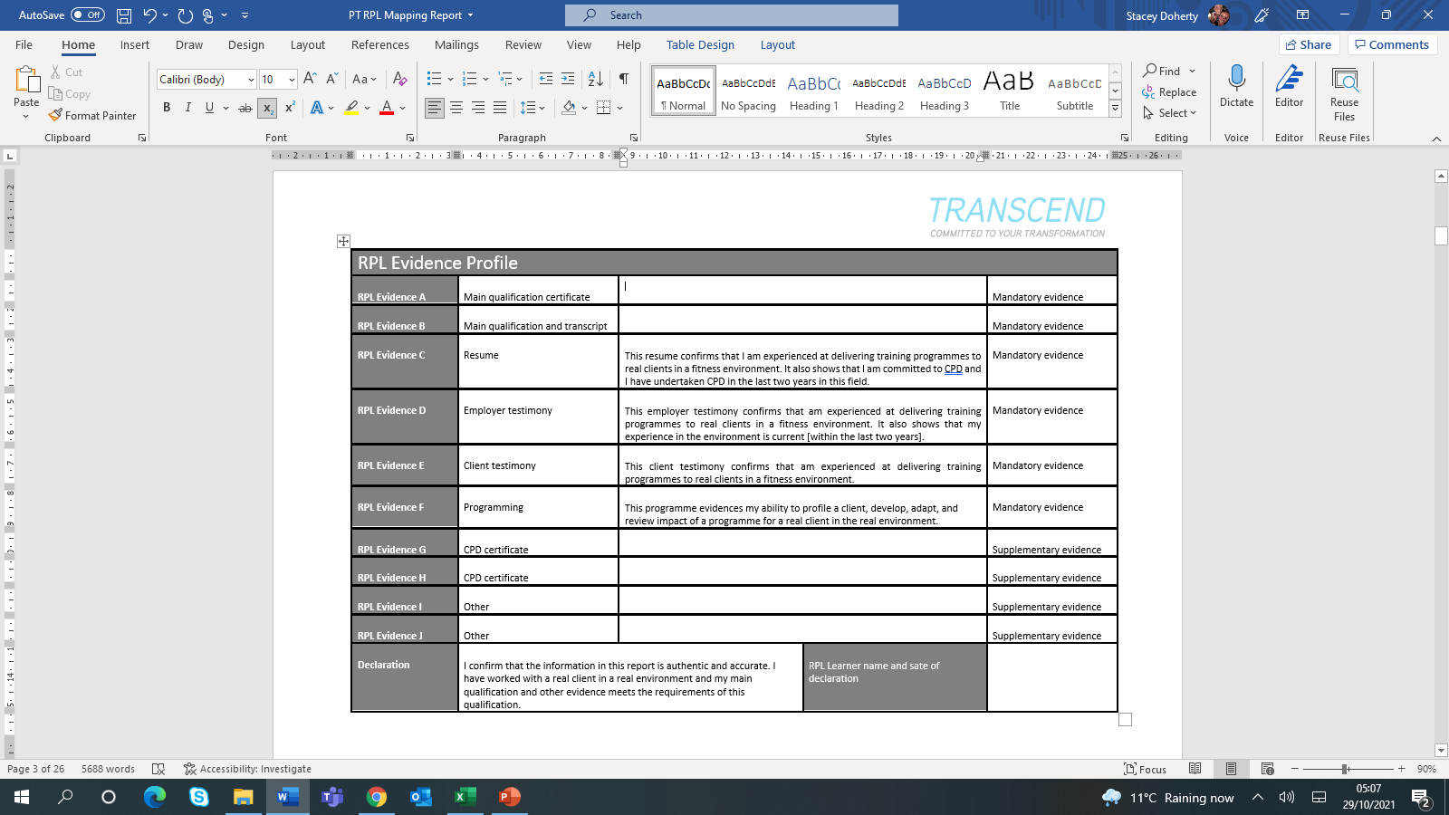
RPL Mapping
Turn to page 4 to populate your RPL Evidence Profile by listing the evidence of your achievements
You will see that some of the evidence descriptions have been completed to help you.
This refers to the statements associated with your resume, employer testimonial, client testimonial and client profile and programme.

Slide 12
RPL Mapping
Remain on page 4 of your RPL Mapping Document and populate the boxes provided with information on your substantial and comparable qualification achievement. Here are some examples:
If you have two significant qualifications – simply choose one to populate here and use the CPD space further down the page to add the other. You must always submit a transcript – without this we cannot do the RPL assessment.
Remember to save an electronic copy of your qualification certificate into a folder ready for submission and label this as EVIDENCE A. Then Save your qualification Transcript and label this as EVIDENCE B

Slide 13
RPL Mapping
Remain on page 4 of your RPL Mapping Document and prepare your resume! Make sure this is current and contains accurate information on your experience as a personal training in the live training environment. Also make sure that any CPD is captured in your resume as confirmed in the statement.
Remember to save an electronic copy of your resume into a folder ready for submission and label this as EVIDENCE C.

Slide 14
RPL Mapping
Remain on page 4 of your RPL Mapping Document and request you employer and client testimonials! If you are a sole trader we will accept a peer testimony from another qualified personal trainer in the industry.
You MUST have a minimum of one employer or peer testimony and one client testimony. If you wish to submit more to make your submission more comprehensive then this is good practice. Your evidence must showcase that you have worked in the industry in the last two years. You must use the testimony templates that we have provided to you as these are already mapped to the qualification skills criteria.
Remember to save electronic copies of your testimonials into a folder ready for submission and label these as EVIDENCE D and EVIDENCE E.
If you have two or more copies of testimonials it is recommended that you labels these as EVIDENCE D1, EVIDENCE D2, EVIDENCE E1 and EVIDENCE E2 and so on.

Slide 15
RPL Mapping
Remain on page 4 of your RPL Mapping Document and then request populate the spaces provided to showcase any RELEVANT CPD! Here are some examples:
RPL Evidence G | CPD certificate | Kettlebells Training Certificate safety [state the training company] | Supplementary evidence
RPL Evidence H | CPD certificate | Safeguarding Certificate [state the training company] | Supplementary evidence
RPL Evidence I | Other | In house training on health and safety [state the actual company] | Supplementary evidence
RPL Evidence J | Other | Publication of research into applied physiology | Supplementary evidence
Remember to save electronic copies of your CPD and other evidence into a folder ready for submission and label these as EVIDENCE G, EVIDENCE H, EVIDENCE I and EVIDENCE J
If you have more! evidence than spaces provided simply add some more boxes continue the labelling as shown

Slide 16
RPL Mapping
Remain on page 4 of your RPL Mapping Document to complete the declaration!
Well done! You are now ready to commence the mapping of your evidence to the qualification criteria!
Lets look at how to do this right now!

Slide 17
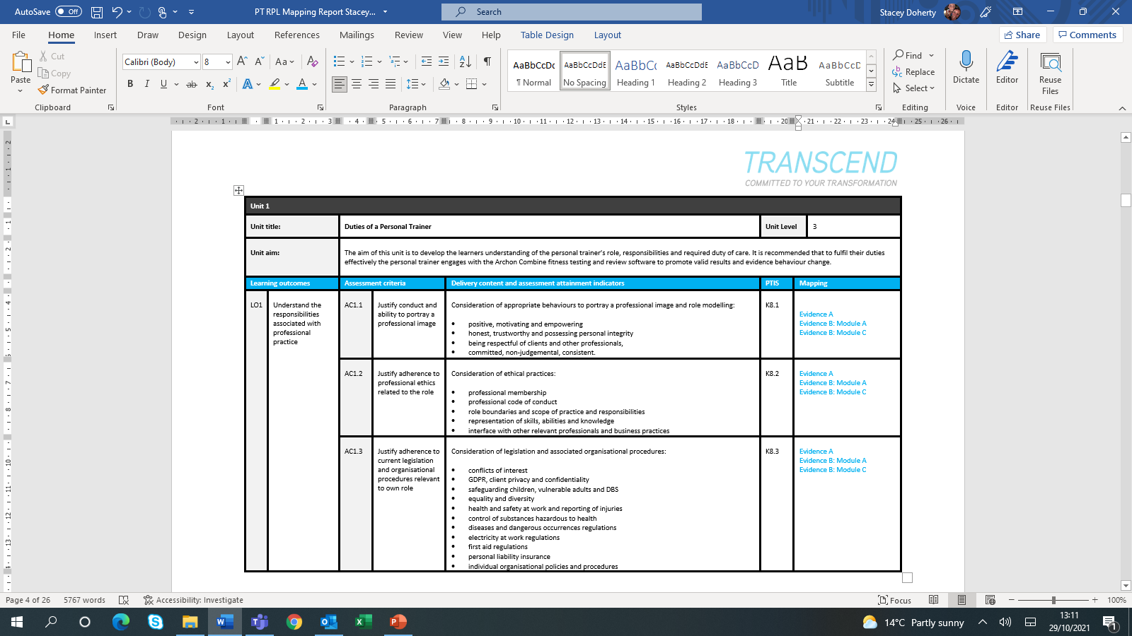
RPL Mapping
Turn to page 5 of your RPL Mapping Document to commence the mapping exercise!
Read through all of the qualification assessment criteria. Identify which of your evidence showcases when you achieved that criteria by checking the delivery content – then simply map it as shown here!

Slide 18
RPL Mapping
Units 1 – 6 are knowledge units. It is recommended therefore that you use your evidence from your qualification certificates and transcript to map into the criteria for these units.
In some cases you may find that simply stating Evidence B: Module B is enough and clear. For example if you have done an anatomy and physiology in a module in your degree or BTEC programme.

Slide 19
RPL Mapping
You might feel that sometimes you need to add a note for clarity as shown here:
You should not leave anything to chance – if you feel the need to clarify how you have met the criteria then make sure that you do!

Slide 20
RPL Mapping
Units 1 – 6 are knowledge units. It is recommended therefore that you use your evidence from your qualification certificates, transcript and CPD training to map into the criteria for these units.
Unit 7 is the skills based unit. is recommended therefore that you use your evidence from your employer testimonial and client testimonials and programme!
Don’t forget to map in evidence from your CPD where this is relevant!

Slide 21
RPL Mapping
Unit 8 is the business skills unit. Some learners have found this tricky to evidence.
Some people have a business qualification. Others have attended in house training. Others have managed the business, financials and marking and a sole trader. Here is an example:
If you do not have business planning evidence, please contact us as we have an assessment and guidance that you can complete and submit as evidence. Failure to request this in advance will lead to additional assessment charges.

Slide 22
RPL Mapping
Here are some frequently asked questions!

Slide 23
RPL Mapping
You must map your evidence to 100% of the criteria.
This does take time but will ensure that you have the best chance of success to be exempt from any additional assessments

Slide 24
RPL Mapping
Having completed the mapping you will see whether you are eligible. You must be able to evidence 100% of the criteria to be exempt from additional assessment and charges.
If you do not meet the majority of the criteria, please do NOT make an RPL submission and do register onto a full training and assessment programme.
If you are confident in that your mapping exercise showcases how you meet the criteria it is your decision to make a payment and submission. Payments are not refundable.
We will now describe the RPL Assessment process for those who wish to proceed.

Slide 25
RPL Process
STEP 01: RPL Payment and submission | To commence the RPL process please make sure that you are eligible. If you have a comparable or higher-level qualification AND current industry experience and you can evidence this in your mapping activities, then you are eligible. The fee for the RPL process is £180. This pays for your registration onto the qualification, RPL Assessment and the moderation procedures. If you require the additional Unit 8 assessment, payment will be £240. If you wish to proceed, you can use the secure STRIPE payment link (please use the same email address that we have responded to): £180 - https://buy.stripe.com/eVafZ7aD4gMkasw7ss £240 - https://buy.stripe.com/7sIcMVcLc2Vu6cg145 Alternatively please make a BACS payment to INSPIRATUS TRAINING LTD as your training provider. Please use your first initial, surname name and CIMSPA as a reference i.e: J.BloggsCIMSPA Sort Code: 16 58 10 Account Number 20318626 The fees are non-returnable. And in making the payment you are automatically agreeing to comply with the Learning Contract outlined on page 4 of the RPL Mapping Report. Having made the payment, PLEASE email services@inspiratus.org.uk who will send you a personalised link to submit your RPL Mapping Report and all evidence. If you require additional assessments due to failure to submit enough or inaccurate evidence, you will be charged for additional assessments as outlined in the next slide.

Slide 26
RPL Process
STEP 02: RPL assessment and results | Upon receipt of RPL Mapping Report and supporting evidence the INSPIRATUS will conduct the RPL Assessment as your recognised centre. Outcomes will be subject to internal moderation. The assessment and internal moderation processes can take up to 2 calendar months. Upon completion, one of the following outcomes will be confirmed: Outcome 1: Qualification Achieved. INSPIRATUS will submit results to Transcend as the awarding organisation. External moderation will be completed by Transcend and results or eCertficates will be released. External quality assurance and certification can take up to a further 2 calendar months. Outcome 2: Qualification Part Achieved. INSPIRATUS will notify you via email to confirm that your RPL mapping and portfolio of evidence has met more than 50% but less than 100% of the qualification criteria. You will be asked to complete a programme of learning and assessment for the criteria which you have not met. You will be charged at £60 per qualification unit where there are outstanding gaps. In the event that a practical observation is required in the live personal training environment with a real client this will be charged at £300 per observation plus travel fees for the assessor. Upon successful completion of the re-assessment all evidence will be submitted for internal moderation prior to confirmation of results. INSPIRATUS will submit results to Transcend as the awarding organsiation. External moderation will be completed by the Transcend and results or eCertficates will be released. External quality assurance and certification can take up to 2 calendar months. Outcome 3: Qualification Not Achieved. INSPIRATUS will notify you via email to confirm that you have not been successful. We will recommend that you attend a full programme of learning and assessment to complete the qualification.

Slide 27
CIMSPA Membership
Upon successful achievement of the
Transcend Level 3 Diploma in Personal Training you can submit your eCertificate to CIMSPA to support your application for CIMSPA membership.

Slide 28
#RPL
Thank you!
Thank you!
Thank you!
Thank you!
Thank you!

