Slide 1
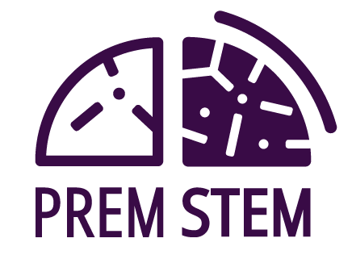
PremStem Co-creation Workshops
Reflections of a Clinical Stakeholder
Thursday 15th May 2025
PremStem Conference Barcelona
Mr William Dawes FRCS (SN) PhD
Notes:
I was asked to talk about my experience of being involved in the co-creation workshops
I was fortunate enough to be involved in four workshops
3 in 2022 and 1 in 2023

Slide 2
Brief..
“lay the foundations for societal and professional acceptance to perform clinical trials with stem cells in clinically fragile infants”

Slide 3
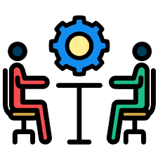
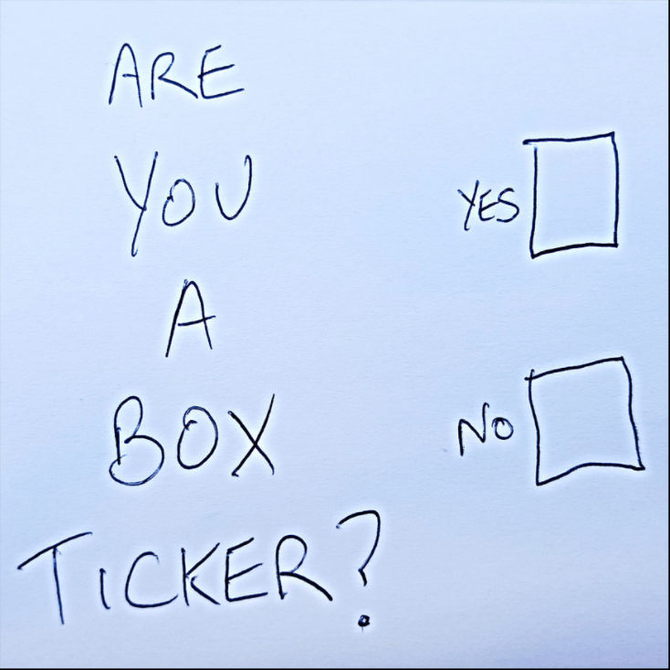
Going into the process
Keen to be involved
Skeptical.. but went with an open mind
Tick box or time well spent?
Notes:
My background as a Paediatirc Neurosurgeon
Main focus of research was really looking at Neonatal Intraventricular Haemorrhage and post haemorrhagic hydrocephalus
In truth since Yamanaka discovered his factors I’ve been really interested in the potential for this therapy to improve outcome
My PhD thesis was looking at the used of neural stem cells as therapeutic targets in germinal matrix haemorrhage
Its really encouraging to see how far the field has come and it is a real honour to be a small part of this conference so thank you to Hannah and the organisers for giving me this opportunity
So I guess going into the process I was keen to be involved – this is an area close to my heart so anything that helps to build towards this goal feels worthwhile
I have some experience with Patient and public engagement activities through the work I’ve done in setting up clinical trails but I’d never participated in a co-creation workshop before – or if I’m honest what the process would involve..
To be brutally honest I did have some reservations – request of funder or truly a useful exercise – I think as a clinician scientist we tend to think we already know what we need to know and – better off just getting on with the science – these exercises are to show willing rather than actually being a useful outcome driven process.
In short, would this be a tick-box exercise or time well spent ?

Slide 4

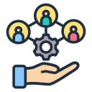
Experience of being involved
Motivating and thought provoking
Surprisingly emotional
Independent facilitator was key
No hierarchy of stakeholders
Notes:
The meetings were online and as I said I was fortunate enough to attend 4 workshops
We all had to use alias’ which was quite funny when you didn’t realise someone was talking to you.. But we muddled through..
All sessions began with an empathic story – this was grounding and sobering and gave context and import to the work
My main lasting impression was really the skill and patience of the facilitating team
I think achieving this in person is difficult but achieving this on-line was really an impassive feat – so I caveat my response by saying that I think we had an expert facilitator which made a big difference – my concern would be what the value of the process would be
Everything was designed to facilitate an open forum for discussion
I think we all internally role out eyes when we’re asked to participate – but I this was integral to the process and I have to admit that I did come to enjoy it..
Overall I think that I benefited from the process – I think it was expertly facilitated and really highlights the need to have a third party – level hierarchy with someone else leading I think is important.

Slide 5

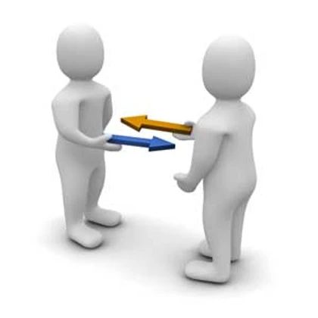
What I learned..
Patient and Public Involvement and Engagement is not a one-way process
Disconnect felt by scientists
Reflecting on the language used
More than just the science
Notes:
So difficult to quantify what came out of the workshops..?
Specifically to this trial
Language that we use
Overcoming our intrinsic bias whilst remaining enthusiastic about the trial
Balancing supportive care and giving parents time against being patronizing
Broader learnings from the process
Developing an understanding of the regulatory steps that need to be overcome
The number of stakeholders involved
The power of public and patient engagement
Brought home the reality of what is needed to bring this therapy into mainstream practice.. I guess the proof here is the quality of the therapy – if it works it will be adopted widely?
The was some realistion of the task ahead and how difficult introducing this new therapy might be
So what did I learn – profoundly I learned that PPIE is not a one way process – I like to think of myself as empathic and cognisant of others and their beliefs and expectations.
Reflect on the language that we use and what this means to parents
Reality of paying for the glasses (retinopathy of prematurity) – which I must profess I’d never really considered..
The need to care for the parents as well as the child – especially important for the scientists involved in the field – two way process to really see the benefit of the work being done..
Sadly there is a perception of PPIE being a tick box exercise
Coincided with PPIE work I was doing which showed the importance of assessing outcomes in shunt trials..
Participatory research
Community-Based Participatory Research – asking the public what they want / need in their area
Patient advocacy movements – HIV/AIDS demanding inclusion
Citizen science
Patient-centered healthcare
INVOLVE 1996 – pushed for patient and public involvement in science
Patients as collaborators rather than passive recipients

Slide 6
So in summary..
I personally benefitted from the process
Would the process be as meaningful without an expert facilitator?
Did we achieve our brief..?
Notes:
Undoubtably time well spent
Bringing this therapy into mainsteam practice will need more than good science.
Highly recommend to all stakeholders to engage
We had an expert facilitator – what would happen in the facilitator wasn’t as expert?
Tick box or time well spent – definitely from a personal perspective this was time well spent
Not real science – it’s over to you.. I think the sessions were as productive and engaging as this method can achieve ..

