Slide 1

Accessory Dwelling Unit’s
ADU’s & You

Slide 2
California’s housing Challenge
Inventory
Affordability
Rising Rents

Slide 3
California’s Solution
Assembly Bill 68 & 434 (AB 68 & AB 434)
Assembly Bill 1033 (ab 1033)
Senate Bill 9 (sb 9)
SENATE BILL 1211(SB 1211)

Slide 4
Opportunities created
Increased housing supply
Increased affordability/qualification
Additional Income
Multi-generational living
Increased Property Value

Slide 5
Who benefits?
Homeowners
Homebuyers
Realtors
Contractors
Lenders

Slide 6
AB 68 & 434
Assembly Bill 68 allows landlords and homeowners to add 2 more units – an ADU and a Junior Accessory Dwelling Unit (JADU) – on any residential lot. This means you can legally create a triplex on every single lot (if your lot meets size and setback requirements) according to the 2024 ADU laws in California.
Additional units can be added to existing multi-family buildings like apartment complexes. Building owners can convert any non-habitable rooms, like attics, basements, garages, etc. into legal additional units.
Under AB 68, municipalities will be required to approve the following:
Single Family Homes:
One ADU (up to 1,200 sq. ft.) and one Junior ADU (a unit of not more than 500 sq. ft. and contained entirely within an existing single-family structure) per lot.
One detached ADU (up to 1,200 sq. ft.) that is new construction, existing structure, or the same footprint as the existing structure, along with one JADU.
Multifamily Dwellings
Multiple ADUs within existing multifamily structures.
Two detached ADUs on a multi-family lot.
Assembly Bill 434 requires all California cities and municipalities to have a pre-approved ADU plan scheme in place by January 1, 2025. In order for plans to be pre-approved for use by applicants or other property owners in the future, cities must review and accept submissions for them, typically by an architect. Cities may choose to charge a fee to access the designs, and for processing, as well as for modifications required to meet property-specific requirements.

Slide 7
AB 1033
New Law - AB 1033
California has historically allowed local agencies to prohibit the separate sale of ADUs from the primary dwelling for owners, investors, and developers. Assembly Bill 1033 will allow homeowners to sell one or more ADUs separately from their primary residence. The law authorizes (but does not require) local agencies to adopt local ordinances allowing ADUs to be sold as condominiums separately from the primary dwelling with approval from the California Department of Real Estate. Homeowners may consider creating a Homeowners Association (HOA) between the primary residence and the ADU to manage the common property.

Slide 8
Zoning and Land Use
Double check zoning requirement and ensure condominium conversions are allowed.
Submit application to local planning department for land use approval.
Condominium Plan
Set up an association to manage the new condominium(s).
Have a public report prepared detailing information on the property, the units and the association.
Have a new plat map drawn, legally defining the divided units and common areas.

Slide 9
Legal Documents
Covenants, Conditions and Restrictions, (CC&Rs), need to be drawn for the association.
A Homeowner’s Association (HOA) needs to be established to manage rules, dues and recurring expenses.
Title work
The title company will work on preparing new legal descriptions and setting up new parcel number(s) with the tax assessor.
Next a deed will need to be drawn for each individual unit.
Local approval
Once documents are completed, they will need to be submitted to the city or municipality for approval.
The local government will approve the Final Map and the Condominium Plan
State Approval
AB1033 removed the statewide prohibition regarding conversion of an ADU to a condominium.
This does not mean your new condominium is automatically approved.
An application will need to be submitted to The Department of Real Estate (DRE) for a Public Report aka Subdivision Public Report.
The DRE will also review the plan for compliance with Consumer Protection laws.

Slide 10
Final Steps
Once all plans are approved, it is time to complete the sale of your new unit!
You will want to open escrow with the title company that helped prepare the legal description for the deed.
Upon funding the sale, title will record the deed with the county recorder and the transaction will be complete.

Slide 11
SB 9
Senate Bill 9. This relates to duplexes and lot splits. SB 9 provides for the ministerial approval of converting existing homes occupied by a homeowner into a duplex if certain eligibility restrictions are satisfied. It also allows a single-family home lot to be split into two lots, and a duplex to be built on each lot, provided that the initial home is occupied by the owner as their primary residence for at least three years.
Some key points of SB 9:
Projects must be for residential use only.
Properties are within an urbanized area designated by the City and are not within agricultural, historic, and very high fire severity zones.
Parking requirements need to be met unless ½ mile from a public transportation stop.
The project will be subject to local short-term rental requirements.
May include connected structures (duplex) if they comply with building code safety standards.
If a lot is split, the project may be subject to City or County easements and must be roughly split in half.
Lots must meet minimum size requirements for a lot split.
The lot cannot be adjacent to another lot that has been split using SB 9.
Please keep in mind there are exceptions and restrictions to SB 9 that need to be fully understood.

Slide 12
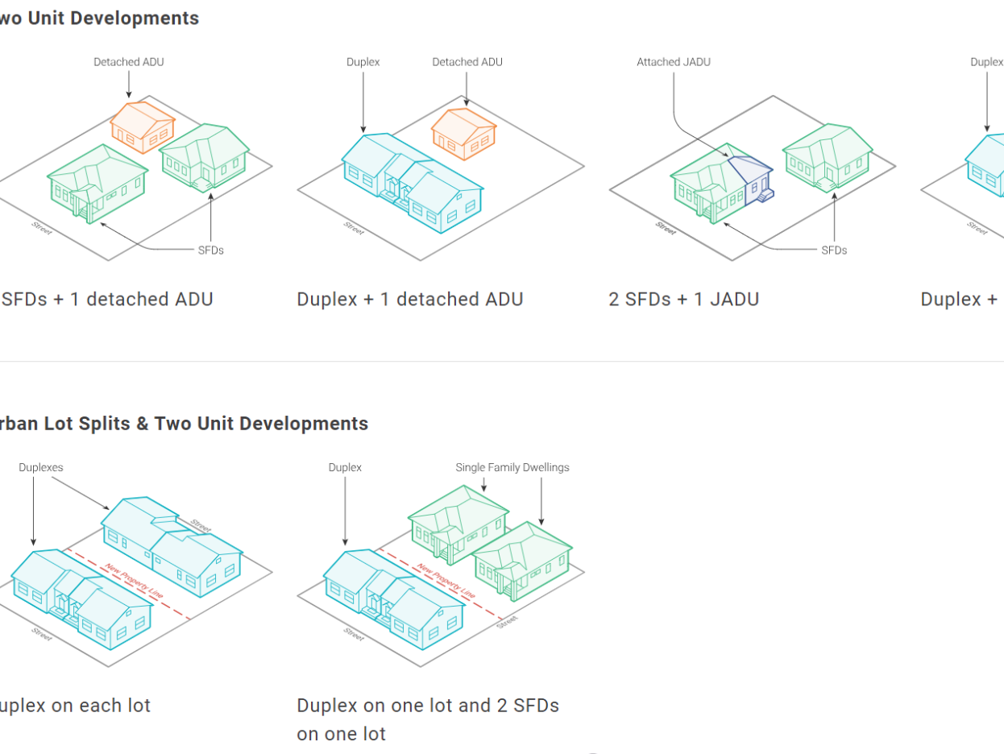

Slide 13
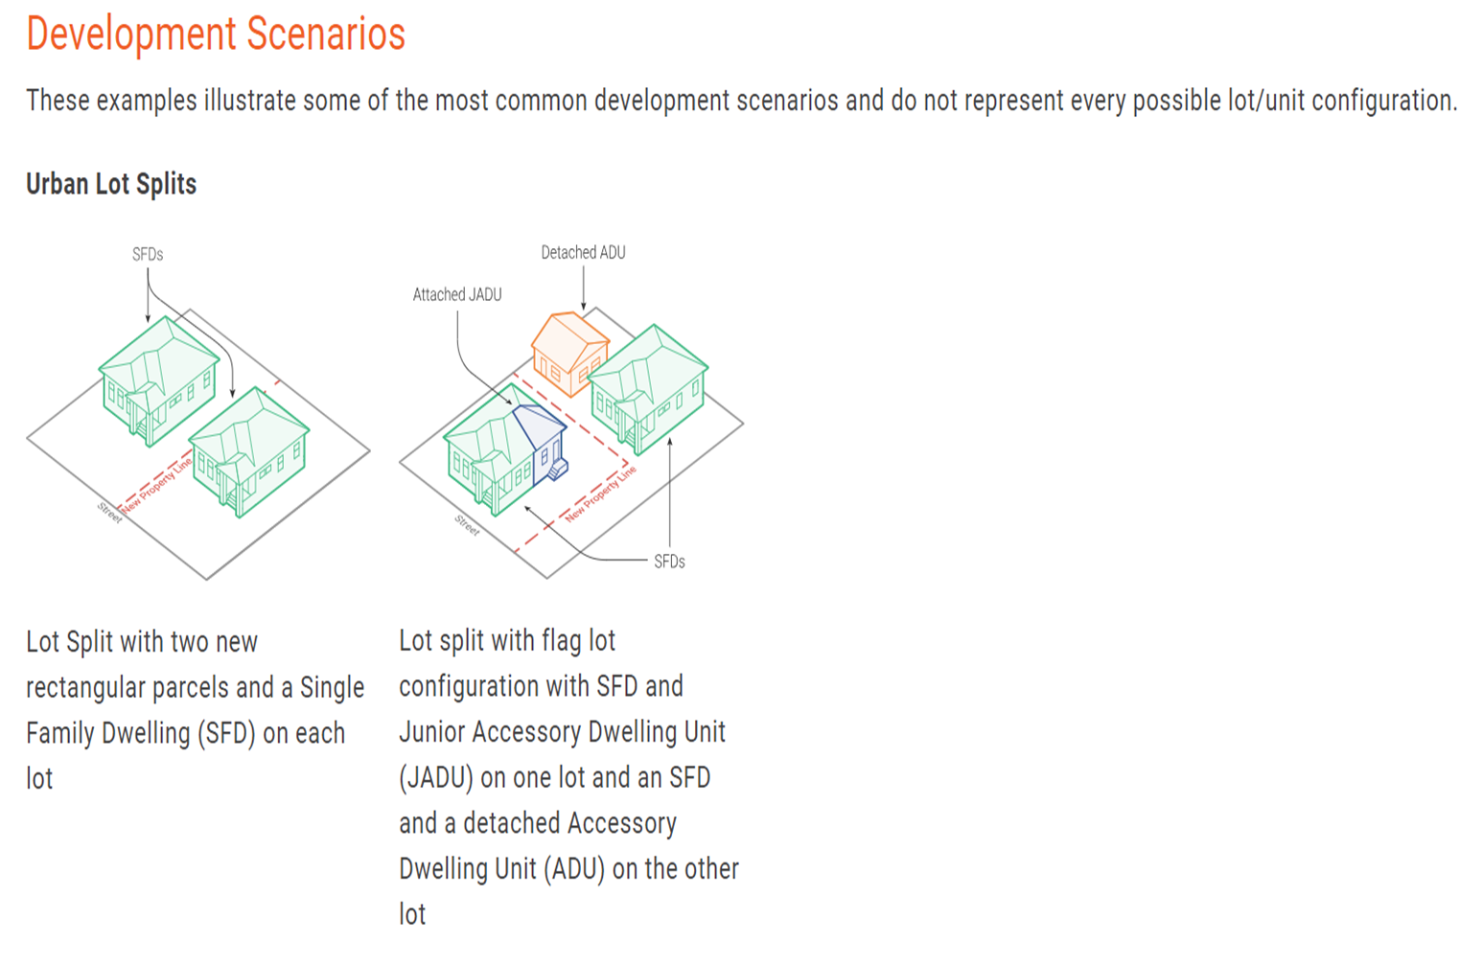

Slide 14
Lenders and lot splits.
FNMA, FHLMC, FHA and VA will allow a partial release which allows for lot splits. Each one has slightly different requirements. The servicer may also have additional requirements.
Items required by First Bank:
Current appraisal (ordered by lender/servicer) reflecting value of property before and after the release.
A survey of the full property reflecting the land to be released showing location of any structures.
Copy of the purchase contract if applicable
Updated legal description of land to be released and land to be retained
Partial release document to be prepared by an attorney or title company.
*Items above subject to change by agencies or First Bank.

Slide 15
SB 1211
SB 1211 will continue this trend and encourage more ADUs on multifamily properties by removing common barriers to their construction.
Current law allows up to two detached ADUs on properties with multi-family housing, as well as additional interior ADUs – example, they are built within the existing building, such as in a basement or garage.
This restriction on the number of detached ADUs, combined with the requirement that additional homes may only be built within existing structures, means that many properties cannot legally accommodate more homes – even if they have room to build them.
SB 1211 increases the current restriction on the number of ADUs on a multifamily property that can be detached from 2 to up to 8, depending on the existing number of multifamily units on the site. SB 1211 also prohibits local governments from requiring replacement of surface parking spaces when existing parking is repurposed for ADUs.
The number of ADU’s cannot exceed the number of units. For example, a 5-unit property is limited to 5 ADU’s.

Slide 16
Financing
HELOC’s
Cash-Out Refinance
Construction Loans
Home Improvement Loans
*Caution – Although the state allows 2 ADU’s per property. The financing agencies only allow 1. FNMA, FHLMC, FHA & VA.

Slide 17
Resources
https://symbium.com/research/california-adu/ventura
https://www.ezplans.com/blog/2024/01/05/2024-guide-to-the-new-adu-laws-in-california/
https://cayimby.org/legislation/sb-9/
https://www.ventura.org/residents/housing/
https://nationalmortgageprofessional.com/news/adus-can-now-be-sold-separately-california
https://cayimby.org/legislation/sb-1211/

