Slide 1
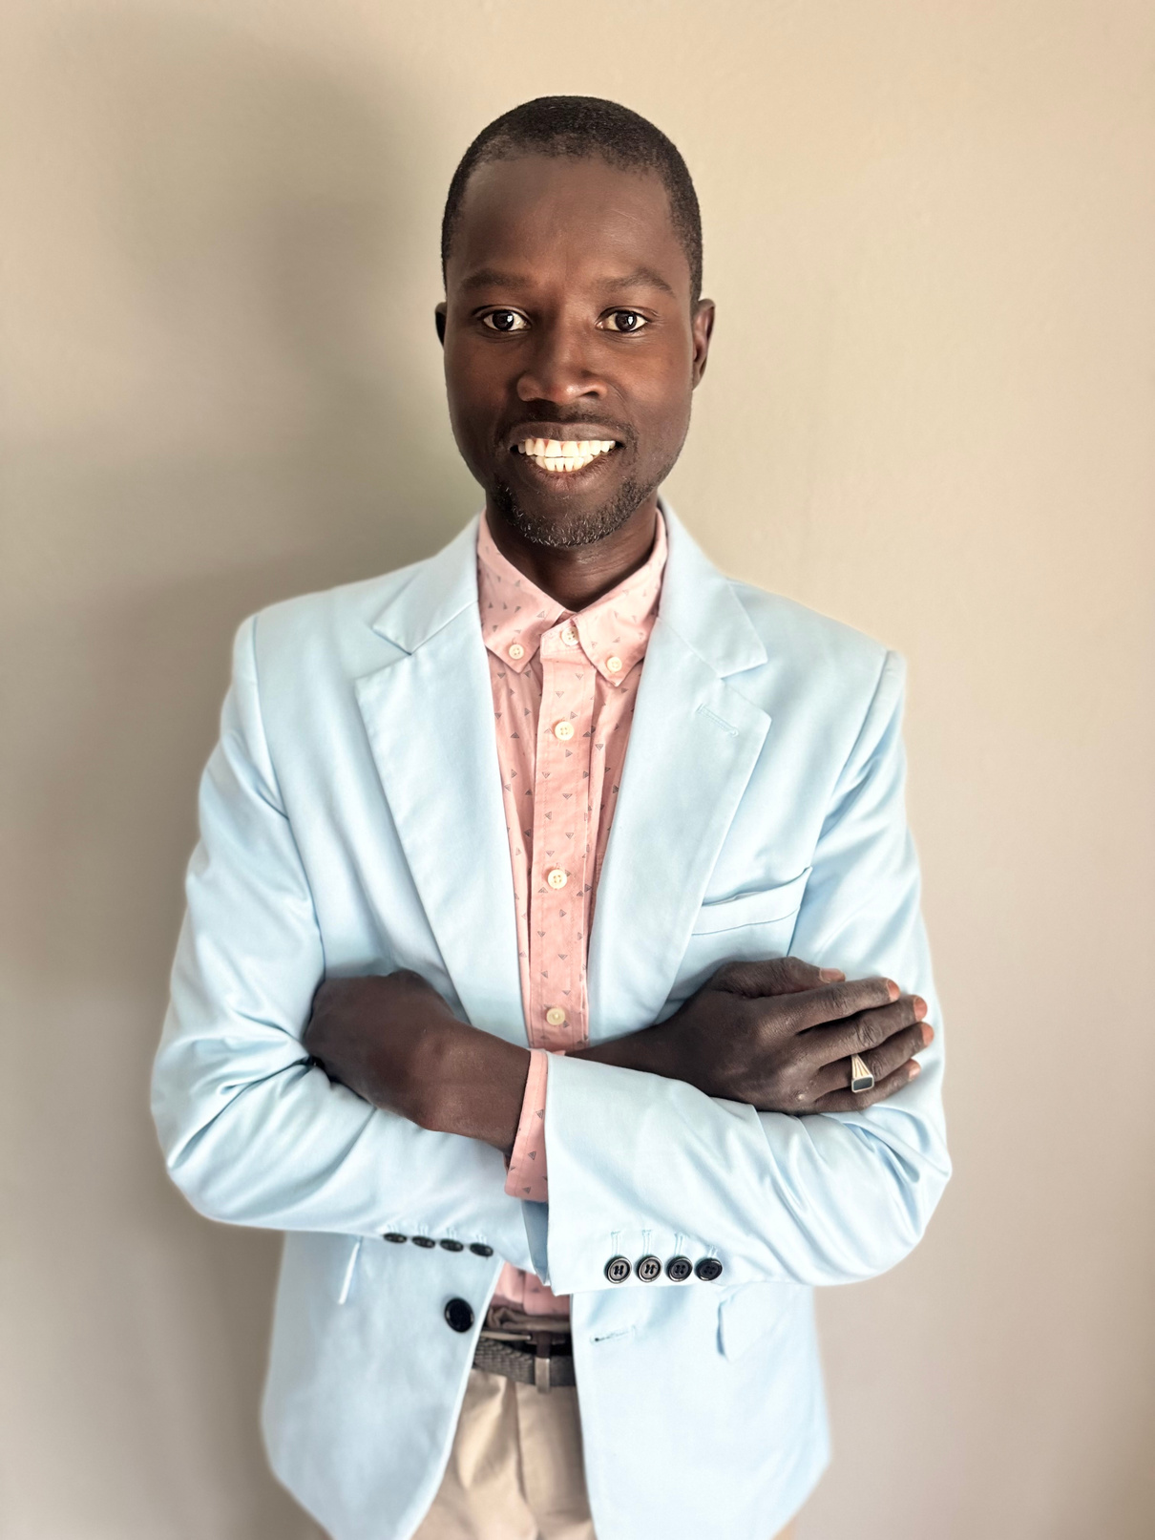



WATSO FOR AURORA CITY COUNCIL
AT LARGE
FIVE POINT CAMPAIGN
PROPOSAL
Prepared By
WATSON GOMES
AURORA, Colorado
www.watsonforaurora.com

Slide 2

INTRODUCTION
This campaign proposal outlines a comprehensive vision for Aurora, focusing on affordable housing, education, childcare, public safety, and job creation. The objective is to foster inclusive, sustainable communities where every family can thrive.
SUMMARY
As your next City Councilmember, I am committed to advocating for:
  Affordable housing and community-led redevelopment
  Support for education and early childhood programs
  A compassionate approach to homelessness
  Improved public safety through community trust
  Job creation rooted in local investment

Slide 3
OBJECTIVE
This campaign proposal outlines a comprehensive vision for Aurora, focusing on affordable housing, education, childcare, public safety, and job creation. The objective is to foster inclusive, sustainable communities where every family can thrive.

Slide 4

THE PROBLEM
Aurora faces a pressing issue of inequality in housing, education, and employment opportunities. Many families struggle to find safe, affordable housing while lacking access to quality education and childcare. The homelessness crisis continues to grow, exacerbated by inadequate support systems. Furthermore, public safety measures often lack community trust and accountability, leading to heightened fears rather than safety. Addressing these interconnected challenges is crucial for fostering a thriving, inclusive city where every resident feels secure and valued.
This campaign matters because it aims to create a sustainable future for all families in Aurora, ensuring that everyone has the opportunity to thrive in a safe and supportive environment.

Slide 5

WATSO FOR AURORA CITY COUNCIL
At LARGE
SOLUTION: 1
As your future City Councilmember, my commitment is to advocate for affordable housing, childcare, education/environmental sustainability, job creation, and the establishment of safe, inclusive, and sustainable communities throughout Aurora. Every family deserves a secure and stable home, and we must take decisive action to turn this vision into reality.
1 Housing, Neighborhoods, and Redevelopment
Increase Affordable Housing—Community-Driven Initiatives
  Empower City Development: I will promote a program where Aurora takes on the role of a builder, not just a regulator, to decrease costs and guarantee affordability.
  Incentivizing Affordability: Collaborate with private developers by providing incentives, expedited permitting, and flexible zoning for projects that incorporate affordable housing units.
  Support First-Time Homebuyers: Expand down-payment assistance and housing counseling to help working families secure their first homes.
Revitalize Neighborhoods with Purpose and Equity
  Redevelopment with Dignity: Convert vacant lots and neglected spaces into vibrant housing, small business areas, and green public parks.
  Sustainable Practices: Ensure that all redevelopment adheres to green building standards to minimize environmental impact.
  Cultural Preservation: Safeguard historic sites and culturally significant regions to maintain community pride.
Promote Homeownership and Stability
  Educate Communities: Offer free workshops covering budgeting, home upkeep, and tenant rights.
  Tax Relief for Residents: Advocate for tax breaks or caps for seniors and long-term residents to prevent displacement.
  Protect Tenants: Strengthen regulations to protect renters from unjust evictions and uncontrolled rent increases.

Slide 6
WATSO FOR AURORA CITY COUNCIL
At LARGE
SOLUTION: 1
Solution 1 Solution 1 Housing, Neighborhoods, and Redevelopment
Invest in Community Infrastructure and Quality of Life
  Enhance Connectivity: Improve sidewalks, bike lanes, and public transportation in housing zones.
  Comprehensive Services: Collaborate with nonprofits to offer integrated services—childcare, healthcare, job training—near affordable housing.
Engage the Community in Decision-Making
  Community-Led Planning: Establish neighborhood forums and advisory boards that empower residents to influence redevelopment.
  Inclusive Representation: Ensure that BIPOC, immigrant, and low-income voices shape housing decisions.
Plan for Sustainable Growth
  Focus on Density: Encourage mixed-use developments near public transport and job centers to limit sprawl and protect green spaces.
  Ensure Balance: Make certain that new developments include parks, libraries, and community centers for improved livability.
Address Homelessness with Compassion and Solutions
  Homelessness is a systemic issue, not a personal failing. As your City Councilmember, I will tackle homelessness as a solvable challenge in housing and public health.
Expand Permanent Supportive Housing
  Invest in “Housing First” initiatives that provide stable housing without preconditions, alongside supportive services like mental health care.
  Utilize city-owned land for the development of permanent supportive housing.

Slide 7
WATSO FOR AURORA CITY COUNCIL
At LARGE
SOLUTION: 1
Solution 1 Solution 1 Housing, Neighborhoods, and Redevelopment
Establish a Homeless Response Task Force
  Collaborate with housing experts and community members to create data-driven strategies.
  Foster coordination among police, health services, and outreach teams for comprehensive care.
Prevent Homelessness Before It Occurs
  Offer emergency rental assistance and mediation services to avert evictions.
  Streamline access to state and federal support systems.
Create Transitional Housing and Safe Shelter Options
  Develop tiny home villages and safe overnight shelters with on-site services.
  Support low-barrier shelters that accommodate families and individuals with pets.
Prioritize Outreach and Comprehensive Services
  Fund outreach teams trained in trauma-informed care and mental health.
  Provide mobile clinics and job readiness support for those experiencing homelessness.
Collaborate with Regional Initiatives
  Work alongside the Metro Denver Homeless Initiative to align resources and expand outreach efforts.

Slide 8
WATSO FOR AURORA CITY COUNCIL
At LARGE
SOLUTION: 2
EDUCTION/ENVIRONMENT
Enhance Teacher Compensation and Retention
  Create incentives for teachers in underserved schools, including loan forgiveness programs.
Fully Fund Public Education
  Advocate for increased funding for K–12 schools, updated technology, and smaller class sizes.
  Support essential services such as mental health counselors and after-school programs.
Expand Early Childhood Education
  Boost funding for accessible pre-K programs and partner with community organizations to establish early learning hubs.
Transform Community College into City University
  Advocate for program expansions in technology, healthcare, and trades, and seek funding to reduce tuition costs.
Address Local Student Debt Crisis
  Support scholarship funds and promote financial literacy initiatives in high schools.
Make Schools Community Hubs
  Keep schools open for adult education, job training, and community events.
Champion Career and Technical Education
  Expand vocational training in high schools and create pathways for dual enrollment.

Slide 9
WATSO FOR AURORA CITY COUNCIL
At LARGE
SOLUTION: 2
EDUCTION/ENVIRONMENT
Quality education is a cornerstone for a thriving community. I aim to enhance educational opportunities while also addressing environmental issues. This includes investing in green initiatives within schools and promoting curricula that focus on environmental stewardship. A well-educated populace is vital for addressing future challenges and ensuring a sustainable environment.
Issue:
Aurora consistently struggles to meet federal clean air standards due to high levels of ground-level ozone and PM2.5. This pollution is primarily caused by traffic, oil and gas activities, and regional wildfires. The impact is severe, exacerbating asthma and other respiratory illnesses, especially in vulnerable populations such as children and older adults.
Priority Actions:
  Expand Electric Vehicle Charging & Incentivize Clean Transit
    Implement more electric vehicle (EV) charging stations throughout the city.
    Provide incentives for residents to use clean transportation options, such as electric buses and carpooling.
    Goal: Reduce tailpipe emissions, which are the primary sources of particulate matter (PM) and ozone.
  Strengthen Emissions Regulations
    Enforce stricter emissions controls on industrial operations and oil and gas entities.
    Require regular monitoring and reporting of emissions to ensure compliance with environmental standards.
    Goal: Significantly reduce ozone precursors and improve air quality.

Slide 10
WATSO FOR AURORA CITY COUNCIL
At LARGE
SOLUTION: 3
CHILDCARE ACCESS
Every family in Aurora deserves access to safe, high-quality childcare, irrespective of income or work schedule. We must take bold actions to provide families with extended hours and financial support.
Collaborate with Community Organizations
  Increase capacity by partnering with trusted local nonprofits and offering microgrants for childcare programs.
Strengthen Access to State Assistance
  Establish a task force to help families navigate child care assistance programs.
Expand Aurora Public Schools’ Early Childhood Offerings
  Advocate for extended hours and increased city investment in before- and after-care services.
Support Cooperative Childcare Networks
  Facilitate the formation of licensed micro co-ops to reduce costs.
Extend Operating Hours for Daycare Services
  Partner with providers to offer extended care hours for working families.
Create an Online Resource Hub
  Develop a centralized portal for affordable childcare information in multiple languages.

Slide 11
WATSO FOR AURORA CITY COUNCIL
At LARGE
SOLUTION: 4
PUBLIC SAFETY WITH COMMUNITY ACCOUNTABILITY
Public safety must be grounded in justice and collaboration. As your councilmember, I will advocate for a system where residents are protected by law enforcement, fostering trust within our communities.
Establish a Community Public Safety Council
  Create a permanent advisory council composed of diverse community members to influence safety policies.
Enhance Civilian Oversight and Accountability
  Strengthen the powers of oversight bodies to investigate misconduct and require public reporting.
Implement a Restorative Justice Initiative
  Offer alternatives to arrest for non-violent offenses through community mediation and restorative sessions.
Improve Officer Training and Involvement
  Equip officers with de-escalation and cultural competency training, while encouraging community engagement.
Ensure Transparent Data Access
  Develop a dashboard to track public safety data and hold regular community discussions.
Invest in Violence Prevention Programs
  Fund community-based initiatives to address the root causes of crime.

Slide 12
WATSO FOR AURORA CITY COUNCIL
At LARGE
SOLUTION: 5
JOB CREATION
A safer, stronger Aurora begins with job creation. My plan aims to generate quality, community-centered jobs through investments in childcare, public safety, and restorative services.
Initiate a Community Jobs Corps
  Create a program to hire local residents for essential public service roles, focusing on safety and equity.
Invest in the Childcare Workforce
  Expand and elevate the childcare workforce while ensuring better wages and standards.
Grow Public Safety Jobs with Accountability
  Redirect resources to create community safety roles that foster trust.
Enhance Mental Health and Crisis Response Jobs
  Hire skilled non-law enforcement responders to manage crisis situations effectively.
Develop a Digital Job Hub
  Launch an online portal to connect residents with job opportunities created through city initiatives.
Support Small Business Growth
  Provide grants and resources to fuel local entrepreneurship and job creation.

Slide 13
VOTE
WATSON GOMES
AURORA CITY COUNCIL AT LARGE
Childcare is essential infrastructure. As your City Council member, I will advocate for working families and ensure every child in Aurora receives the best possible start.
This is more than a jobs plan; it’s a vision for community prosperity. By investing in essential services, we will build a city where every resident has access to opportunities and a pathway forward. Let’s ensure Aurora works for everyone.
Justice must be a foundational principle, not an option. With your support, I will work to create a public safety system that prioritizes community voices and protects all residents with dignity and transparency.
HELP OUR CAUSE
Your support and contributions will enable us to meet our goals and fund our initiatives to create a brighter future for our students and community.
GO TO https://watsonforaurora.com/donate
Watson for Aurora city council
At LARGE

