Slide 1
Applying MS-Thermashield

Slide 2
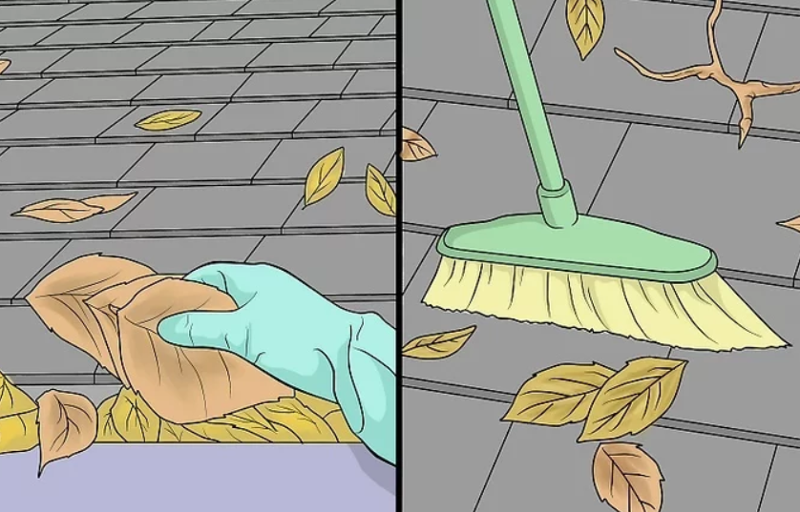
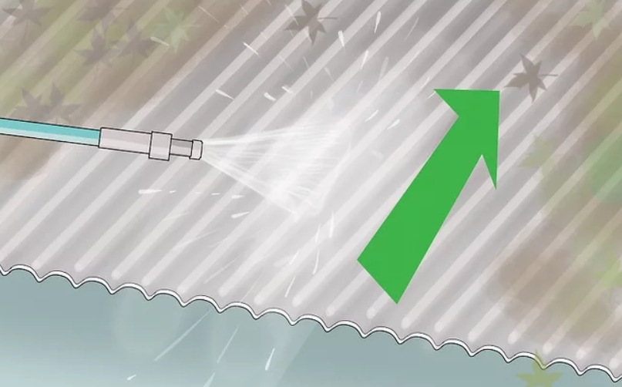
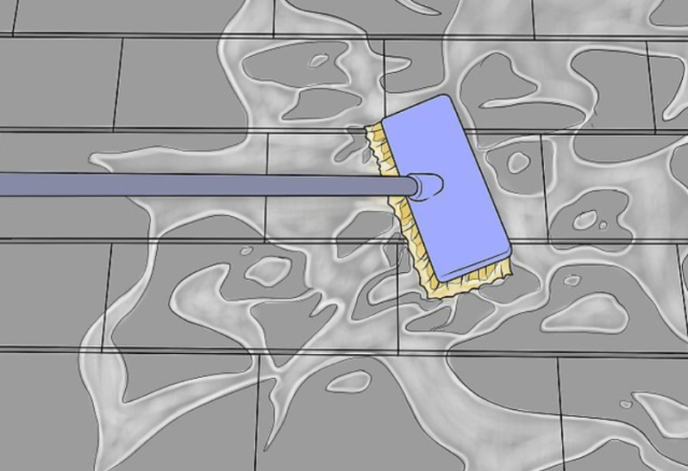
Clean Roof
1. Clean Roof by removing loose debris and using a stiff brush to remove any visible debris
2. Power wash to remove the bake on dirt and debris
3. Scrub remaining dirt and debris and power wash the area again. Allow the surface to dry (at lease 24 hours).

Slide 3
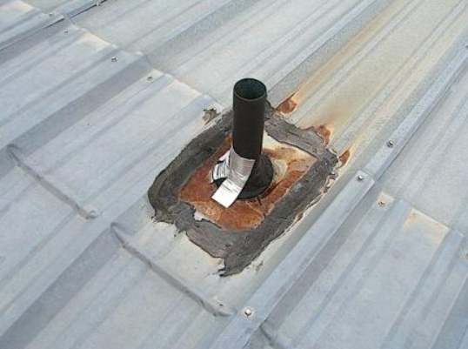
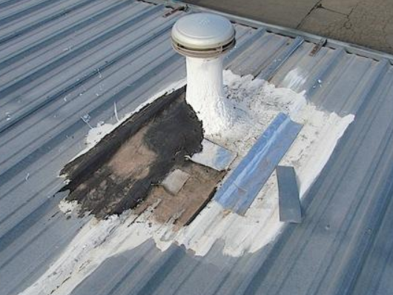
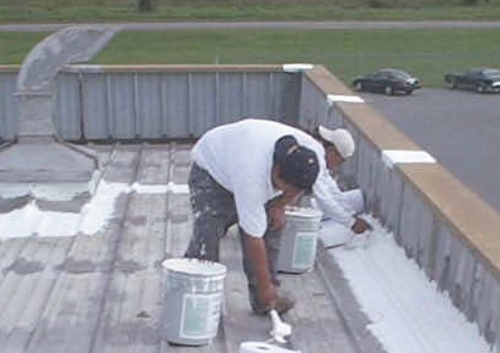
Inspect and Treat Problem Area
1. Remove rust by using wire brush.
2. Repair any leaks and other damages by patching it with compatible materials and sealant. Replace the roofing material if can not be repaired.
3. Apply MS-Prime on the repaired surfaces over the patches and sealants. This step is very important, MS- Thermashield is a top coat that is meant to flex, not a roof sealer.

Slide 4
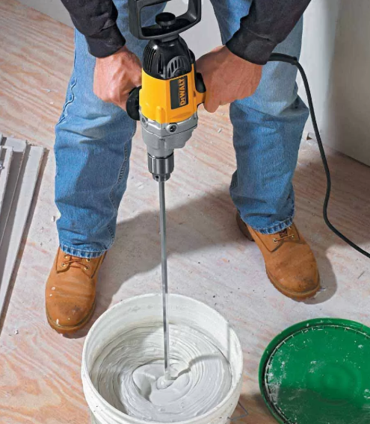
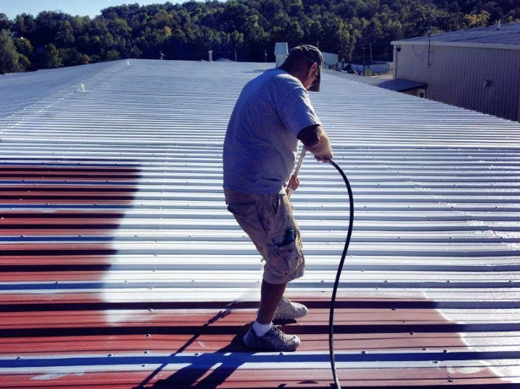
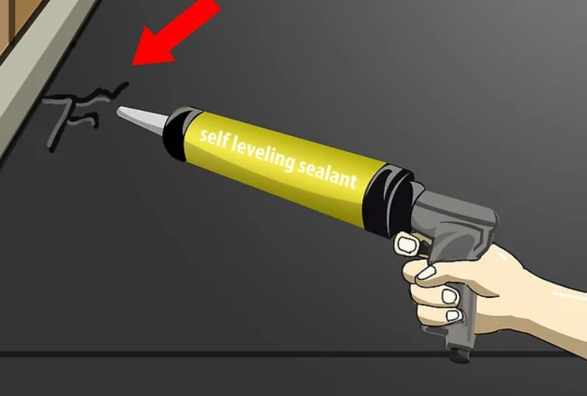
Apply Primer
2. Apply primer using spray, brush or roller. Apply a minimum of 6 mil wet thickness. Allow primer to dry.
3. Inspect primed roof for possible leaks and damages. If damages are found, treat the problem area per previous steps.
1. Mix MS-Prime by using a spin mixer. Mix completely for 5-10 minutes until the mix is homogenius.

Slide 5
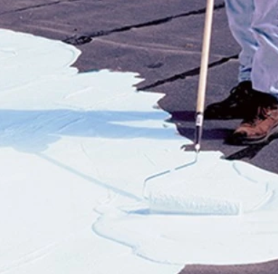
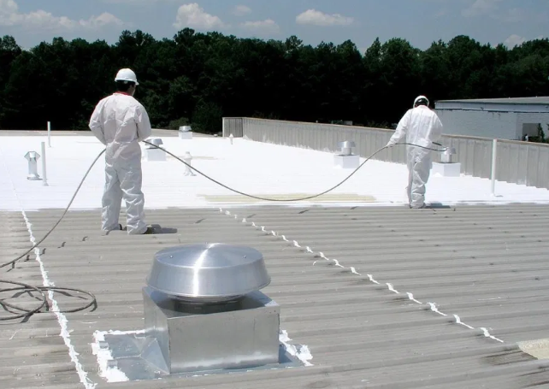
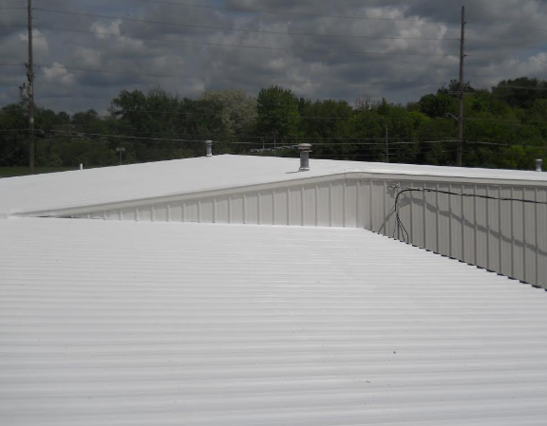
Apply Top Coat
1. Apply top coat by using brush, roller or spray (Graco Pro Sprayer are ideal).
2. Apply a minimum of 6 mil wet coat as evenly as possible.
3. Inspect the roof to make sure that proper even coverage is applied. If needed due to different surface apply a second 6 mil coat.

