Slide 1
Webex Meeting Dates
Tuesday Night Meetings – 7:30 – 8:30 pm
10/6, 10/20, 11/3, & 11/17
Saturday Morning Meetings – 9:30 – 10:30 am
10/17, 11/14, 12/12, 1/16 & 2/13

Slide 2
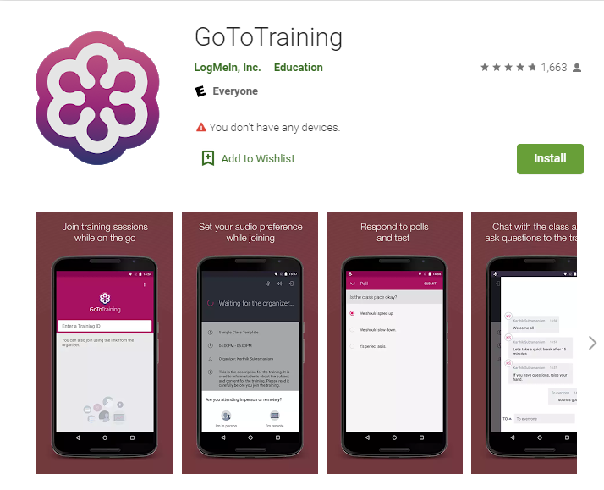

Download GoToTraining for Apple Or Android (if you wish to use a Tablet or Phone)

Slide 3
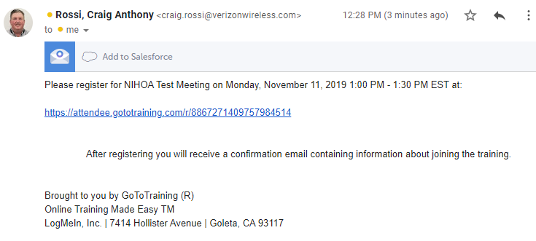
You will get invite to register for the call

Slide 4
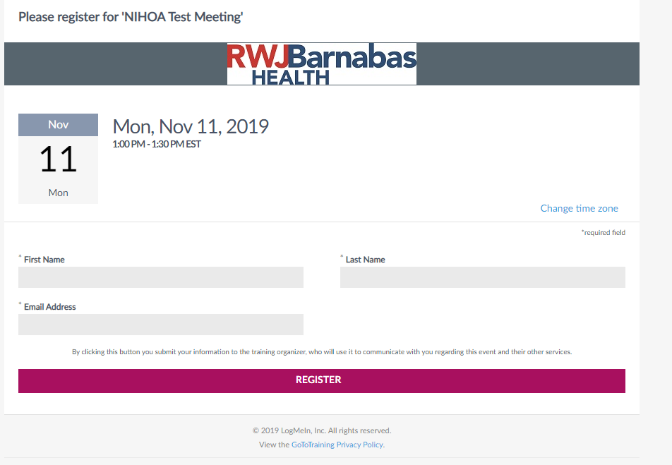
Complete the Registration for the event.

Slide 5
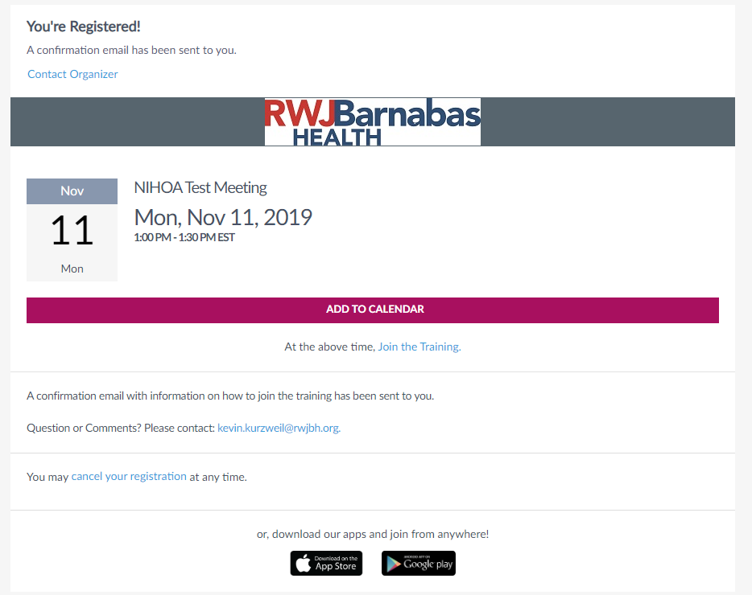
Add to calendar

Slide 6
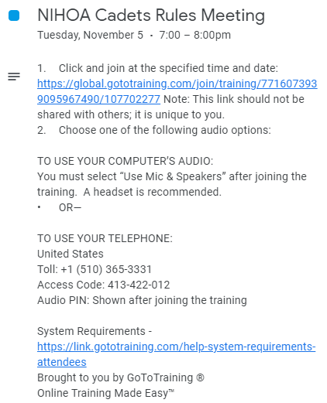
Click on link in Invite

Slide 7
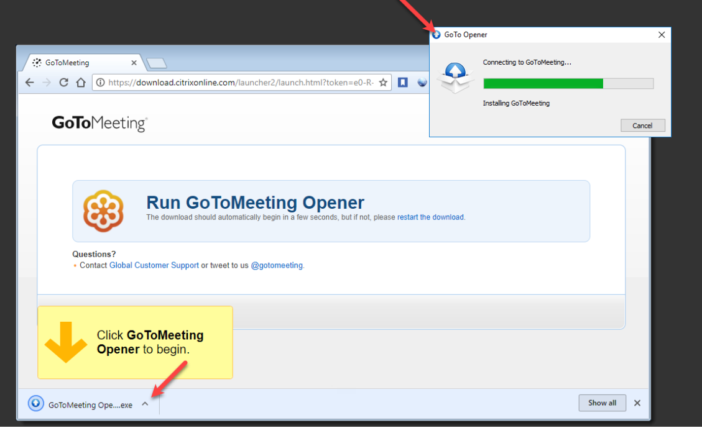
If you are using a PC/Laptop you will need to install GoToTraining Opener

Slide 8
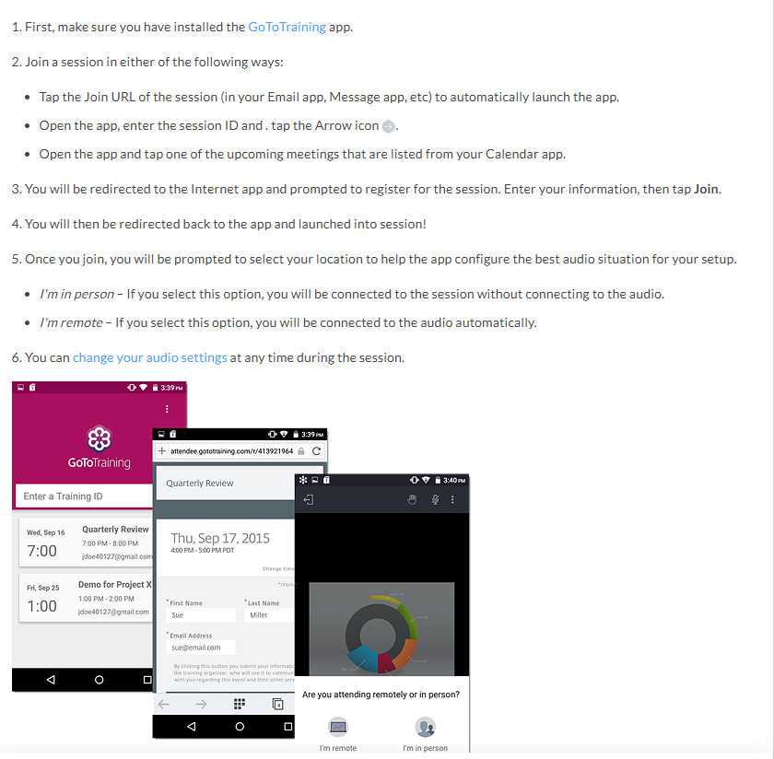
Important step to take BEFORE meeting

Slide 9
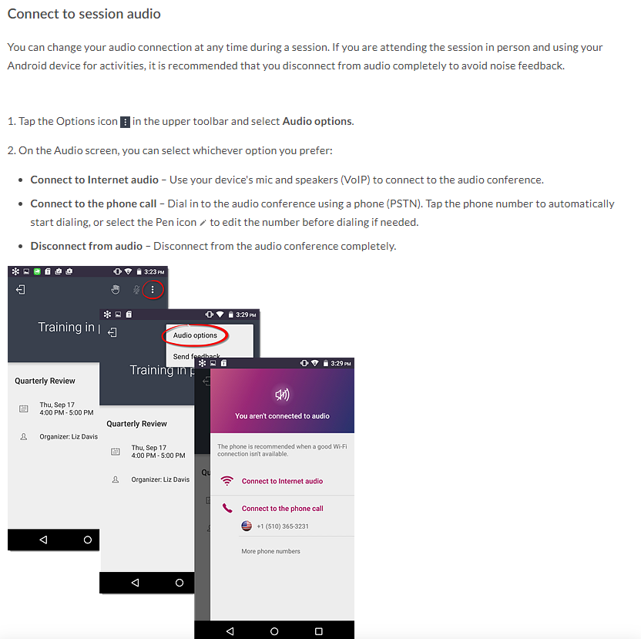
October 10, 2018 Meeting
Cranford High School
AGENDA

Slide 10
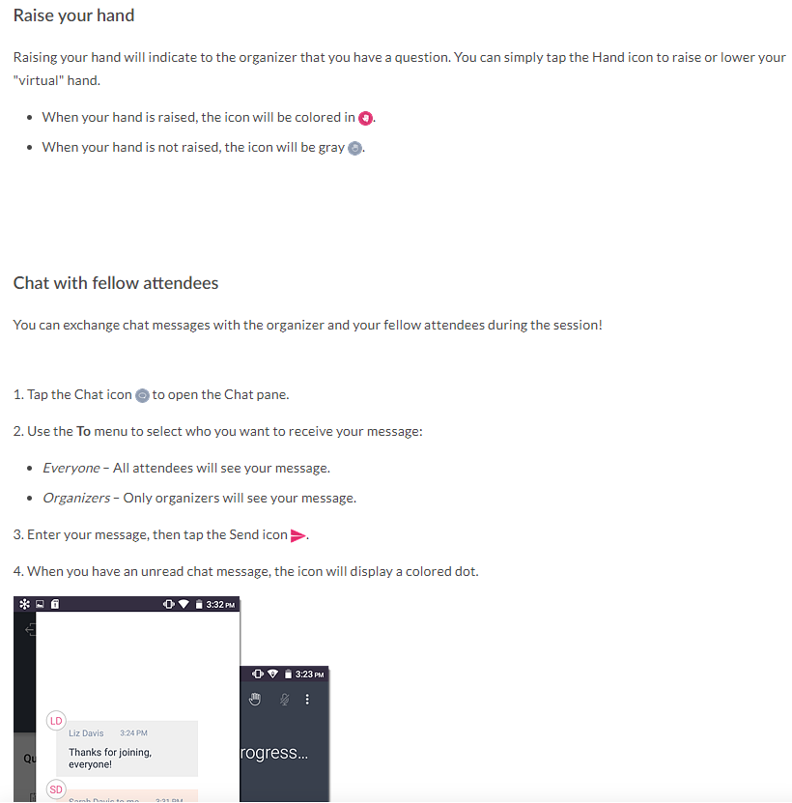
October 10, 2018 Meeting
Cranford High School
AGENDA

Slide 11
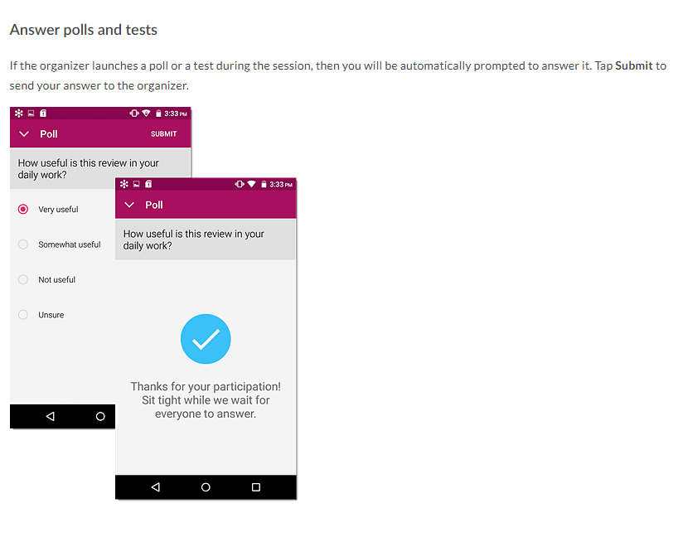
October 10, 2018 Meeting
Cranford High School
AGENDA

Slide 12
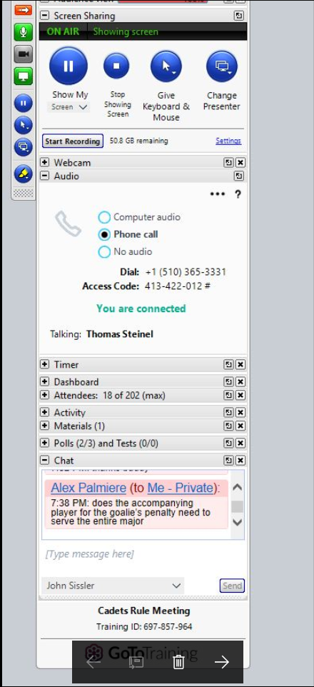
All Participants will be muted – Use chat to ask questions

Slide 13
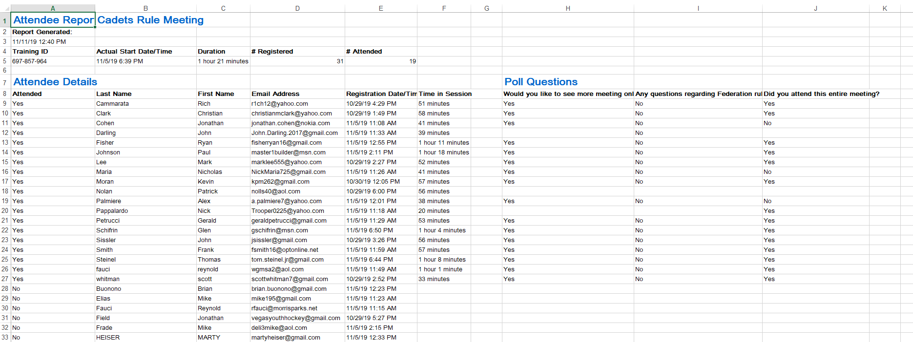
This is how meeting attendance will be taken (90% of entire meeting)
AGENDA

Slide 14
Resources
Craig Rossi – 908-963-4726
Kevin Kurzweil – 908-380-3941

