Slide 1
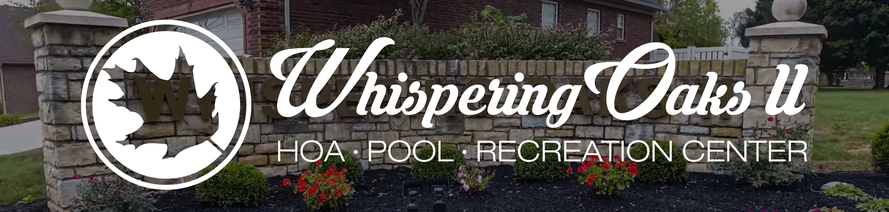
Whispering Oaks II HOA Town Hall Proposed Pool & Rec Space Expansion
WELCOME, NEIGHBORS!

Slide 2
Meeting and Voting Process
5 town hall meetings: 4/27, 4/29, 5/2, 5/3, and 5/7
Inform as many neighbors as possible.
Give neighbors an opportunity to voice their questions or concerns
Questions asked at meetings will be researched and added to FAQ sheet.
FAQ will be updated after each meeting and posted on HOA website.
Voting process:
A final paper ballot will be mailed to each household after 5/7.
A printable PDF ballot will also be available for download on our website.
Electronic online voting will also be available; instructions will be included in the mailing with the paper ballot.
Voting will be open 5/8-5/20.
Paper ballots can be placed in Clubhouse mailbox or presented in person on the day of the final special meeting.
All early ballots will remain sealed until counted on 5/20.

Slide 3
Meeting and Voting Process, cont.
Final special meeting and ballot count:
Final meeting will be Saturday, 5/20 at 12:00 PM
All votes need to be collected by close of meeting at 1:00 PM
Votes will be counted by a group of neighbor volunteers and 1 board member
Requirements to approve the measure:
Quorum – 40% of purchased homes
Currently 268 homes, so a quorum is 108 votes.
This number will be updated prior to 5/20 to reflect any newly sold homes
2/3 of the submitted votes (i.e. 72) need to be in favor of the measure for it to be approved.
LandMill has decided to abstain from the vote.
Their votes will not be added to reach a quorum.
They wish to stay neutral on this issue as they feel it should be decided by the homeowners only.

Slide 4
Shared Agreements
Town halls are being held on 4/27, 4/29, 5/2, 5/3, and 5/7.
No final decision on the project approach has been made yet.
Everyone has an equal voice, including homeowners attending via live stream.
All questions are valid and will be fully heard and addressed.
Raise your hand to be called on by the meeting chairperson.

Slide 5
Shared Agreements
Speak one at a time, listen to each other, and respect each other’s viewpoints.
Voting will take place May 5-20 by paper or electronic ballot.
Each homeowner will have 1 vote per address.
Great ideas may be incorporated into the options presented on the ballot, including various project approaches and voting options on the ballot.

Slide 6
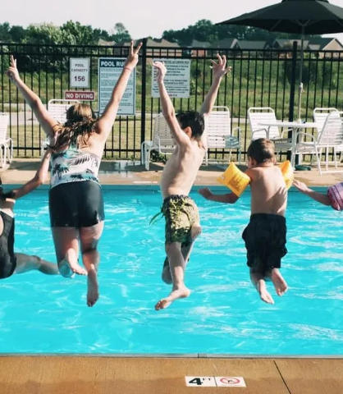
Pool Expansion Project History
Expansion first discussed on or around 2013
Membership approved $10,000/year for 5 years for downpayment
6th-year quorum wasn’t present, so we operated off previous year’s budget.
Currently, we have $60,000 saved for expansion.
Project has had no serious work done since original vote

Slide 7
Pool Expansion Project History
Original intent: expand pool capacity for current and future neighbors
At the time, there were approximately150 homes in the neighborhood. The development was planned for approximately 325.

Slide 8
Pool Expansion Project History
The thought at the time was the current pool did not have the needed capacity for the future growth.
Feedback from neighbors (who didn't normally utilize the pool) caused the scope of the project to expand to its current state.

Slide 9
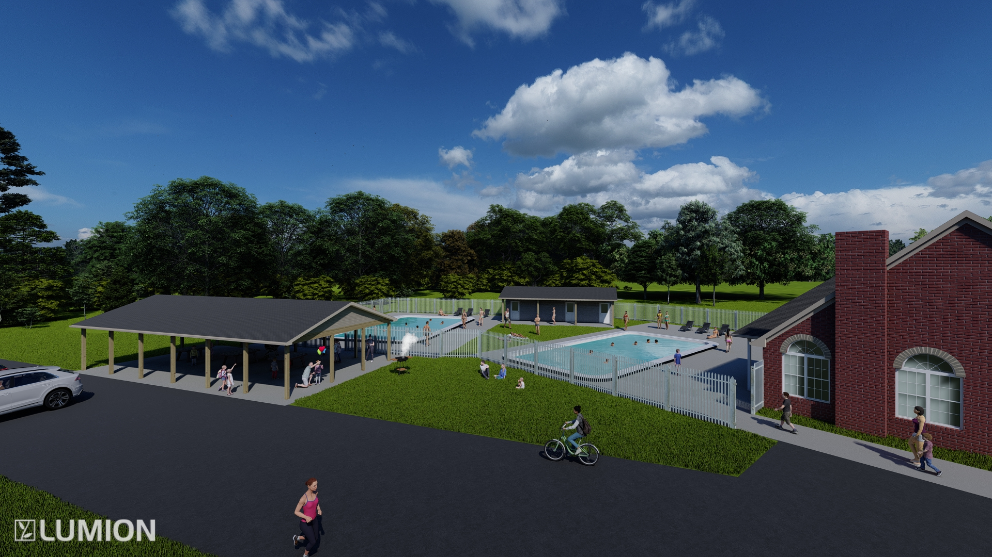
Proposed Expanded Pool & Rec Space Layout

Slide 10
Project Scope: Additional Pool
New pool same size as current pool
50’ x 30’ & depth 3’ to 5’ on deep end
5’ wide entry steps on shallow end
Pool bench seating from steps & along sides
Seat approximately 18” deep
Should make the pool more parent- and kid-friendly
Estimated cost of additional pool - $177,780
Includes: pump, all accessories, placards, railings, and installation

Slide 11
Project Scope: Pool house and pumphouse
New pool house to include:
Men’s and women’s restrooms
Outdoor shower
Additional pool pump and other equipment
Additional facility storage
Estimated cost of pool house and pumphouse - $135,597
Includes: framing, plumbing, electric, all lighting and plumbing fixtures, footers, retaining wall and brick face for retaining wall, overhangs/siding, shingles, guttering and downspouts, insulation, drywall, and paint

Slide 12
Project Scope: Pavilion
Multi-use pavilion:
Dimensions: 48’ x 25’
Includes electric lighting and ceiling fans
Perfect location for:
Annual meeting
Picnics
Neighborhood hangout
Parents watching kids on playground
Picnic tables + seating to be added over time
Estimated cost of pavilion - $55,000
Includes: concrete, framing materials, electrical wiring, fixtures, shingles, siding, and flat black ceiling paint

Slide 13
Project Scope: Playground & Basketball Half-court
Professional grade equipment
As nice as any in Jeff and surrounding area
Pole lighting for evening use
Both accessible year-round
Excellent additions for those who may not utilize the pool
Wonderful place for our rapidly growing population of neighborhood children to meet and spend time
Estimated cost of playground and basketball court - $105,000
Includes: concrete, delivery and installation of all equipment, electrical wiring and installation of pole lighting

Slide 14
Project Scope: Additional Project Expenses
Estimated cost to purchase the adjacent lot directly behind current pool - $50,000
LandMill has agreed to sell us the lot if project is approved.
Estimated cost of site prep - $107,335
Includes: site excavation, grading, provide and place fill rock, water and sewer line installation
Estimated cost to install retaining wall - $68,834
Due to elevation fall of the lots, a retaining wall and steps would be added between pool area and playground + basketball court area.
Approximately140’ long x 5’ tall
Includes: block, gravel backfill, and drainage

Slide 15
Project Scope: Additional Project Expenses – cont.
Estimated cost of project fencing - $17,313
Approximately 300’ of 5’ tall aluminum fence w/2 gates
Estimated cost of additional parking - 21,000
Asphalt for 16 additional parking spaces.
Estimated 20% Contractor’s margin - $156,677

Slide 17
Project Financing
Estimated total cost of project - $980,000
This number does not match listed totals
Per First Financial Bank, we can be approved for 10-yr fixed/20-yr amortized loan secured by:
Increase in annual HOA dues
Appraised value of existing clubhouse and pool
Adjusted dues of approximately $650-$700/yr ($55-$59/mo) would generate an extra ~$96,000-$110,000/yr in revenue.
No liens or security would be placed on any neighbor’s personal property.

Slide 18
Project Financing, cont.
Construction would begin this fall.
Option to do a phased approach:
Due to required site prep, pool and pavilion would be first phase
Cost of first phase - approximately $685,000
Other options?

