Slide 1
Troop 75 Summer Camp 2023
Scout and Parent Information
March 22, 2023

Slide 2
Summer Camp
July 23 – July 29, 2023
WHERE: Winnebago Scout Reservation, Rockaway, NJ

Slide 3
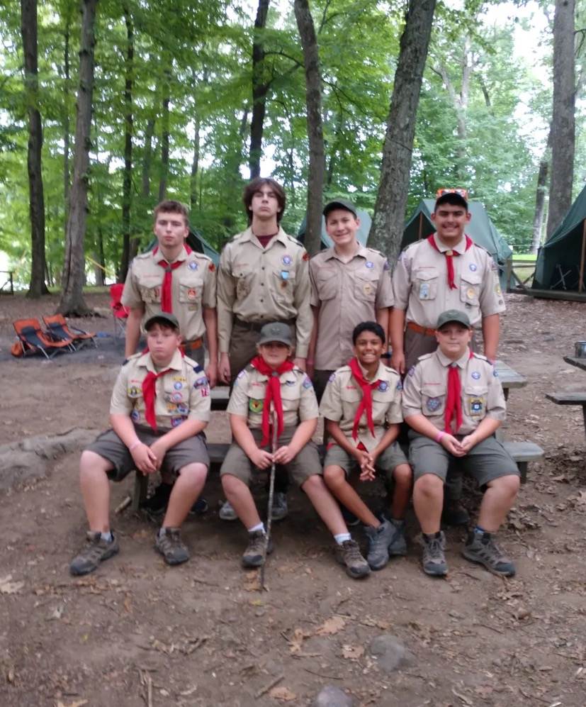

Slide 4
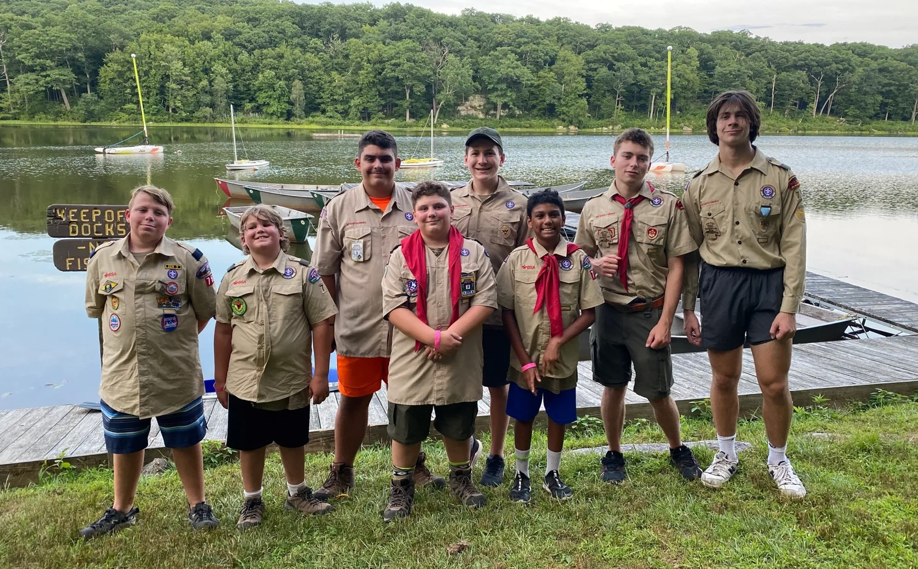

Slide 5
Register Early to take advantage of Early Bird Discount
Registration
Current Scouts:
$590 - if you pay on or before 5/01
$640 - if you pay after 5/01
New Scouts (those joining Troop in March 2023):
$590 - if you pay on or before 6/01
$640 - if you pay after 6/01
$50 multi sibling discounts are available.
Scouts are linked in the registration process and then discount can be applied

Slide 6
FORMS
Forms can be found on the Troop 75 Website. You only need a completed registration form & check to reserve a spot
Complete your Medical Forms early (Parts A, B & C)
If your scout had his annual physical
after 7/30/2022, physician can complete Part C based
upon results of that physical
The camp physical can be used for the 2023-2024 Scout year
Forms should be complete JUNE 19TH parents meeting so that we have time to make sure that they are complete
Forms that must be provided
Medical Form (parts A, B & C)
Copy of insurance card (front & back)
Food allergy/dietary requirements
Three Strikes Agreement (signed by scout and parent)
Merit Badge Planning Sheet if needed
Part C requires Physician signature

Slide 7
Save the Date
June 19th
Scouts & Parents are invited to attend a “PREPARE YOUR SCOUT FOR SUMMER CAMP” presentation
June 19th at 7:00 p.m. in Randolf Hall.
During this meeting, scouts will finalize their Merit Badge selections if needed. Camp Leaders will be available for scouts who need guidance or advice about merit badges and pre-requisite work. You will also hear about the Drop-off and Pick-up Rules, camp rules, camp activities, and some packing helpful hints. There will be a Q&A session at the end

Slide 8
Earning Merit Badges at Summer Camp
Start your planning early!
Find partially completed Blue Cards from past years
Encourage Scout to complete partial this summer
Review the Merit Badge Schedule before selecting badges
Some have prerequisites or require a certain rank
Merit Badge worksheets can be downloaded
meritbadge.org, etc.
Complete required prerequisites before arrival at camp
Refer to “Notes” section for info about what scout must
bring to camp for that merit badge
COMPLETED Merit Badge Planning Sheets must be handed in on or before June 19th
Contact Mr. Hrycak, an ASM, or Mrs. Kimball if you need assistance.

Slide 9
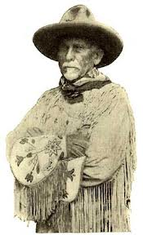
Dan Beard Scouts and Merit Badges
Program is designed for 1st or 2nd year scouts. Troop 75 leadership requires that the first year scouts at camp attend the Dan Beard program.
Scout will focus their time working on rank requirements
Scout can earn Fingerprinting and Indian Lore merit badges during their free time (sign up required)
Scouts form their own Dan Beard patrol
Work together and can eat together
Camp with the Troop
Prepare for Thursday outpost adventure
Complete many camping requirements

Slide 10
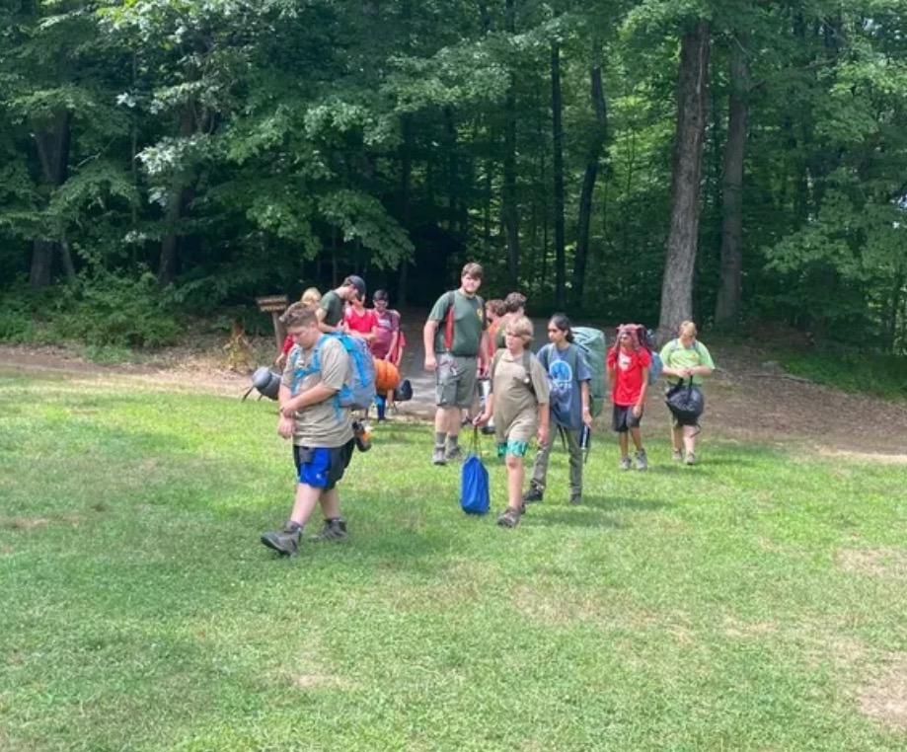

Slide 11
Other Activities
THERE
ARE
SO MANY
FUN
THINGS
TO
DO
AT
CAMP
Zip Lining across Durham Pond
Plus Adventure Course
2 ziplines, Must be ~90 lbs. to ride
In-site Cooking
Dutch Oven Dessert Competition
Night Watch
Campfire on site after 8pm

Slide 12
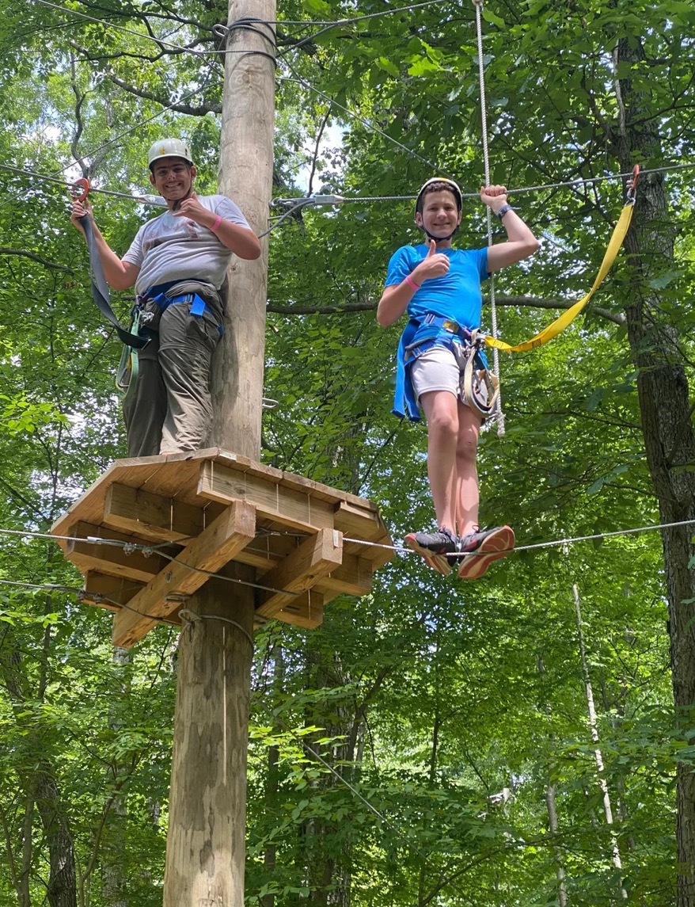

Slide 13
(Other Activities)²
THERE
ARE
SO MANY
FUN
THINGS
TO
DO
AT
CAMP
Troop Plaque
Leave a legacy you will be proud to see years from now
Polar Bear Swim (meet at waterfront 6:45 am)
Mountain Biking
Basketball, Tetherball
Paul Bunyan Woodsman Award
Teach Totin’ Chip to other Scouts
Complete a Woodsman Project

Slide 14
(Other Activities)³
THERE
ARE
SO MANY
FUN
THINGS
TO
DO
AT
CAMP
Fishing
Bring your own fishing rod. Catch a largemouth bass,
smallmouth bass, perch. License required if over 16.
Fishing Contest: Catch a 12” fish for the
Ecology aquarium
Fish fry every Friday for Fishing Merit Badge
Hikes, outpost camping, mile swim, etc.
Talk to an ASM to sign up

Slide 15
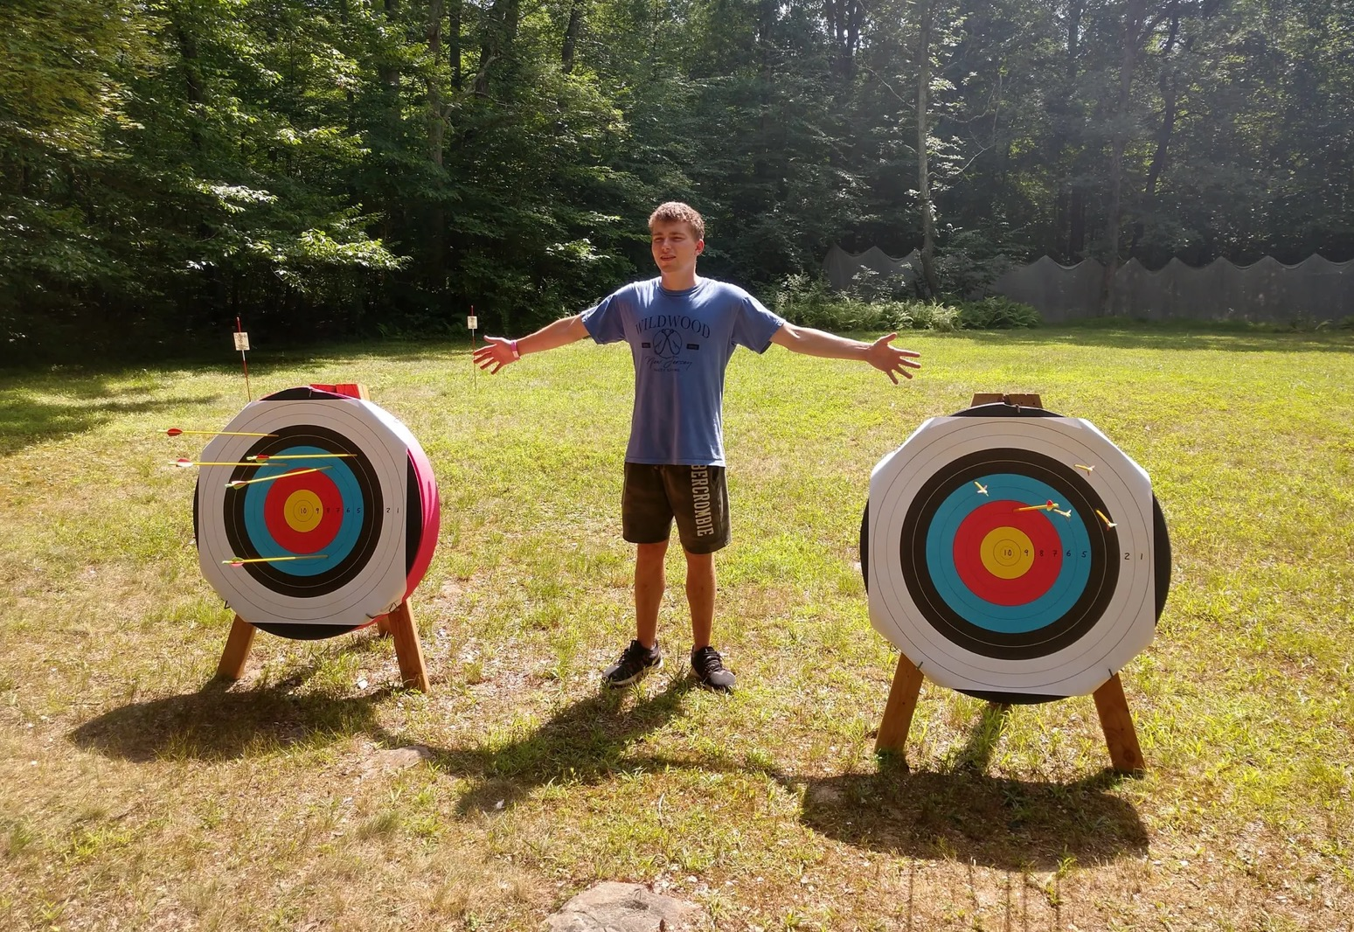

Slide 16
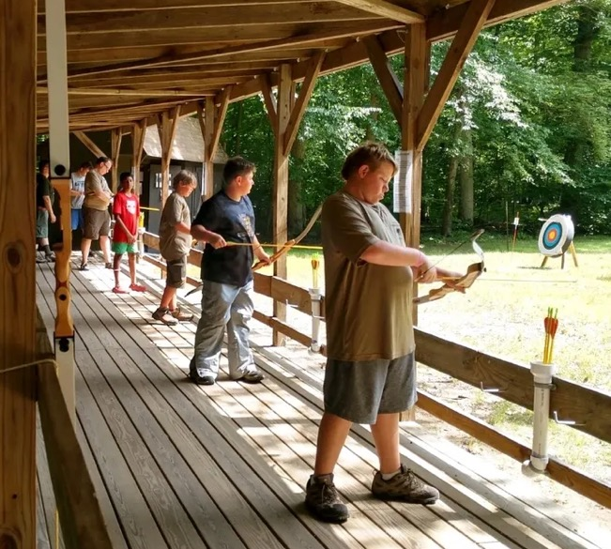

Slide 17
Winnebago Acorn Award
Special form used to record completion of requirements
Accomplish five (5) of the seven (7) items
SM or SPL can initial any of the completed requirements
Turn in the completed form to the SPL
Green Bar Bill Award
Special form used to record completion of requirements
SPL can initial any of the completed requirements
Requires at least 50% of the patrol to participate
Turn in the completed form to the SPL
Baden Powell Award
Special form used to record completion of requirements
SM initials requirements as they are completed
Requires at least 50% of the patrol to participate
Turn in the completed form to Commissioner by 5pm Friday

Slide 18
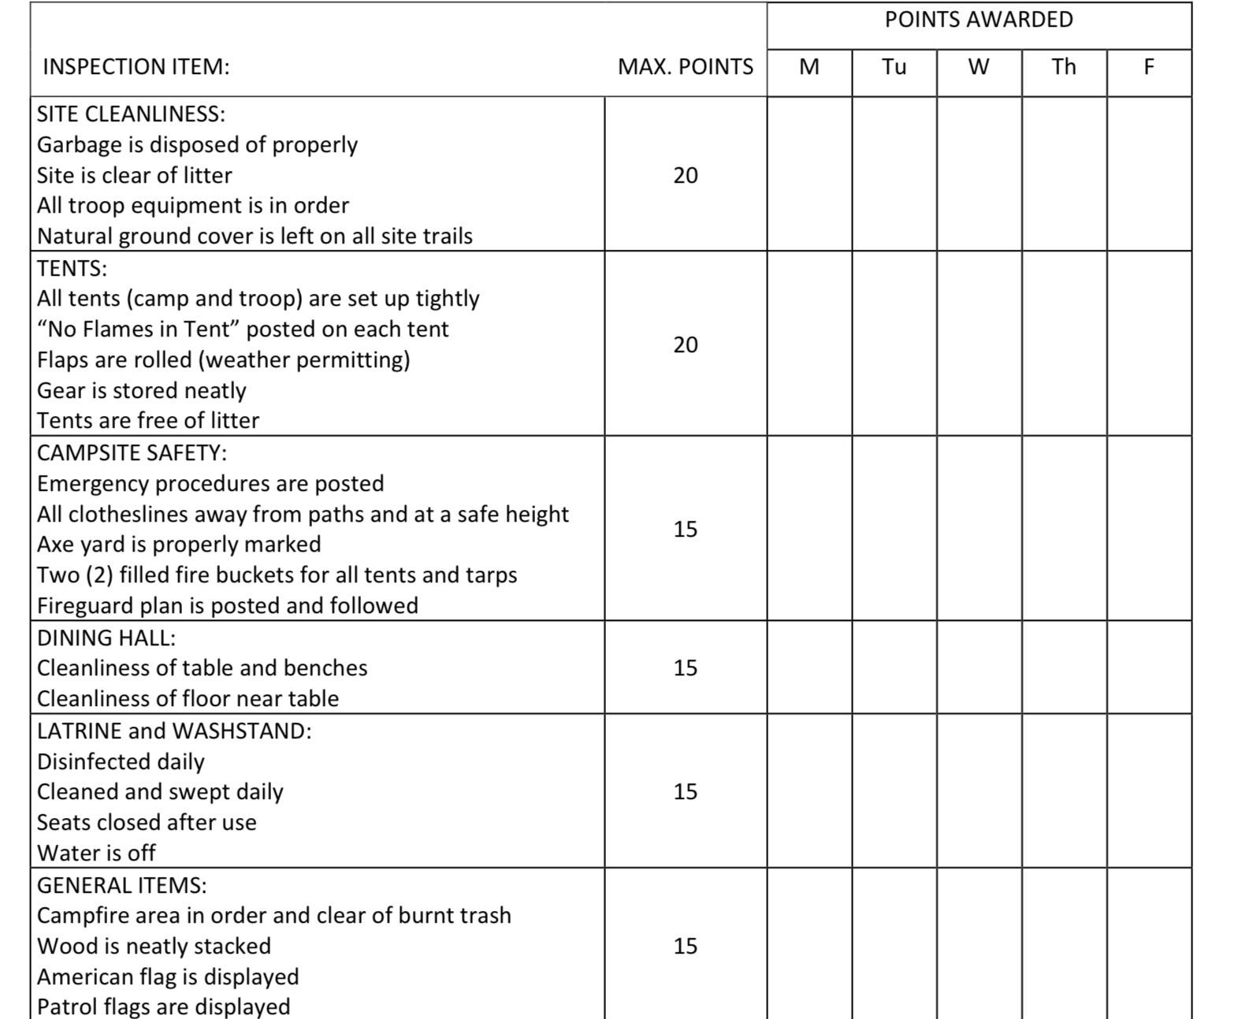
Duty Roster Items in Camp

Slide 19
Three Strikes Form
A signed agreement outlining acceptable behavior in camp. We want to establish rules and standards up front, to ensure a safe and enjoyable week for all.
Typical inappropriate behavior includes, but is not limited to: physical or verbal bullying (meanness intended to intimidate, demean, create fear or segregate), harassing (ridiculing, name calling), hazing or initiation activities, not following Troop Leader instructions, general mischief, excessive shouting or cursing, etc.
Should your son have to be disciplined, the “three-strikes” rule is applied.
The first strike involves the Troop Leader explaining the infraction and why it is important that the rules and Troop Leader instructions be followed.
The second strike involves Troop Leader notification of the Scout’s parents, then discussing the infraction with the Scout and the parents.
Should the inappropriate behavior continue, the third strike again involves notification of the Scout’s parents. However, the Troop Leader will then work together with the parents to decide on whether the Scout should be given another chance or be removed from camp.

Slide 20
On-Site Leaders
ASM Ron Scorese
ASM Anthony Hidalgo
Declan Mulcahy
Rolling Leaders: Margaret Begley, Beth Rees
Registration, Payment & Forms
Margaret Begley 917-359-7495 (margaret.begley@gmail.com)
Forms drop-off Address: 224 Stoughton Ave., Cranford

Slide 21
Help with Camp Fees
We would like every scout who wants to go to camp to have that opportunity!
Thomas A. Pepe Camping Scholarships are open to all Patriots’ Path Council youth. The application deadline for Scouts BSA summer camp programs is April 1.
You are not required to request money from the troop.
For more information, please visit the Patriots Path website at www.ppcbsa.org/camping.

Slide 22
Help with Camp Fees
Troop 75 Subsidy
Incentive is based on Troop participation and signing up for Troop summer camp. There are 5 criteria, each worth 1 point. Achieving 4 points entitles the scout to $ 200 subsidy for summer camp fees.
60% Attendance in Troop Meetings - (attending 20 meetings out of 33 meetings for the year)
Attending 60% of Camping Trips - (attending 7 trips out of 12 trips)
Service to the Troop by participating in 4 of the following events (if held):
Food Drive
Luminary Sale
Pancake Breakfast
Blood Drive
Memorial Day Parade
VFW Breakfast
VFW Flag Retirement Ceremony
Represent the Troop at Pack 75 Events, Pinewood Derby or Blue & Gold.
Advance at least 1 rank for the year.

Slide 23
Questions ??

