Slide 1
The
GOLDEN TEXT
Workshop
ver.8.26

Slide 2
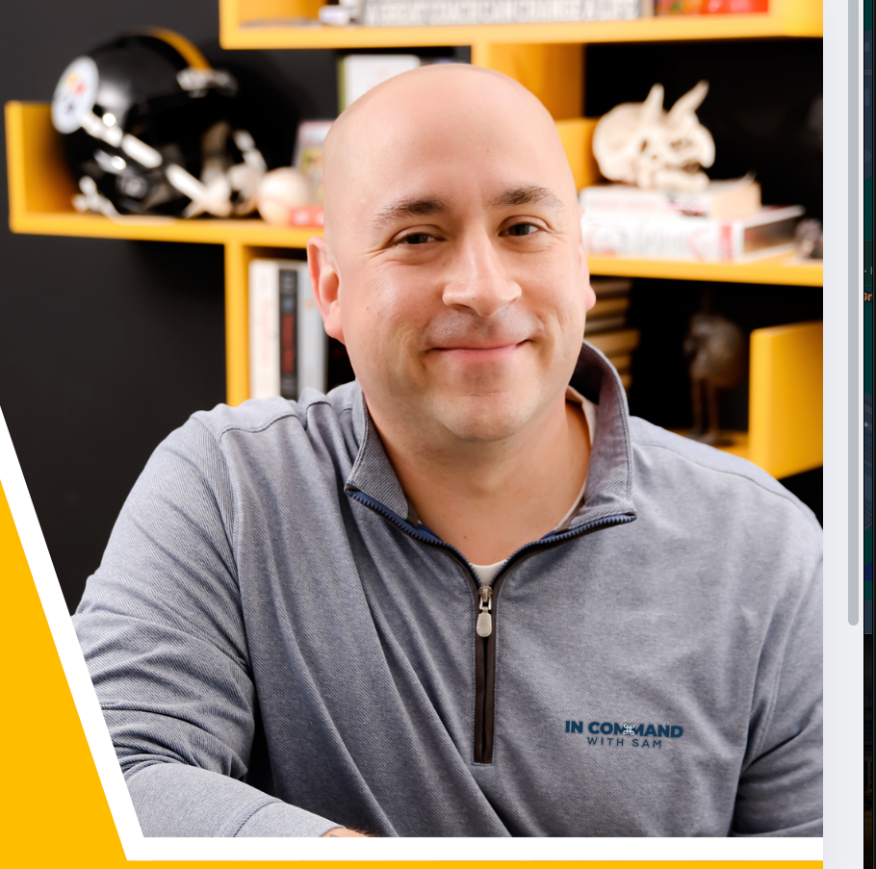
SAMUAL
JACKSON
  LEGACY- DIR. INNOVATION & TECH
  MAPS COACH
  LABS ADVISOR
  CO-FOUNDER OF COMMAND CAMPUS
@SINCERELYSAMUAL
Notes:
Go Slow!
Legacy - 7 Market Centers 2,000 Agents
6 years
Andy Lesley LG Glenn
MAPS - Command/Social Media/ Technology Operations
@SincerelySamuAl - Add me - FB, INSTA, LINKEDin, Tok

Slide 3
The
GOLDEN TEXT
Workshop
ORIGIN STORY
Notes:
It was 2021.
Real estate was on fire and nobody was leaving their houses.
My OP Andy Peters felt it. Andy doesn't wait around for somebody else to solve a problem. He took a concept that had already proven itself in direct mail — the Golden Letter — and asked a simple question.
What if we just texted it?
That was the spark.
I took that spark and built the
Golden Text Workshop around it. Teaching locally within my market centers for about a year.
And then something unexpected happened.
It worked everywhere.
Seriously. From Dothan, Alabama to Ljubljana,(loobleeana) Slovenia — agents texting from their own phones, on WhatsApp, in languages I don't even speak, connecting with people in their communities the same exact way.
Same phone. Same courage. Same result.
And that's when I realized something that changed everything.
In a world racing toward artificial intelligence and automation — where every tool is trying to remove the human from the conversation — Golden Text was running the other direction.
We were never building a system to send texts for you. We were building something to make you brave enough to send them yourself.
The send button is always yours.
The relationship is always yours.
The courage is always yours.
Golden Text just makes sure you show up to use all three. 🫧

Slide 4

WARNING! Never use or leave artificial or prerecorded messages, and never call/text a number on any Do Not Call list. Callers who violate the National Do Not Call (DNC) Registry and the Telephone Consumer Protection Act (TCPA) face potentially catastrophic legal damages.

Slide 5

TCPA/Do Not Call FAQs
TELEMARKETING
TCPA/Do Not Call FAQs
1. What is a “telemarketing” call or text?
6. What are examples of a written agreement with proper consent language?
Telemarketing calls and texts are calls and texts made for the purpose of promoting or encouraging the use of your services. Calls can have more than one purpose. If one of the purposes is telemarketing, then the TCPA and Do Not Call rules apply.
Here’s an example of a written TCPA consent agreement through a web form:
By checking this box, you agree that [name of agent] [a representative from name of office] may contact you at the telephone number you provided, even if your number is on a federal, state, or internal Do Not Call list, and may send marketing calls and texts to you using an automated system for selection or dialing of numbers or pre-recorded or artificial voice messages that relate to real estate products or services. Your consent is not required to purchase products or services. You may unsubscribe at any time.
2. Are there any policies or procedures that I need to have in place before I start making telemarketing
calls and texts?
Yes. The TCPA requires that persons making telemarketing calls and texts have written procedures for maintaining an internal Do Not Call (DNC) list. An internal DNC list is a list of consumers who have asked not to be called or texted by you or your Market Center.
The required written procedures must include the following minimum standards:
(1) Written policy. You must have a written policy for maintaining an internal DNC list. This written policy must be
made available to consumers upon request.
(2) Training of personnel engaged in telemarketing. Anyone engaged in any aspect of telemarketing must be
informed and trained on the existence and use of DNC lists. You can be held liable for TCPA violations committed by
employees, contractors, and vendors who are engaged in telemarketing on your behalf.
(3) Recording, disclosure of DNC requests. If you receive a request not to receive calls or texts from someone, you
must record the request and place the person’s name and telephone number on your internal DNC list at the time the
request is made. You must honor the DNC request.
(4) Identification of callers. Anyone making a call for telemarketing purposes must provide the called party with
their name, the name of the person or entity on whose behalf the call is being made, and a telephone number or
address at which the person or entity may be contacted. Some courts have held that this requirement applies to text
messages too.
(5) Maintenance of internal DNC lists. Anyone making calls for telemarketing purposes must maintain a record of a
consumer’s request not to receive further telemarketing calls and texts. A DNC request must be honored for 5 years
from the time the request is made.
Here’s an example of a written TCPA consent agreement through a paper form:
By signing this form, I consent to receiving telephone calls and texts from [name of agent] [a representative from name of office] using an automated system for selection or dialing of numbers or pre-recorded or artificial voice messages that relate to real estate products or services at this telephone number: (___) ________. I understand that my consent is not required to purchase products or services.
[Signature of consumer]
7. What does it mean to keep a record of consent?
The person calling or texting a consumer must be able to prove that consent was obtained from the consumer in writing. The call/texter needs to be able to prove at a minimum that the consumer (a) agreed to be contacted and solicited via calls and texts from the caller/texter, (b) consented to telemarketing calls and texts using an automatic telephone dialing system or artificial or prerecorded voice (if used by the caller/texter), and (c) provided their telephone number.
8.
Is consent assumed if I’m calling a past client?
Generally, no. You can’t just assume that you have consent to make a telemarketing call to a past client. It depends
on the nature of the call you’re making and what prior consent you obtained. For a past client whose number is on
the National Do Not Call (DNC) Registry, you may make a telemarketing call to that client if you can demonstrate that
you have an “established business relationship” with him or her, or if you have “prior express written consent” to call
him or her.
There are two types of established business relationships that are narrowly defined. First, you can make a
telemarketing call to a client for up to 18 months after the date of the last financial transaction between you and the
client, unless the client asks you not to call again. Second, you may make a telemarketing call for up to 3 months
after a client’s inquiry about your services, unless the client asks you not to call again.
However, you still need to comply with other TCPA requirements even if you have an established business relationship
with a past client. You still need to have prior express written consent from a past client for calls and texts using (a)
an artificial voice, (b) a prerecorded voice, or (c) an automatic telephone dialing system.
Remember that if your client tells you to stop calling or texting at any time, any prior consent and the established business relationship exceptions terminate. You must honor your client’s Do Not Call request. Your client may revoke consent at any time through any reasonable means, including verbally. You may not limit how someone can revoke consent.
3. What are state “mini-TCPA laws”?
Some states have telemarketing laws that have restrictions which are similar to or stricter than the TCPA’s. It is
important that you consult with your Market Center or a lawyer about whether your state’s telemarketing laws impose
requirements in addition to the TCPA and Do Not Call rules.
PRIOR EXPRESS WRITTEN CONSENT
4. What type of consent is needed for telemarketing calls and texts?
Under the TCPA, you need “prior express written consent” for telemarketing calls and texts (a) made to phone numbers on the National Do Not Call Registry and/or made using (b) an artificial voice, (c) a prerecorded voice, or (d) an automatic telephone dialing system.
5. What is prior express written consent?
Prior express written consent means a written agreement that (a) includes consent language which authorizes the
caller to make telemarketing calls and texts to the telephone number provided by the person called, (b) includes the
signature of the person called, and (c) informs the person called that they are not required to enter the agreement as
a condition of purchasing any goods or services. The written agreement does not need to be obtained or maintained
in paper form. You can use an electronic form.
The consent language in the written agreement should be “clear and conspicuous,” identify the person or entity who can call and text the consumer, include consent for use of an artificial or prerecorded voice and an automatic telephone dialing system (if you intend to use these methods), and require the consumer to take some action to accept the consent language. “Clear and conspicuous” means that it is apparent to a reasonable consumer.
9. Do I need prior express written consent for ringless voicemails and voicemail drops?
Yes. The use of a prerecorded voice requires prior express written consent from the consumer who is called. This
requirement includes ringless voicemails and voicemail drops.
NOTICE: This information does not constitute legal advice. While Keller Williams Realty, Inc. (KWRI) has taken due care in the preparation of this information, we do not guarantee its accuracy now or in the future. KWRI shall have no liability or responsibility to any person regarding any loss or damage incurred, or alleged to have incurred, directly or indirectly, by the information contained (or lacking) herein. This information is
NOTICE: This information does not constitute legal advice. While Keller Williams Realty, Inc. (KWRI) has taken due care in the preparation of this information, we do not guarantee its accuracy now or in the future. KWRI shall have no liability or responsibility to any person regarding any loss or damage incurred, or alleged to have incurred, directly or indirectly, by the information contained (or lacking) herein. This information is
not a substitute for consulting with your market center or an attorney to confirm that your practices comply with applicable law.
REV. 06/17/2 4 | ©2024 Keller Williams Realty, Inc.4
not a substitute for consulting with your market center or an attorney to confirm that your practices comply with applicable law.
REV. 06/17/2 4 | ©2024 Keller Williams Realty, Inc.5

Slide 6
TCPA/Do Not Call FAQs
THIRD-PARTY LEAD GENERATORS
TCPA/Do Not Call FAQs
NATIONAL DO NOT CALL REGISTRY
10. Can I avoid TCPA liability if I rely on lead lists provided by third-party lead generators?
14. How do I access the National Do Not Call Registry?
No. As the caller/texter, you are liable for any calls and texts you make that violate the TCPA or Do Not Call rules. Third-party lead generation vendors generally place the burden of complying with the TCPA on you and will not agree to indemnify you for losses or damages you sustain as a result of a TCPA claim made against you.
The FTC has a website – www.telemarketing.donotcall.gov – where you can create an account to access the National Do Not Call Registry and log into the Registry to see if telephone numbers are listed on it. Creating an account is free, and you can check telephone numbers for up to 5 area codes without paying a fee. There is an annual fee for each area code after the first 5. If you have an account, you also can work with a third-party TCPA compliance vendor to access the Registry with your account information and check telephone numbers for you.
The FTC also has a website with a FAQ about the Do Not Call rules and how to use the Registry:
https://www.ftc.gov/business-guidance/resources/qa-telemarketers-sellers-about-dnc-provisions-tsr-0
11. How can I protect myself against TCPA liability if I choose to rely on third-party lead generators?
If you choose to rely on leads obtained from third-party vendors, leads where the consumer has provided prior
express written consent to be called or texted by you carry the least risk.
To determine whether the vendor properly obtained prior express written consent, you should ask:
15. How often do telephone numbers need to be checked against the National Do Not Call Registry?
•
Did the vendor obtain written consent on your behalf? If not, you do not have proper consent to make
telemarketing calls and texts to the consumer if their number is on the National Do Not Call Registry. Consent
cannot be transferred. (See also Question #13 regarding 1:1 consent.)
What was the scope of consent? If the vendor did not obtain the consumer’s consent to telemarketing calls and
texts using an artificial or prerecorded voice or an automatic telephone dialing system for the telephone number
provided, you cannot use those methods for making calls and texts.
How was consent obtained? To be effective, consent must be provided after a “clear and conspicuous” disclosure to the consumer that they will be called and texted. “Clear and conspicuous” means notice that would be apparent to a reasonable consumer.
When was consent obtained? If consent was not obtained recently, there is a risk that the consumer has
subsequently revoked consent or placed their number on the National Do Not Call Registry, or that the telephone
number has been transferred to another consumer who has not provided consent.
Is there a written record of consent and do you have access to it? The caller/texter has the burden of showing
consent. If you do not have a written record of consent, you cannot prove that the consumer provided consent.
If you do not have proper written consent to call or text a lead, you should confirm that the lead’s telephone number
is not on the National Do Not Call Registry, any applicable state Do Not Call list, or an internal Do Not Call list before
making any calls or texts. Telephone numbers must be checked against the National Do Not Call Registry every 31
days if you do not have proper consent to call and text the consumer who has that number.
Telephone numbers must be checked against the National Do Not Call Registry every 31 days if you do not have prior express written consent to call and text the numbers.
•
AUTOMATIC TELEPHONE DIALING SYSTEM (ATDS)
16. What is an “automatic telephone dialing system” (ATDS)?
Under the TCPA, an “automatic telephone dialing system” (ATDS) is equipment that has the capacity to store numbers using a random or sequential number generator or the capacity to produce numbers using a random or sequential number generator. Mobile phones generally will not fall under this definition. Under current case law, most dialers also will not fall under this definition if they use a pre-existing list of telephone numbers instead of generating numbers to be dialed. Some states have broader definitions. It is important that you consult your Market Center or a lawyer about whether you are using a dialing system or platform that may be considered an ATDS under the TCPA or your state’s laws.
•
•
•
17. Do the consent rules for an automatic telephone dialing system (ATDS) apply if I’m just calling one
number at a time?
Yes. If you are using an automatic telephone dialing system (ATDS), the TCPA rules apply, including the need to obtain prior express written consent. Additionally, it does not matter what type of equipment you use to call a number on the National Do Not Call (DNC) Registry, a state DNC list, or internal DNC list. The DNC rules apply to all telemarketing calls.
12. Can I be held be liable for TCPA violations committed by lead generators?
ARTIFICIAL INTELLIGENCE (AI)
18. Can I use AI to make calls and texts?
Yes. If you contract with a vendor to obtain leads on your behalf, you can be held liable for TCPA violations committed by that vendor while working for you.
It depends on how you are using AI. You can use AI technologies to help draft content and construct conversations for use in calls and texts. You must
then follow the TCPA and other applicable laws when you initiate those calls and texts. The FCC has ruled that the
TCPA applies to AI technologies that simulate human voices, resemble or clone the voice of a real person and/or
generate call content using a prerecorded voice.
Do not make an AI-generated voice call or message unless you:
13. What is one-to-one (or 1:1) consent?
The FCC recently ordered that prior express written consent must be obtained on a one-to-one basis. This means that lead generators must obtain a consumer’s prior express written consent for one caller/texter at a time. Lead generation forms that use a single consent for multiple callers/texters or “marketing partners” will not be effective after January 27, 2025. According to the FCC, the new rules make it clear that lead generators must obtain consumer consent to receive calls and texts one seller at a time rather than have a single consent apply to several telemarketers at once.
•
•
•
•
•
Obtain prior express written consent from the called party to do so,
Disclose at the beginning of the call that the called party is interacting with AI,
Identify the person or entity responsible for making the call,
Offer an opt-out method for the called party to request that you stop calling, and
Comply with other TCPA restrictions (including the Do Not Call list).
Do not send an AI-generated text message unless you make clear to the person receiving the text that the person is
not communicating with a human. The AI disclosure must be made at the beginning of the text and must be done in
a way to ensure that recipients don’t think they are interacting with a human at any point in their communications.
NOTICE: This information does not constitute legal advice. While Keller Williams Realty, Inc. (KWRI) has taken due care in the preparation of this information, we do not guarantee its accuracy now or in the future. KWRI shall have no liability or responsibility to any person regarding any loss or damage incurred, or alleged to have incurred, directly or indirectly, by the information contained (or lacking) herein. This information is
NOTICE: This information does not constitute legal advice. While Keller Williams Realty, Inc. (KWRI) has taken due care in the preparation of this information, we do not guarantee its accuracy now or in the future. KWRI shall have no liability or responsibility to any person regarding any loss or damage incurred, or alleged to have incurred, directly or indirectly, by the information contained (or lacking) herein. This information is
not a substitute for consulting with your market center or an attorney to confirm that your practices comply with applicable law.
REV. 06/17/2 4 | ©2024 Keller Williams Realty, Inc.6
not a substitute for consulting with your market center or an attorney to confirm that your practices comply with applicable law.
REV. 06/17/2 4 | ©2024 Keller Williams Realty, Inc.7

Slide 7
How to Avoid TCPA Penalties:
Obtain Prior Express Written Consent:
Ensure you have explicit consent from individuals before sending them any marketing communications, especially texts or automated calls.
Comply with Do Not Call Regulations:
Adhere to the National Do Not Call Registry and maintain internal do-not-call lists.
Proper Disclosures:
Make clear and conspicuous disclosures in your marketing communications, including your company name and contact information
Keep Accurate Records:
Maintain detailed records of consent and opt-outs.
Train Your Staff:
Ensure your employees are trained on TCPA compliance and understand the importance of obtaining proper consent.
Monitor Your Campaigns:
Regularly monitor your marketing campaigns for potential TCPA violations.
Notes:
BRIEFLY COVER

Slide 8


the average person responds to an email within 90 minutes, the average text message response happens within
90 SECONDS!
CTIA - The Wireless Association
Notes:
AND according to infoblip
90% of users read Text Messages within 3 Minutes
Email knocks on the door. A text walks right in.
And for someone who wouldn't be caught dead doorknocking - we'll take it!!

Slide 9
The
GOLDEN TEXT
Workshop
GAMEPLAN

Slide 10



Send
40+
Texts!
PLAY TO WIN
  RINGERS ON! TURN THE SOUND ON YOUR PHONE NOTIFICATIONS
  SAM WILL DISPLAY A TEXT MESSAGE WITH INSTRUCTIONS
  SEND TEXT TO AT LEAST 5 PEOPLE (MORE INSTRUCTIONS PROVIDED)
  IF YOU RECEIVE A PHONE CALL, PLEASE POLITELY LEAVE THE ROOM
    BUT DEFINITELY TAKE THAT CALL!!
  IF YOU RECEIVE A TEXT RESPONSE - RAISE YOUR HAND!
    WE’LL COME UP WITH RESPONSES AS A GROUP
  SET THE APPOINTMENT!
Sounds like we should meet!

Slide 11

CAN YOU BE BRAVE
... for 90 seconds?
Notes:
We're about to take the next hour and prospect business.
Play all in - 40+ texts today
Every text you don't send is an appointment you already gave away. - Samual
Every commission check you've ever wanted is sitting in someone's contact list, waiting on a brave moment - Samual
Can you let all the excuses go for just a moment to be brave and prospect some business with me?
drop a chat!

Slide 12

The Golden Text

Slide 13


1A
Would you be willing to sell your house to one of our buyers?
- Sam Jackson, KW
the golden text

Slide 14
1B
We have motivated buyers actively looking for homes - if the numbers made sense, would you consider selling your home?
optimized golden text

Slide 15

MOFIR
Message
Method
DIRECT
INDIRECT
PROSPECT
MARKET
  Buy
  Sell
  Invest
  Market Report
  CMA
  Vendor List
  Call
  Text
  Email
  Direct Message
  Door Knock
  Direct Mail
  Email
  Social Media
  Best Buy
  App
  $avings

Slide 16

#1 Appt Setter!
2.
Have your real estate needs changed?
Do you have any questions about the changing real estate market?
Real Estate Context

Slide 17
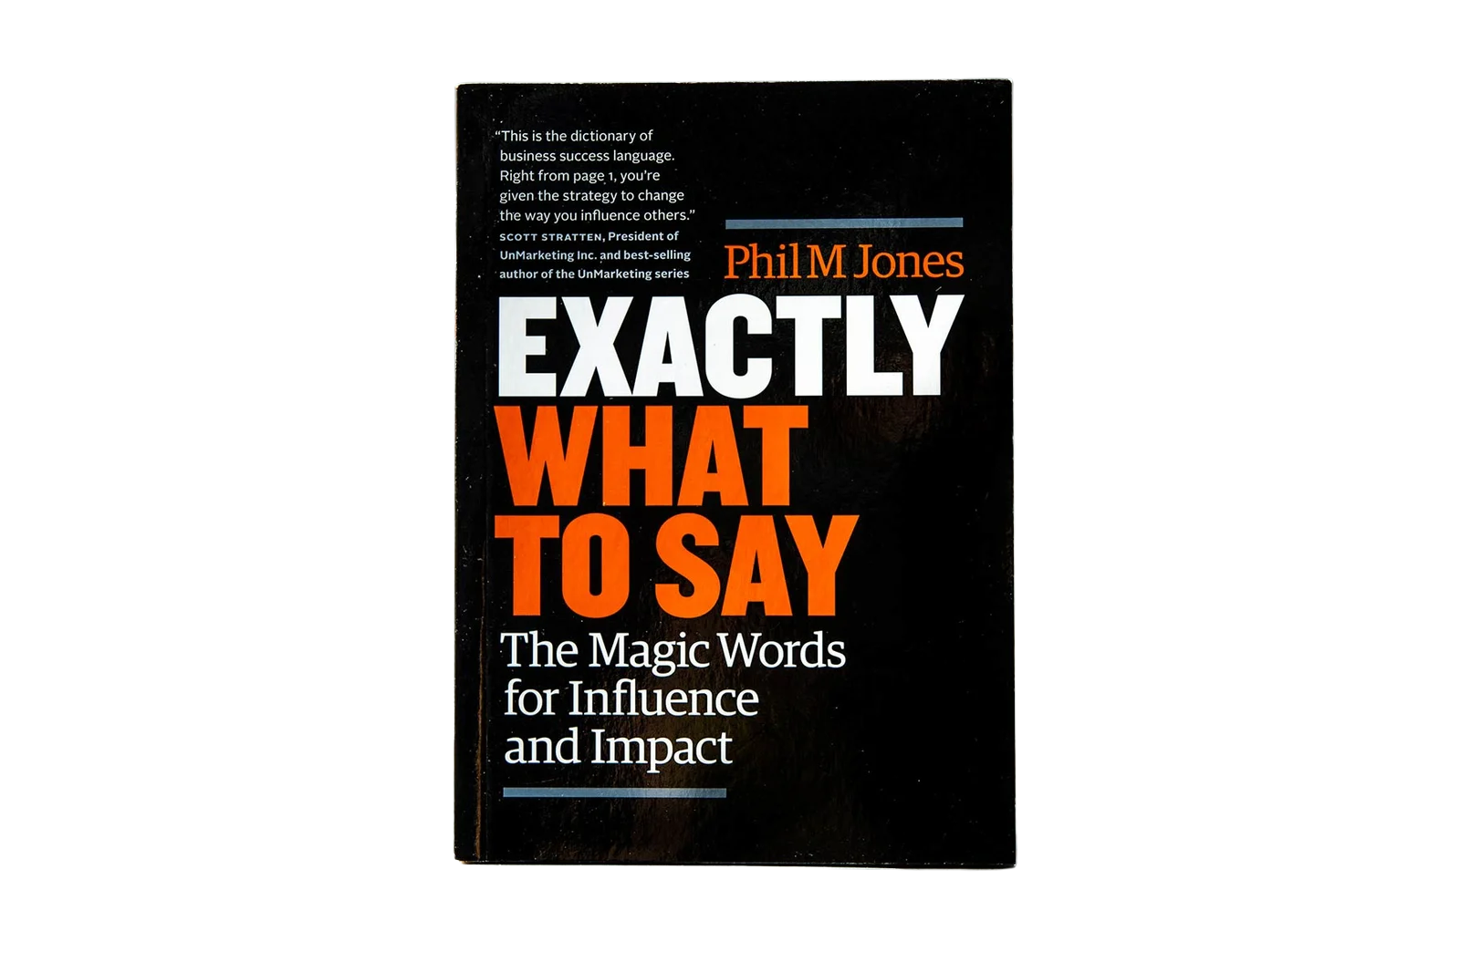
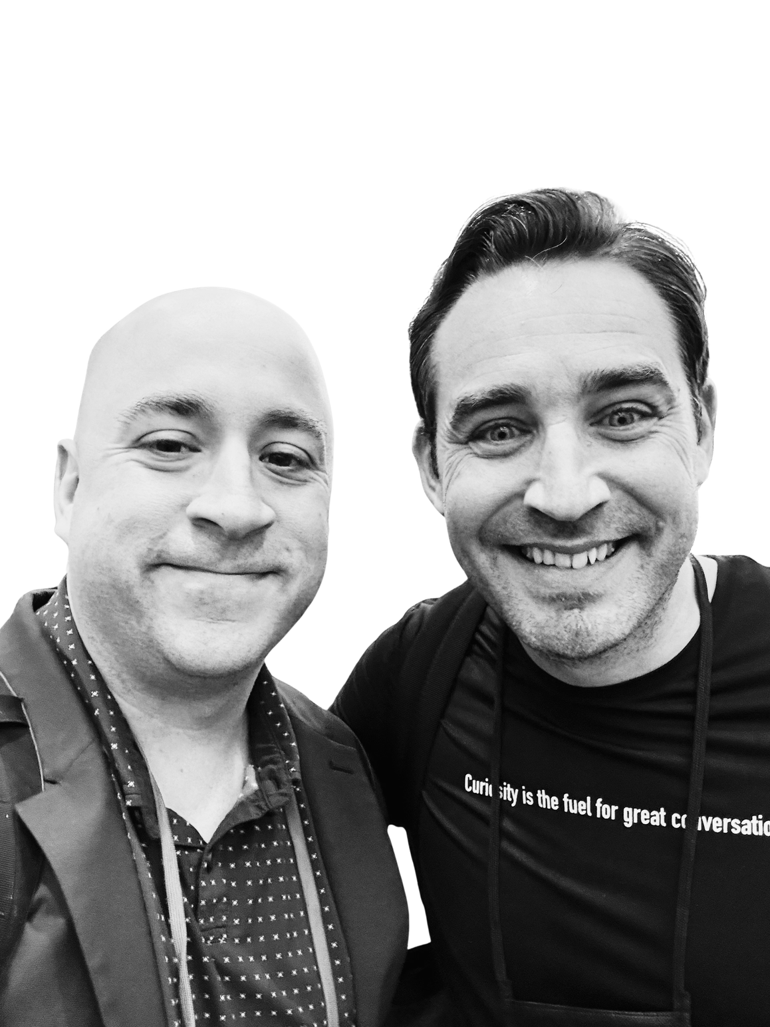
Phil M Jones

Slide 18

3
Hey [Name]! Would it make sense to start you on a home search at any point in 2026?
Any Plans Text

Slide 19
4
Homeowners that I talk to are always shocked when they find out what their home is actually worth today.
Want me to pull yours?
I’m Shocked Text

Slide 20
5
I’m not sure it’s for you but,
there are a handful of homes I found that are a DEAL right now!
Any interest?
Discount Rack Text

Slide 21
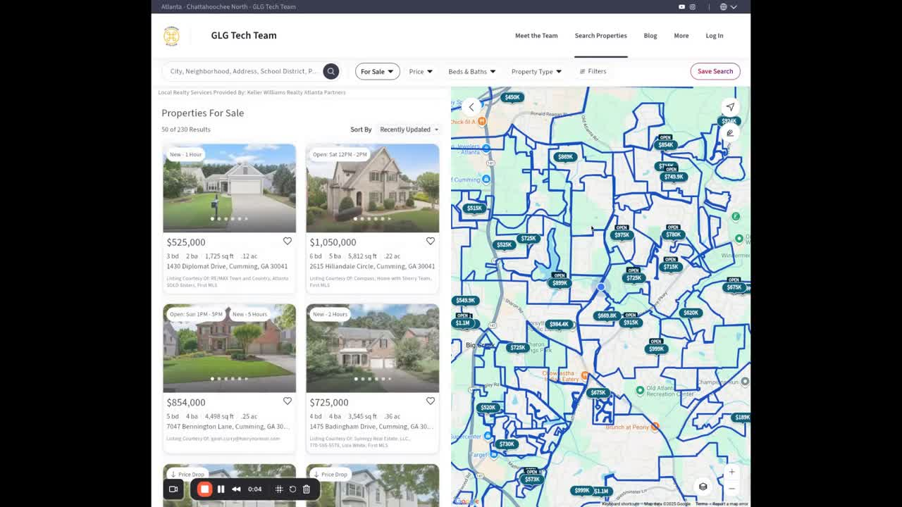
Price Reduced Homes - .KW.com

Slide 22
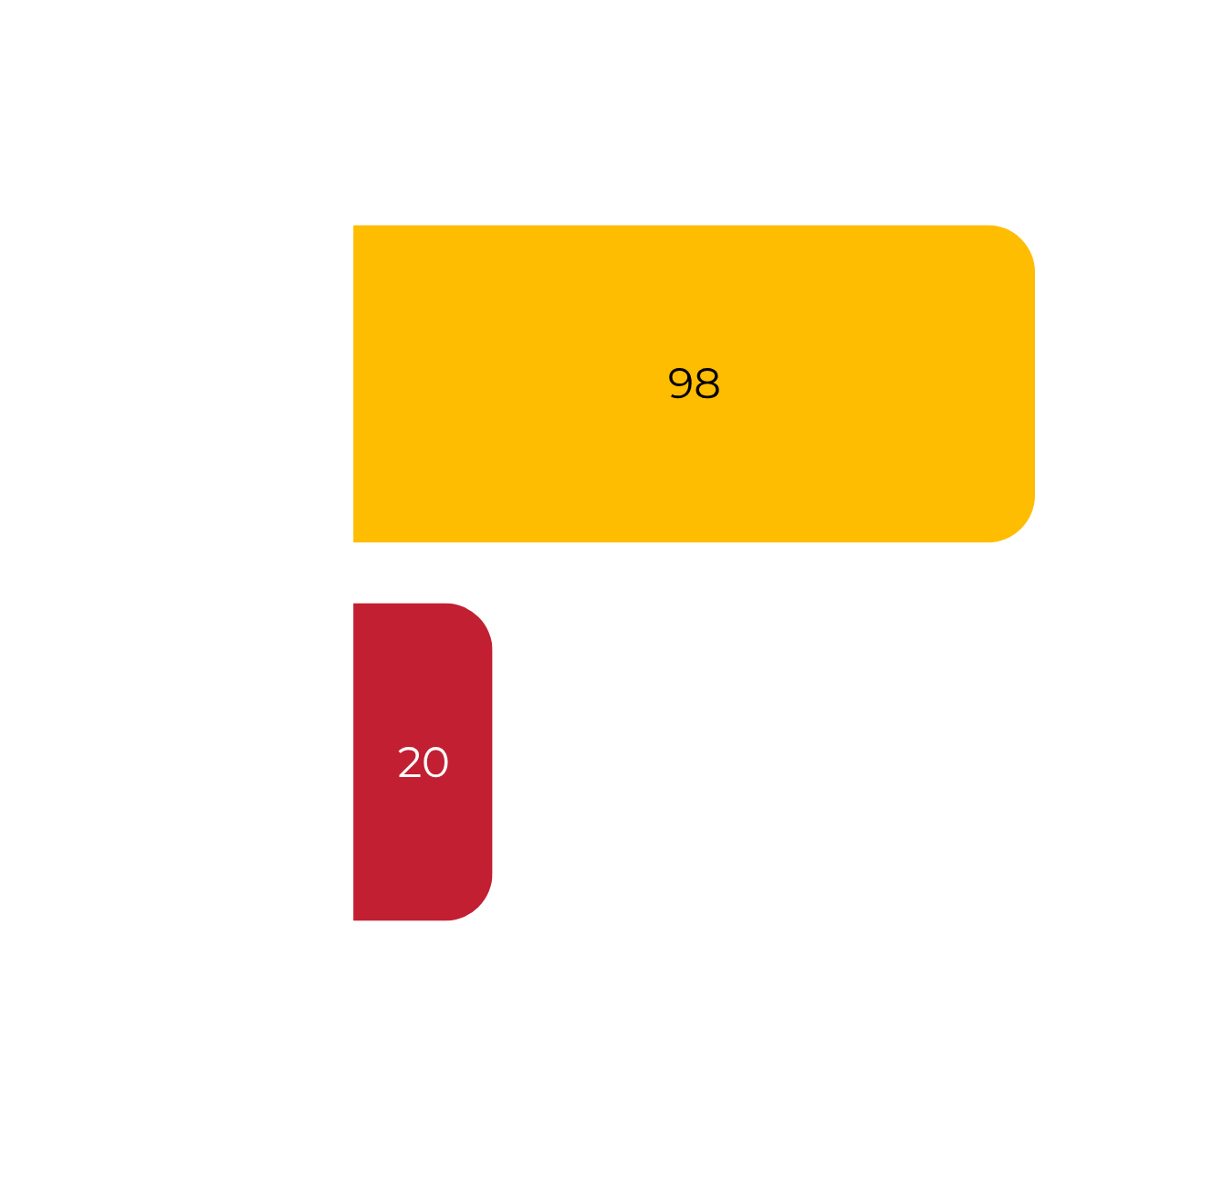
Text is
Better
Notes:
SMS open rate is around 98%, vastly outperforming email's typical 20% — source: Forbes via Infobip. Infobip

Slide 23
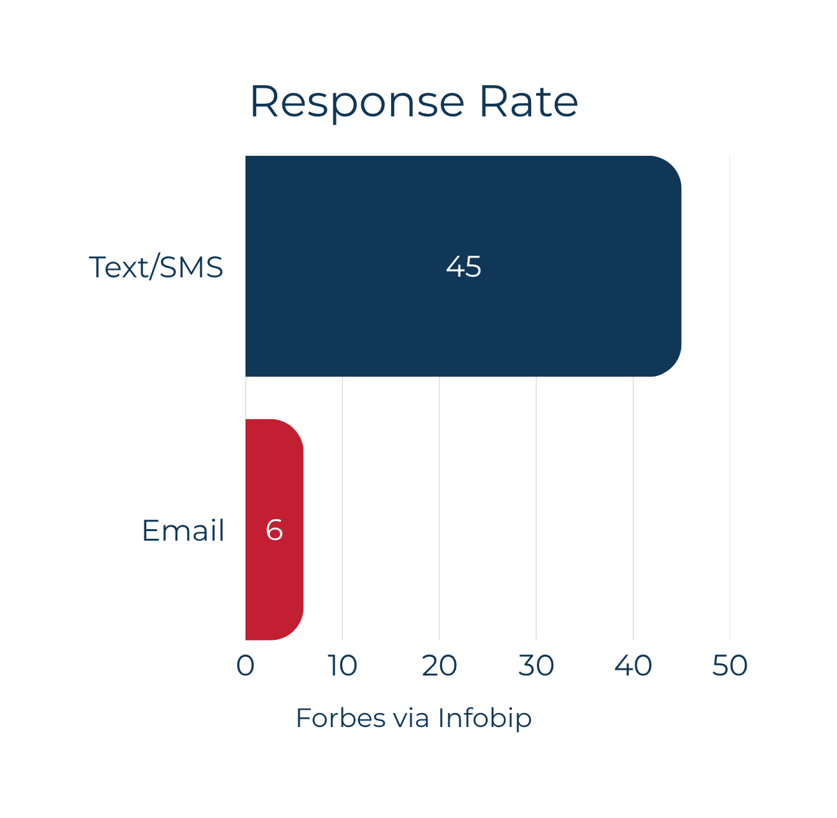
Text is
Better
Notes:
SMS open rate is around 98%, vastly outperforming email's typical 20% — source: Forbes via Infobip. Infobip

Slide 24
6A
How open minded would you be to getting set up on a custom home search? Are you thinking about moving in the next 18 months?
Open Minded Buyers

Slide 25
6B
How open minded would you be to finding out how much buyers are paying for houses right now in your neighborhood?
Open Minded Sellers
Notes:
Pitch Neighborhood Nurture as indirect offer

Slide 26
6C
How open minded would you be to be to grabbing coffee and sharing your real estate goals with me?
Open Minded Goals

Slide 27
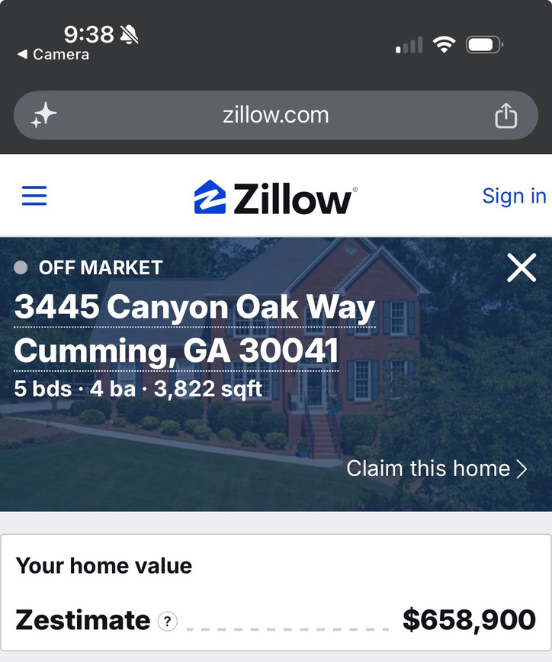
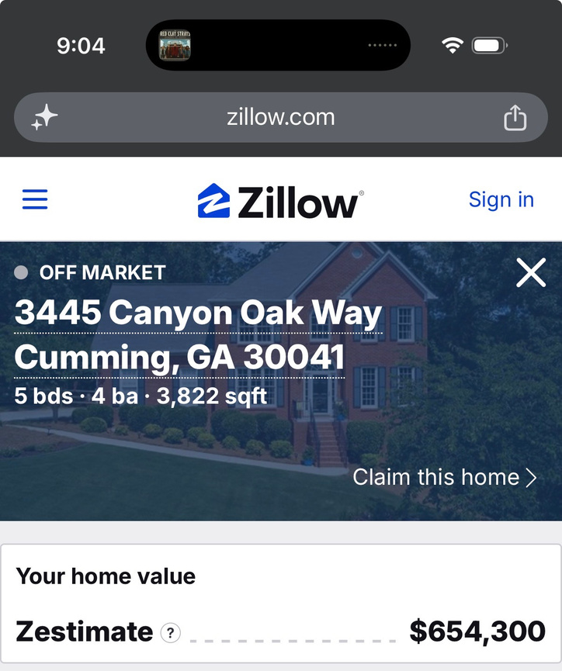
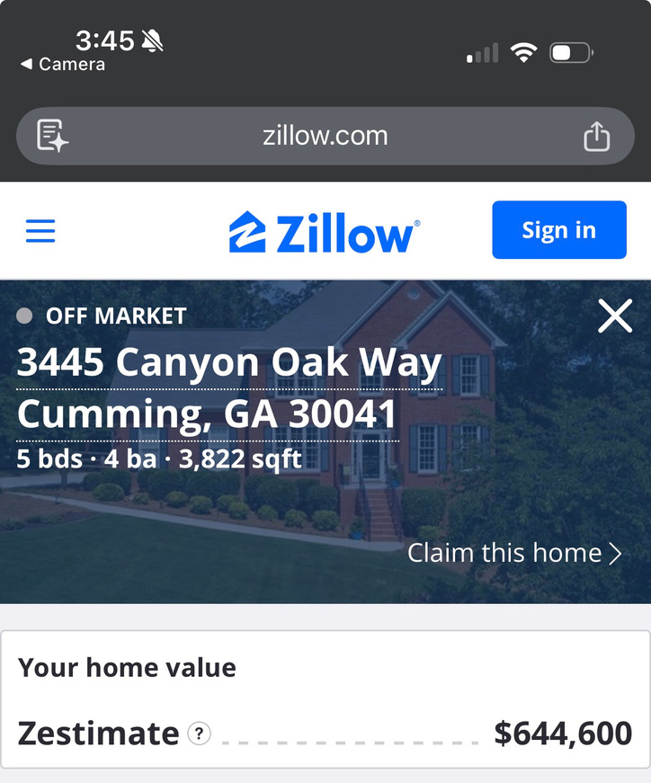
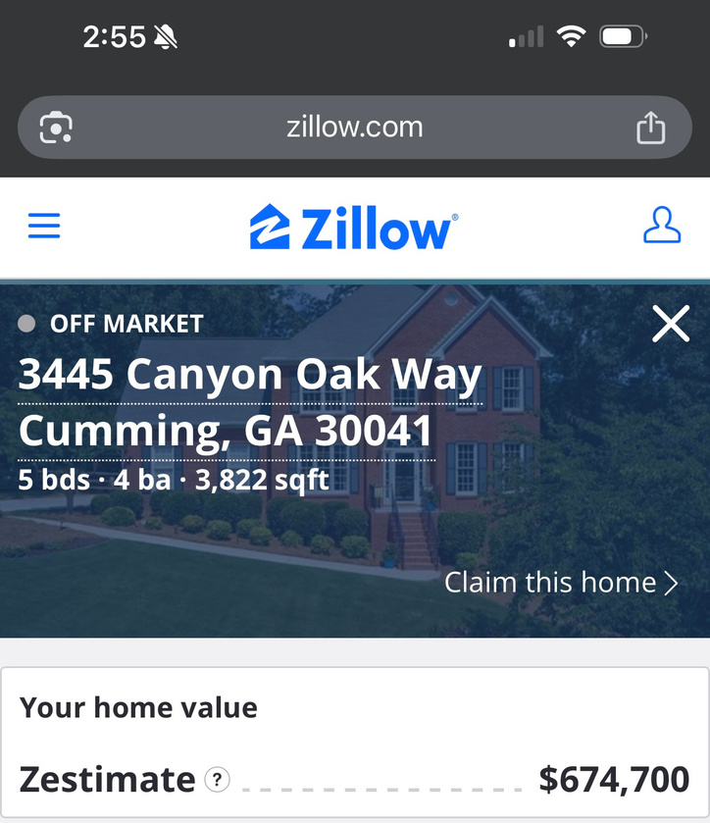
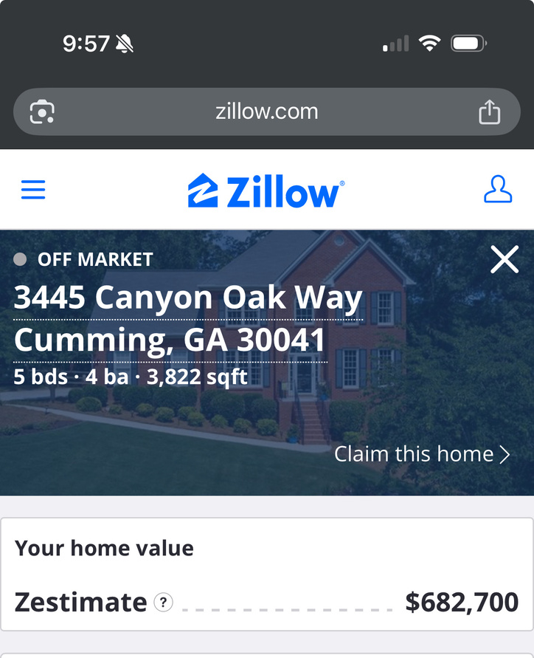
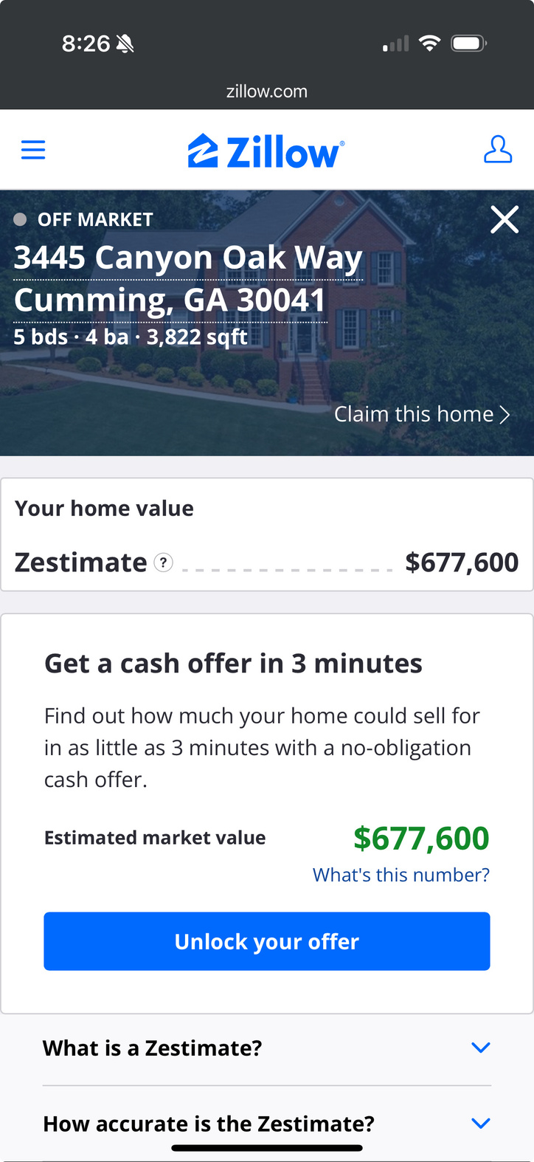
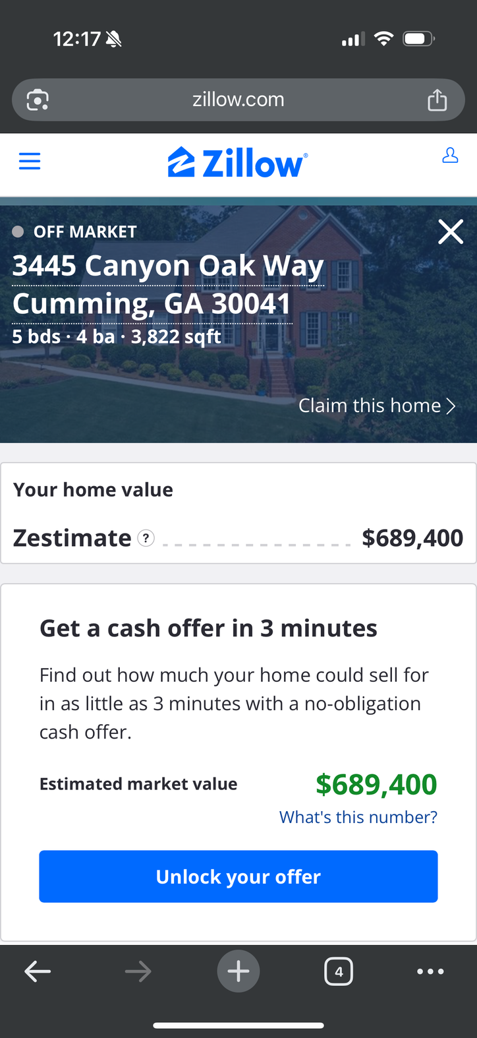

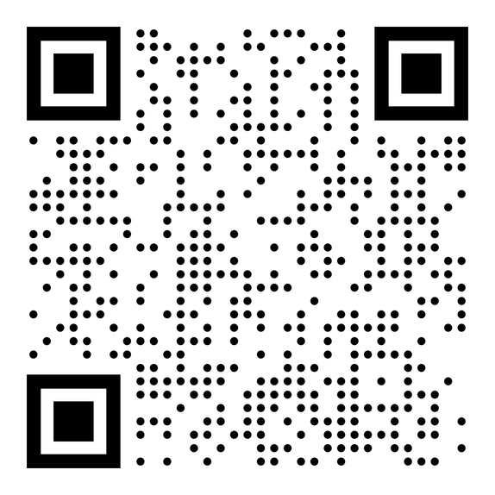

7
estimate
What are your thoughts on this?
The Textimate

Slide 28
VIDEO
TEXT

Slide 29
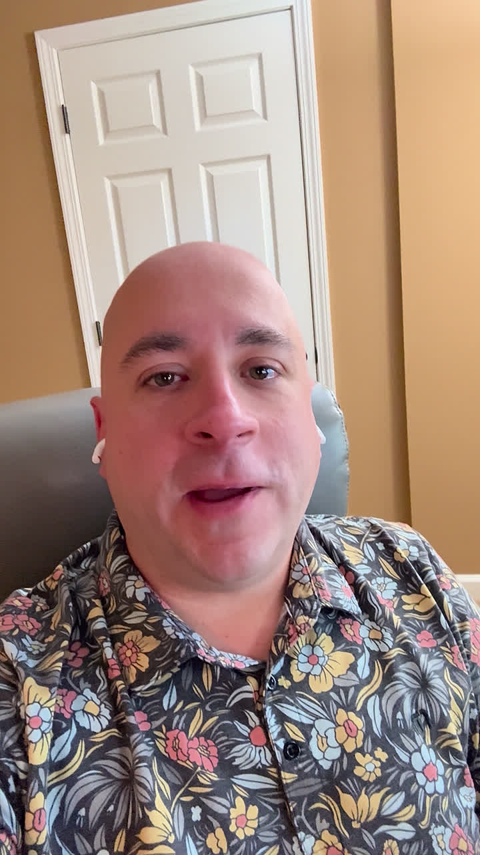
8
Video Text: First Client | Past Clients
  “I was thinking of you”
  Share gratitude
  Be authentic
  “If I can be of any help”
  NO SALES ASKS
Notes:
Don't worry!! You have options!!

Slide 30
4 Gratitude Video Styles
I Still Remember When...
Because of You, I...
You Were
My First.
I’m Not Asking for Anything
Remember that time your life was impacted by a client. Big or small? When do you think of them?
Gratitude to your very first client! Did they know you were
THAT new?
Hi. It’s been a while - just wanted to pop in your messages to see how you have been!
Pull a specific memory, something that was funny or something unique!
Notes:
"You were my first." — Say it out loud. Own it. There's something powerful about letting someone know they weren't just a client, they were the beginning of something.
"I still remember when..." — Pull one specific detail. The address, the moment they said yes, how nervous you were. Specificity is what separates a real message from a generic one.
Did something really funny happen while showing buyers? What types of people have inside jokes or funny memories? - friends!!
"Because of you, I..." — Connect the dot between that first transaction and where you are today. Let them feel the weight of what their trust actually meant to your life and career.
"I'm not asking for anything..." — Say this one. It disarms every instinct they have that a call or message from an agent always comes with a pitch. Pure gratitude lands harder when they know there's no hook.

Slide 31
Consumers retain 95% of a message when watching a video, compared to only 10% when reading text.
Source: RESIMPLI

Slide 32
PROFIT
SHARE

Slide 33
Hey[Name]! I’ve always enjoyed working with you, I was wondering, how open minded would you be to......
a) coming over to KW?
b) meeting my team leader?

Slide 34


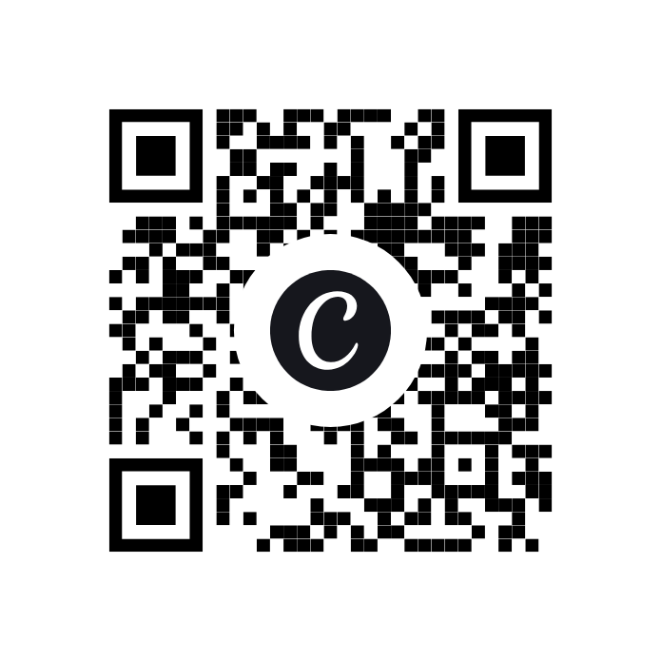
DOWNLOAD
THE GOLDEN
TEXTS

Slide 35

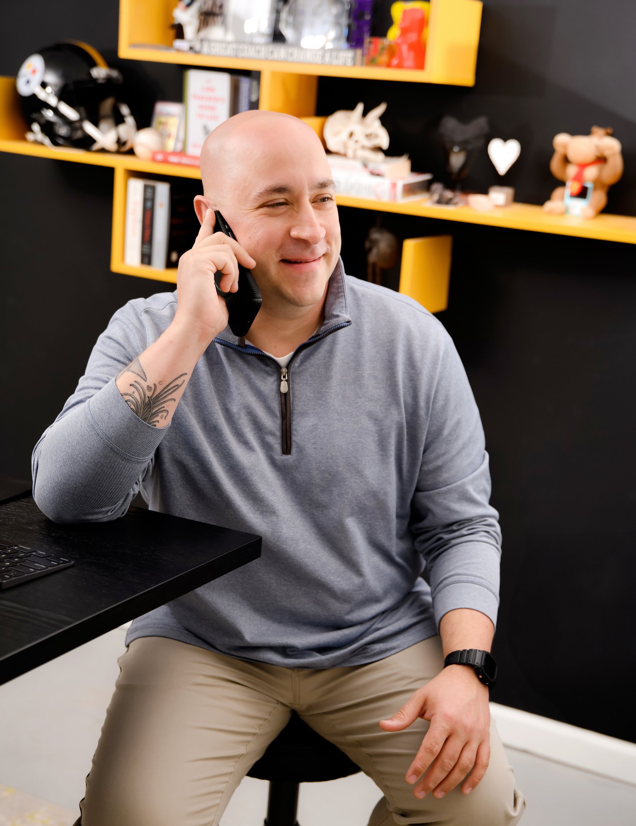
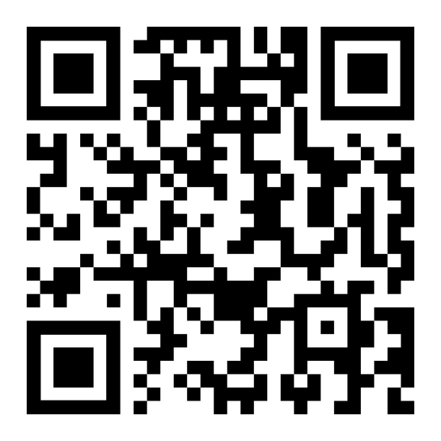
LEAVE A KIND WORD?
THANK YOU!
What class did you attend with Sam?
What did you want to learn by attending?
What was the biggest takeaway you had from Sam?
What problem did Sam help solve in your business?

Slide 36
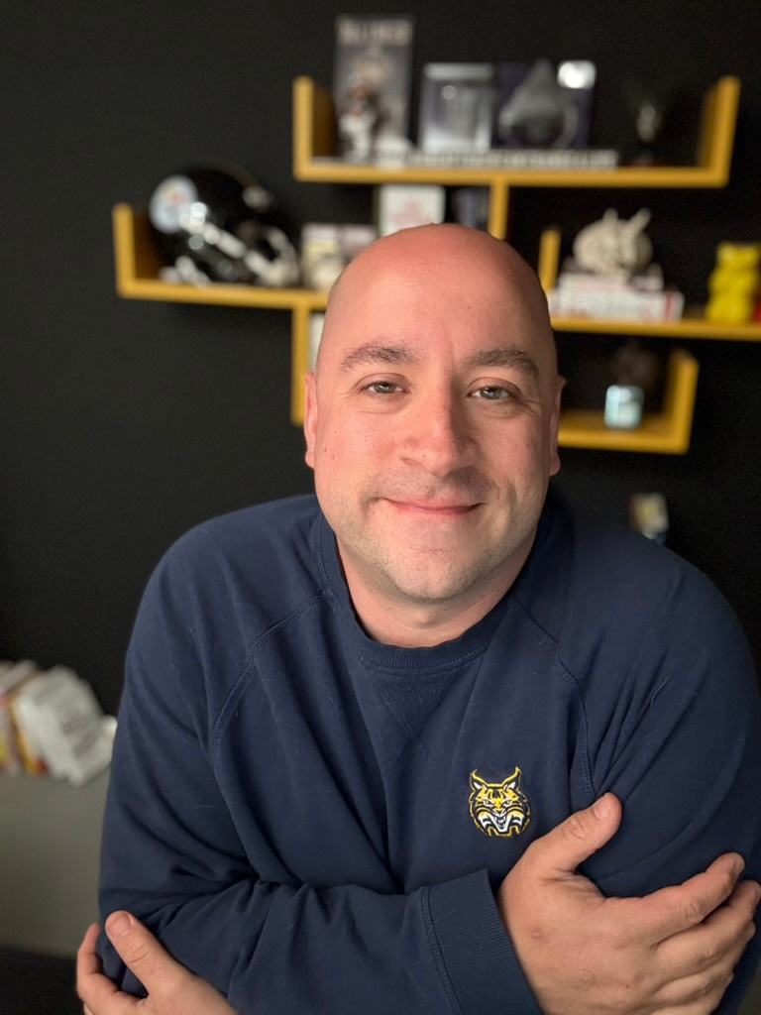
NEED A COACH?
ASK ME ABOUT MAPS COACHING!
Sam.Jackson@kw.com
(412) 965-3702
SincerelySamual.com

