Slide 1
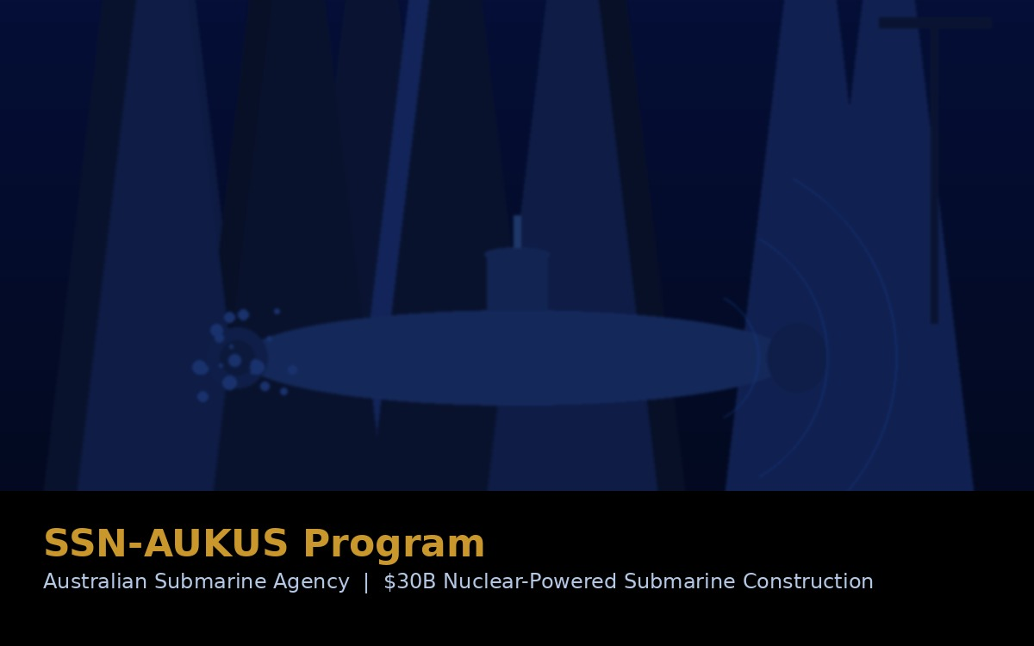
PROJECT 02
SSN-AUKUS Program
Australian Submarine Agency — Nuclear-Powered Submarine Construction
The Osborne Submarine Construction Yard represents up to AU$30 billion in long-term investment — the most consequential industrial transformation in Australia's Defence history. M2T supported engineering assurance, design governance, and nuclear regulatory compliance as an above-the-line technical consultant to the Australian Submarine Agency.
AU$3.9B
~AU$30B
5,500+
SSN-AUKUS
Down-payment
announced Feb 2026
Total program
estimate (long-term)
Peak direct jobs
at Osborne
First boat target:
construction by ~2030
CLIENT: AUSTRALIAN SUBMARINE AGENCY (ASA)
Role: Above-the-line technical consultant — engineering, safety & regulatory assurance
AU$3.9B confirmed investment, Feb 2026 | US and UK experts advising on expanded Osborne Naval Shipyard | Source: ASA, Navy Lookout

Slide 2
How M2T Supported the ASA / AUKUS Program
★ Design & Combat Systems Assurance
We supported engineering assurance activities across submarine design and combat system integration, ensuring that technical outputs aligned with Defence requirements and emerging nuclear safety standards.
★ Assurance of the ~$30B Submarine Construction Yard
We contributed to infrastructure assurance across the Osborne Nuclear-Powered Submarine Construction Yard — a program with total long-term investment estimated at up to AU$30B. Our work covered nuclear regulatory compliance, design verification, and certification pathway development.
Joint Assurance Framework
We supported development of a joint assurance framework coordinating Defence, federal regulators, nuclear specialists, engineering authorities, and local communities.
PROJECT 02
Nuclear Infrastructure Compliance
SSN-AUKUS
Program
Contributed to design reviews, hazard analysis, safety case development, and certification evidence across construction and commissioning phases of nuclear-related facilities.
Regulatory Alignment
Assisted in interpreting emerging Australian nuclear regulations and international standards, translating requirements into engineering evidence packs for certification bodies.
Nuclear Infrastructure Assurance
Project Controls & Reporting
System Safety Engineering
Design Assurance
Provided project controls support — design change management, cost modelling, and schedule assurance — maintaining baseline integrity throughout a high-risk program.
Configuration Management
Regulatory Compliance
Stakeholder & Community Engagement
Project Controls
Produced clear technical reporting for government officials, regulators, and local communities, translating complex nuclear engineering into accessible, accurate public communication.
Hazard Analysis
Community & Stakeholder Engagement

