Slide 1
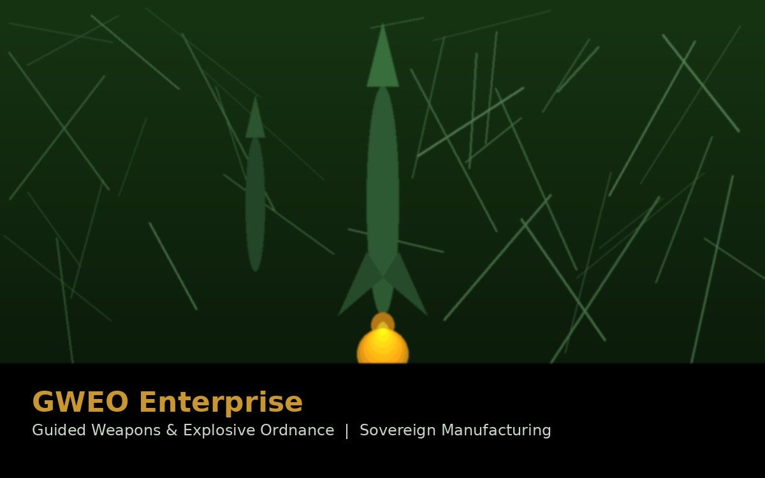
PROJECT 01
GWEO Enterprise
Guided Weapons & Explosive Ordnance — Australia's Sovereign Strike Capability
Australia fired its first domestically assembled GMLRS missile at Woomera in April 2026 — the first nation outside the United States to do so. M2T supported the engineering and governance foundations that made this historic milestone possible.
AU$37.4M
4,000
Mar 2024
Dec 2025
GWPC Risk Reduction
Contract
GMLRS rockets / yr
planned peak output
Australia–US
GWEO MoU signed
Port Wakefield
facility opened
CLIENT: GWEO GROUP / DEPT. OF DEFENCE
Role: Above-the-line technical consultant & subject matter support
Port Wakefield Missile Assembly Facility opened December 2025 — first GMLRS assembled outside the US

Slide 2
How M2T Supported the GWEO Program
★ Manufacturing Engineering Division Backbone
We supported the development of the inaugural GWEO Manufacturing Division Technical Governance Framework — the engineering system underpinning how guided weapons are manufactured in Australia.
★ Enabled Australia's First Assembly & Live Fire of GMLRS
Australia test-fired its first locally assembled GMLRS at Woomera in April 2026 — the only nation outside the US to do so. M2T's governance, safety, and T&E support contributed to the frameworks that validated and assured this historic milestone.
Australia–US GWEO Memorandum of Understanding
Our team supported technical analysis and alignment for the March 2024 bilateral agreement enabling up to 4,000 GMLRS rockets per year — 10× Australia's own needs.
PROJECT 01
Engineering Workforce Planning (GWPC)
GWEO
Enterprise
We assisted in designing the workforce model for the Guided Weapons Production Capability, mapping APS, ADF, and contractor roles across a 10-year horizon.
Test & Evaluation Planning
Contributed to Test & Evaluation Master Plans, safety-integrated trial frameworks, and OEM test failure root-cause analysis.
Engineering Governance
Supply Chain & Compliance Assurance
System Safety & Certification
Technical Workforce Design
Supported supplier evaluation, NEQ calculations, and compliance assessments protecting the Commonwealth's procurement interests throughout the acquisition lifecycle.
ILS & Supply Chain
Test & Evaluation
Cost Modelling for Cabinet Submissions
Bilateral MoU Support
Provided technical-economic modelling of T&E infrastructure and range assets that informed multi-billion dollar Government investment decisions.
Cost & Technical Modelling
Supplier Compliance Assurance

