Slide 1
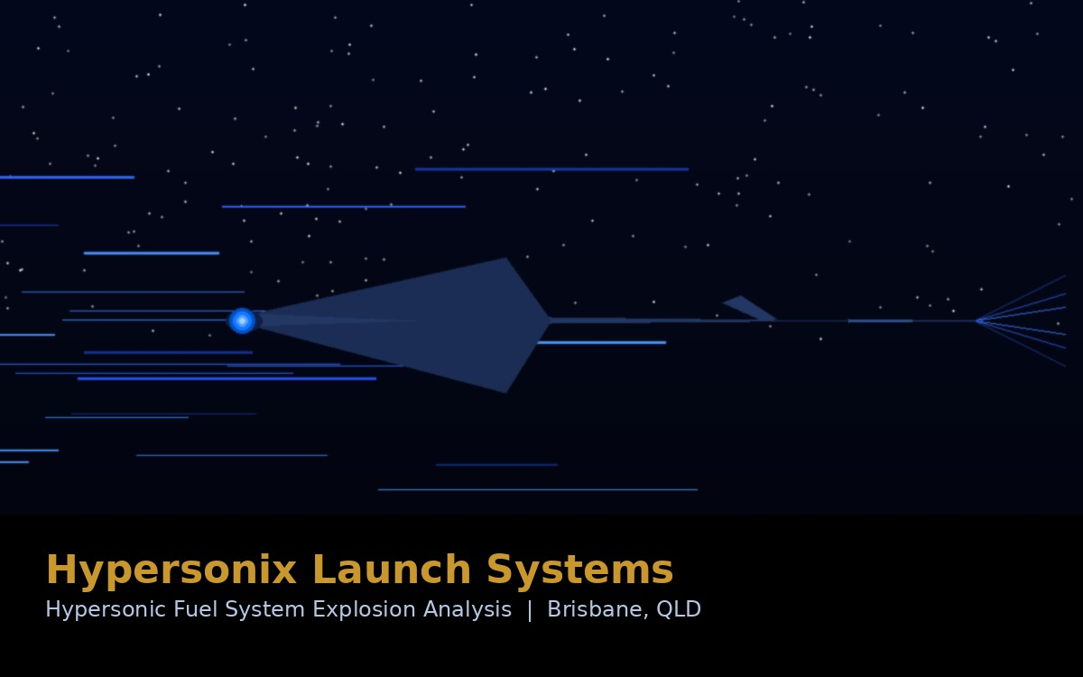
PROJECT 03
Hypersonix Launch
Systems
Fuel System Explosion Analysis — Hypersonic Vehicle Testing Safety
Hypersonix Launch Systems engaged M2T to provide specialist explosive engineering analysis for their high-pressure hydrogen COPV fuel system testing program at Carole Park, Brisbane. M2T provided a structured hazard assessment covering blast overpressure, fragmentation, and risk mitigation recommendations — supporting safe hypersonic vehicle development in Australia.
COPV
Bow-Tie
Gurney
DEOP 101
Carbon-Overwound
Pressure Vessel — H₂
Analysis methodology
for 2–3 hazard events
Fragmentation model
used for assessment
Primary reference
standard applied
CLIENT: HYPERSONIX LAUNCH SYSTEMS (HLS)
Role: Independent specialist technical advisory — explosive hazard analysis
Carole Park, Brisbane QLD | SoW ENGDOC-1290889023-141346 | Key personnel: Paul Summerton (Snr Engr), Helen Hann (Chief Engr)

Slide 2
How M2T Supported Hypersonix
★ Fuel System Explosion & Fragmentation Analysis
We conducted specialist analysis of possible scenarios arising from rupture or explosion of the high-pressure hydrogen COPV fuel tank — including blast overpressure, shock wave propagation, and high-speed fragmentation from stainless steel tubes and fittings.
★ Structured Risk Methodology — Bow-Tie, Gurney & Huang Models
Our approach applied bow-tie analysis across 2–3 hazardous event scenarios, Gurney models for fragmentation assessment, and Huang et al. methodology for blast overpressure — referenced against DEOP 101, relevant STANAGs, and MIL-STD standards.
Scenario Identification & Likelihood Rating
We developed a structured list of potential rupture and explosion scenarios, rated by likelihood and consequence, providing HLS with a clear picture of their risk exposure.
PROJECT 03
Hazard Log Development
Hypersonix
Launch Systems
A hazard log was developed using Defence Hazard Risk Management (DHRM) methodology — giving HLS a documented, auditable basis for their risk management decisions.
Blast Overpressure & Fragmentation Quantification
Calculated specific blast overpressure threats and fragmentation hazard zones to enable HLS to determine appropriate exclusion distances and barrier requirements.
Explosive Hazard Analysis
Mitigation Recommendations
Blast Overpressure Assessment
Fragmentation Analysis (Gurney)
We offered practical advice on controls to reduce the severity of each consequence, including recommendations on which specialist suppliers could deliver physical mitigation solutions.
Bow-Tie Risk Methodology
COPV / High-Pressure Vessel Risk
Independent Technical Advisory — Not Regulatory Compliance
Hazard Log Development
Consistent with the SoW, our work constituted technical advice using established engineering methods — not a certified Defence EO compliance trace — providing HLS with expert guidance while maintaining appropriate scope boundaries.
Technical Safety Advisory
Hydrogen System Safety

Slide 3
GWEO ENTERPRISE
SSN-AUKUS / ASA
HYPERSONIX
Sovereign
Weapons Industry
Nuclear
Submarine Future
Hypersonic
Vehicle Safety
Engineering governance, safety, T&E, ILS, and workforce planning — from the manufacturing backbone to the Australia–US MoU enabling up to 4,000 GMLRS per year.
Design assurance, nuclear infrastructure compliance, regulatory alignment, and project controls for Australia's most consequential Defence program.
Specialist explosive hazard analysis — blast overpressure, fragmentation, and risk mitigation for high-pressure hydrogen COPV fuel system testing.
Talk to us about your program.
EMAIL
WEBSITE
PHONE
LOCATION
admin@m2ts.com.au
www.m2ts.com.au
0438 275 517
Canberra, ACT
M2T Solutions Pty Ltd | DISP Member | Veteran-Owned | ABN 58 670 163 630

