Slide 1
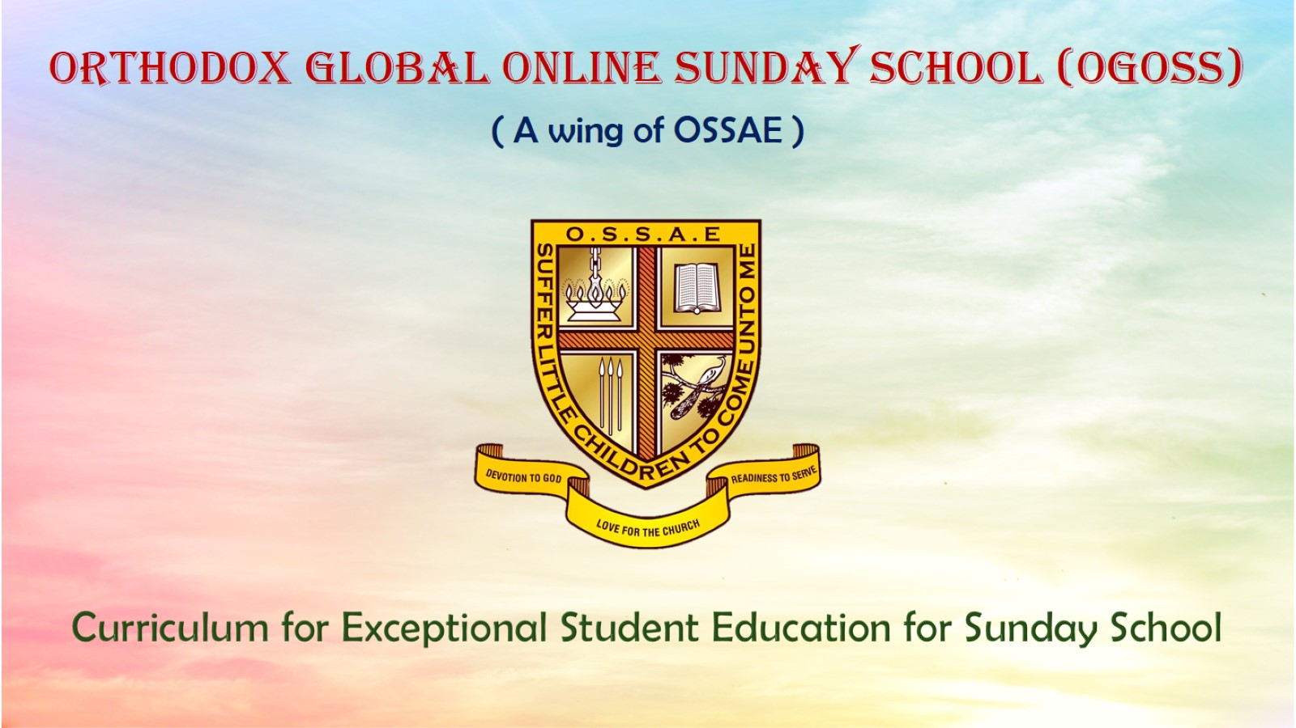
Orthodox Global Online Sunday School (OGOSS)

Slide 2
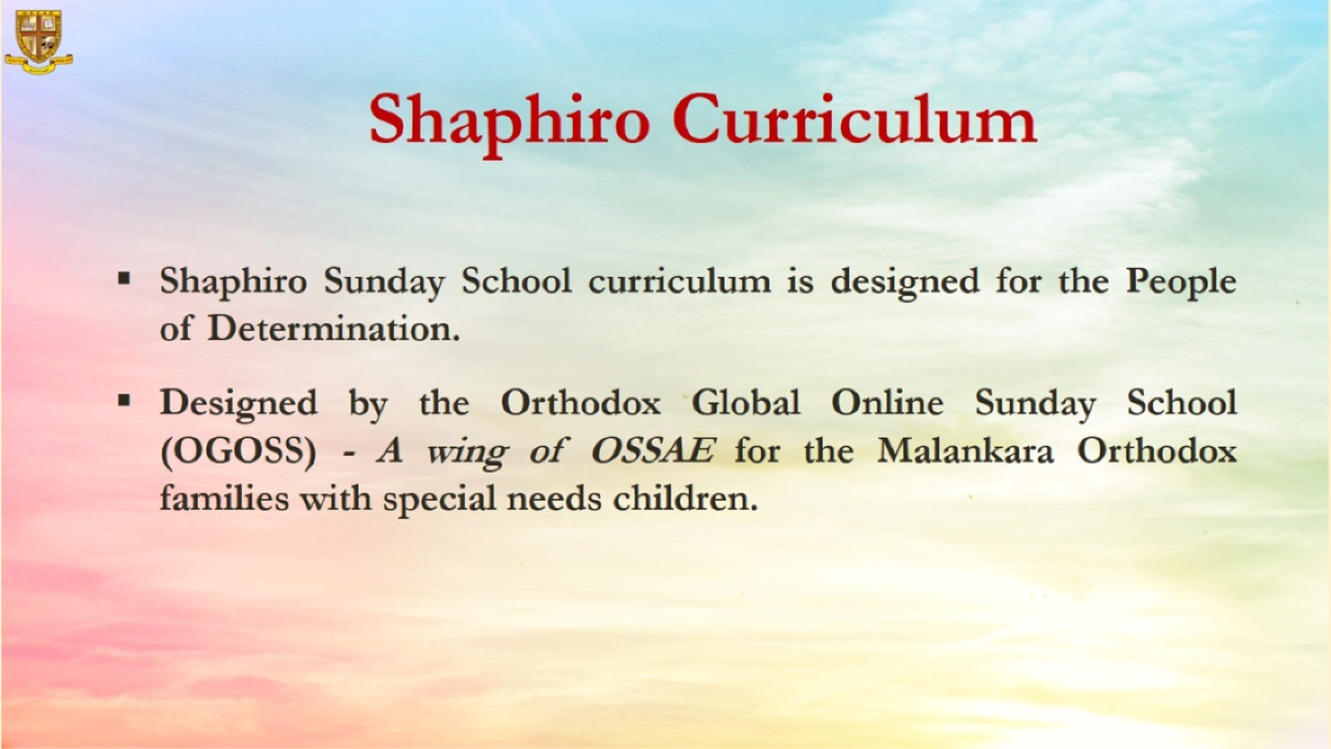

Slide 3
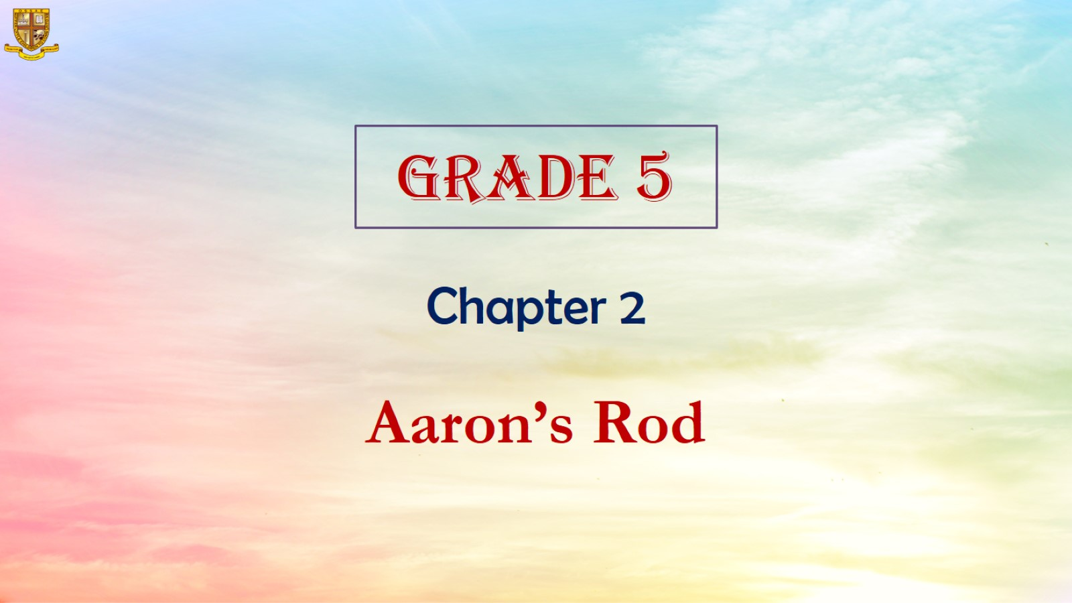

Slide 4
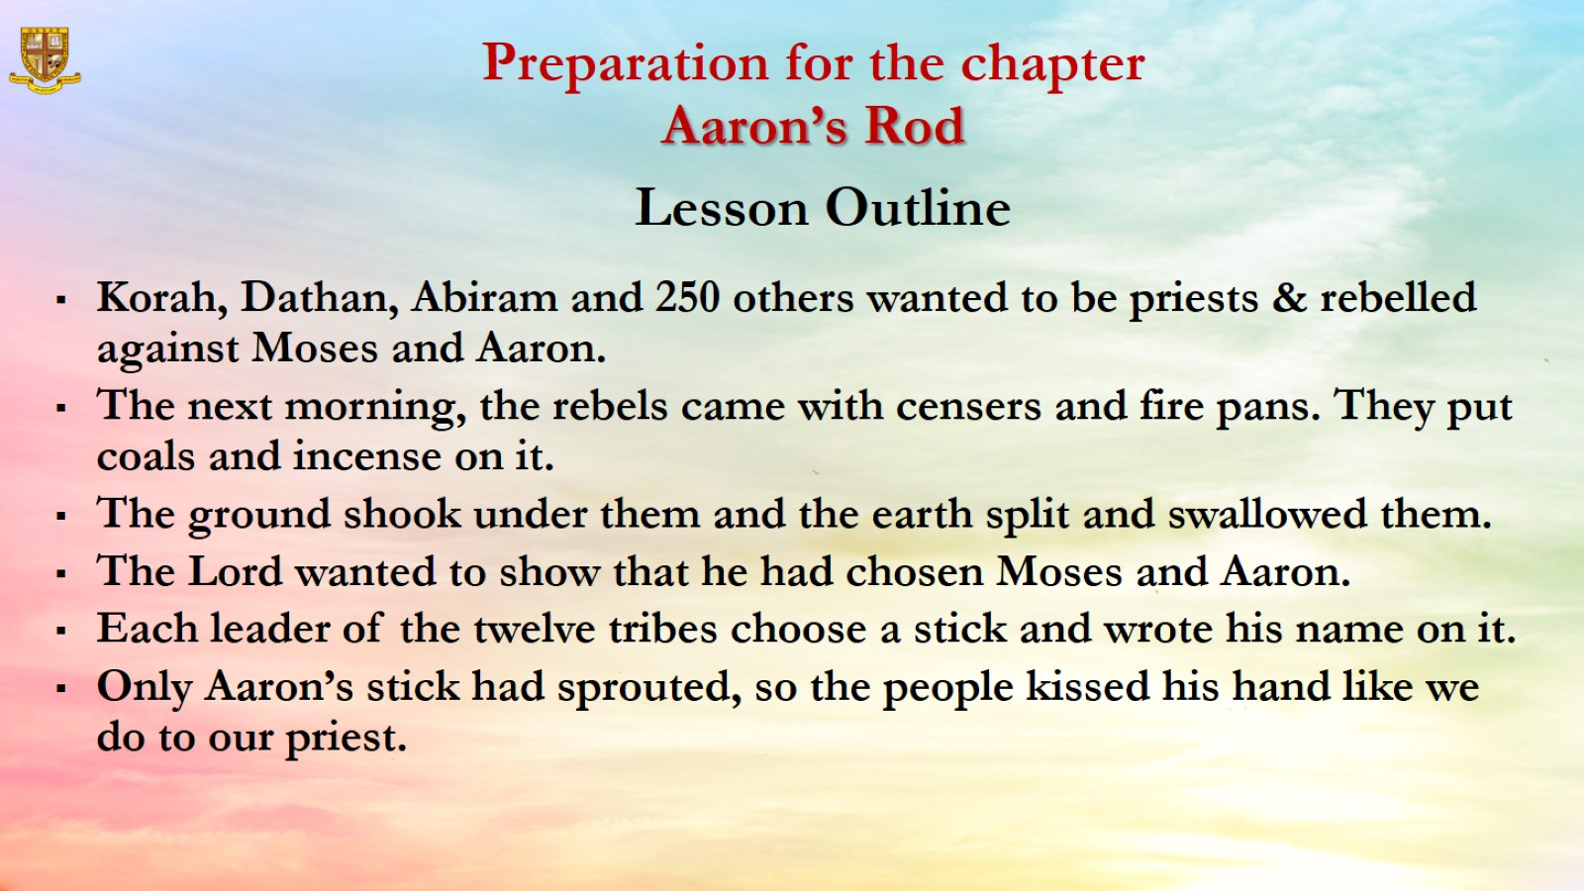
Preparation for the chapter
Aaron’s Rod

Slide 5
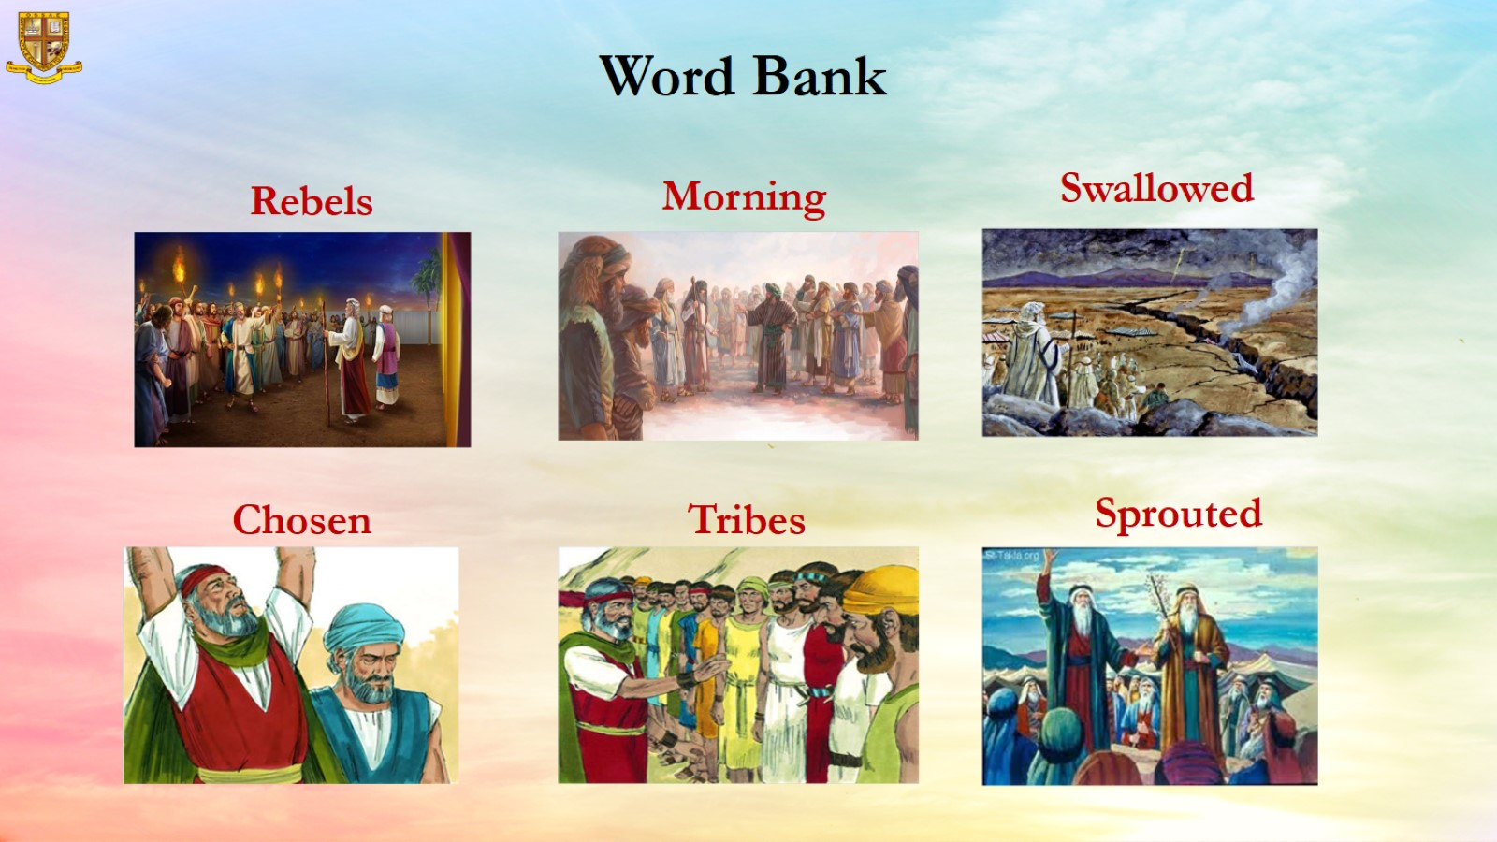
Word Bank

Slide 6
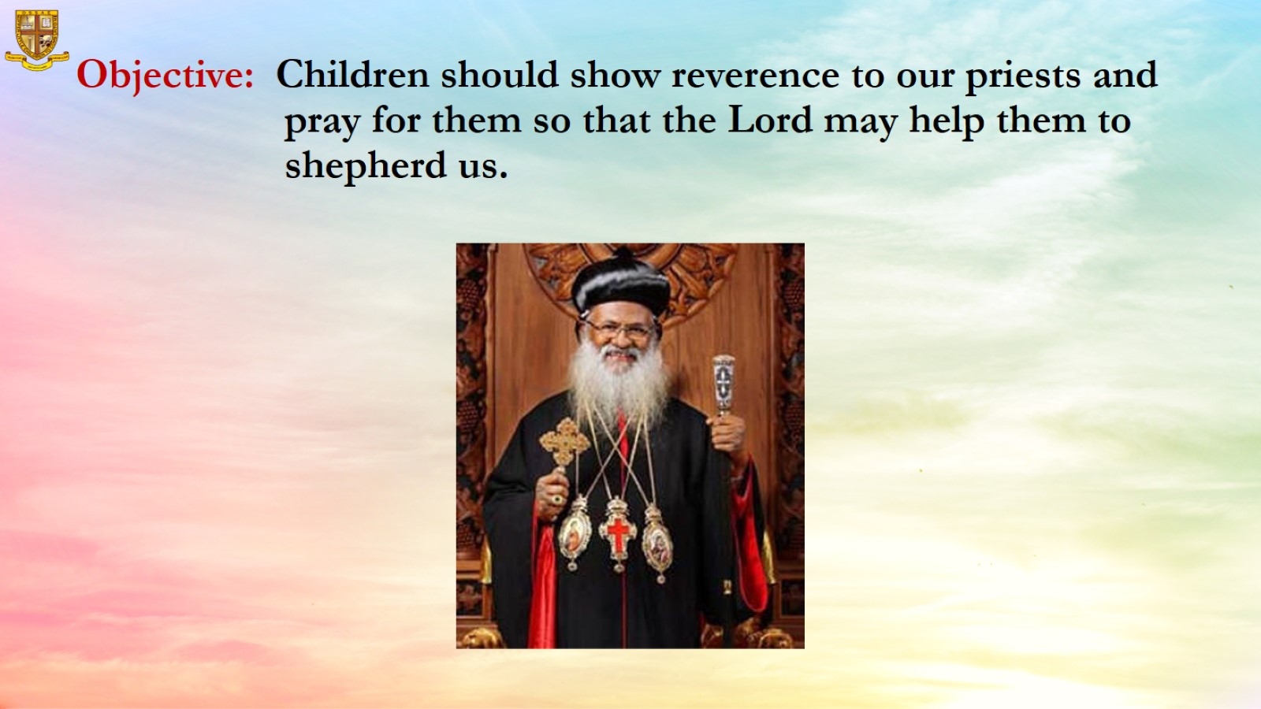
Objective: Children should show reverence to our priests and pray for them so that the Lord may help them to shepherd us.

Slide 7
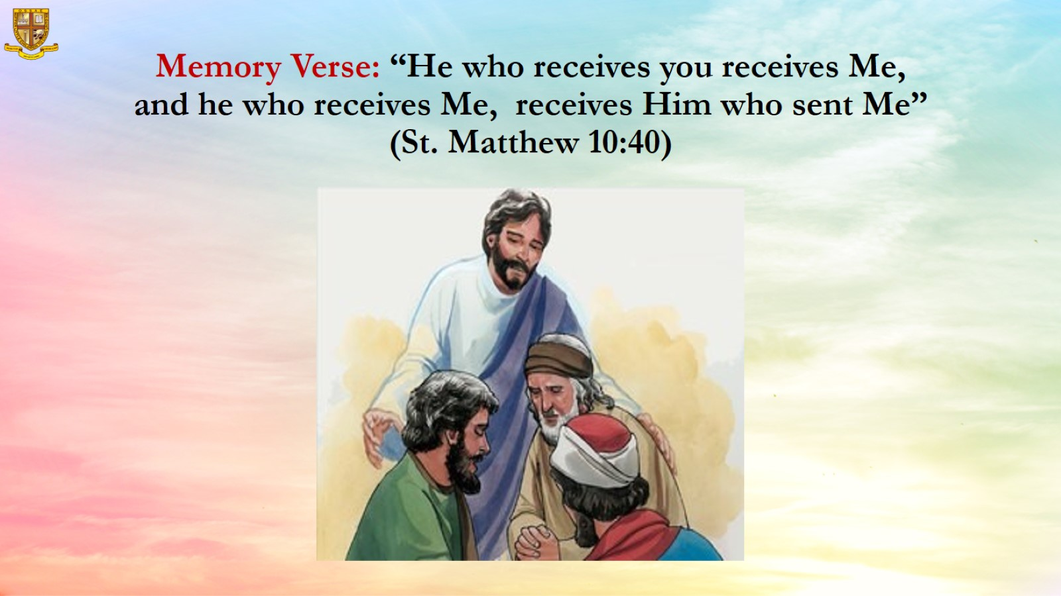
Memory Verse: “He who receives you receives Me, and he who receives Me, receives Him who sent Me” (St. Matthew 10:40)

Slide 8
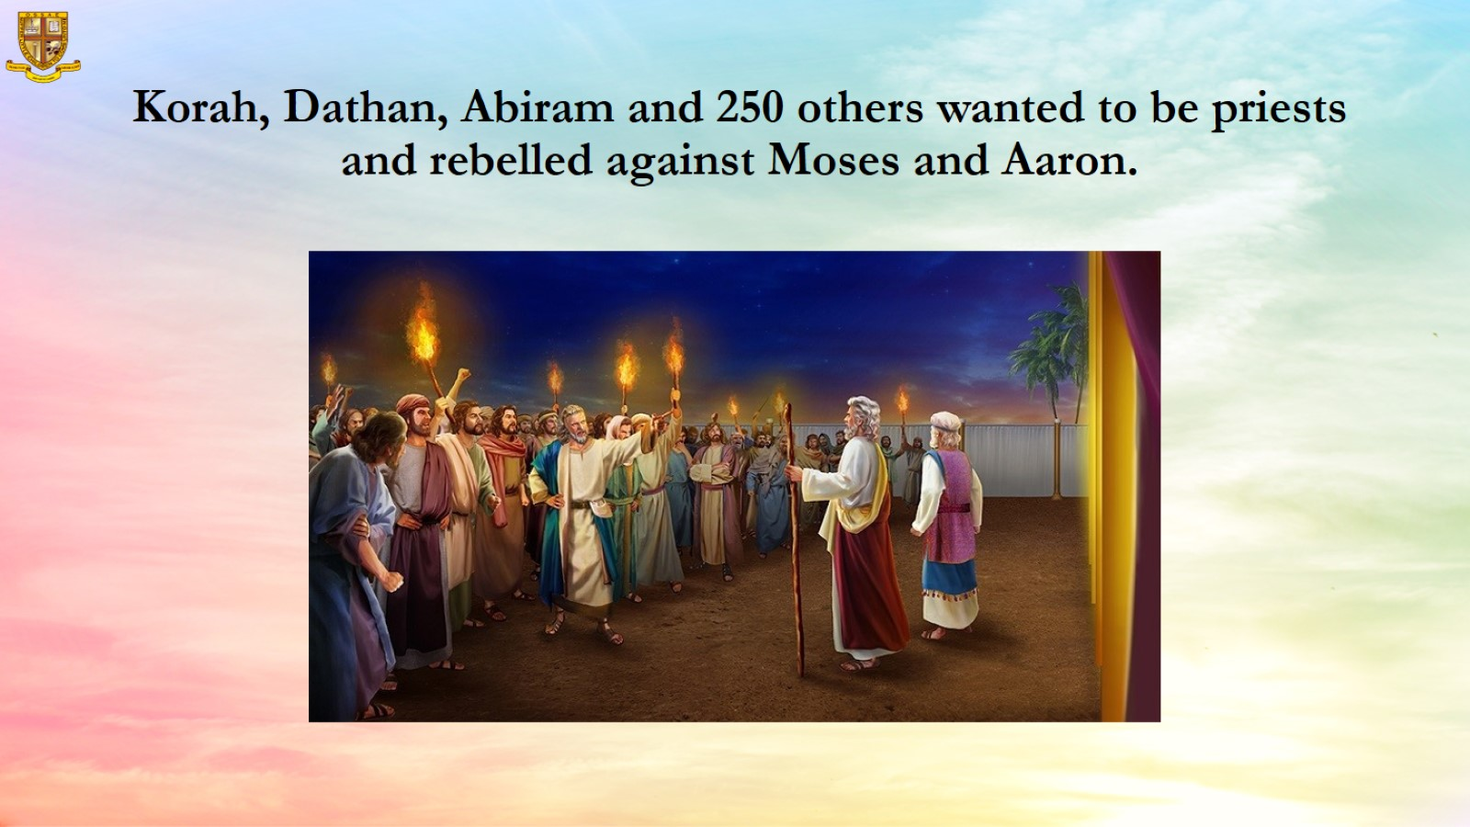
Korah, Dathan, Abiram and 250 others wanted to be priests and rebelled against Moses and Aaron.

Slide 9
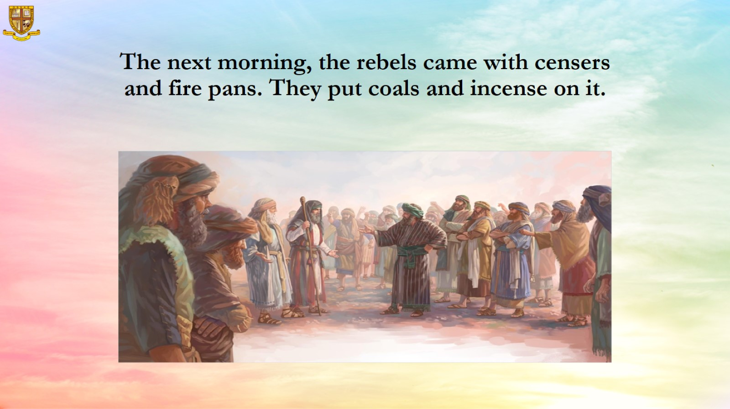
The next morning, the rebels came with censers and fire pans. They put coals and incense on it.

Slide 10
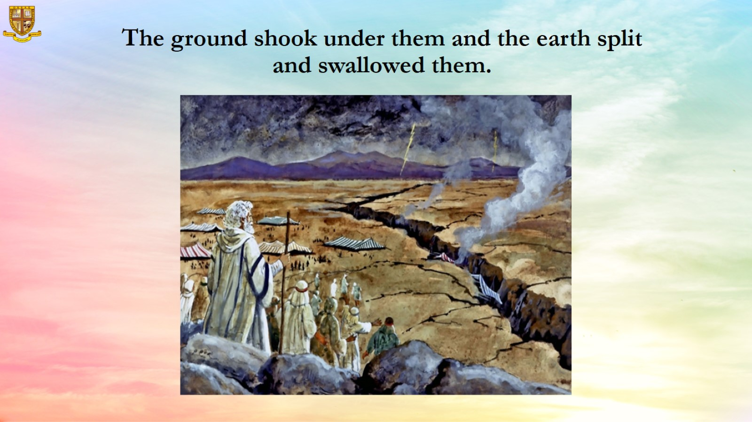
The ground shook under them and the earth split and swallowed them.

Slide 11
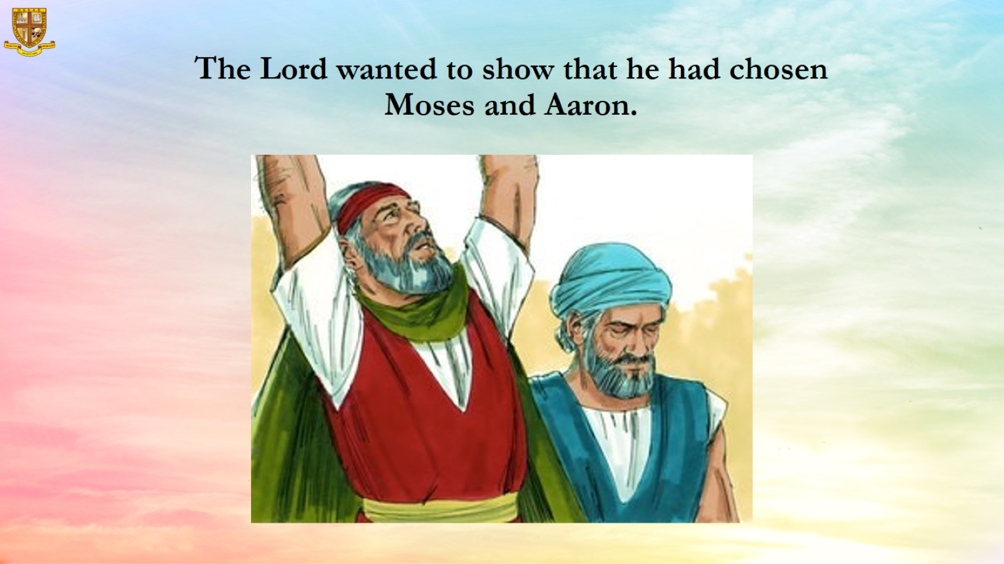
The Lord wanted to show that he had chosen Moses and Aaron.

Slide 12
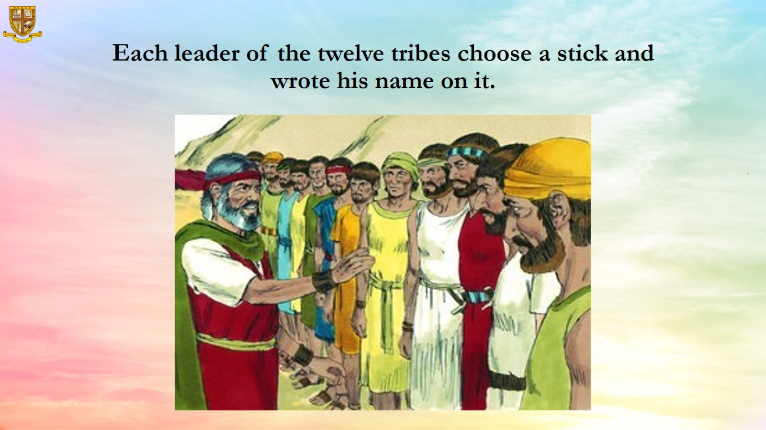
Each leader of the twelve tribes choose a stick and wrote his name on it.

Slide 13
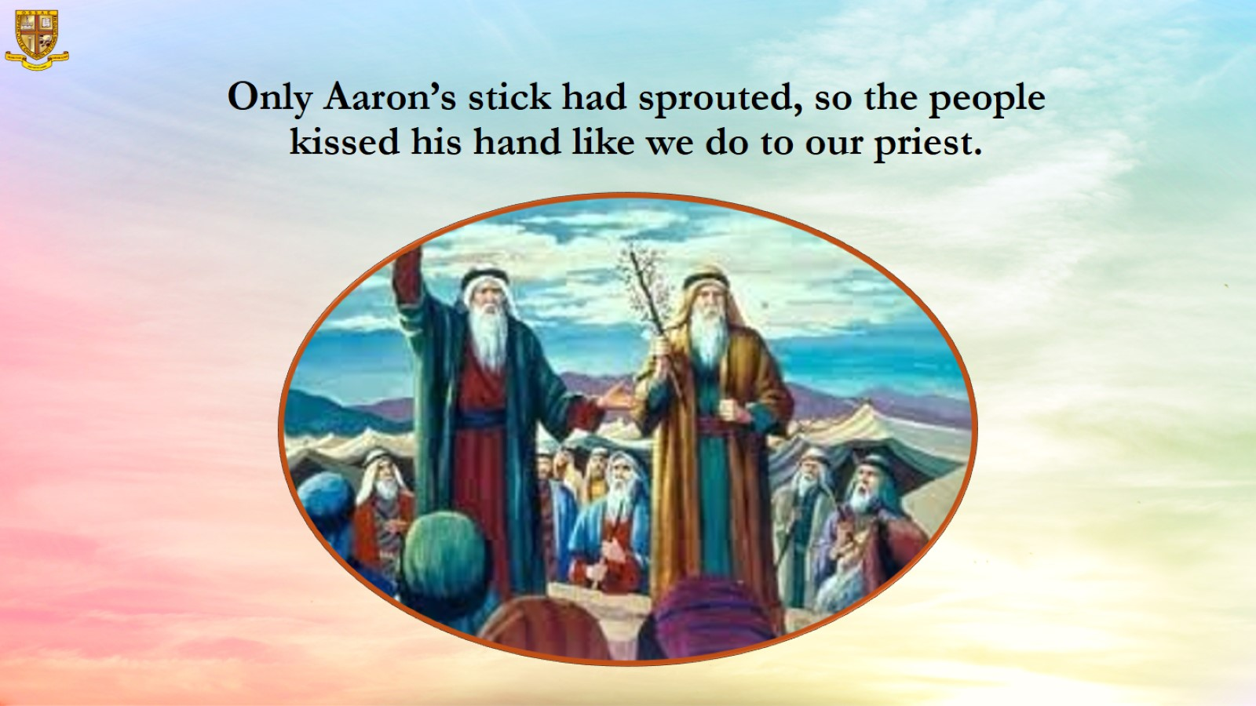
Only Aaron’s stick had sprouted, so the people kissed his hand like we do to our priest.

Slide 14
