Slide 1
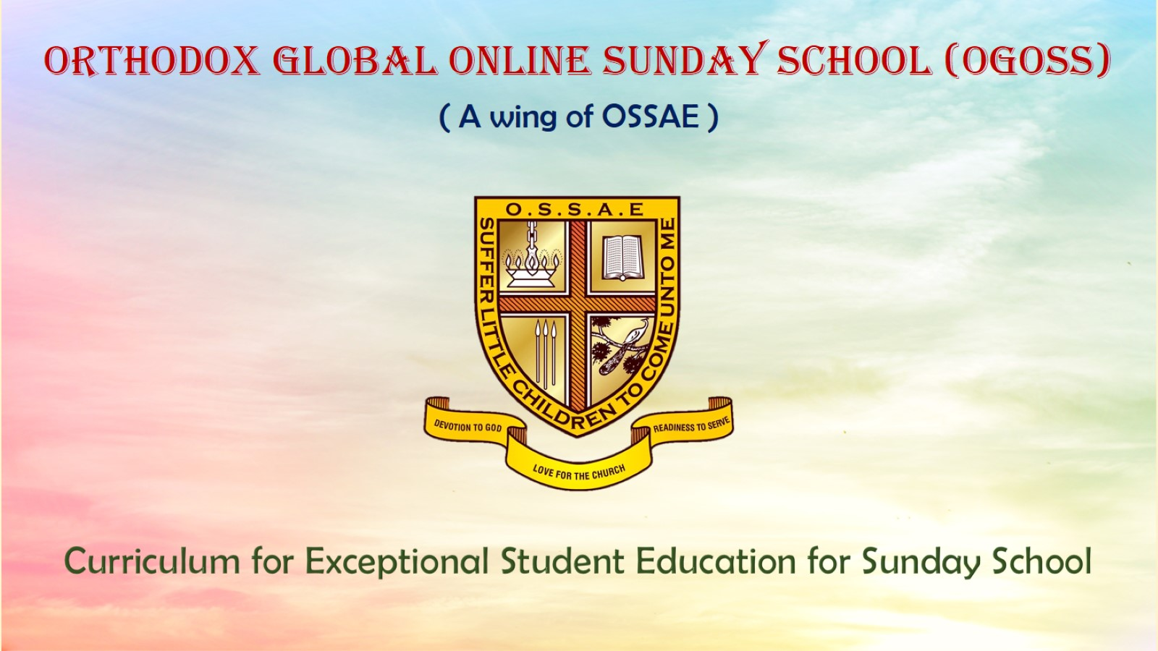
Orthodox Global Online Sunday School (OGOSS)

Slide 2
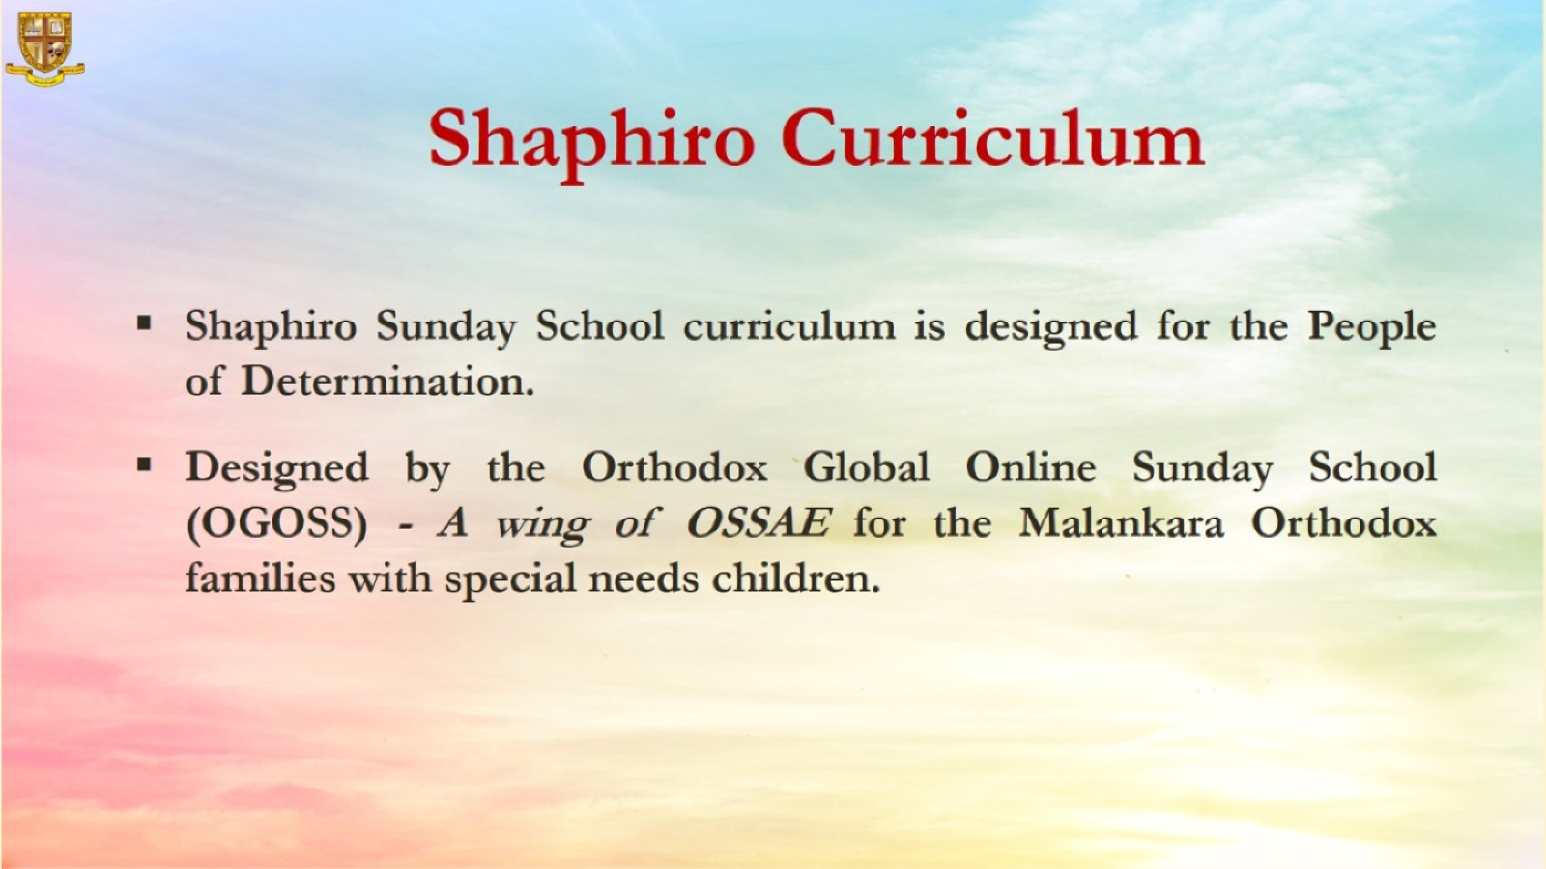

Slide 3
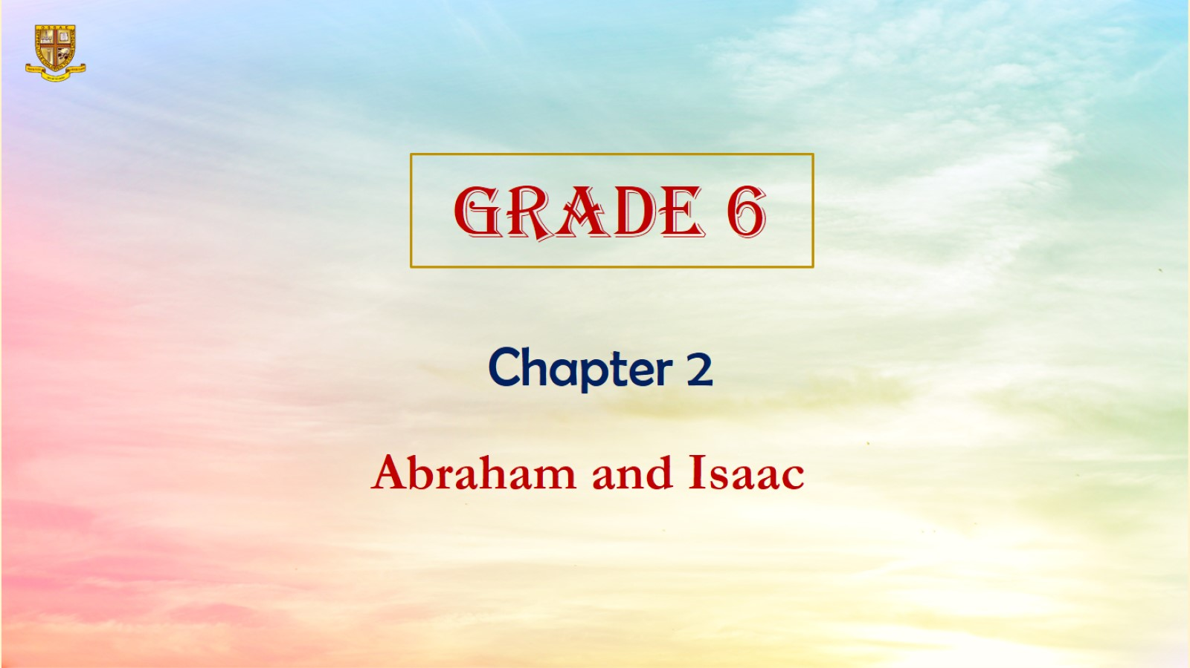

Slide 4
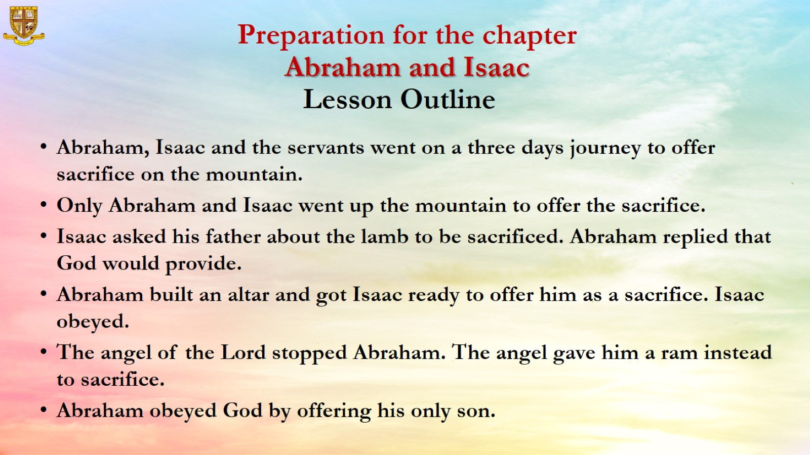
Preparation for the chapter
Abraham and Isaac

Slide 5
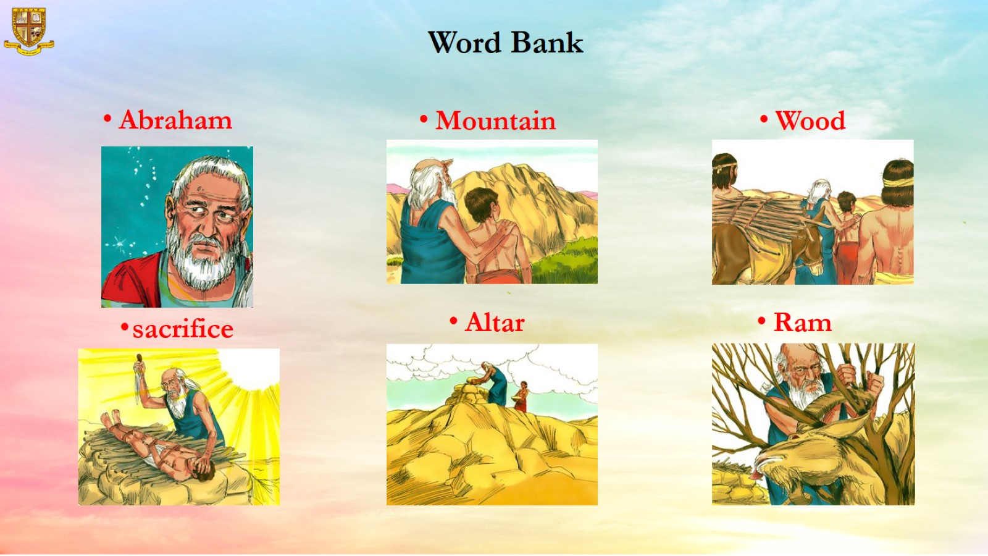
Word Bank

Slide 6
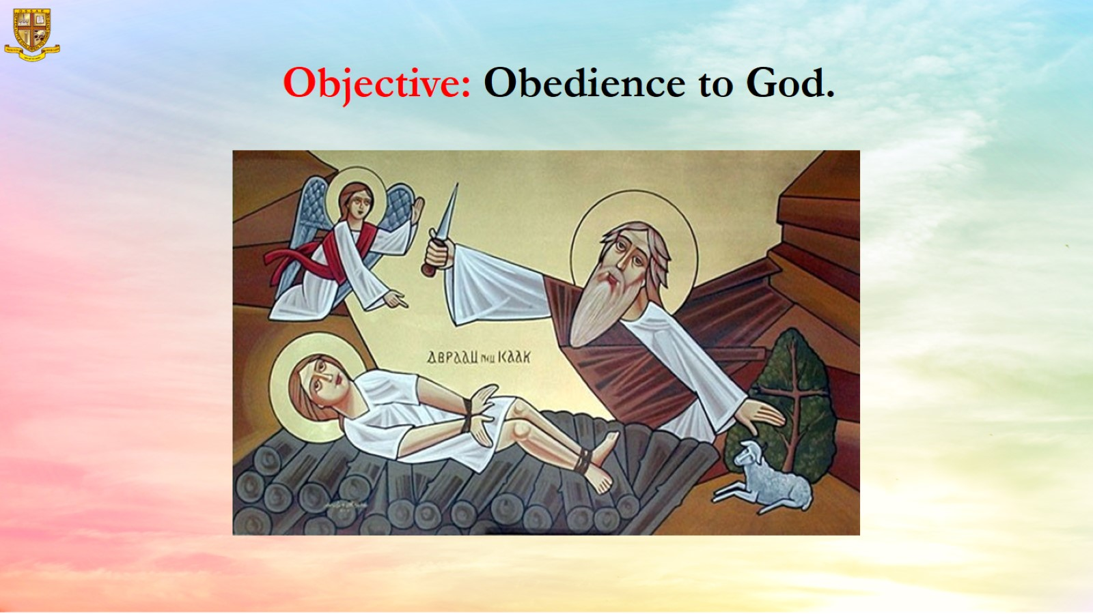
Objective: Obedience to God.

Slide 7
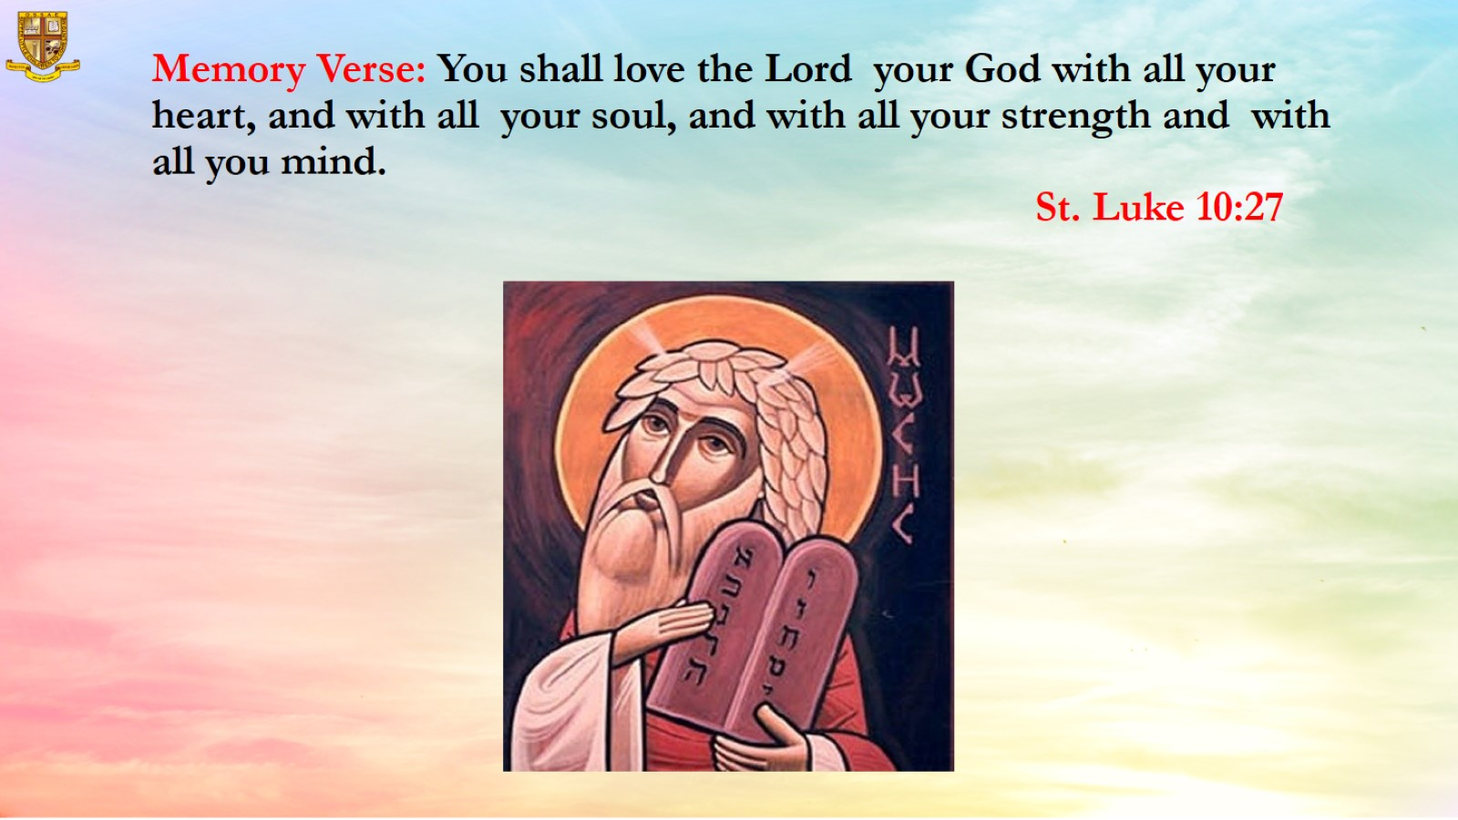
Memory Verse: You shall love the Lord your God with all your heart, and with all your soul, and with all your strength and with all you mind.
St. Luke 10:27

Slide 8
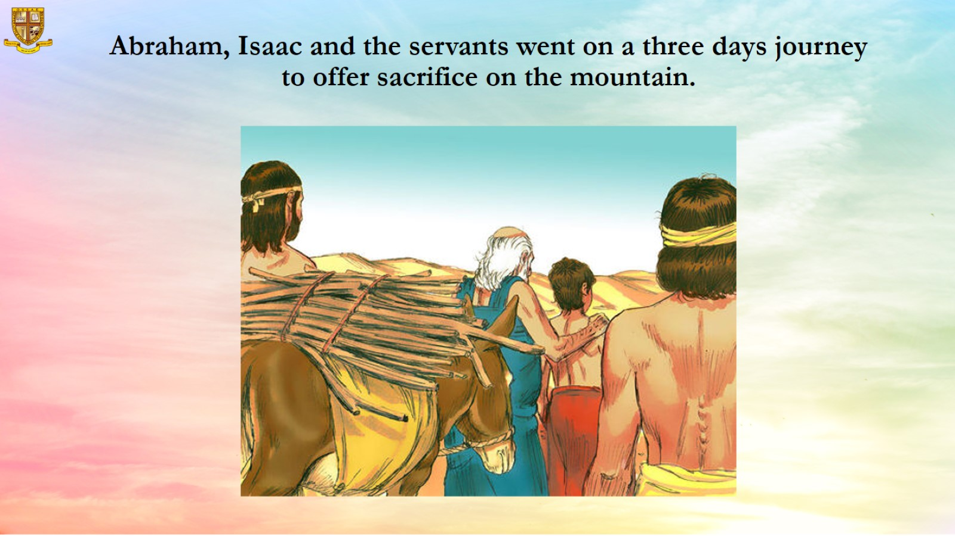
Abraham, Isaac and the servants went on a three days journey to offer sacrifice on the mountain.

Slide 9
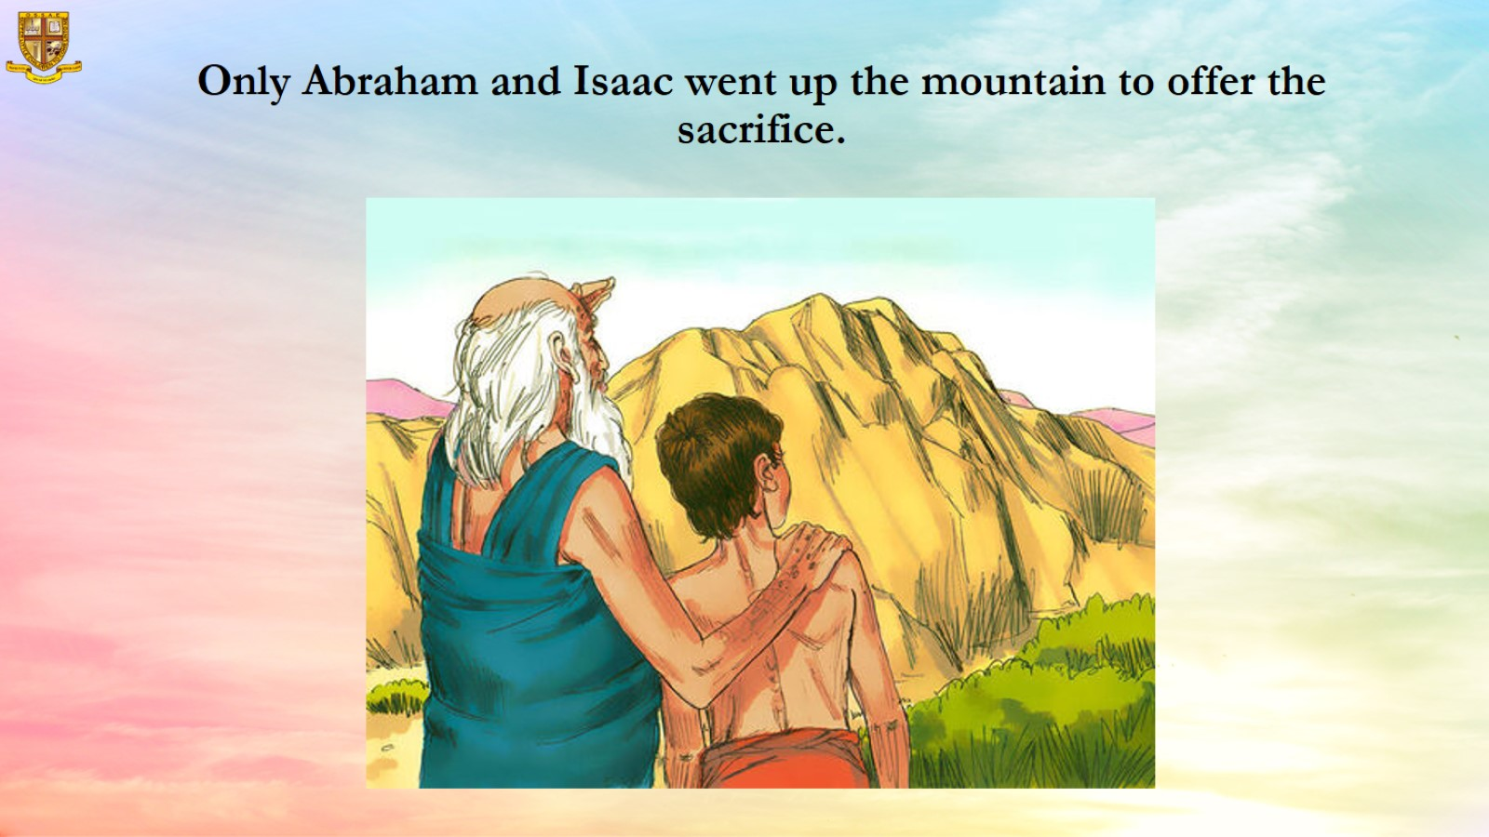
Only Abraham and Isaac went up the mountain to offer the sacrifice.

Slide 10
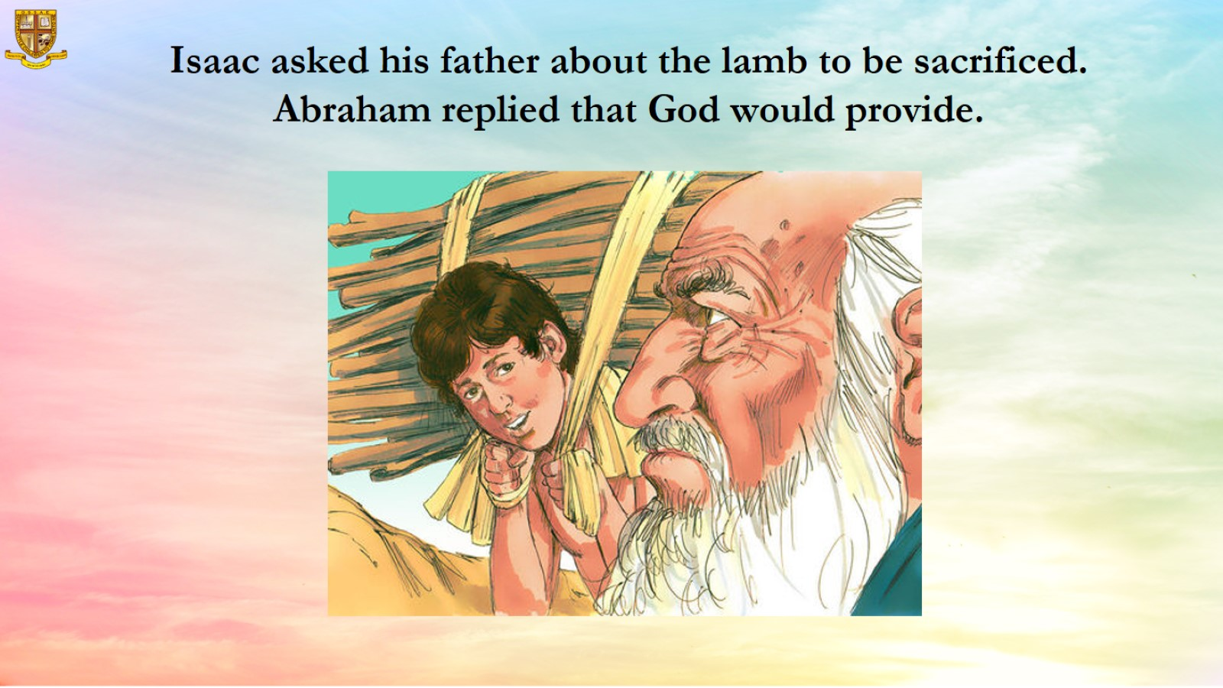
  Isaac asked his father about the lamb to be sacrificed. Abraham replied that God would provide.

Slide 11
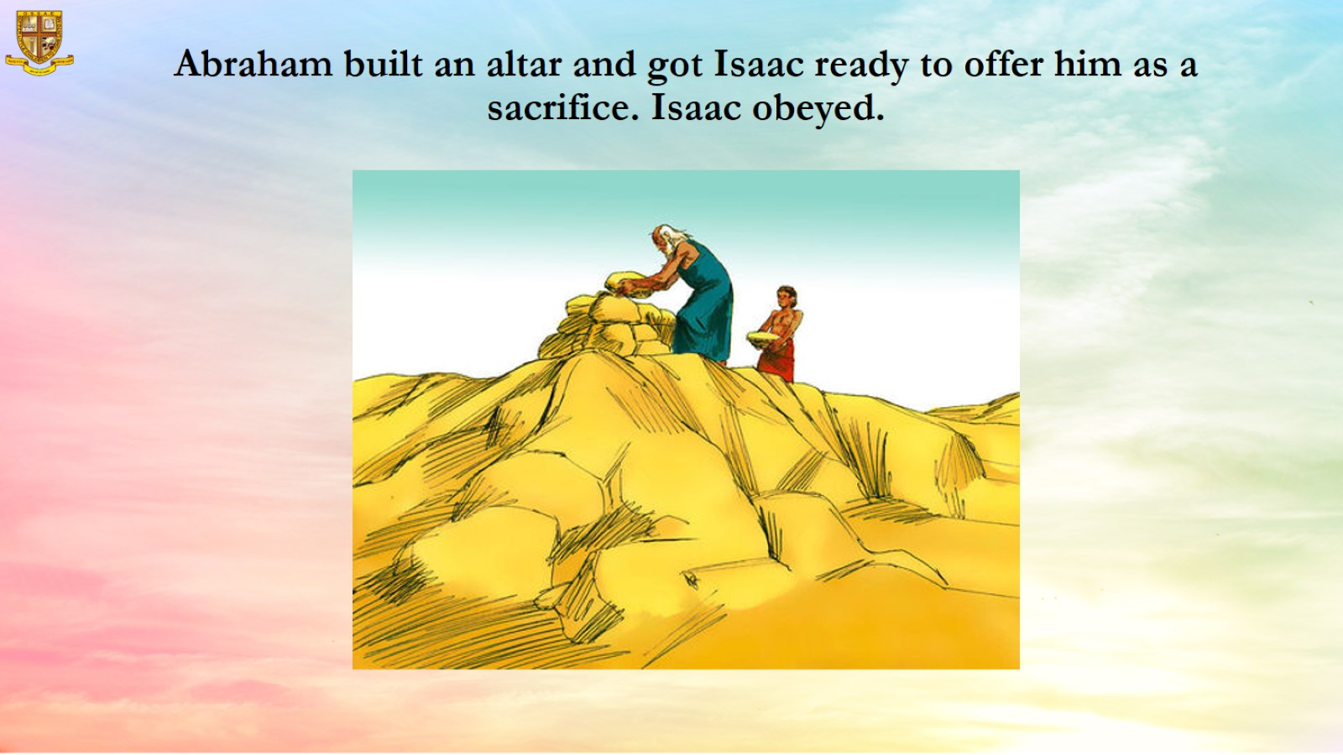
Abraham built an altar and got Isaac ready to offer him as a sacrifice. Isaac obeyed.

Slide 12
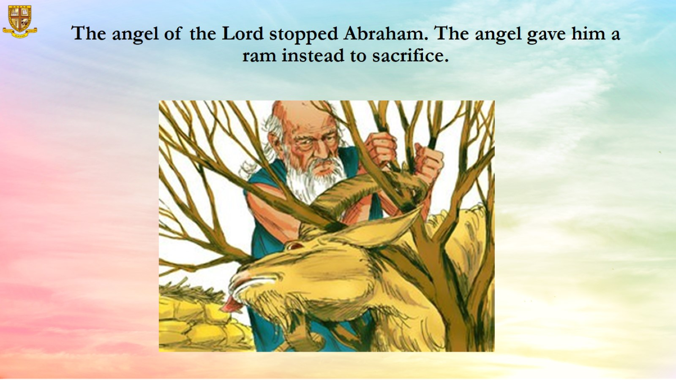
The angel of the Lord stopped Abraham. The angel gave him a ram instead to sacrifice.

Slide 13
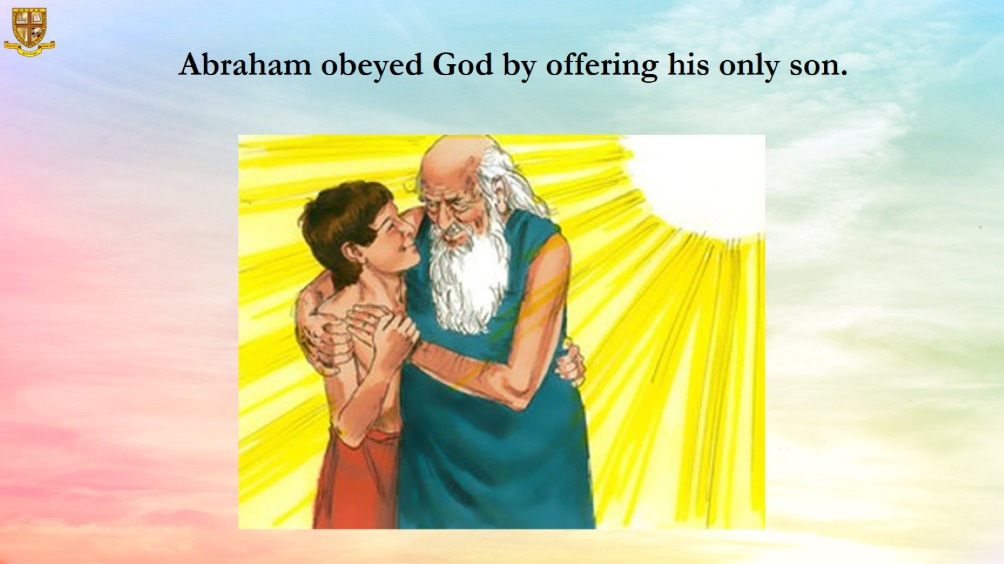
Abraham obeyed God by offering his only son.

Slide 14
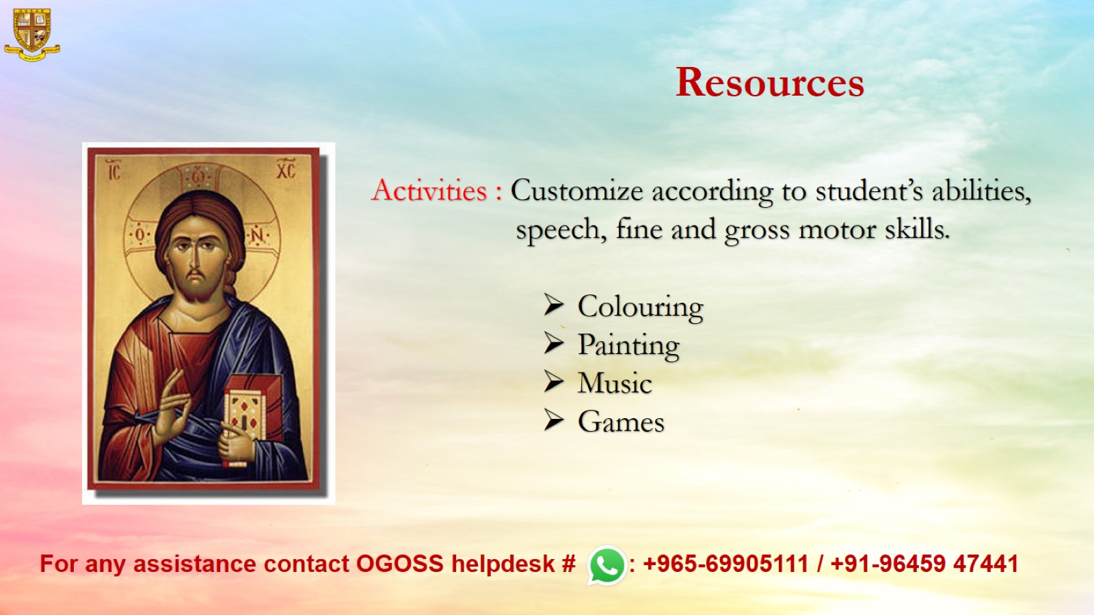
Resources

