Slide 1


Slide 2
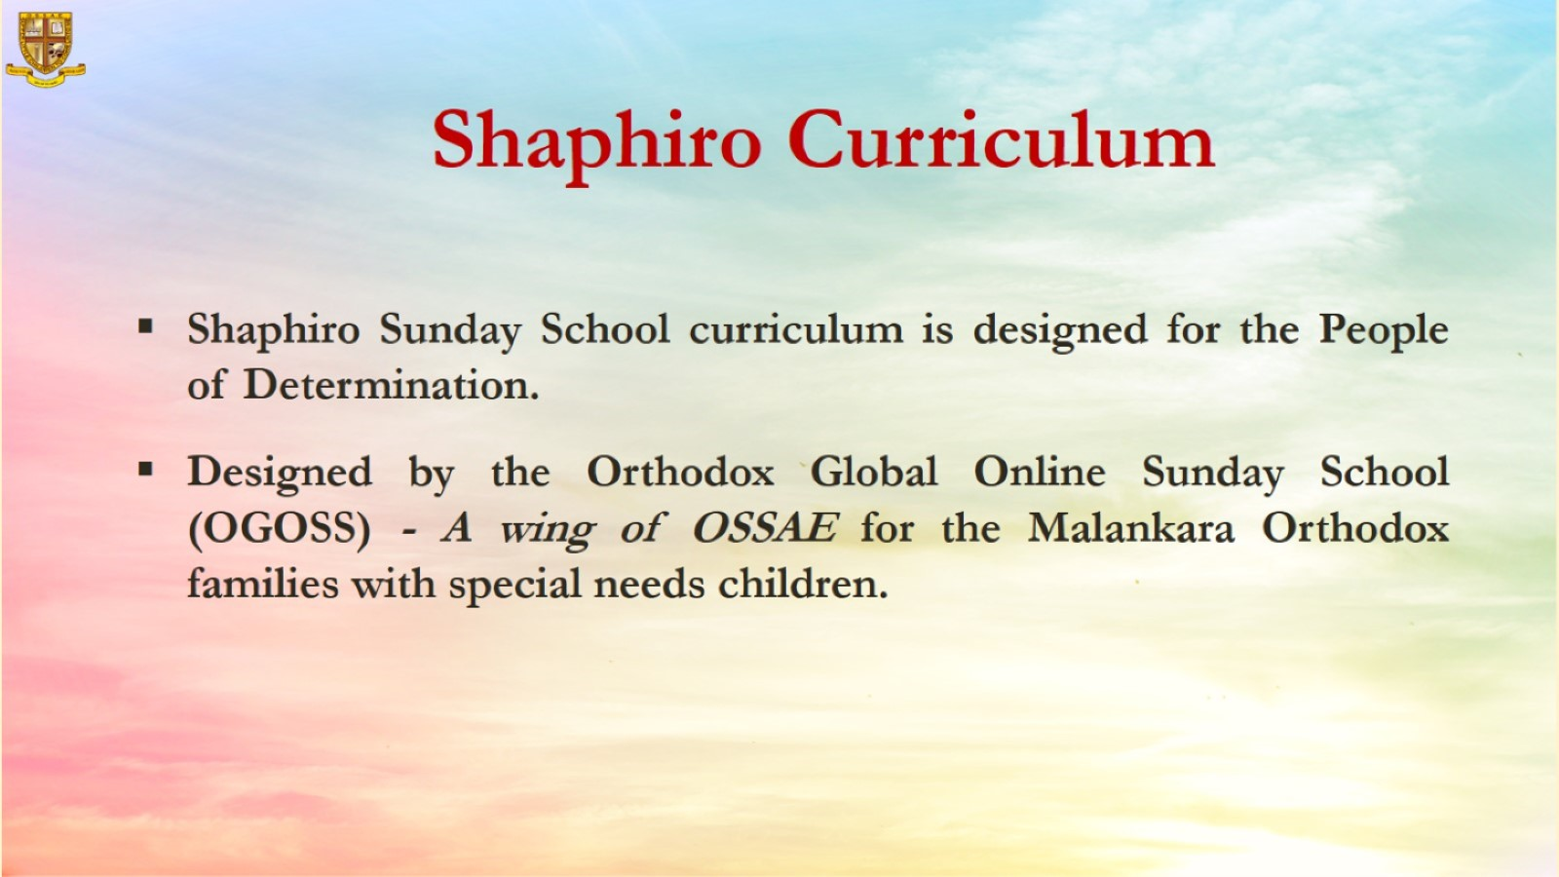

Slide 3
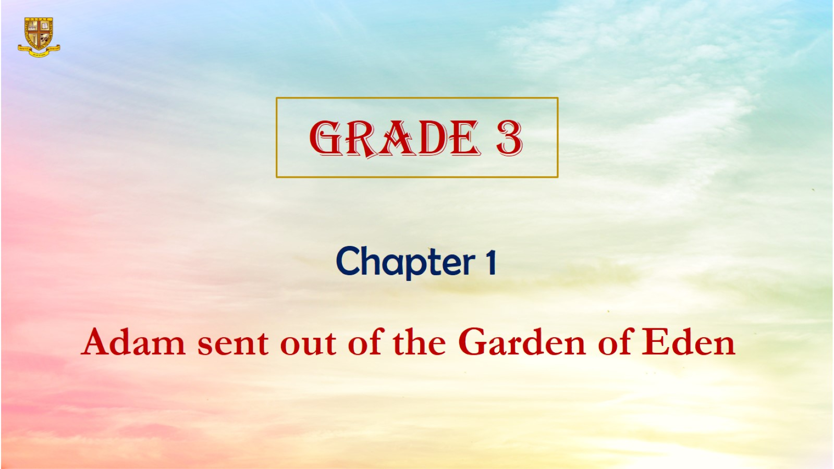

Slide 4
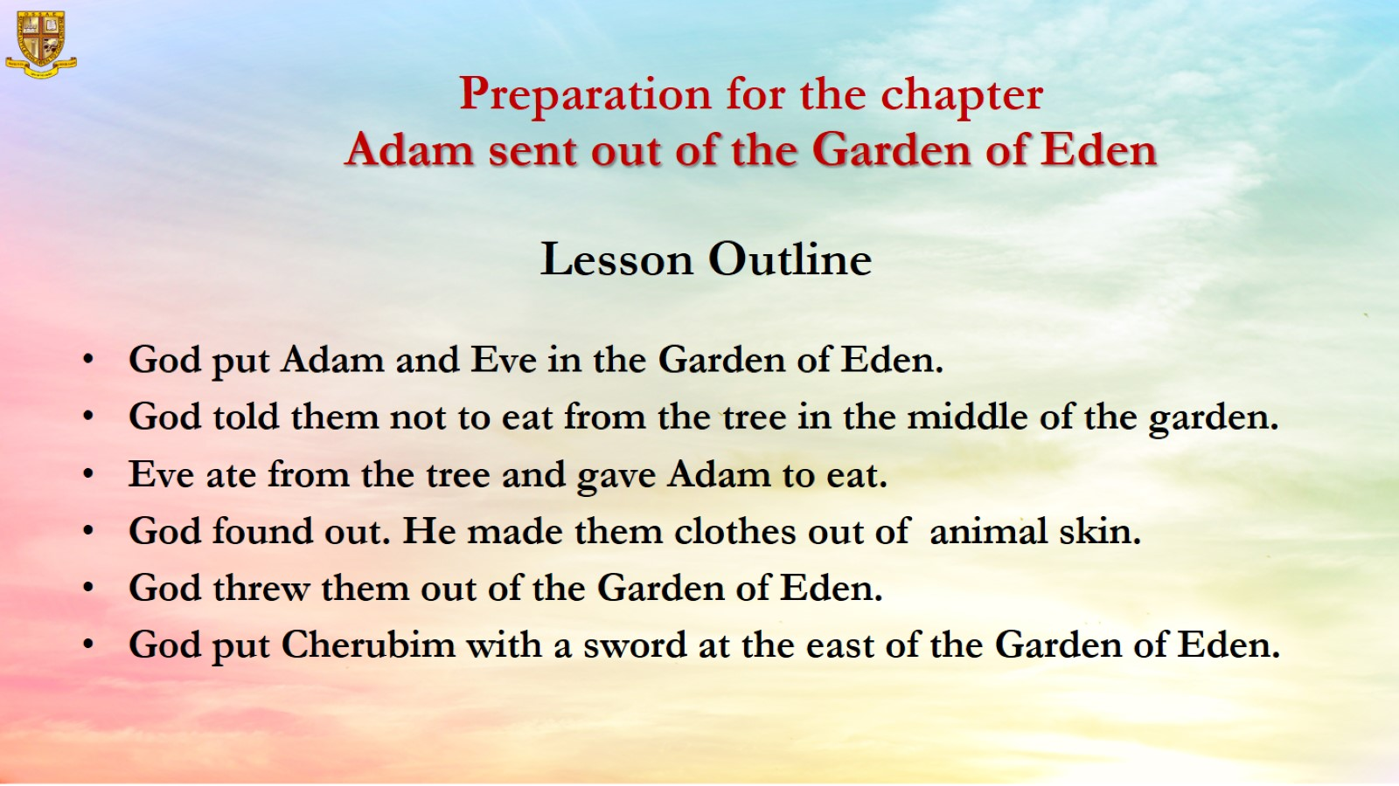
Preparation for the chapter
Adam sent out of the Garden of Eden

Slide 5
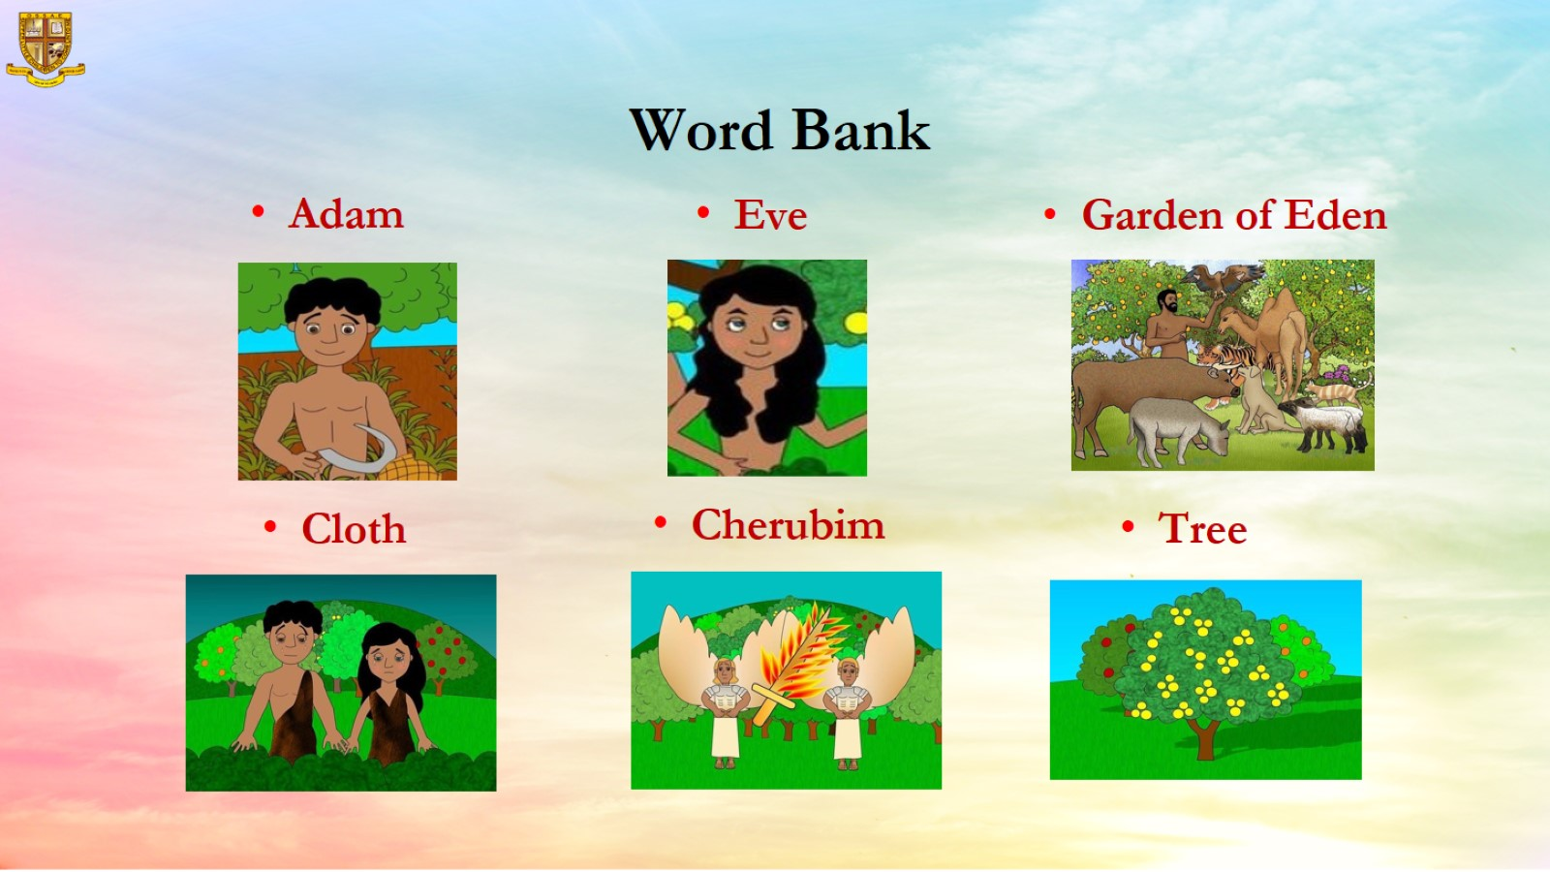
Word Bank

Slide 6
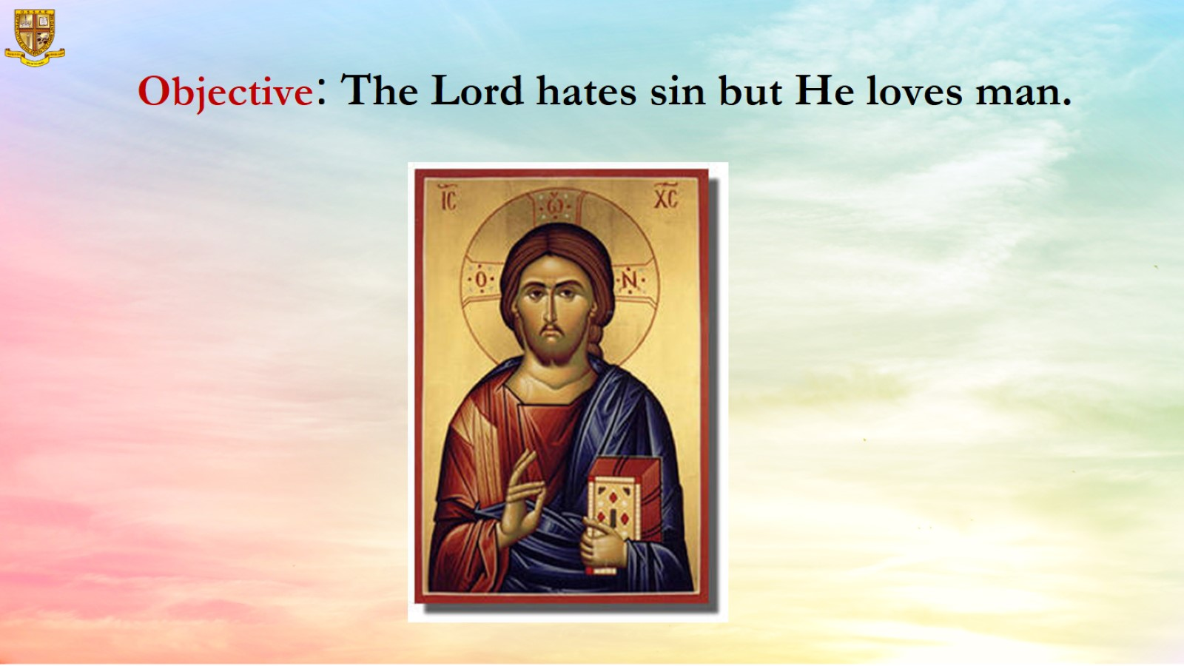
Objective: The Lord hates sin but He loves man.

Slide 7
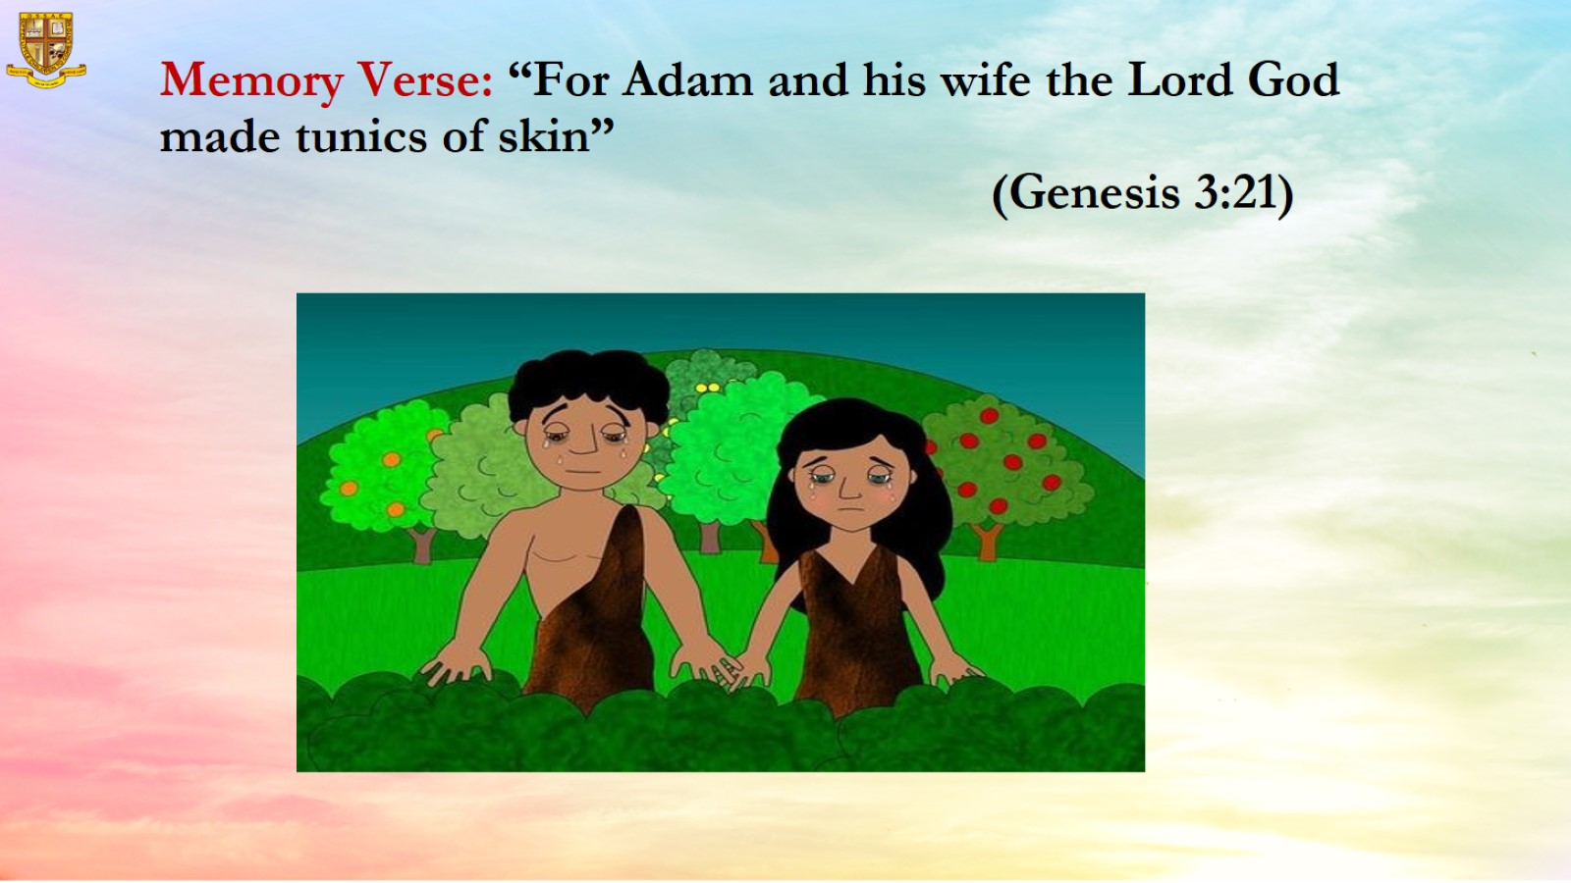
Memory Verse: “For Adam and his wife the Lord God made tunics of skin” (Genesis 3:21)

Slide 8
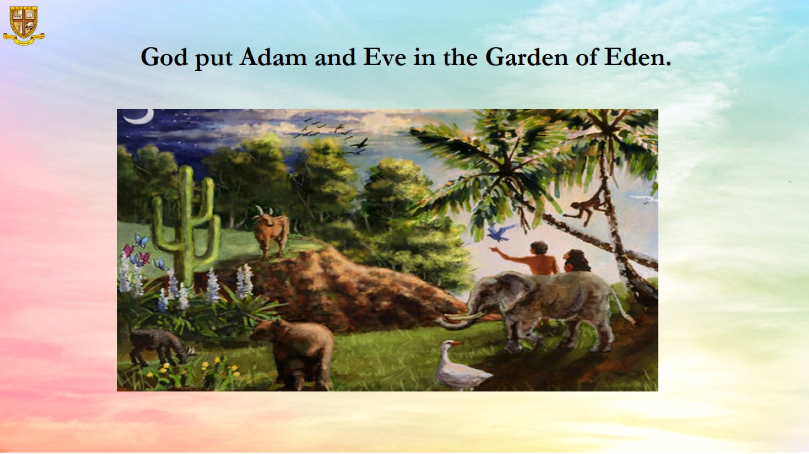
God put Adam and Eve in the Garden of Eden.

Slide 9
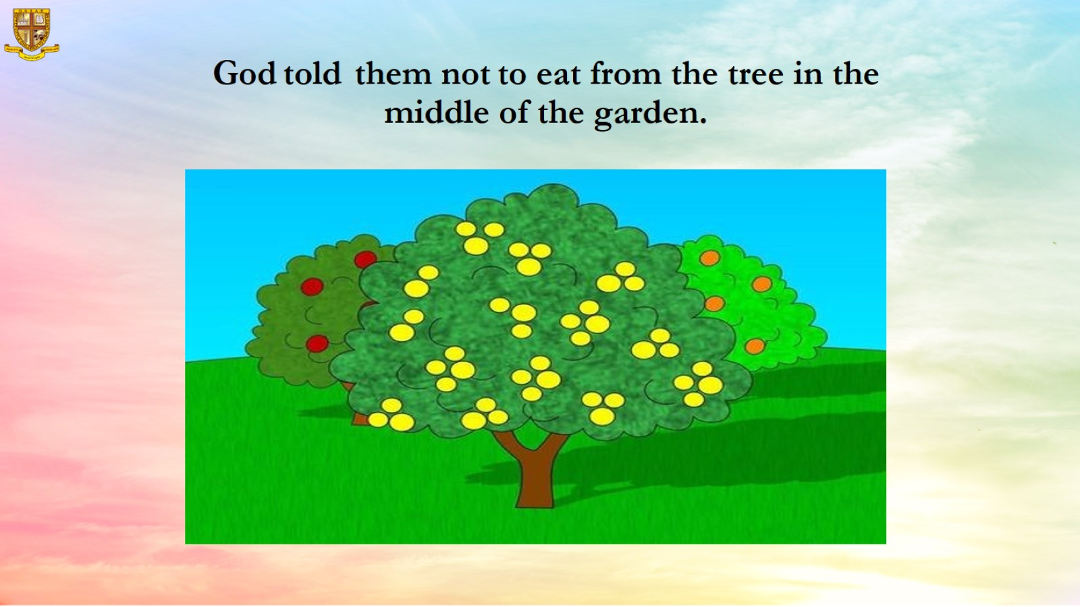
God told them not to eat from the tree in the middle of the garden.

Slide 10
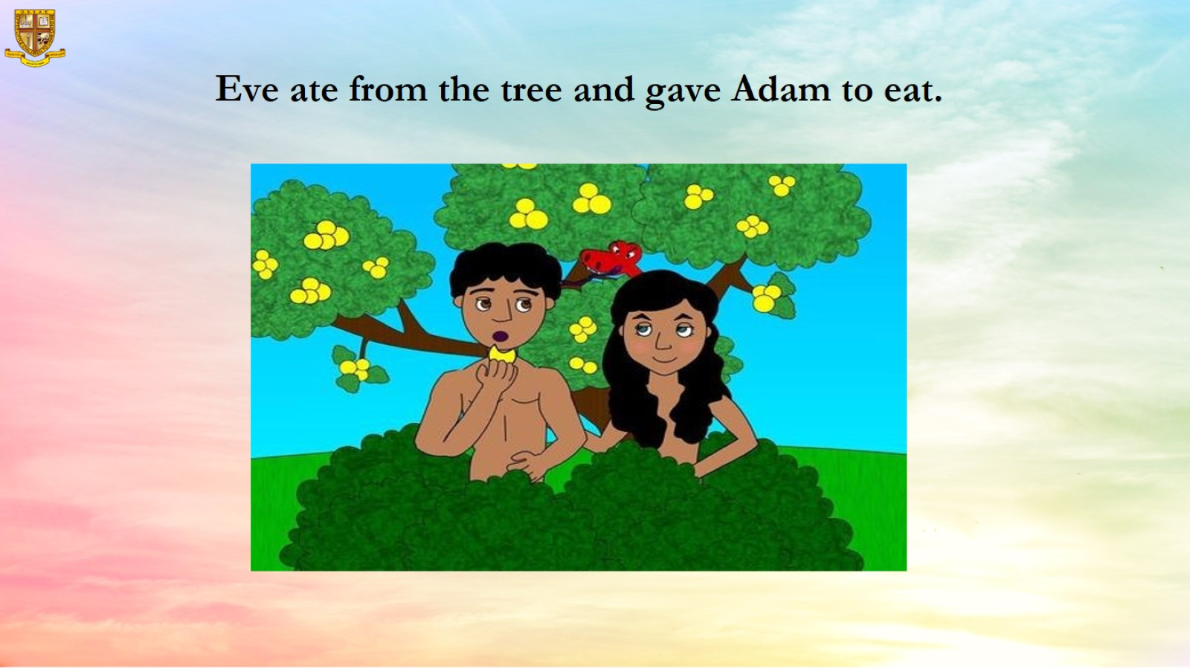
Eve ate from the tree and gave Adam to eat.

Slide 11
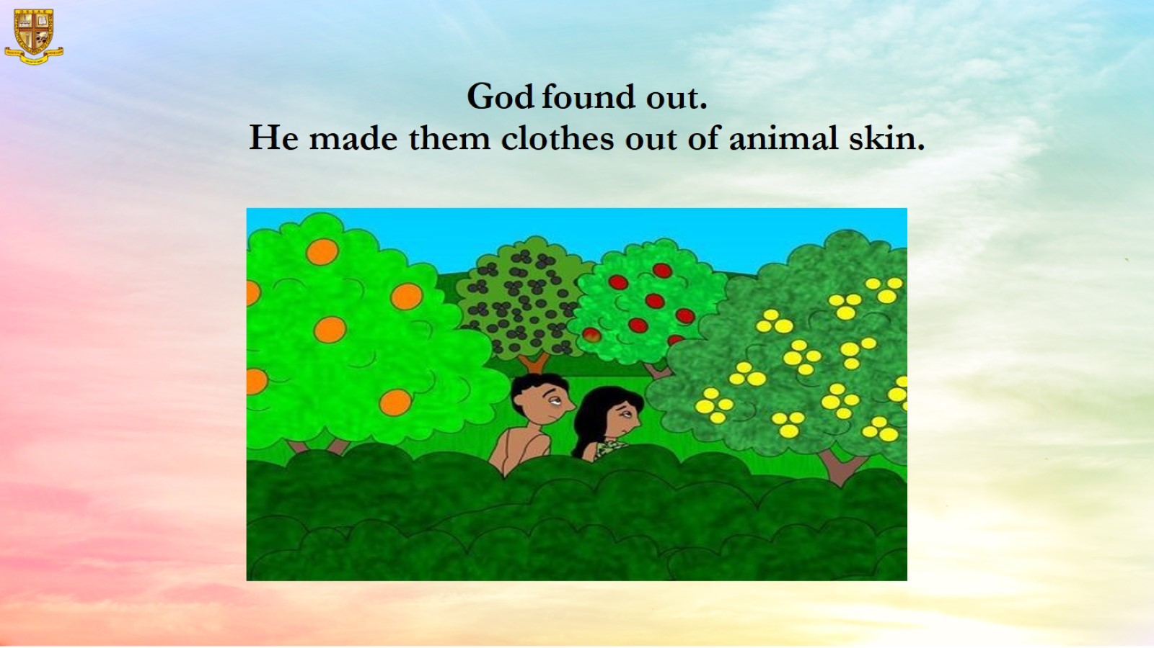
God found out.
He made them clothes out of animal skin.

Slide 12
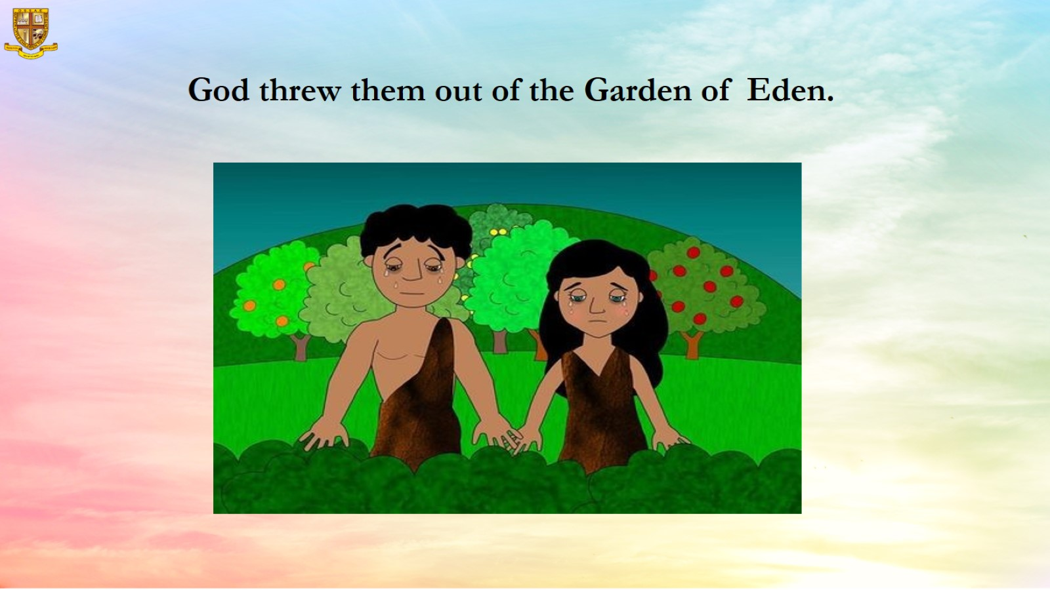
God threw them out of the Garden of Eden.

Slide 13
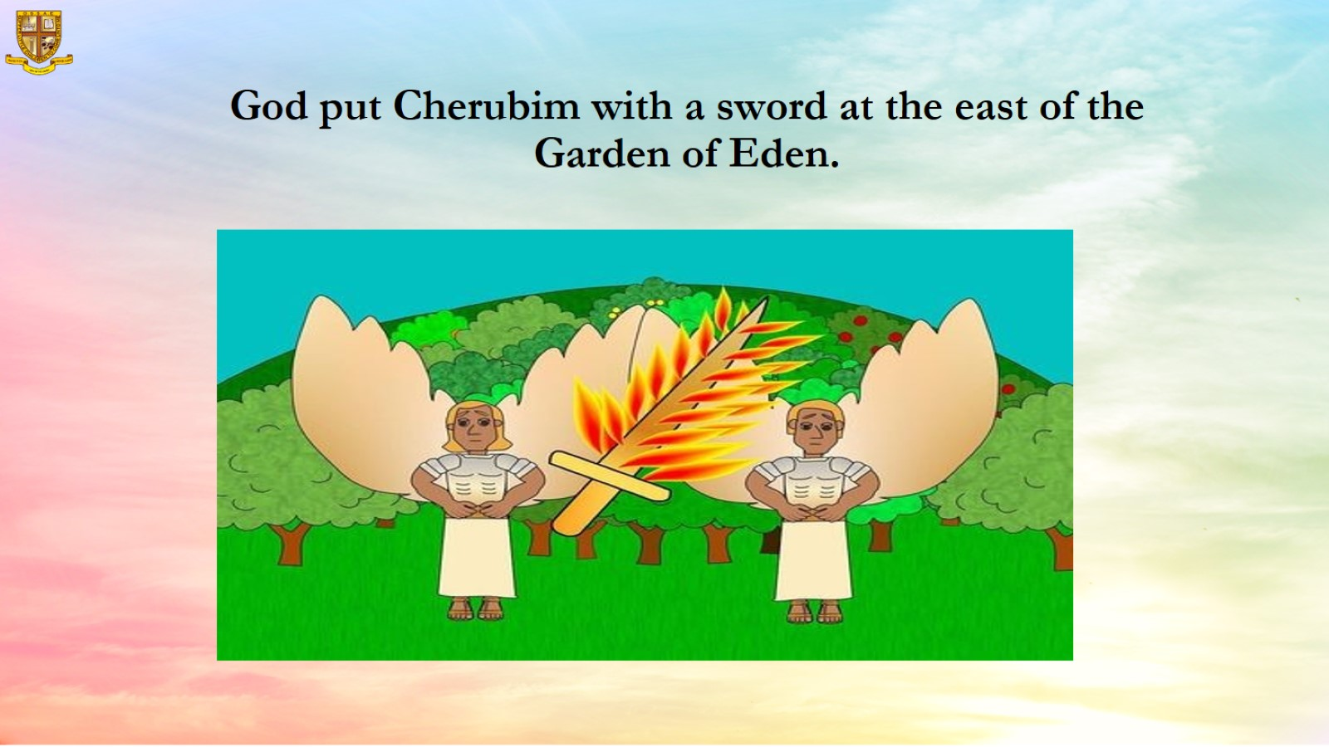
God put Cherubim with a sword at the east of the
Garden of Eden.

Slide 14
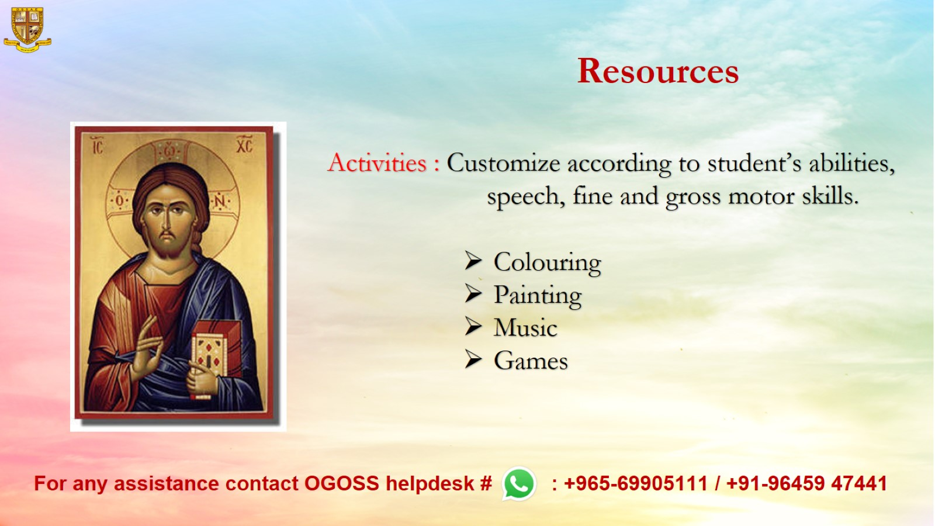
Resources

