Slide 1


Slide 2
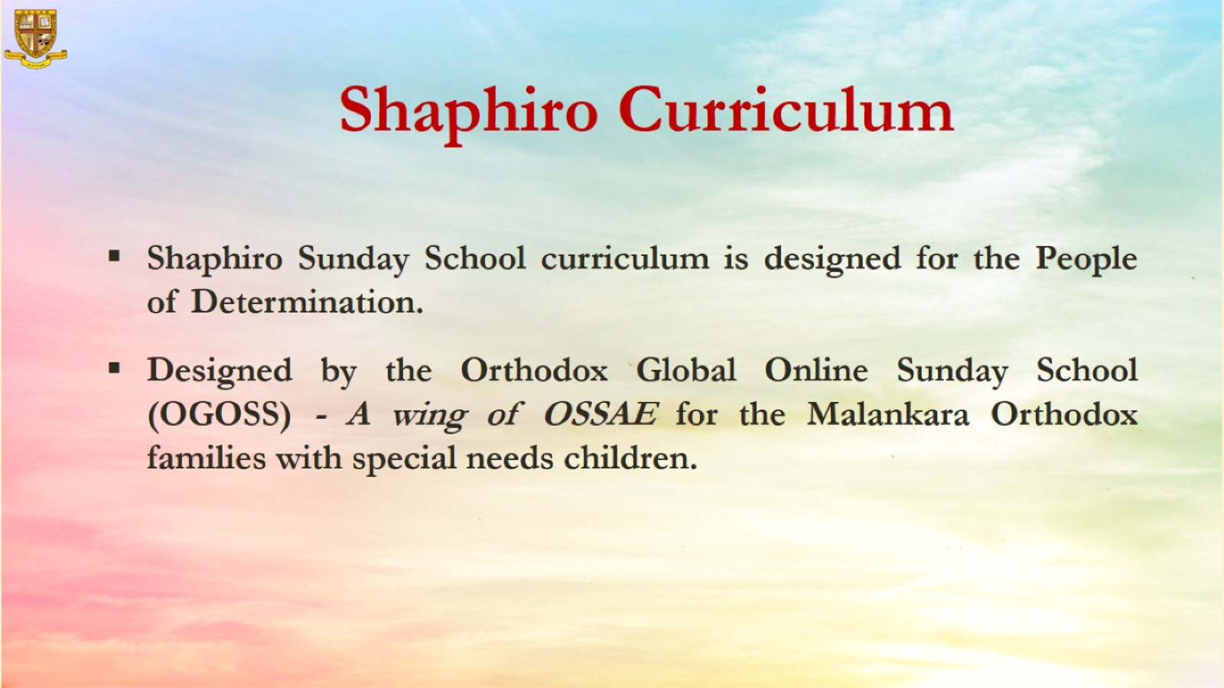

Slide 3

Grade 1
Chapter 1
Adam in the garden of Eden

Slide 4

Preparation for Adam in Garden of Eden
Lesson Outline
Preparation for the chapter
Adam in the garden of Eden
Lesson Outline
God created a man named Adam and planted a garden in Eden for him.
God said that he can eat from all the trees except the one in the middle of the garden.
Adam obeyed God and didn’t eat from that tree.
All the animals obeyed Adam and he named them.
Adam thanked God for all of this, but he was lonely.
God is kind and made a woman to help Adam. Adam called her Eve.

Slide 5
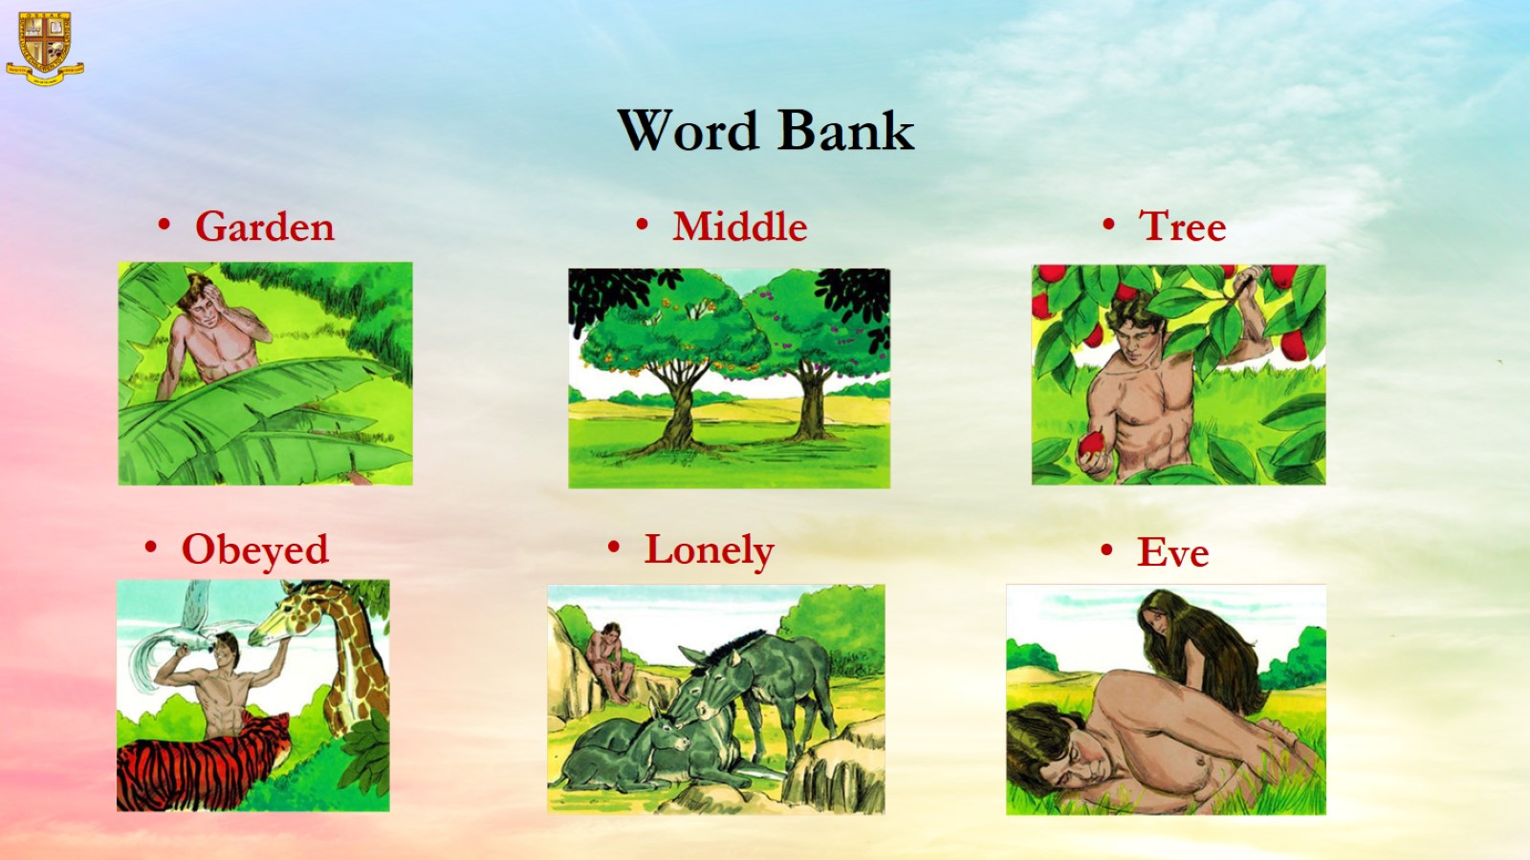
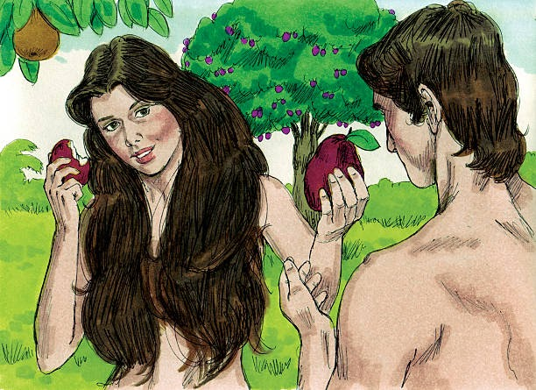
Word Bank

Slide 6
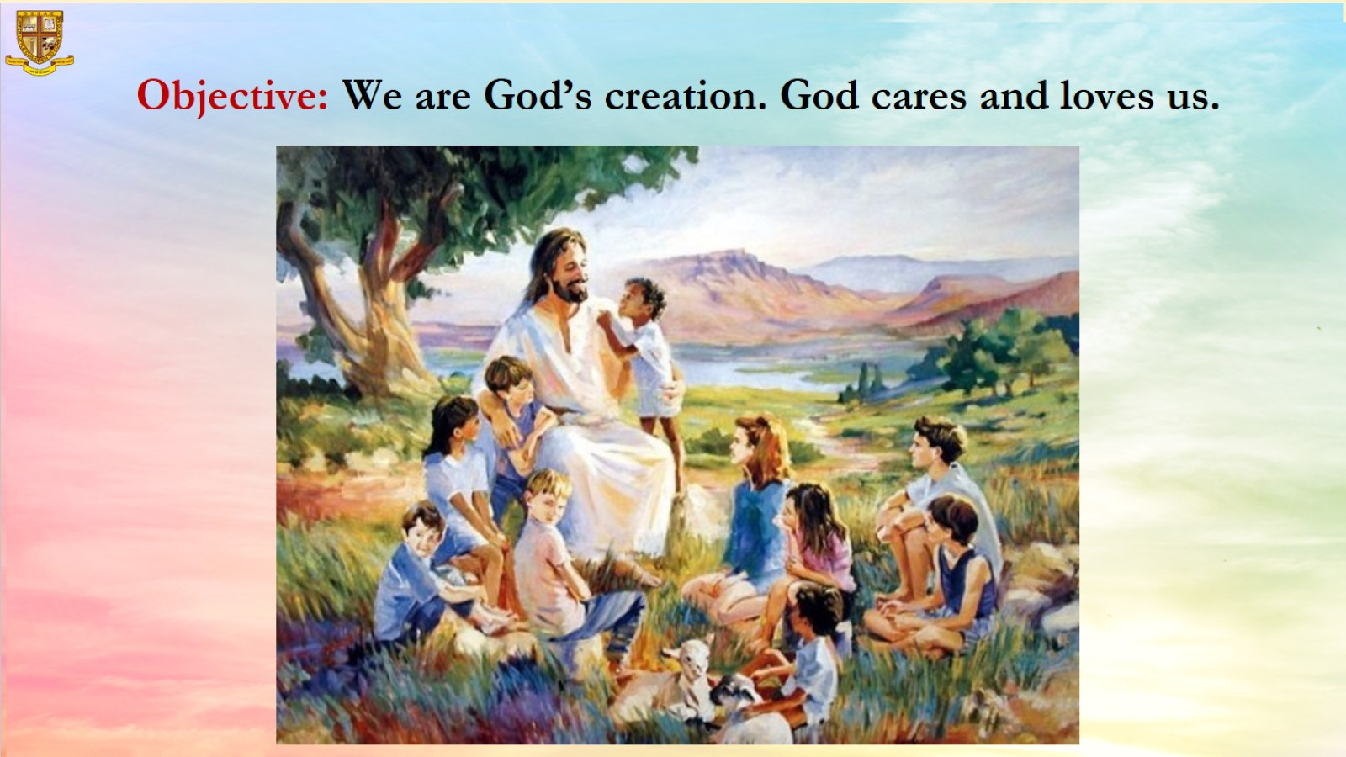
Objective: We are God’s creation. God cares and loves us.

Slide 7
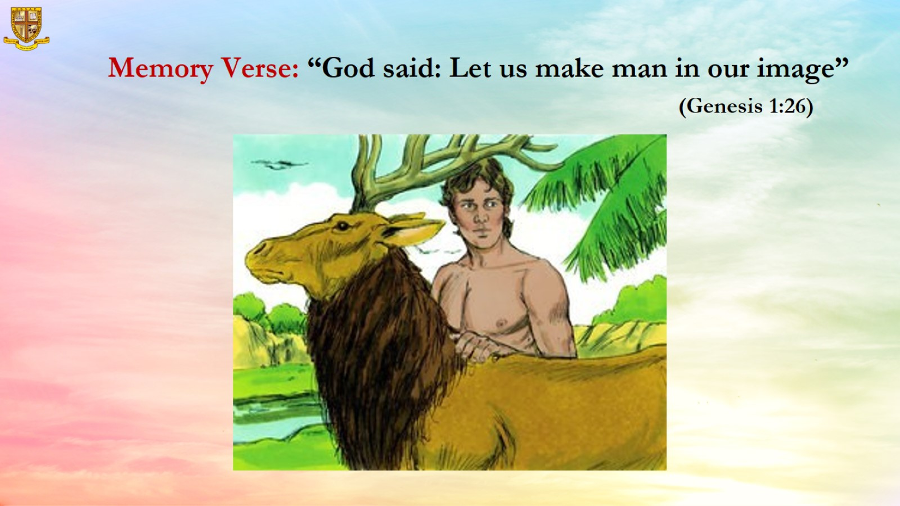

Slide 8
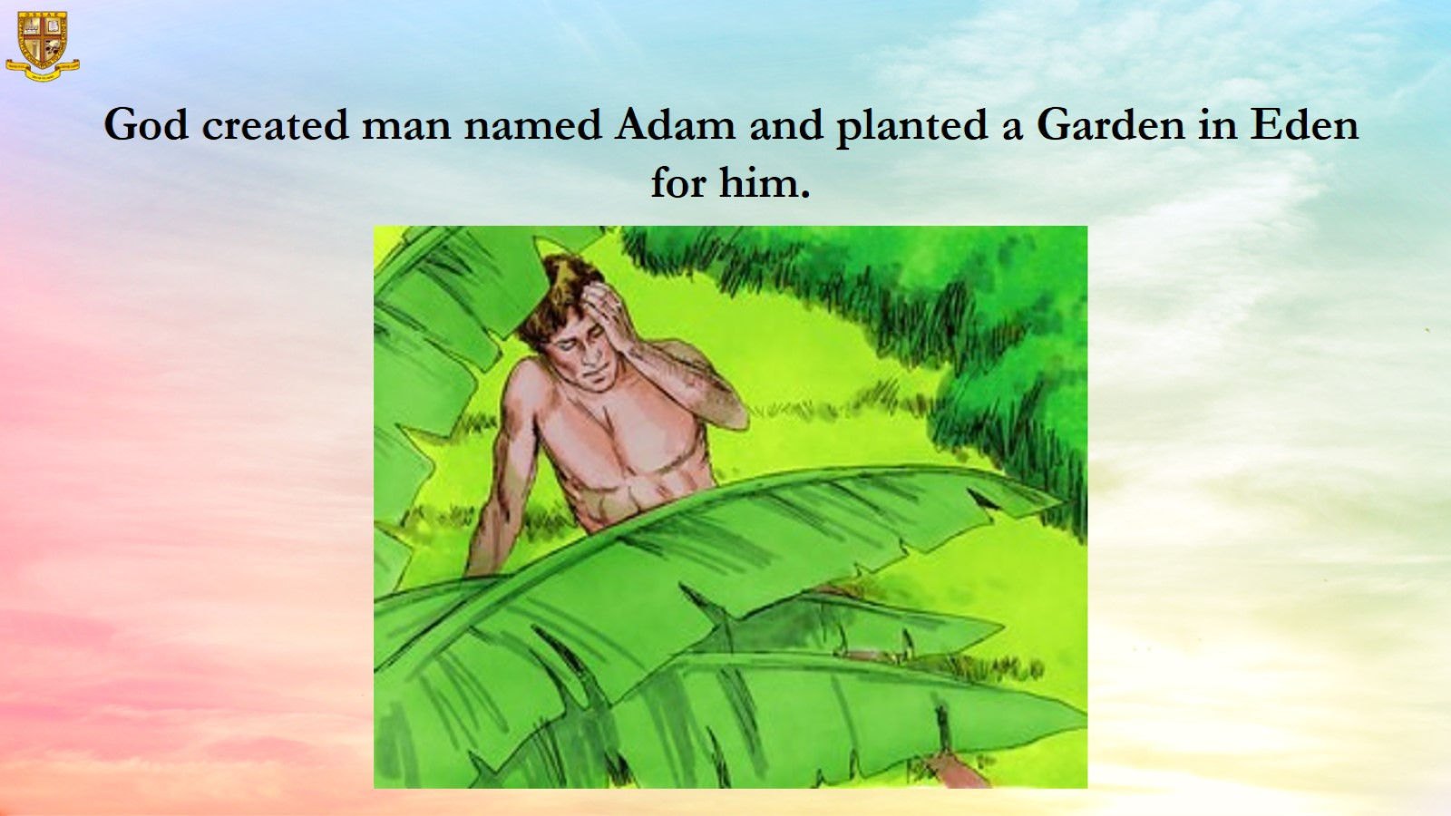

Slide 9
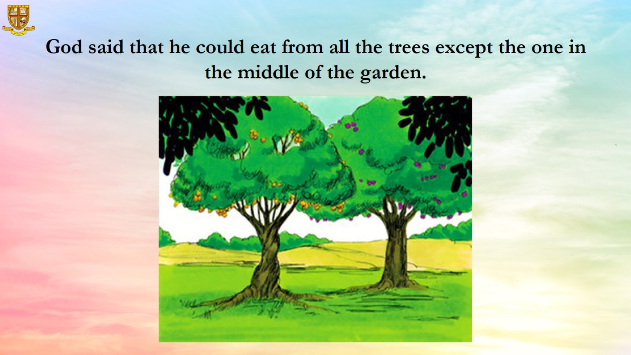

Slide 10
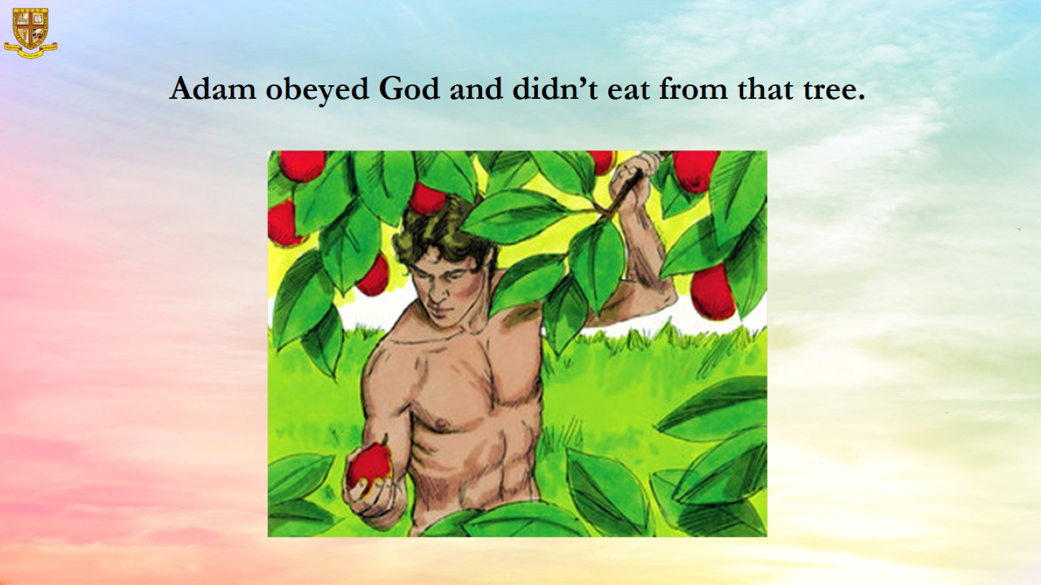

Slide 11
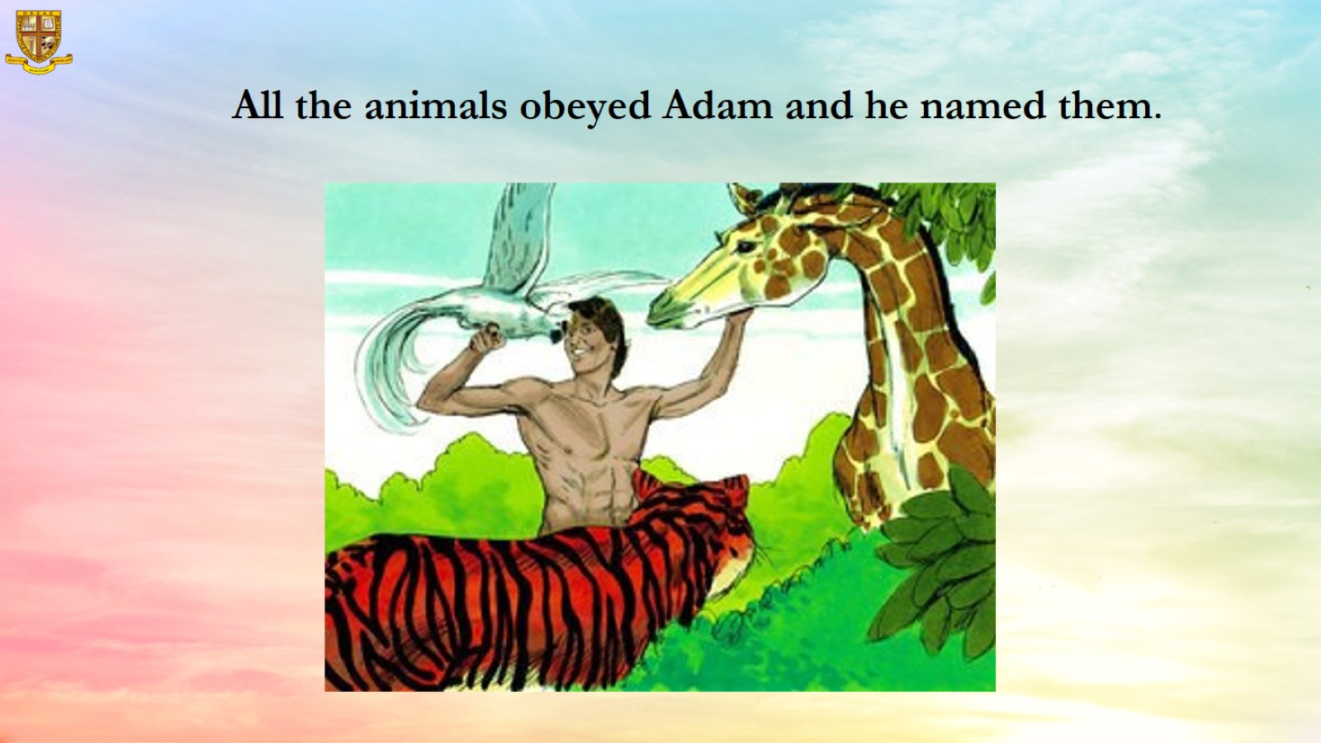

Slide 12
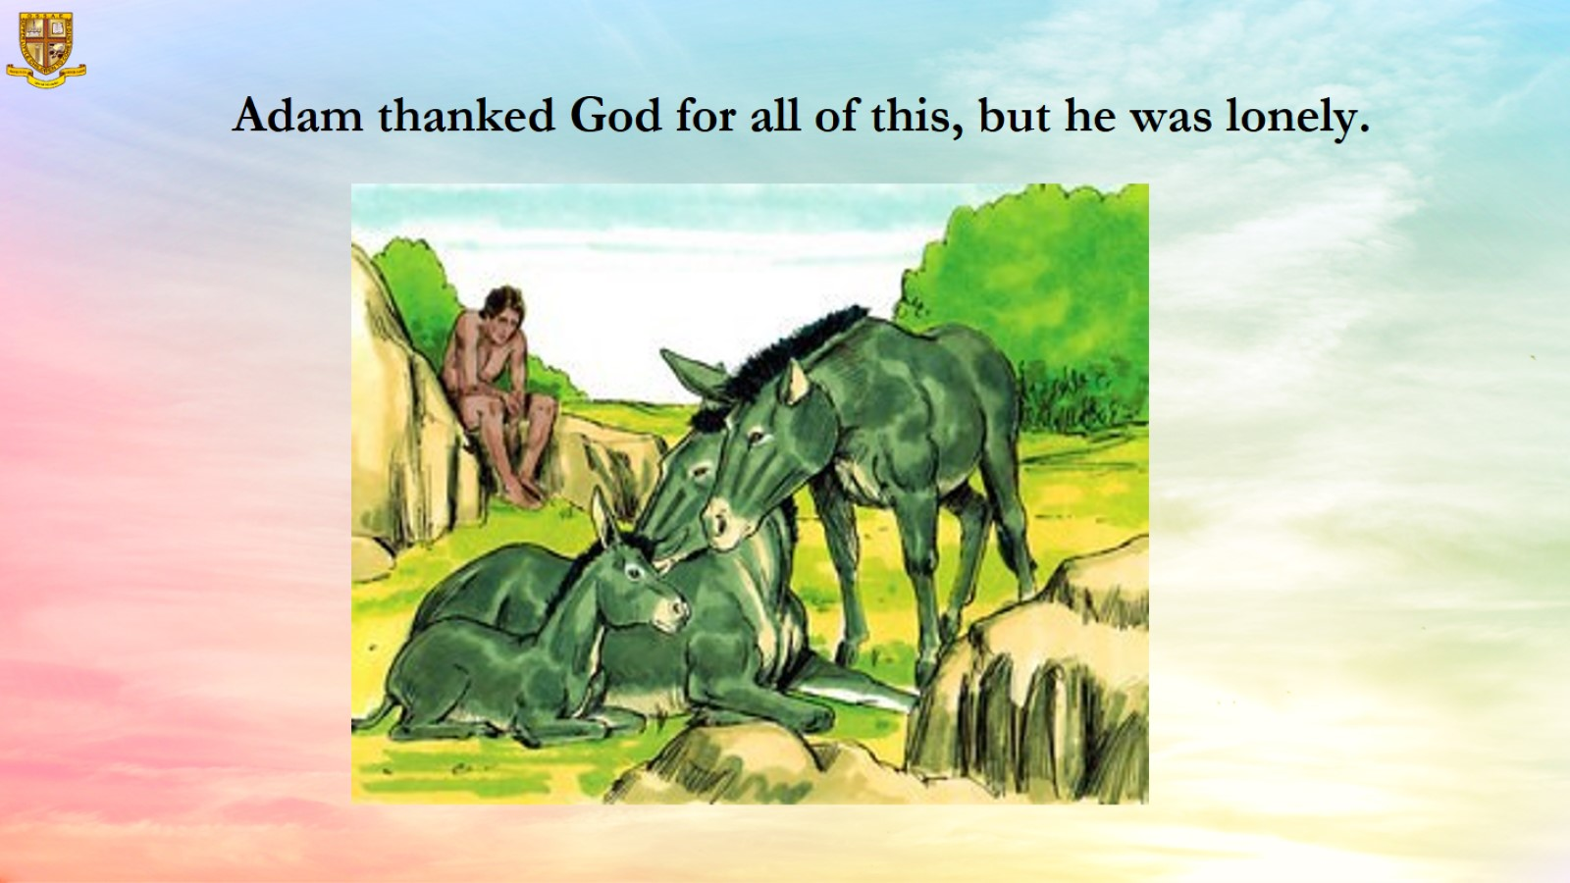

Slide 13
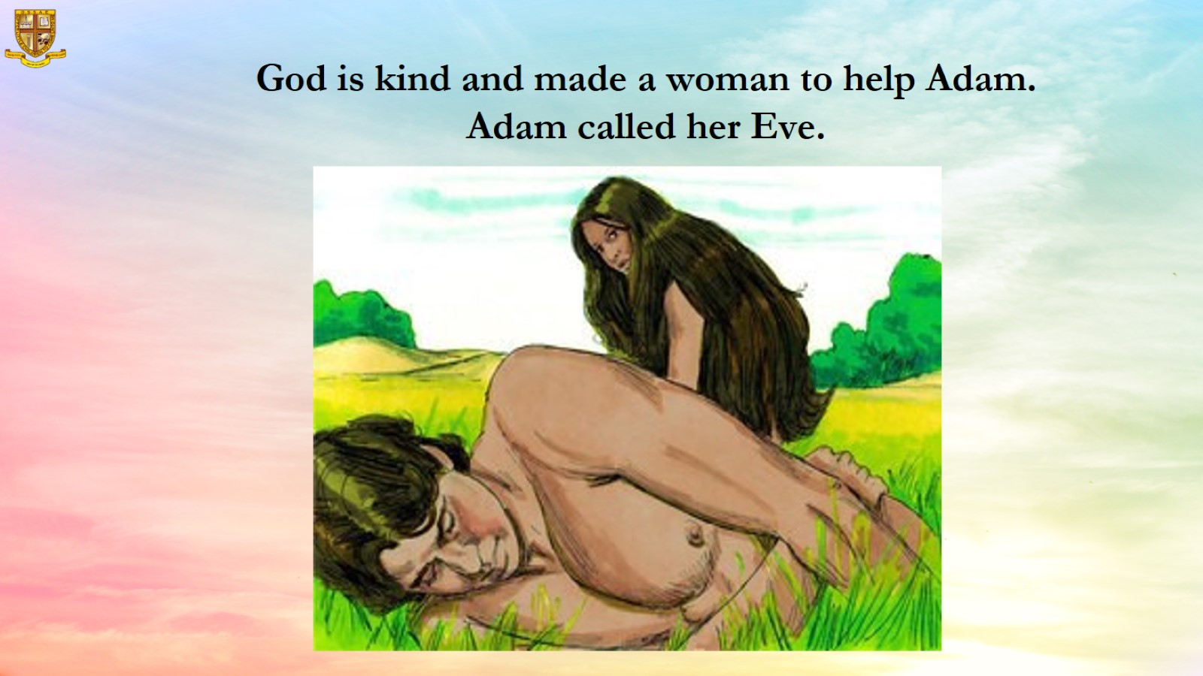

Slide 14
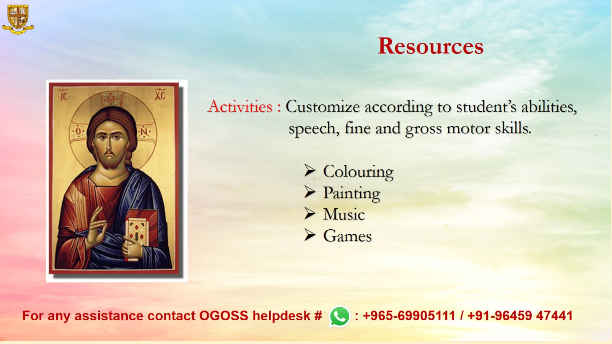
Resources

