Slide 1
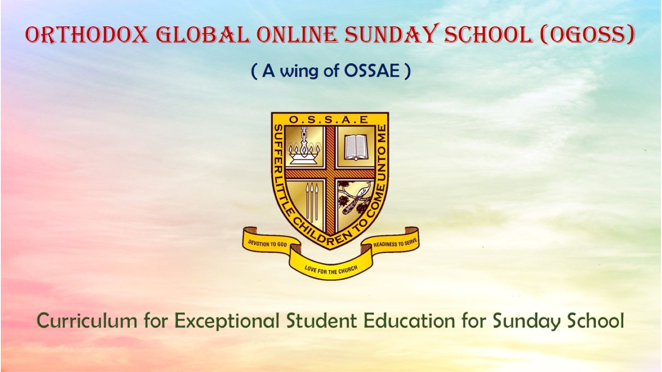
Orthodox Global Online Sunday School (OGOSS)

Slide 2
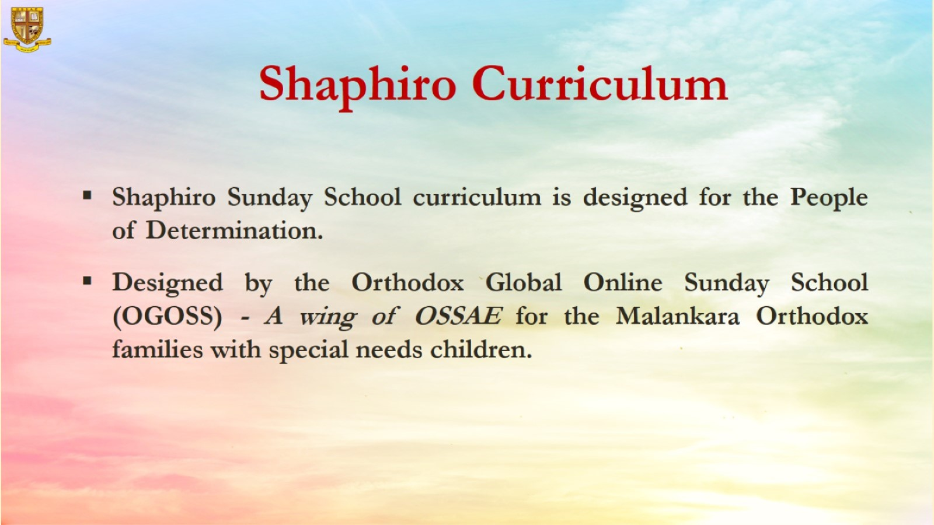

Slide 3
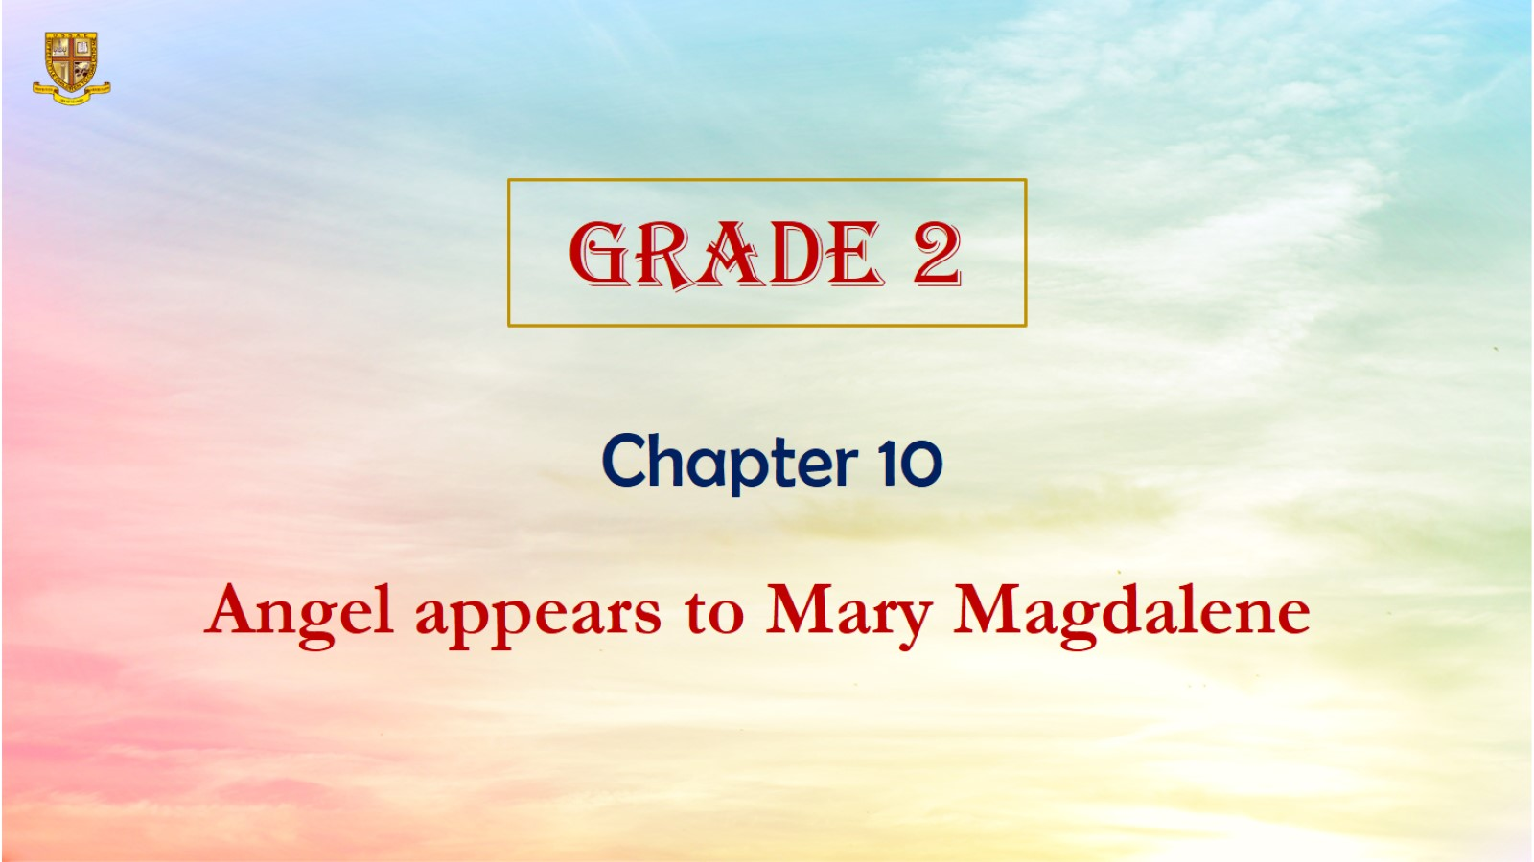

Slide 4
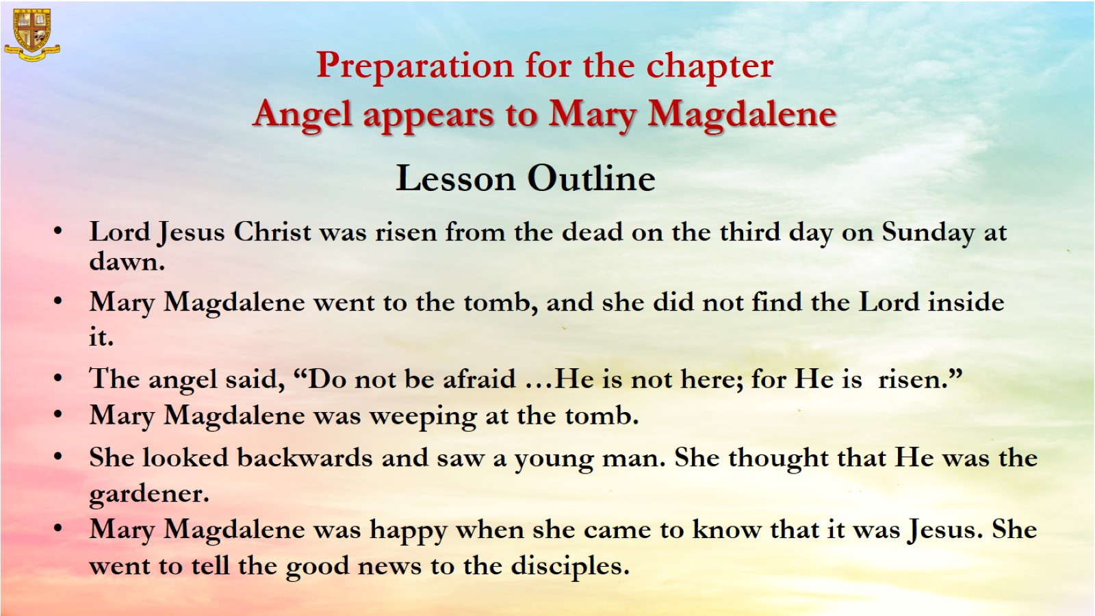
Preparation for the chapter
Angel appears to Mary Magdalene

Slide 5
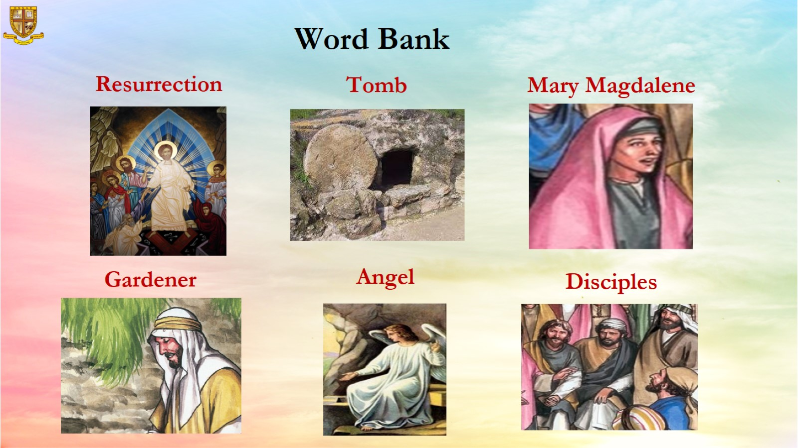
Word Bank

Slide 6
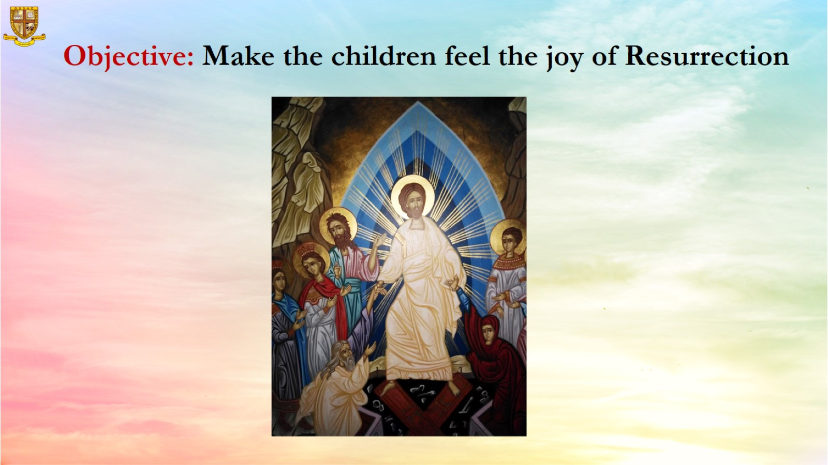
Objective: Make the children feel the joy of Resurrection

Slide 7
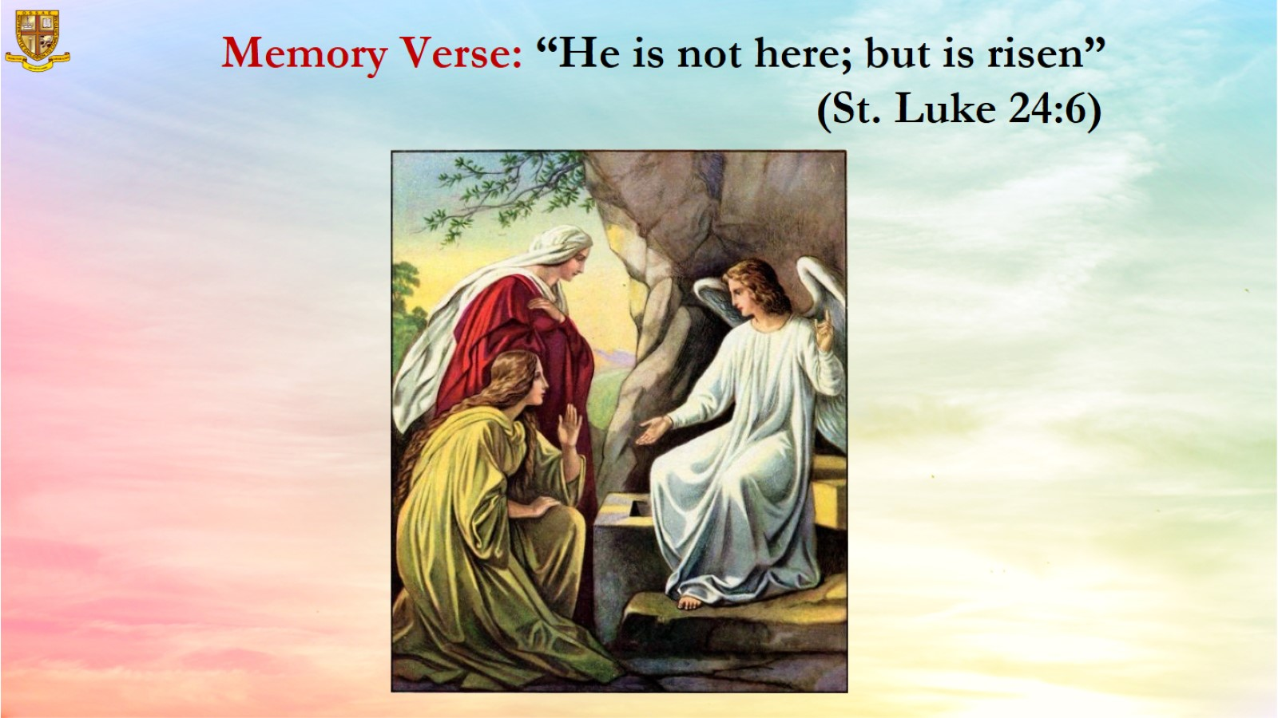
Memory Verse: “He is not here; but is risen”
(St. Luke 24:6)

Slide 8
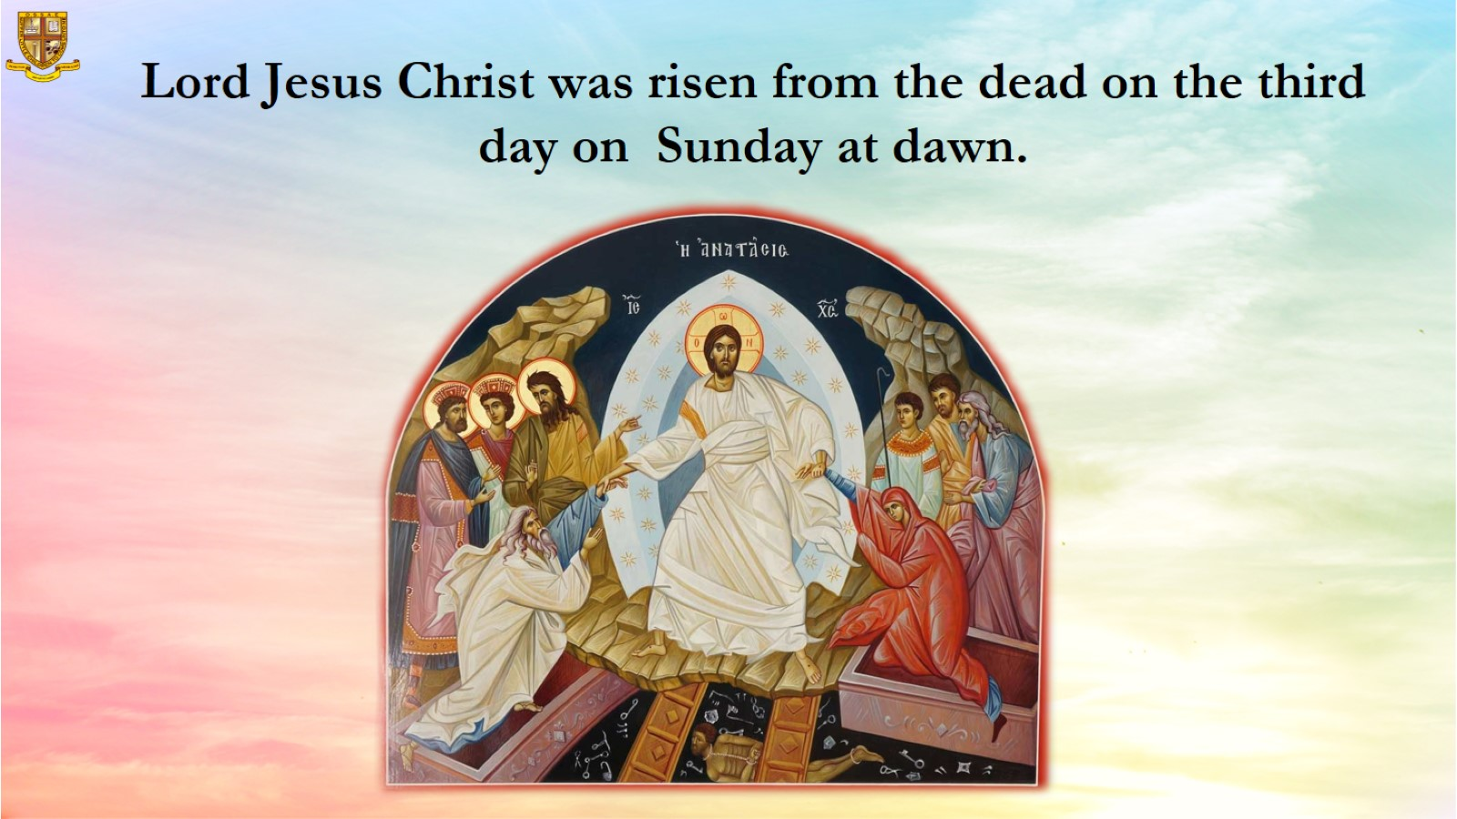
Lord Jesus Christ was risen from the dead on the third day on Sunday at dawn.

Slide 9
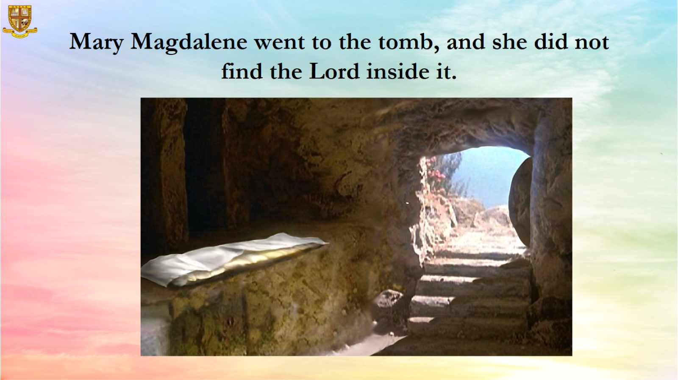
Mary Magdalene went to the tomb, and she did not find the Lord inside it.

Slide 10
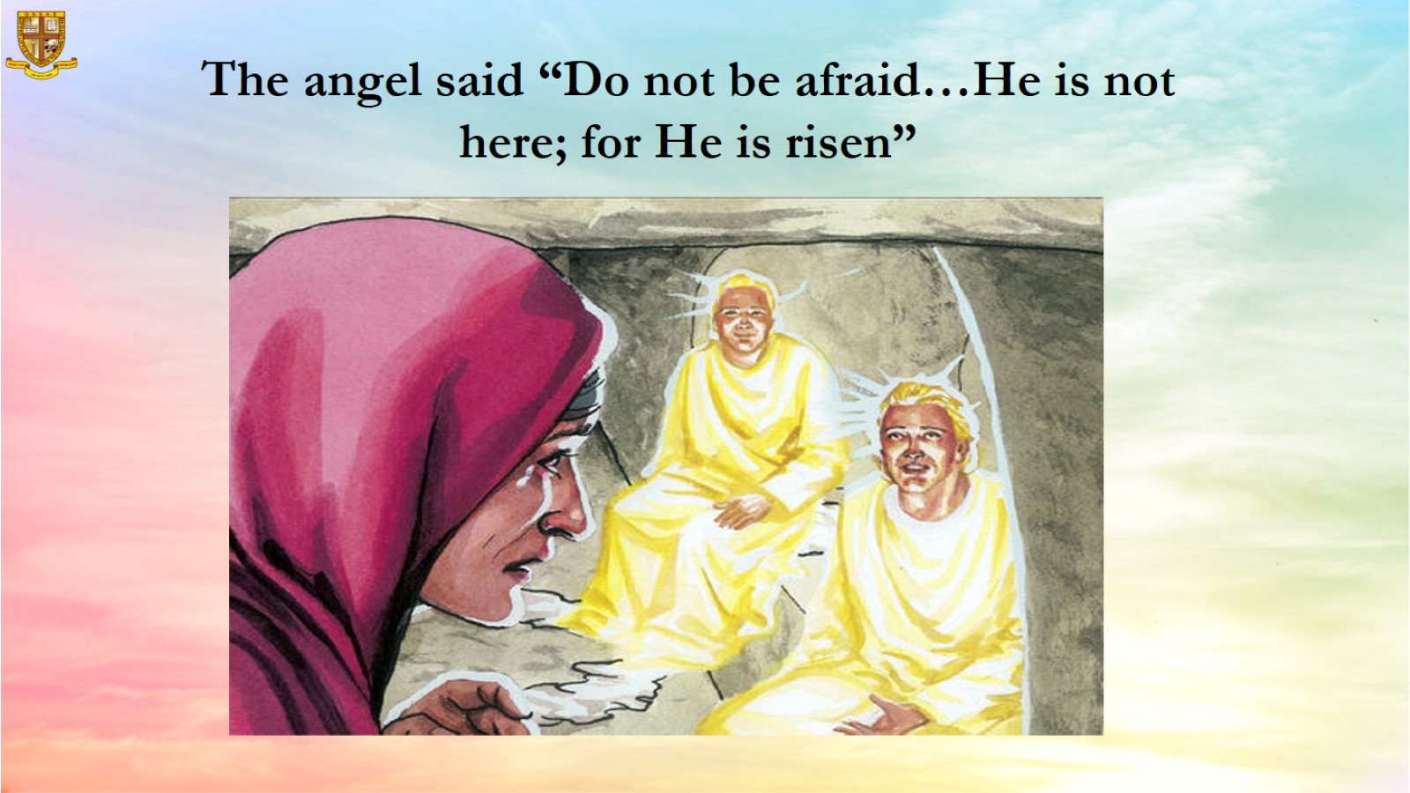

Slide 11
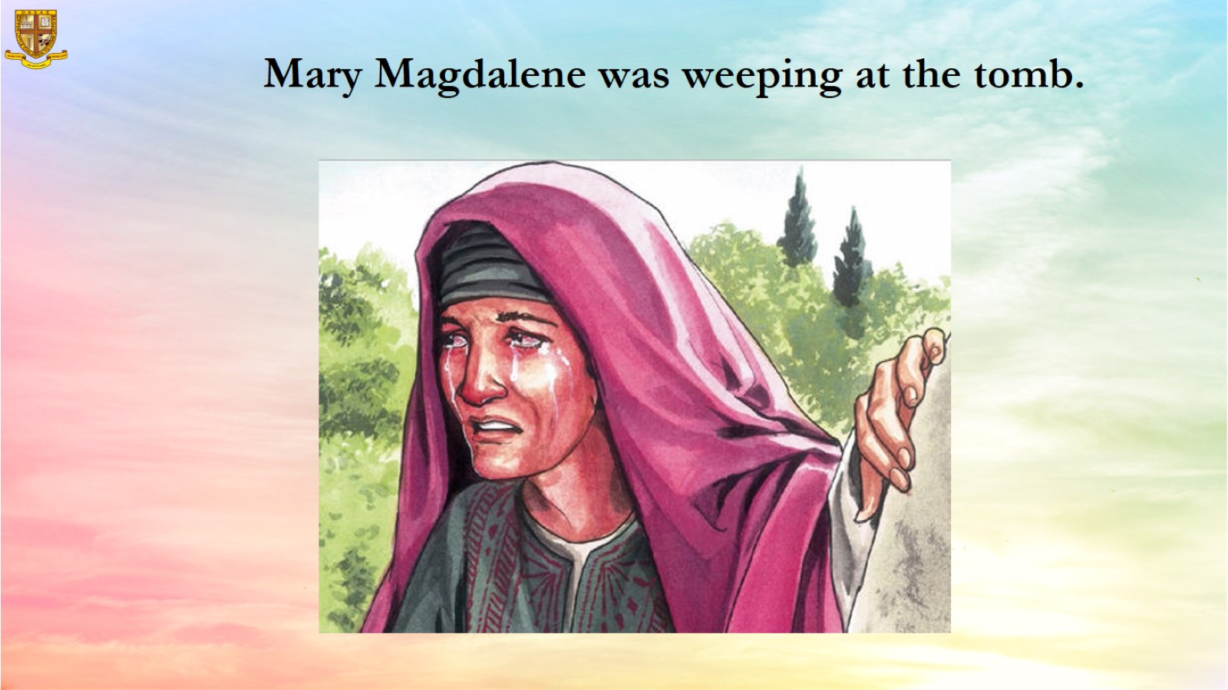
Mary Magdalene was weeping at the tomb.

Slide 12
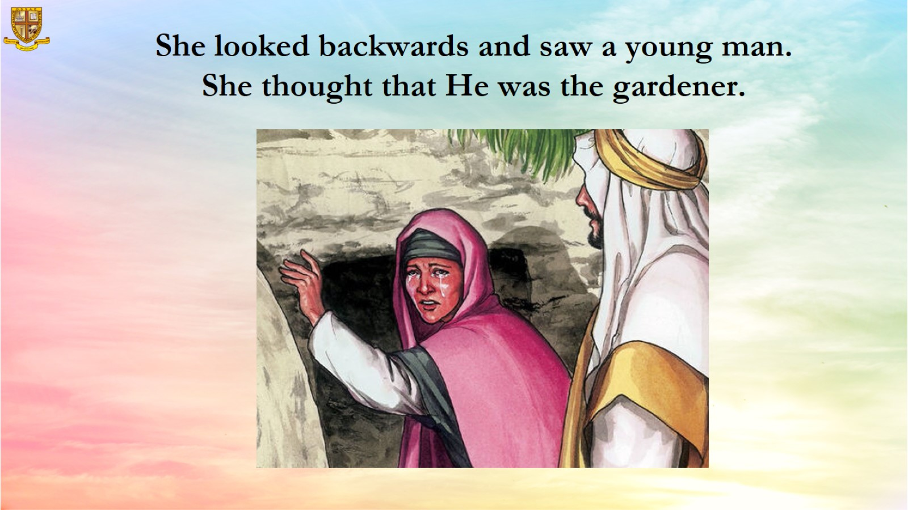
She looked backwards and saw a young man.
She thought that He was the gardener.

Slide 13
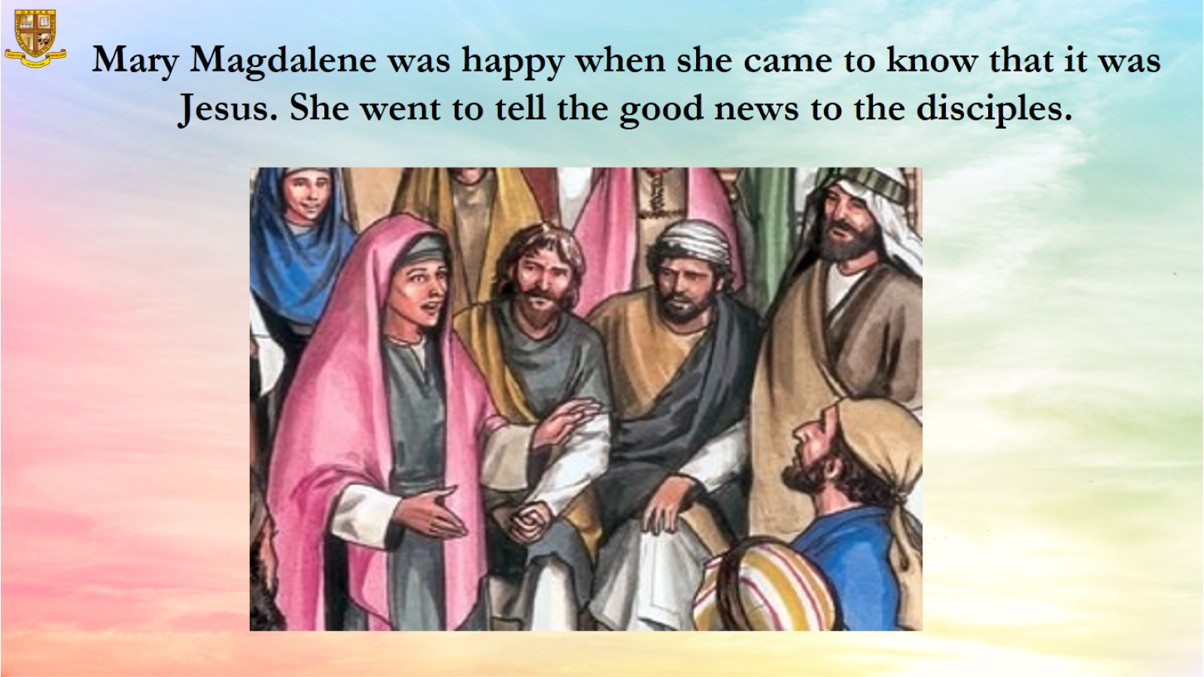
Mary Magdalene was happy when she came to know that it was Jesus. She went to tell the good news to the disciples.

Slide 14
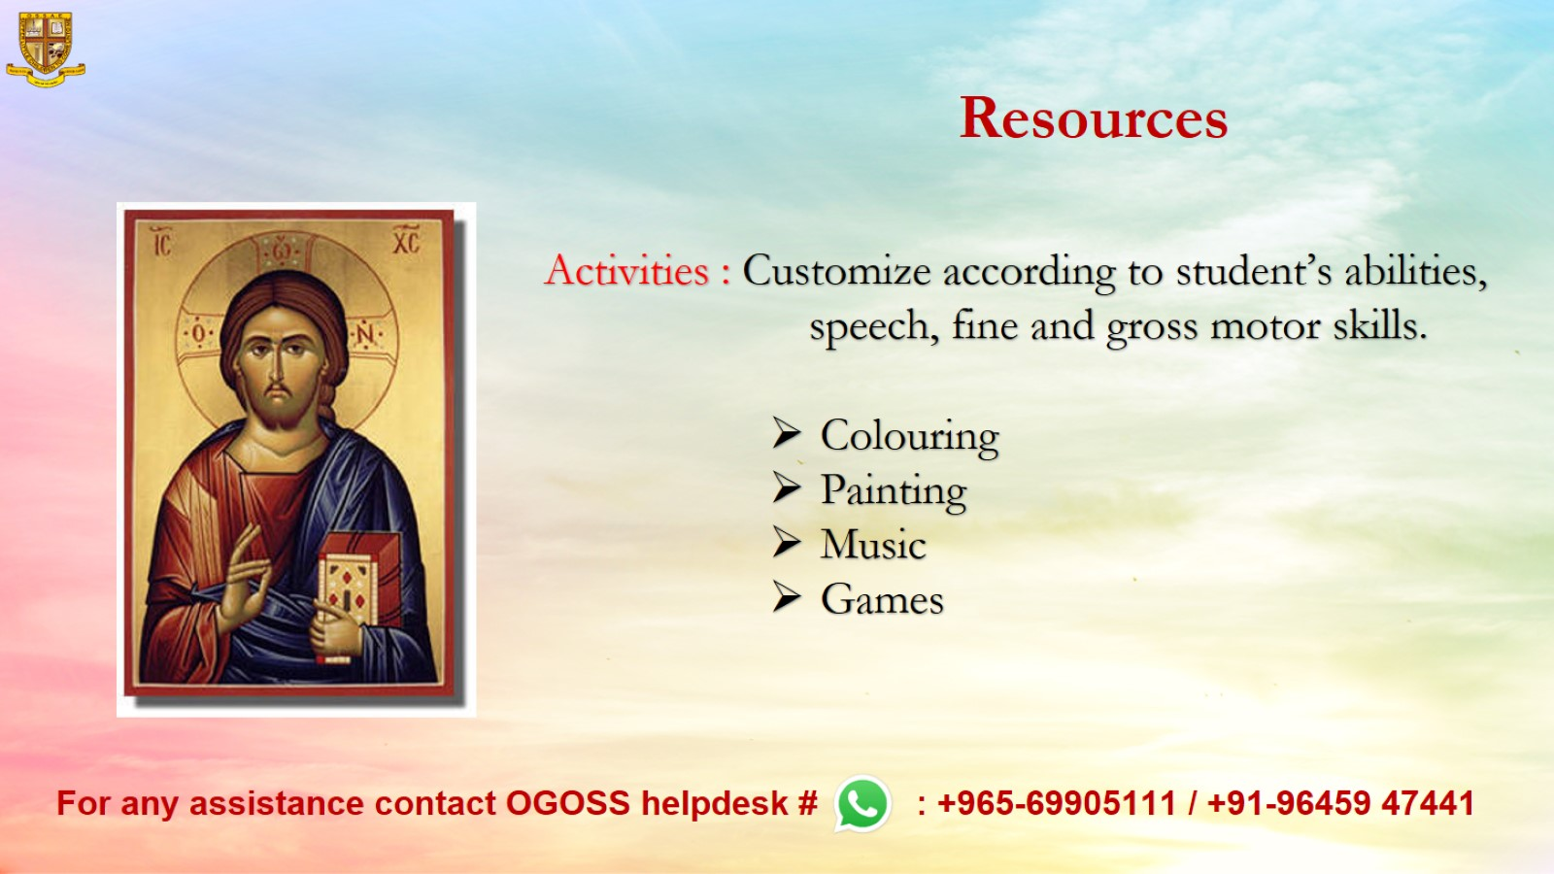
Resources

