Slide 1


Slide 2


Slide 3


Grade 1
Chapter 4
Angels and the shepherds

Slide 4
Preparation for The Angel and the Shepherds
Lesson Outline
Preparation for the chapter
Angels and the shepherds
Lesson Outline
Some shepherds saw a bright light in the sky.
An angel was up in the sky. The angel told the shepherds about the birth of Christ.
The shepherds rejoiced.
The angel told the shepherds where to find Jesus.
They went to Bethlehem. They found baby Jesus.
The shepherds also saw St. Mary and Joseph the carpenter.

Slide 5
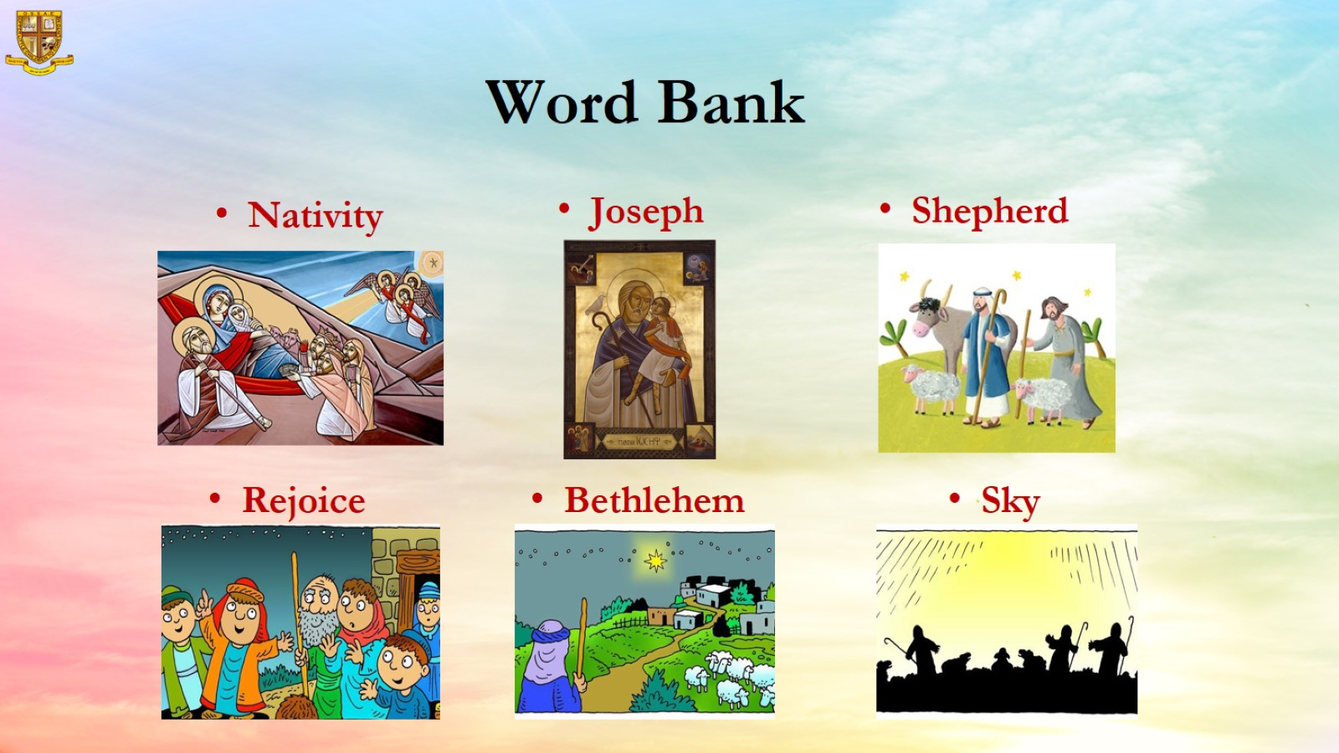
Word Bank

Slide 6
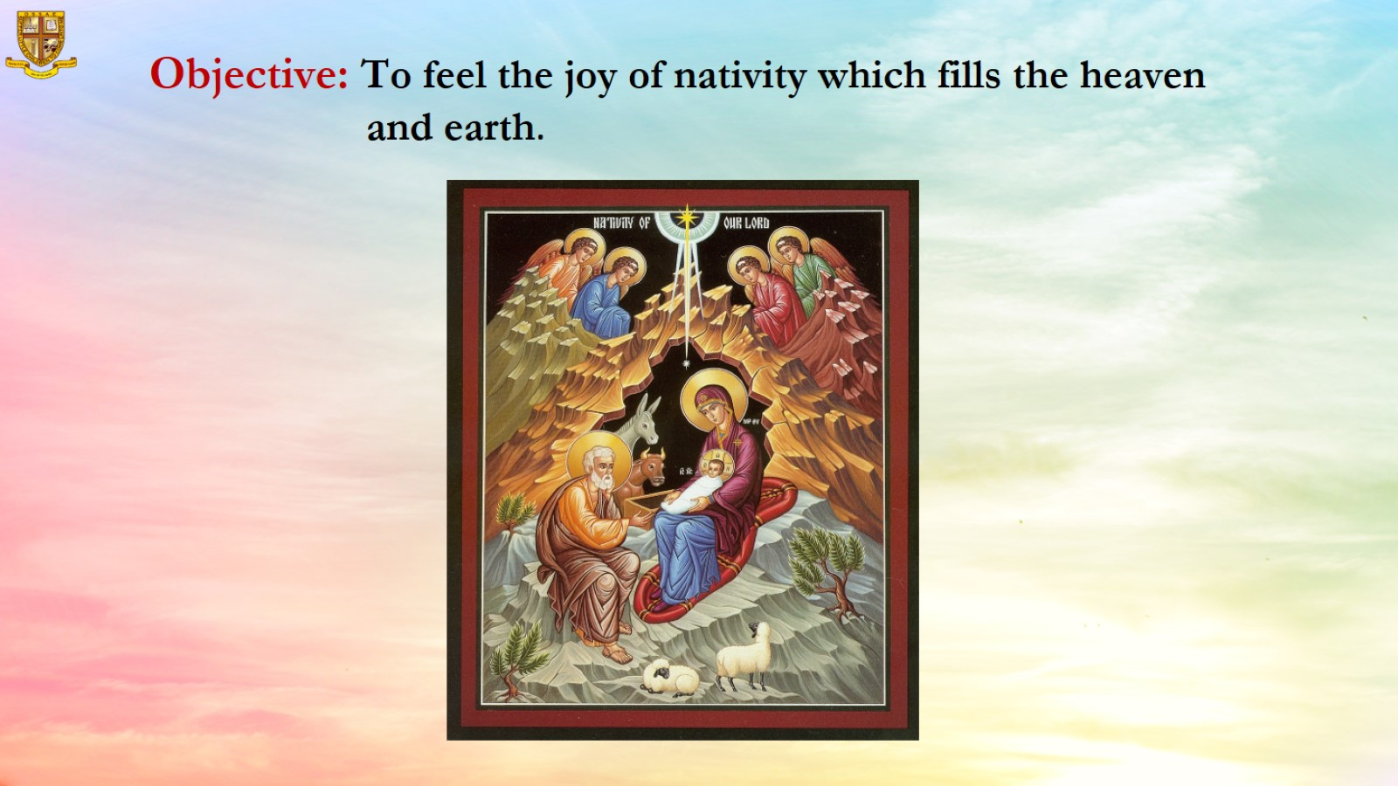

Slide 7
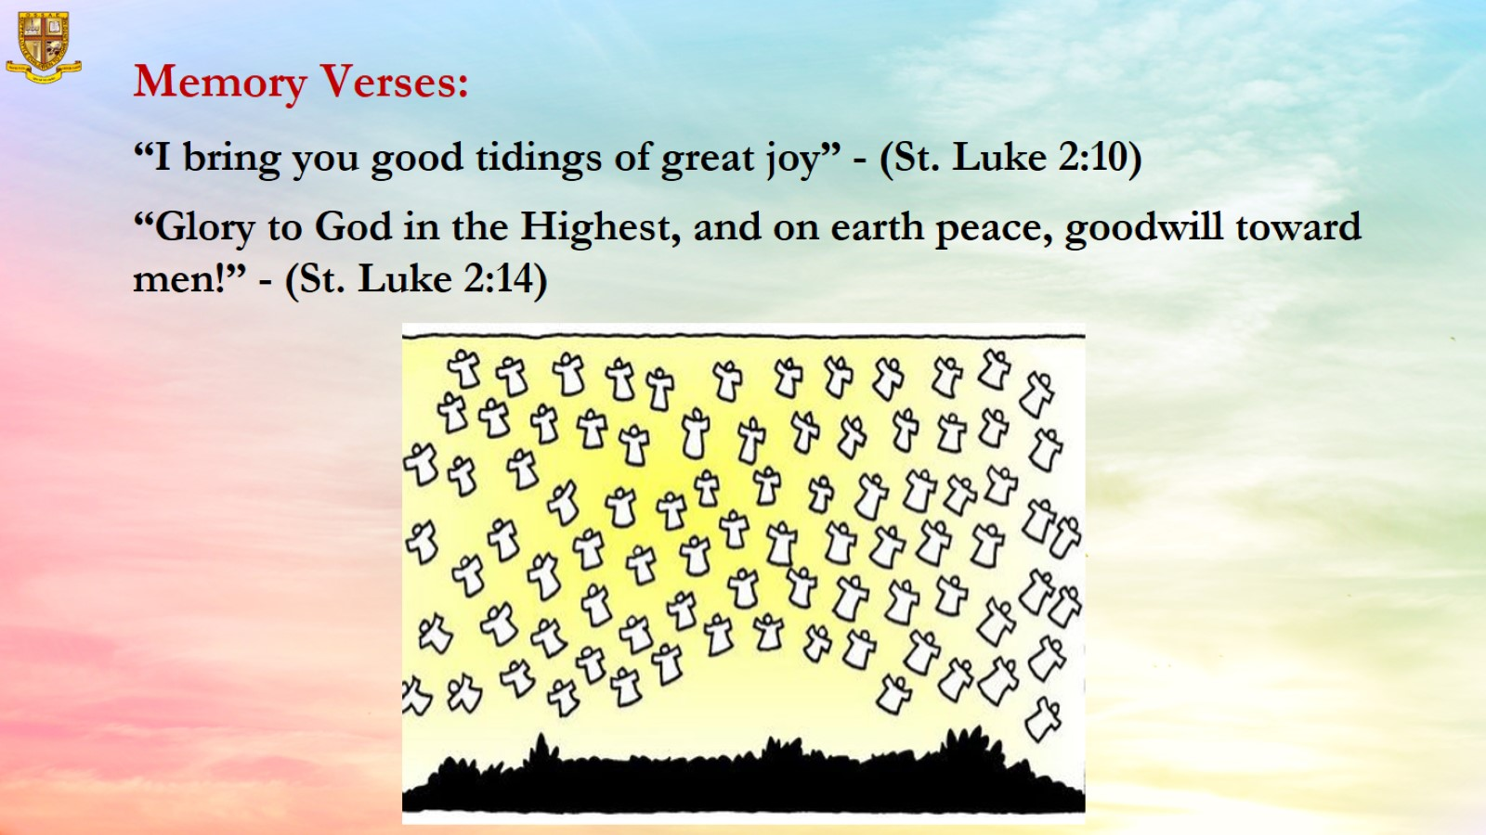
Memory Verses:
“I bring you good tidings of great joy” - (St. Luke 2:10)
“Glory to God in the Highest, and on earth peace, goodwill toward men!” - (St. Luke 2:14)

Slide 8
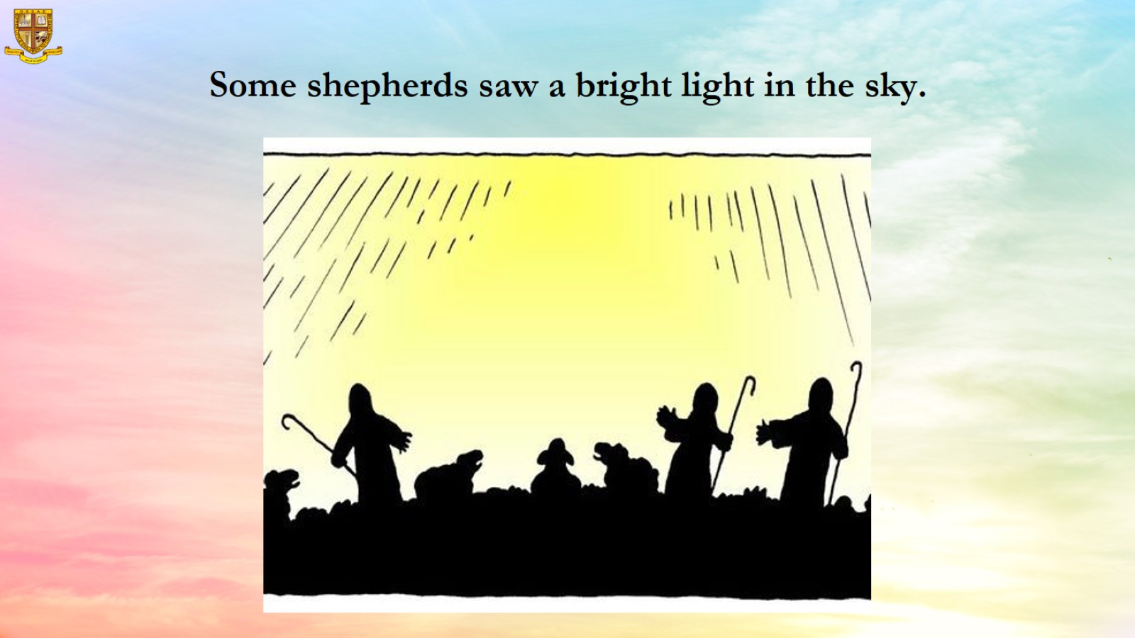

Slide 9
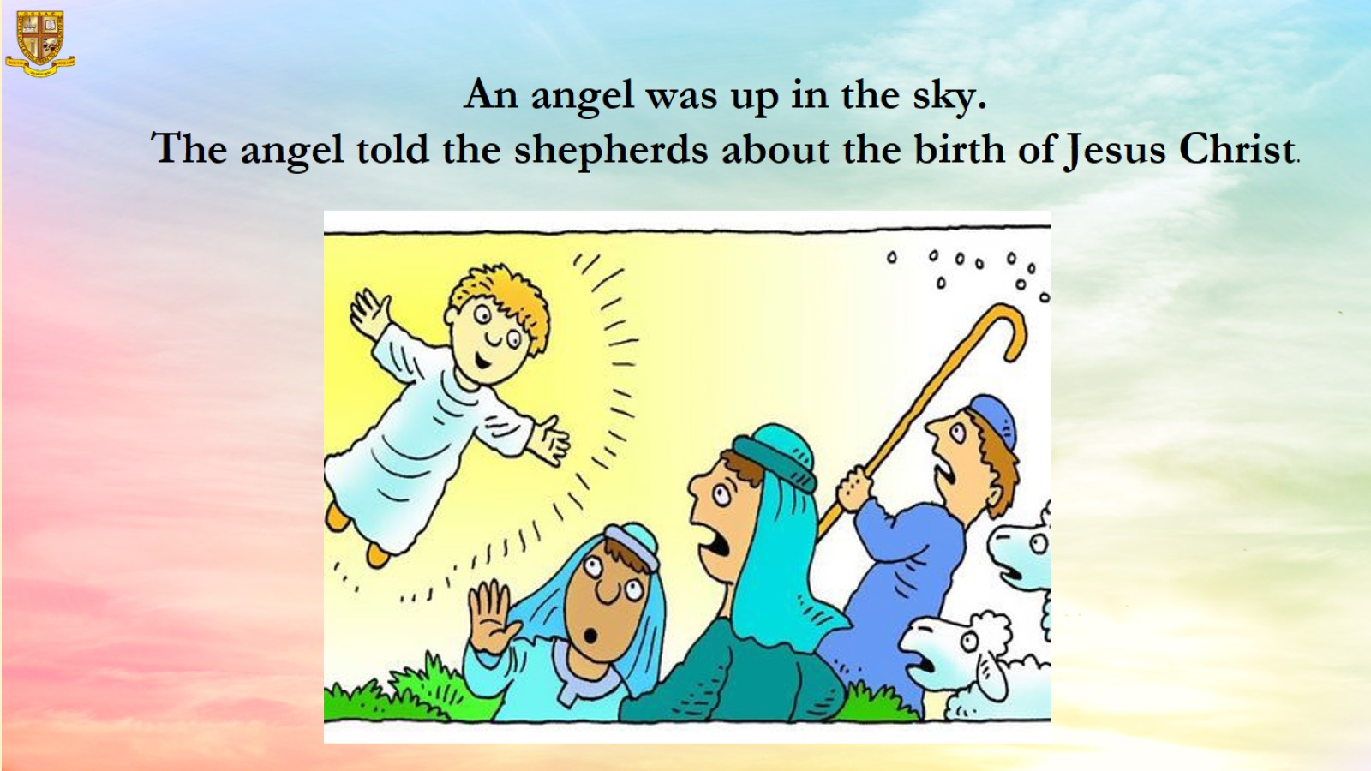

Slide 10
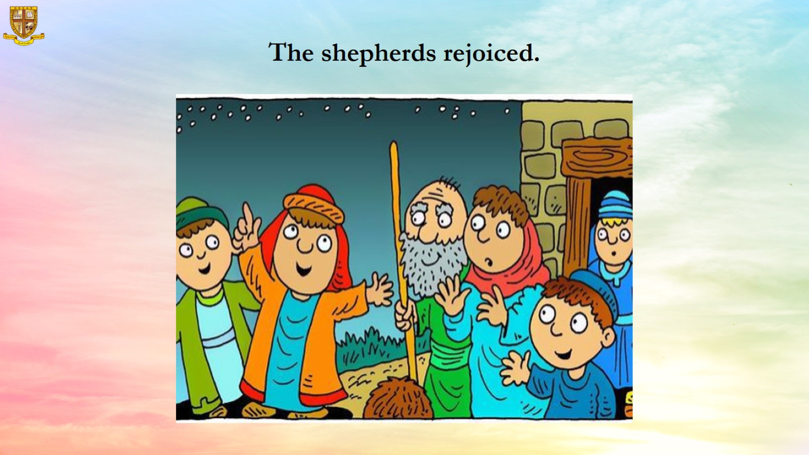

Slide 11
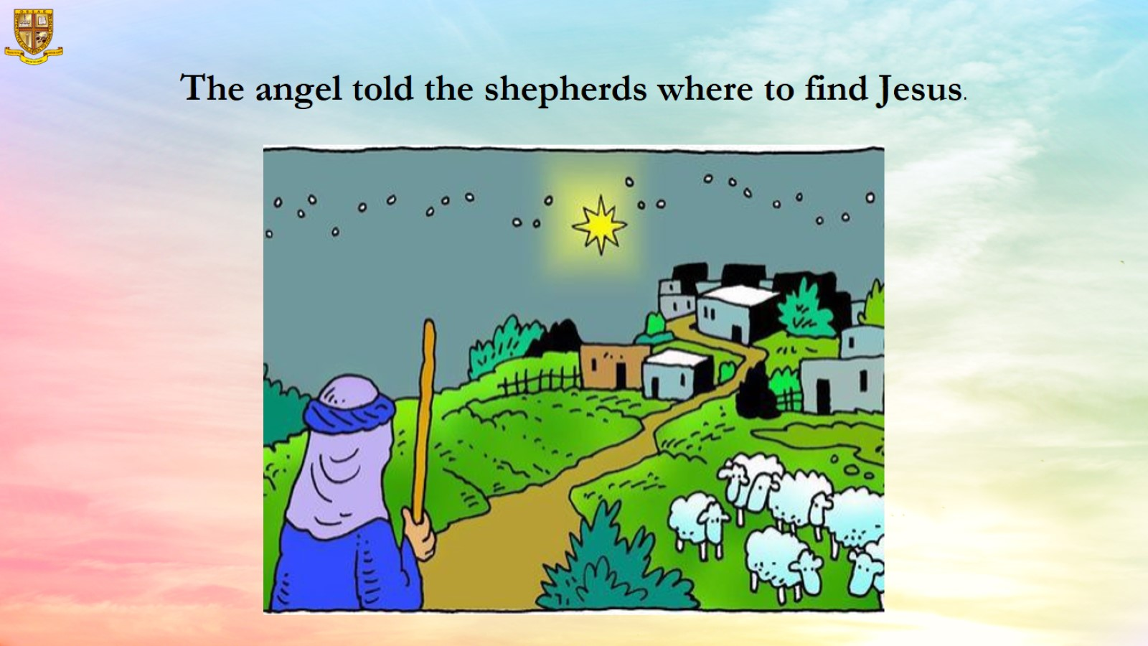

Slide 12
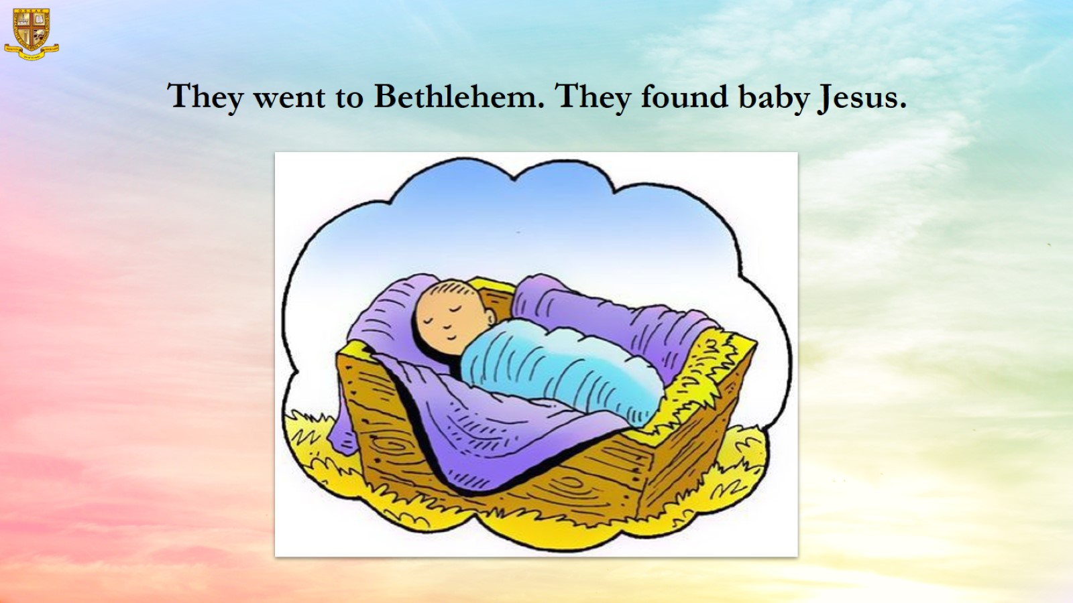

Slide 13
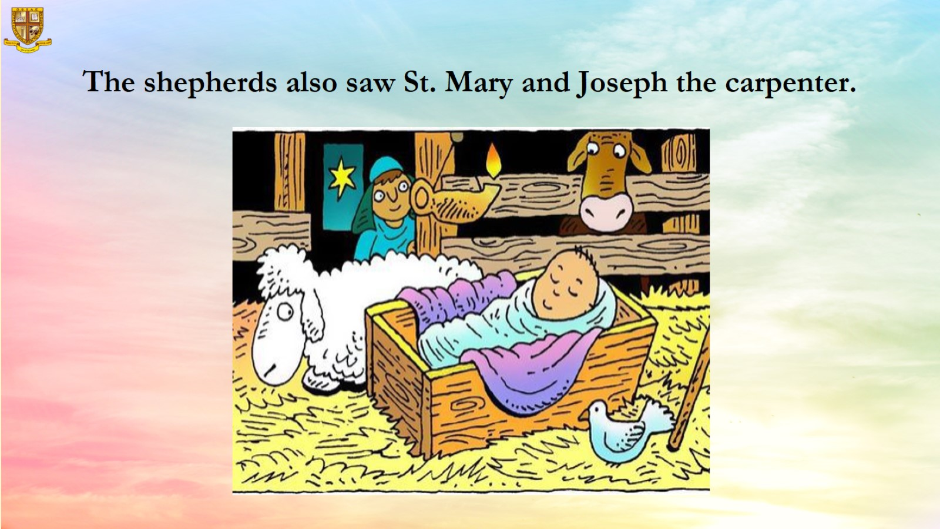
The shepherds also saw St. Mary and Joseph the carpenter.

Slide 14

Resources

