Slide 1

Orthodox Global Online Sunday School (OGOSS)

Slide 2
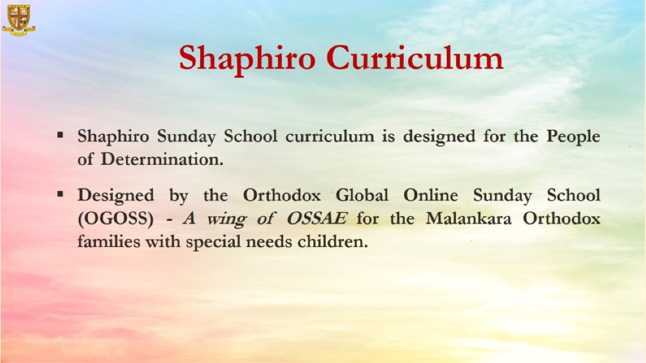

Slide 3
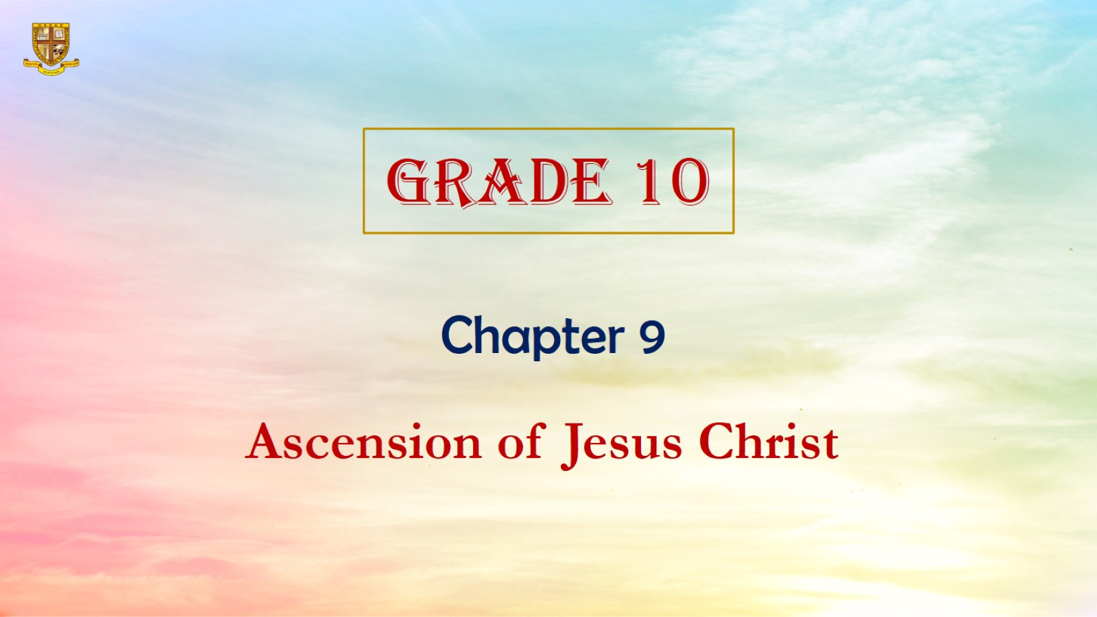

Slide 4
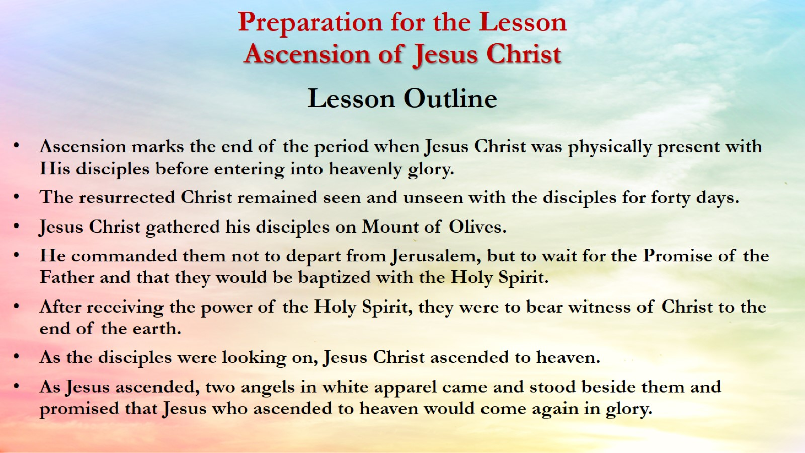
Preparation for the Lesson
Ascension of Jesus Christ
Lesson Outline

Slide 5
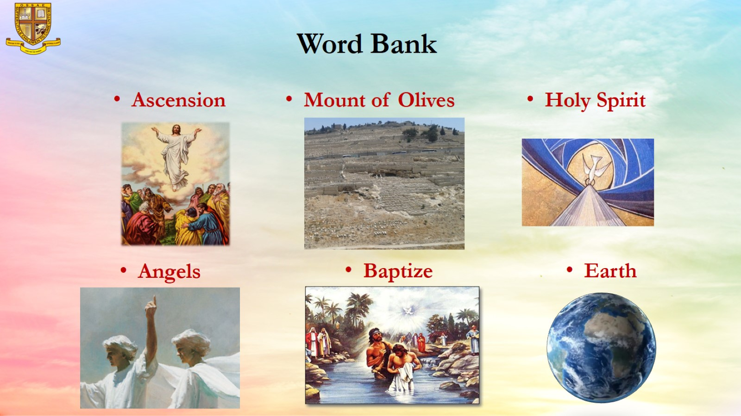
Word Bank

Slide 6
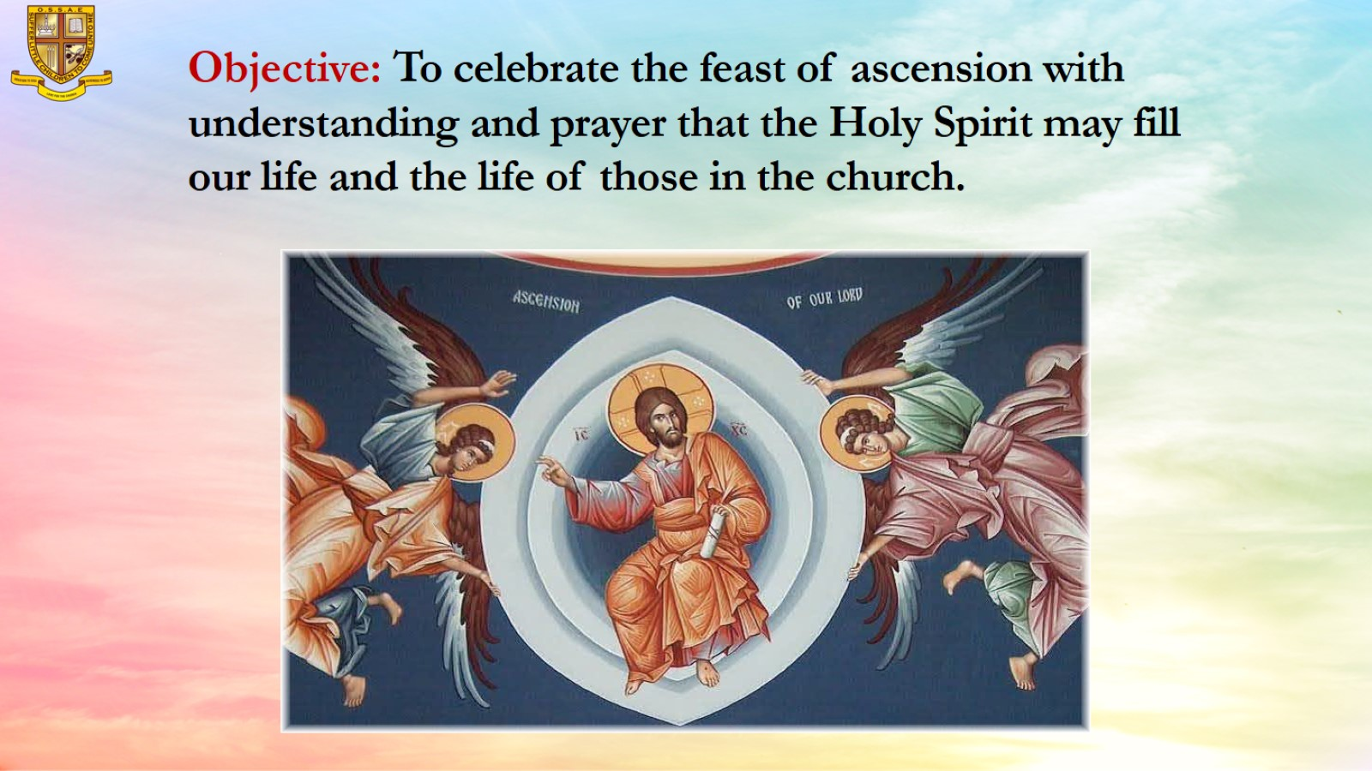
Objective: To celebrate the feast of ascension with understanding and prayer that the Holy Spirit may fill our life and the life of those in the church.

Slide 7
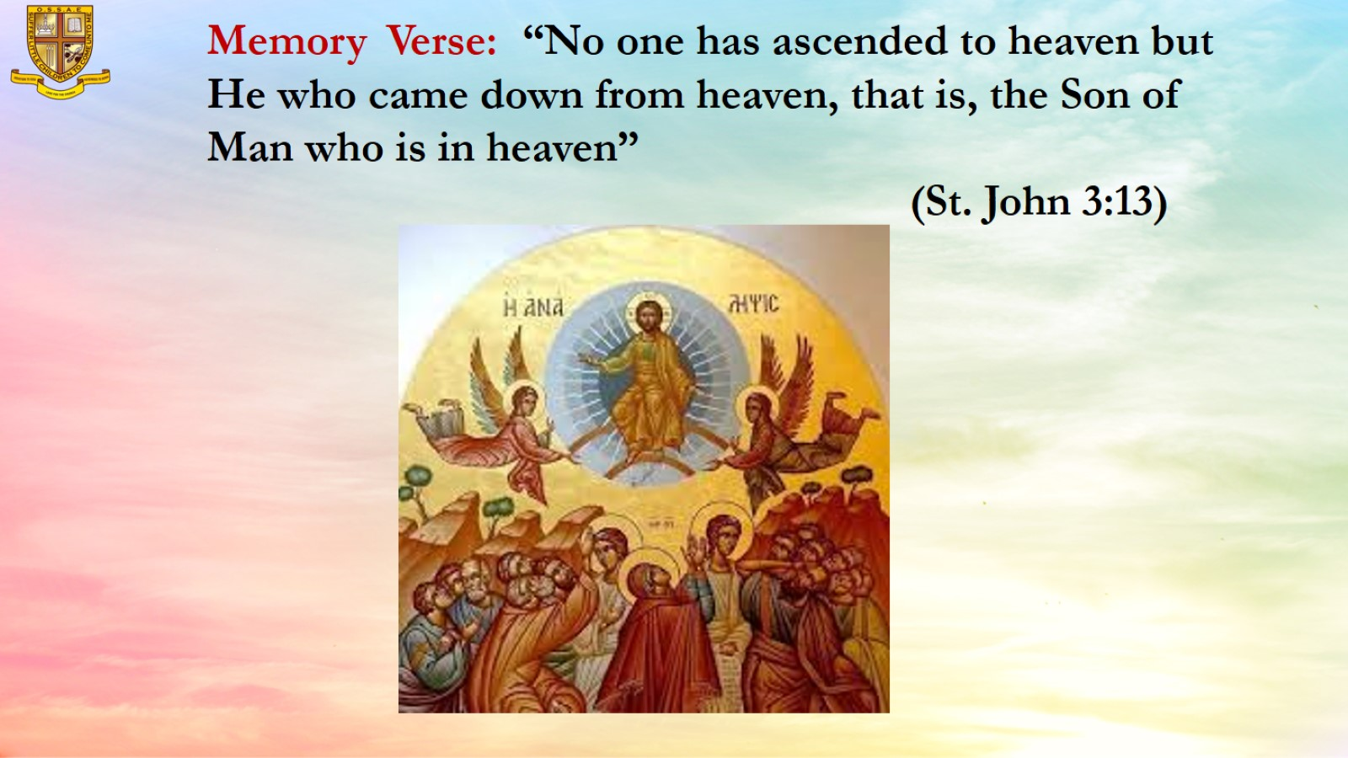
Memory Verse: “No one has ascended to heaven but He who came down from heaven, that is, the Son of Man who is in heaven”
(St. John 3:13)

Slide 8
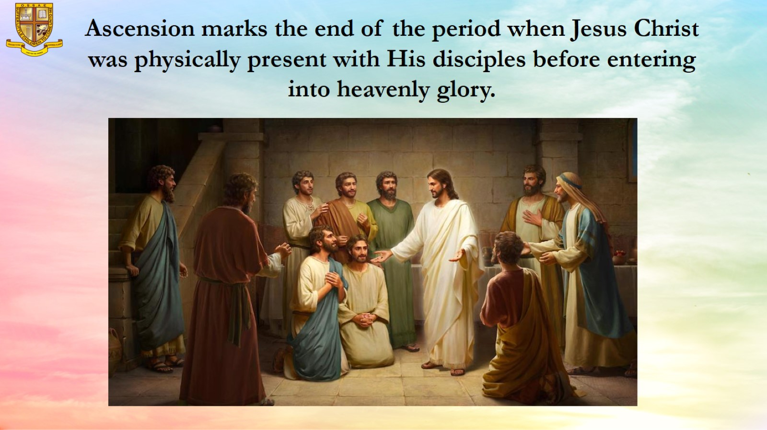
Ascension marks the end of the period when Jesus Christ was physically present with His disciples before entering into heavenly glory.

Slide 9
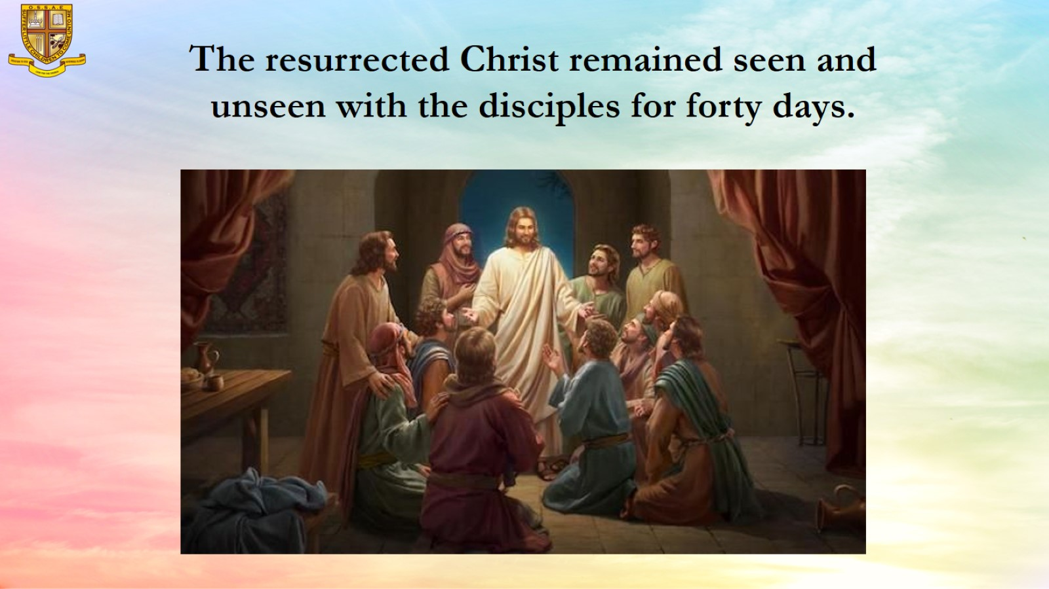

Slide 10
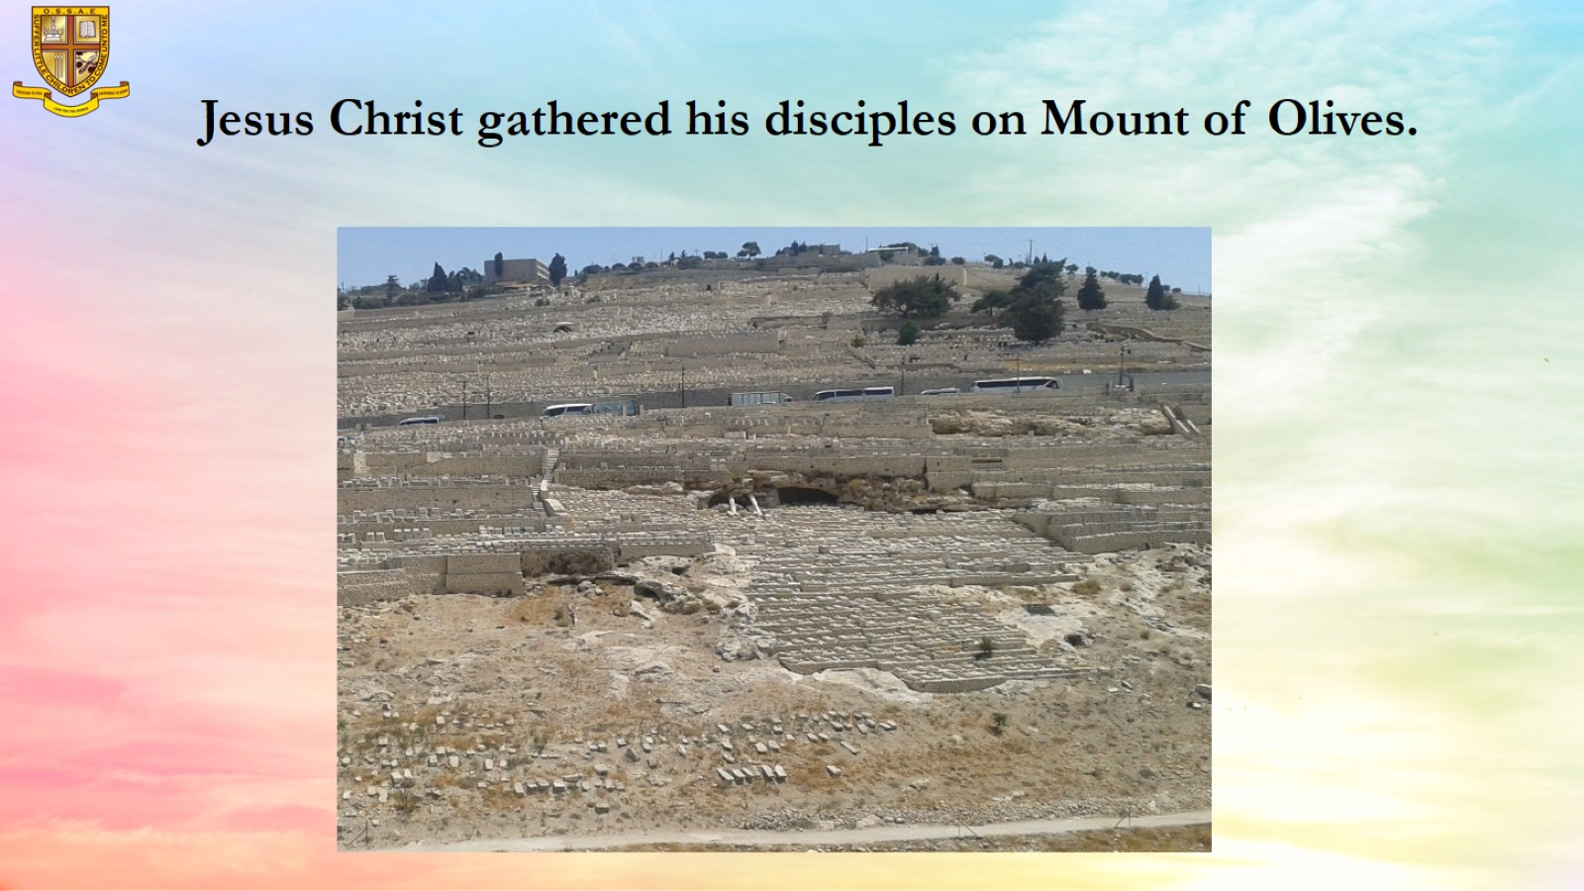
Jesus Christ gathered his disciples on Mount of Olives.

Slide 11
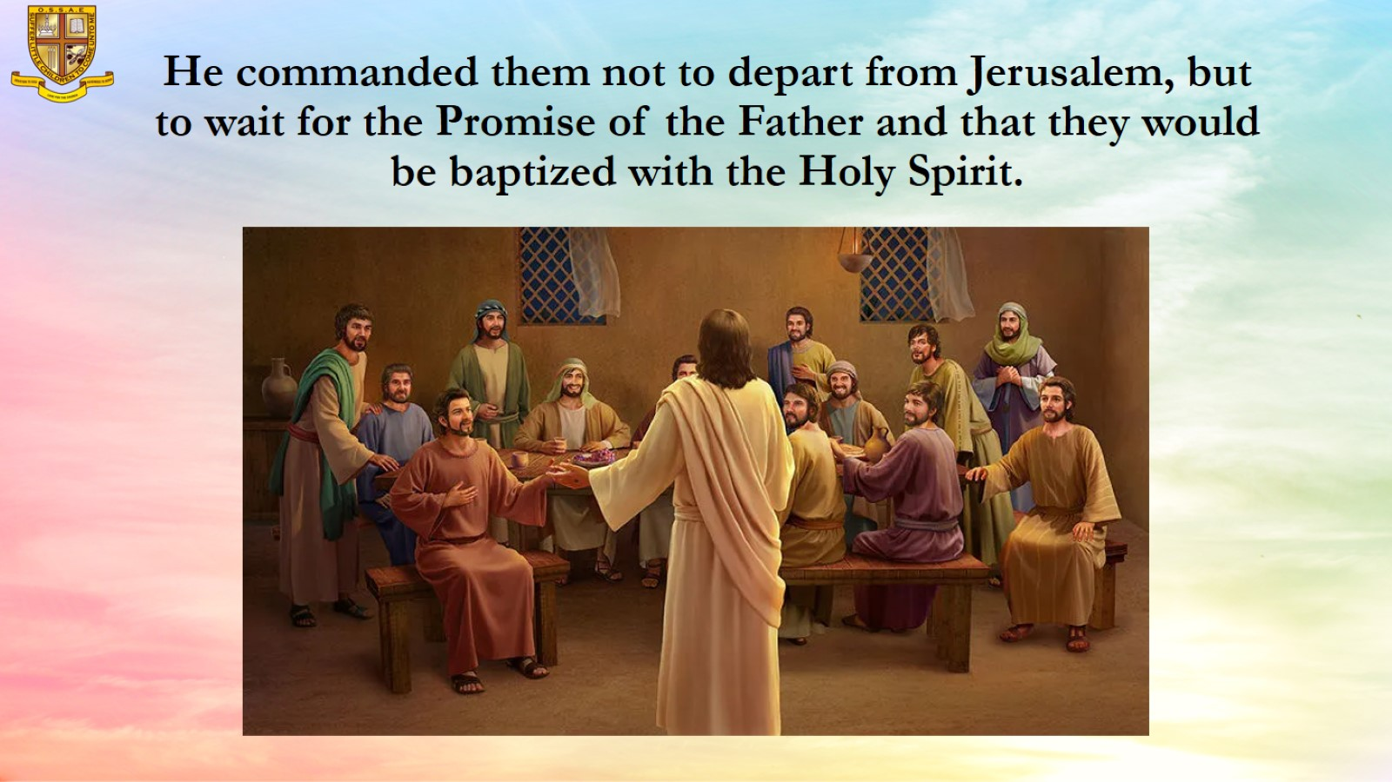
He commanded them not to depart from Jerusalem, but to wait for the Promise of the Father and that they would be baptized with the Holy Spirit.

Slide 12
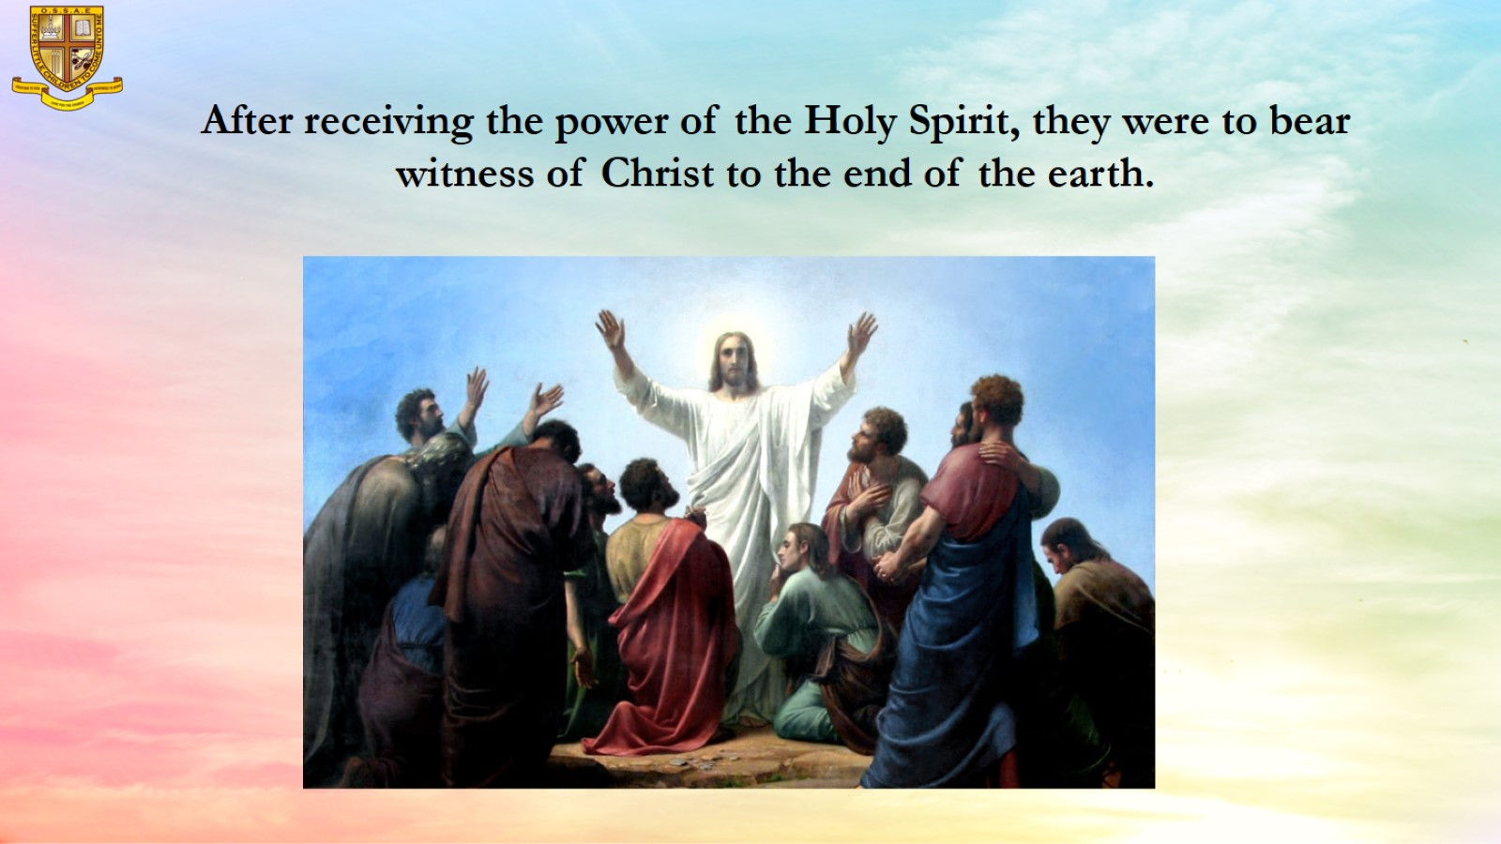
After receiving the power of the Holy Spirit, they were to bear witness of Christ to the end of the earth.

Slide 13
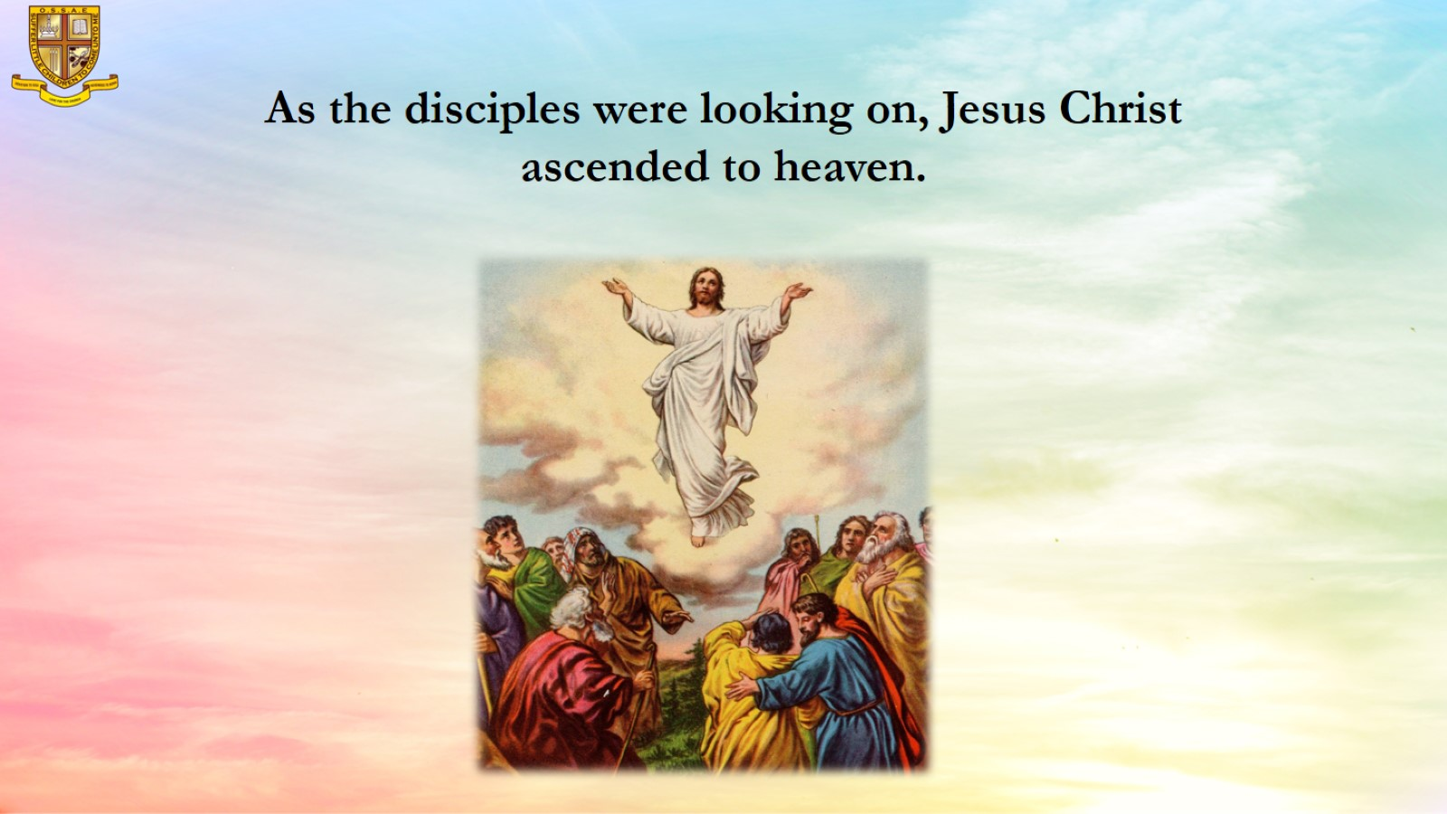
As the disciples were looking on, Jesus Christ ascended to heaven.

Slide 14
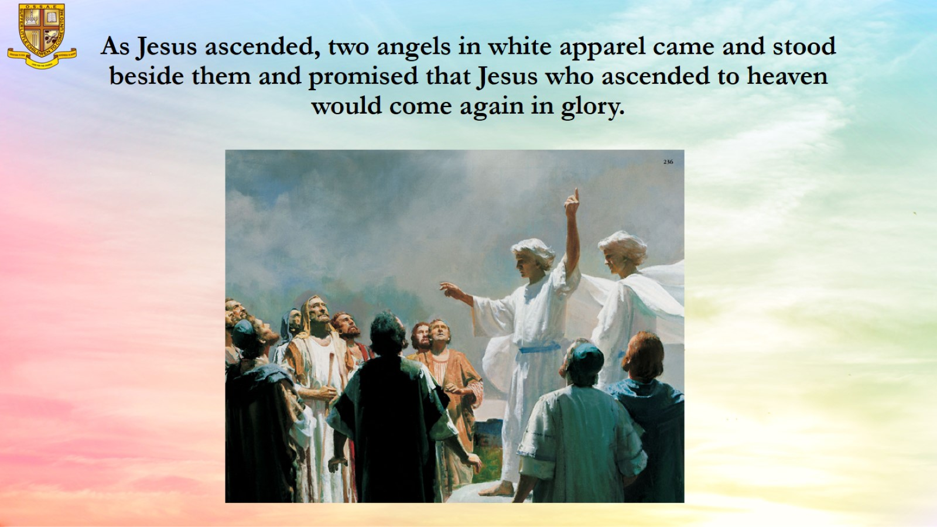
As Jesus ascended, two angels in white apparel came and stood beside them and promised that Jesus who ascended to heaven would come again in glory.

Slide 15
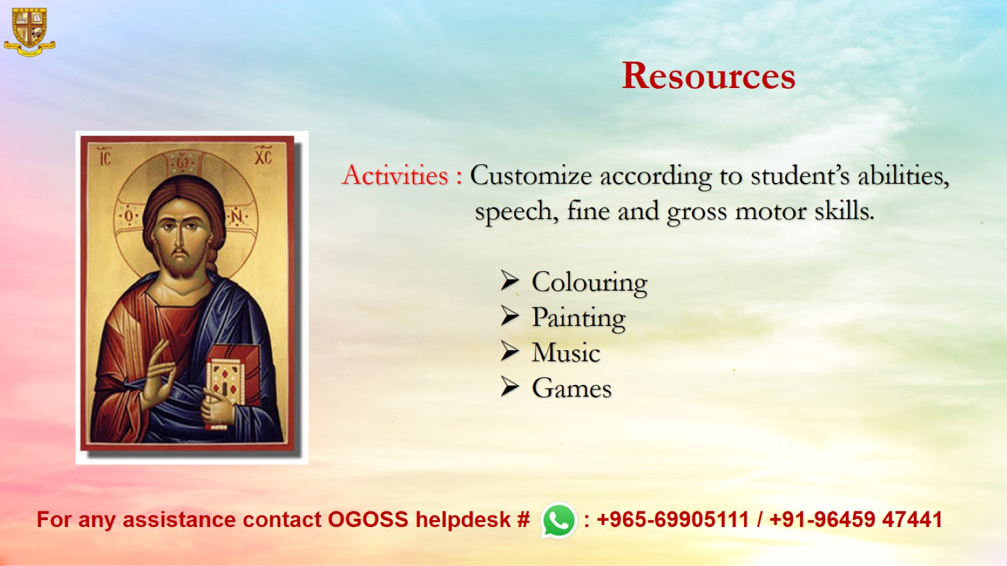
Resources

