Slide 1
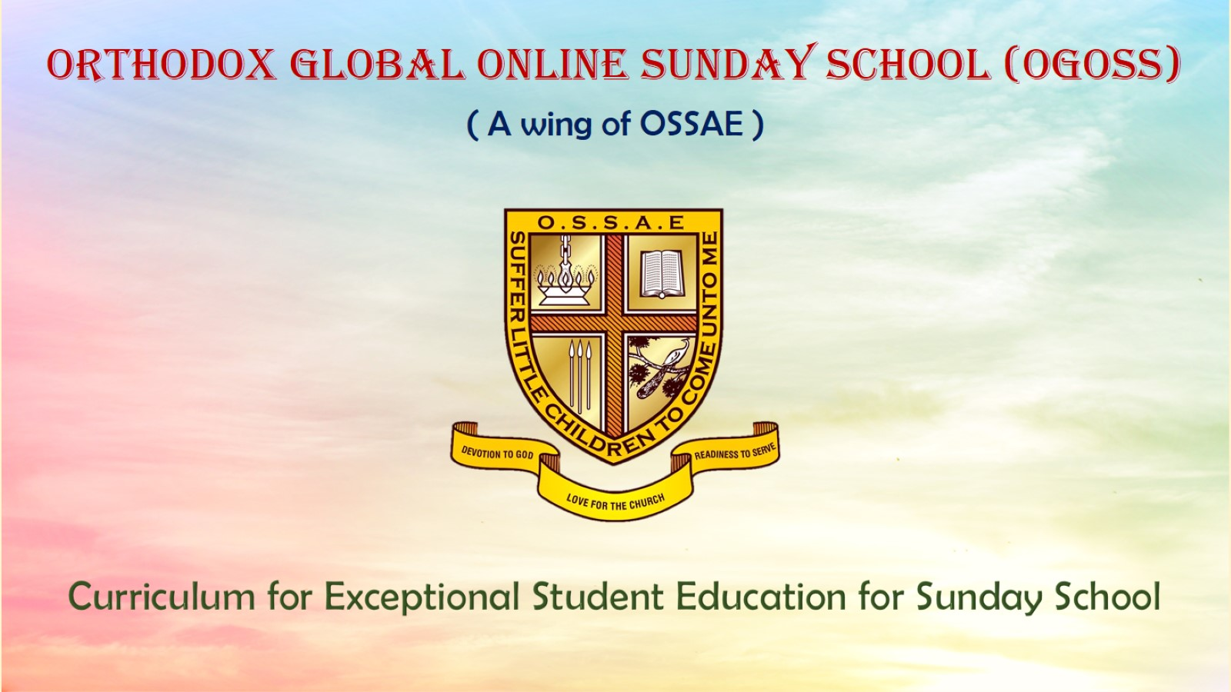
Orthodox Global Online Sunday School (OGOSS)

Slide 2
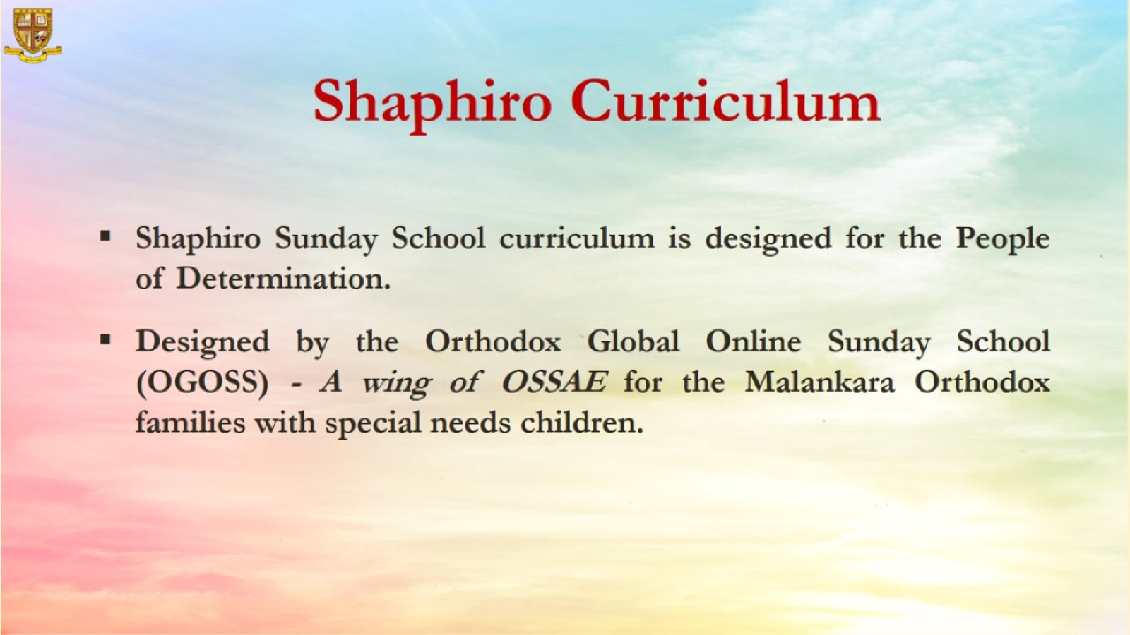

Slide 3


Slide 4
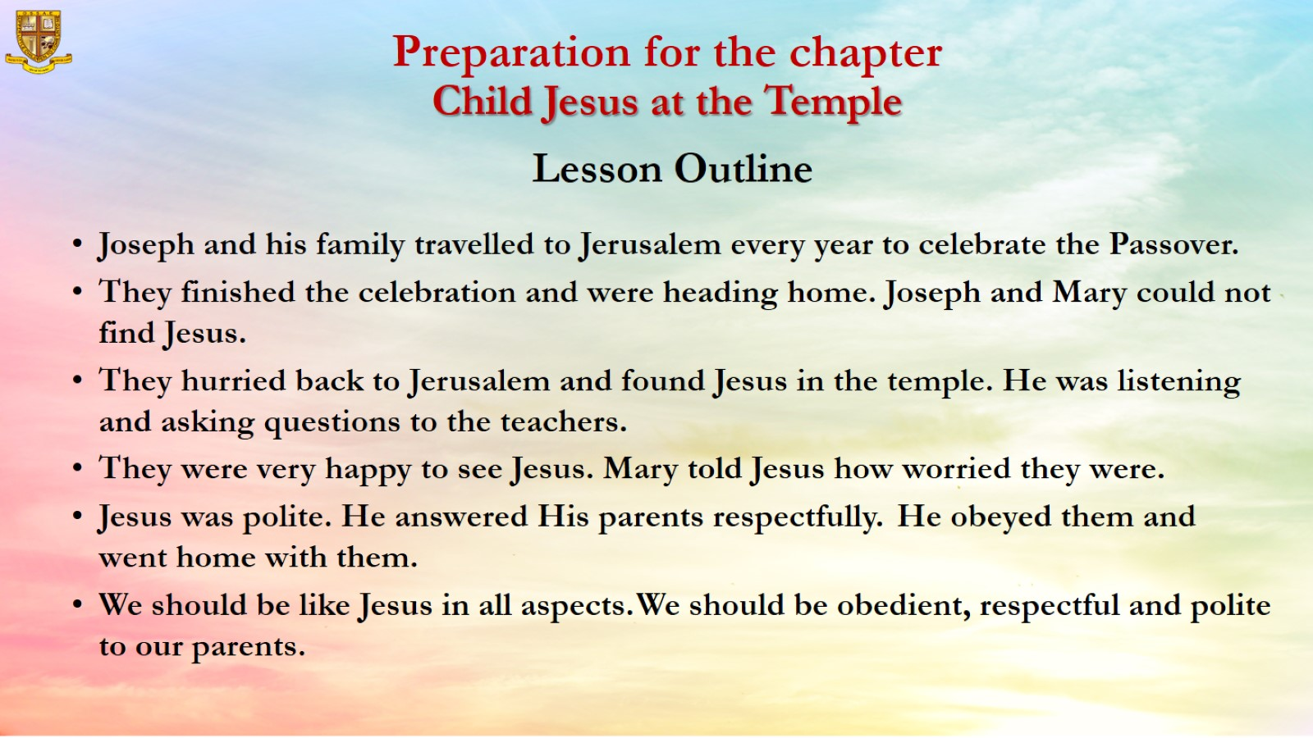
Preparation for the chapter
Child Jesus at the Temple
Lesson Outline

Slide 5
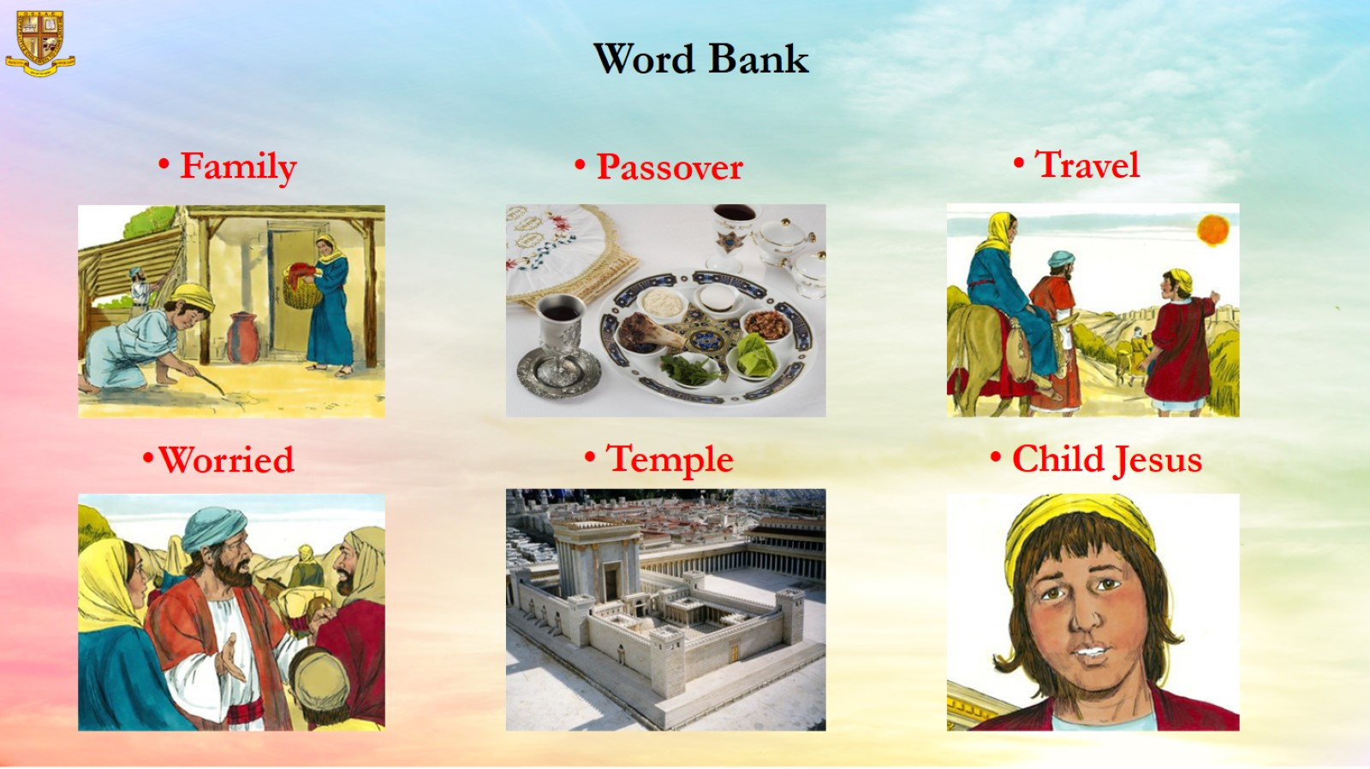
Word Bank

Slide 6
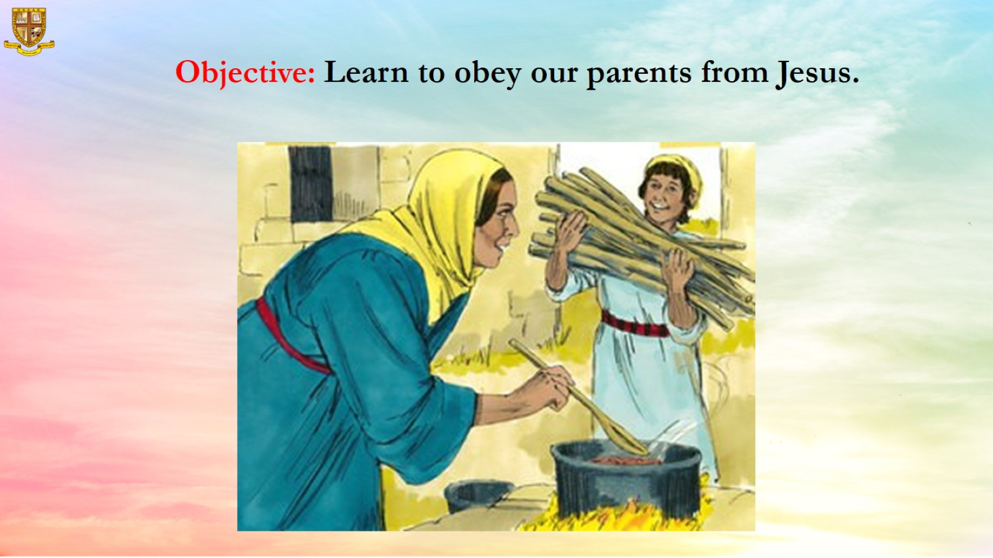
Objective: Learn to obey our parents from Jesus.

Slide 7
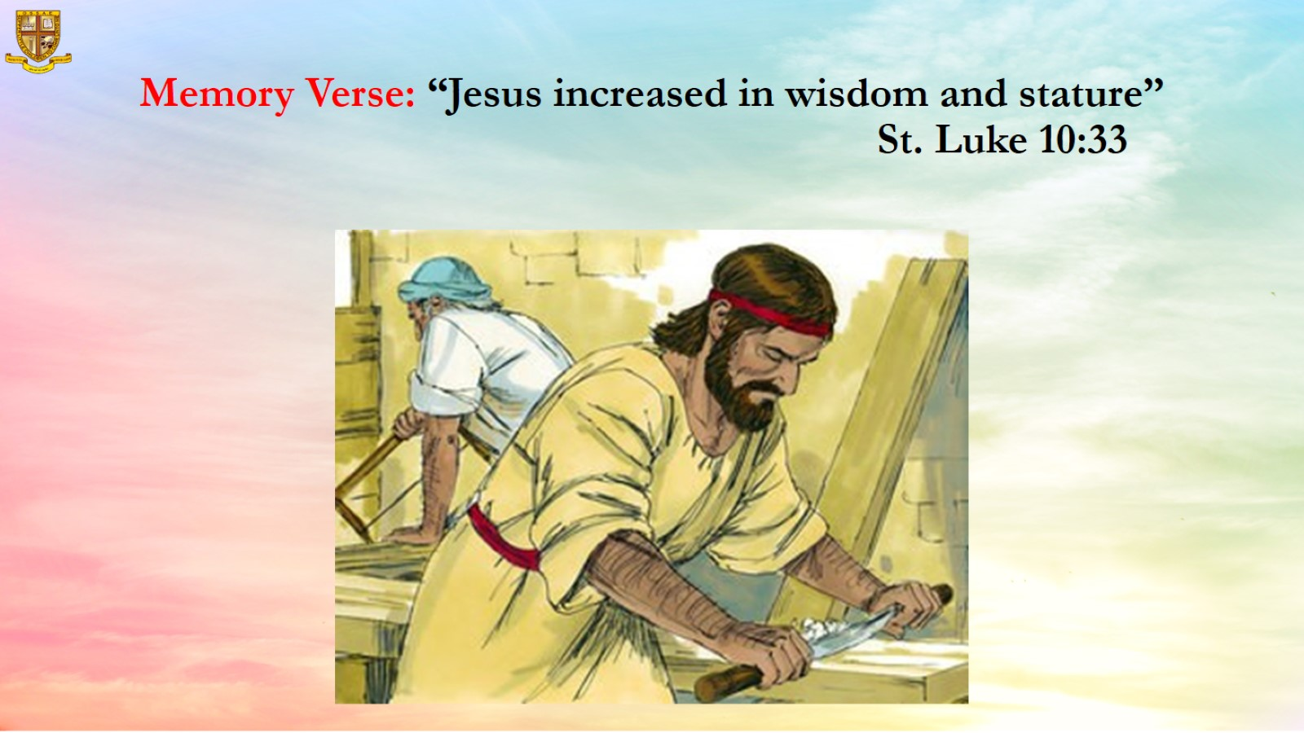
Memory Verse: “Jesus increased in wisdom and stature”
St. Luke 10:33

Slide 8
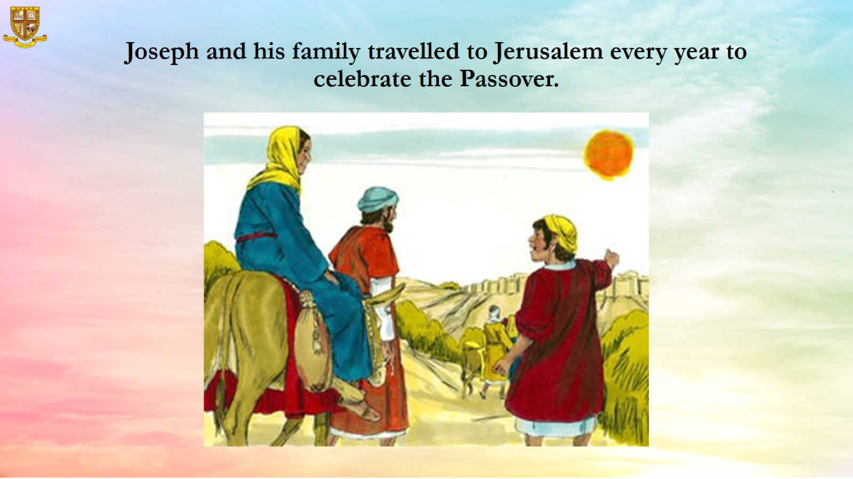
Joseph and his family travelled to Jerusalem every year to celebrate the Passover.

Slide 9
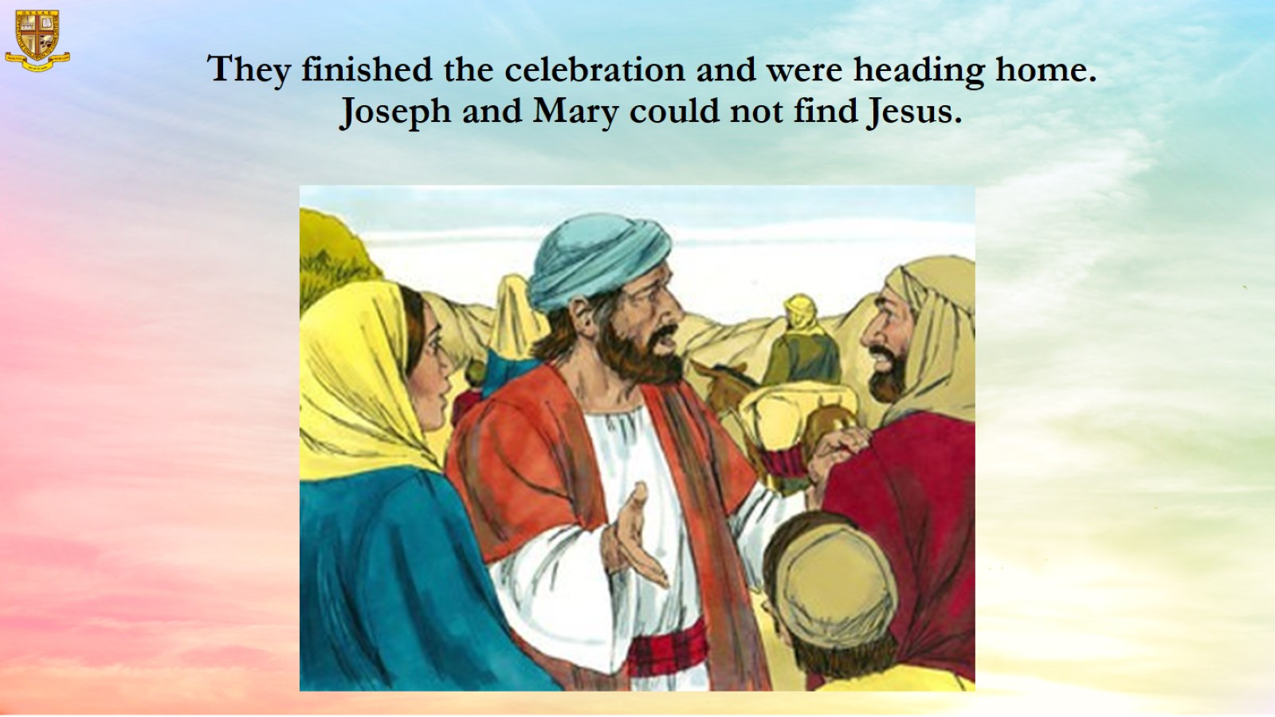
They finished the celebration and were heading home.
Joseph and Mary could not find Jesus.

Slide 10
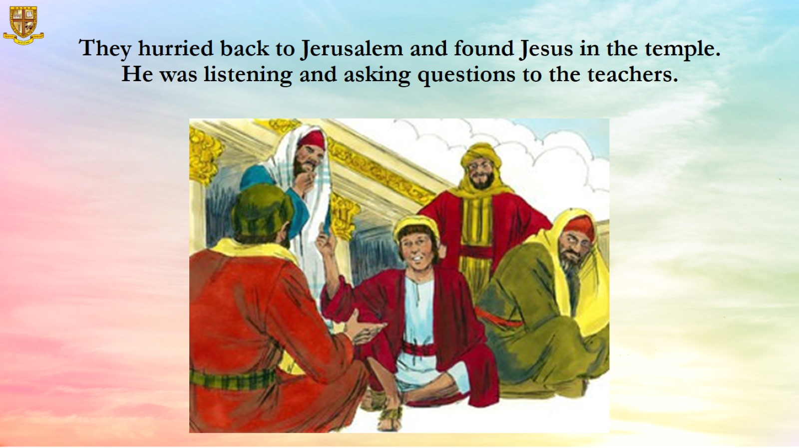
They hurried back to Jerusalem and found Jesus in the temple. He was listening and asking questions to the teachers.

Slide 11
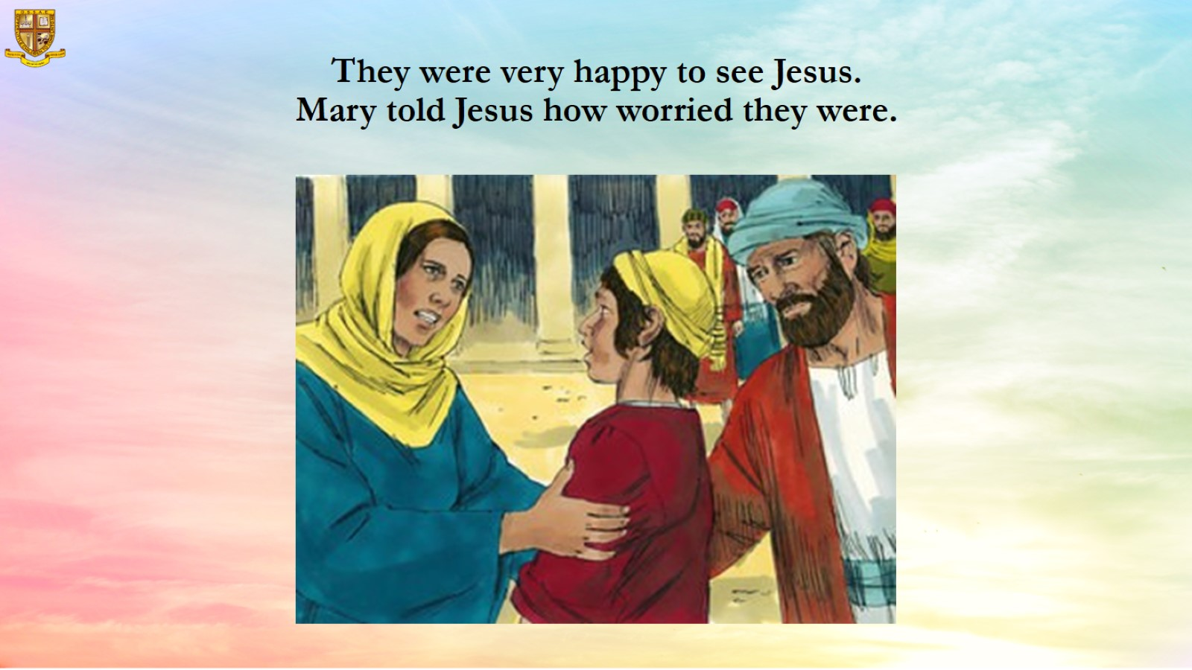
They were very happy to see Jesus.
Mary told Jesus how worried they were.

Slide 12
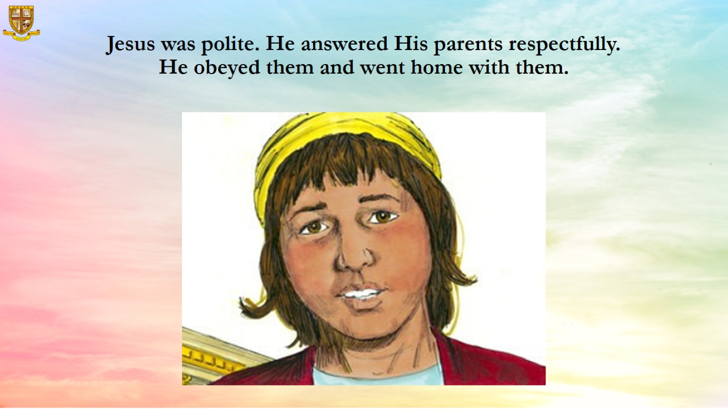
Jesus was polite. He answered His parents respectfully.
He obeyed them and went home with them.

Slide 13
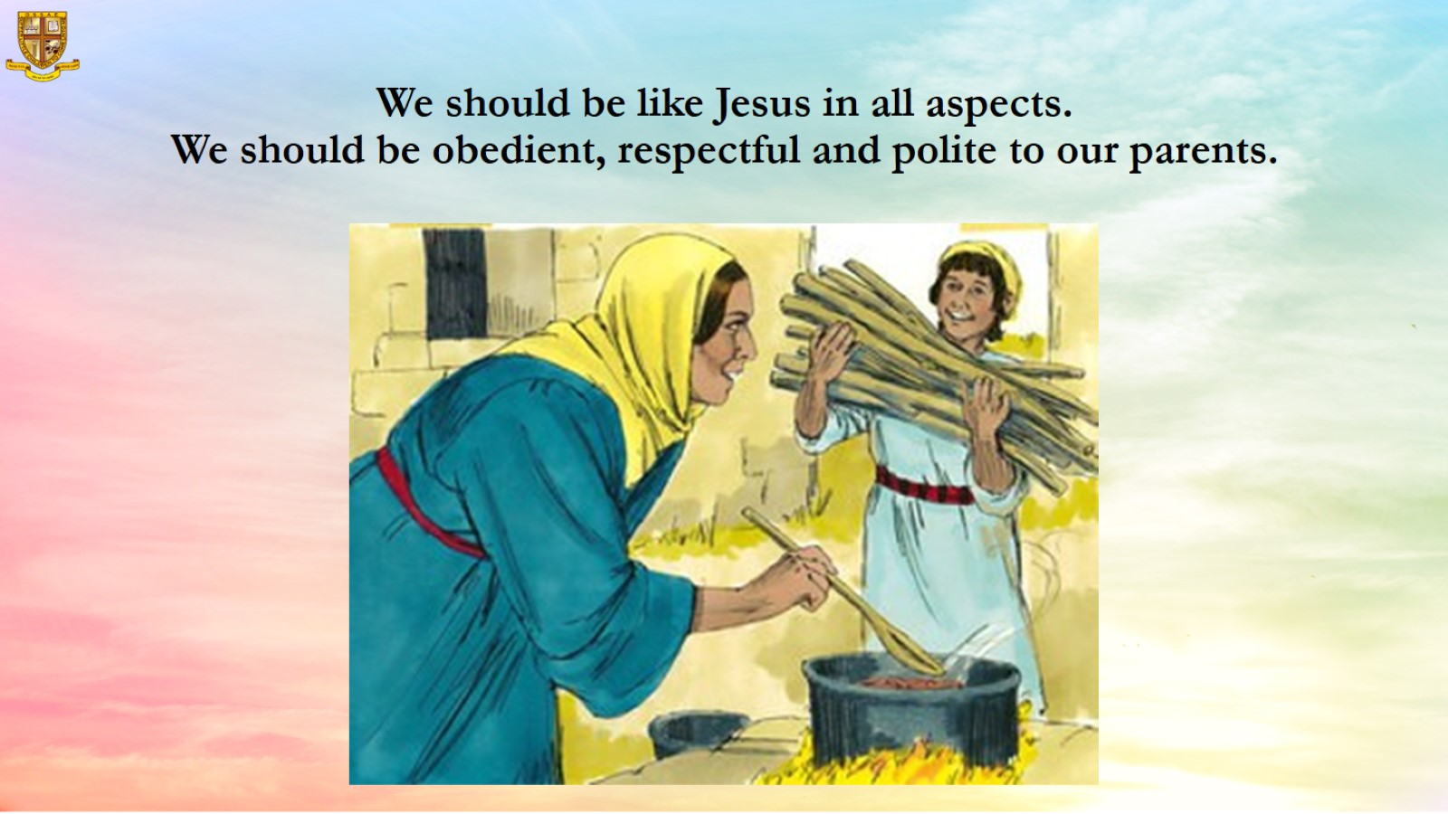
We should be like Jesus in all aspects.
We should be obedient, respectful and polite to our parents.

Slide 14
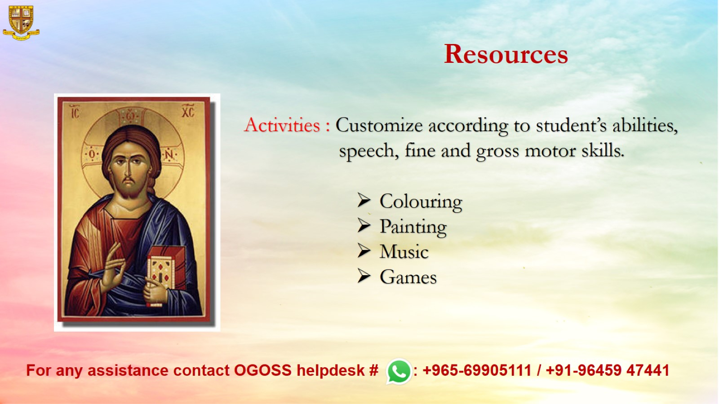
Resources

