Slide 1


Slide 2
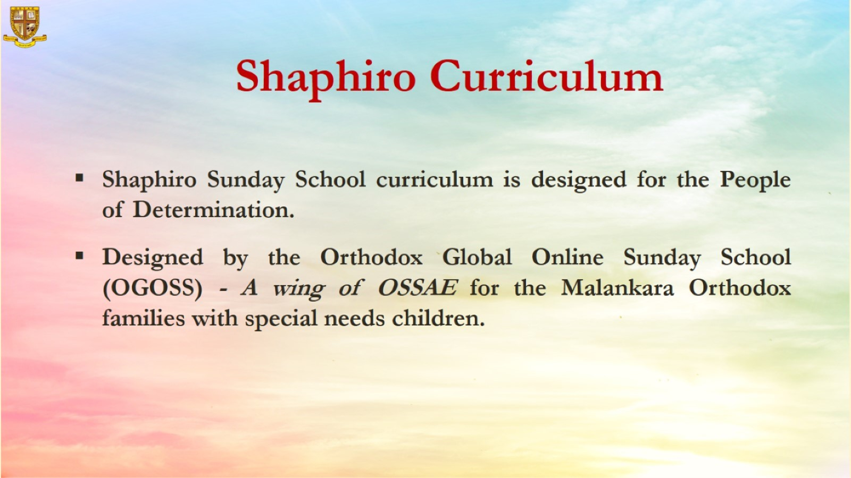

Slide 3
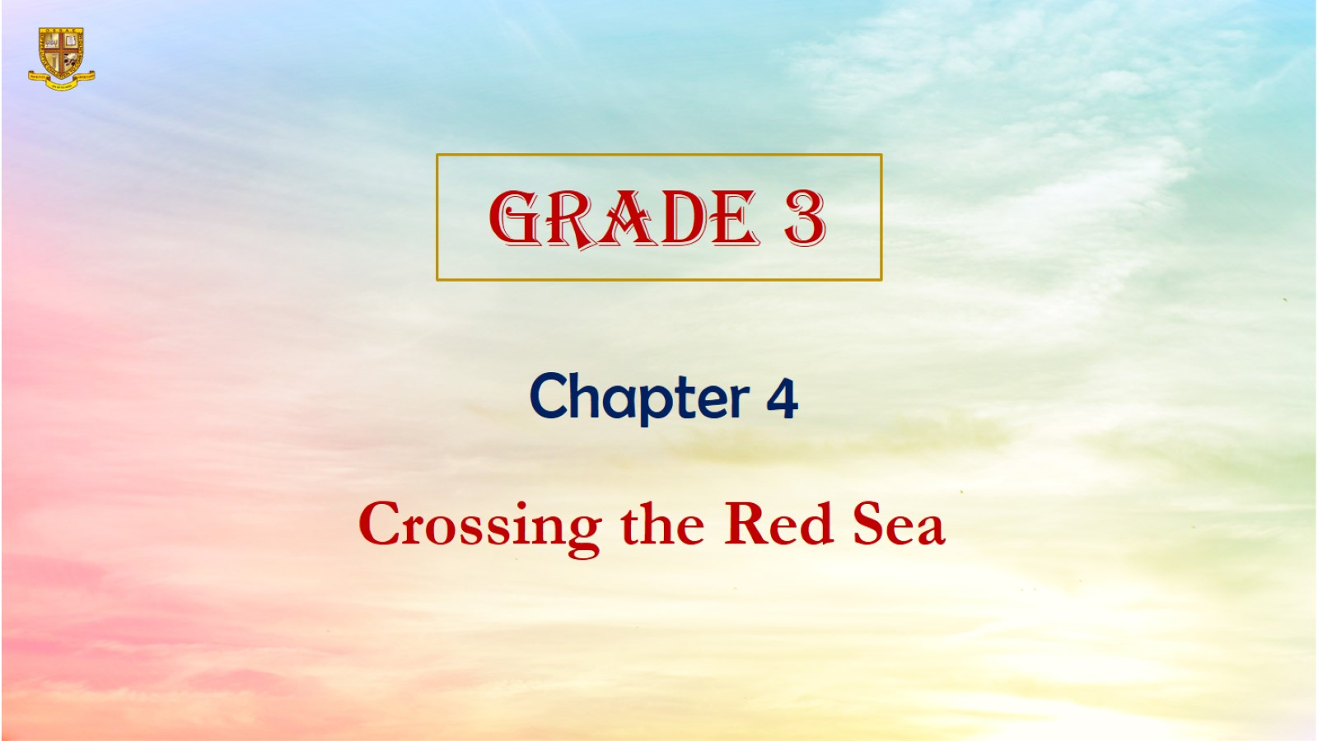

Slide 4
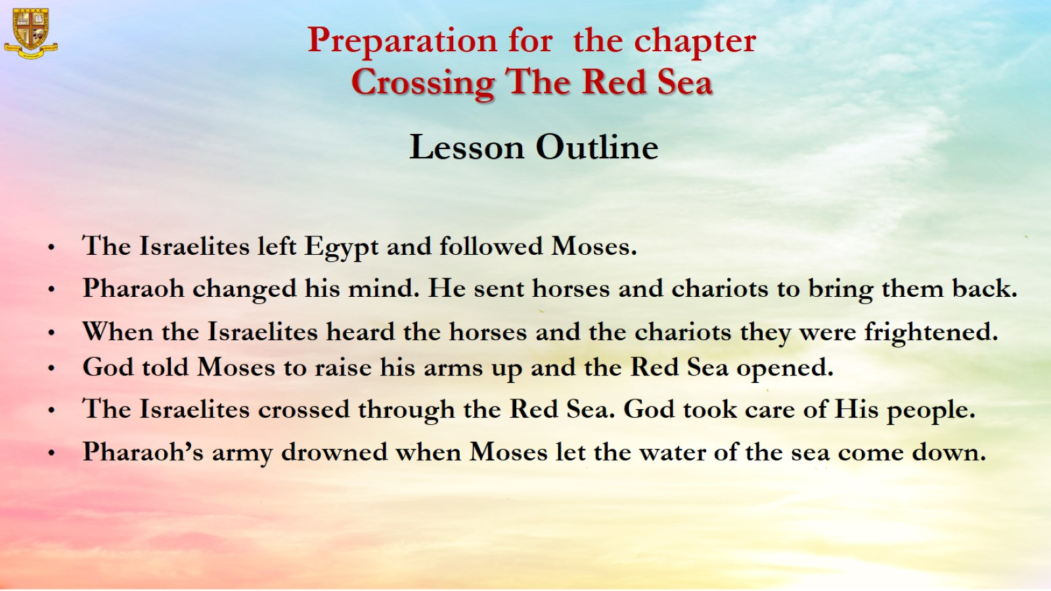
Preparation for the chapter
Crossing The Red Sea

Slide 5
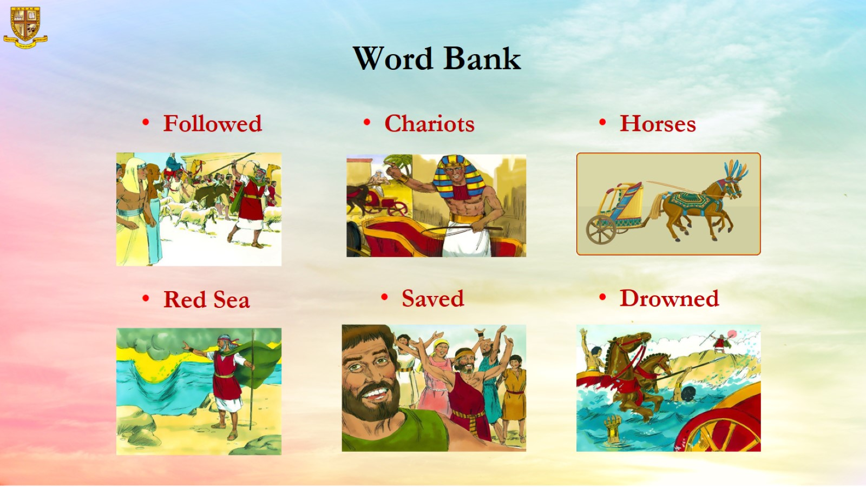
Word Bank

Slide 6
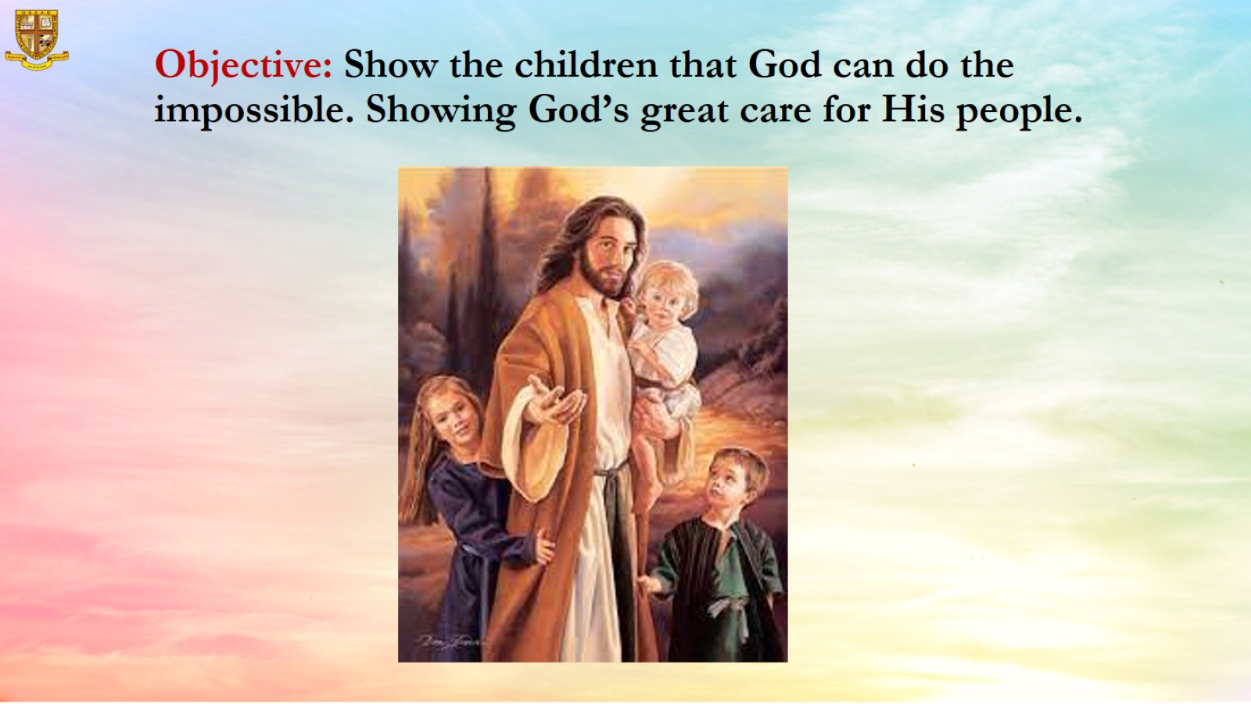
Objective: Show the children that God can do the impossible. Showing God’s great care for His people.

Slide 7
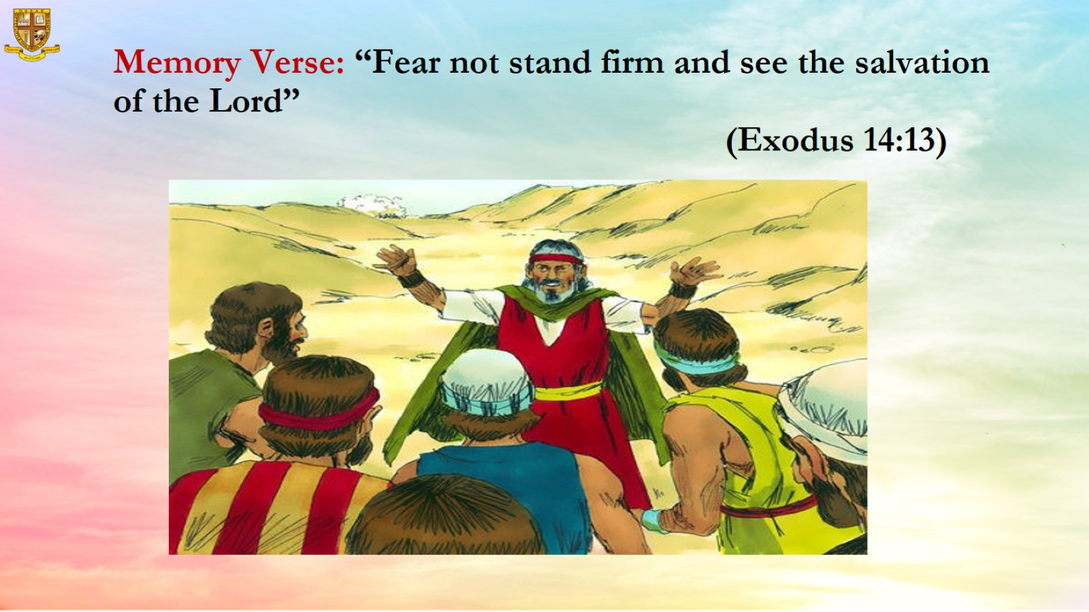
Memory Verse: “Fear not stand firm and see the salvation of the Lord”
(Exodus 14:13)

Slide 8
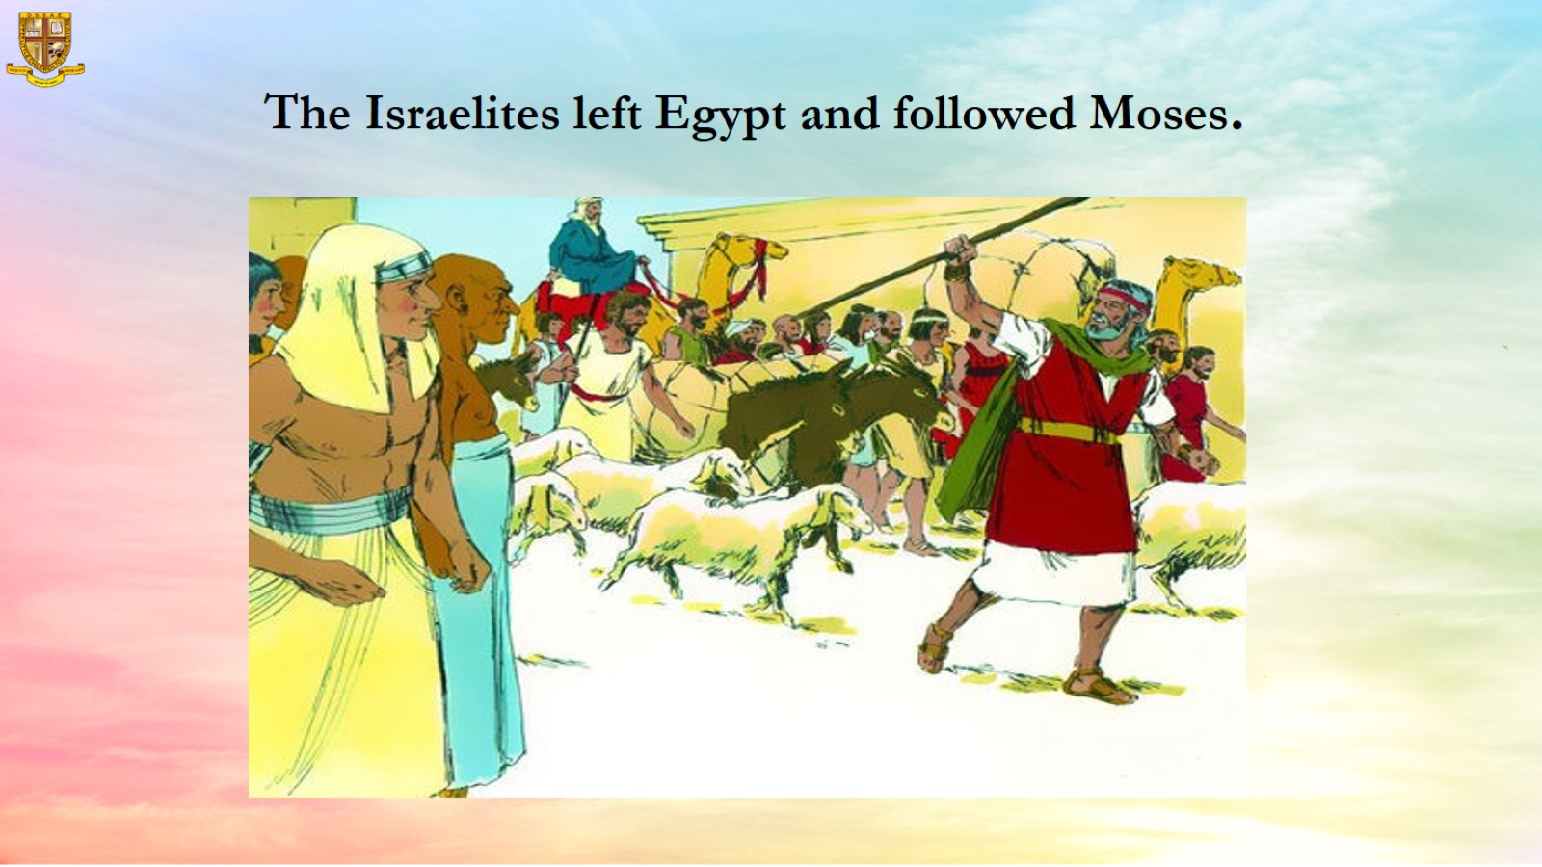

Slide 9
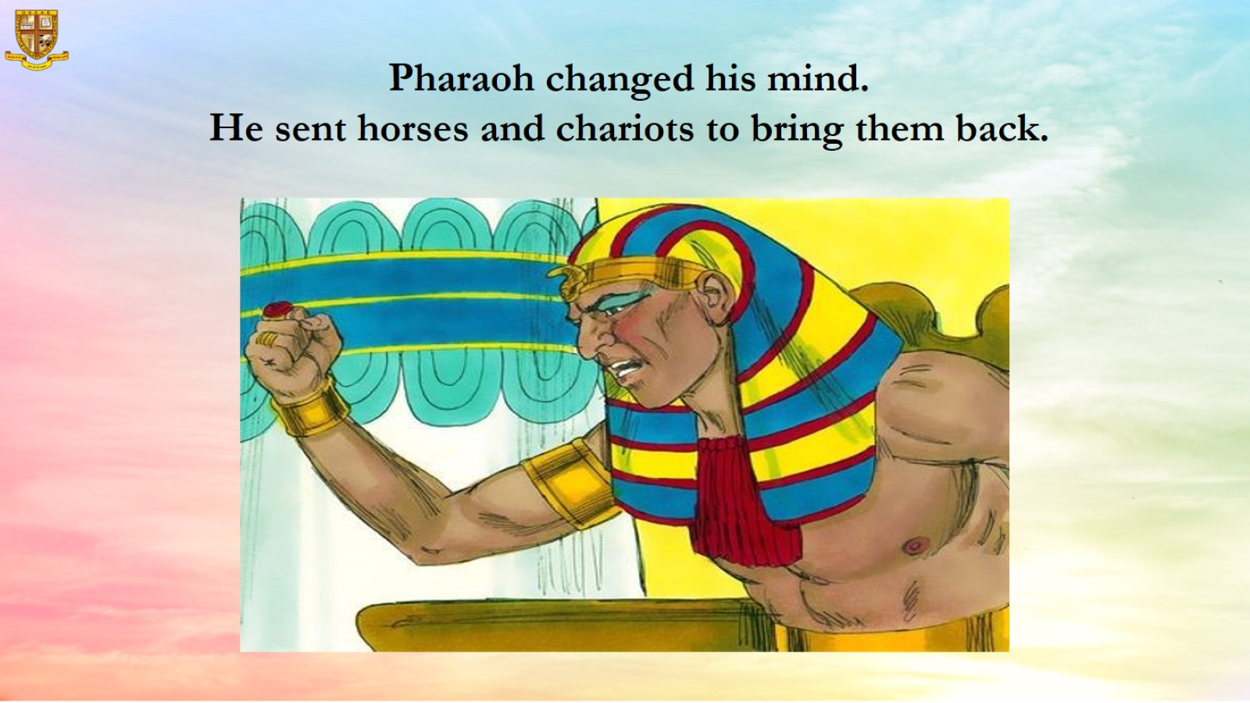

Slide 10
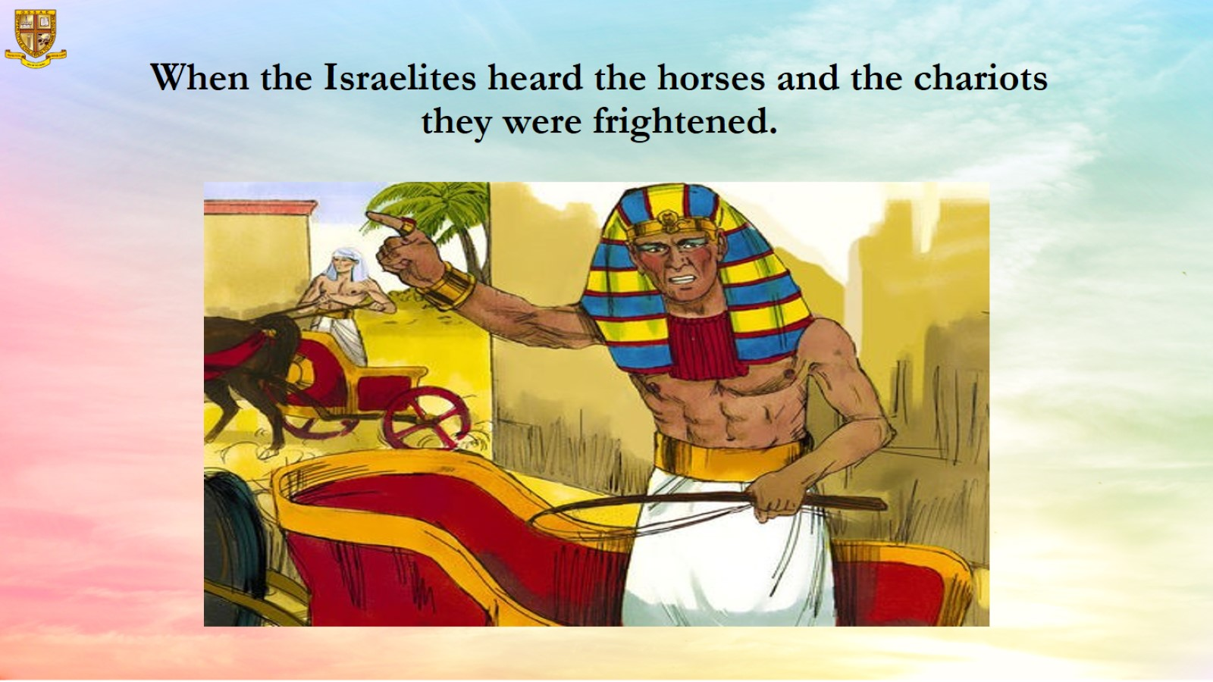
When the Israelites heard the horses and the chariots they were frightened.

Slide 11
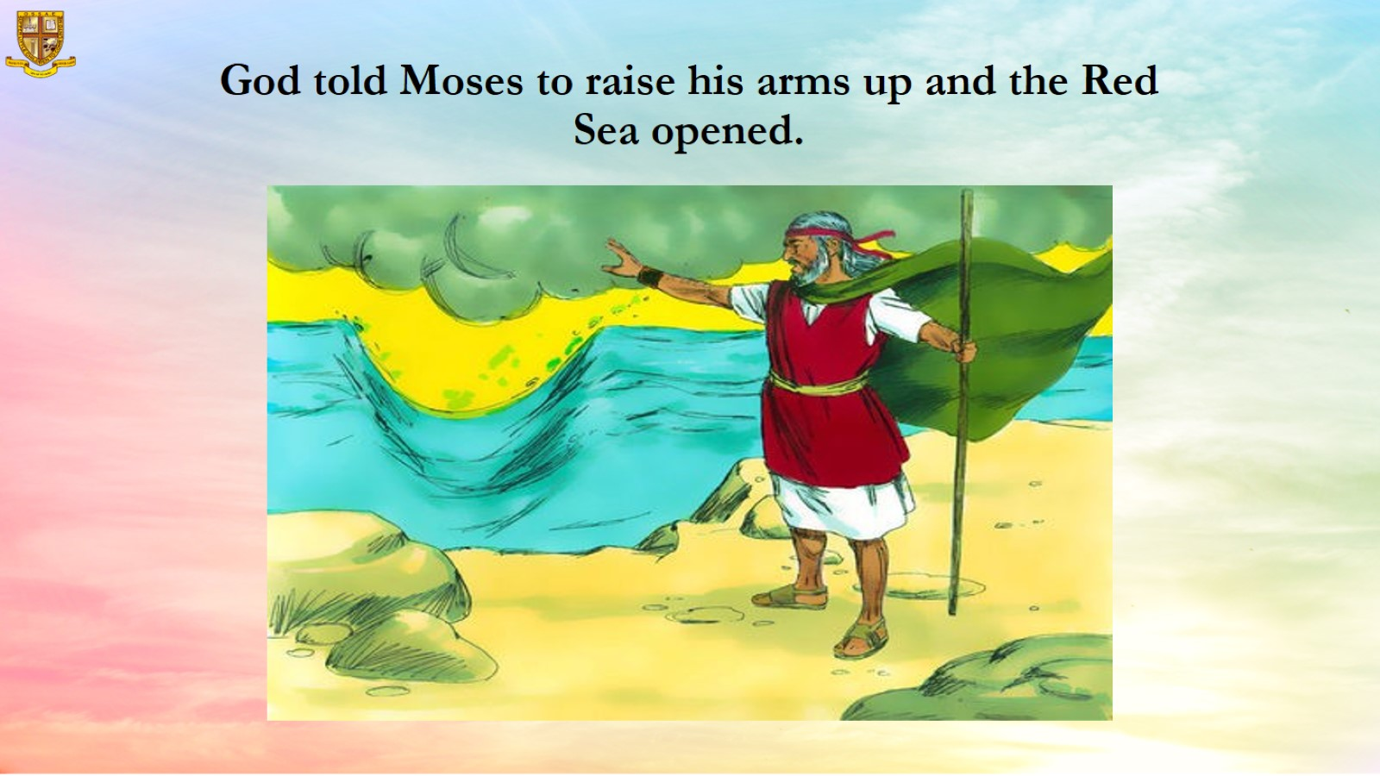
God told Moses to raise his arms up and the Red Sea opened.

Slide 12
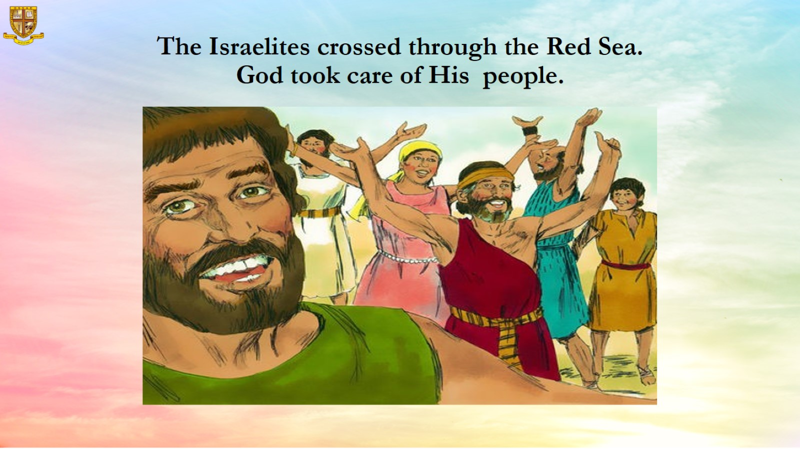
The Israelites crossed through the Red Sea.
God took care of His people.

Slide 13
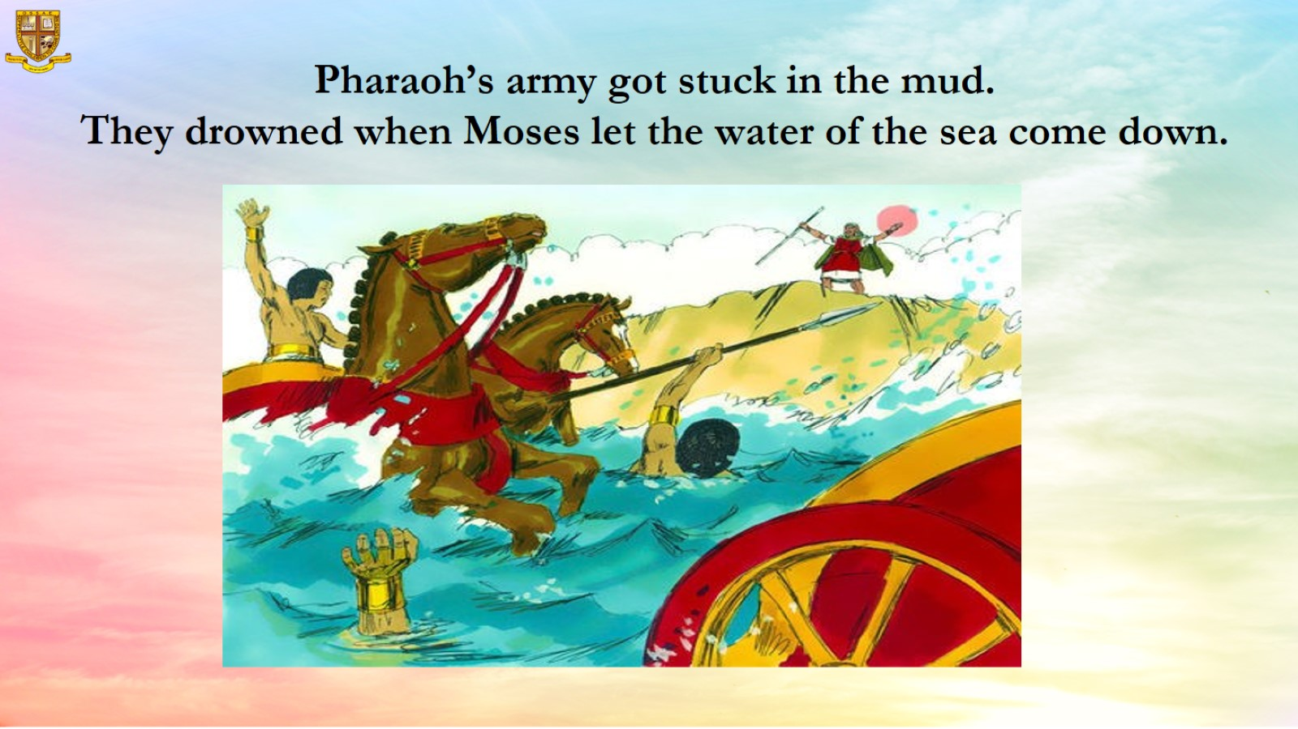

Slide 14
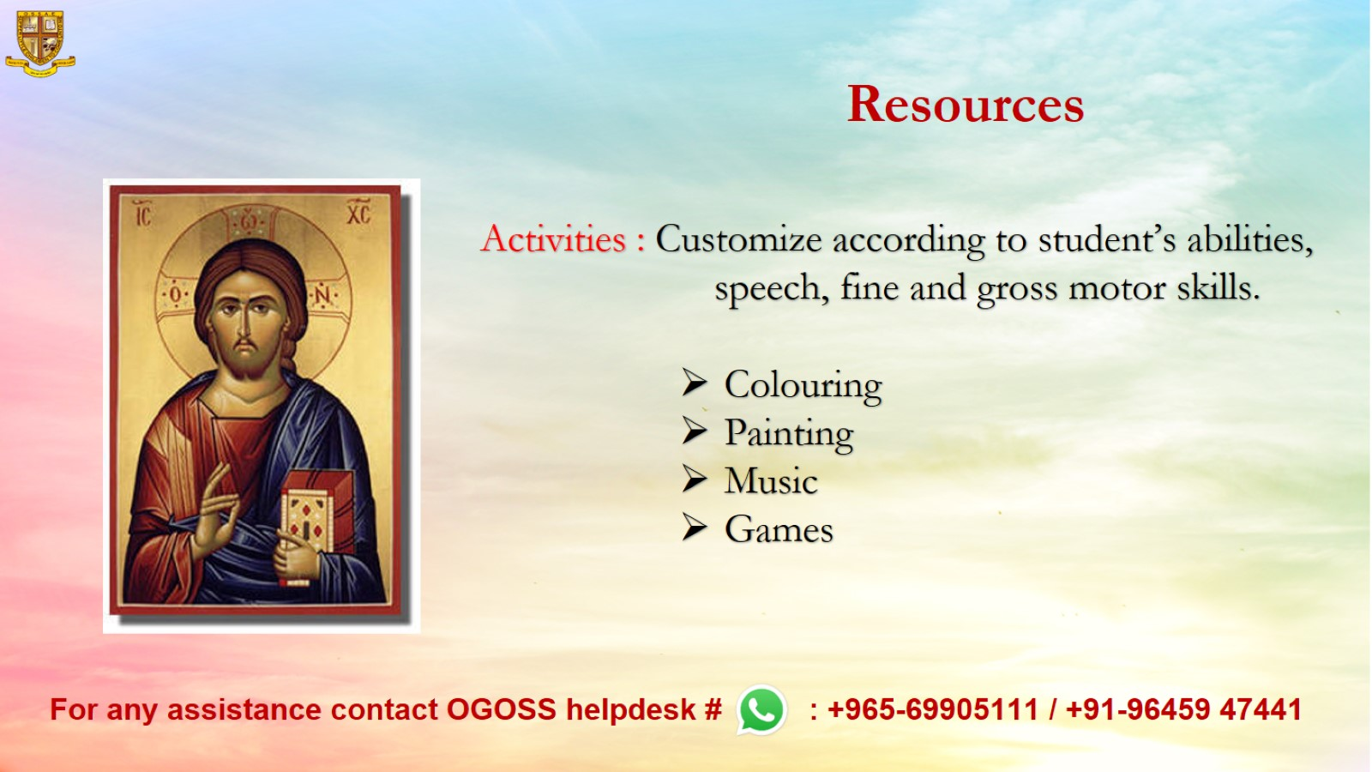
Resources

