Slide 1

Orthodox Global Online Sunday School (OGOSS)

Slide 2
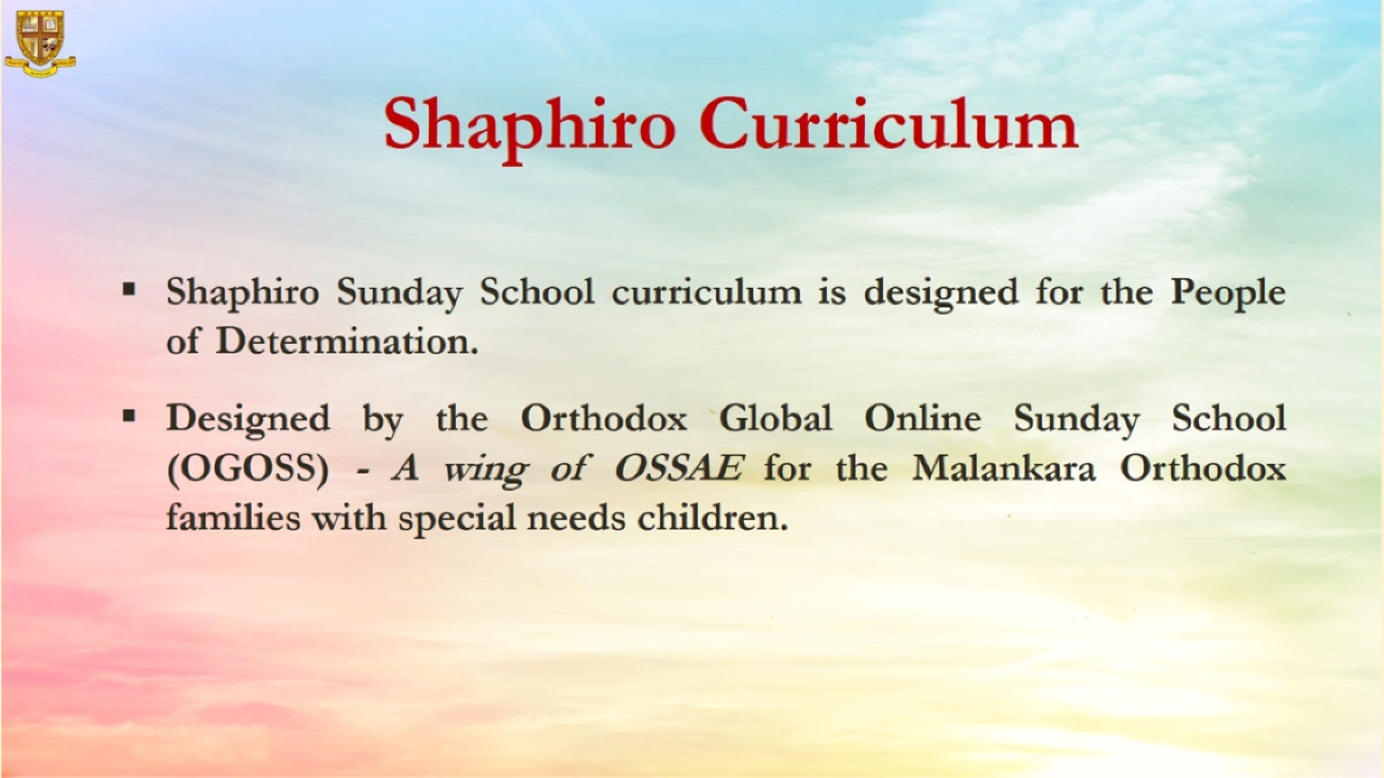

Slide 3
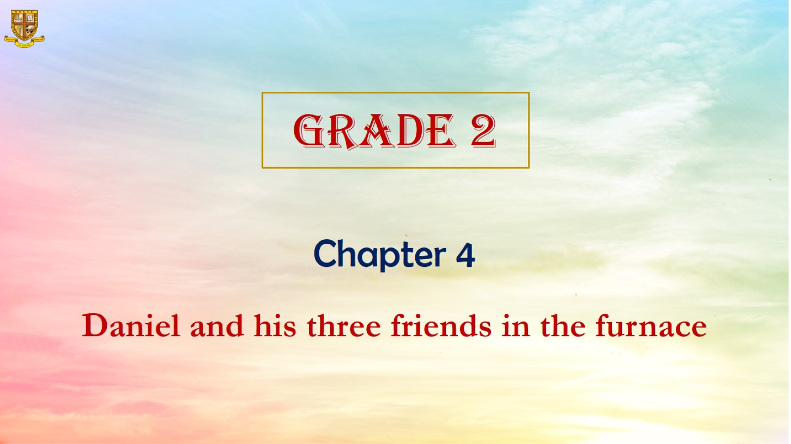

Slide 4
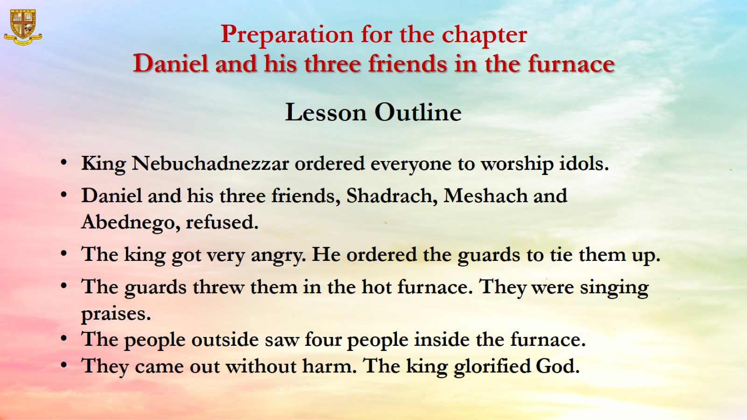
Preparation for the chapter
Daniel and his three friends in the furnace
Lesson Outline

Slide 5
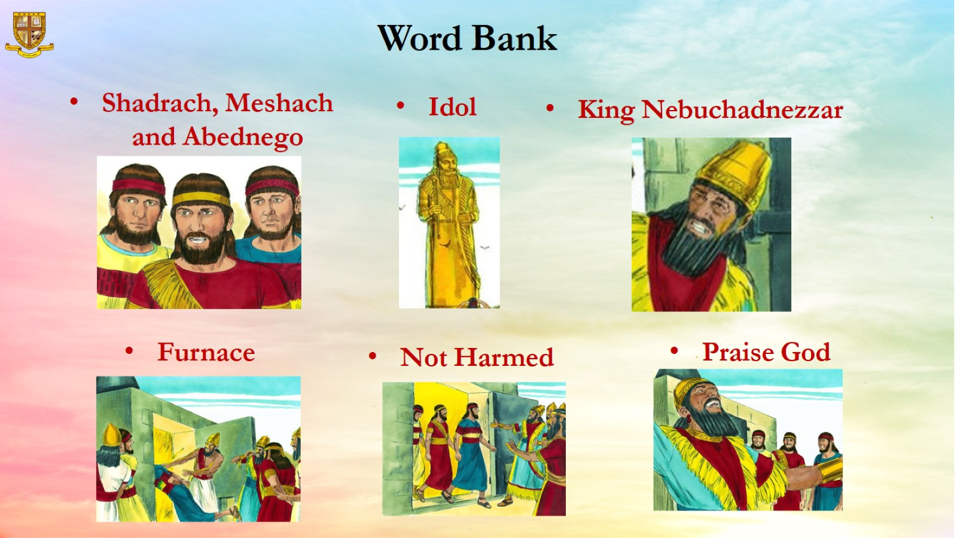
Word Bank

Slide 6
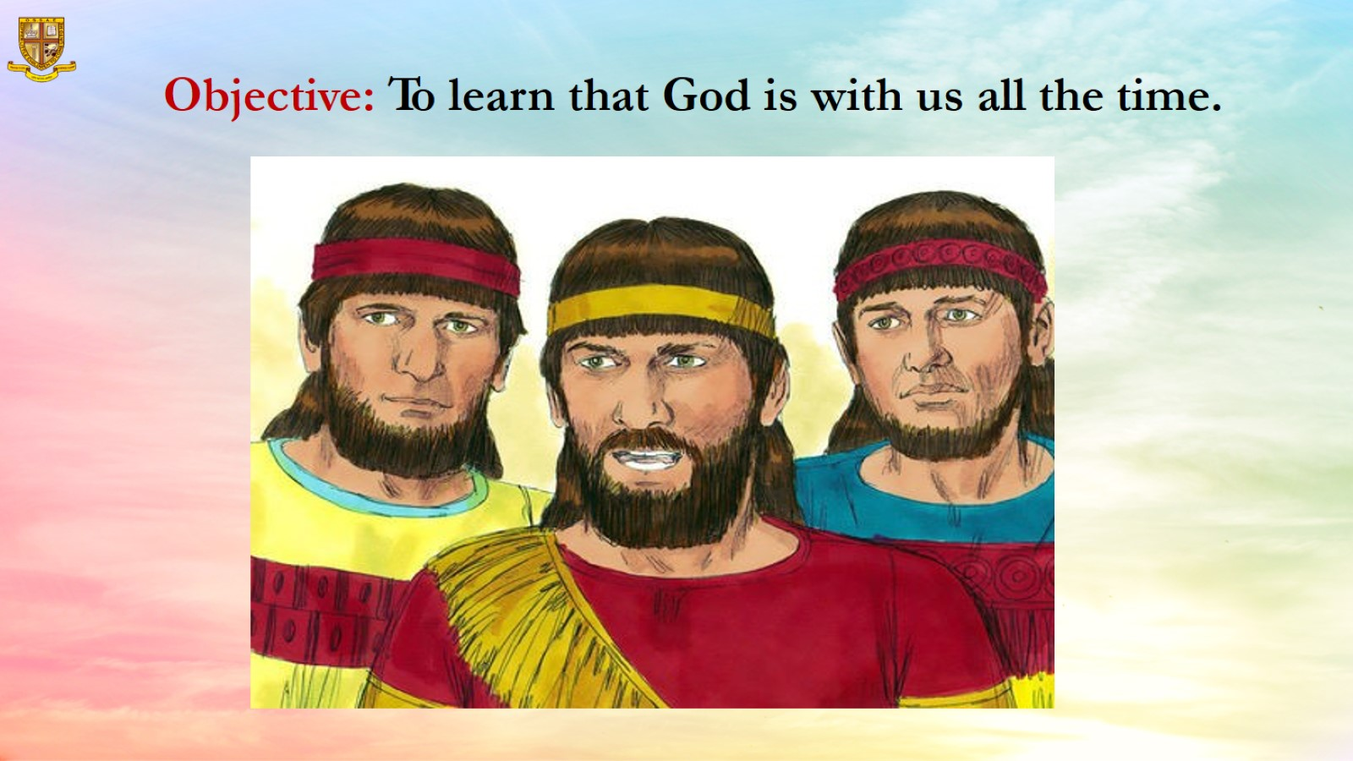
Objective: To learn that God is with us all the time.

Slide 7
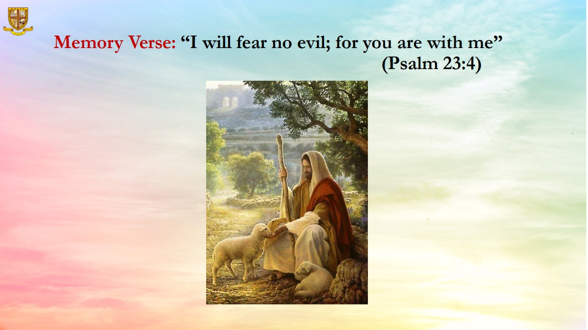
Memory Verse: “I will fear no evil; for you are with me” (Psalm 23:4)

Slide 8
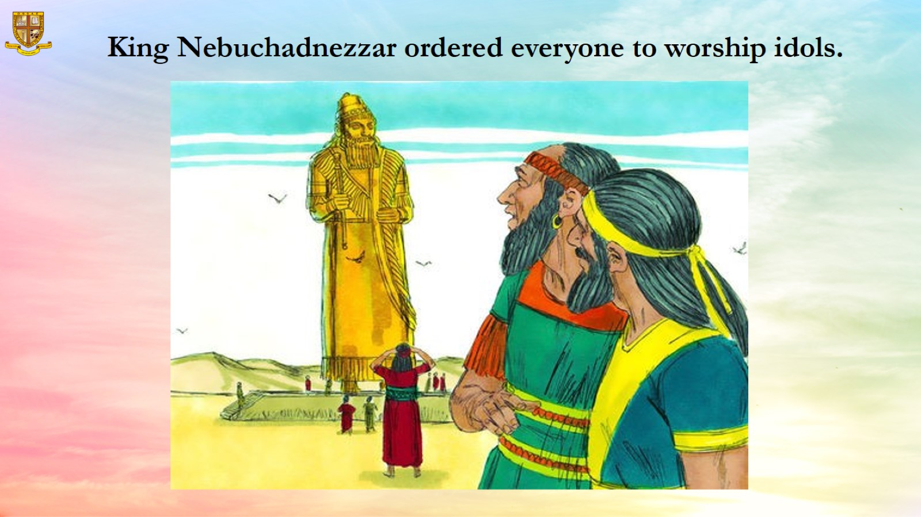

Slide 9
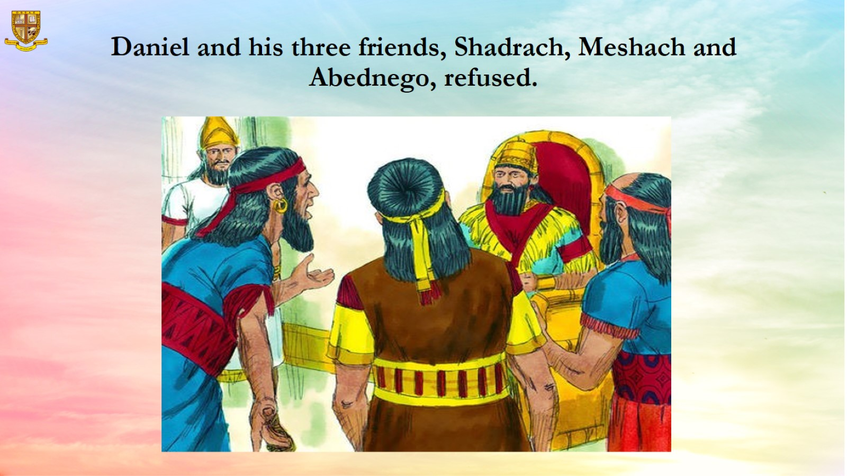
Daniel and his three friends, Shadrach, Meshach and Abednego, refused.

Slide 10
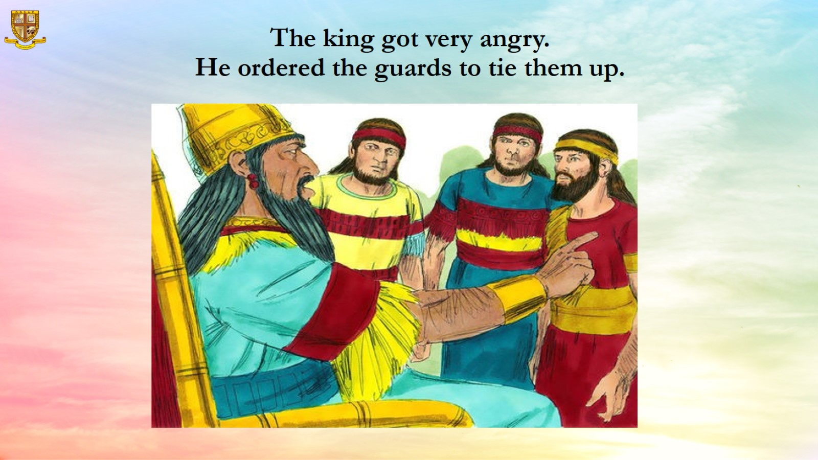
The king got very angry.
He ordered the guards to tie them up.

Slide 11
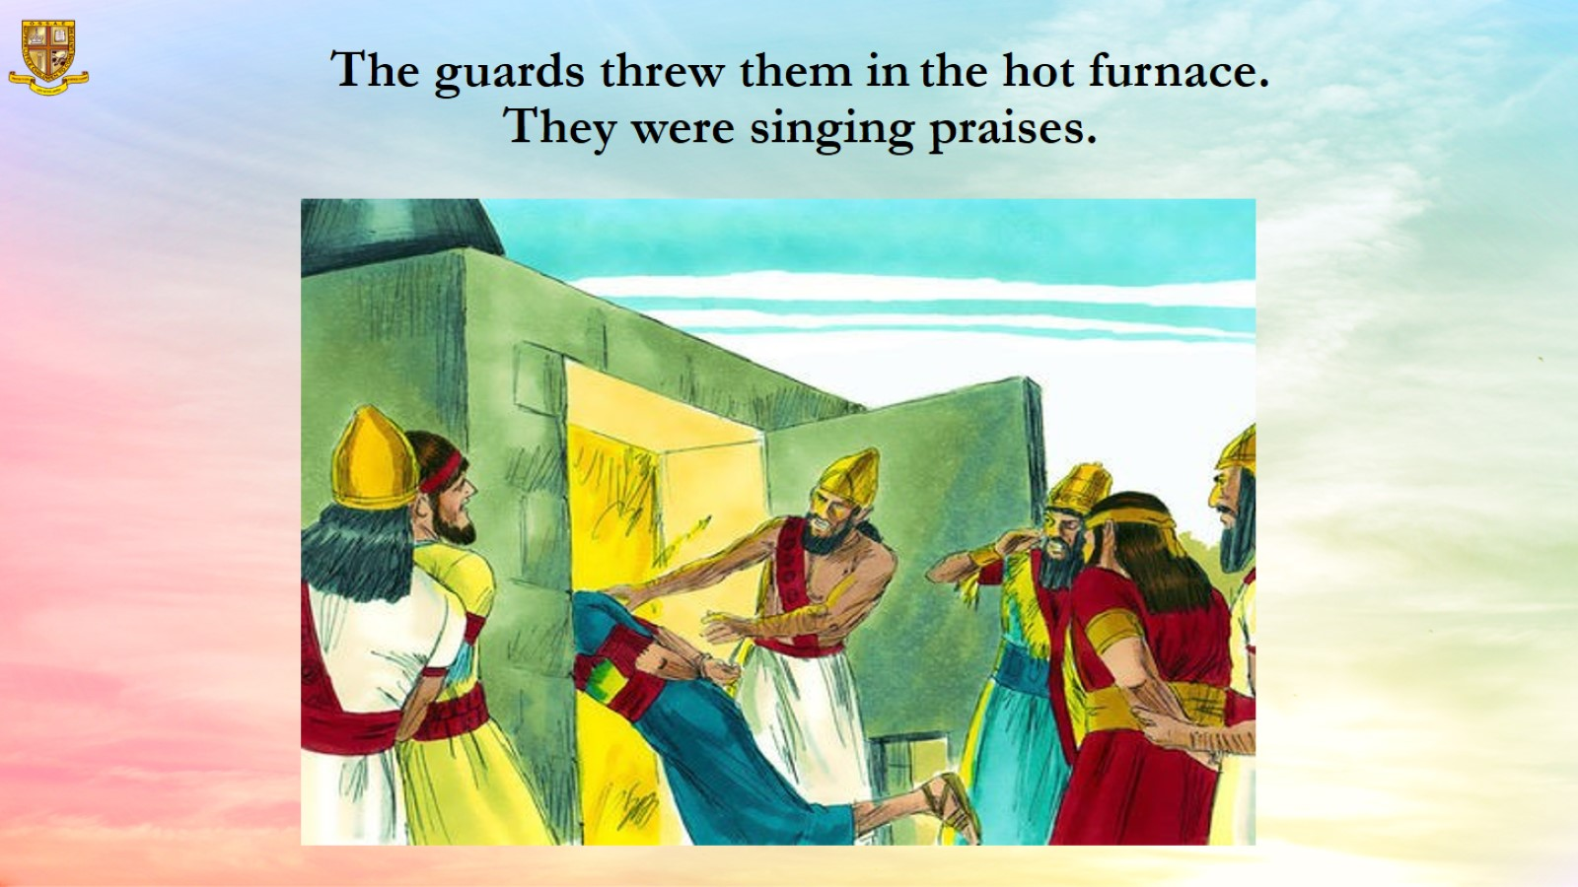
The guards threw them in the hot furnace.
They were singing praises.

Slide 12
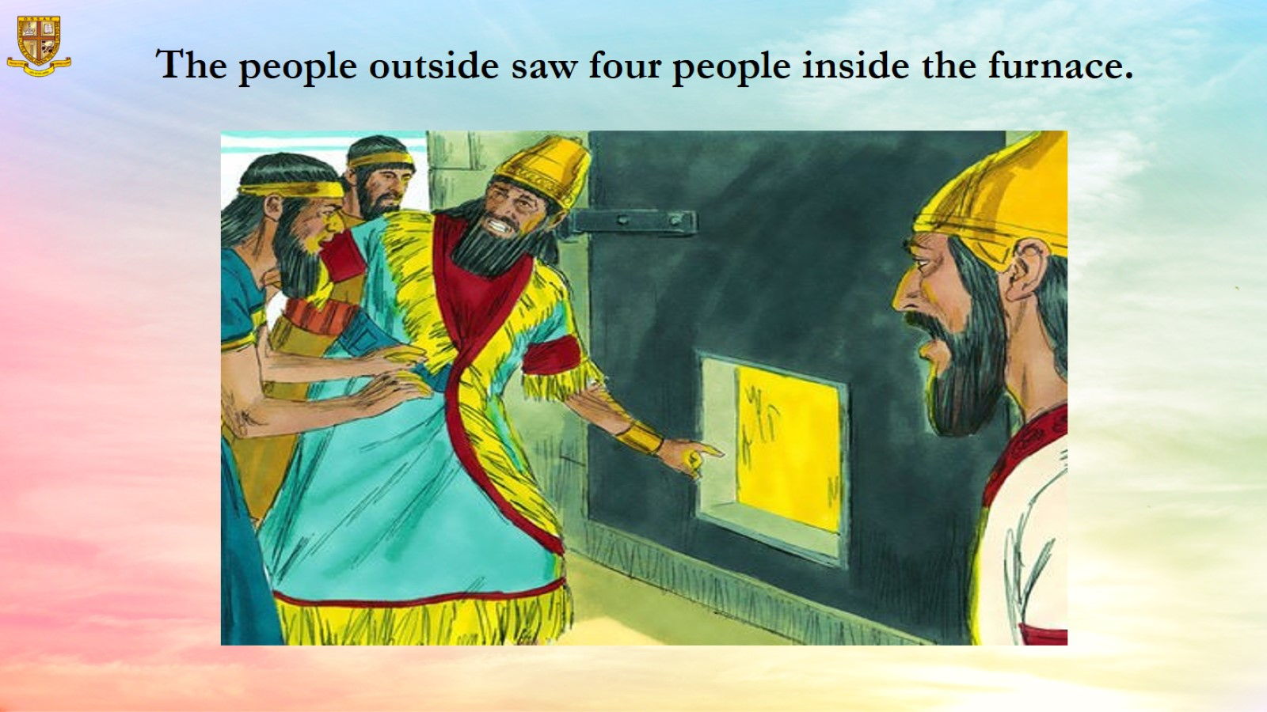
The people outside saw four people inside the furnace.

Slide 13
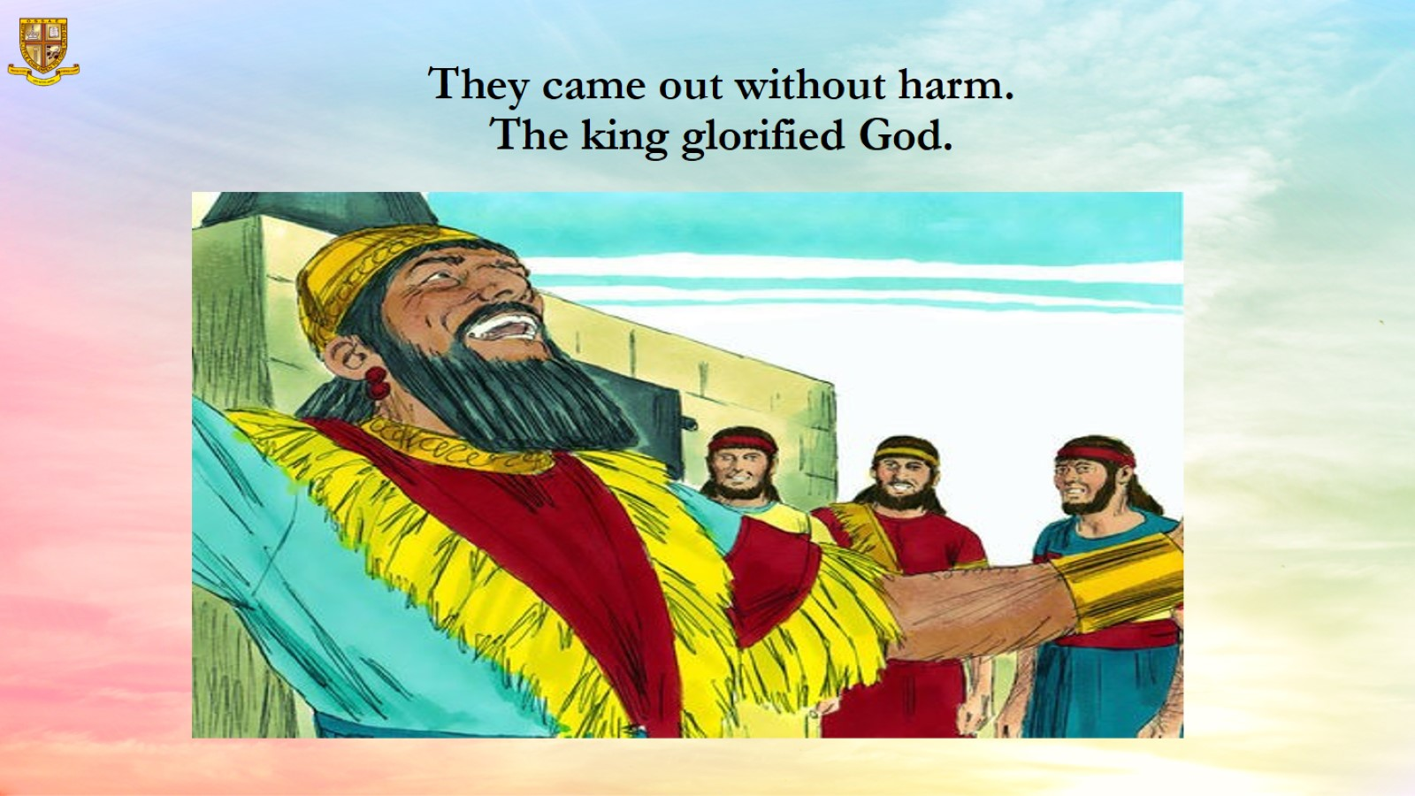
They came out without harm.
The king glorified God.

Slide 14
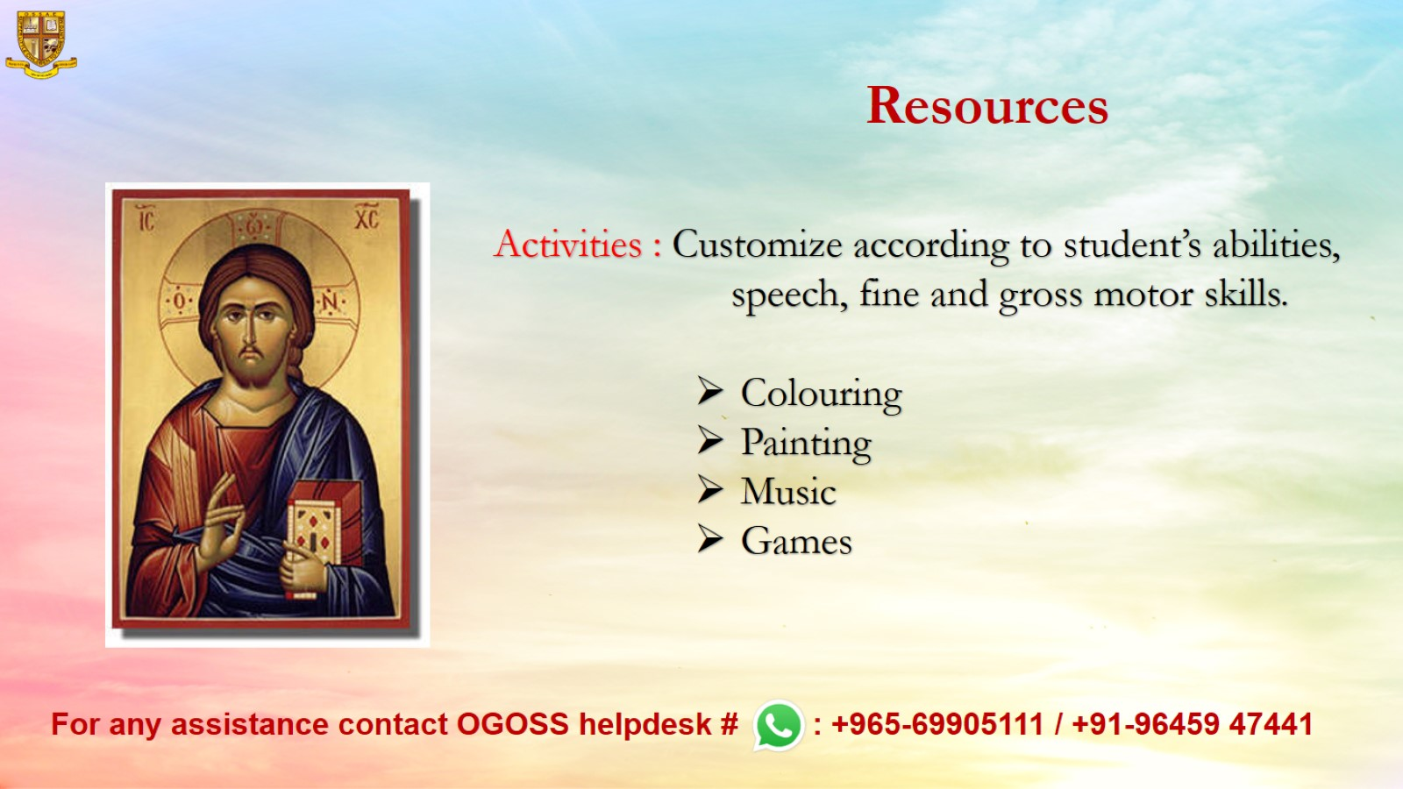
Resources

