Slide 1
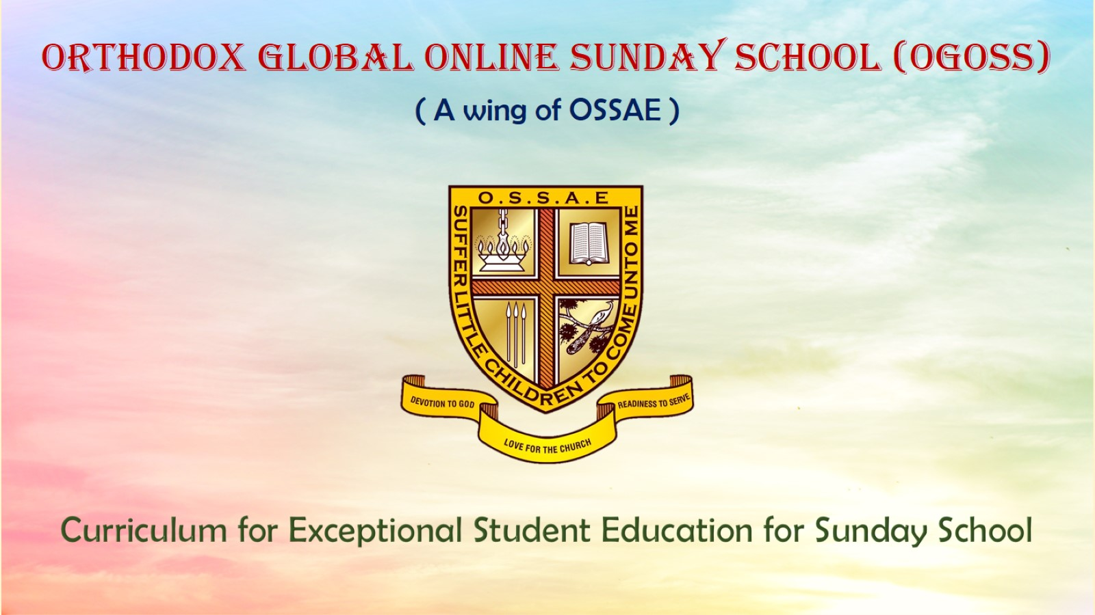
Orthodox Global Online Sunday School (OGOSS)

Slide 2
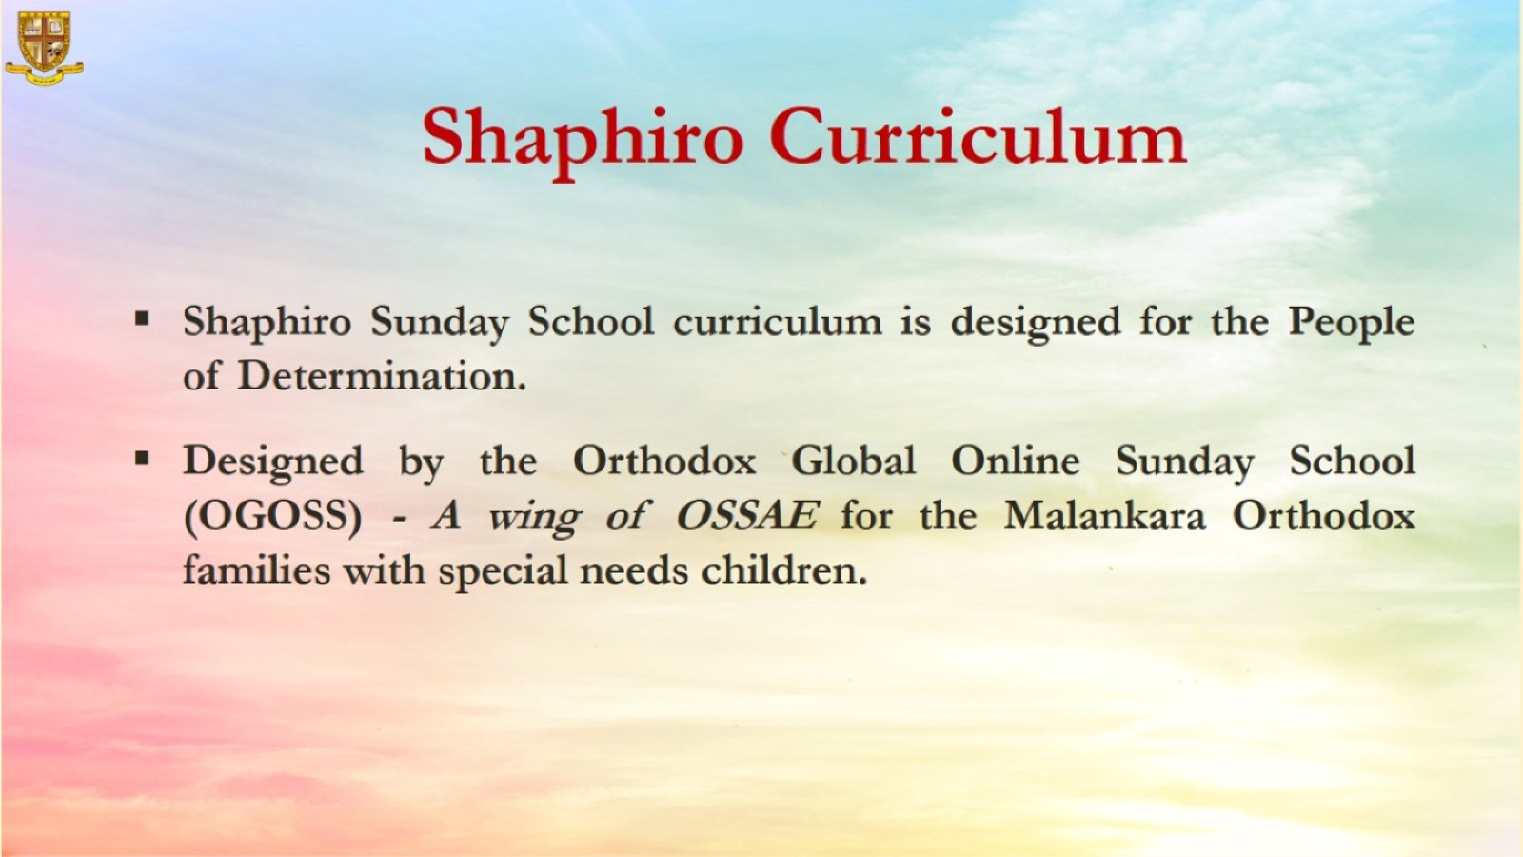

Slide 3
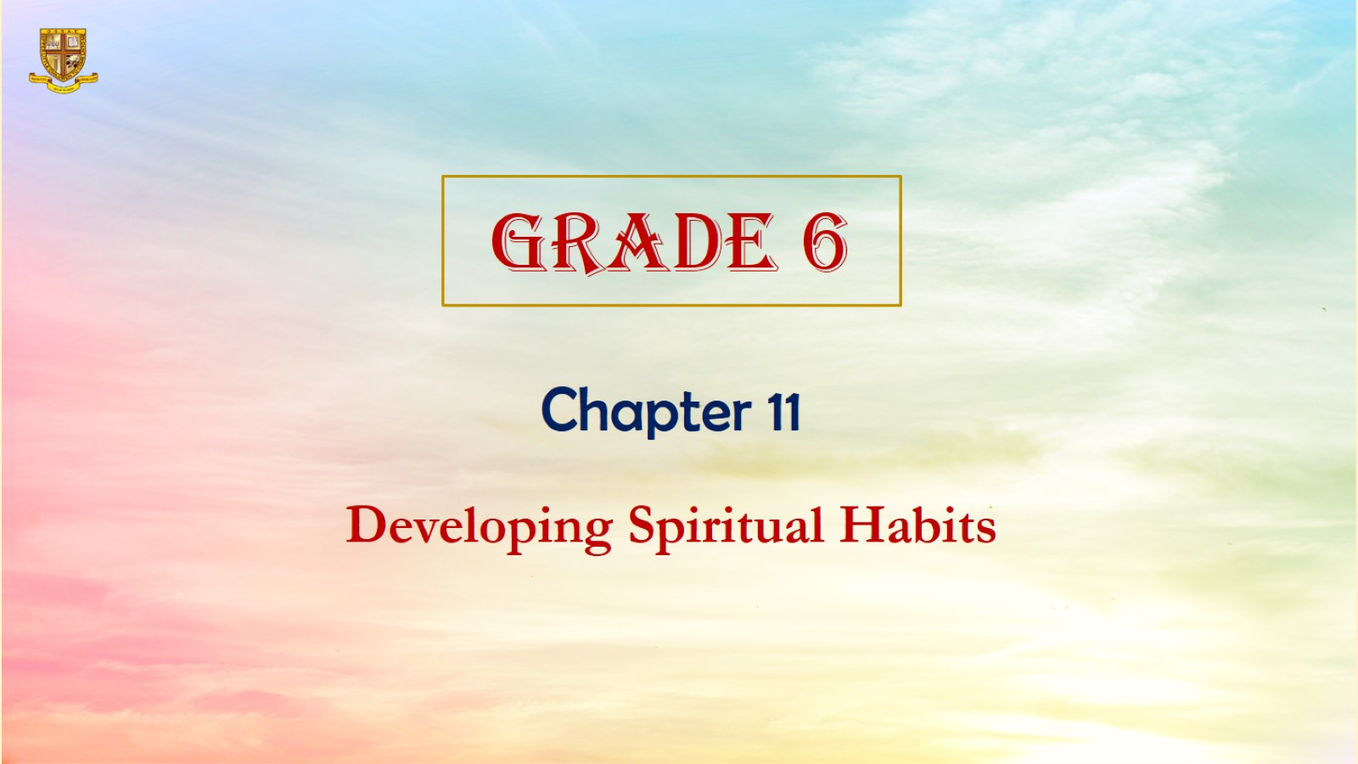

Slide 4
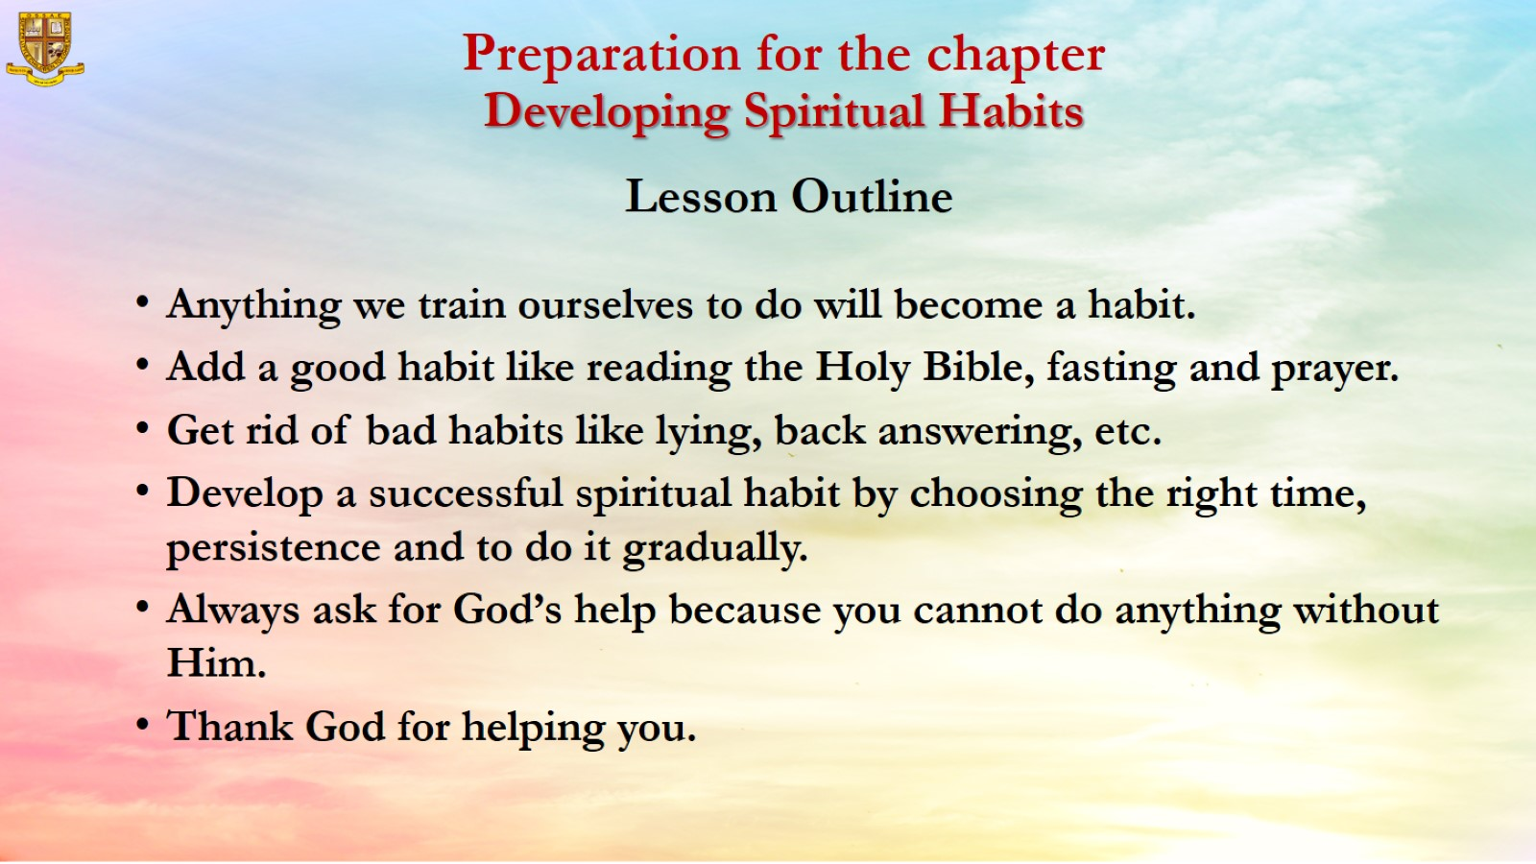
Preparation for the chapter
Developing Spiritual Habits
Lesson Outline

Slide 5
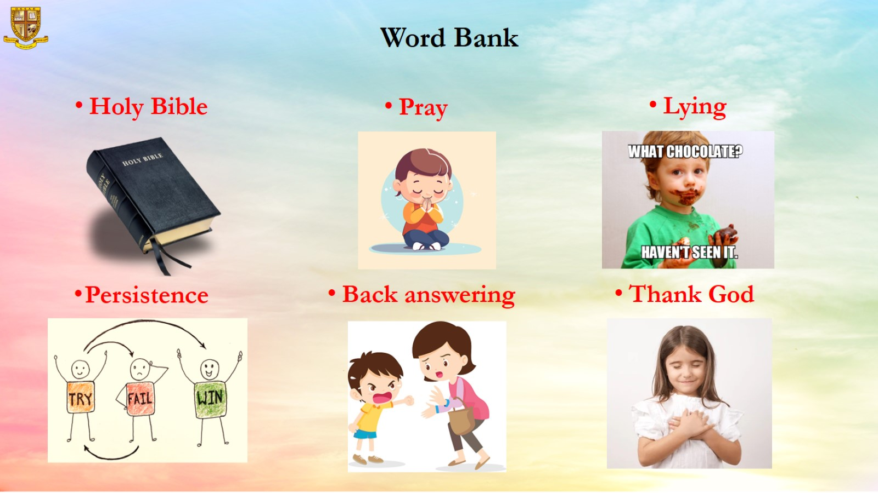
Word Bank

Slide 6
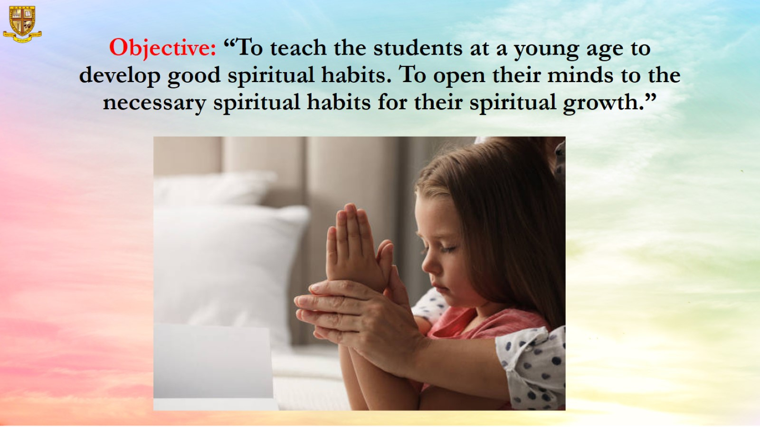
Objective: “To teach the students at a young age to develop good spiritual habits. To open their minds to the necessary spiritual habits for their spiritual growth.”

Slide 7
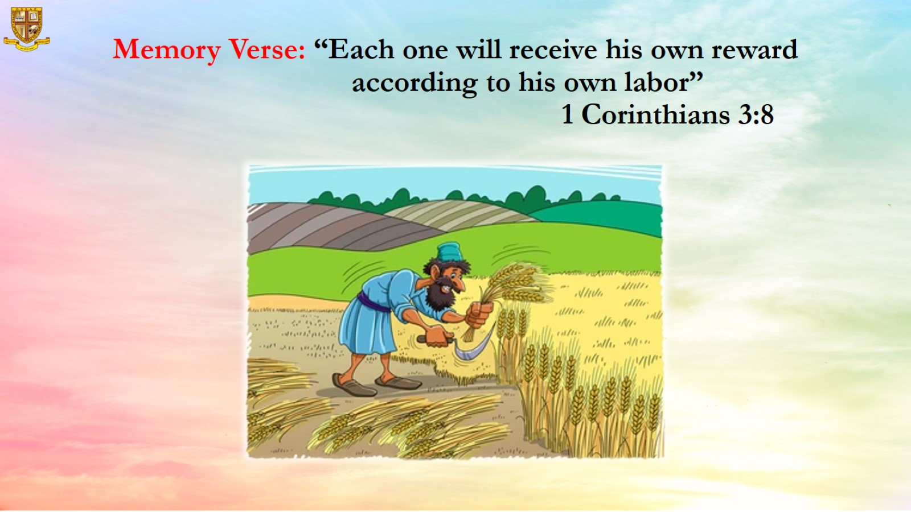
Memory Verse: “Each one will receive his own reward according to his own labor”
1 Corinthians 3:8

Slide 8
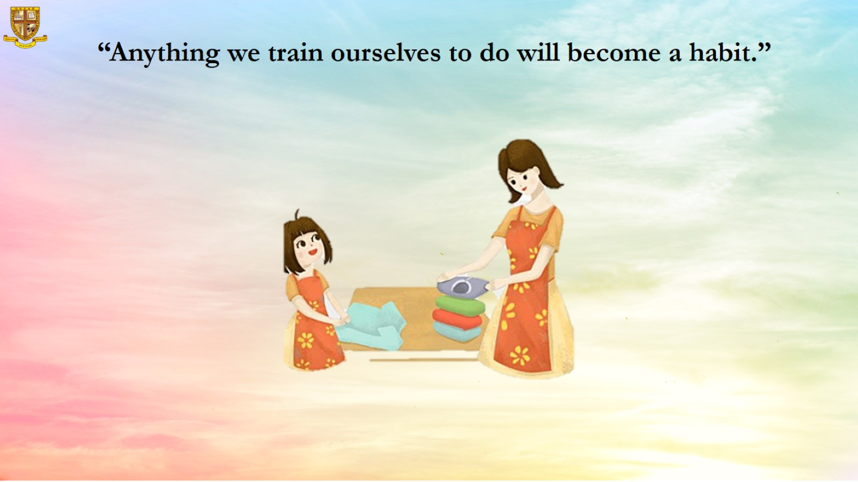
“Anything we train ourselves to do will become a habit.”

Slide 9
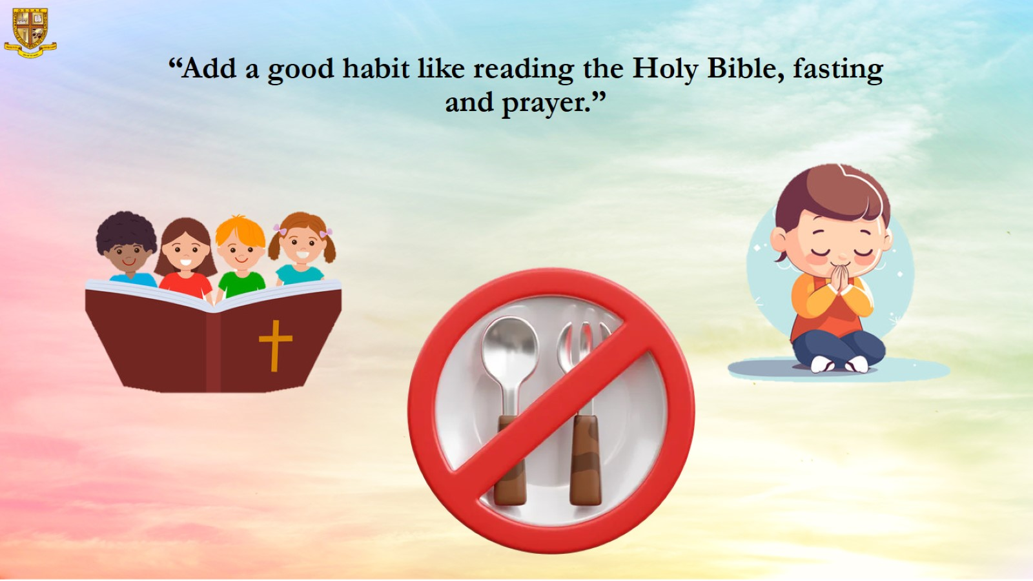
“Add a good habit like reading the Holy Bible, fasting and prayer.”

Slide 10
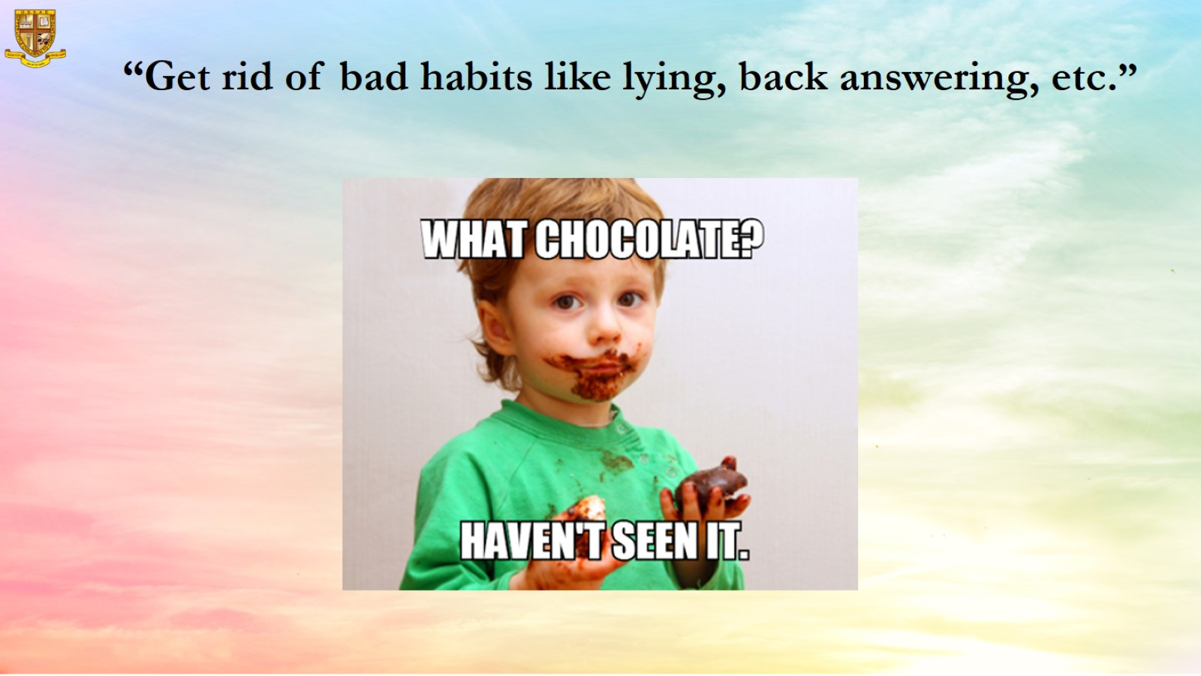
“Get rid of bad habits like lying, back answering, etc.”

Slide 11
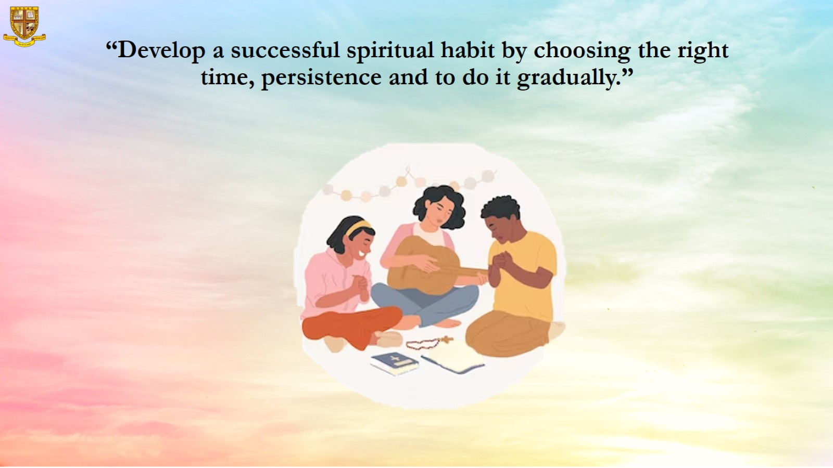
“Develop a successful spiritual habit by choosing the right time, persistence and to do it gradually.”

Slide 12

“Always ask for God’s help because you cannot do anything without Him.”

Slide 13

“Thank God for helping you.”

Slide 14
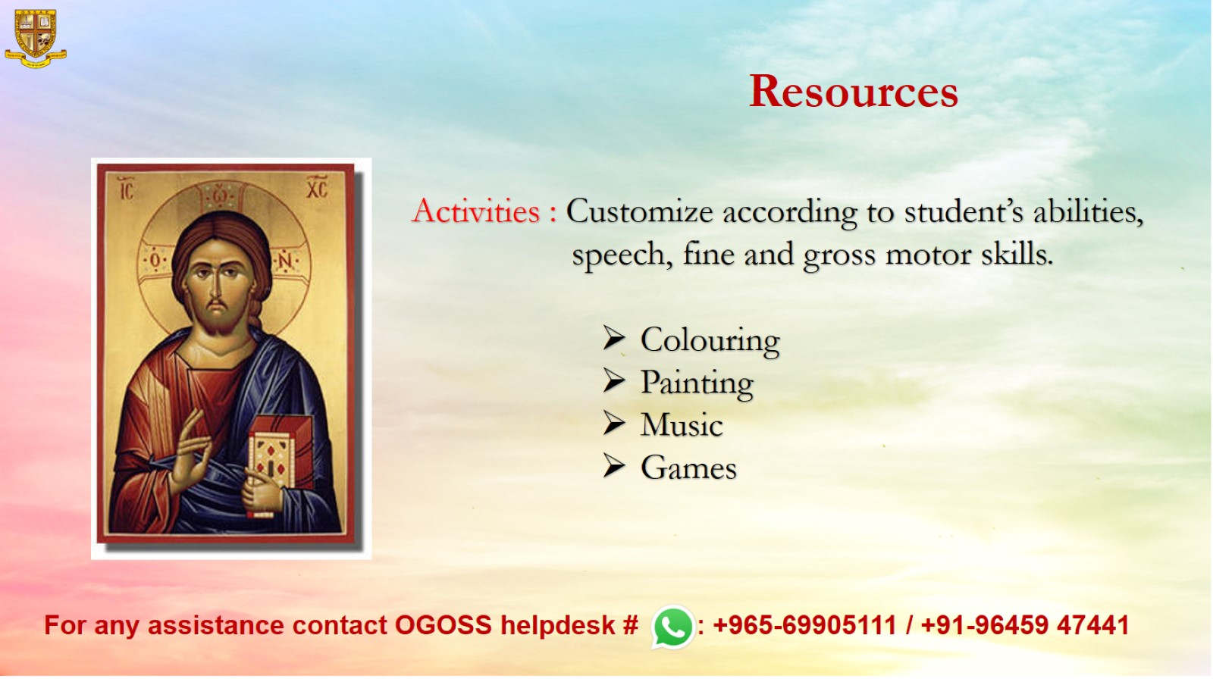
Resources

