Slide 1
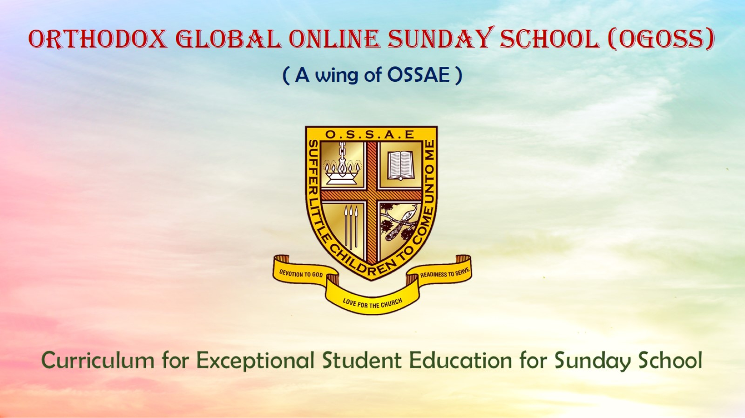
Orthodox Global Online Sunday School (OGOSS)

Slide 2
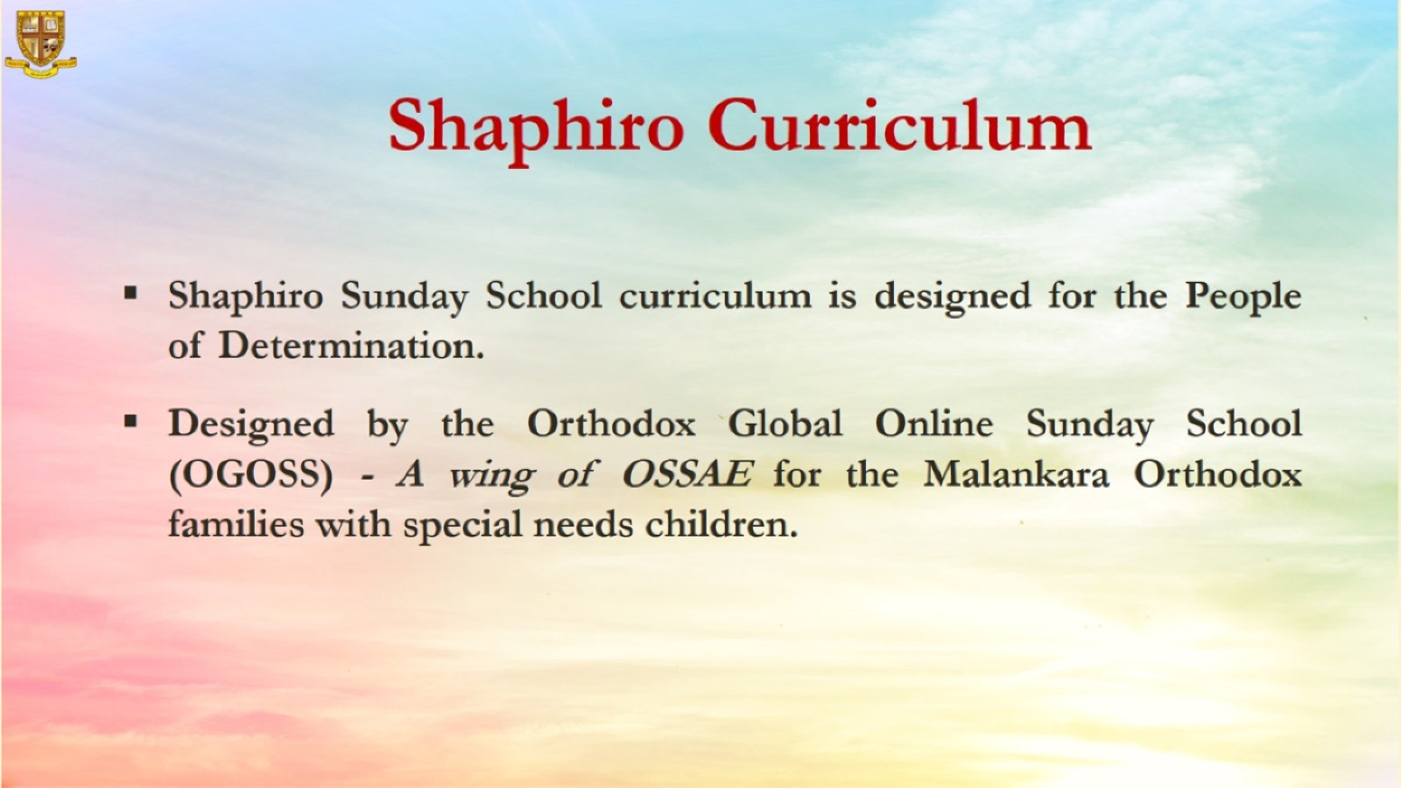

Slide 3
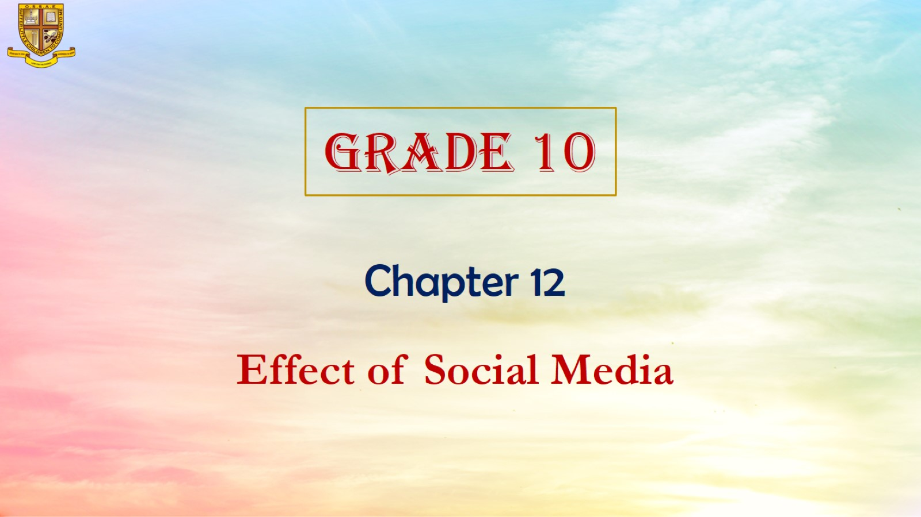

Slide 4
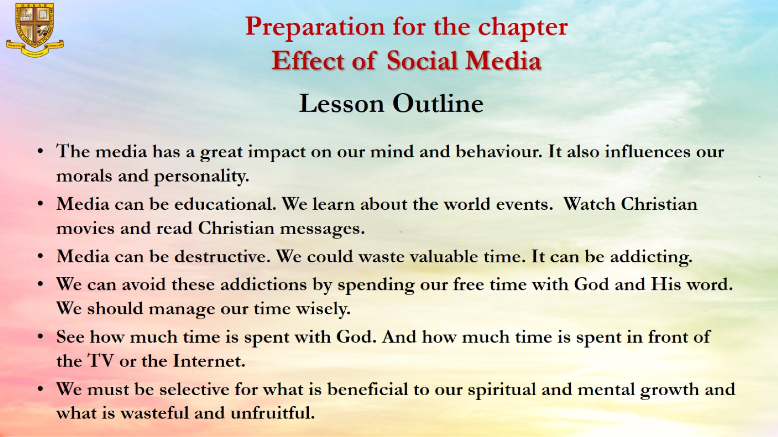
Preparation for the chapter
Effect of Social Media

Slide 5
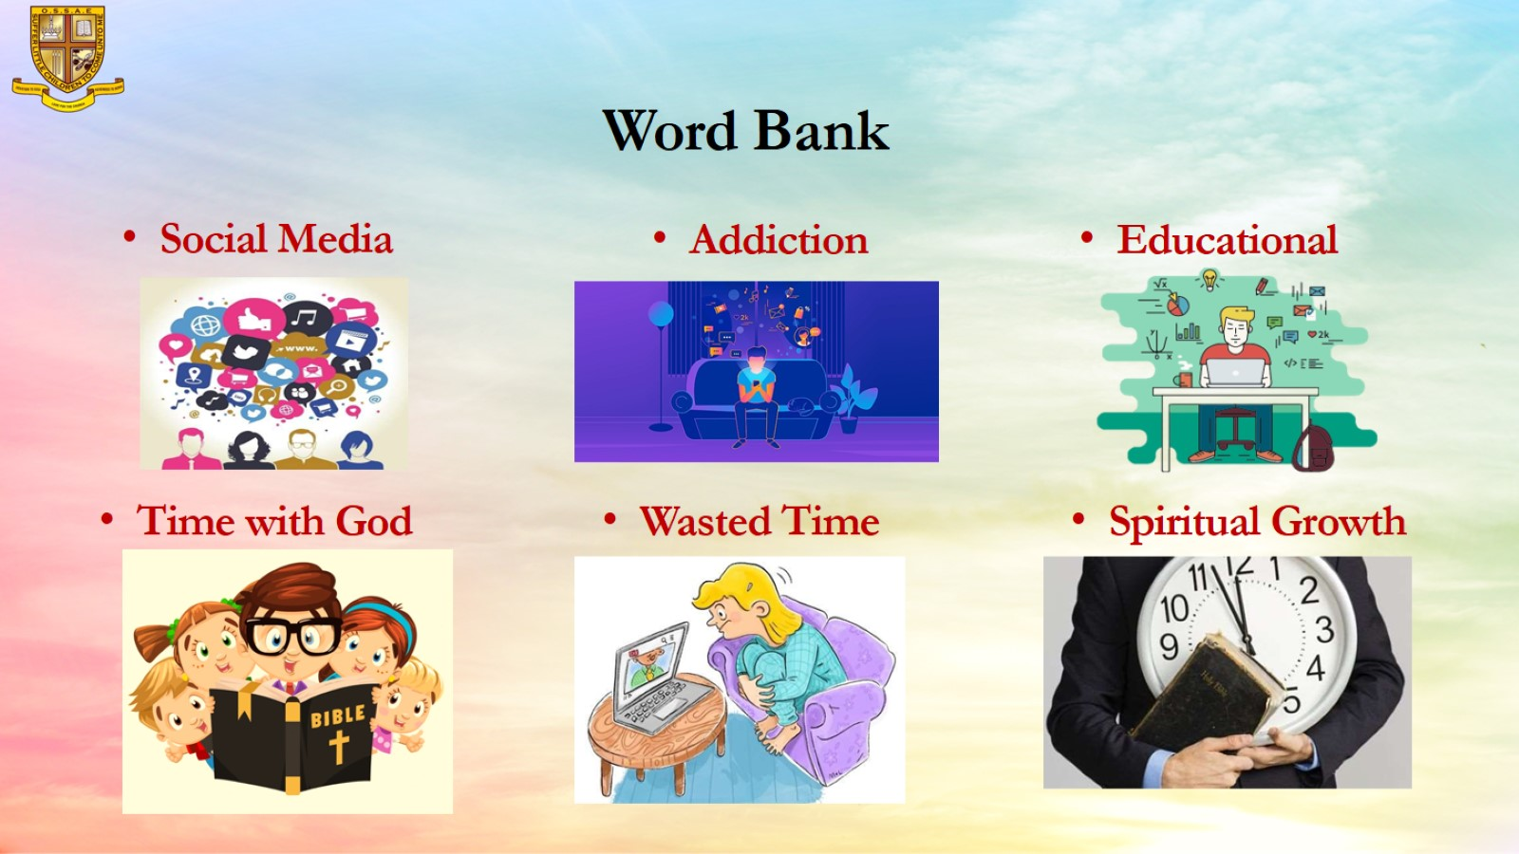
Word Bank

Slide 6
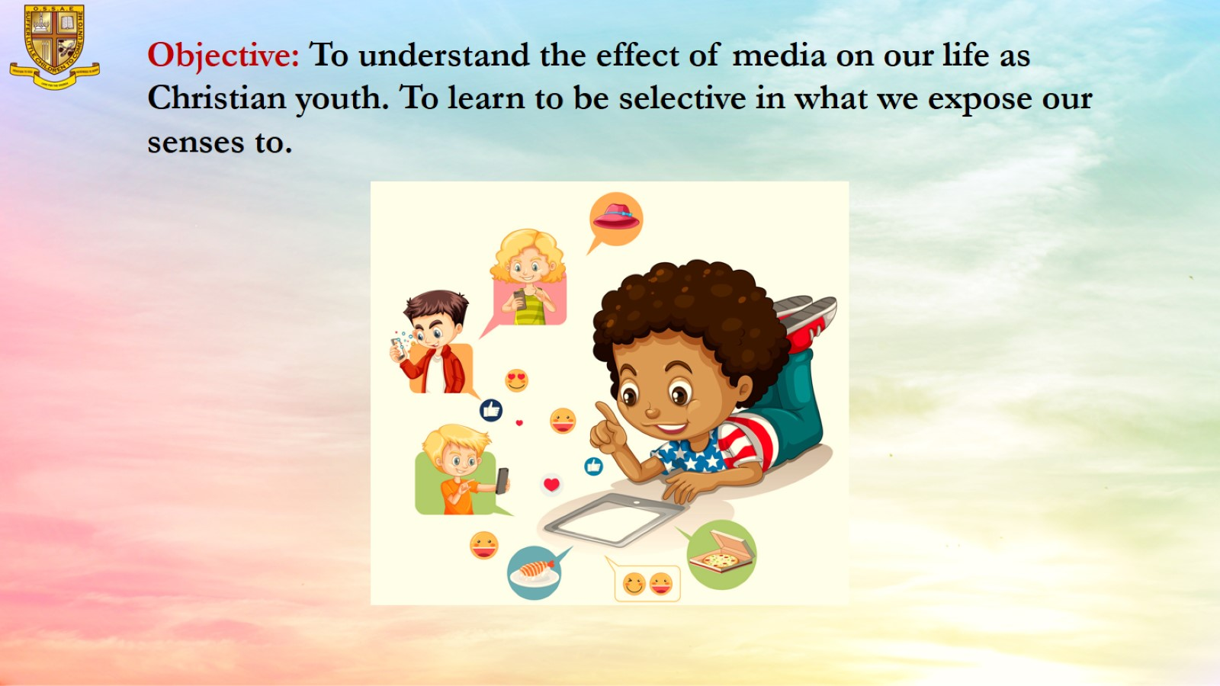
Objective: To understand the effect of media on our life as Christian youth. To learn to be selective in what we expose our senses to.

Slide 7
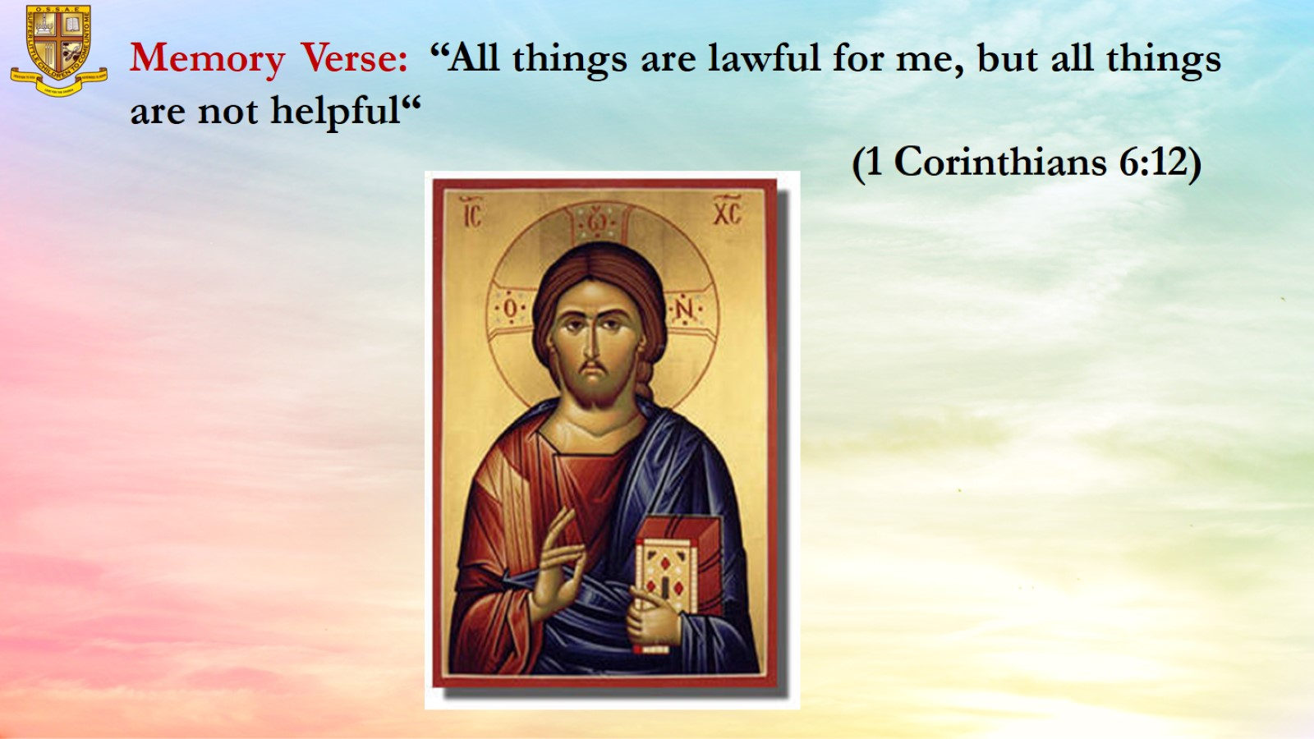
Memory Verse: “All things are lawful for me, but all things are not helpful“ (1 Corinthians 6:12)

Slide 8

The media has a great impact on our mind and behaviour.
It also influences our morals and personality.

Slide 9

Media can be educational.
We learn about the world events.
Watch Christian movies and read Christian messages.

Slide 10
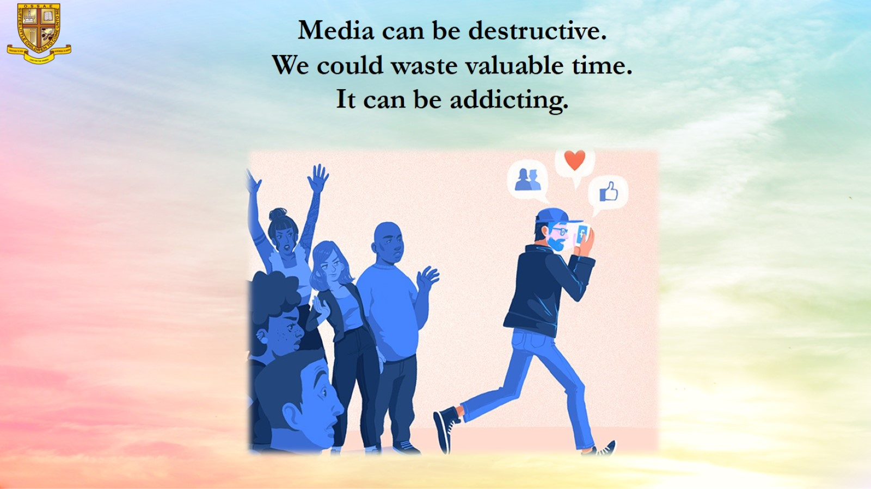
Media can be destructive.
We could waste valuable time.
It can be addicting.

Slide 11

We can avoid these addictions by spending our free time with God and His word. We should manage our time wisely.

Slide 12
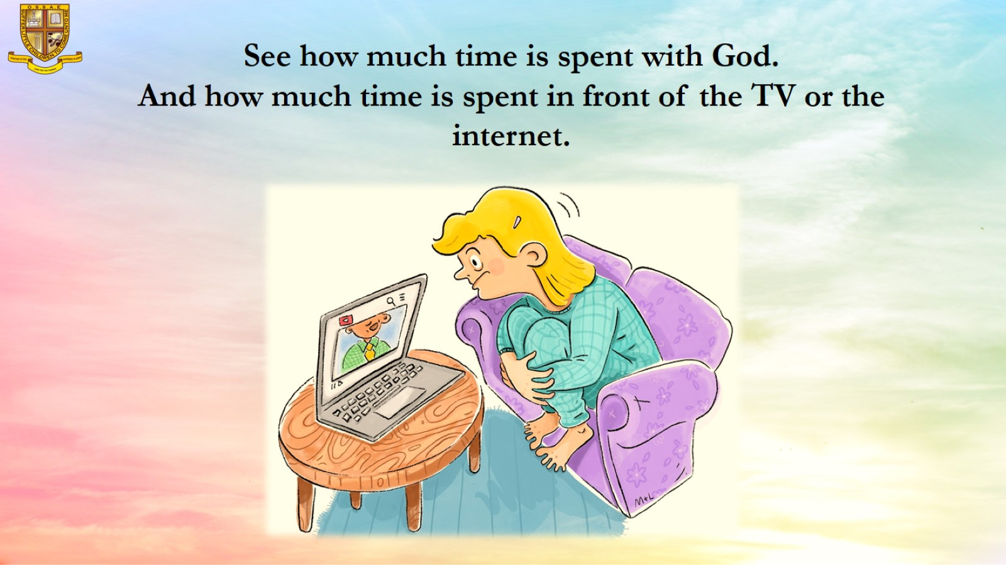
See how much time is spent with God.
And how much time is spent in front of the TV or the internet.

Slide 13

We must be selective for what is beneficial to our spiritual and mental growth and what is wasteful and unfruitful.

Slide 14
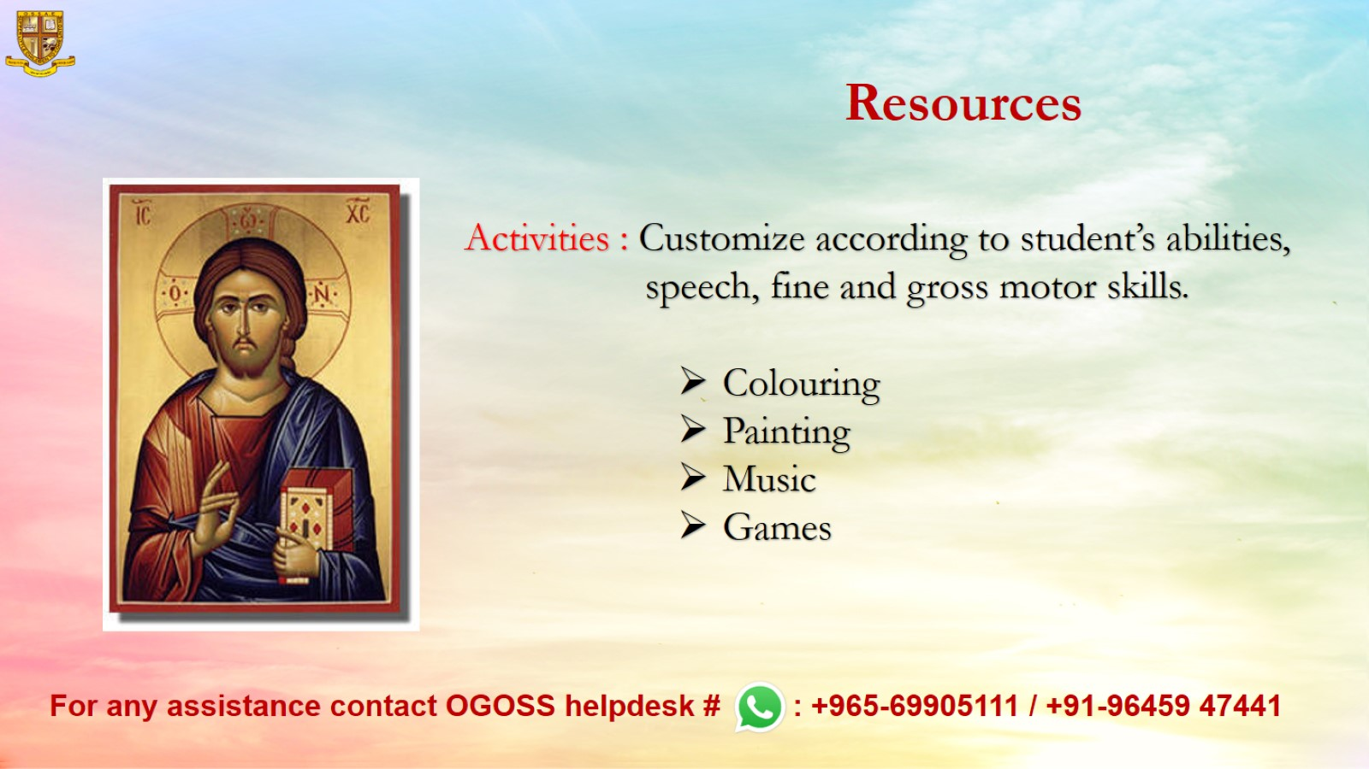
Resources

