Slide 1

Orthodox Global Online Sunday School (OGOSS)

Slide 2


Slide 3


Slide 4
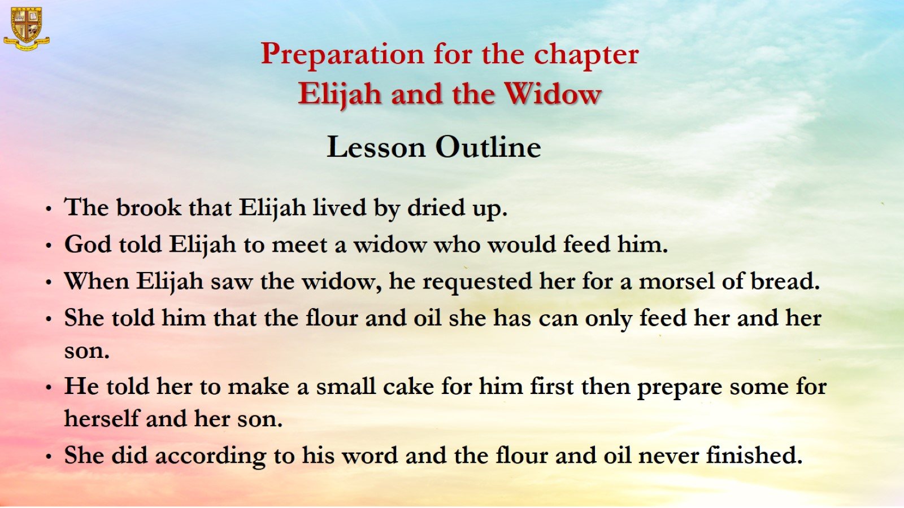
Preparation for the chapter
Elijah and the Widow

Slide 5
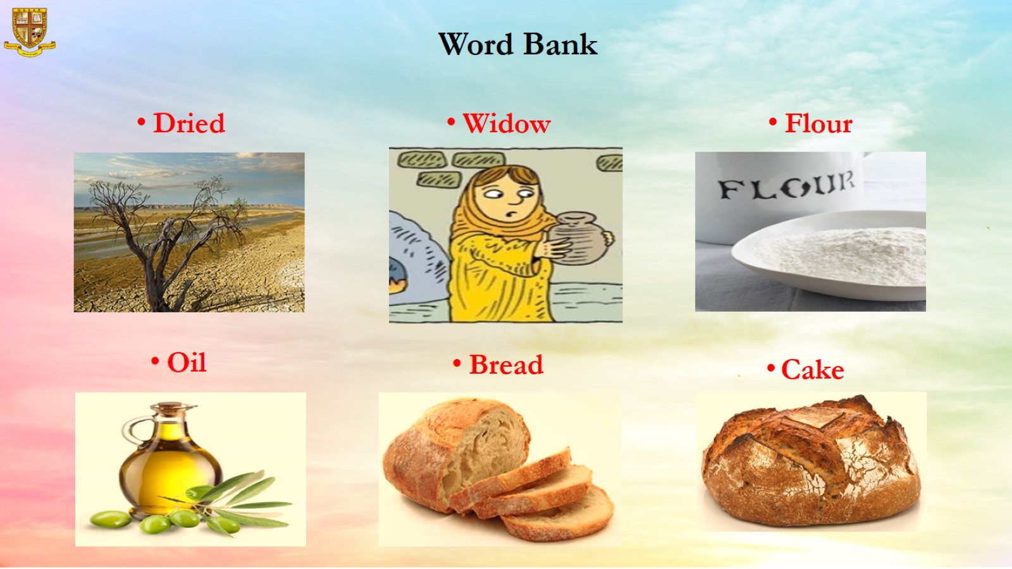
Word Bank

Slide 6
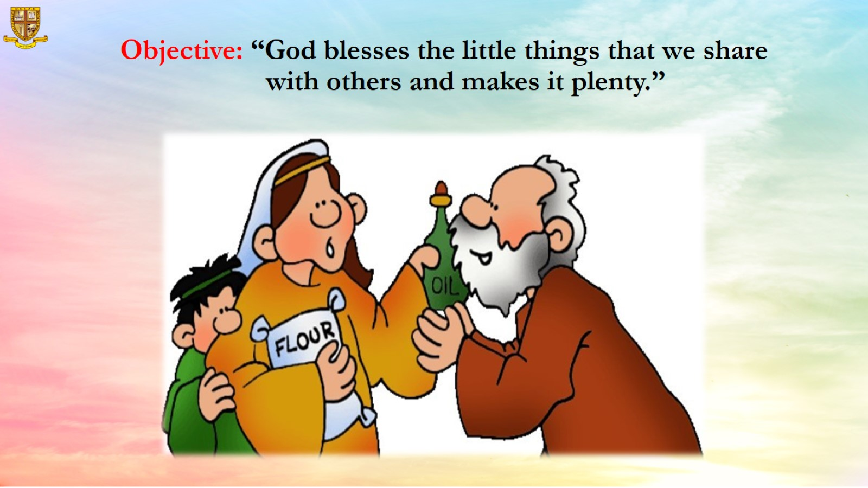
Objective: “God blesses the little things that we share with others and makes it plenty.”

Slide 7
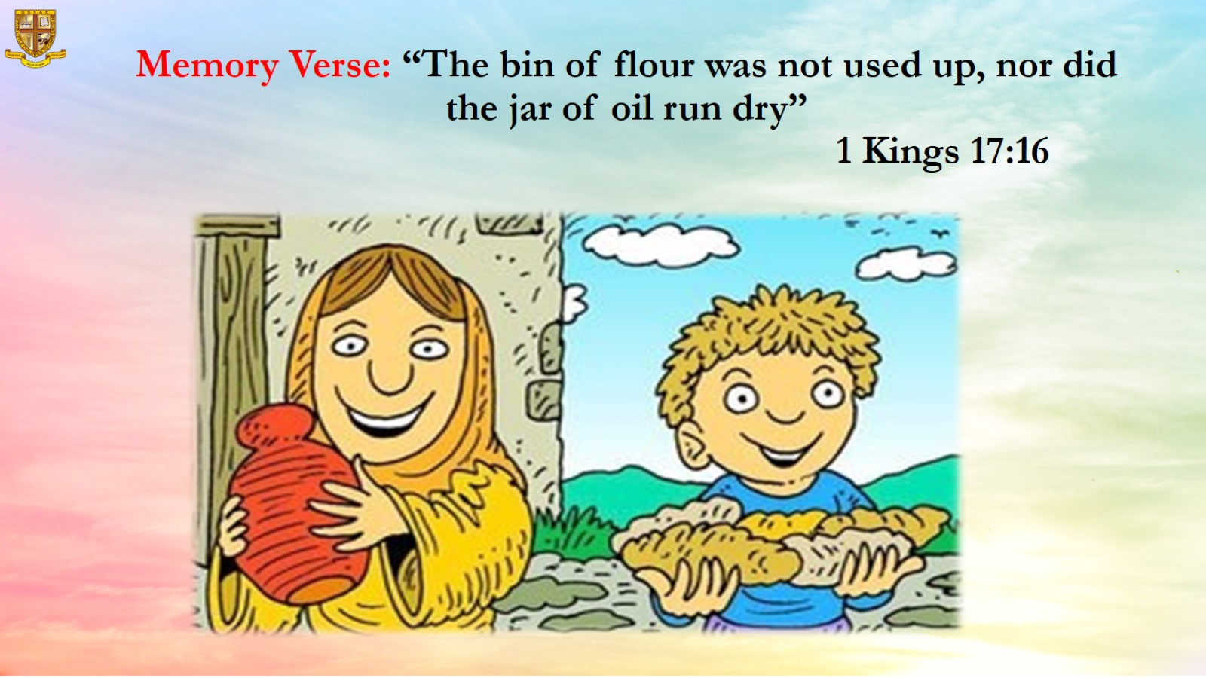
Memory Verse: “The bin of flour was not used up, nor did the jar of oil run dry”
1 Kings 17:16

Slide 8

The brook that Elijah lived by dried up.

Slide 9
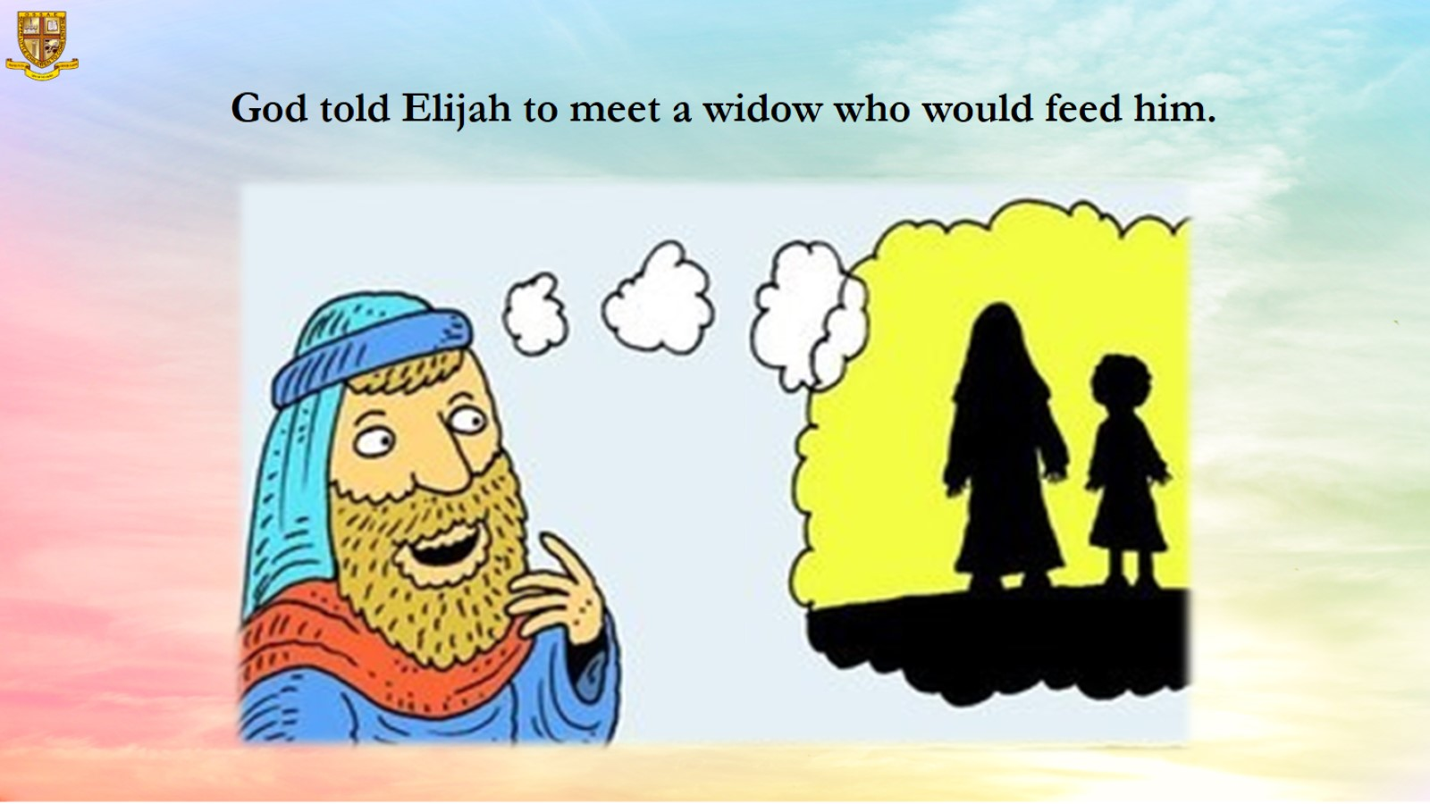
God told Elijah to meet a widow who would feed him.

Slide 10
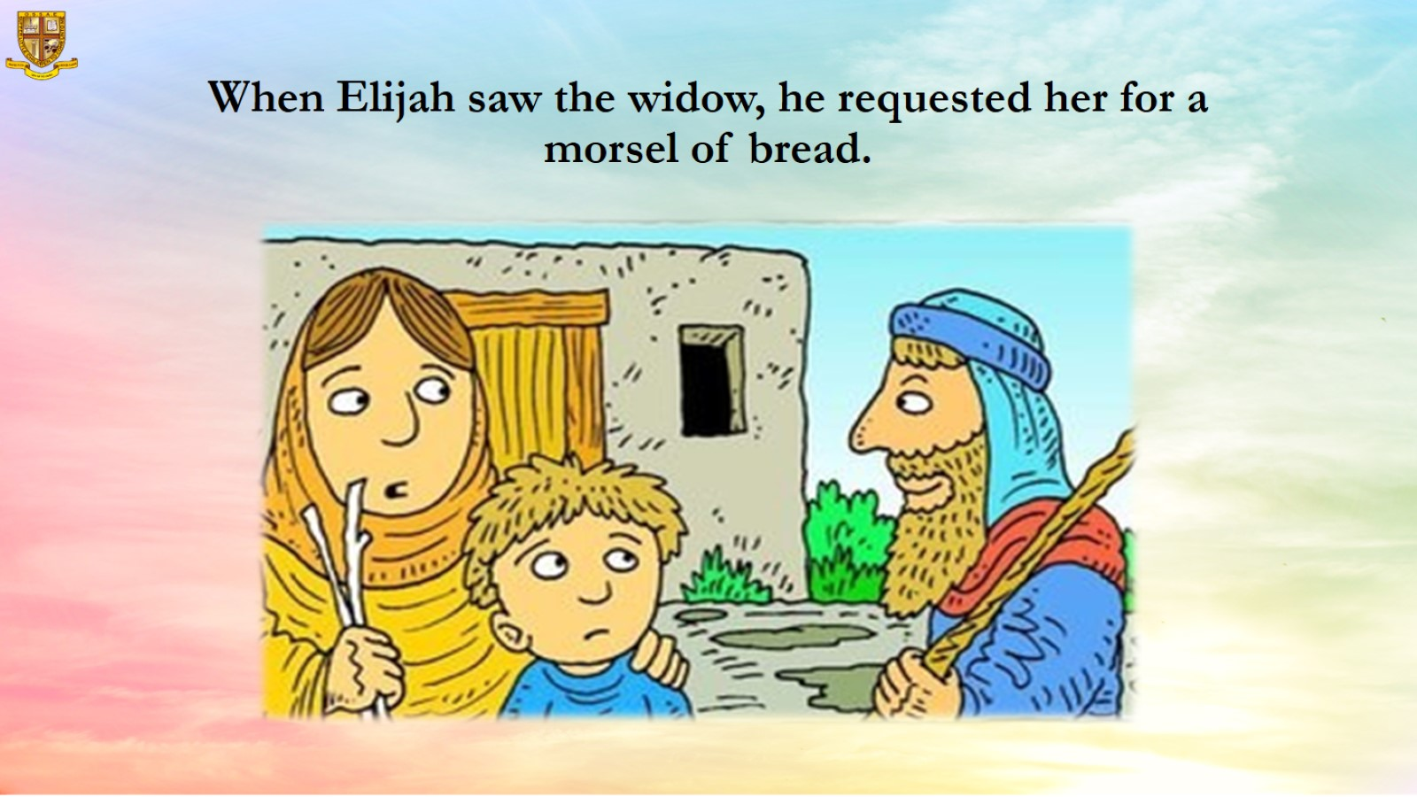
When Elijah saw the widow, he requested her for a morsel of bread.

Slide 11
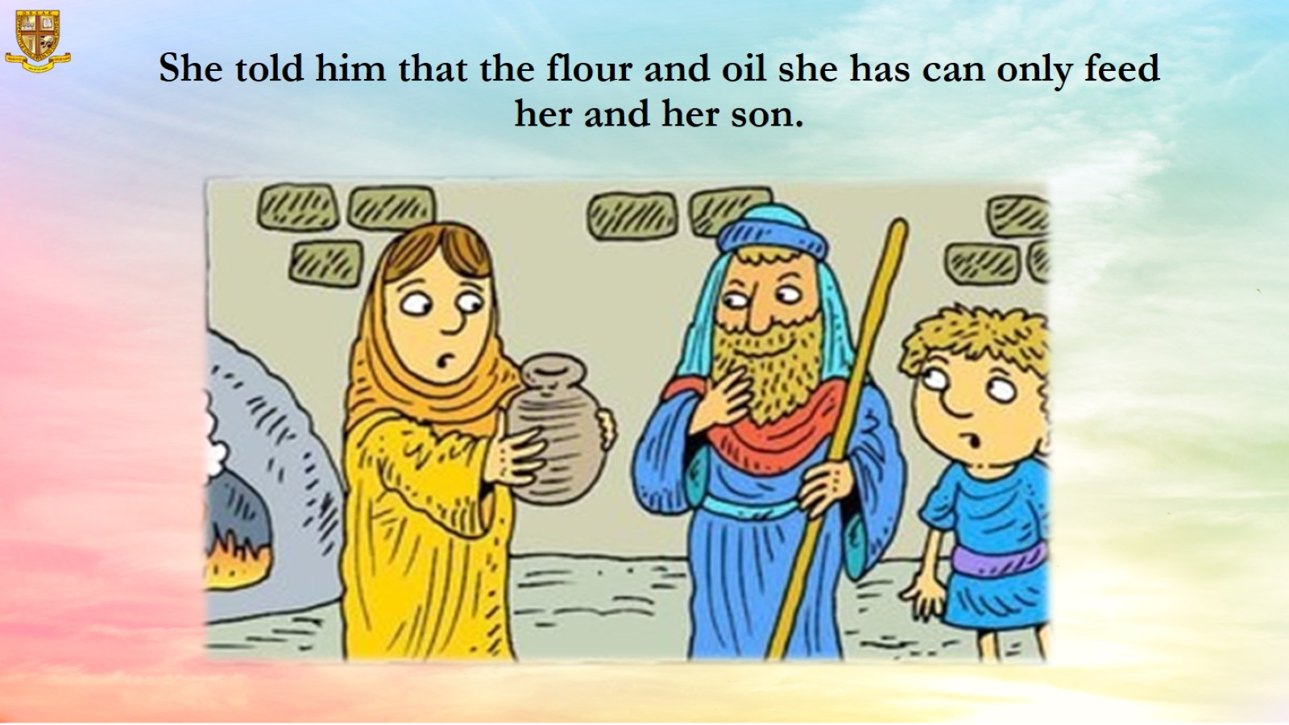
She told him that the flour and oil she has can only feed her and her son.

Slide 12
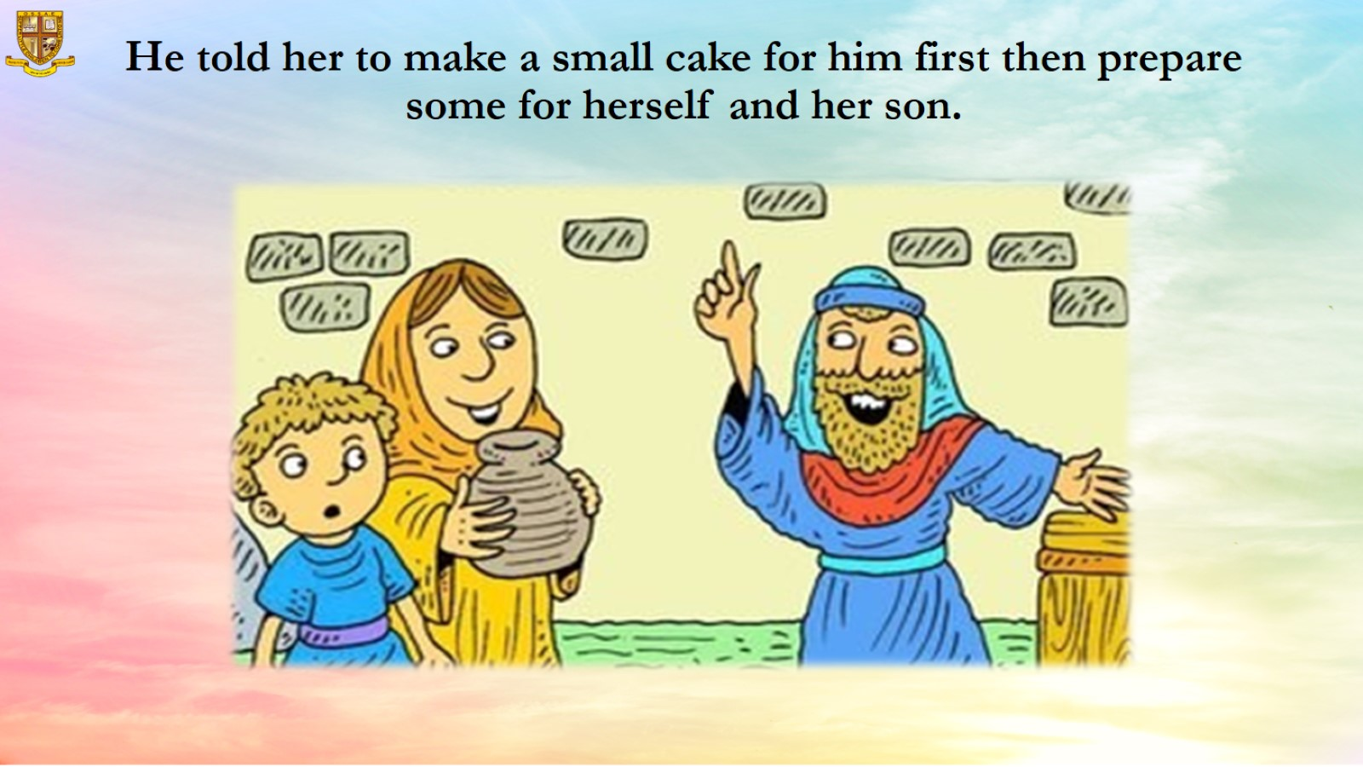
He told her to make a small cake for him first then prepare some for herself and her son.

Slide 13
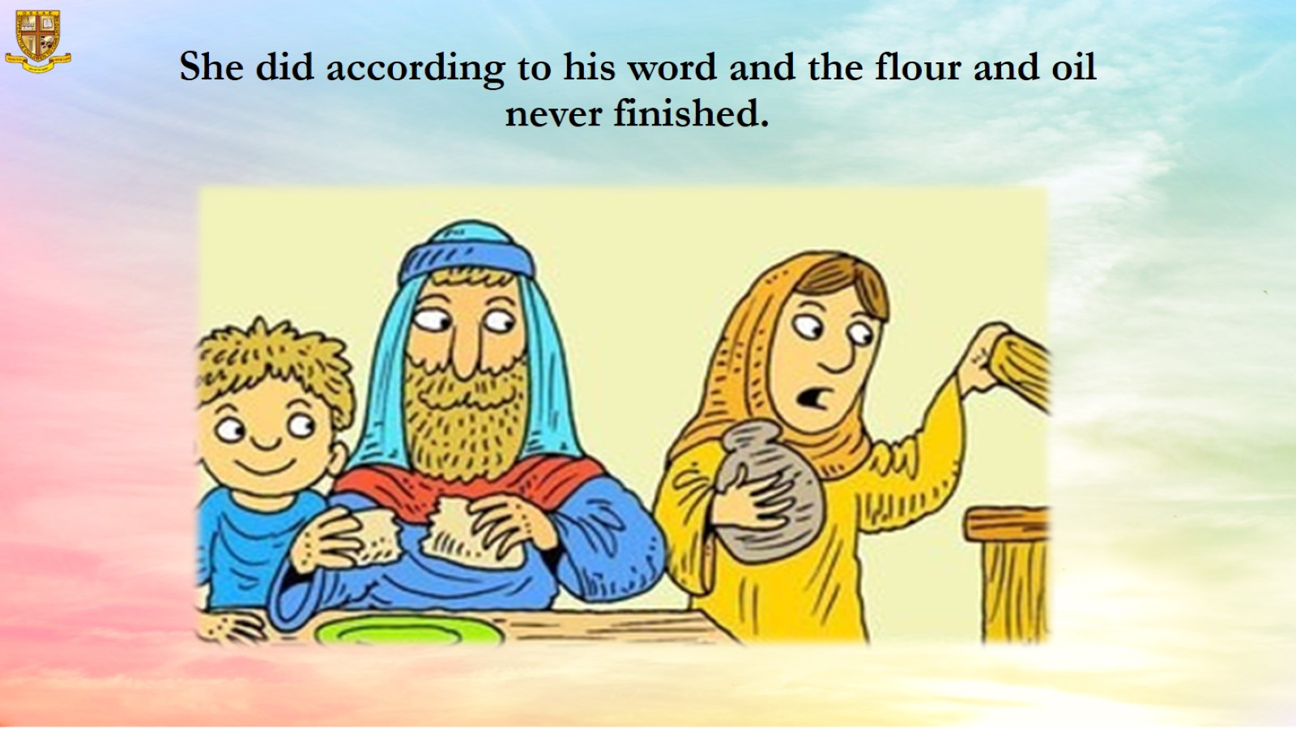
She did according to his word and the flour and oil never finished.

Slide 14
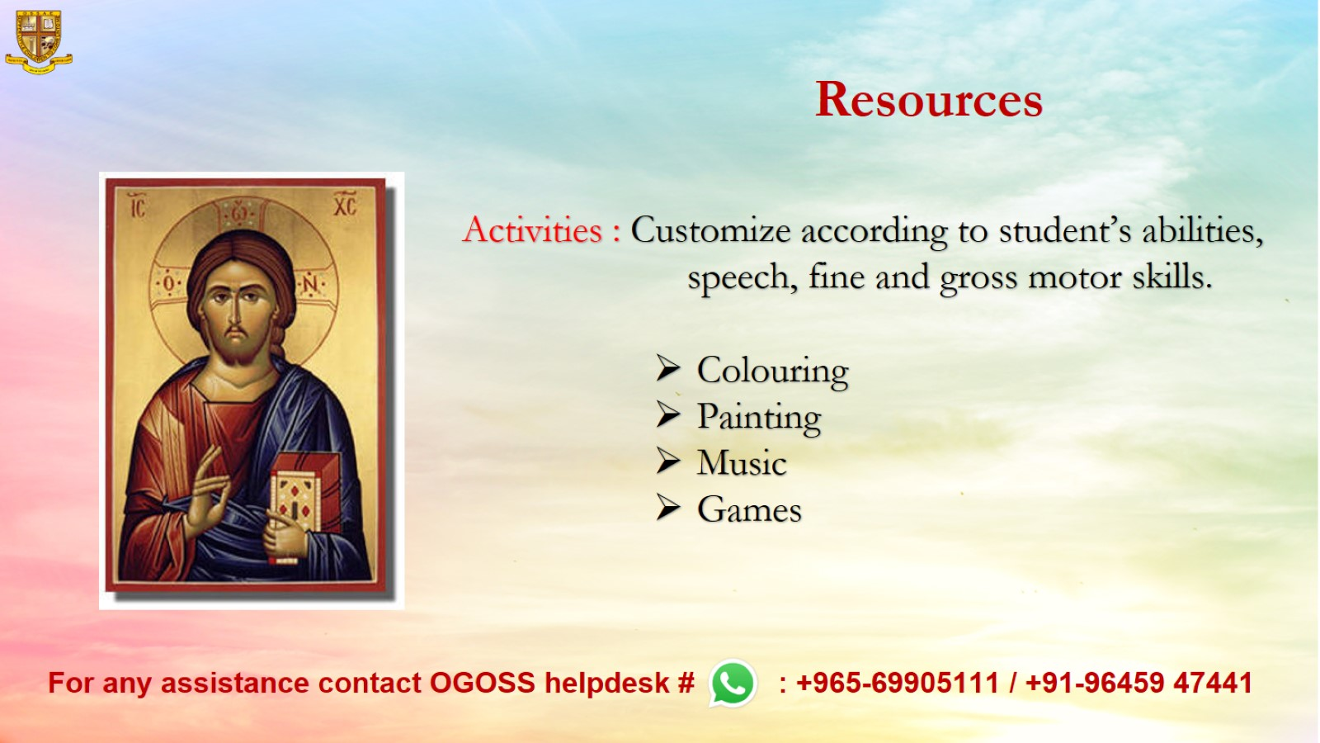
Resources

