Slide 1

Orthodox Global Online Sunday School (OGOSS)

Slide 2
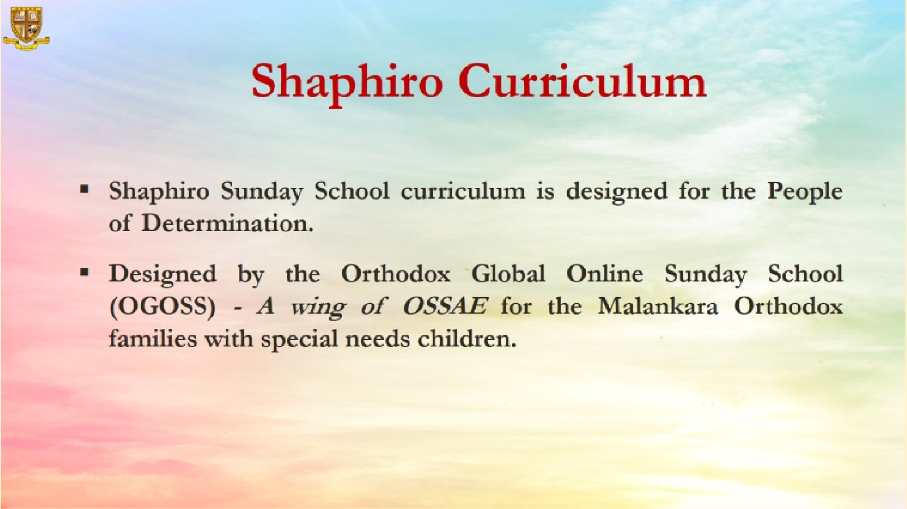

Slide 3
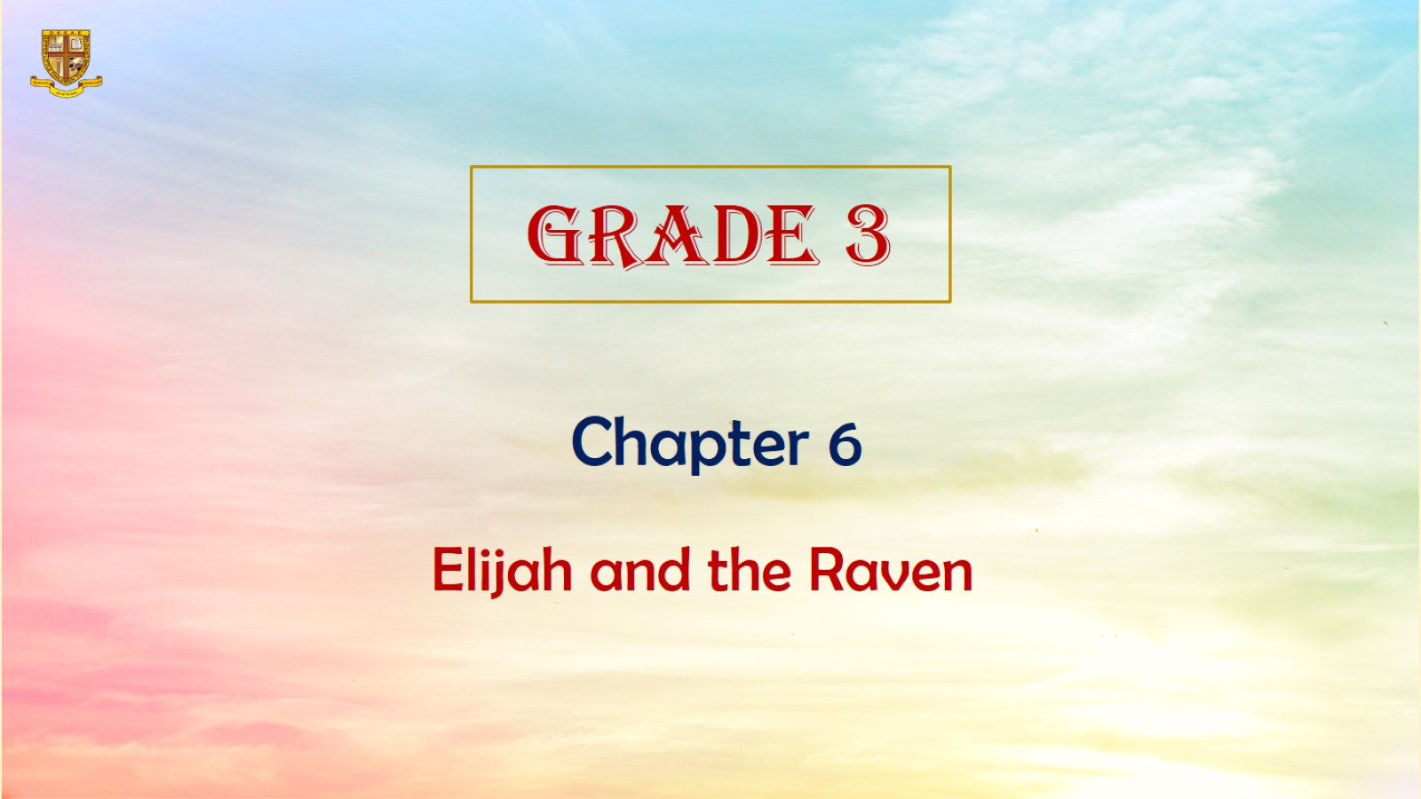

Slide 4
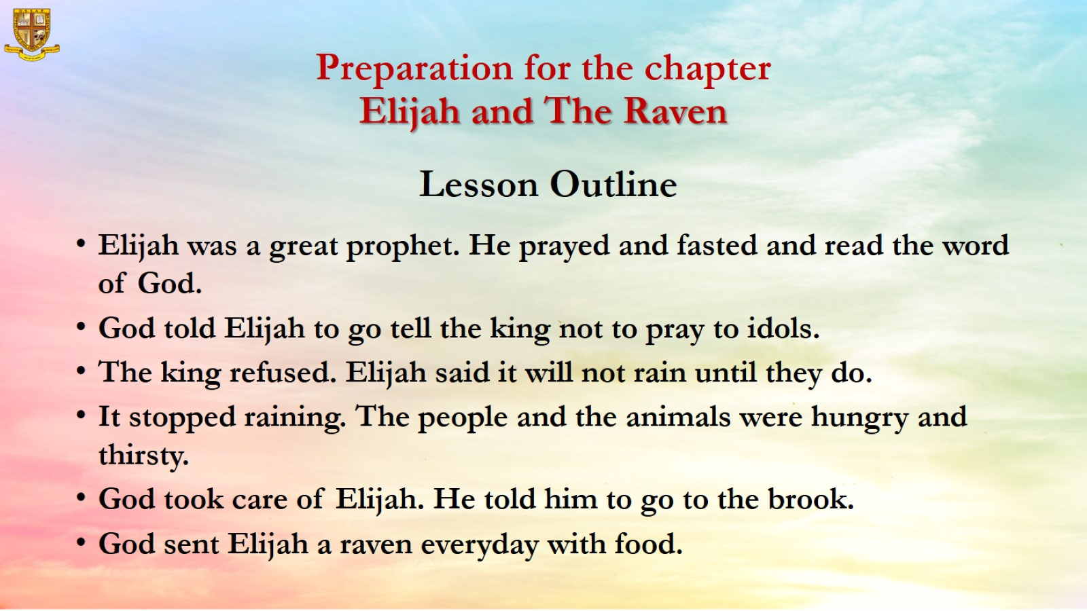
Preparation for the chapter
Elijah and The Raven
Lesson Outline

Slide 5
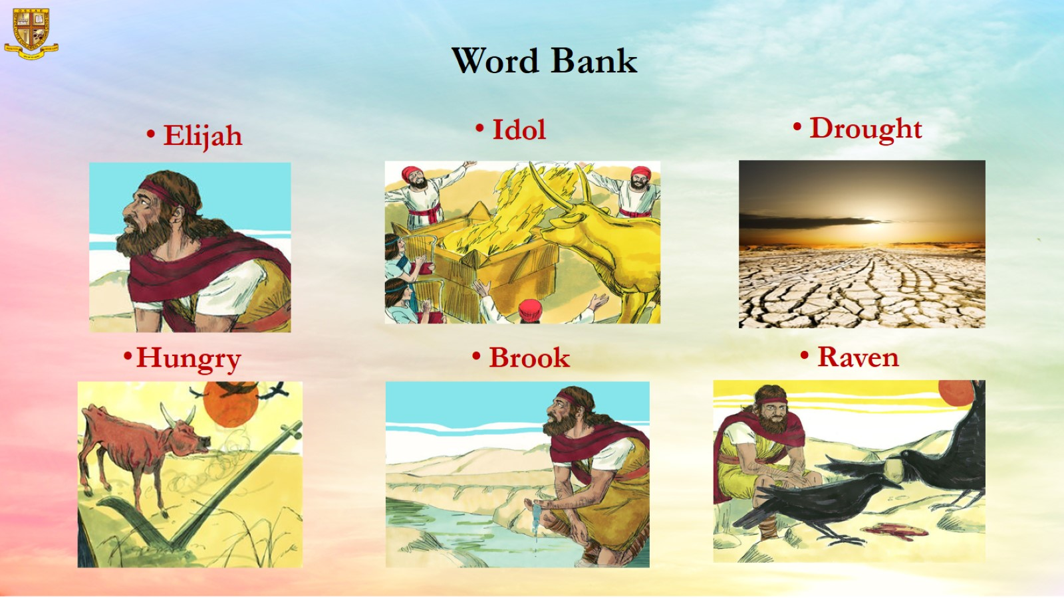
Word Bank

Slide 6
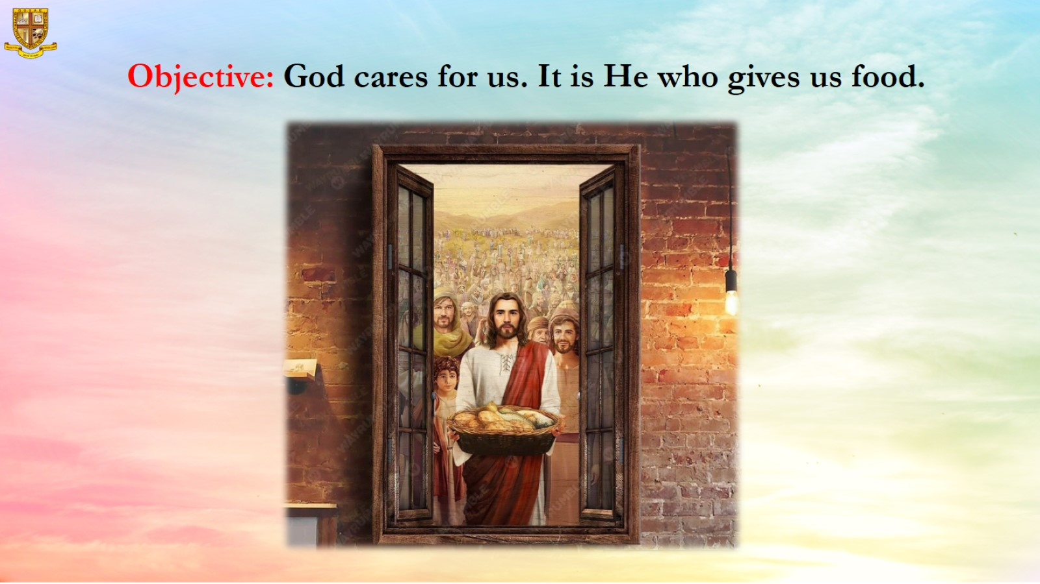
Objective: God cares for us. It is He who gives us food.

Slide 7
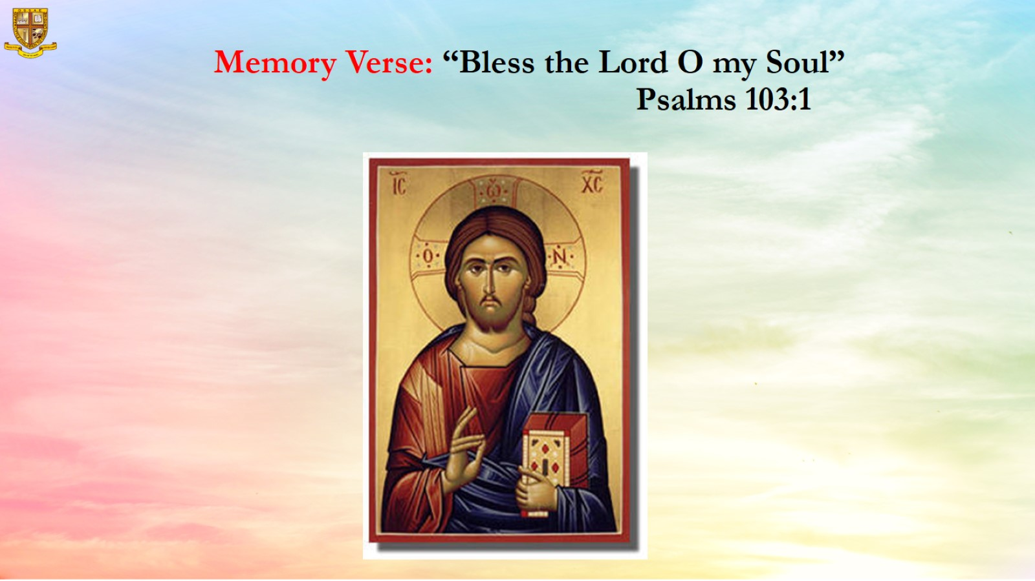
Memory Verse: “Bless the Lord O my Soul” Psalms 103:1

Slide 8
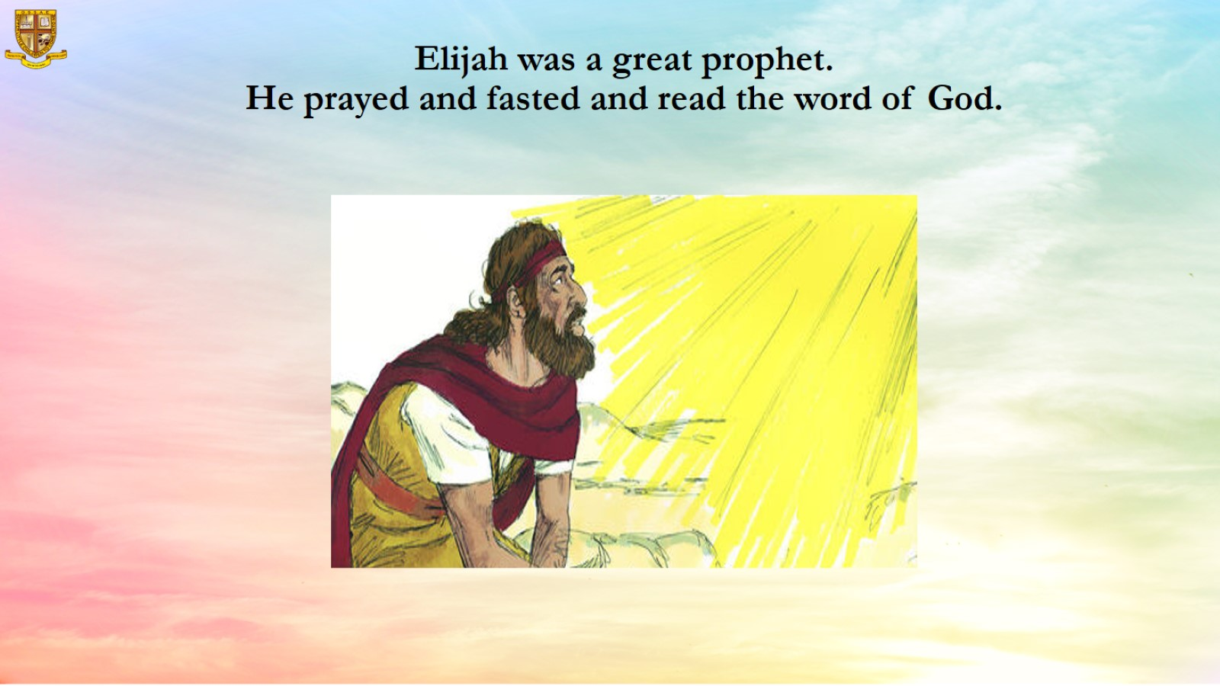
Elijah was a great prophet.
He prayed and fasted and read the word of God.

Slide 9
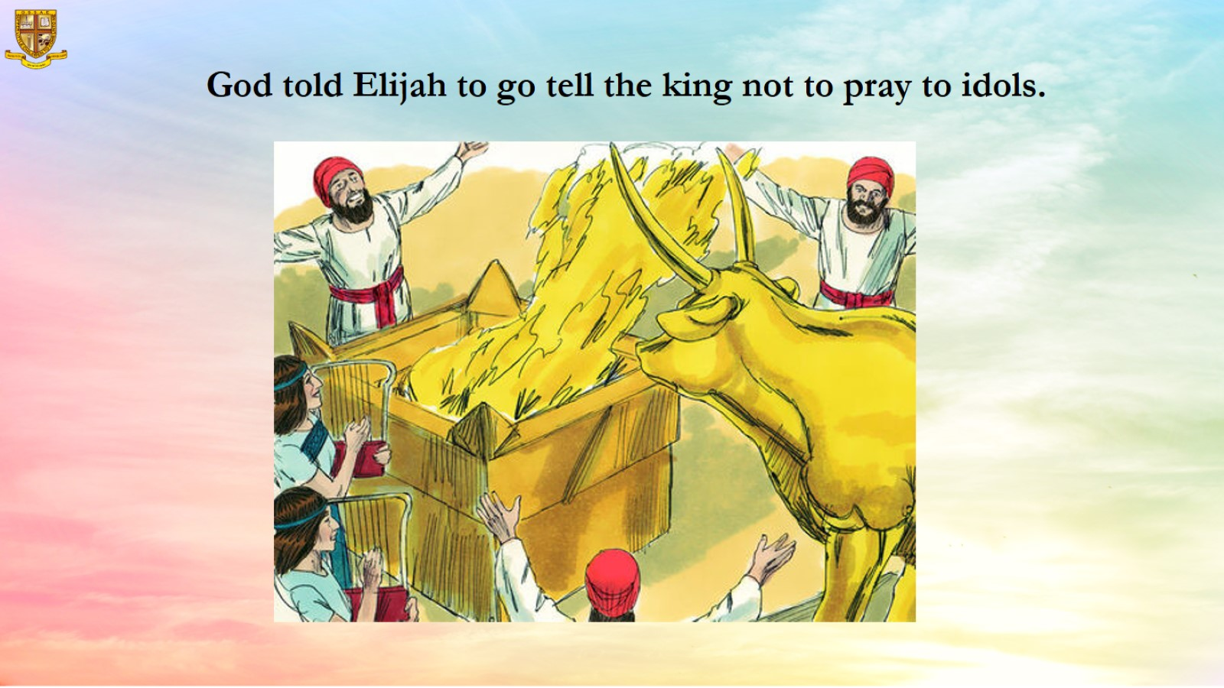
God told Elijah to go tell the king not to pray to idols.

Slide 10
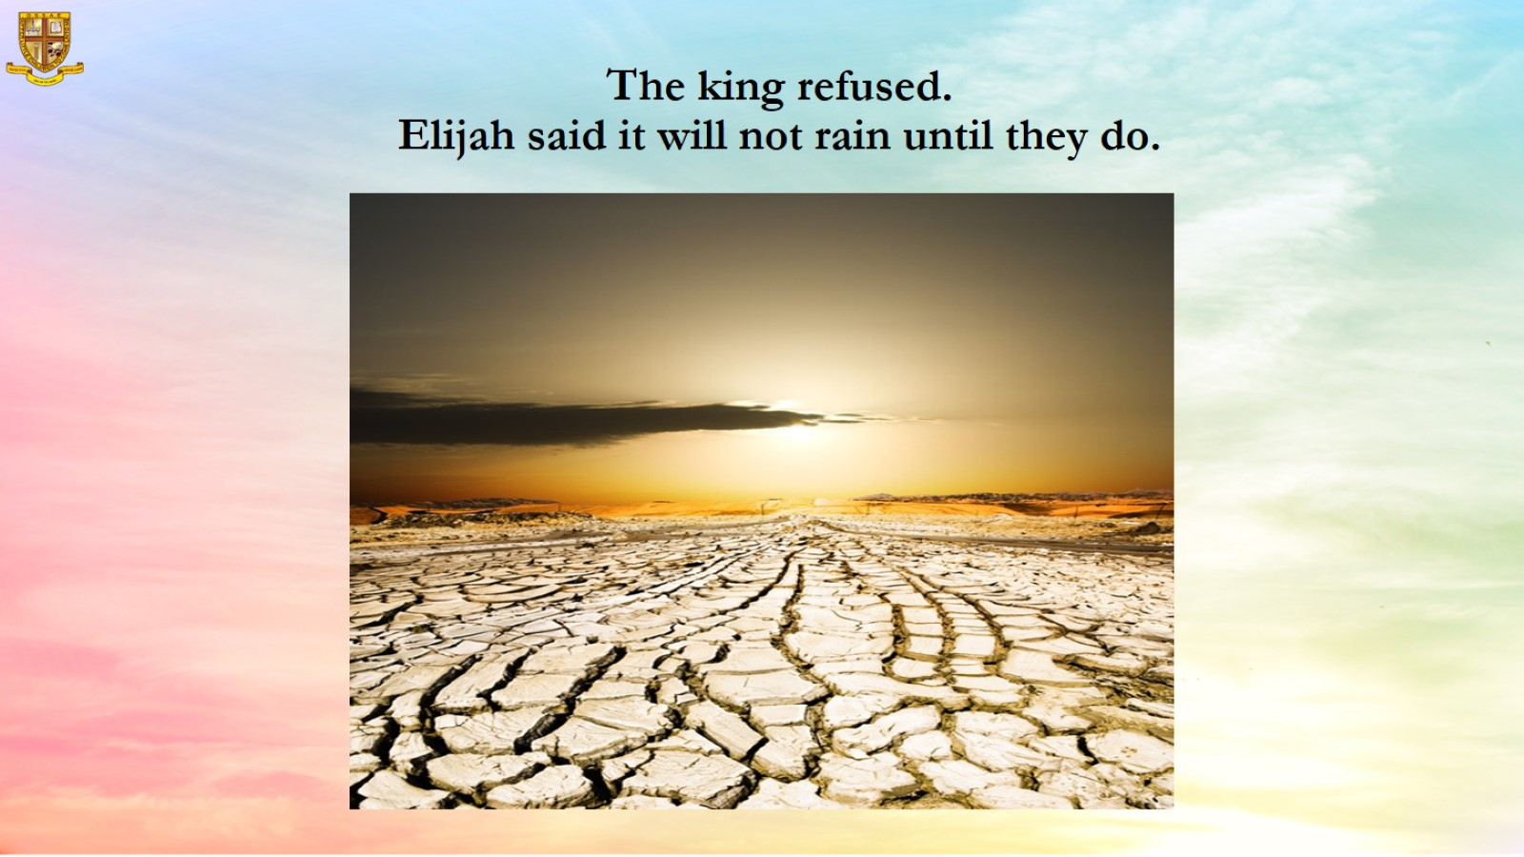
The king refused.
Elijah said it will not rain until they do.

Slide 11
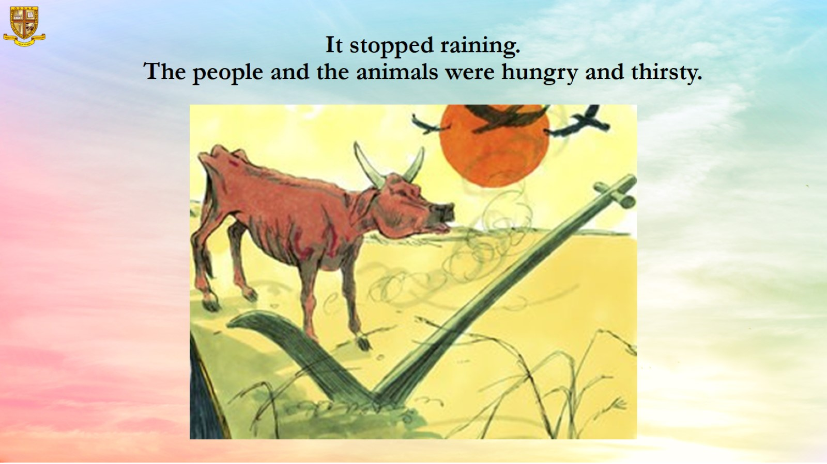
It stopped raining.
The people and the animals were hungry and thirsty.

Slide 12
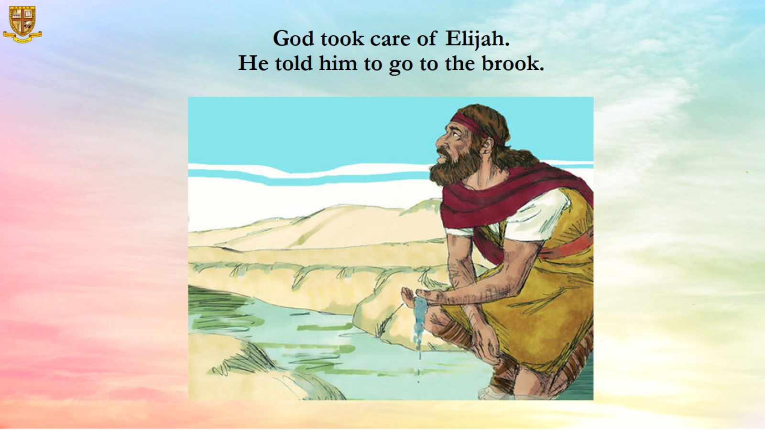
God took care of Elijah.
He told him to go to the brook.

Slide 13
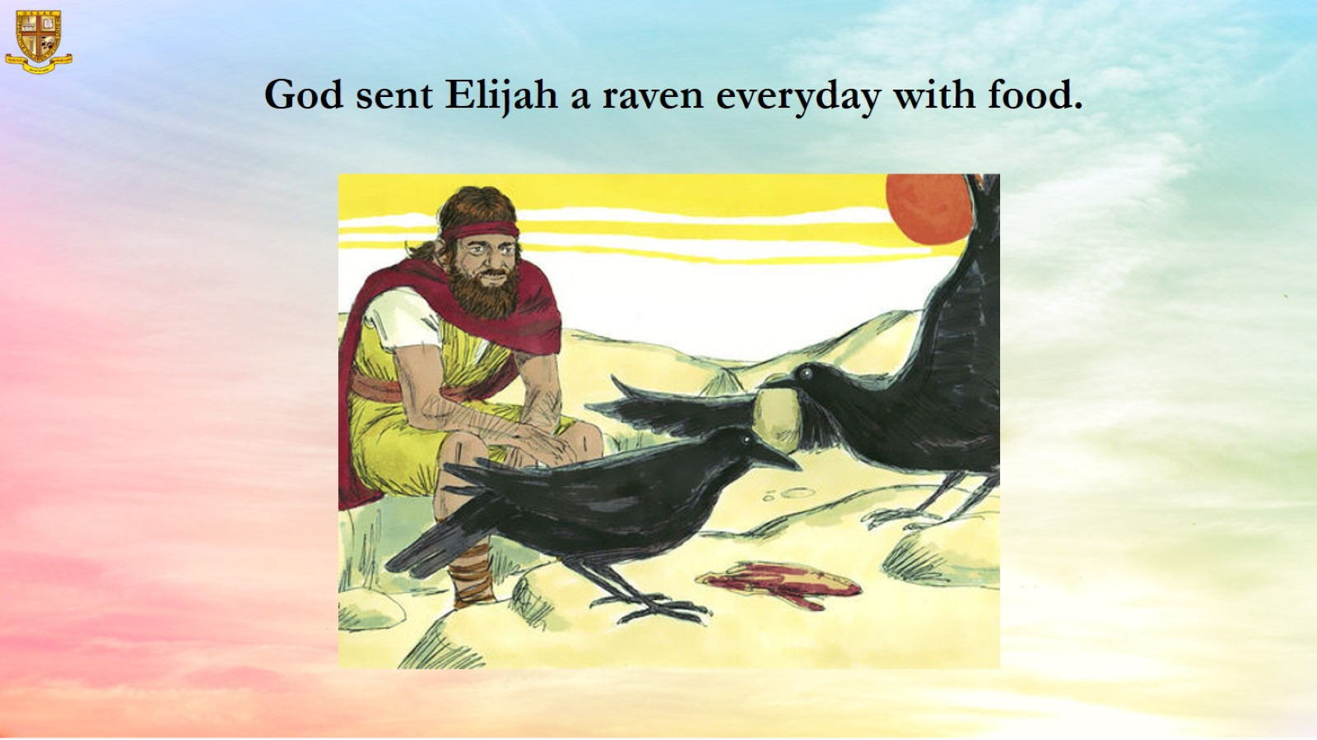
God sent Elijah a raven everyday with food.

Slide 14
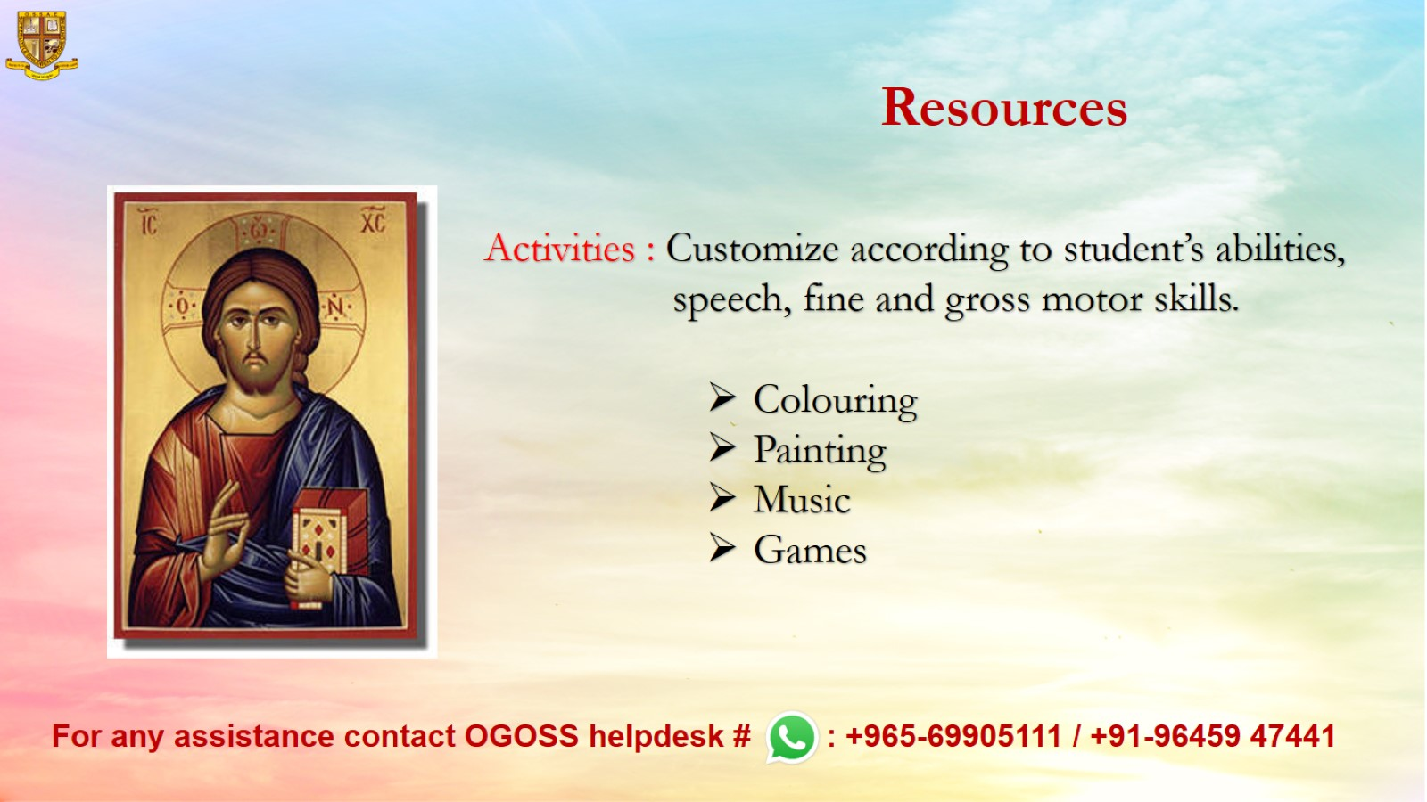
Resources

